Slide 1
Using Code Inspection to Detect and Manage Potential Security Vulnerabilities
A Case Study With ASP.NET and Custom FxCop Rules
- Chris Shaffer

Slide 2
We’ll be addressing…
Cross-Site Request Forgery
Cross-Site Scripting
JSON Request Hijacking
SQL Injection
Management and Inventory of application’s attack surface
Enforcing organization-specific best practices

Slide 3

static code analysis
Back up … What is it, anyway?

Slide 4
Static Code Analysis
It’s code that reads other code and analyzes it.
FxCop is a static analysis program used to find flaws in design, usage, and failure to adhere to best practices.
Most security scanning tools try to attack an active, running application.

Slide 5
Advantages to Static Analysis
Can run scans much faster
Easier to run in a continuous integration environment (don’t require a database or server)
Can detect things like inappropriate design that might not leave externally visible evidence
Can detect unsafe functions before code that calls them is even written
Of course, it works best in parallel, not as a replacement

Slide 6
Cross-site request forgery
First, let’s review how CRSF attacks work

Slide 7
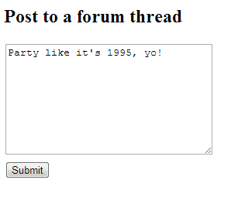
So, a victim is logged into a site …
For this example, let’s pretend the authentication of this site is secure …

Slide 8
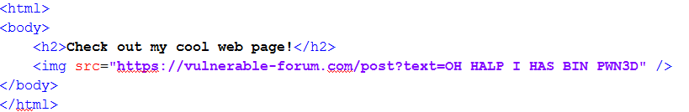
An attacker tricks them into clicking a link …
… or maybe they use a cross-site scripting vulnerability on a trusted site to stick that image in an ad on a news site …
If the victim user is logged into that site, and opens this link in the same browser, it’s going to use their login cookie and execute as if they made clicked that button themselves.

Slide 9
Or maybe the attacker is even more brazen …
“Hey, click this link!”
https://vulnerable-forum.com/post?somecrap=look-nontechnical-users-arent-even-going-to-read-this-seriously-its-techie-computer-nerd-stuff&nonsense=30ijrf3j09fij3ef09j3f0i3j2390fj30i4h4309u3409hf30f9h340&text=O%20HALP%20I%20STILL%20HAS%20BIN%20PWN3D
“Oh, I use that forum all the time, of course I can trust a link to an article on it.”
You were about to say something about not trusting external URL-Referrers?

Slide 10
CSRF Mitigation
An application-wide solution

Slide 11
how code analysis fits in
Catching your mistakes

Slide 12
Cross-Site Scripting
What happens when code bypasses the framework’s protections?

Slide 13
JSON Request Hijacking
If you have to support crappy browsers…

Slide 14
Authentication and Authorization
Policing to ensure the proper checks are in place.

Slide 15
SQL injection
The final frontier.
And you thought it was space…

Slide 16
Enforcing best practices
Insert witty subtitle here.

Slide 17
Next Steps
Code that’s not complied into an assembly…
Html.Raw(), etc. in .cshtml files
We can probably still point FxCop at precompiled assemblies, but will need different rules and standards for those
Dynamic SQL inside stored procedures
JavaScript. You should never rely on client-side code for security, but it seems like there is potential for static analysis here
For example: catching code that makes a GET request to one of the actions turned up by the anti-CSRF rule, so they don’t turn into page breaks
Mass Assignment attacks
Make that SQL injection rule actually work
And more …

Slide 18

Questions
Ask them.

