Slide 1
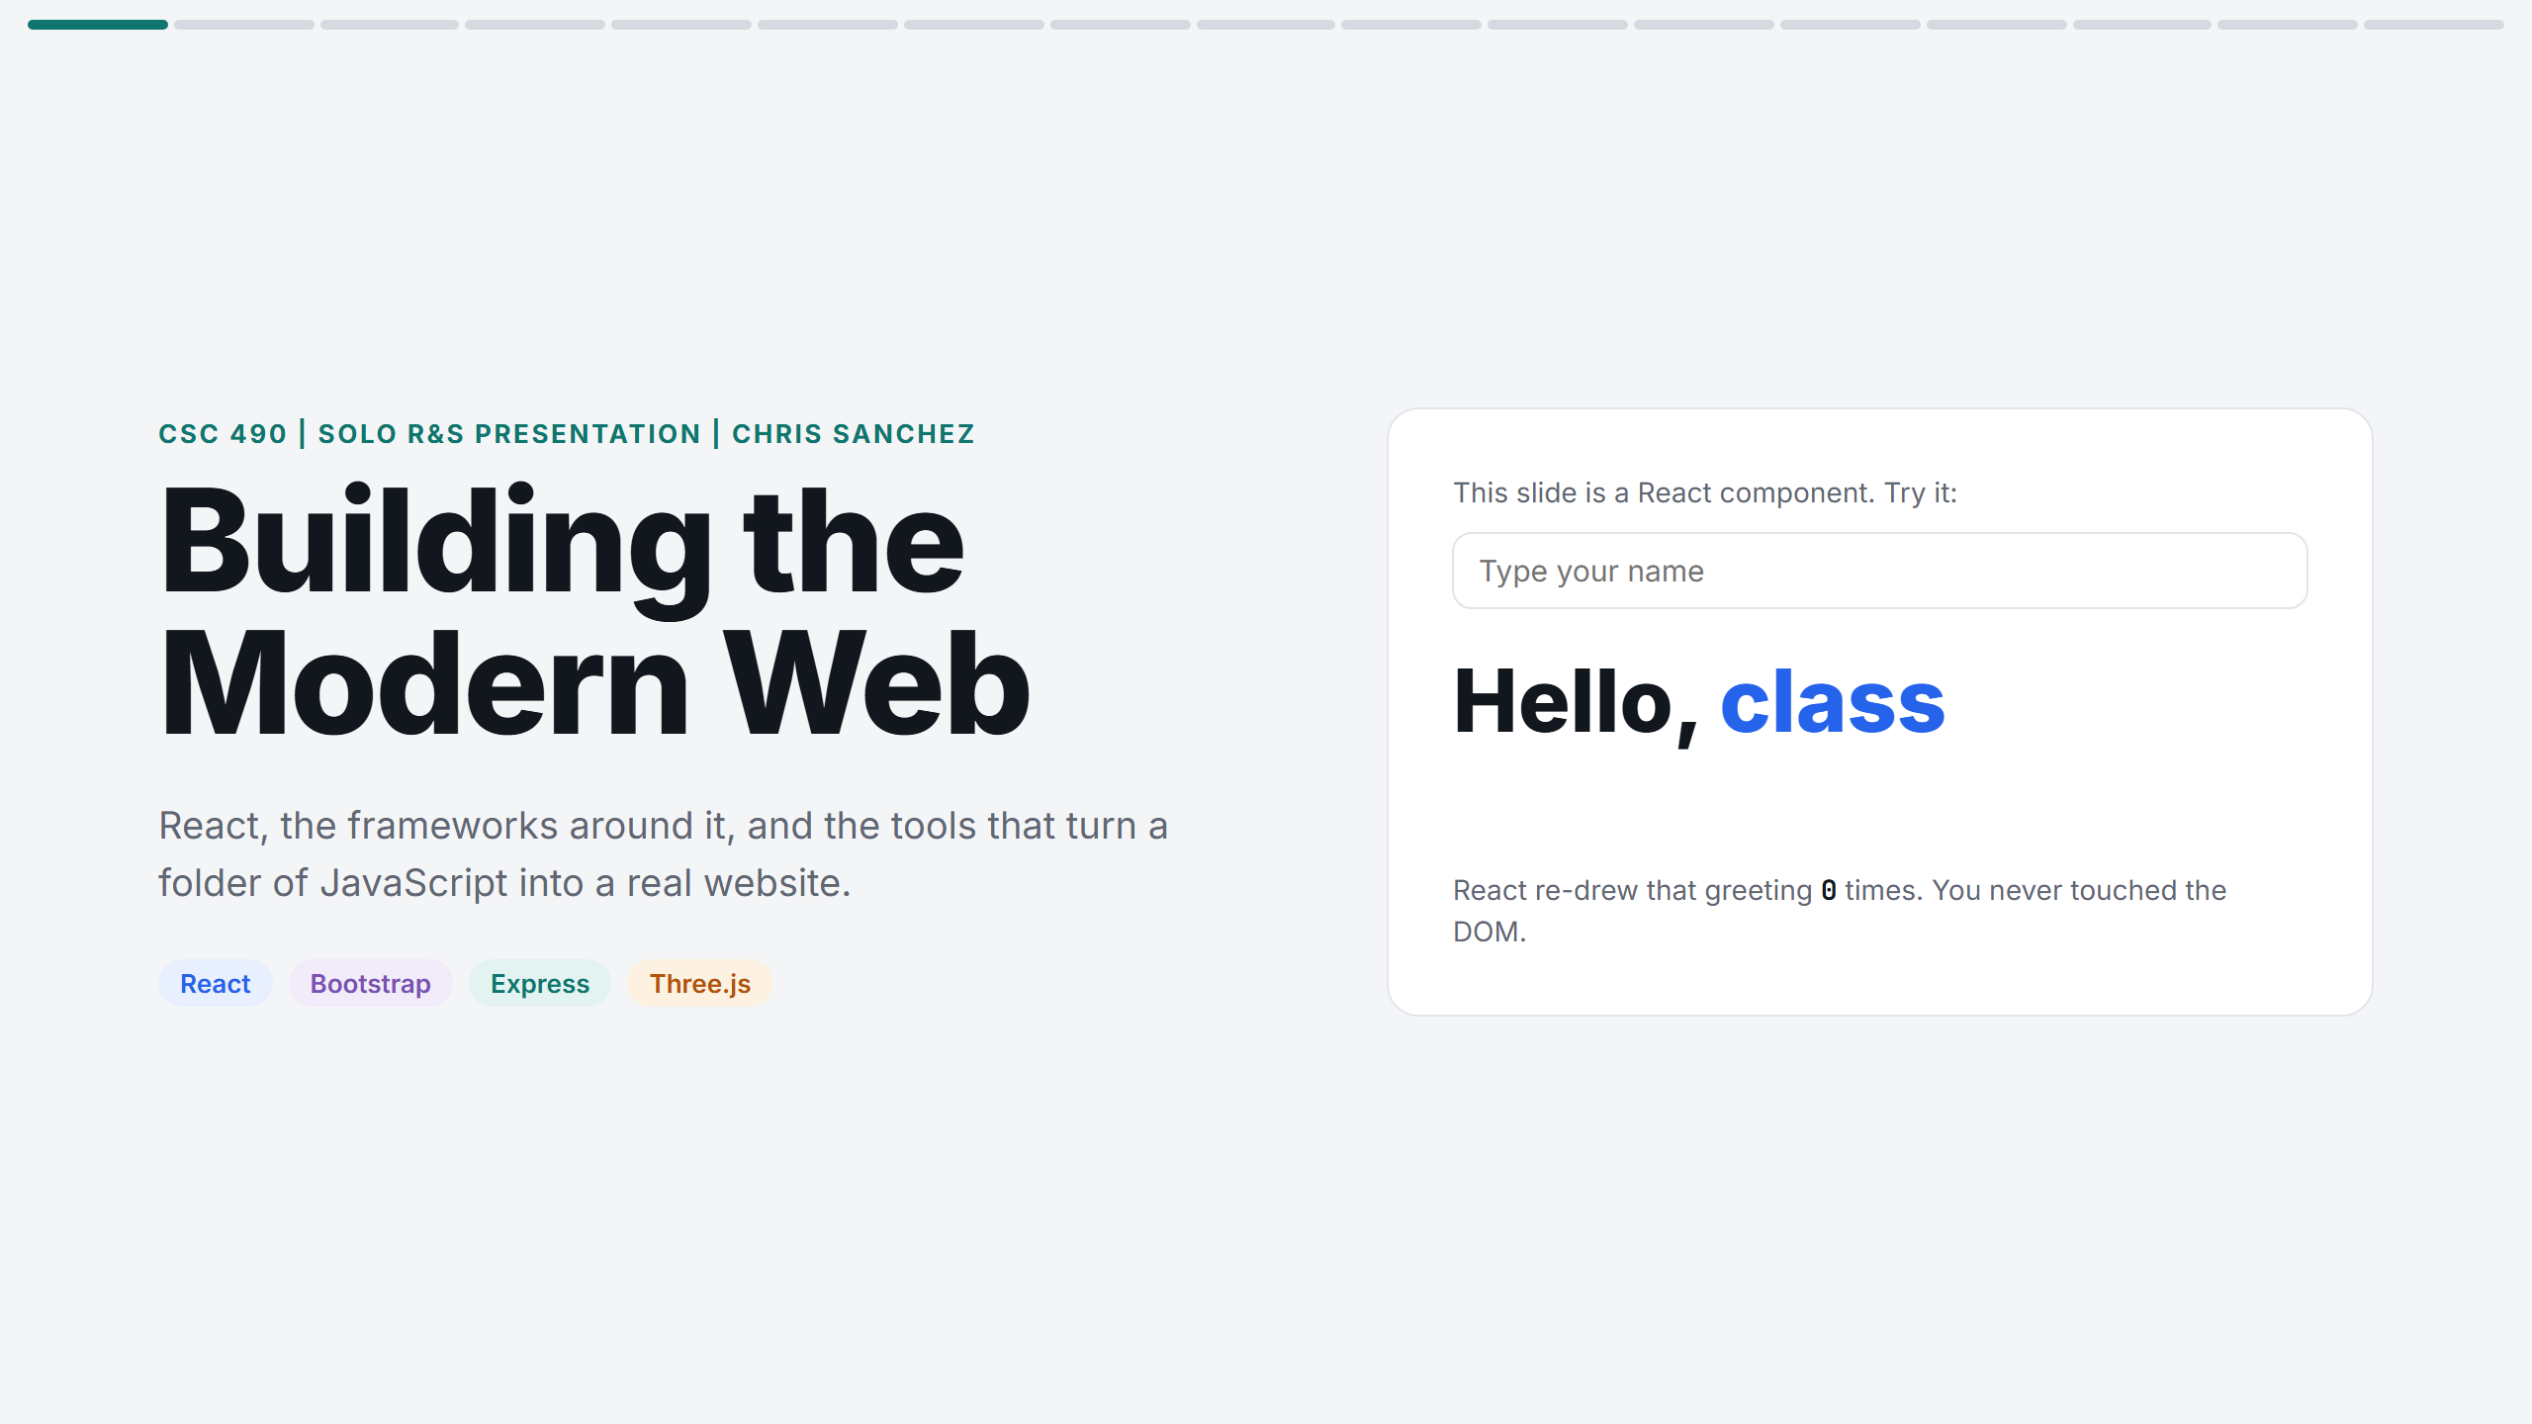
Notes:
Introduce yourself and the topic. Type a classmate's name into the box: the greeting updates and the counter goes up. Point out that the slide is a React component and you never touched the DOM yourself.

Slide 2
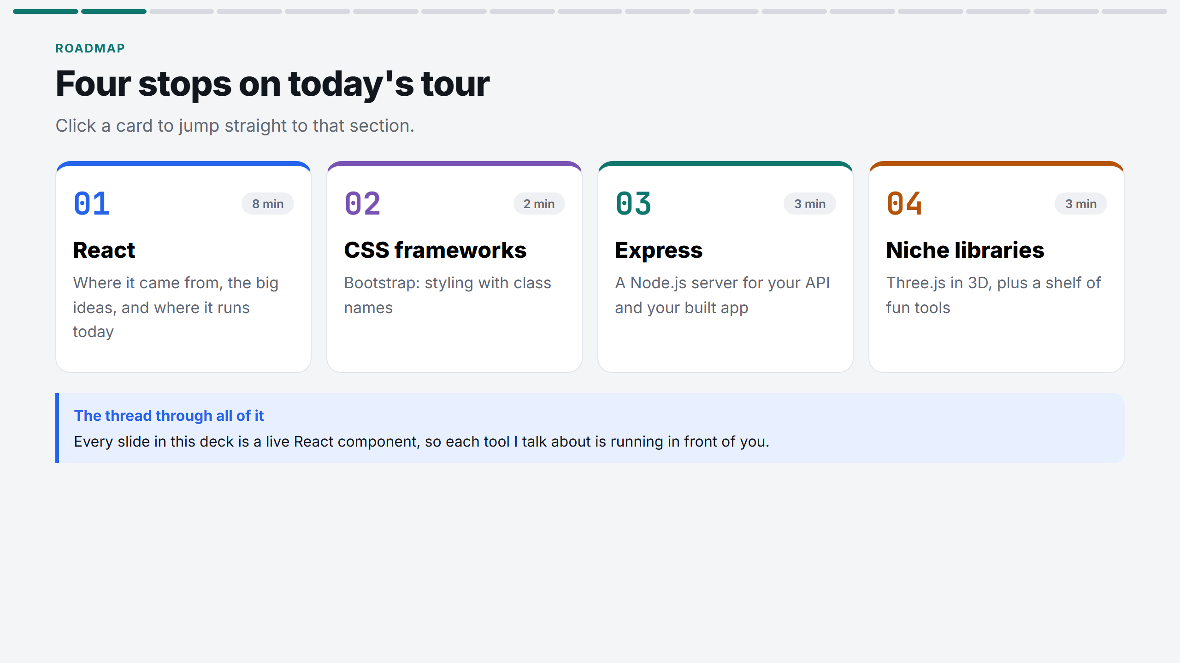
Notes:
Name the four parts. Explain why you chose this topic: you are passionate about web development and wanted the slides themselves to be the demo. You can click a card to jump to its section.

Slide 3
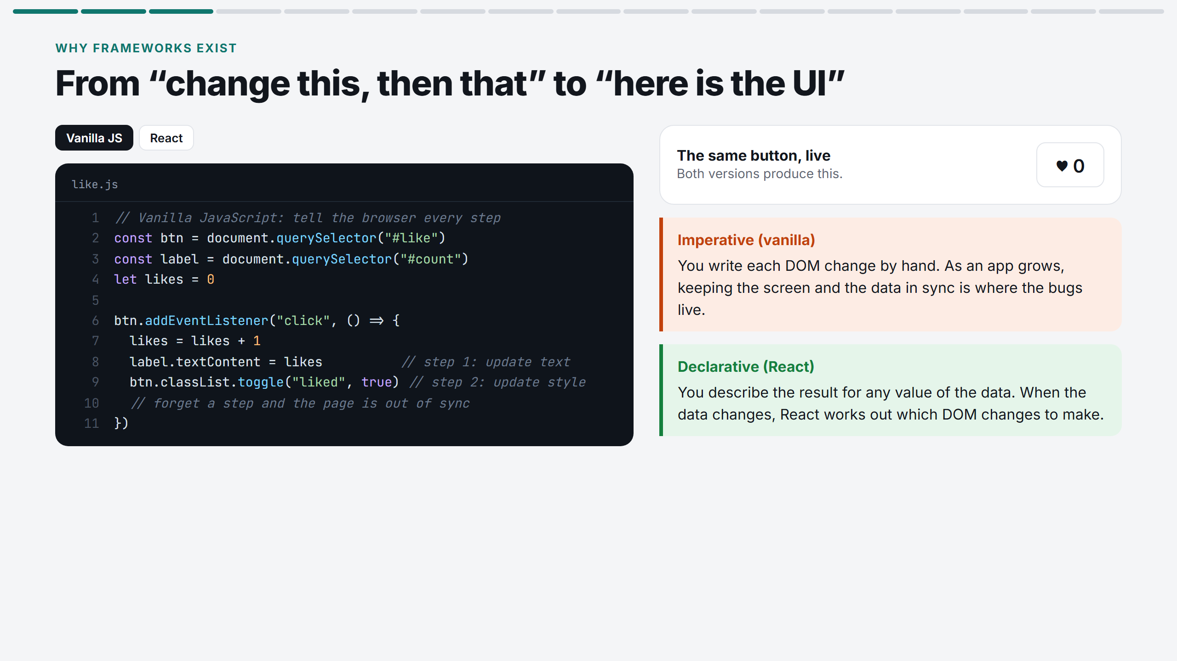
Notes:
Start on Vanilla JS. Point at the two manual steps on lines 8 and 9. Click the heart. Switch to React: same result, but you only describe the UI. Key words: imperative vs declarative.

Slide 4
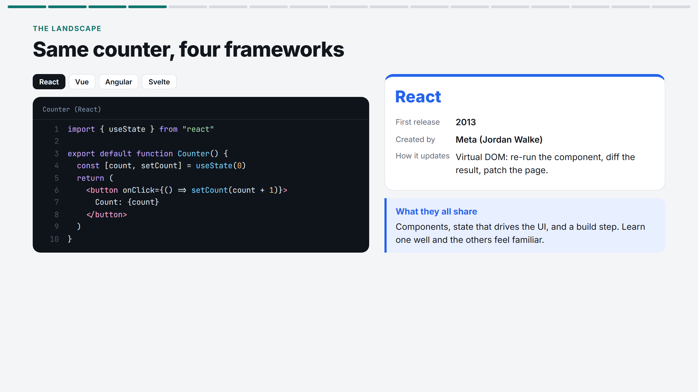
Notes:
Click through all four tabs. The goal is not to pick a winner. Every framework has components and state; they differ in how they update the page. React uses a virtual DOM, Svelte compiles it away.

Slide 5
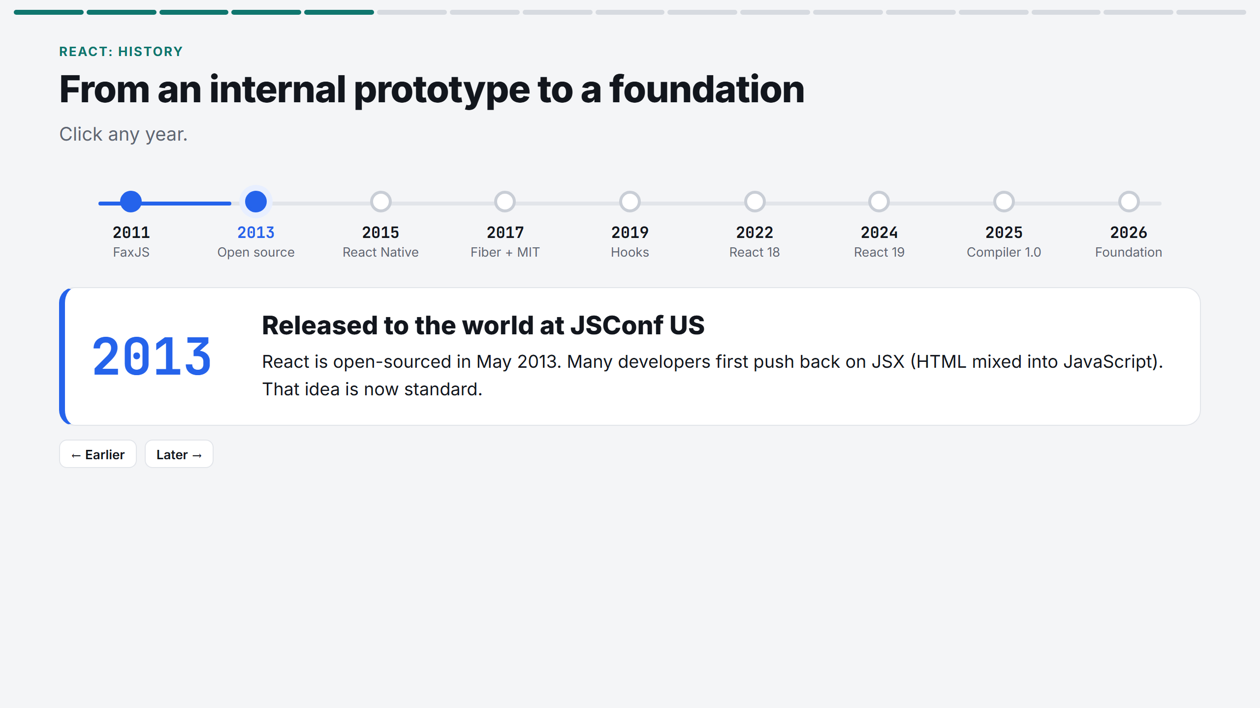
Notes:
Walk the timeline left to right with Later. Stress three moments: 2013 open source, 2019 Hooks, 2026 React Foundation (no longer just Meta's project).

Slide 6
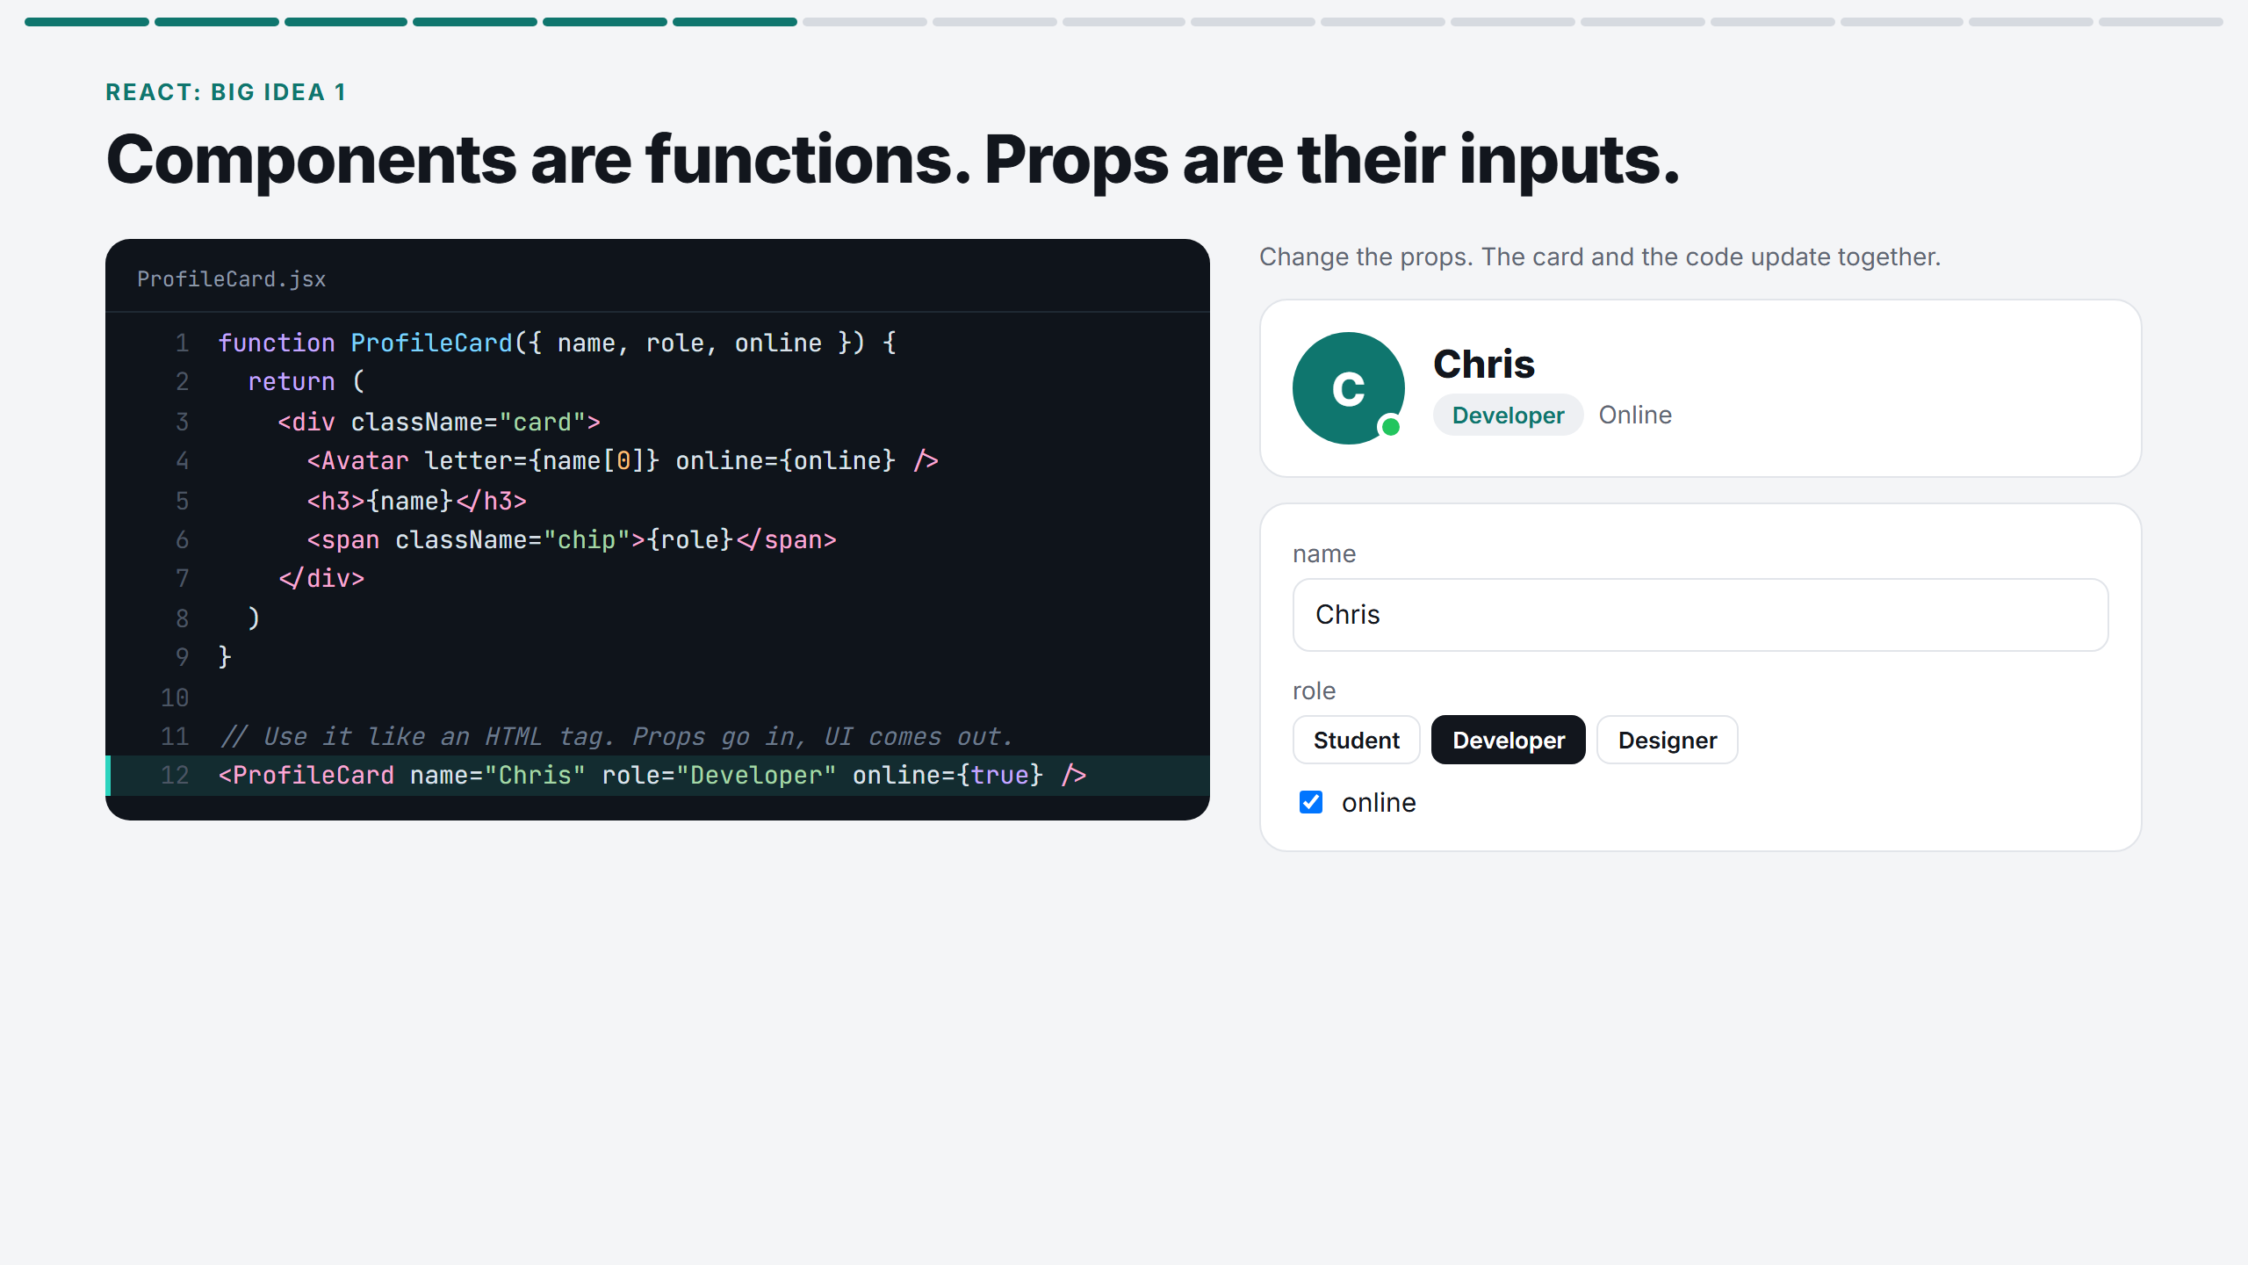
Notes:
Type a classmate's name and change the role. The card and line 12 of the code change together. Props in, UI out: a component is just a function.

Slide 7
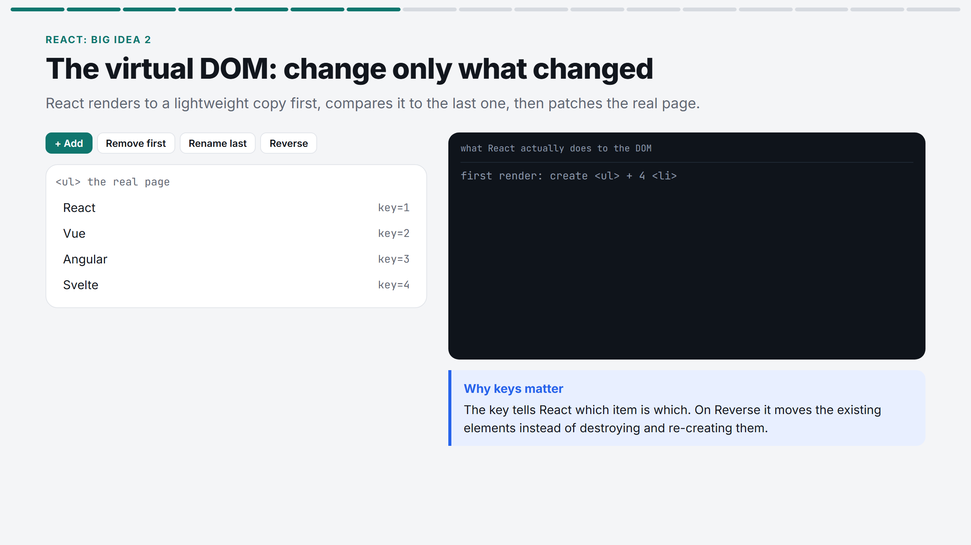
Notes:
Click Add, then Rename last, then Reverse. Read the log: React only inserts, updates or moves what changed. Keys are how it knows which item is which.

Slide 8
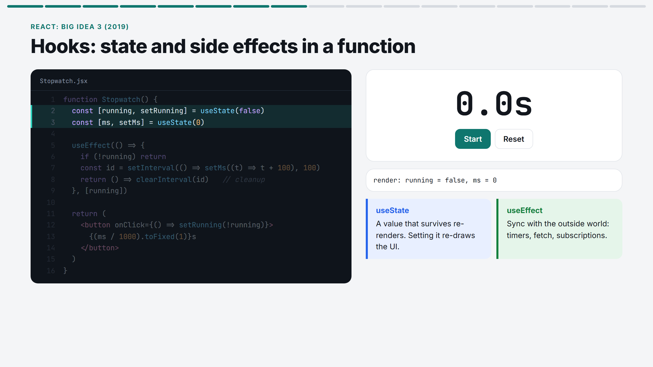
Notes:
Press Start: the highlighted lines show the effect creating an interval. Press Stop: line 8, the cleanup, runs. Hooks came in 2019 and replaced class components.

Slide 9
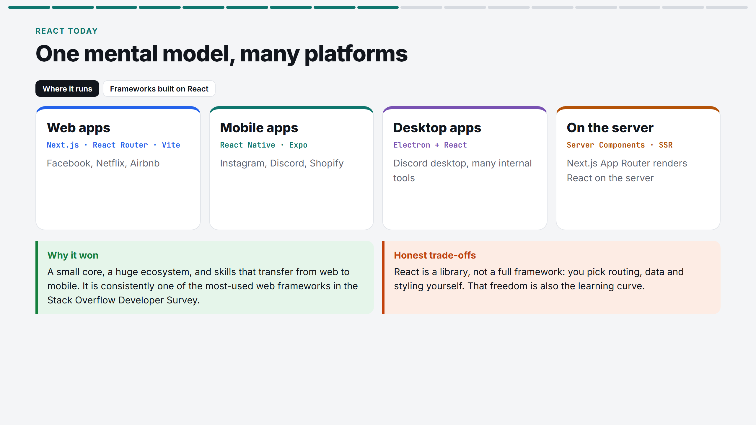
Notes:
Web, mobile, desktop, server: same component model. Flip to the frameworks tab: Next.js, React Router, Expo, Vite. End with the honest trade-offs.

Slide 10
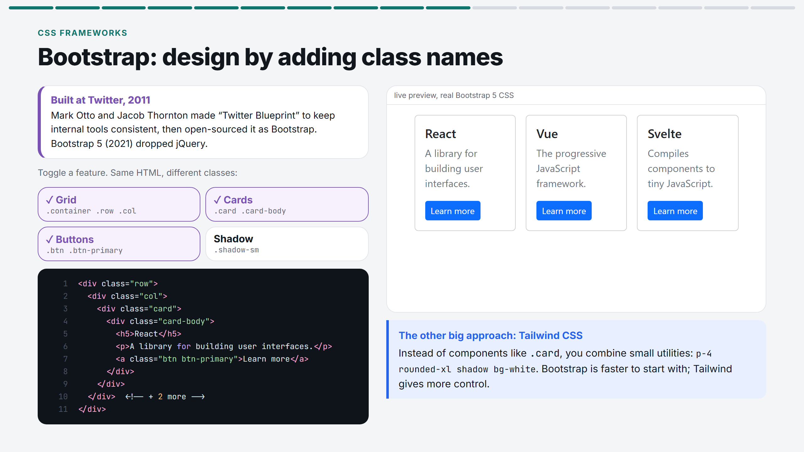
Notes:
Turn the features off one by one until it is plain HTML, then back on. The HTML structure never changes; only class names do. Mention Tailwind as the utility-first alternative.

Slide 11
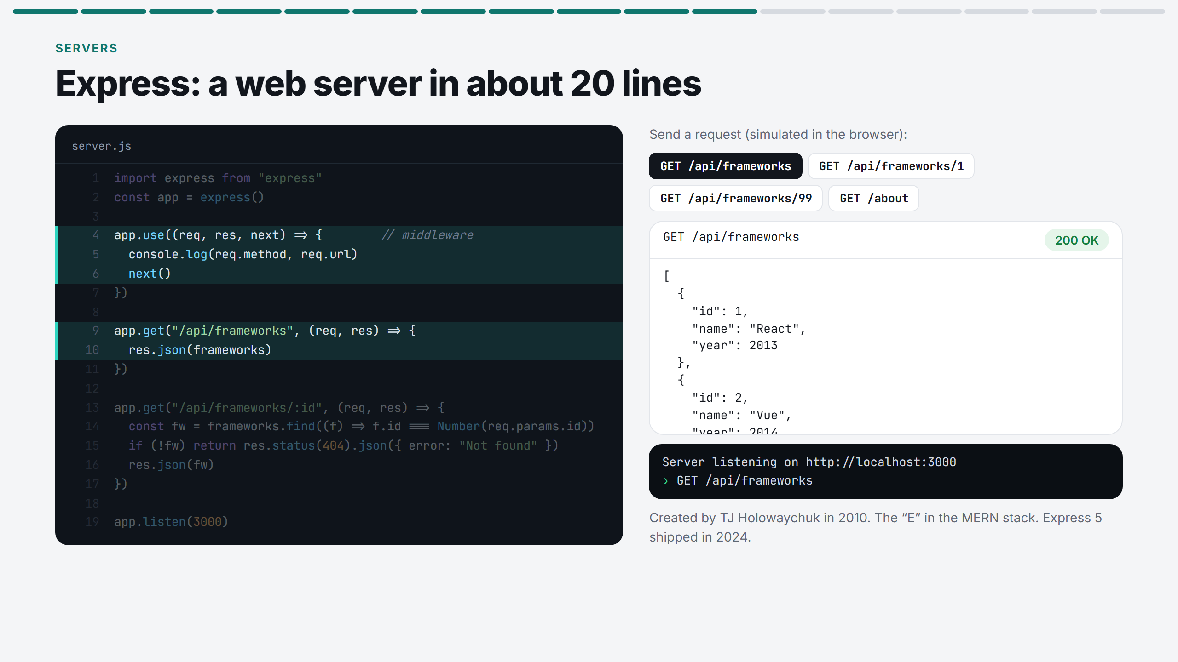
Notes:
Click each request. Watch which lines highlight: middleware runs every time, then the matching route. /api/frameworks/99 hits the 404 line; /about matches no route at all.

Slide 12
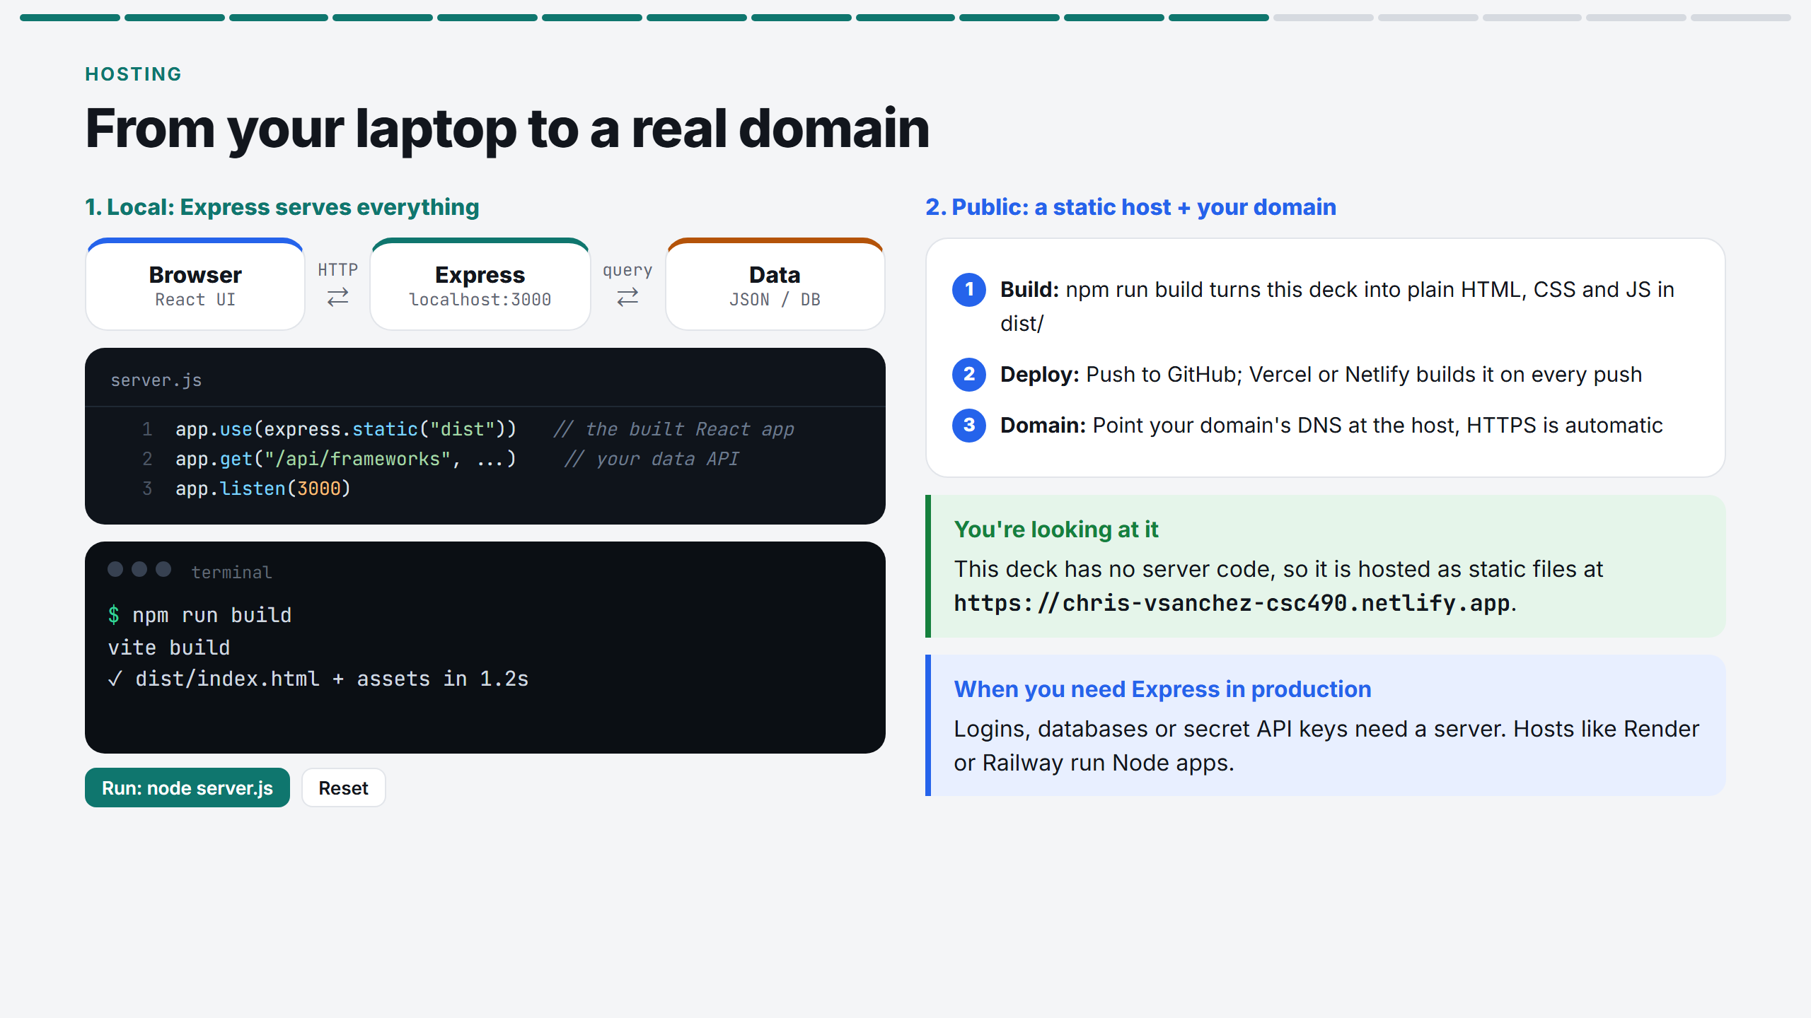
Notes:
Run the two terminal commands. Locally Express serves the built React app plus the API. Then explain how this deck went live: build, push, Vercel, DNS.

Slide 13
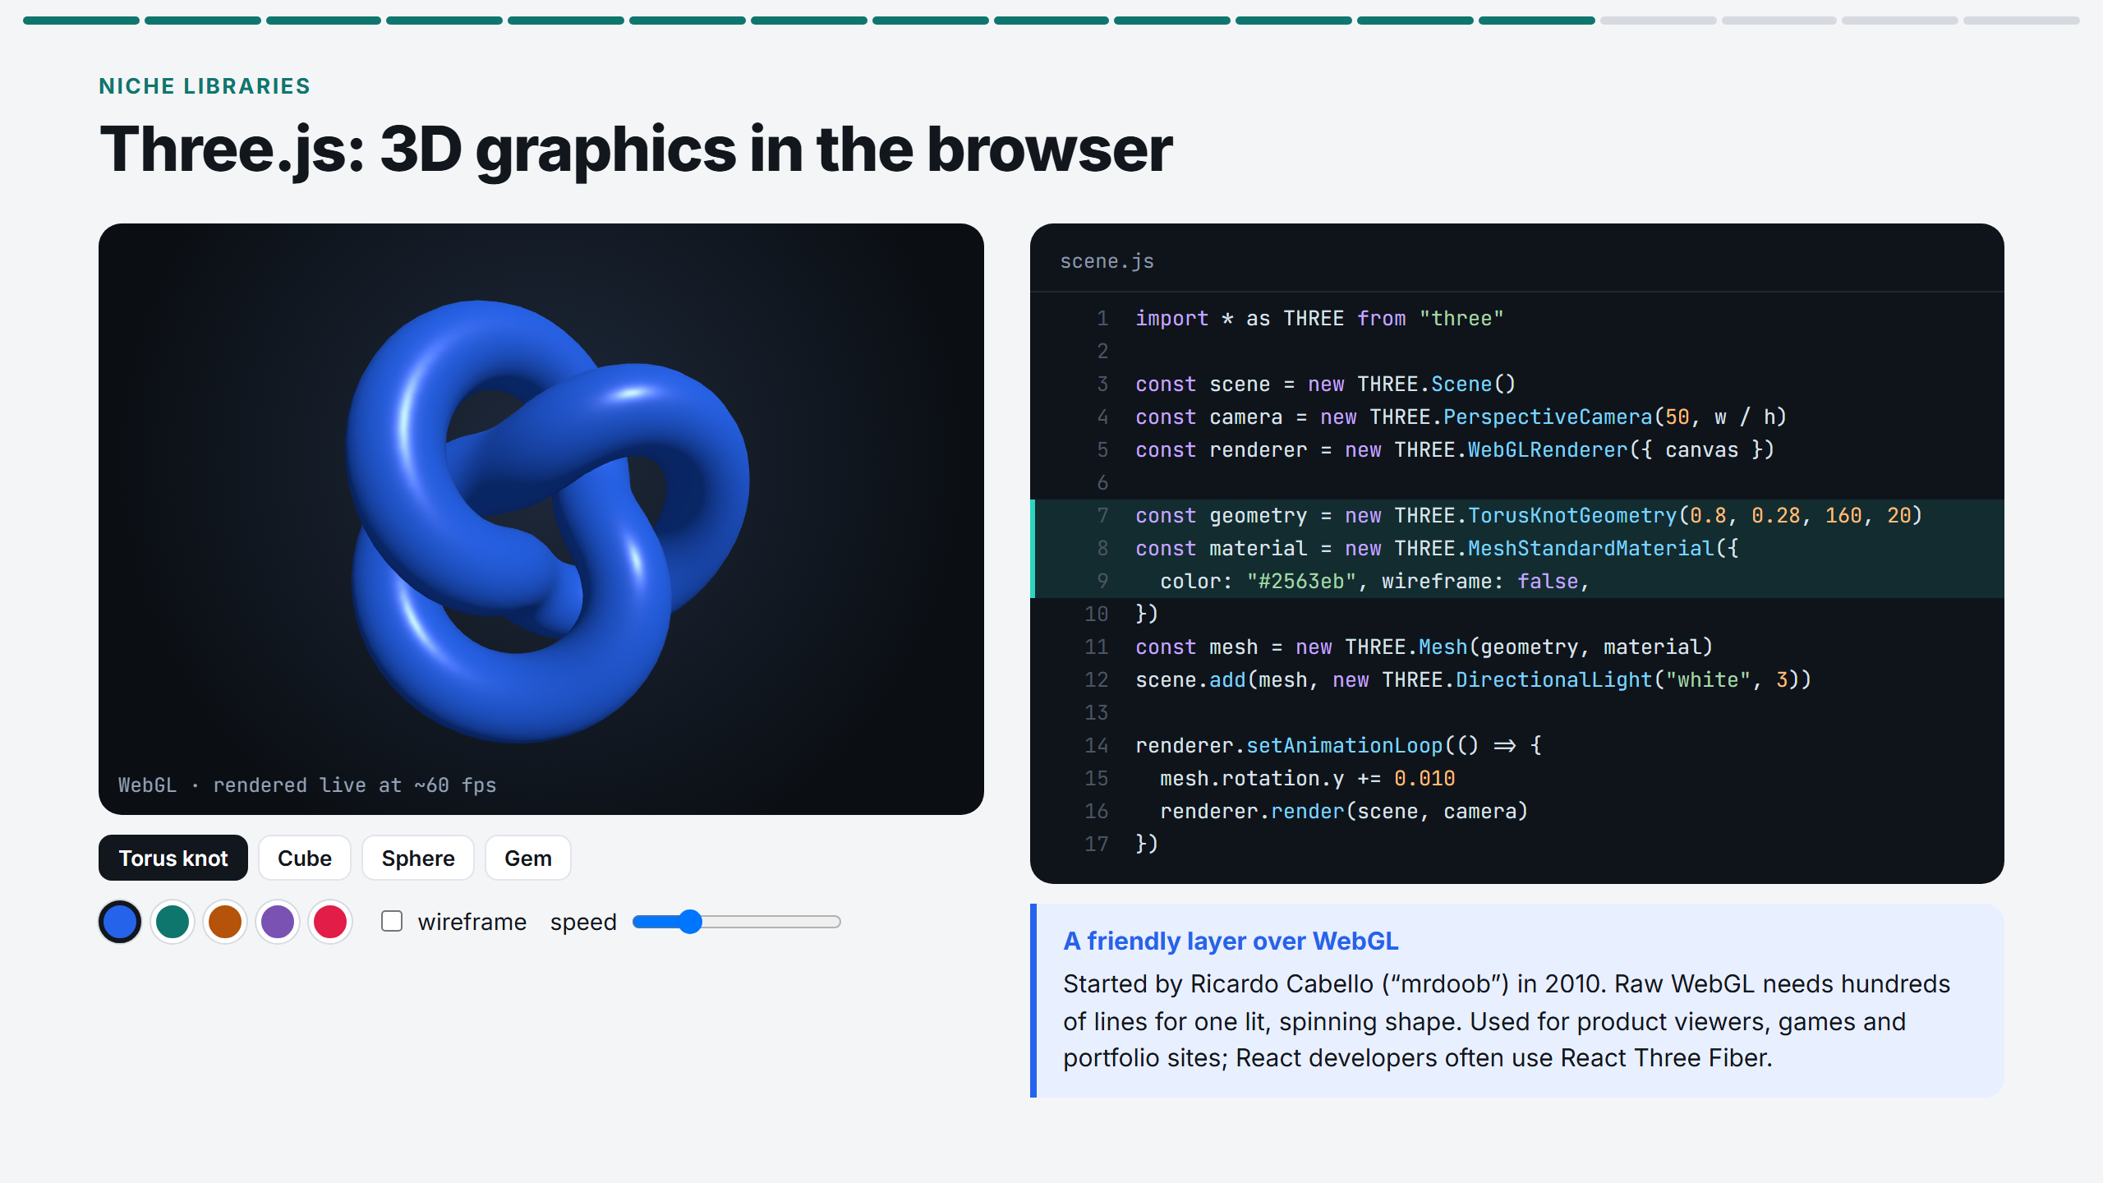
Notes:
Change the shape, colour, wireframe and speed. Lines 7 to 9 of the code update. Point out that this is real WebGL running inside a React component.

Slide 14
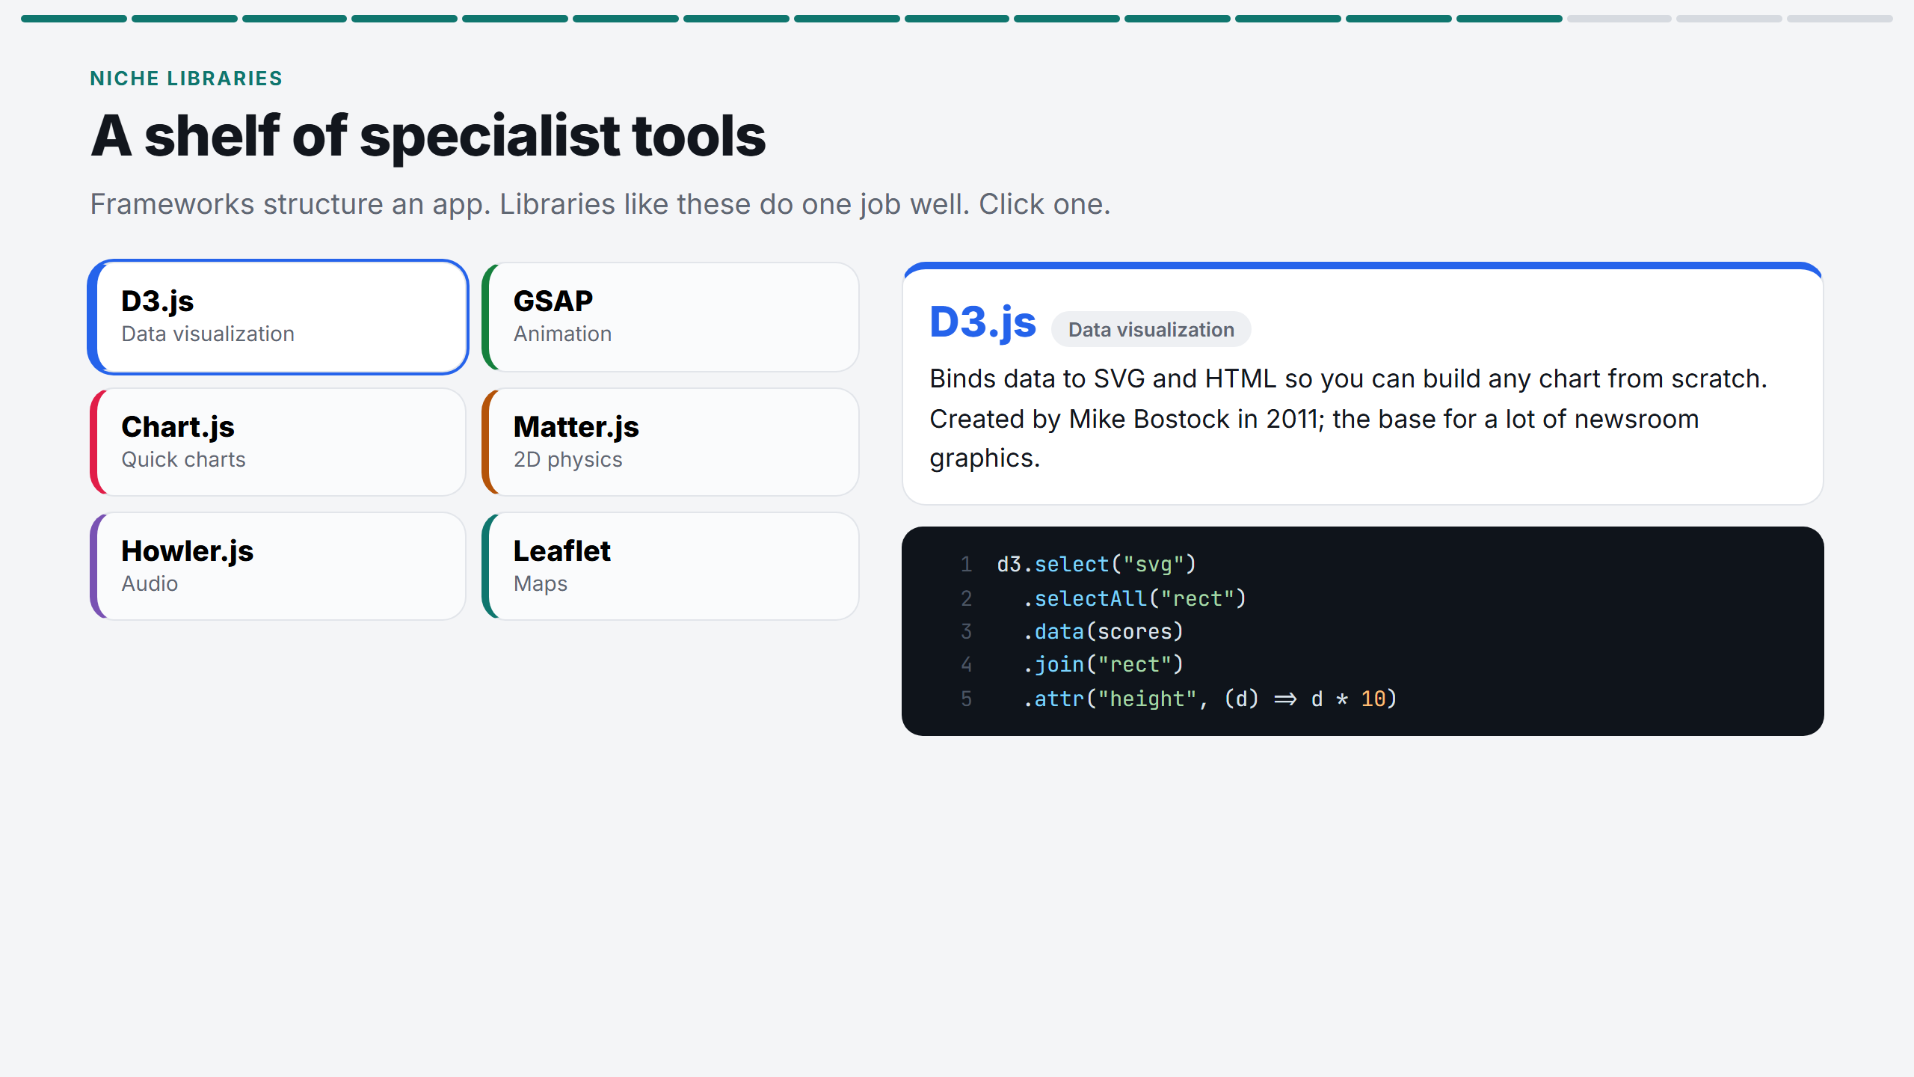
Notes:
Click two or three that interest you: D3 for data, GSAP for animation, Matter.js for physics. Frameworks give structure; libraries do one job well.

Slide 15
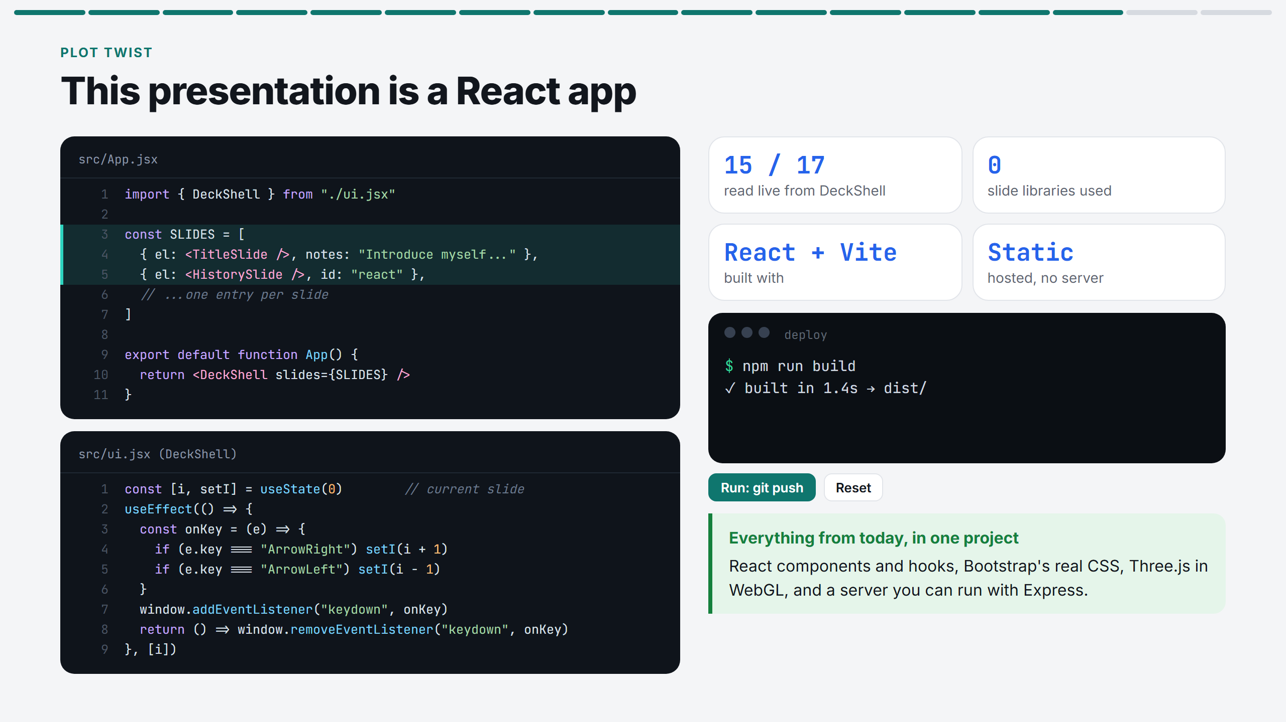
Notes:
Reveal: the whole deck is a React app built with Vite and hosted as static files. The slide counter is read live. Run the deploy commands.

Slide 16
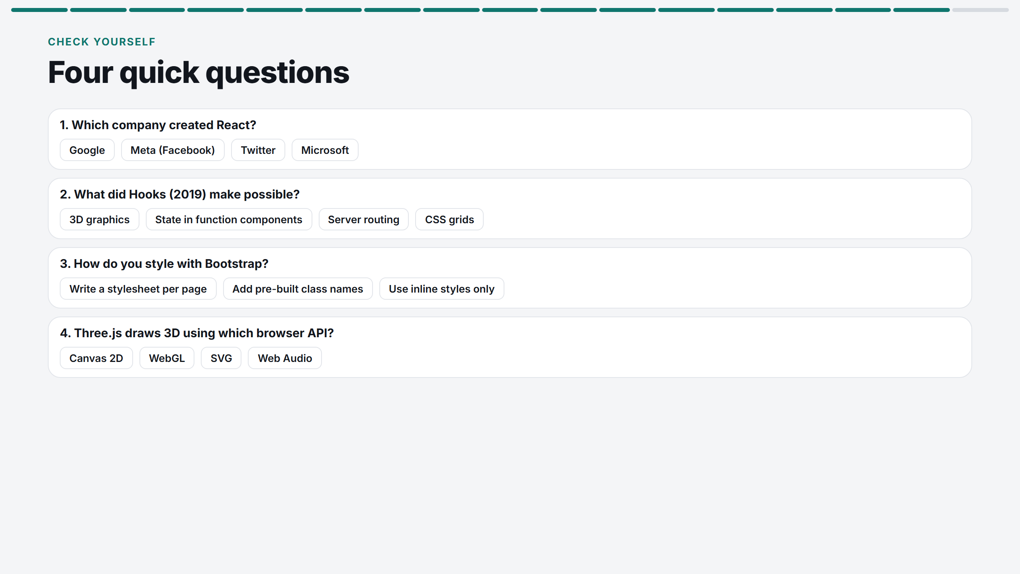
Notes:
Ask the class to answer out loud before you click. Four questions, about 90 seconds.

Slide 17
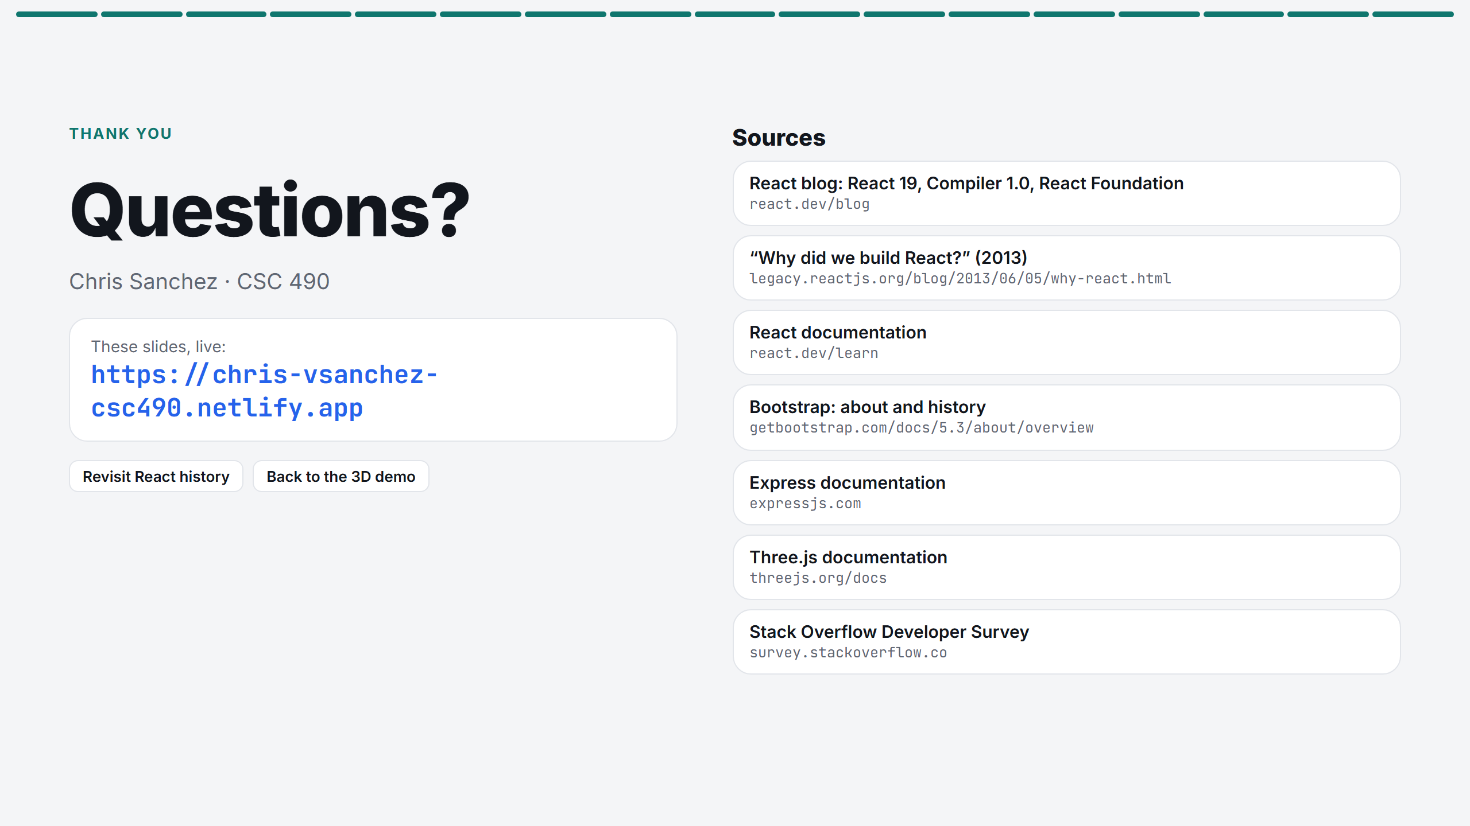
Notes:
Thank everyone, give the domain, and take questions. The buttons jump back to the React history or the 3D demo if someone asks.

