Slide 1
Biophysics II docking protein-protein
Joao, Olga Ibañez, Charlotte Nachtegael

Slide 2
Protein-protein docking methods

Slide 3
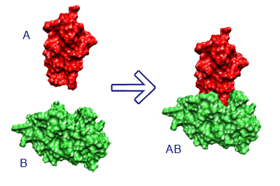
Introduction
What is protein-protein docking ?
Protein-protein interaction
Biological processes
Genetic diseases
Interesting questions
Affinity of binding ?
Important residues for interface binding ?
https://vred.bioinf.uni-sb.de/DFG-protein-protein-docking/DATA/projectsummary.shtml
Notes:
Olga

Slide 4
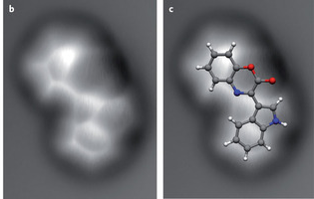
Introduction
Available material : high- and low-resolution structures of proteins
Recent advances in submolecular resolution with scanning probe microscopy, Nature Chemistry 3,273–278 (2011)
Notes:
Olga

Slide 5
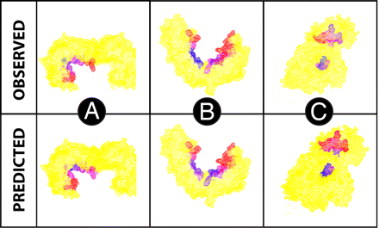
Flexibility and DOF
Notes:
Joao

Slide 6
No conformational changes
« Rigid-body docking »
Fast-Fourier transformation
Geometric hashing
When ?
Low-resolution structures
No changes or moderate enough
Notes:
Olga

Slide 7
Few conformational changes
« Partially flexible docking »
Considering only side-chain DOF minimal flexibility
Improve rigid-body docking
Only if changes moderate
Notes:
Joao

Slide 8
Big conformational changes
Use high-resolution structures
Problems of high-resolution methods
Scoring
Increase of local minima
Slow convergence of results
Notes:
Joao

Slide 9
Big conformational changes
How to restrict the conformational space
Restrict number of DOF
Template-based docking
Notes:
Olga

Slide 10
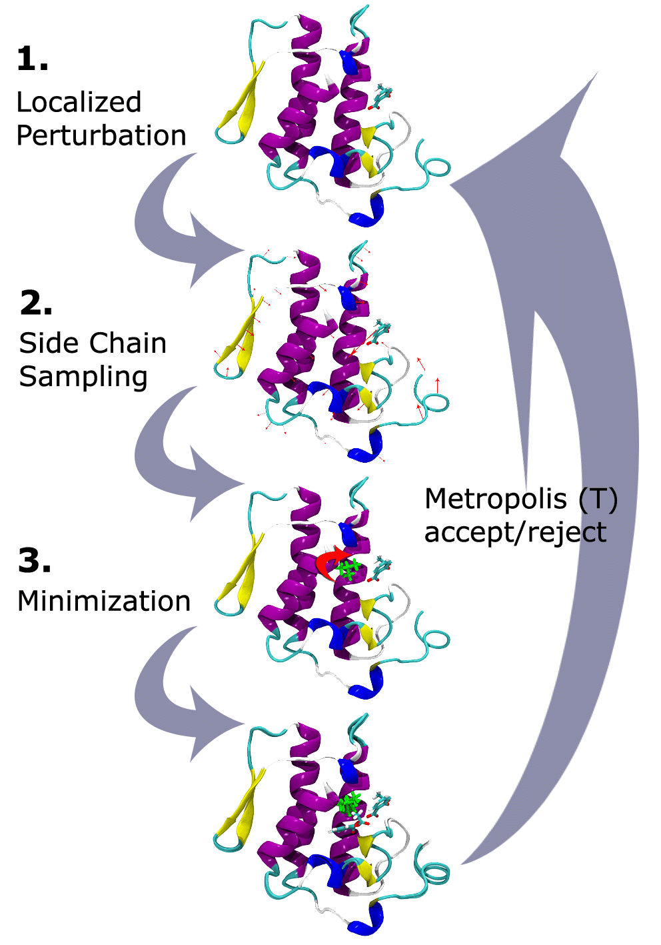
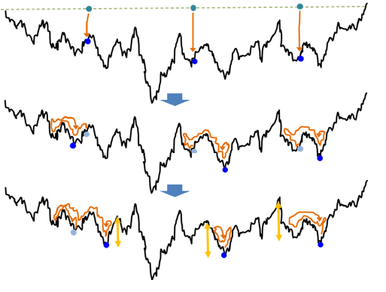
Big conformational changes
Single-trajectory method
Monte Carlo Minimization
Molecular Dynamics
Population-based methods
Notes:
Joao

Slide 11
Big conformational changes
Single-trajectory methods
Monte Carlo Minimization
Molecular Dynamics
Population-based methods
Notes:
Olga

Slide 12
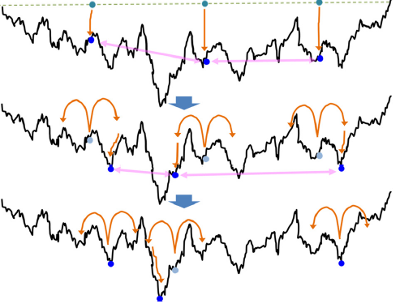
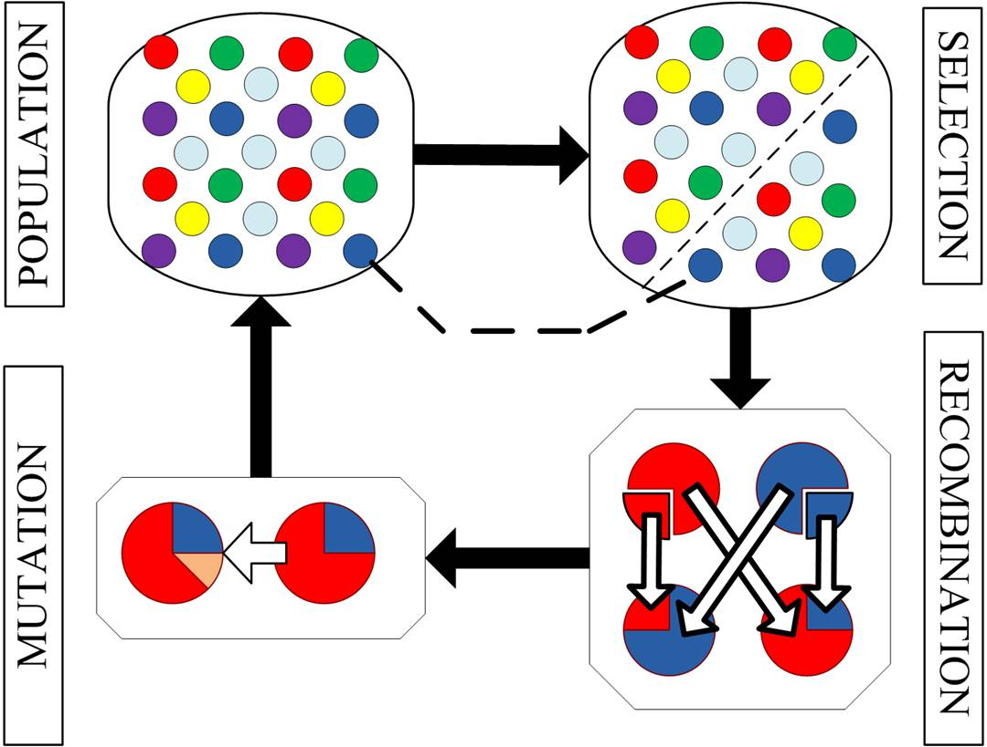
Big conformational changes
Single-trajectory method
Population-based methods
Notes:
Charlotte

Slide 13
Two challenges in protein-protein docking
Backbone DOF
Identify regions implied in binding
ENM method
Water role in binding process
Notes:
Charlotte

Slide 14
Two challenges in protein-protein docking
Backbone DOF
Water role in binding process
Involved electrostatic interaction and hydrogen-bonds network
Rotamer approach
Docking with protein-water
Notes:
Olga

Slide 15
How to score all these structures complexes ?

Slide 16
Sampling and scoring
Sampling implicitly scores
BUT
An additional scoring step is added to rerank structures
ALTHOUGH
Methods integrating sampling and scoring give better results
Notes:
Joao

Slide 17
Why decoupling ?
Simplifies computational problem
Use of decoys set
Can be stored
Easy to use for development and refinment of the scoring function
Notes:
Joao

Slide 18
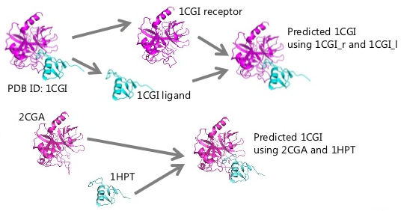
How do we build decoys set ?
Perturbation
Docking of bound proteins
Docking of unbound proteins
Notes:
Joao

Slide 19
Influence of decoys set on scoring function
Influence of nature proteins
Influence of bound/unbound proteins docking set
Influence of docking algorithm used for obtaining set
Notes:
Charlotte

Slide 20
Proof of concept : CAPRI
Part sampling + part scoring
best scorer is only as good as the 9th best predictor
best scorers are not necessarily the same
Notes:
Charlotte

Slide 21
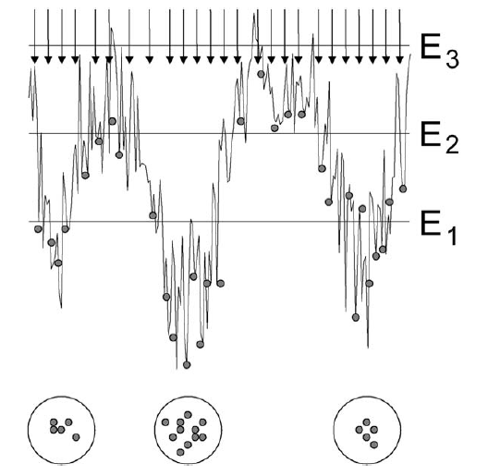
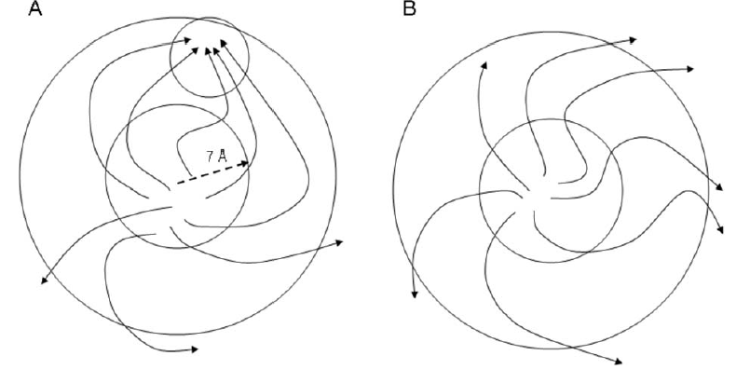
Methods integrating sampling and scoring
Monte Carlo Minimization
Concept of cluster size
Resampling clusters to refine results
Notes:
Charlotte

Slide 22
TAKE-HOME message
Choice of docking methods depends on :
Material available : low- or high-resolution structures
A priori information : no/few/large conformational changes for binding
Docking methods are single-trajetory or population-based
Sampling and scoring should be integrated
If not, the construction of decoys set should use a docking method as close as possible to the sampling method developed and used docking unbound proteins methods
Notes:
Charlotte

