Slide 1
Firebase Authentication
For Android App Development In Java

Slide 2
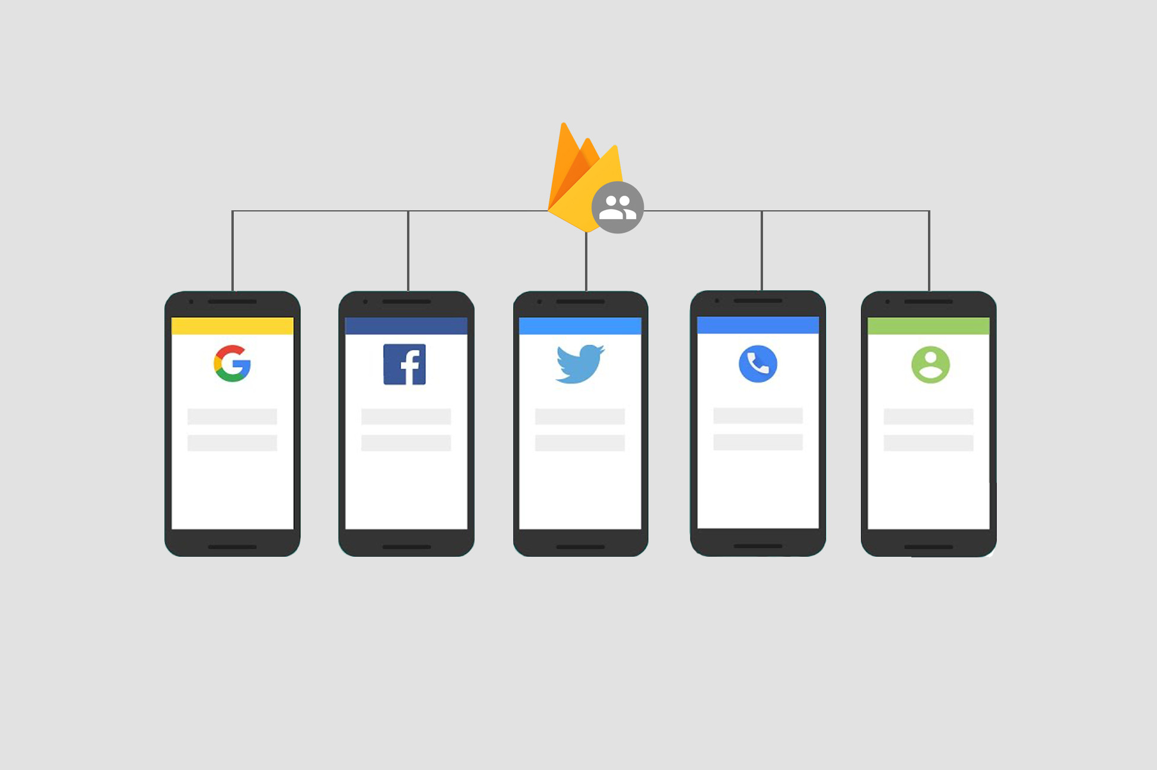
What is it?
(UnityAssetCollection.com, n.d.)
Notes:
Most apps require some sort of user authentication. Firebase authentication is a tool that can be used by developers to implement user authentication. Unlike other ways of implementing authentication, firebase is fairly easy to implement in an android application.

Slide 3
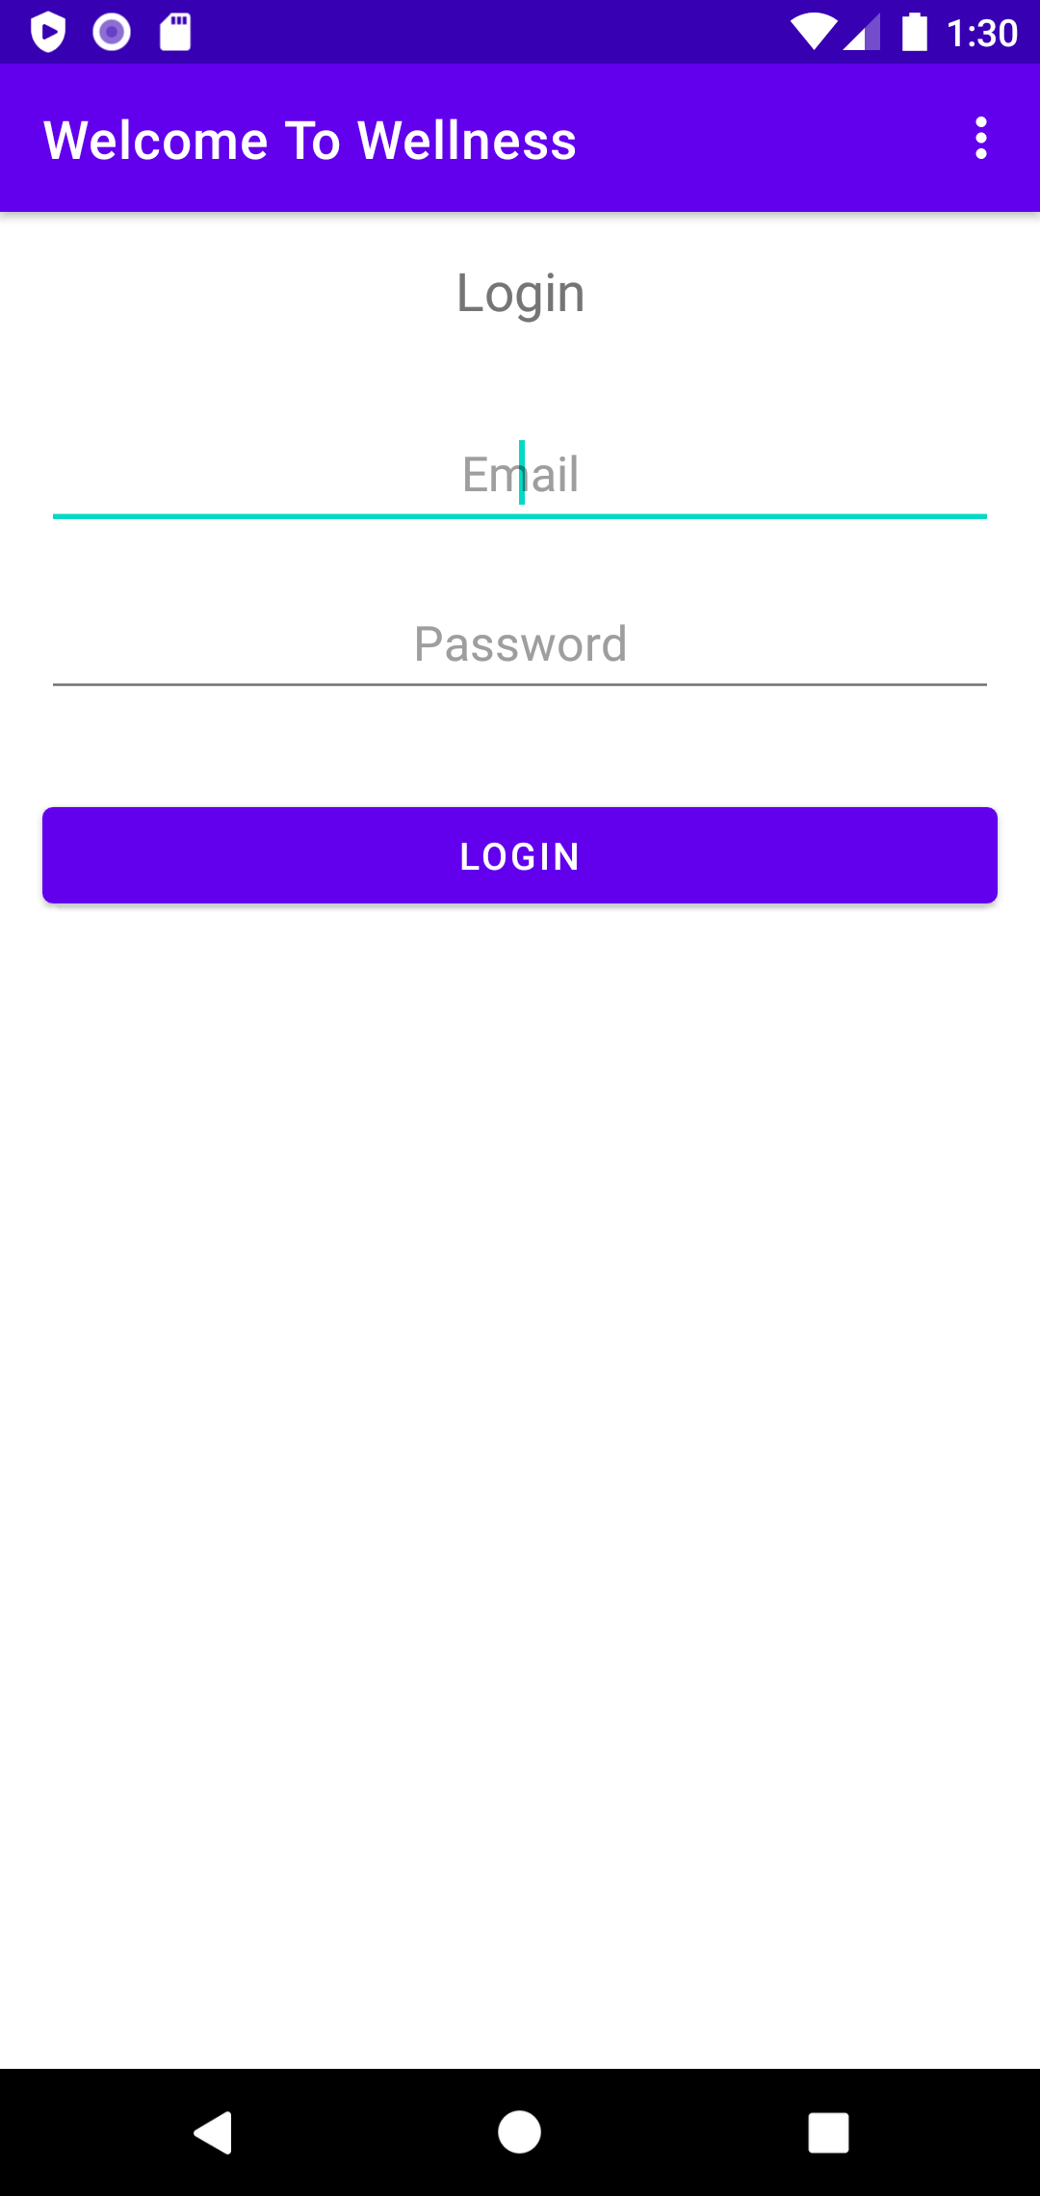
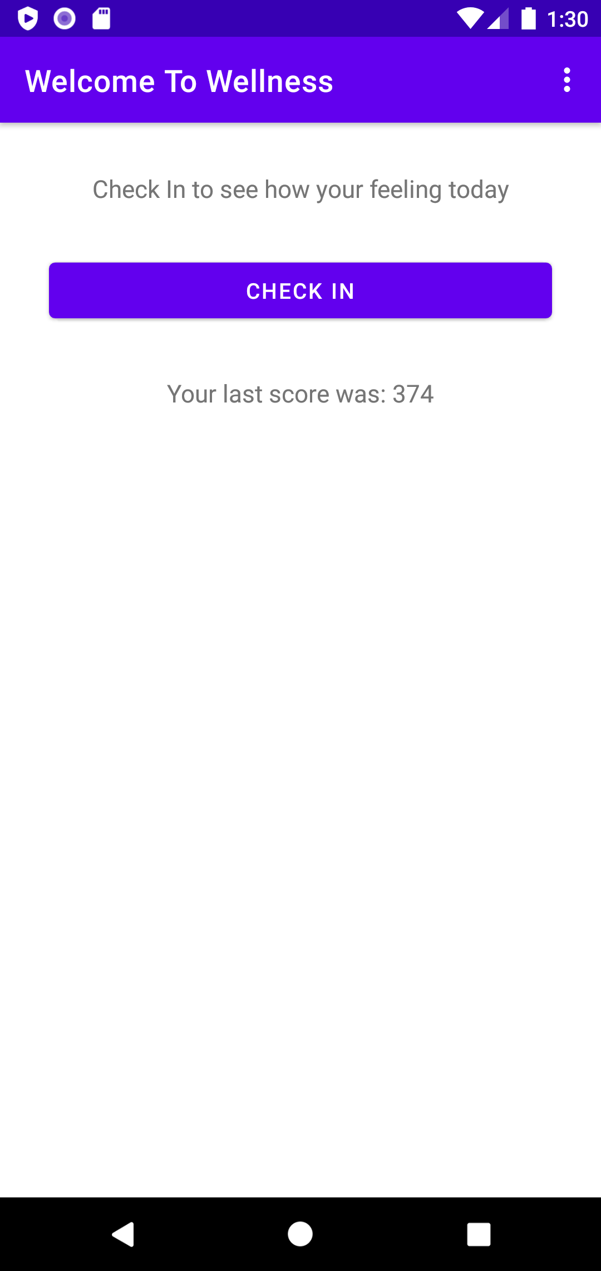
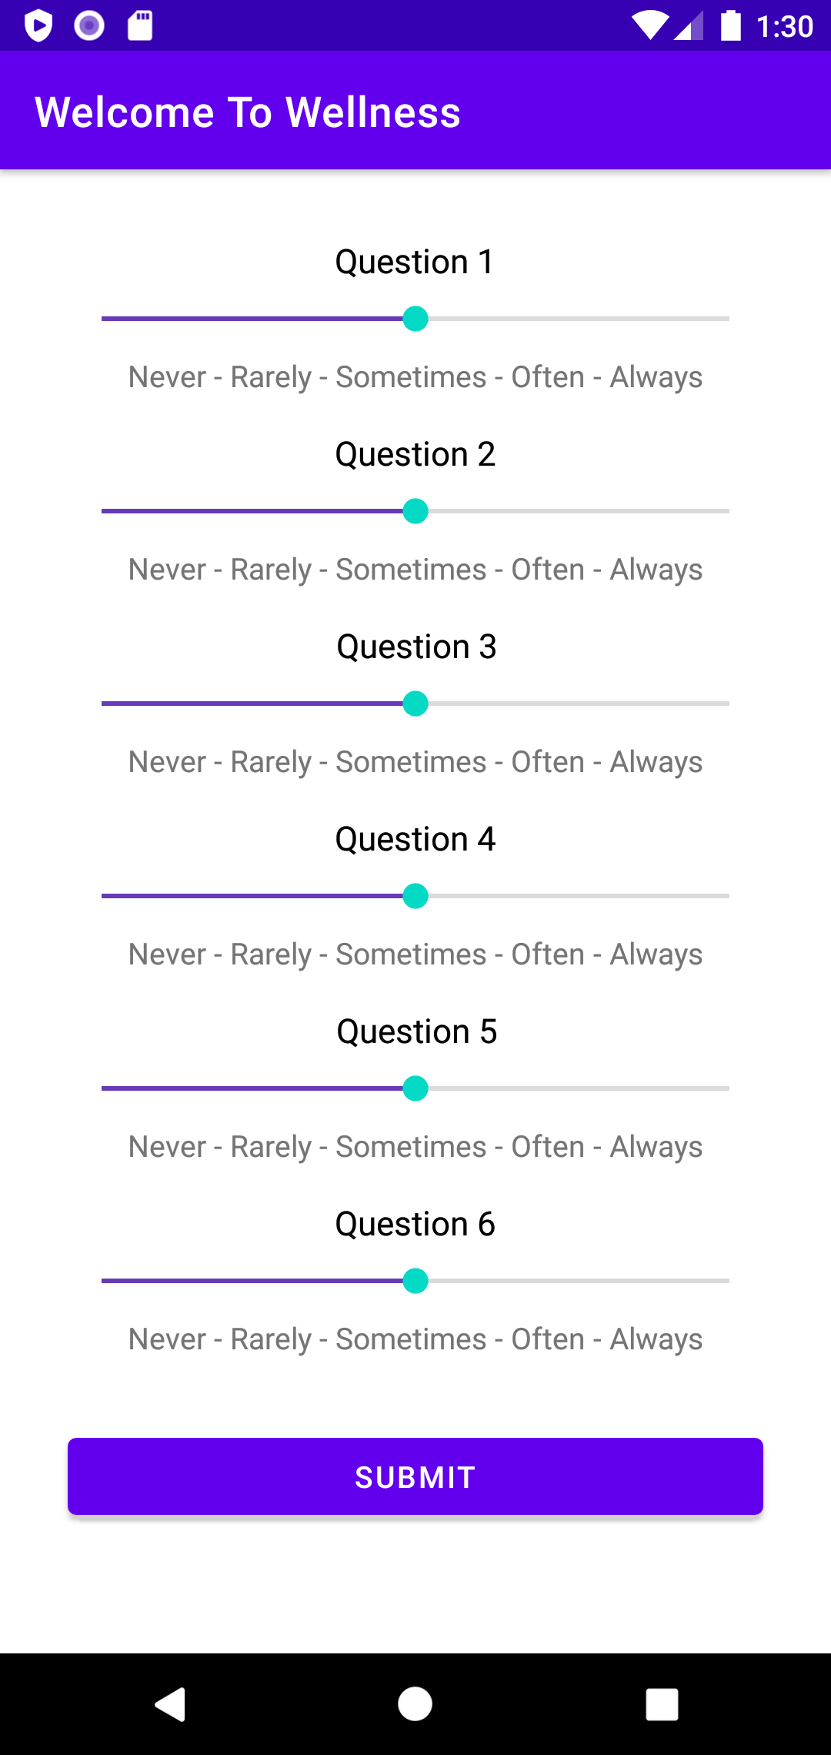
How I Did
Notes:
I was able to complete my main goal for the lab which was the firebase authentication. I also did make a somewhat useable app that allows a user to express how they are feeling on a particular day. However, I wasn’t able to add any more pages or features.

Slide 4
Demo

Slide 5
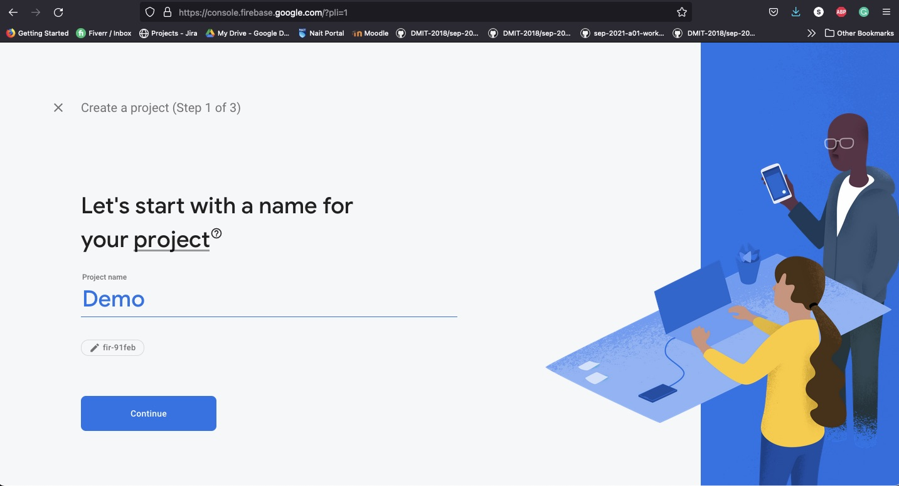
Implementation
Notes:
For you to be able to implement firebase authentication, you first have to create a firebase project. Got to Firebase.com and click on Get Started. Once you do this you can then name your project.

Slide 6
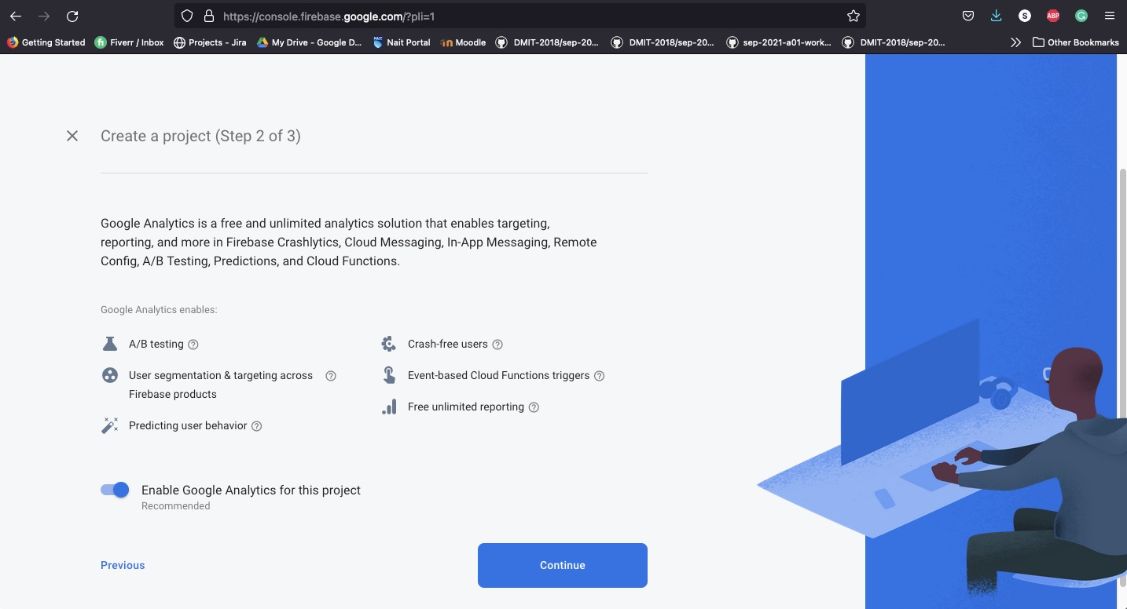
Create Firebase Project
Notes:
Once you create a name for your project you have the option to use google analytics. For this project it doesn’t matter but on any regular projects most people should opt-in as it doesn’t change the way you implement it.

Slide 7
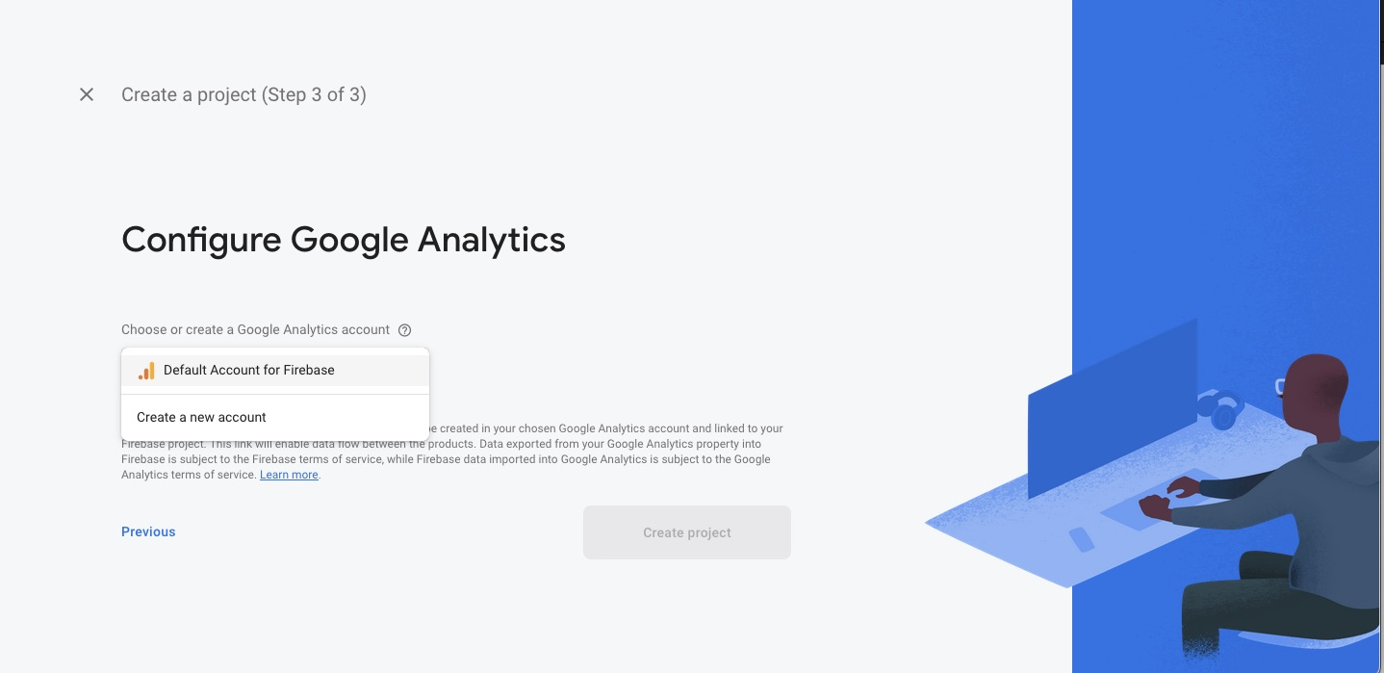
Create Firebase Project
Notes:
If you do opt-in for Google analytics you will have to choose what account you want to use for the analytics

Slide 8
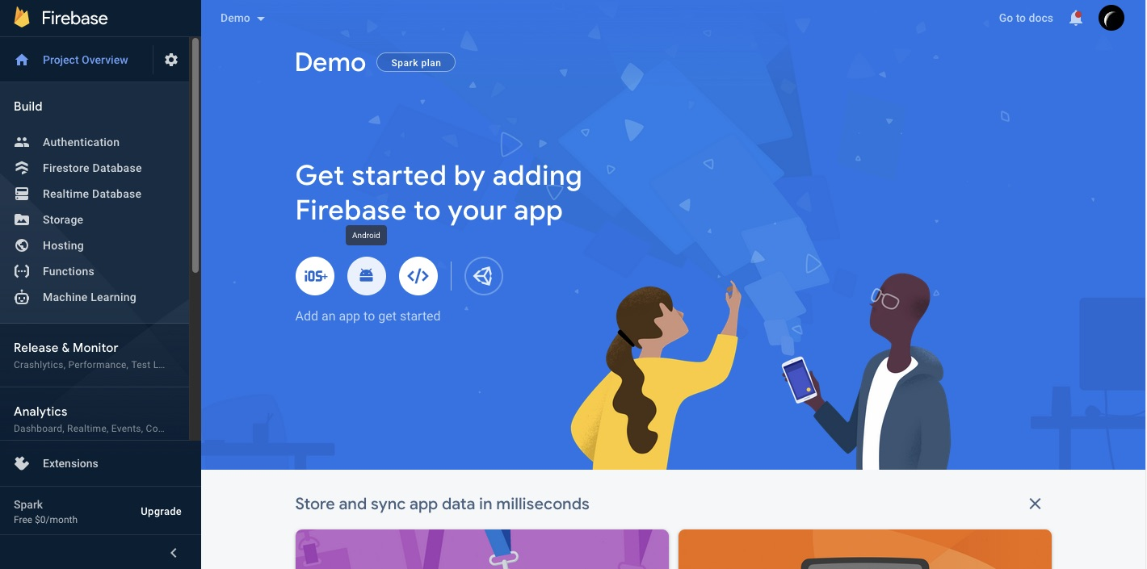
Create Firebase Project
Notes:
Once the project has been created, you should see a screen like this here.

Slide 9
Create Android Project
Now Create a new android project with an empty activity. Make sure to have an API of 26 or later.

Slide 10
Implement Firebase
Notes:
Once your android project has been built, you now need to go back to firebase in your browser and click on the android icon. Firebase will then walk you through how to implement firebase into your project.

Slide 11
Implement Authentication
This should go just below the plugins section
These will go inside the dependencies section
In the module level Build.Gradle file, make sure you have added these dependencies
Once finished, run project sync

Slide 12
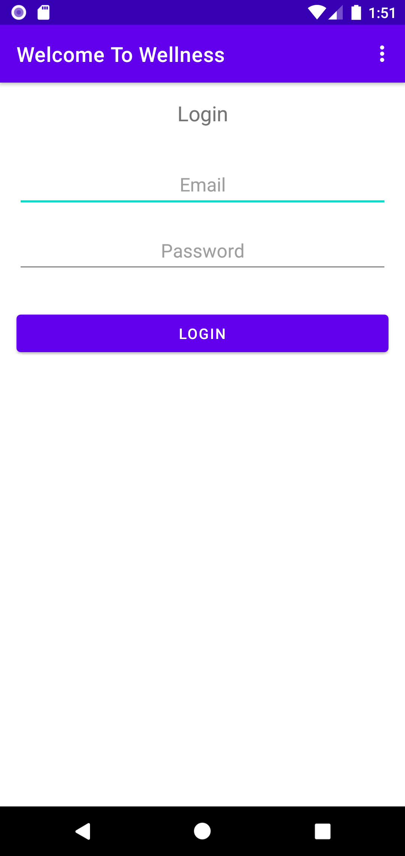
Implement Authentication
Next, design and create two new activities.
One for Sign In and the other for Sign Up.

Slide 13

Implement Authentication
Feel free to create a menu that allows the user to switch between the login, and sign-up pages and an option to sign-out.

Slide 14
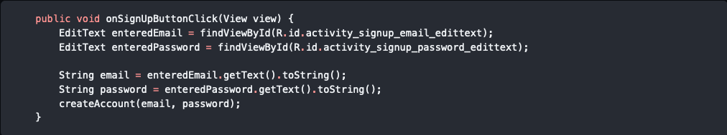
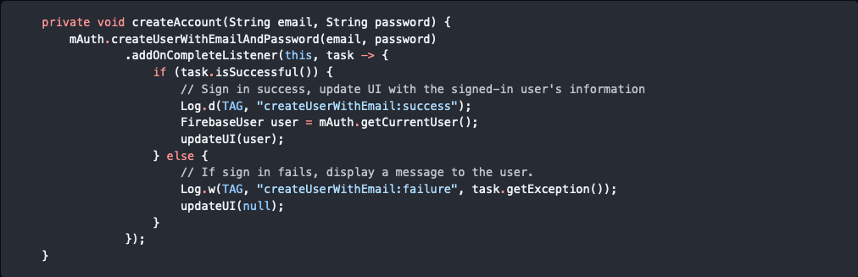
In the sign-up activity, you will need to implement these two methods. Make sure to also create an instance of firebase auth, in this case it’s the variable mAuth.
The createAccount method uses the entered credentials to create a user with email and password. If successful it then creates and assigns a variable called user to hold the current user value
The method will then call the updateUI method and either pass in the user or a null value

Slide 15
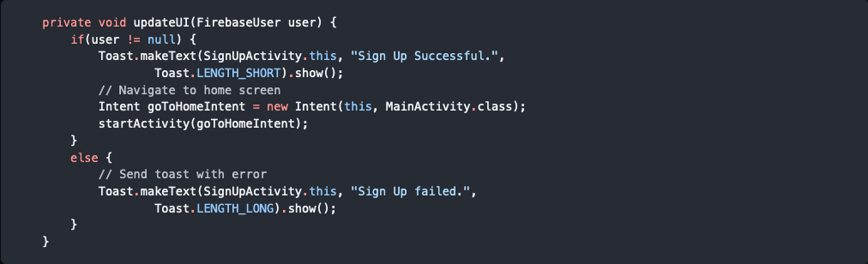
The updateUI determines if the user is signed-in.
Then depending on the result, it will either send the user to the home page or display a message telling the user that the sign-up was not successful.

Slide 16
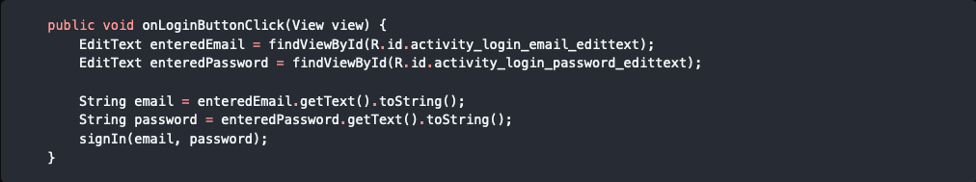
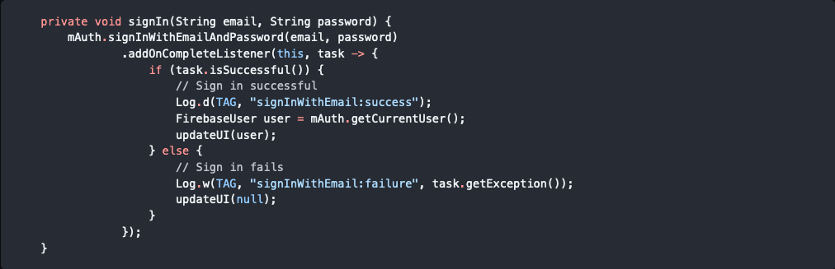
In the sign-in activity, you will need to implement these two methods. Make sure to also create an instance of firebase auth, in this case it’s the variable mAuth.
The sign-in method is fairly similar to the sign-up method except for the different method (signInWithEmailAndPassword).

Slide 17
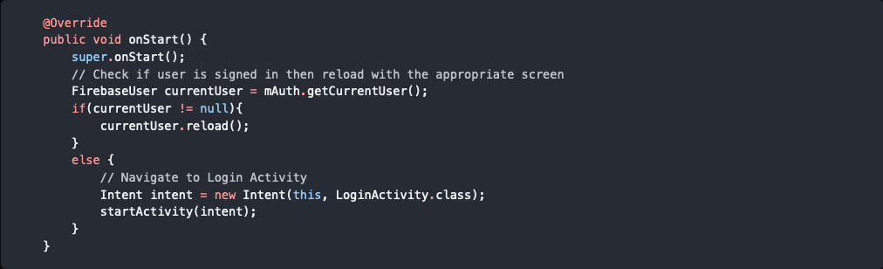
Lastly, in the MainActivity, add the onStart method
This method checks to see if there is a user signed in. If there is the home page is reloaded, if not the user is sent to the login page. This is so that the user doesn’t have to sign-in every time they open the app.

Slide 18
Questions?
Email: csmall8@nait.ca
GitHub Page: github.com/Chris-small1234/FirebaseAuthenticationTutorial

