Slide 1
Python Tuples
By Christopher Douglas

Slide 2

What are Tuples?
  Tuples
    Tuples are ordered, immutable sequences of elements
    Represented using parentheses ()
    Less methods than a list
    Tuples use less memory

Slide 3
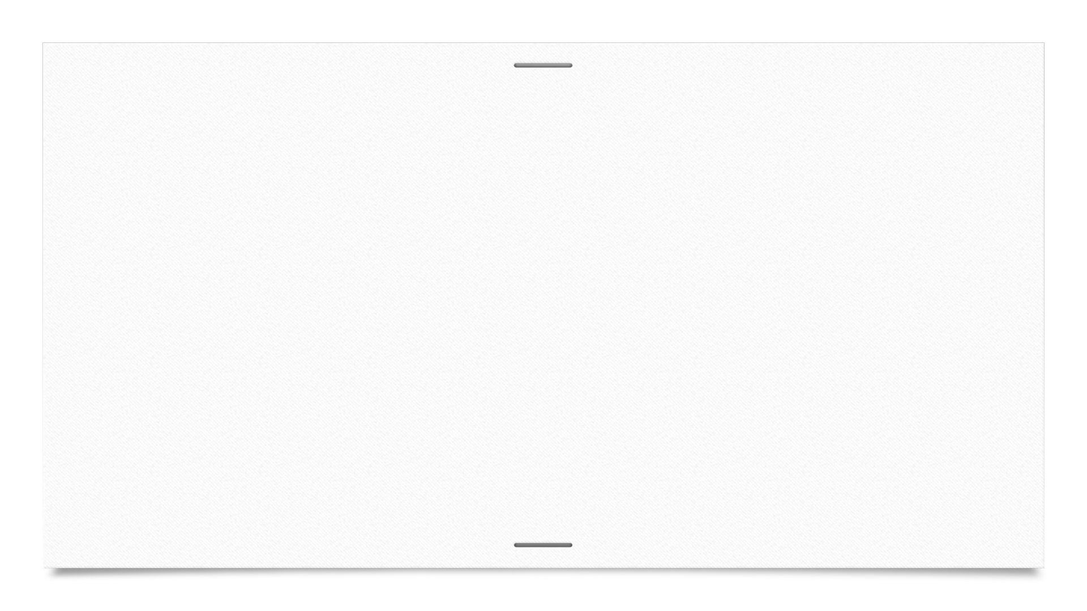


How to make a Tuple
Tuples can contain any data type
To access elements in tuple you must use indexing (starting from 0)

Slide 4
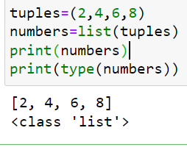
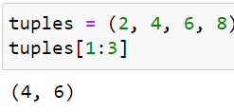
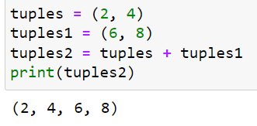
What operations can you use?
What you can do
Slicing: accessing a range of elements
Concatenation: combining two tuples into a new one
Length, Min, Max, Avg, Count, Etc.
Converting a tuple to list

Slide 5
Why use tuples
  Faster to use
  Best for data that should not change like: Names, Ages, Dates, Times, Etc

