Slide 1
PdO thin films for oxide TFTs
Project status: data, crystallinity, ANOVA and the next design
Hall mobility
Carrier concentration
XRD crystallinity
DMREF · NU – ND · 30 September 2026

Slide 2
Where the project stands
From one substrate to three configurations
2025
Apr – Aug 2026
Jul – Aug 2026
Sep 2026 →
InOx screening
PdO on Al₂O₃ / sapphire
PdO on HfO₂ / Si
Three configurations
Taguchi L8 / L32 designs on InOx TFTs
Sobol 23 × 3 · Hall (May) · XRD (Aug)
5 trial conditions · high variance → dropped
Sapphire data + two new Si stacks
Objectives throughout: mobility ↑ · carrier concentration ↓ · crystallinity ↓ (amorphous PdO)

Slide 3
Current stage: three configurations
Touching layer drives the film; the base substrate matters only through IR heating
PdO
PdO
PdO
ALD Al₂O₃ (10–20 nm)
Al₂O₃
TiO₂
SiO₂ (to confirm)
SiO₂ (to confirm)
sapphire
Si wafer
Si wafer
Al₂O₃ / sapphire
Al₂O₃ / Si
TiO₂ / Si
ALD Al₂O₃ on c-plane sapphire
Same Al₂O₃ touching layer, now on a Si base
TiO₂ touching layer on a Si base
14 / 23 conditions
23 new recipes × 3
23 new recipes × 3
Hall + XRD in hand
Design ready
Design ready
HfO₂ dropped after the 15 Sep meeting; 5 HfO₂ conditions kept only as context.

Slide 4
Inputs and outputs
10 process factors + configuration in, three measured responses out
Deposition (sputter Pd)
Power
2–40 W
Hall mobility
↑
O₂ flow
0.3–20 sccm
Pressure
2–10 mTorr
cm²/V·s · Hall effect, per film
Temperature
25 / 425 °C
Pd thickness
1–10 nm
PdO film
3 replicates per recipe
Carrier concentration
↓
Oxidation (Pd → PdO)
Temperature
200–700 °C
cm⁻³ · Hall effect, modelled on log₁₀
Pressure
0.02 / 1 atm
Time
0–120 min
Crystallinity index
↓
Vacuum anneal
Temperature
25–300 °C
% · PdO(101) XRD area; amorphous wanted
Time
0–120 min
Configuration touching layer / substrate
Contact failures are recorded too: they train the feasibility model.

Slide 5
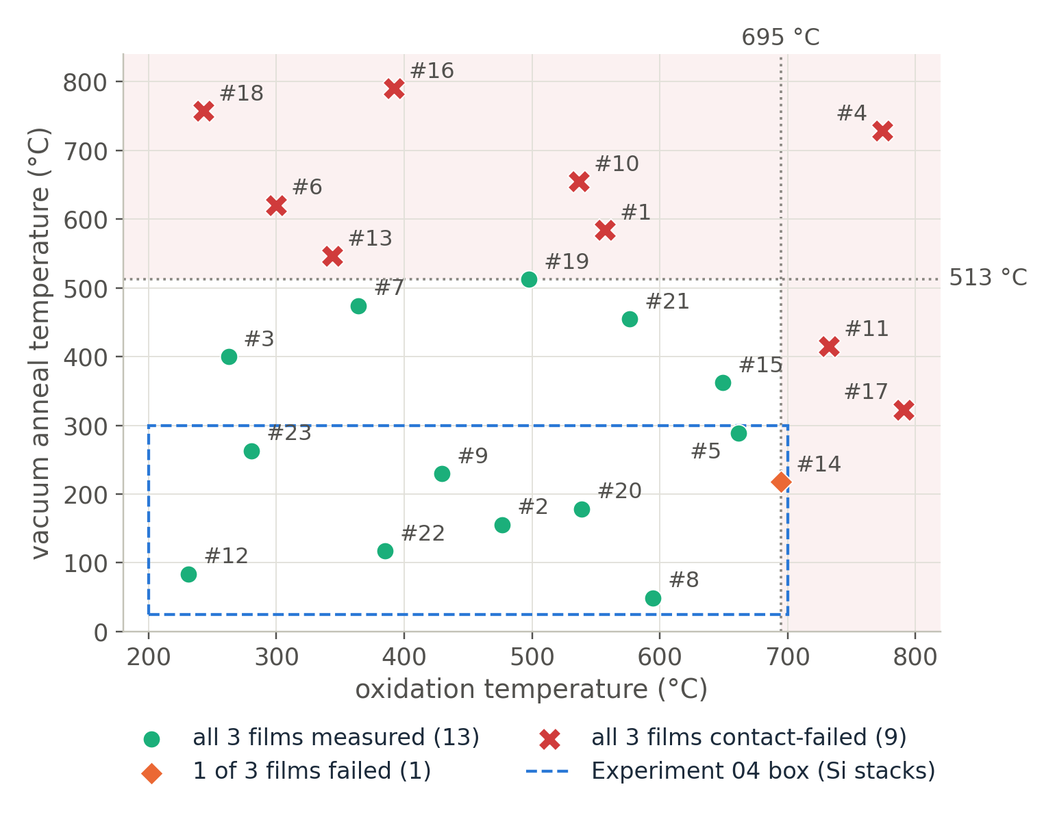
Received data: Al₂O₃ / sapphire Sobol batch
Factors fabricated as designed; every recipe annealed > 513 °C or oxidised > 695 °C failed
69
films fabricated
9 recipes contact-failed on all 3 films; #14 lost 1 of 3
41
with Hall data
XRD scanned on the 14 surviving recipes (42 films)
42
with XRD
14 / 23
usable conditions

Slide 6
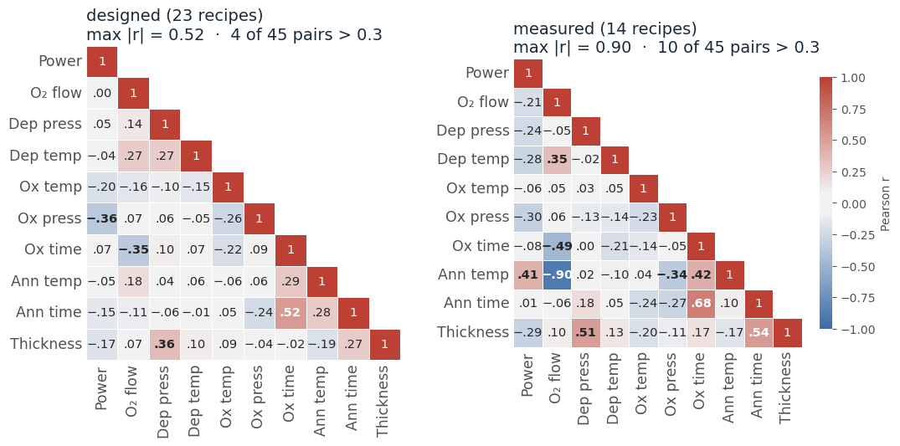
Sapphire design: input correlations
Pearson r between the 10 factors · as designed (23 recipes) and as measured (14 that survived Hall)
0.52
max |r| as designed
typical of a 23-point Sobol (0.48); optimised LHS gives 0.21
0.90
max |r| as measured
O₂ flow × anneal temperature
New Si batch (sliced optimised LHS): max |r| 0.24 and 0.21 per stack, 0.11 combined.
Why it matters: the failures removed most hot-anneal recipes, so in the data O₂ flow and anneal temperature move together; the ANOVA cannot separate their effects.

Slide 7
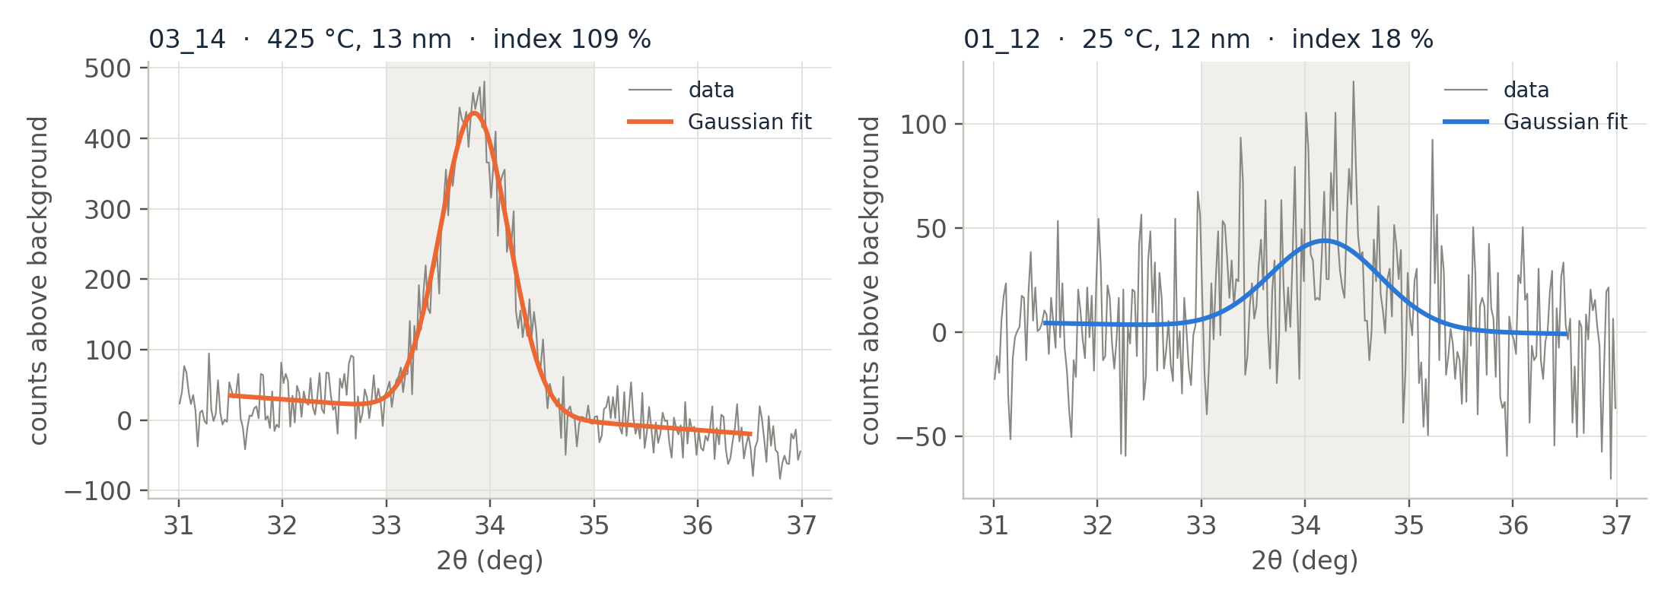
XRD: how crystallinity is quantified
PdO(101) at 33.8° is the 100 % line of PDF 00-041-1107 and the only film peak on sapphire
Crystallinity index
C = 100 · A₁₀₁ / A_{ref}
A₁₀₁: net area 33–35° above a linear baseline
A_{ref}: mean of the 3 strongest films
Peak detected if Gaussian SNR ≥ 3
Crystalline / (crystalline + amorphous) is not measurable here: the film is < 2 % of the counts and the "halo" left after subtracting sapphire is a scan artefact
The index is relative: films without a resolved peak read 10–25 %, i.e. below detection, not a measured fraction

Slide 8
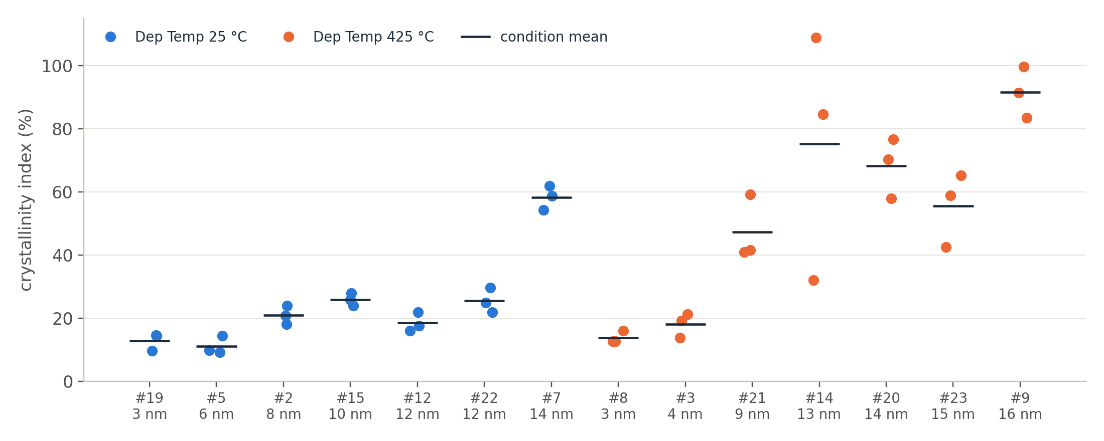
XRD results per condition
19 of 42 films show a resolved PdO(101) peak
Thickness is the main driver: every 25 °C film ≤ 12 nm and 425 °C film ≤ 4 nm stays near the floor
425 °C films ≥ 13 nm reach 56–92 %
Matches the fab team’s slide claims film by film
Replicates agree to a few %, except #14 (32 – 109 %)
final thickness = deposited Pd × 5/3

Slide 9
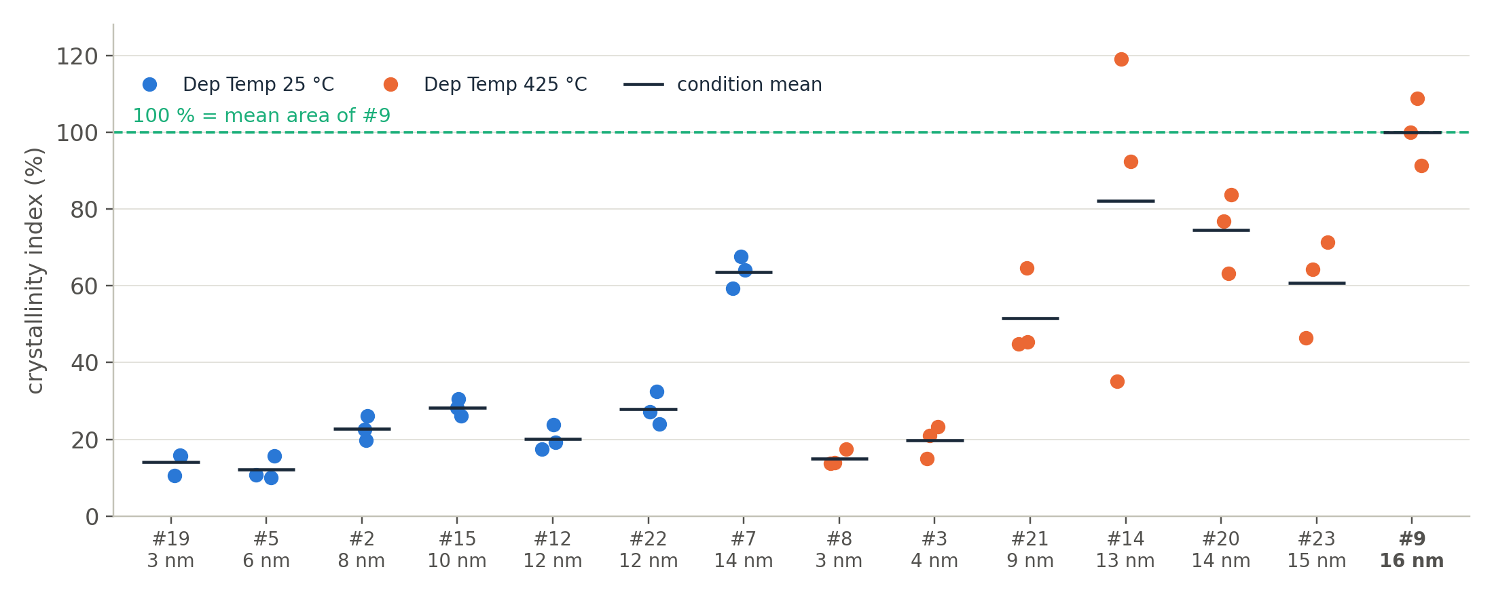
XRD per condition: best recipe as reference
A_ref = mean PdO(101) area of the 3 films of #9 (425 °C, 16 nm), the highest recipe mean
#9 = 100 % by definition; single films can read above it (03_14: 119 %)
425 °C films ≥ 13 nm: recipe means 61–100 %
Every value is the top-3 version × 1.09: ranking, ANOVA F and p, CV and outlier flags do not change
Without the 02_14 outlier, #14 would set the reference instead
C = 100 · A₁₀₁ / Ā₁₀₁(#9)
A_ref | value | #9 | #14 | #20 | strongest film
3 strongest films | 333.9 | 92 % | 75 % | 68 % | 109 %
Best recipe (#9) | 305.6 | 100 % | 82 % | 75 % | 119 %

Slide 10
How the outlier check works
Each recipe keeps its own mean; the IQR is one per response, from all recipes’ deviations
1
Own mean per recipe
Example: recipe #14, crystallinity
Average the replicate films of each recipe: ȳᵢ
1 recipe mean ȳ = 75.2 %
2
Centre each recipe
Film | Value | 2 Deviation | 4 Flag
01_14 | 84.5 % | +9.3 | inside
02_14 | 32.1 % | −43.1 | outlier
03_14 | 108.9 % | +33.8 | outlier
dᵢⱼ = yᵢⱼ − ȳᵢ: subtract the recipe’s own mean (centring, not standardising); every recipe sits at 0
3
One IQR per response
Q1, Q3 from the deviations of all recipes together (41–42 films)
3 all 42 crystallinity deviations: Q1 = −2.8, Q3 = +3.2, IQR = 6.0 → fences −11.8 … +12.2
4
Flag
Most recipes repeat within a few %, so ±12 % is the normal spread; #14’s films sit far outside it.
Film whose deviation lies outside Q1 − 1.5·IQR … Q3 + 1.5·IQR
Why not an IQR of each recipe’s own 3 films? Next slide.

Slide 11
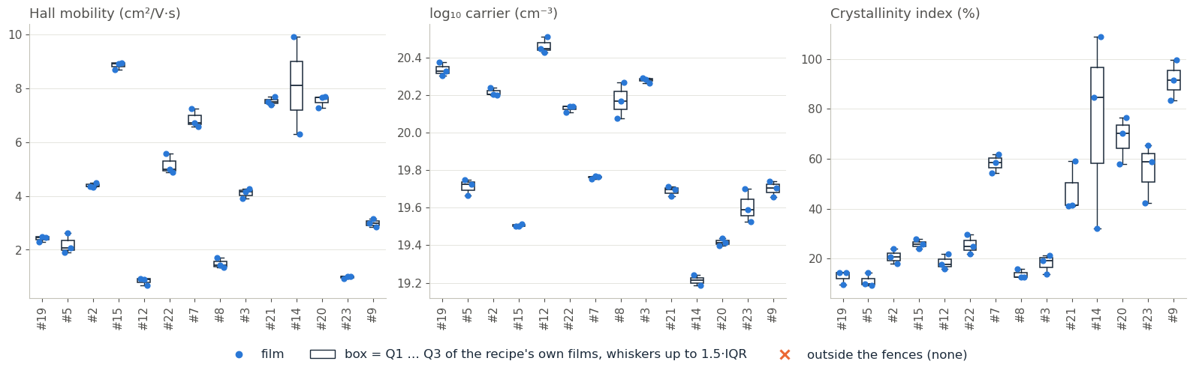
Why not an IQR per recipe?
With 3 films, the quartiles come from those same films: a stray film widens its own fence
#14 crystallinity: 32, 85, 109 %
own IQR 38 → fences 1 … 154 %: nothing flagged
3 replicates: 0 % of outliers caught, even at 10 σ. A per-recipe test needs ≥ 5 replicates; with 3, the scale has to come from all recipes.

Slide 12
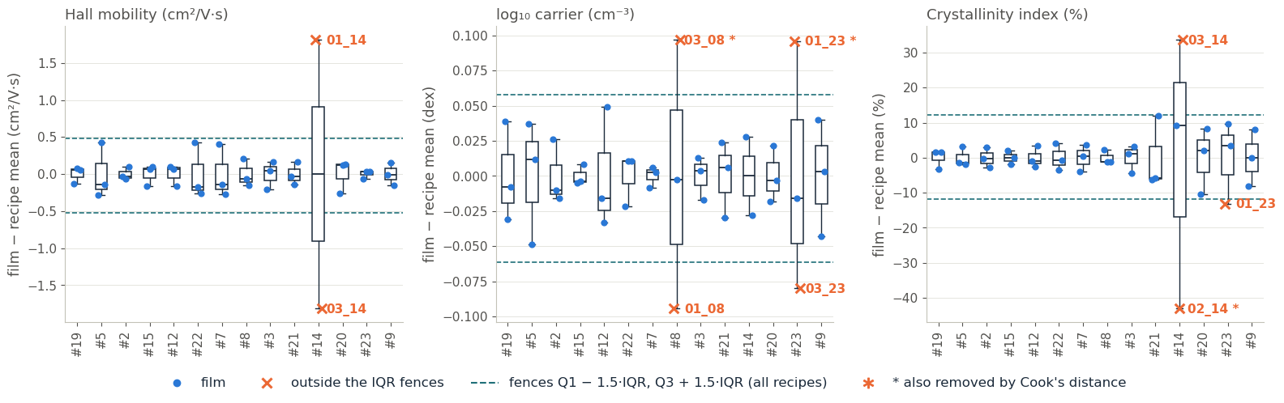
Outlier check: results
Deviation of each film from its own recipe mean · one set of IQR fences per response
Recipe | Flagged by IQR | Removed (Cook's D)
#14 | 01_14, 03_14 mobility · 02_14, 03_14 crystallinity | 02_14 crystallinity
#8 | 01_08, 03_08 carrier | 03_08 carrier
#23 | 01_23, 03_23 carrier · 01_23 crystallinity | 01_23 carrier
9 films in 3 recipes flagged.
A recipe whose films disagree usually puts two films outside. Cook’s distance removes at most one film per recipe; its 3 removals are all IQR-flagged.

Slide 13
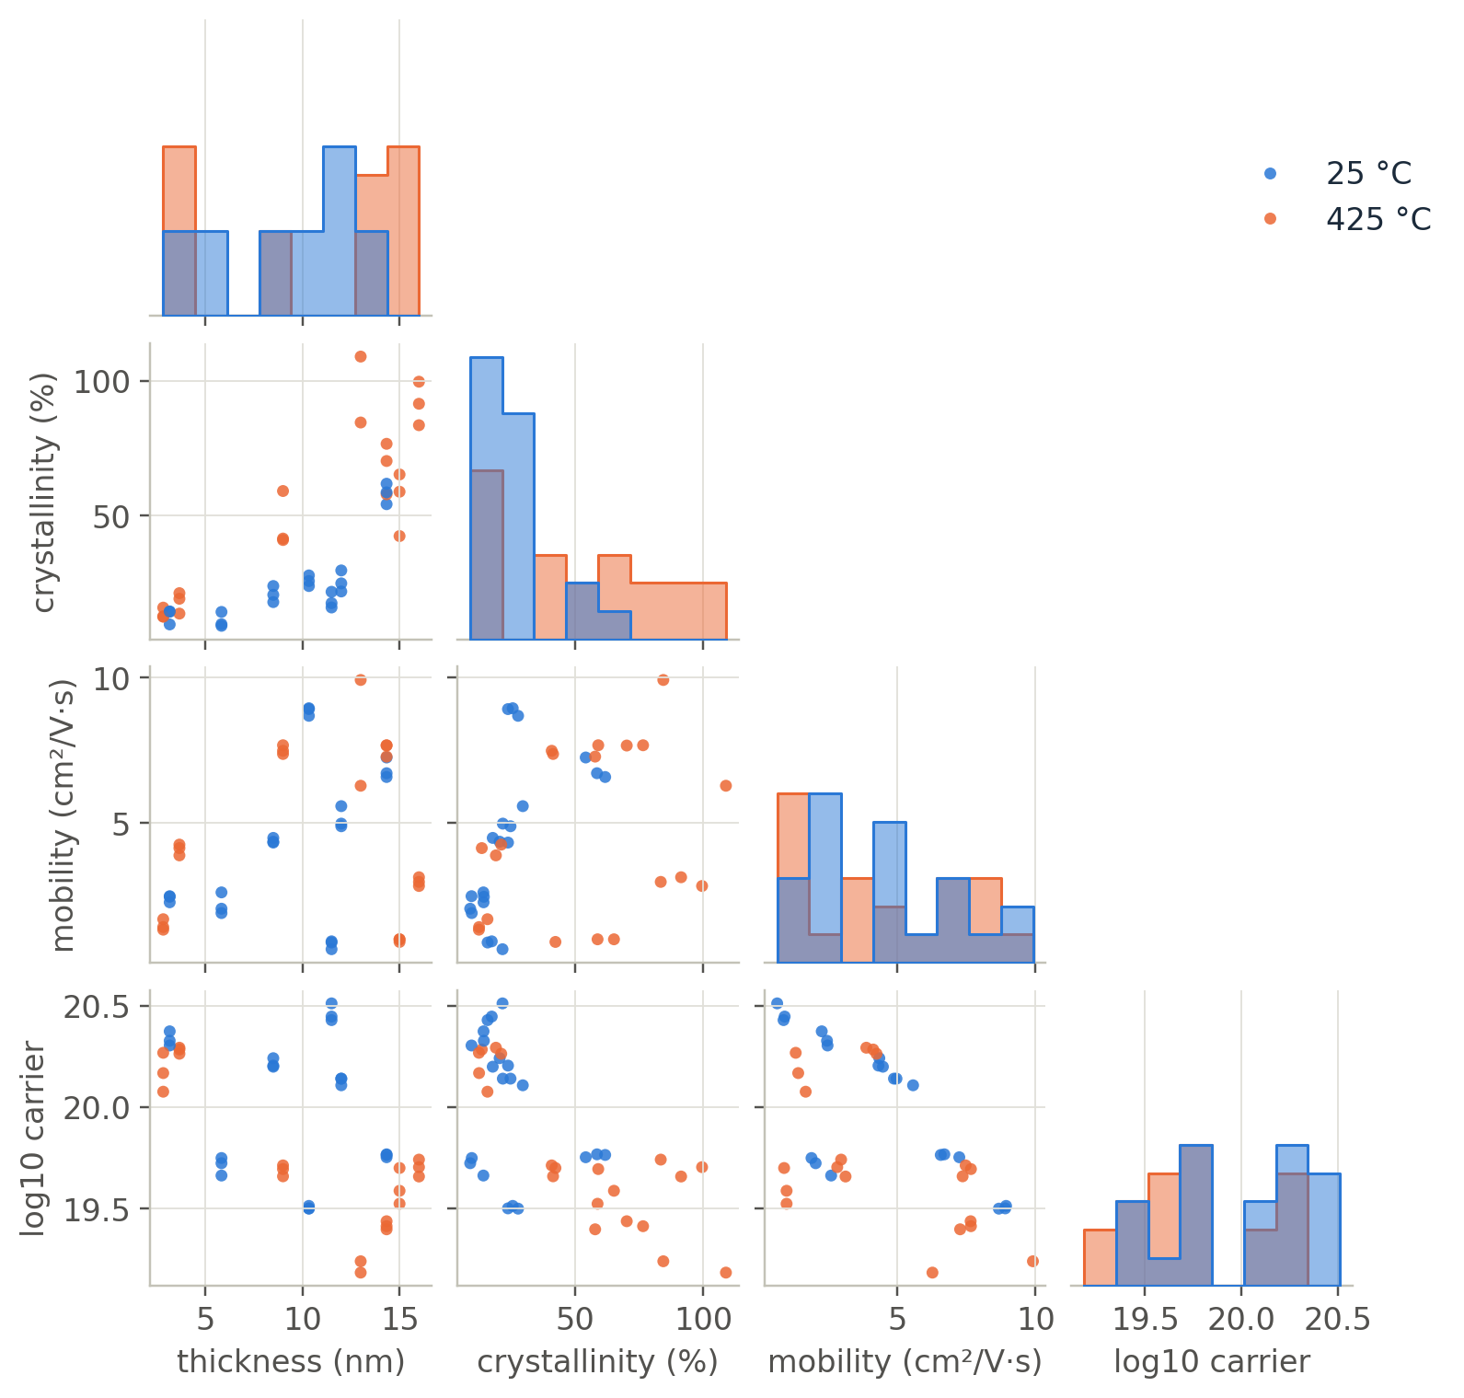
New data at a glance
Film level, 41 films with Hall + XRD, coloured by deposition temperature
1
Thickness → crystallinity
rises steadily with final thickness
2
Two carrier clusters
≈ 10¹⁹·⁵ and ≈ 10²⁰·³ cm⁻³
3
Crystalline films
all sit in the low-carrier cluster
4
Mobility
no simple trend with crystallinity

Slide 14
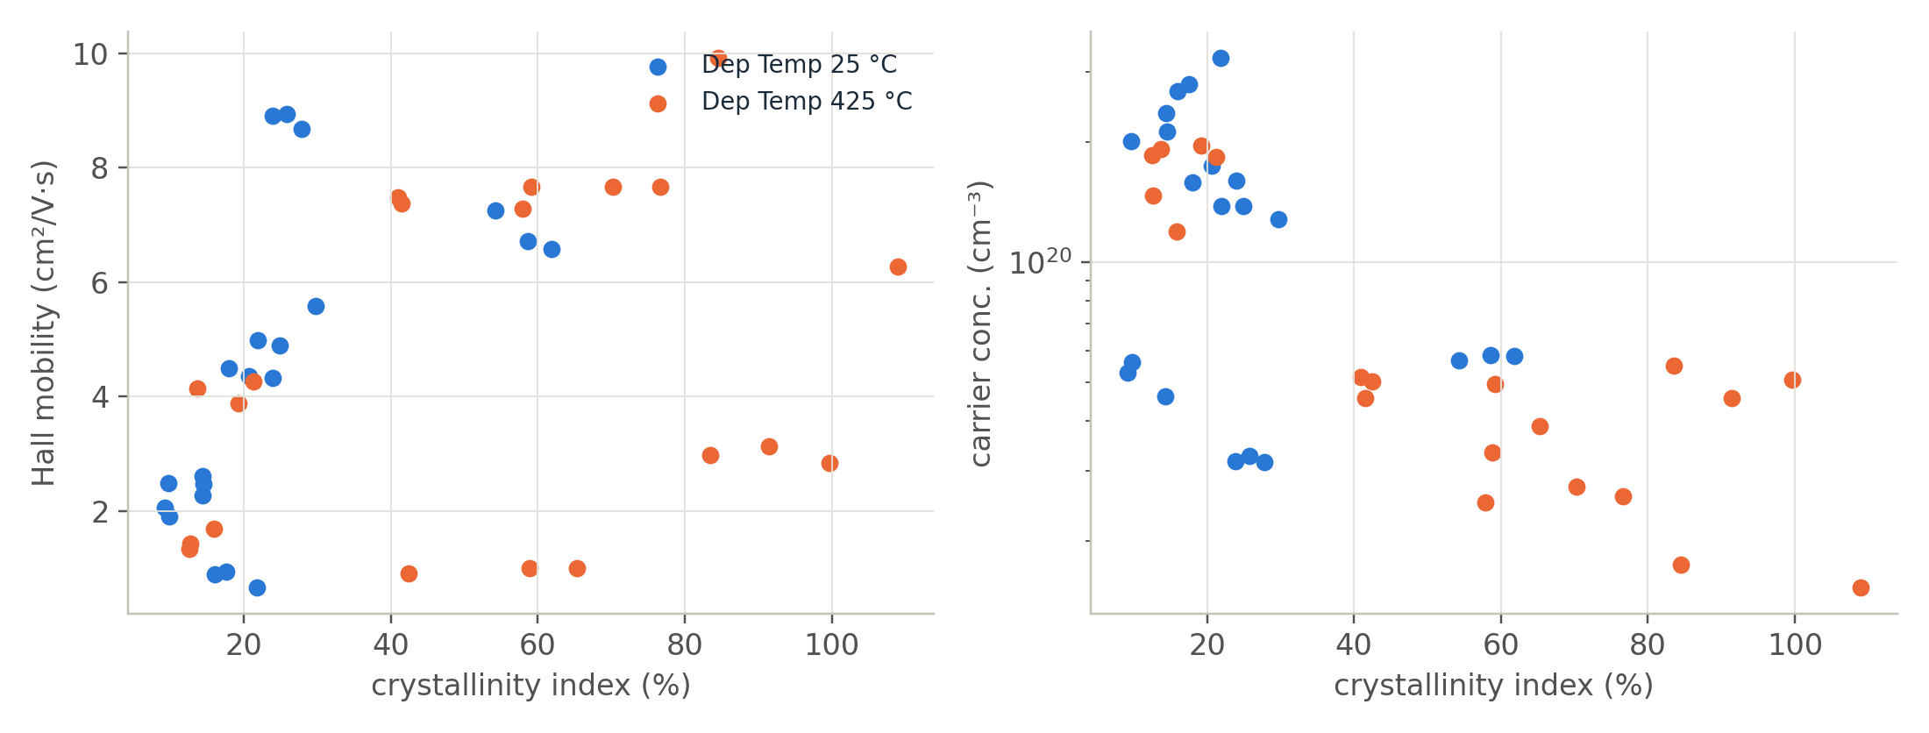
Crystallinity against the Hall responses
Condition-level Spearman correlation, 14 conditions
−0.70
crystallinity vs log carrier
+0.52
crystallinity vs mobility
Amorphous films are the high-carrier films: the two objectives pull against each other
Exceptions exist: #15 is low-crystallinity with 8.8 cm²/V·s; #23 is 55 % with ~1 cm²/V·s → joint optimisation, not a rule

Slide 15
Replicate noise per condition
Mean and coefficient of variation CV = 100·s / mean over replicates, outliers removed
Recipe | Mobility mean | CV % | Carrier mean (cm⁻³) | CV % | Crystallinity mean (%) | CV %
#2 | 4.39 | 1.9 | 1.64·10²⁰ | 5.3 | 20.9 | 14.3
#3 | 4.10 | 4.6 | 1.90·10²⁰ | 3.5 | 18.1 | 21.7
#5 | 2.20 | 17.0 | 5.17·10¹⁹ | 10.0 | 11.1 | 25.3
#7 | 6.85 | 5.2 | 5.77·10¹⁹ | 1.7 | 58.2 | 6.5
#8 | 1.49 | 12.6 | 1.33·10²⁰ | 14.9 | 13.7 | 13.9
#9 | 2.99 | 5.0 | 5.04·10¹⁹ | 9.5 | 91.5 | 8.8
#12 | 0.84 | 17.4 | 2.90·10²⁰ | 10.2 | 18.5 | 16.2
#14 | 8.10 | 31.7 | 1.64·10¹⁹ | 9.1 | 96.7 | 17.9
#15 | 8.84 | 1.6 | 3.20·10¹⁹ | 1.7 | 25.9 | 7.6
#19 | 2.41 | 4.8 | 2.16·10²⁰ | 8.3 | 12.9 | 21.3
#20 | 7.54 | 3.0 | 2.61·10¹⁹ | 4.6 | 68.3 | 13.9
#21 | 7.51 | 2.0 | 4.89·10¹⁹ | 6.2 | 47.2 | 21.9
#22 | 5.15 | 7.3 | 1.35·10²⁰ | 4.3 | 25.5 | 15.4
#23 | 0.98 | 5.3 | 3.60·10¹⁹ | 10.4 | 55.5 | 21.2
5.1 %
median CV, mobility
7.2 %
median CV, carrier
15.8 %
median CV, crystallinity
Outliers removed
Cook's distance > 4/n, max one per condition:
02_14 crystallinity · 03_08, 01_23 carrier
#14 has only 2 Hall films (02_14 contact-failed); orange = CV > 20 %

Slide 16
ANOVA: how variance is split
One-way model, each response analysed separately
Model
τᵢ: effect of group i · ε: replicate noise
Between conditions (14 recipes)
y_{ij} = μ + τ_{i} + ε_{ij}
Response | F (all) | F | p
Mobility | 78.1 | 78.1 | 6.1·10⁻¹⁸
log₁₀ carrier | 206.9 | 384.8 | 2.0·10⁻²⁵
Crystallinity | 14.8 | 49.9 | 2.0·10⁻¹⁵
Decomposition
total = between groups + within groups
SS_{T} = SS_{B} + SS_{W}
F and p with outliers removed; F (all) = every replicate. df = 13 and 25–27.
Test statistic
k groups, N films · large F → means differ beyond noise
F = [SS_{B} / (k − 1)] / [SS_{W} / (N − k)]
The recipe explains every response far beyond replicate noise.
p-value
chance of an F this large if the groups had no effect
p = P( F_{k−1, N−k} ≥ F_{obs} )
Per-factor test: two groups per factor (its two levels, or split at the median); carrier on log₁₀ scale.

Slide 17
ANOVA per factor: F and p
One-way test per factor (two levels, or split at the median), outliers removed · orange = p < 0.05
Factor | Mobility |  | log₁₀ carrier |  | Crystallinity
 | F | p | F | p | F | p
Ox Press (atm) | 73.4 | 1.7·10⁻¹⁰ | 5.7 | 0.023 | 2.2 | 0.150
Dep Thickness (nm) | 0.0 | 0.964 | 2.5 | 0.122 | 27.7 | 5.5·10⁻⁶
Dep Press (mTorr) | 0.1 | 0.805 | 14.5 | 5.2·10⁻⁴ | 19.9 | 6.8·10⁻⁵
Dep Temp (°C) | 0.0 | 0.895 | 6.9 | 0.012 | 14.6 | 4.6·10⁻⁴
Ox Temp (°C) | 4.2 | 0.048 | 8.6 | 0.006 | 0.3 | 0.605
Dep Power (W) | 7.7 | 0.008 | 2.6 | 0.116 | 1.2 | 0.272
Vac Ann Time (min) | 6.2 | 0.018 | 2.0 | 0.167 | 0.4 | 0.553
O2 Flow (sccm) | 0.1 | 0.816 | 4.7 | 0.036 | 1.0 | 0.325
Vac Ann Temp (°C) | 3.5 | 0.071 | 0.0 | 0.979 | 4.4 | 0.043
Ox Time (min) | 0.5 | 0.463 | 0.6 | 0.459 | 1.8 | 0.192
Strongest drivers: oxidation pressure → mobility · deposition pressure → carrier · thickness → crystallinity
Screening only: replicates are not independent and 14 recipes leave some factors confounded (e.g. deposition pressure with thickness).

Slide 18
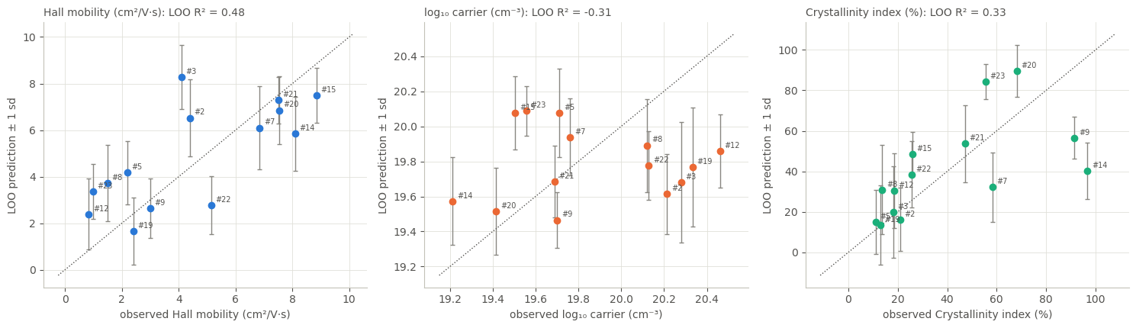
A three-output GP on the current data
14 condition means, SEM² noise, leave-one-out: refit on 13, predict the 14th
0.48
LOO R², Hall mobility
−0.31
LOO R², log₁₀ carrier
0.33
LOO R², Crystallinity
Mobility partly predictable; carrier not yet (worse than the mean); error bars somewhat over-confident. 14 recipes in 10-D is data-starved.

Slide 19
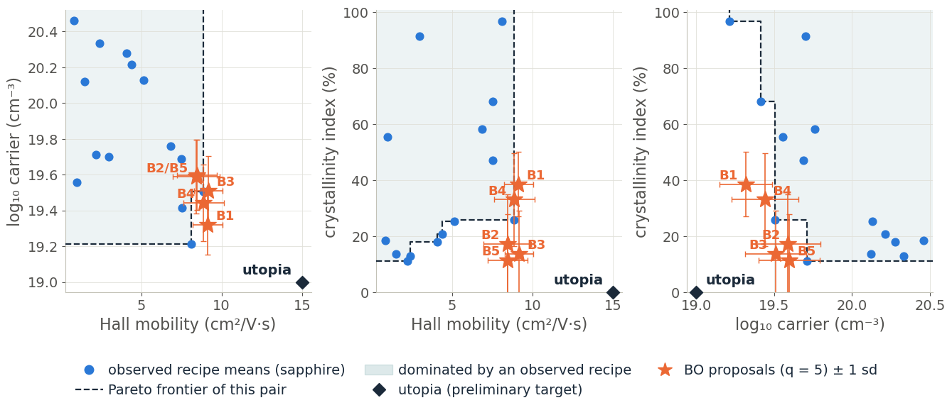
What the data say about new samples
Better = higher mobility, lower carrier, lower crystallinity · GP trained on sapphire data only
Utopia (preliminary target): 15 cm²/V·s, 10¹⁹ cm⁻³, 0 % · best measured so far: 8.8 cm²/V·s (#15), 1.6·10¹⁹ cm⁻³ (#14), 11 % (#5)
BO proposals: all at 25 °C deposition and 0.02 atm, 700 °C oxidation · predicted 8.4–9.2 cm²/V·s, 2–4·10¹⁹ cm⁻³
The #15 recipe family pushed to the box edge, where the model extrapolates and Si may fail: what sapphire favours, to be tested by batch 1.

Slide 20
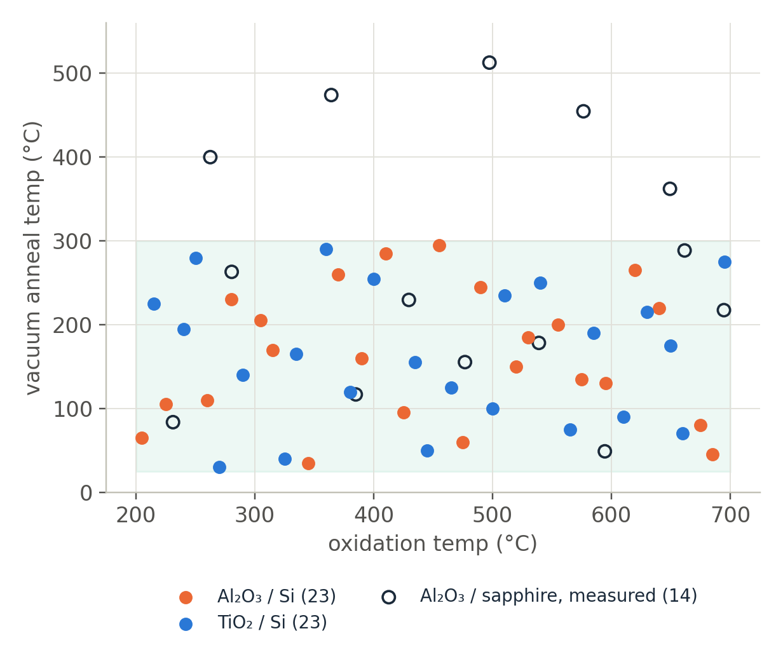
Sampling the two new Si stacks
Sliced Latin hypercube: 46 distinct recipes, no recipe repeated across stacks
Union of 46 is a 46-point LHS; each stack’s 23 is a 23-point LHS
Best-or-equal on union coverage, per-stack quality and stack balance (0.04)
Sobol only catches up after ~100 recipes

Slide 21
Design space for the new batch
Same 10 factors as the sapphire batch; ranges to confirm with ND
Factor | Type | Min | Max | Resolution | Change vs sapphire
Dep Power (W) | continuous | 2 | 40 | 1 | 0 W is not a deposition
O₂ Flow (sccm) | continuous | 0.3 | 20 | 0.1
Dep Press (mTorr) | continuous | 2 | 10 | 0.1
Dep Temp (°C) | two-level | 25 | 425 | 25 / 425
Ox Temp (°C) | continuous | 200 | 700 | 5 | best sapphire film at 695 °C
Ox Press (atm) | two-level | 0.02 | 1 | 0.02 / 1 | to confirm
Ox Time (min) | continuous | 0 | 120 | 0.1
Vac Ann Temp (°C) | continuous | 25 | 300 | 5 | failures ≥ 325 °C on Si
Vac Ann Time (min) | continuous | 0 | 120 | 0.1
Dep Thickness (nm) | continuous | 1 | 10 | 0.1

Slide 22
Next steps
1
Confirm ranges with ND
2
Fabricate 2 × 23 × 3
oxidation pressure levels, 700 °C ceiling on Si
Al₂O₃/Si and TiO₂/Si, IDs AlSi-NN-rR / TiSi-NN-rR
3
Test transfer from sapphire
4
Three-objective BO
does Al₂O₃/sapphire predict Al₂O₃/Si?
mobility ↑ · carrier ↓ · crystallinity ↓, stack as input, SEM² noise

