Slide 1
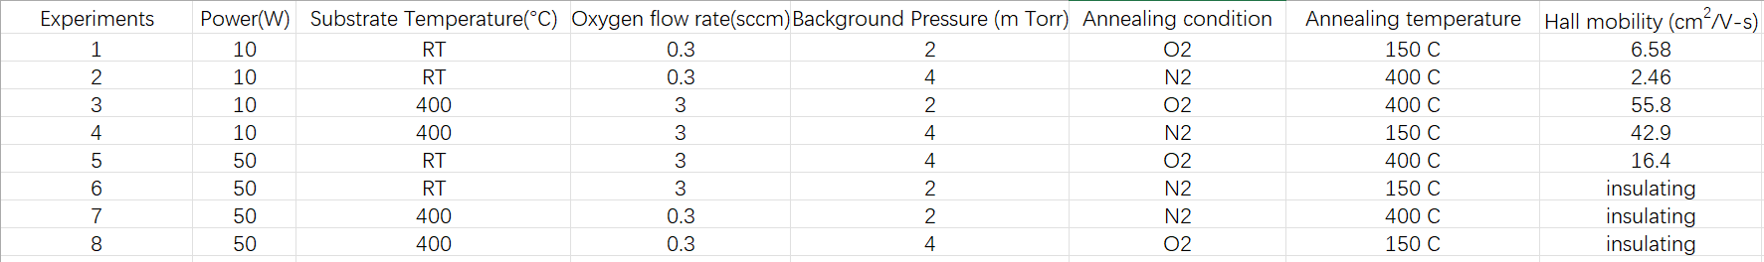
NW Collaboration work:
Previous: We repeated three samples for each condition from 1 to 5 and performed XRD and XPS measurements on each sample. However, since the Corial RIE tool was down, I was unable to get the Hall mobility data. Although the Corial was back online last week, all those earlier samples had become insulating after being stored for about one month.

Slide 2
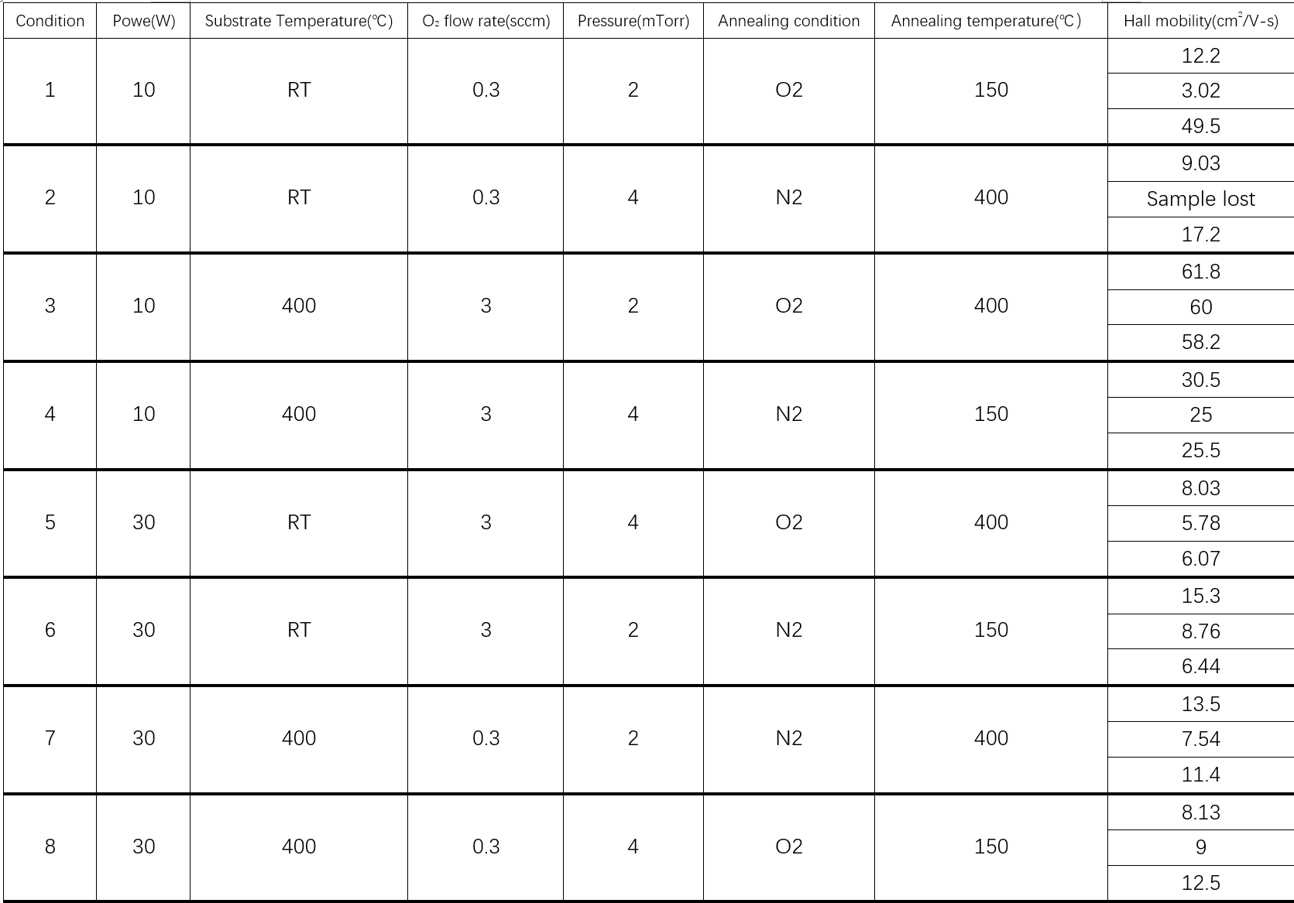
NW Collaboration work:
In this week, we reprepared 3 samples from condition 1 to condition 8 for each condition. We also decreased the maximum power from 50W to 30W to ensure we can get the Hall mobility data.
Did XRD and XPS on each sample
The Hall mobility data are shown here. Except for conditions 1 and 2, other conditions exhibit good repeatability and reasonable values.

Slide 3
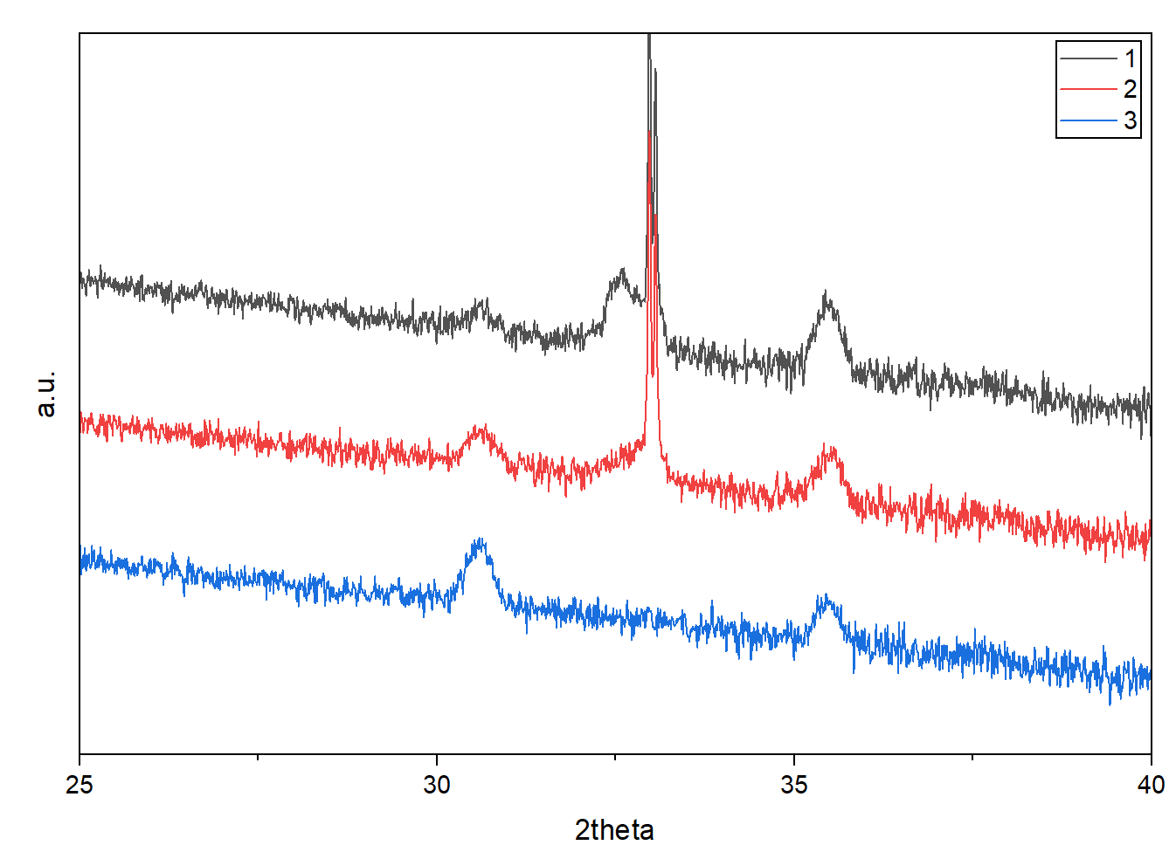
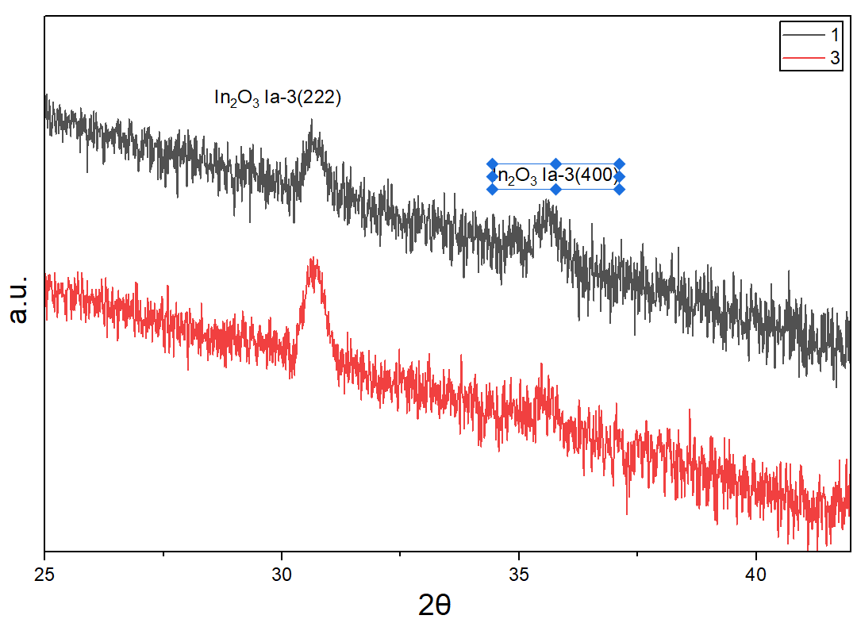
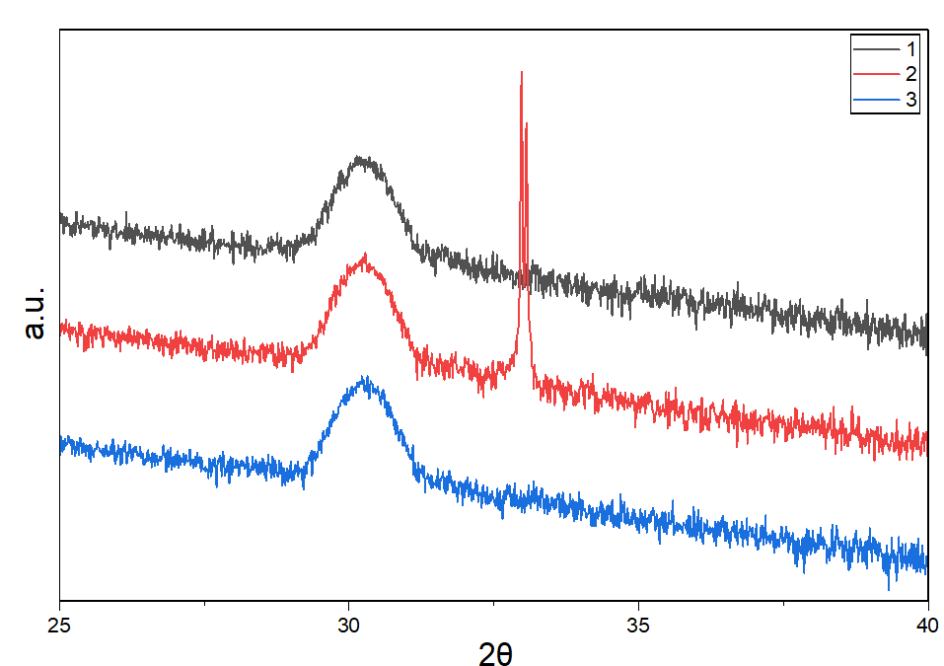
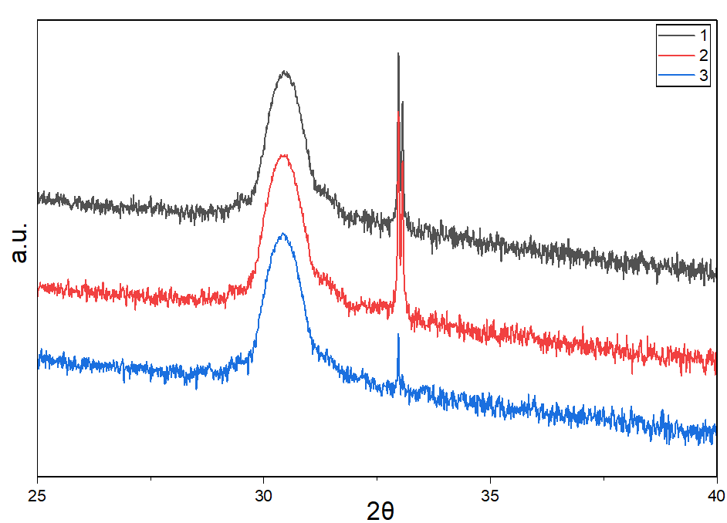
Condition1
Condition2
Condition3
Condition4

Slide 4
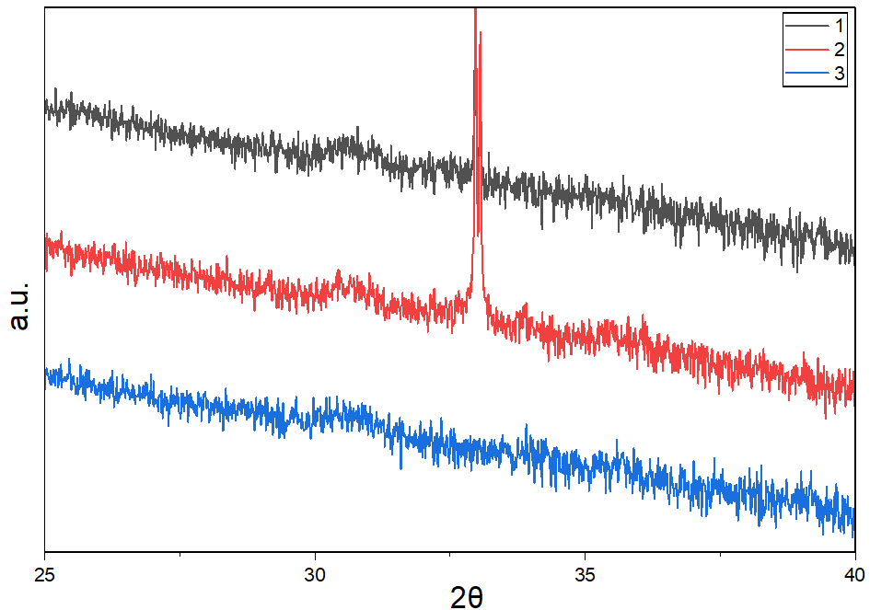
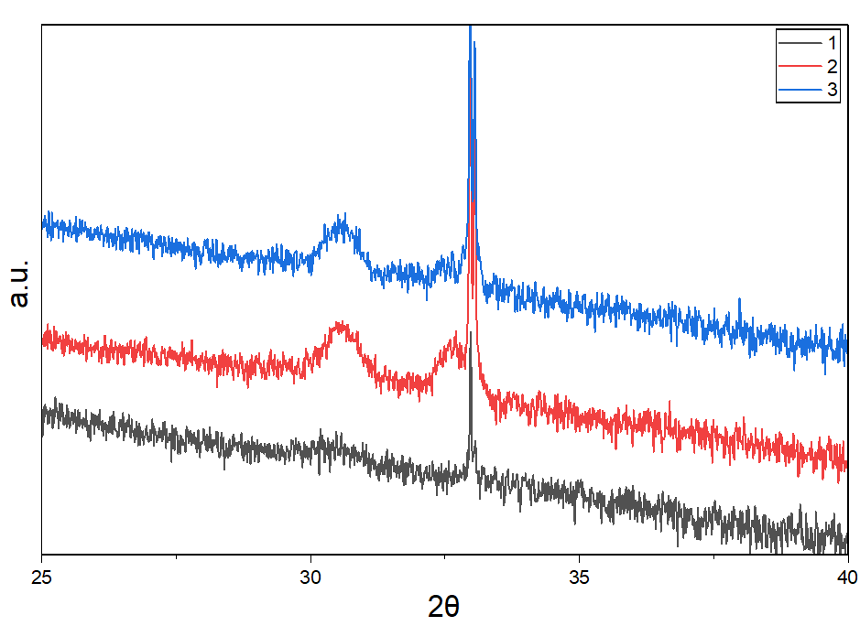
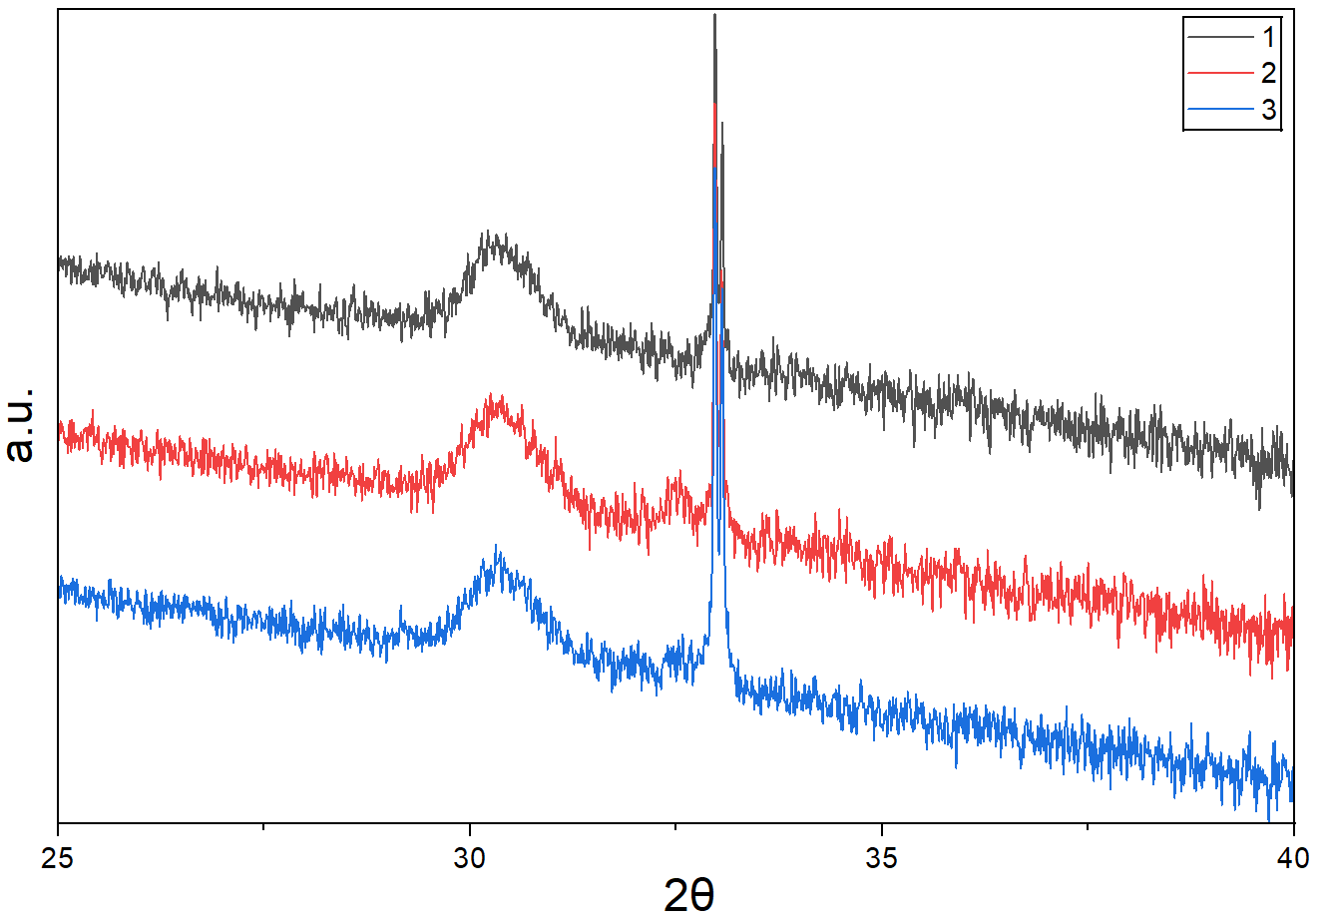
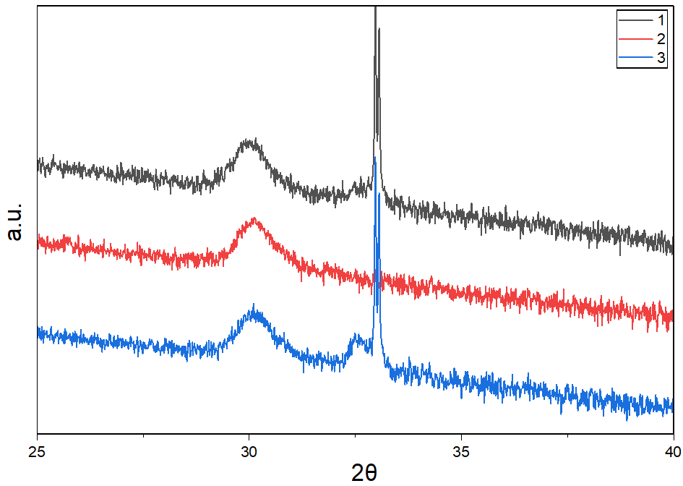
Condition5
Condition6
Condition7
Condition8

Slide 5
XRD data
 | Condition 1 |  |  | Condition2 |  | Condition3 |  |  | Condition4
Sample | 1 | 2 | 3 | 1 | 3 | 1 | 2 | 3 | 1 | 2 | 3
Peak position | 1: 30.7; 2: 32.4; 3: 35.1 | 1: 30.7; 2: 35.4 | 1: 30.6 2: 35.4 | 1:30.5 2:35.6 | 1: 30.7 2: 35.5 | 30.4 | 30.5 | 30.4 | 30.1 | 30.3 | 30.3
Height | 1: 328; 2: 1253; 3: 1076 | 1: 689; 2: 832 | 1: 1261 2: 630 | 1: 853 2: 519 | 1: 1312 2: 486 | 11239 | 11477 | 11524 | 2849 | 3456 | 3230
FWHM | 1: 0.12; 2: 0.26; 3: 0.12 | 1: 0.09; 2: 0.05 | 1: 0.35 2: 0.20 | 1:0.15 2:0.20 | 0.55 | 0.69 | 0.67 | 0.68 | 1.00 | 0.87 | 0.97

Slide 6
XRD data
 | Condition 5 |  |  | Condition6 |  |  | Condition7 |  |  | Condition8
Sample | 1 | 2 | 3 | 1 | 2 | 3 | 1 | 2 | 3 | 1 | 2 | 3
Peak position | 30.7 | 30.7 | 30.7 | 30.3 | 1: 30.6 2: 32.5 | 1: 30.6 | 30.2 | 30.3 | 30.3 | 30.1 | 30.1 | 1: 30.1 2: 32.5
Height | 211 | 163 | 1: 103 | 270 | 1: 1038 2: 707 | 740 | 1452 | 1295 | 1641 | 1798 | 1694 | 1: 1857 2: 926
FWHM | 0.85 | 0.68 | 0.69 | 1.08 | 1: 0.72 2: 0.29 | 0.59 | 0.52 | 0.63 | 0.33 | 0.54 | 0.56 | 1: 0.50 2: 0.31

Slide 7
XPS data
 | Condition 1 |  |  | Condition2 |  | Condition3 |  |  | Condition4
Sample | 1 | 2 | 3 | 1 | 3 | 1 | 2 | 3 | 1 | 2 | 3
In 3d peak position | 451.7; 444.2 | 451.5; 444.0 | 451.3; 443.8 | 451.4; 443.8 | 451.4; 443.9 | 451.5; 444.0 | 451.5; 444.0 | 451.6; 444.1 | 451.4; 443.9 | 451.5; 444.0 | 451.5; 444.0
Ta 4f peak position | Too weak | Too weak | Too weak | Too weak | Too weak | Too weak | Too weak | Too weak | Too weak | Too weak | Too weak
O 1s peak position | 529.7 | 529.4 | 528.4 | 529.4 | 528.4 | 529.4 | 529.5 | 529.6 | 529.4 | 529.6 | 529.5
Area of In 3d | 26247 | 28819 | 28042 | 27761 | 29500 | 32154 | 29472 | 32287``` | 29477 | 28743 | 29933
Area of Ta 4f | Too weak | Too weak | Too weak | Too weak | Too weak | Too weak | Too weak | Too weak | Too weak | Too weak | Too weak
Area of O 1s | 3497 | 3669 | 3617 | 3286 | 3561 | 3641 | 3751 | 3884 | 3374 | 3621 | 3609

Slide 8
XPS data
 | Condition 5 |  |  | Condition6 |  |  | Condition7 |  |  | Condition4
Sample | 1 | 2 | 3 | 1 | 2 | 3 | 1 | 2 | 3 | 1 | 2 | 3
In 3d peak position | 451.7; 444.1 | 451.9; 444.4 | 452.0; 444.5 | 451.7; 444.1 | 451.7; 444.1 | 451.8; 444.3 | 452.0; 444.4 | 451.7; 444.6 | 452.2; 444.1 | 452.0; 444.4 | 451.9; 444.3 | 451.7; 444.2
Ta 4f peak position | 27.9; 26.0 | 27.9; 26.1 | 28.0; 26.1 | 27.6; 25.9 | 27.5; 25.8 | 27.5; 25.9 | 27.9; 26.1 | 27.6; 25.7 | 28.0; 26.2 | 27.7; 25.9 | 27.9; 26.0 | 28.0; 26.2
O 1s peak position | 529.7 | 529.4 | 529.9 | 529.6 | 530.0 | 529.7 | 529.9 | 529.6 | 530.1 | 530.0 | 529.8 | 529.7
Area of In 3d | 29546 | 28482 | 28745 | 24357 | 25799 | 26081 | 24237 | 22617 | 23240 | 24203 | 25148 | 25365
Area of Ta 4f | 209 | 187 | 138 | 152 | 108 | 148 | 905 | 871 | 764 | 551 | 681 | 665
Area of O 1s | 3824 | 3669 | 3956 | 3959 | 4035 | 4357 | 4264 | 3479 | 3512 | 3943 | 4154 | 4214

