Slide 1
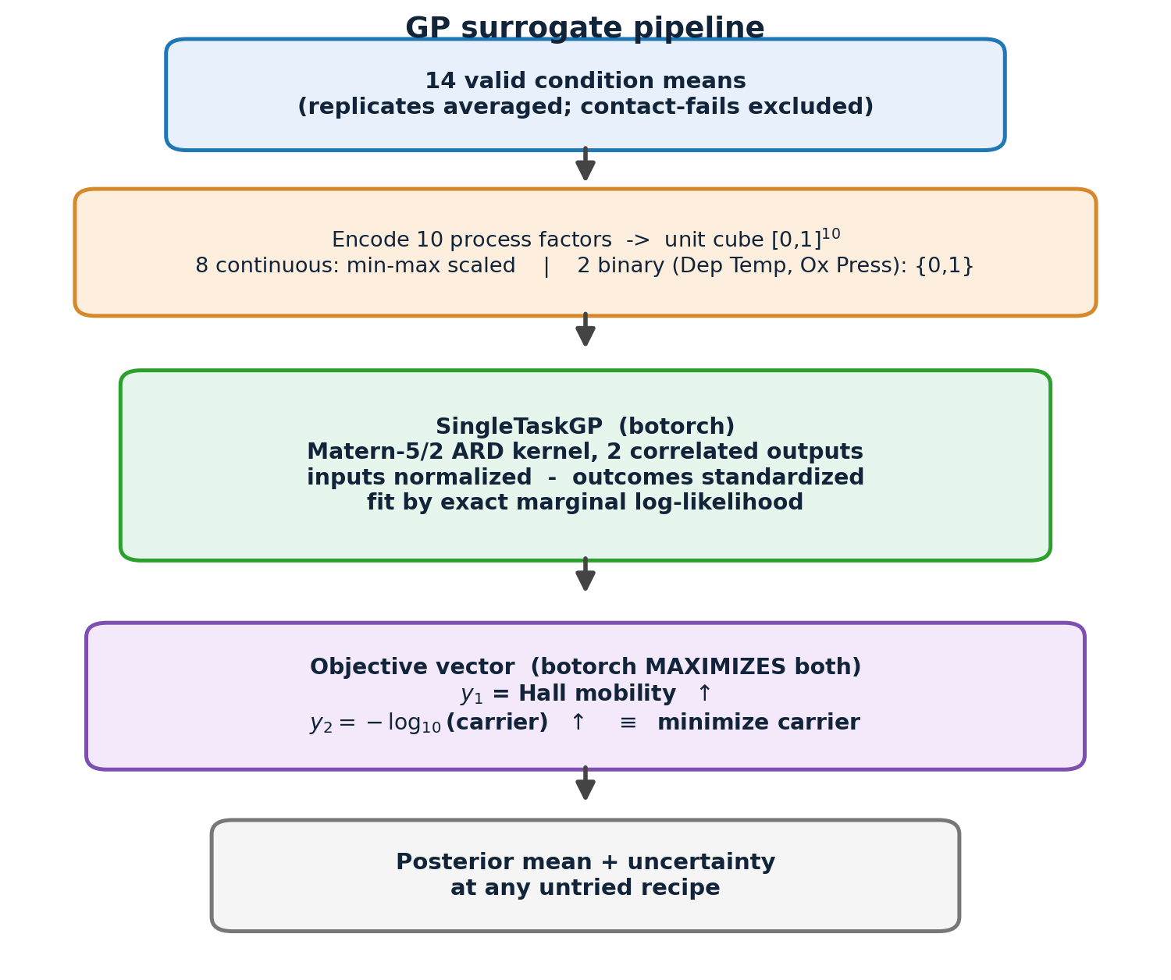
§8 MULTI-OBJECTIVE BAYESIAN OPTIMIZATION / MODEL
Surrogate model: multi-output Gaussian Process
• Why a GP? Linear models (§5) were not predictive at n=14; a GP is built for small, noisy, high-dimensional data and returns calibrated uncertainty.
• Training data: 14 valid condition means — replicates averaged, contact-fail runs excluded (failures are not modeled).
• 10 process factors encoded to the unit cube [0,1]¹⁰:
  – 8 continuous factors: min–max scaled to their bounds
  – 2 binary factors (Dep Temp, Ox Press): mapped to {0, 1}
• Model: botorch SingleTaskGP — 2 correlated outputs, Matérn-5/2 ARD kernel, inputs normalized, outcomes standardized; fit by exact marginal log-likelihood.
• Objectives (botorch maximizes): y₁ = mobility ↑ ; y₂ = −log₁₀(carrier) ↑ ≡ minimize carrier. Carrier in log₁₀ (spans > 1 decade).
• Output: posterior mean + uncertainty at any untried recipe → drives the acquisition search (next slide).

Slide 2
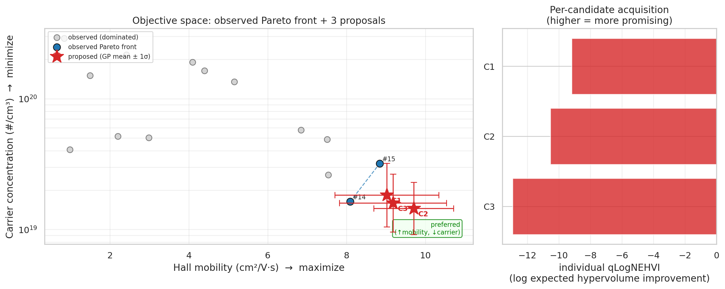
§8 ACQUISITION FUNCTION / WHAT WE OPTIMIZE
Acquisition: qLogNEHVI (batch multi-objective)
• Hypervolume = the scalar quality of the Pareto front: the area/volume it dominates above a reference point. Observed HV = 11.89.
• qLogNoisyExpectedHypervolumeImprovement scores a recipe by its expected increase in that hypervolume.
  – Noisy: integrates over GP posterior → robust to observation noise
  – Log: log-space evaluation → numerically stable optimization
  – q = 3: optimizes a joint batch of 3 (diversity built in); joint score −7.84
• Mixed optimization (optimize_acqf_mixed):
  – enumerate the 4 binary combos (Dep Temp × Ox Press) as fixed features
  – optimize the 8 continuous knobs on [0,1] — 20 restarts, 256 QMC samples
• Failure-aware search bounds: Vac Ann ≤ 550 °C (baked into encoding); Ox Temp ≤ 680 °C for proposals only — GP still trained on the full range.
Objective plane: observed Pareto front + 3 proposals (GP mean ±1σ); right bar = per-candidate qLogNEHVI

Slide 3
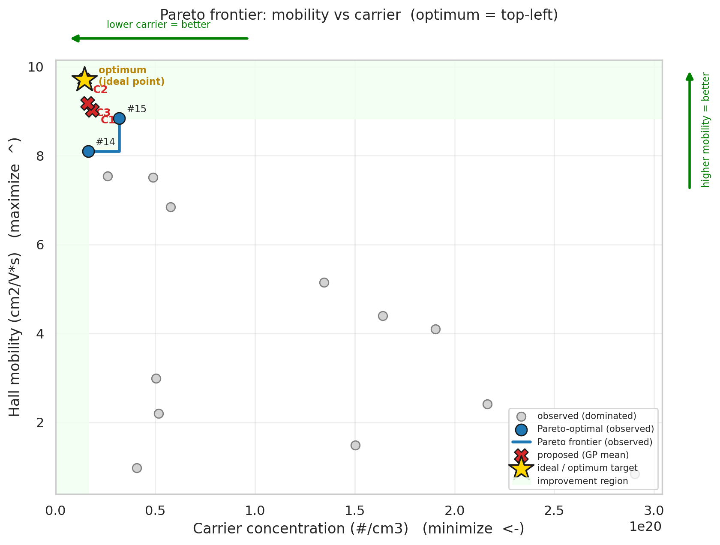
§8 RESULT / WHERE TO SAMPLE NEXT
Output: 3 proposed next experiments
• No single winner — the optimizer returns a Pareto set. The 3 candidates are the points qLogNEHVI expects to expand the front the most.
• Optimum corner = top-left: high mobility, low carrier (gold ideal point).
• Ranked by individual qLogNEHVI → C1 is the most promising single recipe.
• Predictions carry ±1σ uncertainty; proposals push beyond the current front toward the ideal point.
Cand. | Pred. mobility (cm²/V·s) | Pred. carrier (#/cm³) | qLogNEHVI (rank)
C1 | 9.02 ± 1.32 | 1.84e19 | −9.19 (1)
C2 | 9.70 ± 1.01 | 1.45e19 | −10.55 (2)
C3 | 9.18 ± 1.36 | 1.60e19 | −12.94 (3)
Pareto frontier (linear carrier axis): optimum = top-left; gold ★ = ideal point; shaded = improvement region

