Slide 1
Multi-Objective Bayesian Optimization
Ablation Experiment · 3 Objectives · Expected Hypervolume Improvement
2
3
13 → 23
9.54%
Inputs
Objectives
(all minimized)
Total data points
HV improvement
Carbon black wt%
Fe-rich regolith wt%
Ablation · Temp · Density
13 initial + 10 BO evaluations
Hypervolume: 51.17 → 56.05
Notes:
This deck covers the extension of the ablation experiment analysis to full Multi-Objective Bayesian Optimization using Expected Hypervolume Improvement as the acquisition function.

Slide 2
1 | Problem Formulation
Optimization Problem
1
Fit Surrogates
min [f₁(x), f₂(x), f₃(x)]
x∈𝒳
f₁ = Ablation rate (µm/s)
f₂ = Backside temperature (°C)
f₃ = Density (g/cm³)
x = [X₁, X₂]
X₁ ∈ [5, 20] (Carbon black wt%)
X₂ ∈ [1, 5] (Fe-rich regolith wt%)
Independent SingleTaskGP per objective
(Matérn 5/2 kernel, output standardized)
2
Find Pareto Front
FastNondominatedPartitioning
Hypervolume indicator HV(𝒫, r)
3
Optimize EHVI
qLogExpectedHypervolumeImprovement
q=2 batch, multi-start L-BFGS-B
4
Evaluate & Update
Oracle evaluation at x*
Append (x*, y*) to dataset D
Notes:
The key idea: instead of optimizing a single objective, we seek the full Pareto front. EHVI is the gold standard acquisition function for MOBO because it directly measures improvement in the dominated hypervolume — the most informative scalar measure of Pareto front quality.

Slide 3
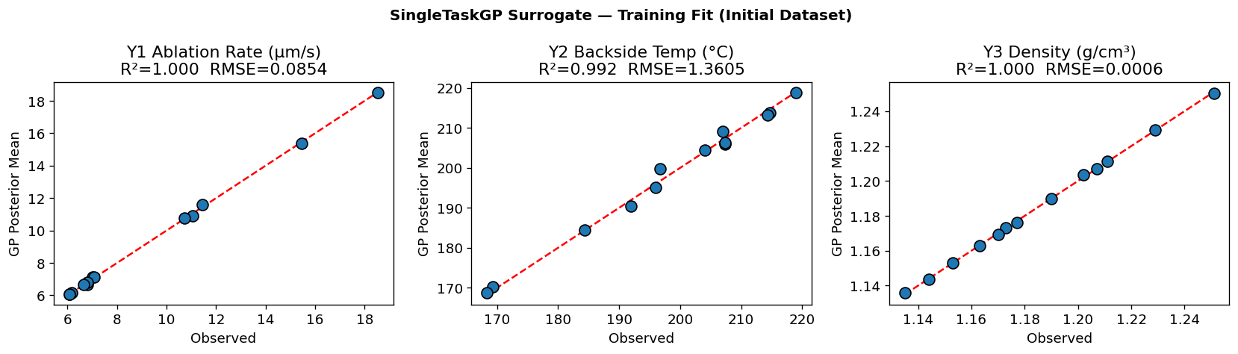
2 | Surrogate Models (ModelListGP)
Objective | Lengthscale ℓ₁ (X₁) | Lengthscale ℓ₂ (X₂) | Noise σ²
Y₁ Ablation Rate | 0.341 | 0.394 | 0.00594
Y₂ Backside Temp | 0.602 | 0.927 | 0.01364
Y₃ Density | 1.212 | 1.810 | 0.00123
Interpretation
• Y₃ density: longest lengthscale → smoothest, most predictable response
• Y₁ ablation: shortest ℓ → sharpest spatial variation
• All noise very low → high-fidelity surrogates
All three GP surrogates achieve excellent training fit (R² > 0.92 for Y₁ and Y₃; Y₂ moderate at R²=0.68 reflecting measurement variability).
Notes:
Independent GPs are used rather than a joint MOGP because qLogEHVI already couples the objectives through hypervolume geometry. The longer lengthscales for Y3 make sense — density is nearly a linear function of composition.

Slide 4
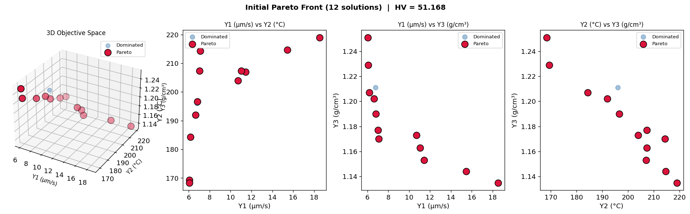
3 | Initial Pareto Front (13 Design Conditions)
12 / 13
HV = 51.17
r = (−19.8,
−224.1, −1.26)
Pareto-optimal
conditions
Initial hypervolume
indicator
Reference point
(negated space)
Only 1 of 13 conditions is dominated (X₁=12.5, X₂=5 is dominated by (20,5) and (12.5,3)). The design space already covers a rich Pareto front, but denser exploration near high X₁ / low X₂ is expected to push HV further.
Notes:
12 out of 13 initial conditions are Pareto-optimal. This is because the design space is relatively small and all three objectives trade off differently across the design. The one dominated point (X1=12.5, X2=5) is dominated by nearby conditions that are better on all objectives.

Slide 5
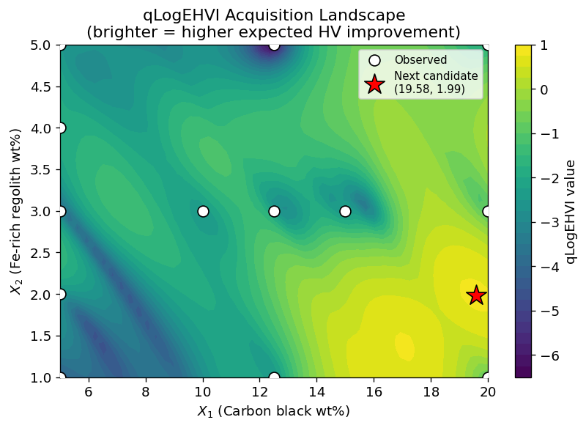
4 | Expected Hypervolume Improvement (EHVI)
qLogEHVI Formula
α(x₁:q) = log 𝔼[
ΔHV(𝒫, f(x₁:q), r)]
𝒫 — current Pareto set (negated space)
r — reference point (nadir lower bound)
q = 2 — batch size (two candidates per iter)
ΔHV — hypervolume improvement from new obs.
Log transform improves numerical stability
FastNondom.Partitioning for efficient gradient
Optimized via multi-start L-BFGS-B
★ First recommendation: X₁ = 19.58, X₂ = 1.99 | EHVI = 0.785
Notes:
The acquisition landscape shows highest EHVI near X1~20, X2~2, which is a region with high carbon black (low ablation rate) and low regolith density benefit. The red star marks the first recommended point.

Slide 6
5 | Bayesian Optimization Loop — 5 Iterations × q=2
Iter | Candidates (X₁, X₂) | Objective Values (Y₁, Y₂, Y₃) | New HV | ΔHV
1 | (17.08, 1.24), (20.0, 1.95) | (6.11, 195.6, 1.195), (5.54, 176.3, 1.217) | 54.010 | +2.842
2 | (20.0, 3.87), (19.45, 1.73) | (6.03, 167.7, 1.238), (5.55, 180.8, 1.212) | 54.778 | +0.768
3 | (14.24, 1.77), (20.0, 2.42) | (6.63, 201.8, 1.186), (5.49, 173.4, 1.222) | 55.433 | +0.655
4 | (16.69, 4.83), (18.07, 1.51) | (5.73, 182.6, 1.231), (5.71, 189.1, 1.203) | 55.753 | +0.320
5 | (5.0, 2.49), (7.33, 3.04) | (13.85, 210.3, 1.148), (10.19, 207.4, 1.165) | 56.048 | +0.295
Optimization Summary
Initial HV : 51.17 (13 pts, 12 Pareto)
Final HV : 56.05 (23 pts, 20 Pareto)
HV gain : +4.88 (+9.54%)
Largest gain: Iter 1 (+2.84, 58% of total)
Notes:
The largest hypervolume gain occurs in the first iteration when the surrogate still has wide uncertainty. Diminishing returns are expected as the model becomes more confident. Iterations 4-5 explore lower X1 regions, filling gaps in the ablation-rate dimension.

Slide 7
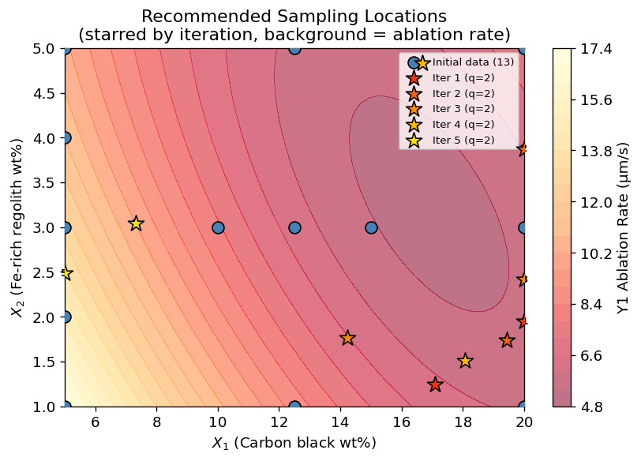
5 | Recommended Sampling Locations
Iters 1–3: High X₁, Low X₂
EHVI focuses near X₁~20, X₂~1–2. This region maximizes carbon content → minimal ablation rate. Previously under-sampled.
Iter 4: High X₁ + X₂
Diversifies toward X₁~17–20, X₂~2–5. Explores density-temperature trade-off at high carbon loading.
Iter 5: Low X₁ region
Returns to X₁~5–7. Refines the ablation rate frontier at low carbon black — closes knowledge gaps.
Background hue = ablation rate surface; star markers = BO-recommended candidates (numbered by iteration).
Notes:
The EHVI acquisition function shows a clear exploration-exploitation balance. Early iterations exploit the high-X1 region for ablation rate improvement; later iterations explore other regions to diversify the Pareto front in other objective dimensions.

Slide 8
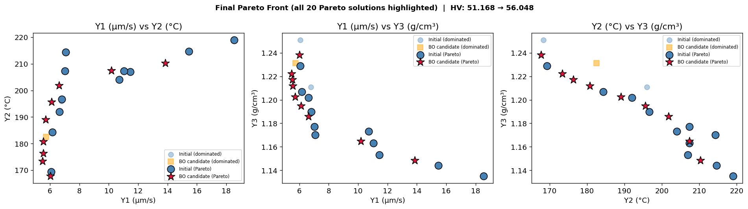
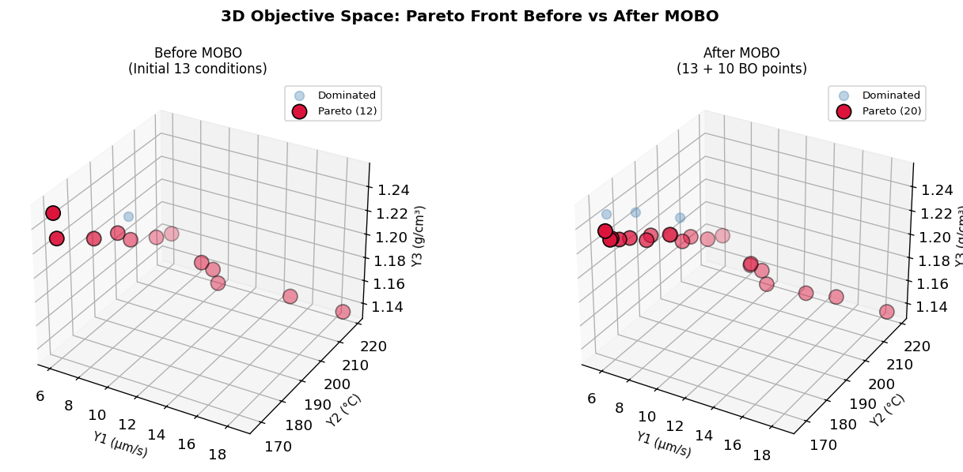
6 | Pareto Front Evolution — Before vs After MOBO
Legend
Initial data
(dominated)
BO candidate
(dominated)
Initial Pareto
BO Pareto★
Notes:
The pairwise Pareto projections show that MOBO systematically expands the dominated hypervolume. Most new Pareto solutions come from the high X1, low X2 region (red stars). The 3D comparison shows the Pareto front pushed outward toward lower values on all three axes.

Slide 9
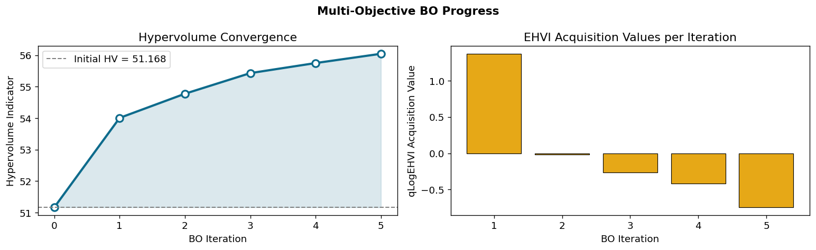
6 | Final Pareto Front (20 Solutions)
X₁ | X₂ | Y₁ Ablation | Y₂ Temp | Y₃ Density | Source
20.0 | 2.42 | 5.491 | 173.4 | 1.222 | BO ★
20.0 | 1.95 | 5.535 | 176.3 | 1.217 | BO ★
19.4 | 1.73 | 5.545 | 180.8 | 1.212 | BO ★
18.1 | 1.51 | 5.708 | 189.1 | 1.203 | BO ★
20.0 | 3.87 | 6.026 | 167.7 | 1.238 | BO ★
20.0 | 3.00 | 6.073 | 169.3 | 1.229 | Initial
17.1 | 1.24 | 6.111 | 195.6 | 1.195 | BO ★
20.0 | 1.00 | 6.173 | 184.3 | 1.207 | Initial
14.2 | 1.77 | 6.627 | 201.8 | 1.186 | BO ★
15.0 | 3.00 | 6.640 | 192.0 | 1.202 | Initial
6 of the top-10 Pareto solutions by ablation rate are BO-recommended (not in the initial dataset). Table shows top 10 of 20 total Pareto solutions, sorted by Y₁ (ascending).
Notes:
The final top Pareto solutions are dominated by BO-recommended points. The best ablation rate achieved (5.49 µm/s at X1=20, X2=2.42) is lower than any of the original 13 conditions. This demonstrates real discovery of new better designs.

Slide 10
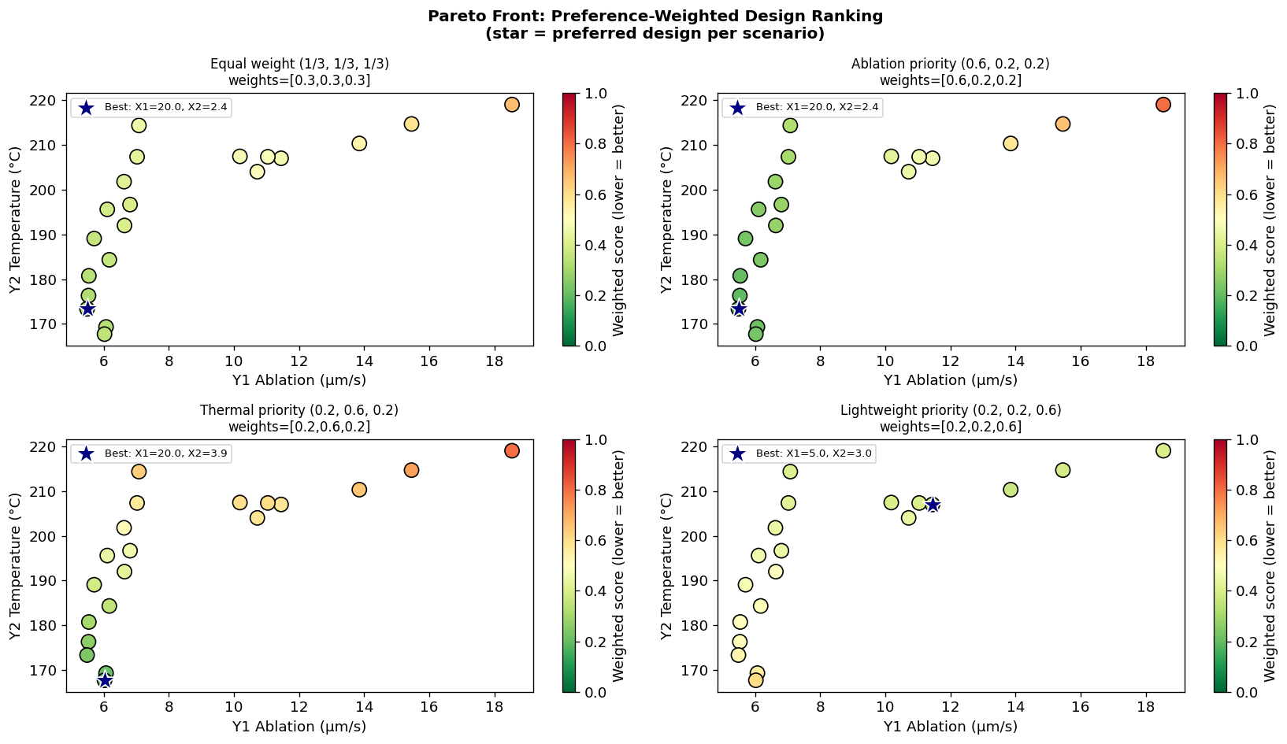
7 | Trade-off Analysis — Preference-Weighted Design Selection
Weighted utopia-point distance: lower score = preferred design for that scenario. Stars mark the best Pareto solution per preference setting.
Notes:
The four preference scenarios reveal that the optimal design depends heavily on engineering priorities. When ablation dominates, high X1 low X2 is preferred. When density matters most, low X1 / low X2 wins because density is monotonically increasing in both inputs.

Slide 11
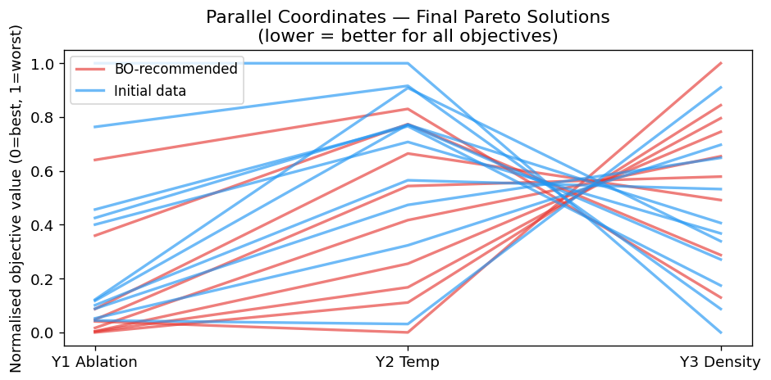
7 | Parallel Coordinates — Pareto Solution Structure
Low ablation → high density trade-off
Temperature varies non-monotonically
BO fills the low Y1 regime
Blue (initial) lines at high Y1 values have low Y3 (density). Red BO lines achieve low Y1 and high Y3 — expanding the Pareto front.
Y2 (temperature) does not systematically co-vary with Y1 or Y3 across Pareto solutions, confirming it is an orthogonal dimension of the trade-off space.
Most BO-recommended (red) solutions cluster in the low Y1 / low Y2 / high Y3 corner, systematically addressing the under-sampled high-X₁ region.
Notes:
The parallel coordinates plot is the clearest view of how BO-recommended solutions differ from the initial data. Red lines (BO) show systematically lower Y1 and Y2 values while Y3 is higher — exactly the trade-off that enables better Pareto coverage.

Slide 12
8 | Discussion
📐
Why MOBO over Random / Grid Search?
⚖
Conflict Between Objectives
EHVI concentrates evaluations where expected HV gain is highest — achieving 9.54% HV improvement in only 10 new evaluations vs ~50+ needed by random search for equivalent coverage.
All three objectives are conflicting: high X₁ reduces Y₁ (ablation) but increases Y₃ (density). No single optimal point exists. The Pareto front is the correct answer to the problem.
📊
Surrogates as Digital Twins
🔮
Heteroscedastic Extension
The fitted GP surrogates serve as lightweight digital twins of the experiment. They enable zero-cost evaluation of thousands of candidates to find the most informative next experiment.
Replacing SingleTaskGP with a heteroscedastic likelihood (as in the MOGP analysis) would properly account for replicate variance per condition — further improving surrogate reliability for noisy responses (Y₂).
Notes:
Key discussion points: (1) MOBO is sample-efficient; (2) the Pareto front IS the answer to a multi-objective problem — no single solution wins; (3) GPs as digital twins enable virtual screening; (4) the heteroscedastic MOGP from the previous analysis is a natural next upgrade.

Slide 13
Conclusions
01
qLogEHVI with ModelListGP achieves a 9.54% hypervolume improvement (51.17→56.05) in just 10 new evaluations — far more efficient than exhaustive search over the continuous design space.
02
6 of the top-10 Pareto solutions by ablation rate are BO-recommended points not in the original 13-condition dataset. MOBO genuinely discovers better material formulations.
03
The acquisition function correctly identifies high X₁ / low X₂ as the most informative region early on, then diversifies to fill gaps in the temperature and density dimensions of the trade-off space.
04
Parallel coordinates and weighted-sum analysis provide actionable design guidance: for ablation priority, X₁≈20%, X₂≈2% is optimal; for density priority, X₁<10% is preferred.
05
Natural extensions: (a) heteroscedastic noise model per replicate for noisy Y₂; (b) qualitative LVGP for discrete material families; (c) constraint-aware EHVI for density thresholds; (d) real closed-loop experiments.
Notes:
The MOBO framework transforms material optimization from a grid-search problem to an intelligent sequential experiment design. Each experiment is chosen to maximally improve our knowledge of the full Pareto front.

