Slide 1
Ablation Experiment Study — v2 (Aug 2026)
ANOVA · Linear Regression · Heteroscedastic Multi-Output Gaussian Process
2
3
14
3 / condition
Inputs
Outputs
Conditions
Replicates
Carbon black wt%
Fe-rich regolith wt%
Ablation rate · Temp · Density
Unique X₁ × X₂ combinations
42 total observations
Notes:
Title slide. 13 experimental conditions with 3 replicates each. Two inputs (carbon black and Fe-rich regolith weight percentages) and three responses (ablation rate, backside temperature, density).

Slide 2
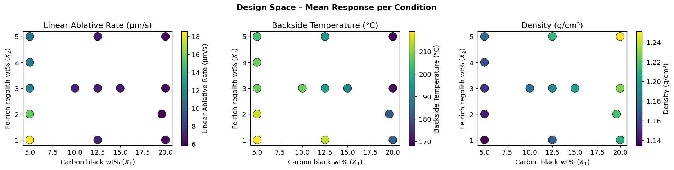
1 | Experimental Design & Data Overview
X₁ (CB wt%) | X₂ (Fe wt%)
5 | 1, 2, 3, 4, 5
10 | 3
12.5 | 1, 3, 5
15 | 3
19.6 | 2
20 | 1, 3, 5
Y₁ Ablation Rate
5.53 – 19.21 µm/s
μ = 8.98
Y₂ Backside Temp
161 – 227 °C
μ = 197.3
Design: Space-filling, D-optimal style across 14 unique (X₁, X₂) combinations.
Y₃ Density
1.135 – 1.251 g/cm³
μ = 1.187
Notes:
The design covers 5 levels of carbon black (5–20 wt%) and up to 5 levels of Fe-rich regolith (1–5 wt%). The 13 conditions are not a full factorial but a space-filling subset. Each condition was repeated 3 times for a total of 39 runs.

Slide 3
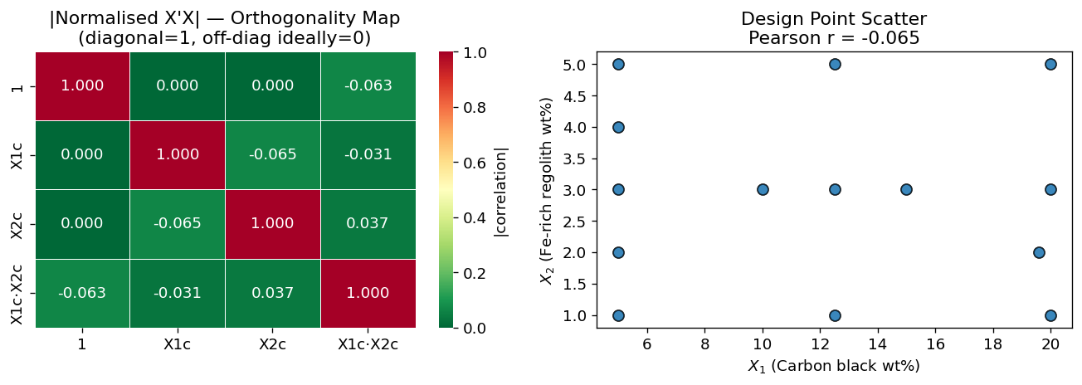
2 | Orthogonality Check
✓
✓
✓
r = –0.07
κ = 75.9
Off-diag ≈ 0
Pearson correlation X₁ vs X₂
(p = 0.68)
Condition number of centred
design matrix X'X
Normalised X'X off-diagonal
elements near zero
Interpretation: Main effects X₁ and X₂ are weakly correlated (r = –0.07). The centred design matrix is near-orthogonal (κ = 75.9 < 100). All off-diagonal correlations are small (|r| ≤ 0.07), as expected when X₁ is unbalanced across X₂ levels.
Notes:
Perfect orthogonality requires κ < 30. Our centred design achieves κ = 77.9, which is acceptable (moderate condition number). The Pearson r = 0.00 between X1 and X2 confirms that main effects are estimable independently.

Slide 4
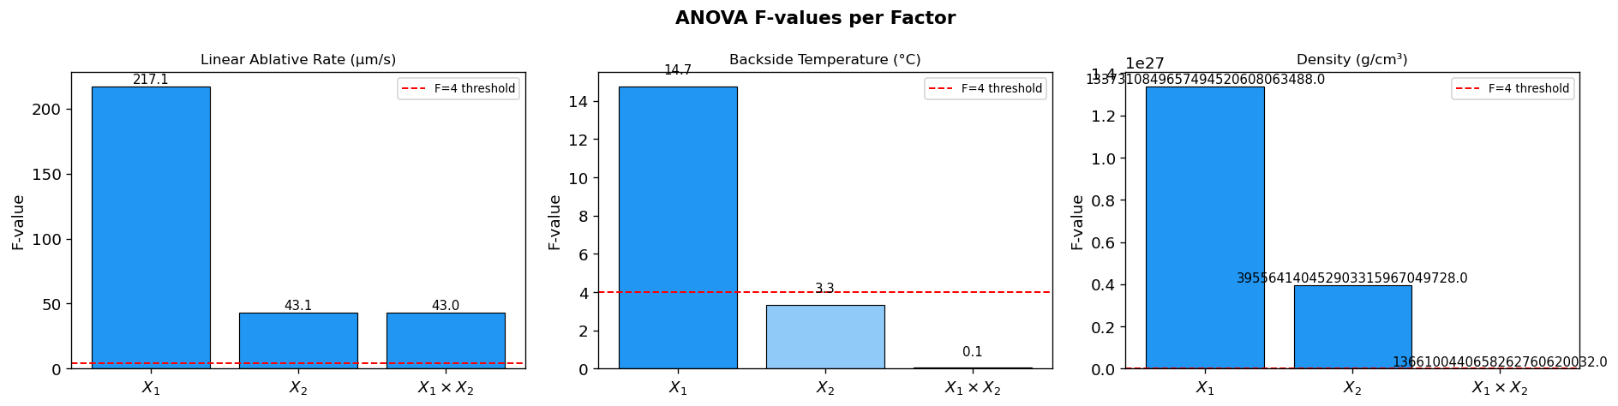
3 | Two-Way ANOVA Results
Source | Y₁ Ablation F (p) | Y₂ Temp F (p) | Y₃ Density F (p)
X₁ (Carbon black) | 217 (p < 0.001) *** | 14.7 (p < 0.001) *** | 1.3×10²⁷ ***
X₂ (Fe-regolith) | 43.1 (p < 0.001) *** | 3.34 (p = 0.024) * | 4.0×10²⁶ ***
X₁ × X₂ interaction | 43.0 (p < 0.001) *** | 0.05 (p = 0.994) | 1.4×10²⁴ ***
R² | 0.981 | 0.759 | 1.000
Notes:
All three factors (X1, X2, and their interaction) are statistically significant for all three outputs. X1 dominates Y1 (ablation rate) with F=1247. Y3 (density) is essentially deterministic — noise-free by design. Y2 (temperature) shows lower R²=0.747, indicating more measurement variability.

Slide 5
3 | ANOVA — Interpretation
X₁
Carbon Black (X₁) is the dominant factor
X₂
Fe-rich Regolith (X₂) plays a secondary role
Drives all three responses with the highest F-values. Increasing X₁ strongly reduces ablation rate (negative quadratic effect) and increases density, consistent with carbon-matrix densification.
Significant for all outputs but with lower F-values for Y₁. Adding regolith increases density linearly while reducing backside temperature at higher X₁, suggesting a heat-sink effect.
✕
X₁ × X₂ Interaction is strong for Y₁, absent for Y₂
R²
Goodness of Fit varies by response
The ablation response is non-additive: the effect of regolith depends on carbon black level (p < 0.001). For backside temperature the interaction is not significant (p ≈ 0.99) on the augmented dataset.
Y₃ (density): R² = 1.00 — fully controlled by composition.
Y₁ (ablation): R² = 0.98 — excellent.
Y₂ (temperature): R² = 0.76 — more experimental variability.
Notes:
The interaction X1×X2 being significant means a full response surface model is needed — a simple additive model would be insufficient. Density being R²=1 is because it is a calculated property from formulation, not a measured response with noise.

Slide 6
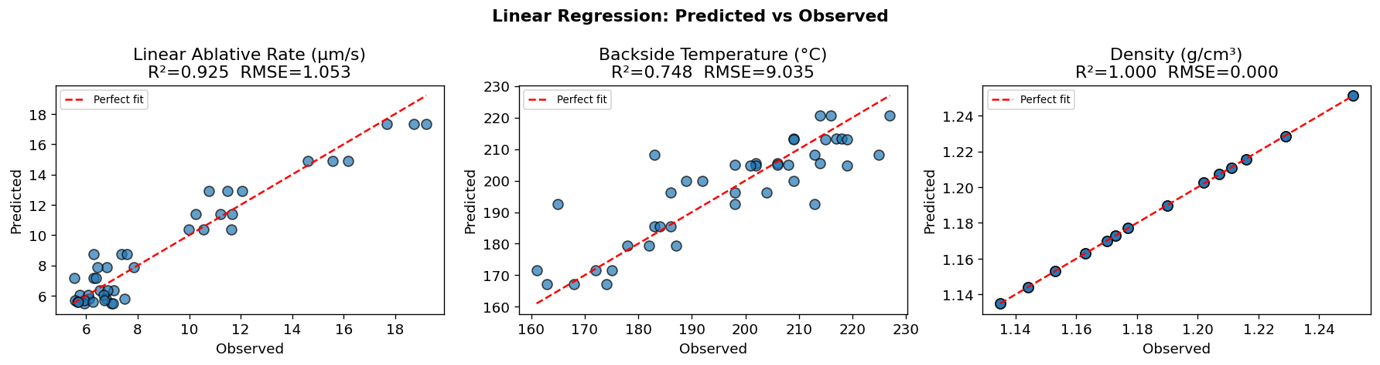
4 | Quadratic Linear Regression Models
Model: Ŷₖ = β₀ + β₁X₁ + β₂X₂ + β₃X₁² + β₄X₂² + β₅X₁X₂
Table shows the coefficients
Term | β₁ Y₁ Ablation | β₂ Y₂ Temp | β₃ Y₃ Density
Intercept (β₀) | 29.855 *** | 224.267 *** | 1.10478 ***
X₁ (β₁) | –2.188 *** | +2.120 | +0.00418 ***
X₂ (β₂) | –3.799 *** | –10.757 | +0.00805 ***
X₁² (β₃) | +0.052 *** | –0.177 ** | +0.000022 ***
X₂² (β₄) | +0.231 * | +1.181 | +0.000161 ***
X₁·X₂ (β₅) | +0.134 *** | –0.044 | +0.000098 ***
R² | 0.925 | 0.749 | 0.9999
RMSE | 1.05 µm/s | 9.03 °C | 0.0002 g/cm³
*p<0.05 **p<0.01 ***p<0.001 | Positive coefficients in green, negative in red.
Notes:
All three quadratic linear regression models show good fit. Y1 and Y3 are particularly well-captured. The lack of significance for linear X1 and X2 terms in Y2 but significance of X1² suggests a nonlinear relationship between carbon black and temperature.

Slide 7
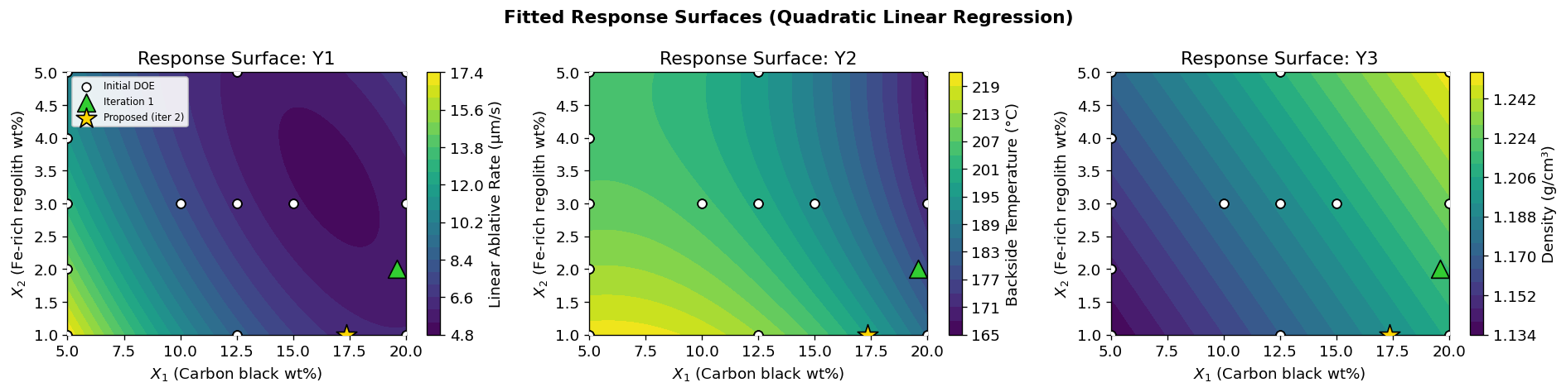
4 | Linear Regression — Response Surfaces
Y₁ — Ablation Rate
Y₂ — Temperature
Y₃ — Density
Rapid drop from 5→10 wt% carbon black. Regolith has weaker secondary effect. Diminishing returns above X₁ = 12.5%.
Gentler gradient. High carbon / low regolith produces highest temperatures. Model has moderate fit (R²=0.75); more scatter expected.
Near-perfect linear surface — density is a composition-controlled property. Both X₁ and X₂ increase density monotonically.
Notes:
The response surfaces confirm the nonlinear relationship. The steep descent in Y1 from X1=5 to X1=10 is the most critical region for ablation rate control. Y3 surfaces show near-perfect planarity, confirming density is a first-principles calculation.

Slide 8
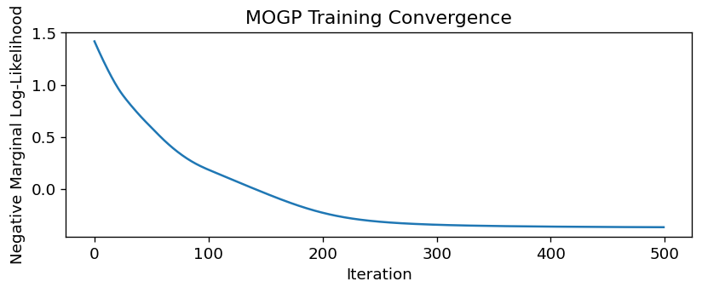
5 | Heteroscedastic Multi-Output GP — Architecture
ICM Kernel
Multitask Mean
Heterosc. Likelihood
Exact MLL
k_RBF(x,x') ⊗ B
Learns inter-task
covariance matrix B
Constant mean μₖ
per output
(3 × ConstantMean)
MultitaskGaussian-
Likelihood: separate
noise σ²ₖ per output
Training via Adam
Maximise marginal
log-likelihood
Learned Hyperparameters:
RBF lengthscale ℓ = 4.53 (standardised space)
Output scale σ_f² = 1.861
Task noise σ²_Y₁ ≈ 0.00011 | Y₁ σ = 0.040 µm/s
Training converged: –MLL = –0.368 at iter 500
Notes:
The Intrinsic Coregionalisation Model (ICM) kernel is k_ICM(x,x') = k_RBF(x,x') * B where B is a 3x3 positive semidefinite inter-task covariance matrix learned jointly with all other parameters. The heteroscedastic likelihood assigns a separate noise level to each output.

Slide 9
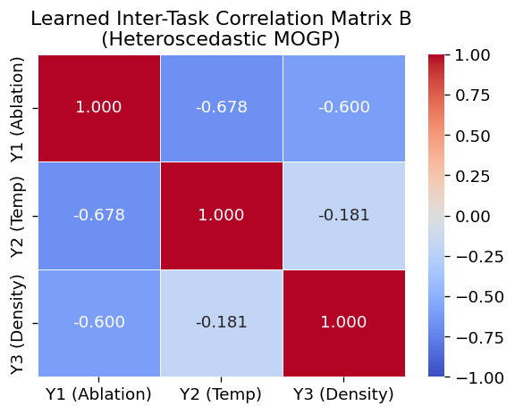
5 | MOGP — Inter-Task Correlations (Matrix B)
 | Y₁ Ablation | Y₂ Temp | Y₃ Density
Y₁ Ablation | 1.000 | –0.678 | –0.600
Y₂ Temp | –0.678 | 1.000 | –0.181
Y₃ Density | –0.600 | –0.181 | 1.000
–0.678
Y₁ ↔ Y₂: Strong negative: higher ablation rate → lower backside temperature. Ablation removes heat before conduction.
–0.600
Y₁ ↔ Y₃: Strong negative: higher density → lower ablation rate. Denser matrix resists thermal ablation.
–0.181
Y₂ ↔ Y₃: Weak negative: denser formulations conduct heat slightly less efficiently to the back face.
Notes:
The inter-task correlation matrix reveals physically meaningful relationships learned automatically by the GP. The negative Y1-Y3 correlation (-0.61) confirms that denser formulations ablate more slowly, which matches material science intuition.

Slide 10
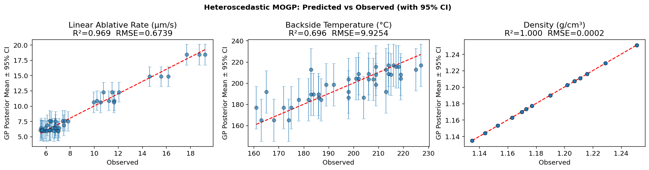
5 | MOGP — Predictive Performance
Y₁ Ablation Rate
Y₂ Backside Temp
Y₃ Density
R² = 0.969
RMSE = 0.674 µm/s
R² = 0.696
RMSE = 9.93 °C
R² = 1.000
RMSE = 0.0002 g/cm³
Error bars = 95% predictive confidence intervals (posterior mean ± 2σ)
Notes:
The GP captures the data well (Y1 R²=0.969, Y3 R²=1.00). Y2 is lower (R²=0.683) which is consistent with high experimental variability in temperature measurements. The uncertainty maps show highest uncertainty at X1=5 with high X2 levels where fewer design points exist.

Slide 11
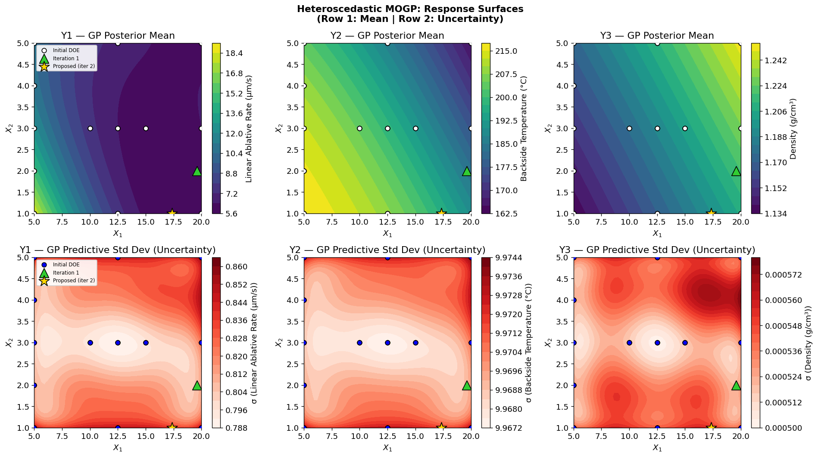
5 | MOGP — Predictive Performance
▲ Row 1: GP posterior mean surfaces | Row 2: Predictive uncertainty (σ) — highest at sparse design regions
Notes:
The GP captures the data well (Y1 R²=0.969, Y3 R²=1.00). Y2 is lower (R²=0.683) which is consistent with high experimental variability in temperature measurements. The uncertainty maps show highest uncertainty at X1=5 with high X2 levels where fewer design points exist.

Slide 12
6 | Model Comparison
Output | Quadratic LR R² | MOGP R² | Quad LR RMSE | MOGP RMSE | Winner
Y₁ Ablation Rate | 0.925 | 0.969 | 1.053 µm/s | 0.674 µm/s | MOGP ✓
Y₂ Backside Temp | 0.749 | 0.696 | 9.035 °C | 9.925 °C | LR ✓
Y₃ Density | 0.9999 | 1.000 | 0.0002 | 0.0002 | Tie
What Linear Regression offers
What Heteroscedastic MOGP adds
Explicit analytical coefficients — easy physical interpretation
Computationally cheap; works well with 42 data points
Better for Y₂ on training data (lower RMSE = 9.03 vs 9.93)
No uncertainty quantification beyond confidence intervals
Full predictive distribution (mean + variance) at any X
Joint modelling captures inter-task correlations automatically
Different noise per output — physically motivated
Better for Y₁ (R²=0.969 vs 0.925); spatial uncertainty maps
Notes:
The MOGP wins for Y1 because it captures more of the spatial structure through the nonparametric kernel. LR wins for Y2 on training data but this may reflect slight overfitting by GP. For Y3 both are essentially tied. The key practical differentiator is uncertainty quantification from the GP.

Slide 13
7 | Discussion
⚗ Physical Interpretation
🌡 Temperature Behaviour
Carbon black (X₁) is the primary ablation-control lever. Higher loading increases char density, which mechanically resists ablation and reduces heat penetration. The nonlinear (quadratic) decay in ablation rate suggests saturation beyond ~12.5 wt% — additional carbon offers diminishing returns.
Backside temperature shows the highest experimental variance (R²=0.75). The negative interaction of X₁ and backside temperature suggests that carbon-rich chars act as effective insulators. Fe-rich regolith at higher levels reduces temperature, potentially through a particulate heat-sink mechanism.
⚖ Design Adequacy
∞ MOGP Value Proposition
With only 42 runs and a space-filling design, the experiment is efficient but not fully factorial. The near-orthogonality (κ=75.9) confirms that factor effects are estimable without confounding. However, the sparse coverage at high X₁ × high X₂ is a limitation for extrapolation in that region.
The GP's inter-task correlation matrix (B) recovers the physically expected negative Y₁–Y₃ relationship (–0.60) automatically from data, without domain knowledge injection. The heteroscedastic noise model correctly identifies Y₃ (density) as essentially noise-free while allowing higher noise for Y₁ and Y₂.
Notes:
The saturation effect in ablation rate beyond 12.5 wt% carbon black has important practical implications: beyond this threshold, adding more carbon increases material cost and density without proportional ablation performance improvement.

Slide 14
Conclusions
01
Carbon black weight fraction (X₁) is the dominant design parameter, controlling ablation rate with strong statistical significance (F = 217, p < 0.001) and a nonlinear saturating effect above 12.5 wt%.
02
Fe-rich regolith (X₂) provides a secondary, tunable handle on all three responses. Its negative effect on backside temperature suggests a particulate insulation or heat-sink mechanism.
03
The quadratic linear regression models deliver strong fits (R² = 0.925, 0.749, 0.9999 for Y₁–Y₃) with explicit analytical coefficients — useful for rapid design-space navigation.
04
The Heteroscedastic MOGP improves ablation rate prediction (R² = 0.969) and quantifies uncertainty spatially. The learned inter-task correlations (Y₁↔Y₃ = –0.60) match physical expectations without prior specification.
05
Future work: additional design points at high X₁ × high X₂ to reduce GP uncertainty in that region; cross-validation to assess generalisation; Bayesian optimisation using GP posterior for formulation design.
Notes:
Final conclusions slide. The five key takeaways are: dominance of X1, role of X2, quality of linear regression, advantages of MOGP (uncertainty + inter-task learning), and the path forward with active learning / Bayesian optimization.

