Slide 1
Multi-Objective Bayesian Optimization — v2
Ablation Zone Design · Real Campaign Update · August 2026
42
53.24
17.4 / 1.0
observations · 14 conditions
hypervolume (from 51.17)
iteration-2 proposal (wt%)
Christian Fernandez · IDEAL, Northwestern University · UIC–NU MIRO project

Slide 2
Campaign Timeline — From Simulation to Real Iterations
Jul 10
NU proposes iteration-1 sample: X₁ = 19.58, X₂ = 1.99 (qLogEHVI = 0.785) → fabricated as 19.6 / 2.0 wt%
Jul 18
GP predictions sent to UIC: Y₁ 5.97 µm/s · Y₂ 177.7 °C · Y₃ 1.2160 g/cm³
Jul 20
UIC tests 3 replicates: Y₁ = 5.65 / 5.68 / 6.27 µm/s — the lowest ablation rates of the campaign
Jul 21
Updated front: hypervolume 51.168 → 53.240 (14 Pareto solutions) · project handover Rick → Christian
Aug 13
July sample merged into dataset (42 obs) · v3 replicate-noise model · iteration-2 sample proposed

Slide 3
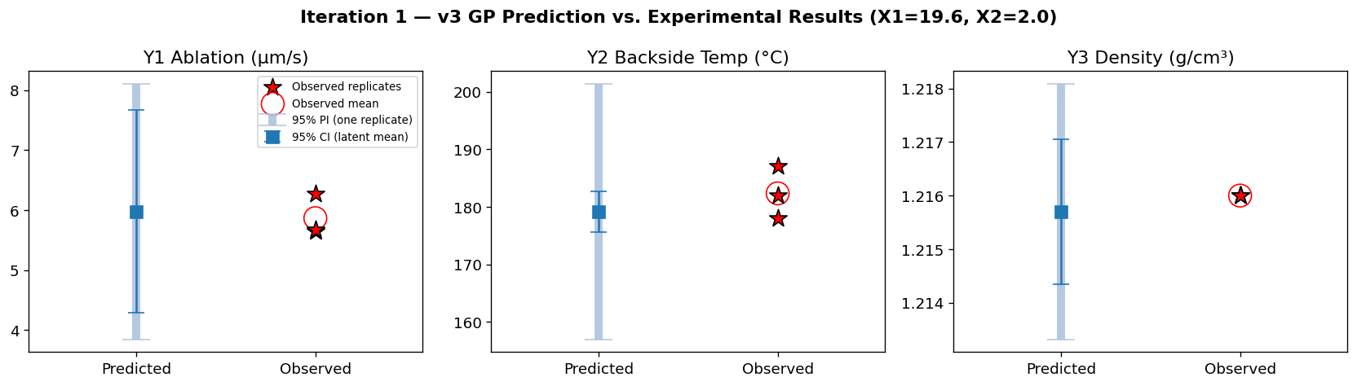
Iteration 1 — Predicted vs. Observed (X₁ = 19.6, X₂ = 2.0)
Y₁ and Y₃ verified (3/3 replicates in band). Y₂ replicates exceeded the latent CI — but all 3 fall inside the 95% prediction interval once replicate noise is modeled (v3). Prediction quality confirmed.

Slide 4
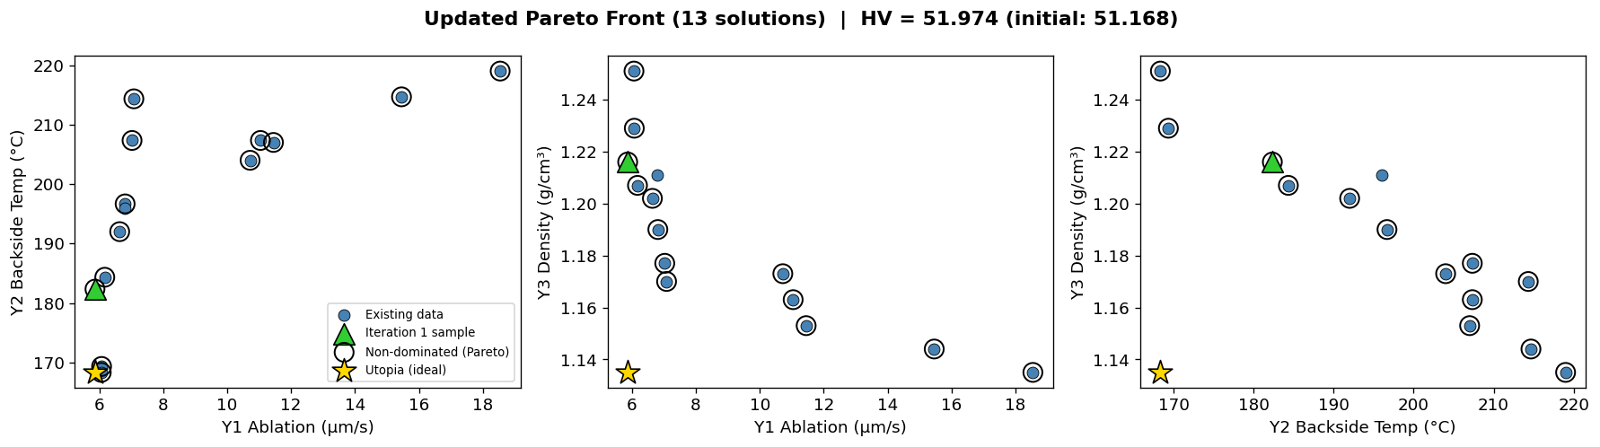
Updated Pareto Front — 14 Conditions
Hypervolume 51.17 → 51.97 on condition means (53.24 with replicates-as-points, the Jul-21 email convention). The new sample sets the campaign-best ablation rate at moderate density cost.

Slide 5
Model Upgrade (v3) — Replicate-Informed Noise
Each GP now receives the measured replicate variance as known observation noise (train_Yvar = s²/n per condition) instead of learning one homoscedastic level.
Predictions report two bands: the latent-mean 95% CI and a 95% prediction interval (PI) that adds the pooled replicate scatter — the correct band for judging individual replicates.
Backside temperature at the iteration-1 sample:
v1/v2 latent CI
177.7 ± 2.8 °C
2 of 3 replicates outside
v3 95% PI
179.2 ± 22.2 °C
3 of 3 replicates inside ✓
Y₂'s learned noise varies ~250× across conditions — the GP was never wrong about the mean, it was reporting the wrong kind of interval. v3 is the active model for recommendations.

Slide 6
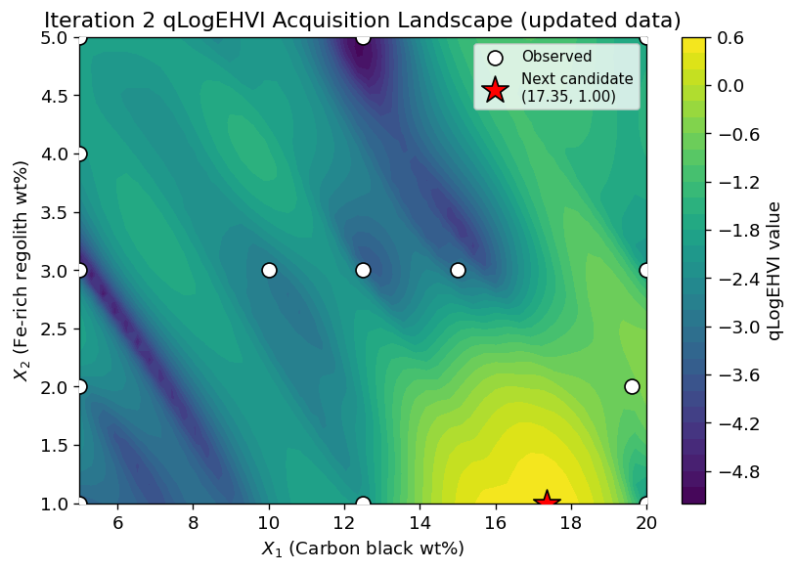
Iteration 2 — Recommended Sample
X₁ = 17.4 wt% carbon black
X₂ = 1.0 wt% regolith
qLogEHVI = 0.53 (v3 model)
Predicted (mean · 95% PI):
Y₁ 5.62 µm/s · [3.2, 8.0]
Y₂ 194.2 °C · [172.5, 215.8]
Y₃ 1.1943 g/cm³ · [1.1918, 1.1968]
Targets the lightweight end of the front: ablation ≈ iteration 1 at markedly lower density. Robust choice — v2 (homoscedastic) proposes 17.3 / 1.1, v3 proposes 17.4 / 1.0.

Slide 7
Conclusions & Next Steps
01
The MOBO pipeline is validated end-to-end: proposal → prediction → fabrication → verification (iteration 1).
02
Replicate-informed noise (v3) fixes the Y₂ calibration miss; prediction intervals now cover all observed replicates.
03
Iteration-2 sample recommended: X₁ = 17.4, X₂ = 1.0 wt% — agreed on by both model variants.
04
Next: UIC fabricates & tests iteration 2 → append replicates to ablation_data.xlsx → re-run v3 for iteration 3.

