Slide 1

Test function and heteroscedastic noise model
True function:
Quantitative Variable:
Qualitative Variable:
15
2
8
0
10
Training samples be like:
$$⋯$$
Heteroscedastic noise model:
where $m\left(x_{2}\right)∈\{10.0, 7.0, 9.0, 5.0, 12.0\}$ corresponds to the qualitative levels $x_{2}$

Slide 2
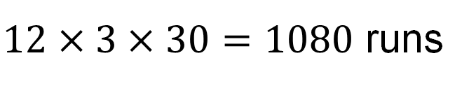
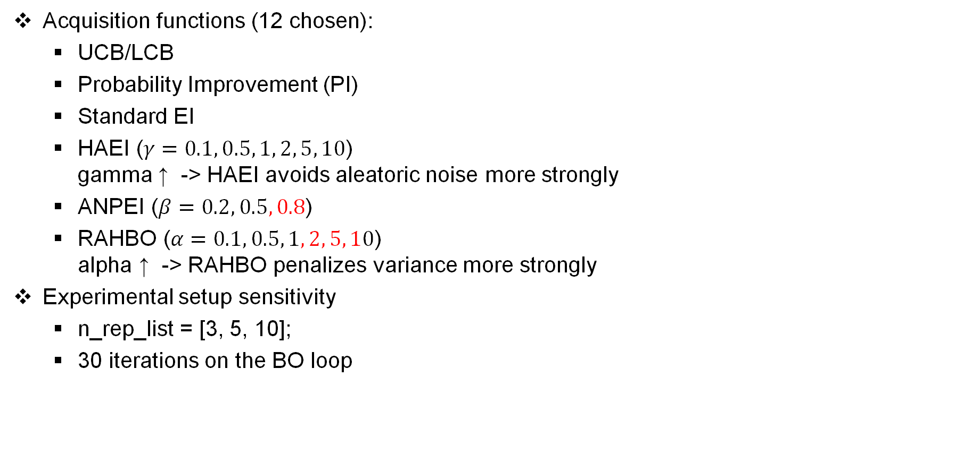
BO Case Study on a Test Problem
Acquisition functions (12 chosen):
UCB/LCB
Probability Improvement (PI)
Standard EI
HAEI ($γ=0.1, 0.5, 1, 2, 5, 10$) gamma ↑ -> HAEI avoids aleatoric noise more strongly
ANPEI ($β=0.2, 0.5, 0.8$)
RAHBO ($α=0.1, 0.5, 1, 2, 5, 10$) alpha ↑ -> RAHBO penalizes variance more strongly
Experimental setup sensitivity
n_rep_list = [3, 5, 10];
30 iterations on the BO loop
n_af
n_seeds
$12×3×30=1080$ runs
n_rep
Model the 5-level
categorical variable
LVGP
One latent-variable GP
Shares, learned latent space
MATLAB
Per-category GP
5 independent GPs
No sharing across categories
botorch
Categorical GP
MixedSingleTaskGP + CategoricalKernel
Shares categorical kernel
botorch

Slide 3
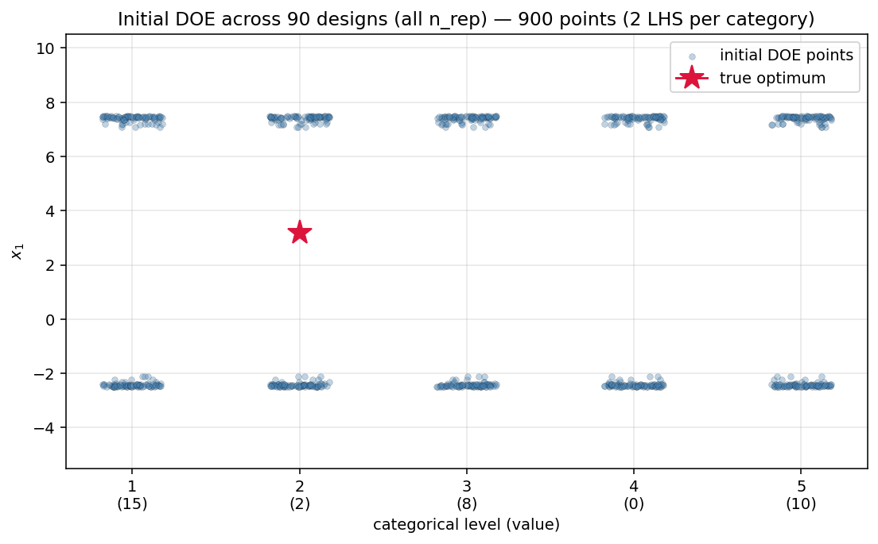
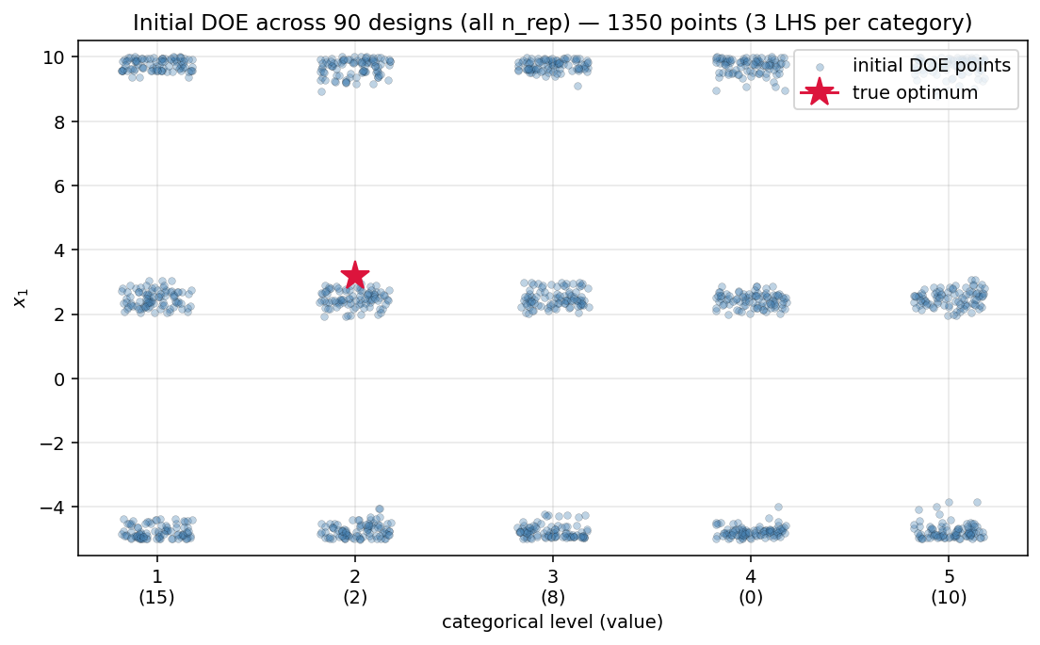
Initial DOE across the runs
Previous DOE
New DOE
We decided to change the initial DOE since in the previous one, one of the samples was very close to the minimum value
true minimum = 0.465. $x_{2}^{∗} = 2$

Slide 4
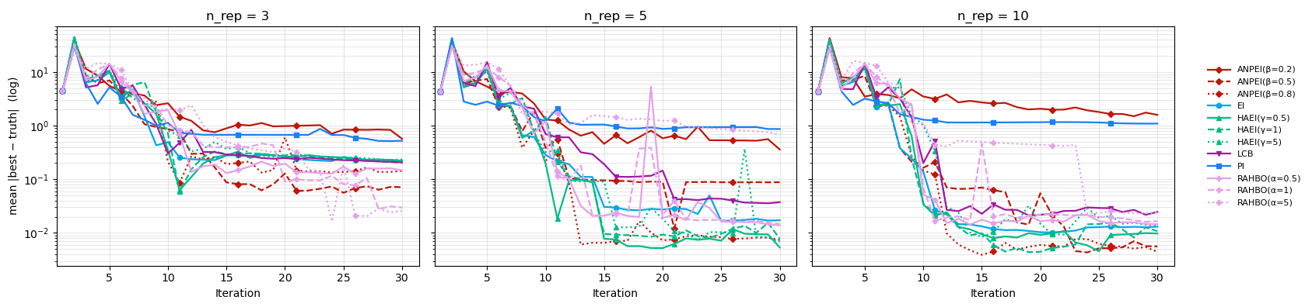
Convergence (in Y) evaluated on the ground truth, log scale
Table from 10 repeated samples, final value
 | type | mean | median
LCB | neutral | 0.0246 | 0.0086
PI | neutral | 1.0864 | 0.1495
EI | neutral | 0.0130 | 0.0037
HAEI(γ=0.5) | risk-aware | 0.0098 | 0.0036
HAEI(γ=1) | risk-aware | 0.0108 | 0.0080
HAEI(γ=5) | risk-aware | 0.0137 | 0.0058
ANPEI(β=0.2) | risk-aware | 1.5829 | 0.2025
ANPEI(β=0.5) | risk-aware | 0.0056 | 0.0012
ANPEI(β=0.8) | risk-aware | 0.0045 | 0.0020
RAHBO(α=0.5) | risk-aware | 0.0145 | 0.0126
RAHBO(α=1) | risk-aware | 0.0166 | 0.0123
RAHBO(α=5) | risk-aware | 0.0240 | 0.0112
When we do 3 replicates all the acquisitions manage to decrease by ~2 orders of magnitude
Having >=5 make that some acquisitions improve by one more order of magnitude
Notes:
-All methods for all problems, because this could be problem dependent, try all methods for all problems
Is there is something we could do to asses weather is a way to identify which acquisition function
Identify which are the methods that are not good and sicscard those

Slide 5
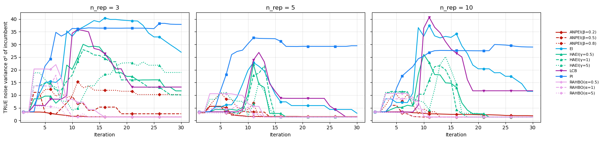
Variance on the best point vs iteration
true minimum: x2=2 X1= 0.465 with σ² = 1.41
Smaller possible variance: x2=4, x1=0, σ² = 0.46
 |  | n_rep=3 |  |  | n_rep=10
 | family | final | median | peak | final | median | peak
LCB | neutral | 13.20 | 1.46 | 52.86 | 11.74 | 1.46 | 42.94
PI | neutral | 37.89 | 45.72 | 46.01 | 28.97 | 45.06 | 32.14
EI | neutral | 26.94 | 45.22 | 56.36 | 11.52 | 1.41 | 61.49
HAEI(γ=0.5) | risk-aware | 11.69 | 1.41 | 42.96 | 1.40 | 1.40 | 41.61
HAEI(γ=1) | risk-aware | 10.08 | 1.42 | 43.98 | 1.40 | 1.40 | 33.30
HAEI(γ=5) | risk-aware | 18.95 | 1.44 | 38.34 | 1.40 | 1.41 | 35.43
ANPEI(β=0.2) | risk-aware | 1.45 | 1.37 | 3.36 | 1.87 | 1.39 | 3.42
ANPEI(β=0.5) | risk-aware | 2.68 | 1.40 | 20.03 | 1.38 | 1.38 | 5.99
ANPEI(β=0.8) | risk-aware | 10.24 | 1.41 | 26.92 | 1.41 | 1.40 | 15.09
RAHBO(α=0.5) | risk-aware | 1.41 | 1.41 | 29.70 | 1.41 | 1.41 | 10.70
RAHBO(α=1) | risk-aware | 1.41 | 1.41 | 18.16 | 1.40 | 1.40 | 9.93
RAHBO(α=5) | risk-aware | 1.41 | 1.41 | 7.04 | 1.39 | 1.40 | 3.36
For some acq σ² stuck high (10-40), the best point it ever visited is way out at extreme
There are some peaks at iteration ~10, I suspect acquisition functions are exploring noisy regions

Slide 6
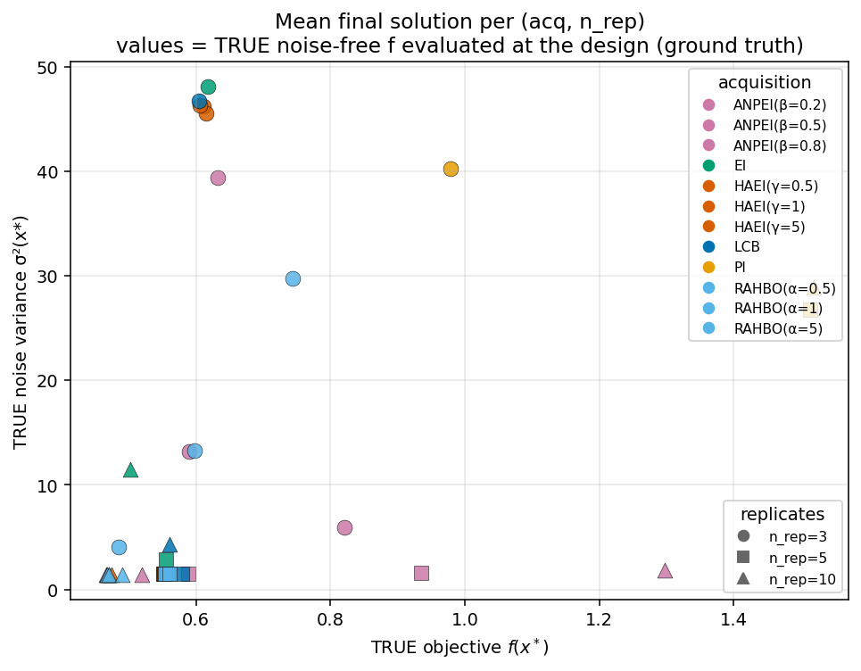
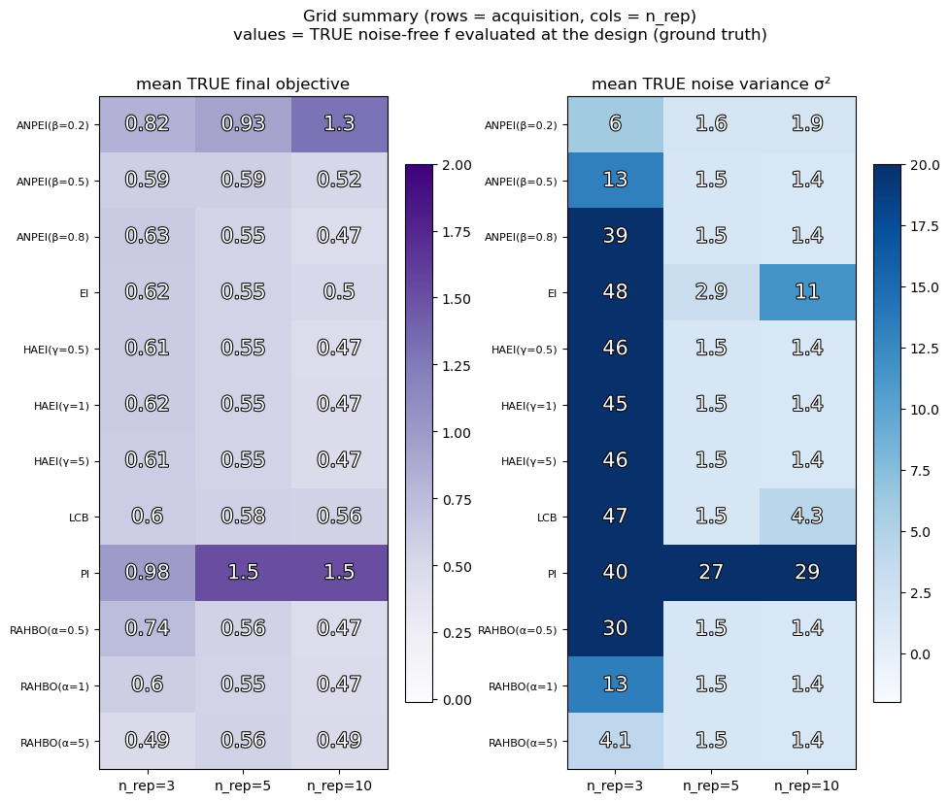
Performance vs robustness, Pareto view ground truth
true minimum: X1= 0.465 with σ² = 1.41
Lower is better
Notes:
- Try to search another type of visualizing, this thing for one problem is not enough

Slide 7
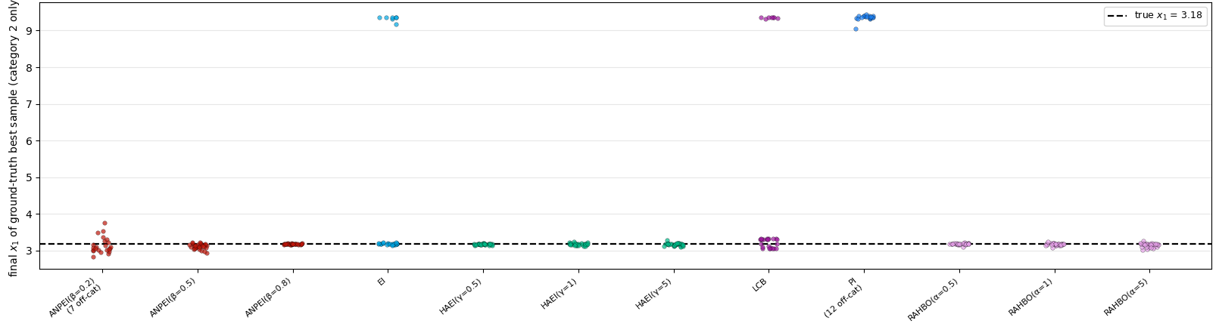
Distribution of the final best input values, on ground truth function
We are visualizing just the second category X2 and continuous variable X1 as vertical label. And in horizontal label we have the different acquisition functions
4
Dashed line = true minimum = 0.465. $x_{2}^{∗} = 2$

Slide 8
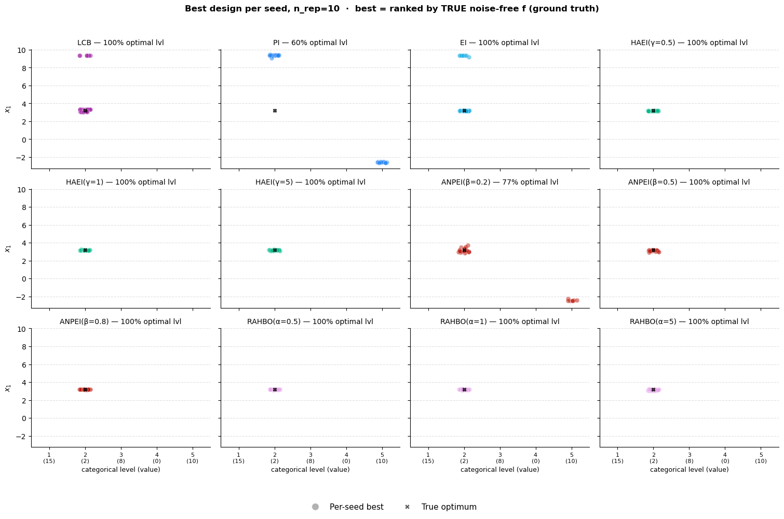
Extra, where the best point is located for each seed
Sampled on the ground truth
This explains why the neutral acquisition functions do not perform as good as the risk-aware

Slide 9
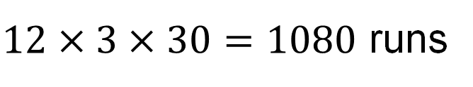
BO Case Study on a Test Problem – Testing different methods
Acquisition functions (12 chosen):
UCB/LCB
Probability Improvement (PI)
Standard EI
HAEI ($γ=0.1, 0.5, 1, 2, 5, 10$) gamma ↑ -> HAEI avoids aleatoric noise more strongly
ANPEI ($β=0.2, 0.5, 0.8$)
RAHBO ($α=0.1, 0.5, 1, 2, 5, 10$) alpha ↑ -> RAHBO penalizes variance more strongly
Experimental setup sensitivity
n_rep_list = [3, 5, 10];
30 iterations on the BO loop
n_af
n_seeds
$12×3×30=1080$ runs
n_rep
Model the 5-level
categorical variable
LVGP
One latent-variable GP
Shares, learned latent space
MATLAB
Per-category GP
5 independent GPs
No sharing across categories
botorch
Categorical GP
MixedSingleTaskGP + CategoricalKernel
Shares categorical kernel
botorch

Slide 10

BO Case Study on a Test Problem – Testing different methods
Acquisition functions (12 chosen):
UCB/LCB
Probability Improvement (PI)
Standard EI
HAEI ($γ=0.1, 0.5, 1, 2, 5, 10$) gamma ↑ -> HAEI avoids aleatoric noise more strongly
ANPEI ($β=0.2, 0.5, 0.8$)
RAHBO ($α=0.1, 0.5, 1, 2, 5, 10$) alpha ↑ -> RAHBO penalizes variance more strongly
Experimental setup sensitivity
n_rep_list = [3, 5, 10];
30 iterations on the BO loop
Model the 5-level
categorical variable
n_af
n_seeds
$12×3×30=1080$ runs
LVGP
n_rep
One latent-variable GP
Shares, learned latent space - 1080 runs
MATLAB
Per-category GP
5 independent GPs
No sharing across categories - 1080 runs
BoTorch
Categorical GP
MixedSingleTaskGP + CategoricalKernel
Shares categorical kernel - 1080 runs
BoTorch
3240 Total runs

Slide 11
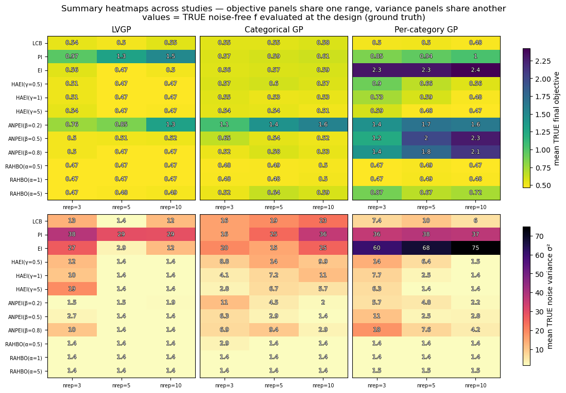
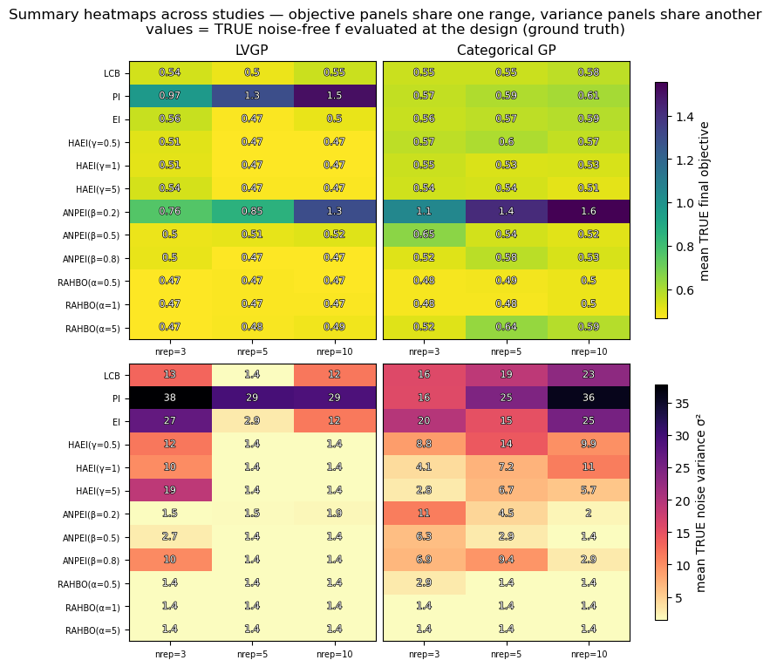
BO Case Study on a Test Problem
RAHBO seems to drives every method to the reliable optimum, objective ≈ 0.47 and σ² ≈ 1.4 for all three studies at every replicate count, because it's the one variance-aware acquisition.
LVGP and the Categorical GP stay near f* (yellow) across nearly all 12 acquisitions
LVGP shows slightly better values
Similarly for the variance LVGP shows some acquisition functions with slightly better values

Slide 12
BO Case Study on a Test Problem
Only RAHBO drives every method to the reliable optimum, objective ≈ 0.47 and σ² ≈ 1.4 for all three studies at every replicate count, because it's the one variance-aware acquisition.
LVGP and the Categorical GP stay near f* (yellow) across nearly all 12 acquisitions
LVGP shows slightly better values
Similarly for the variance LVGP shows some acquisition functions with slightly better values

Slide 13
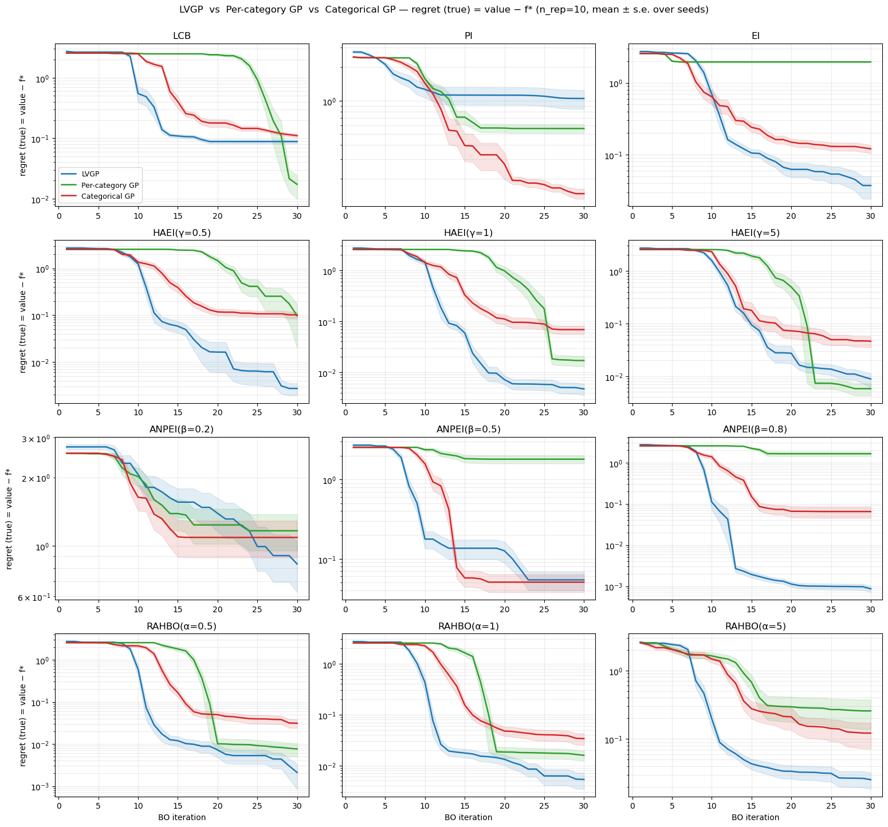
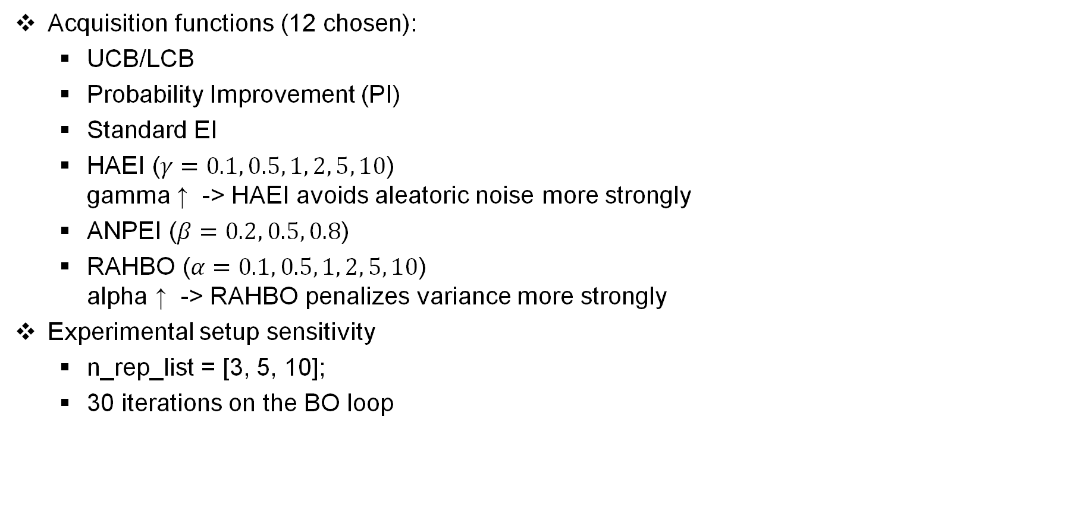
BO Case Study on a Test Problem
Acquisition functions (12 chosen):
UCB/LCB
Probability Improvement (PI)
Standard EI
HAEI ($γ=0.1, 0.5, 1, 2, 5, 10$) gamma ↑ -> HAEI avoids aleatoric noise more strongly
ANPEI ($β=0.2, 0.5, 0.8$)
RAHBO ($α=0.1, 0.5, 1, 2, 5, 10$) alpha ↑ -> RAHBO penalizes variance more strongly
Experimental setup sensitivity
n_rep_list = [3, 5, 10];
30 iterations on the BO loop
LVGP
Per-category GP
Categorical GP
LVGP reaches the lowest regret first in nearly every panel, even order of magnitude on some of the risk-aware acquisitions.
The Categorical GP is consistently in the middle, faster than the Per-category GP, an behind LVGP.

Slide 14
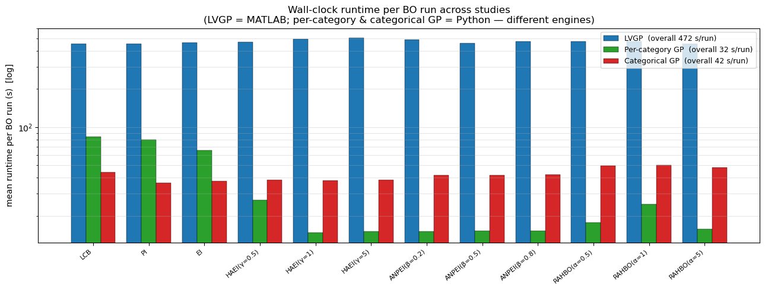
BO Case Study on a Test Problem
Acquisition functions (12 chosen):
UCB/LCB
Probability Improvement (PI)
Standard EI
HAEI ($γ=0.1, 0.5, 1, 2, 5, 10$) gamma ↑ -> HAEI avoids aleatoric noise more strongly
ANPEI ($β=0.2, 0.5, 0.8$)
RAHBO ($α=0.1, 0.5, 1, 2, 5, 10$) alpha ↑ -> RAHBO penalizes variance more strongly
Experimental setup sensitivity
n_rep_list = [3, 5, 10];
30 iterations on the BO loop
LVGP
Per-category GP
Categorical GP
LVGP is the slowest across the 3 methods
LVGP is built on MATLAB, the other 2 are built on python + BoTorch (PyTorch)
study | runs | mean_s | total_hr | Mean runtime relative
LVGP | 1080 | 472.3 | 141.69 | 14.5x
Per-category GP | 1080 | 32.46 | 9.74 | 1.0x
Categorical GP | 1080 | 42.33 | 12.7 | 1.3x
Notes:
This is something we do not care about, we do not care
There is a pythorch version

Slide 15
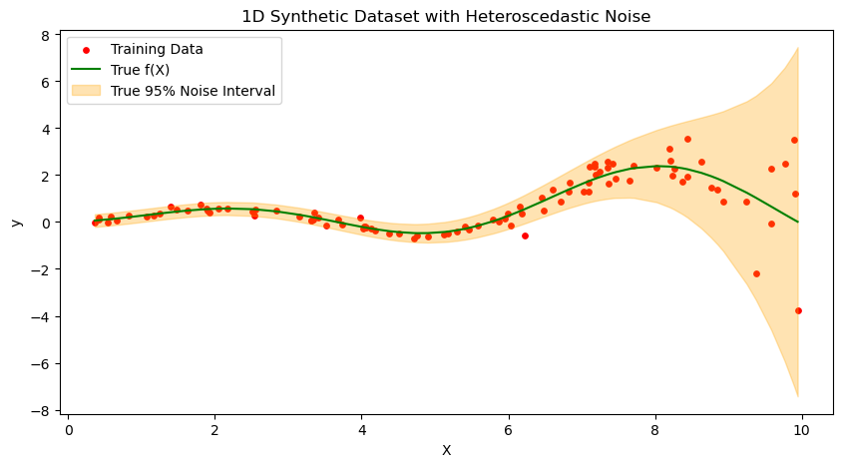

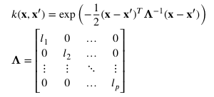

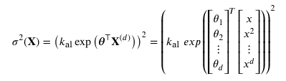

Polynomial implementation – (From paper)
Steps for implementation according to paper
GP
ARD-RBF Kernel
Data Normalization
Model Definition
GP
Automatic Relevance Determination Radial Basis Function
polynomial regression
Prior Assignment:
Assign prior distributions to the hyperparameters
Loss Function Setup
Optimization
Prediction and metrics
Location dependent
Polynomial Regression
MAP Loss
Key difference from noise-free GP
σ²(X) is no longer a single scalar constant, it is a polynomial function of the inputs, learned jointly with the GP kernel hyperparameters via MAP estimation.
The paper also describes steps for multi-dimensional input cases

Slide 16
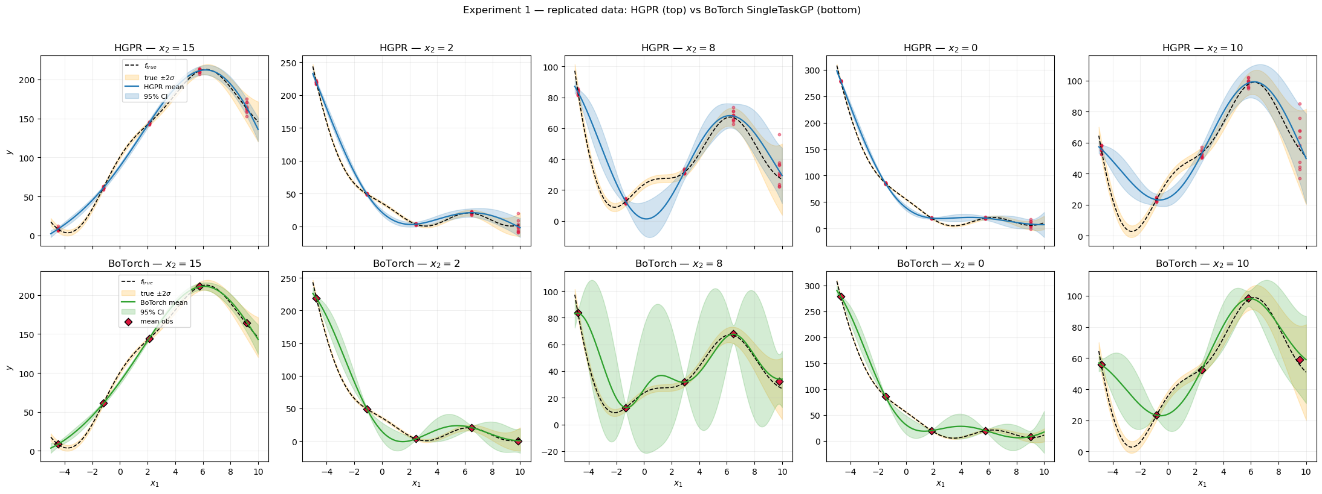
Experiment 1 - replicated samples (5 sites x 10 reps per level)
Notes:
The first slide should give one diagram, what is the problem
The first slide should give more context, more clear, simple, and remind her what is the problem
Always show what is the overall background
Do not show a lot of table or data on the first slide
The firs slide is important because if they are lost, they
Include the hall mobility
UIC
For notremade I can show the replicate data, (the 3 slides)

Slide 17
Experiment 1 - replicated samples (5 sites x 10 reps per level)
Level | Per-category GP |  |  |  | HGPR
 | MAE | RRMSE | IS | COVERAGE | MAE | RRMSE | IS | COVERAGE
15 | 6.7351 | 0.0408 | 158.0434 | 0.45 | 7.1052 | 0.0428 | 163.611 | 0.45
2 | 12.9674 | 0.074 | 211.0685 | 0.55 | 9.2301 | 0.0495 | 211.6895 | 0.5
8 | 7.8141 | 0.1349 | 72.2378 | 0.95 | 10.8792 | 0.1599 | 201.6838 | 0.5
0 | 14.3607 | 0.0571 | 171.8013 | 0.45 | 8.7962 | 0.0355 | 207.3722 | 0.35
10 | 10.1064 | 0.1458 | 128.7969 | 0.6 | 9.539 | 0.1383 | 208.9551 | 0.55
Mean | 10.3967 | 0.0905 | 148.3896 | 0.6 | 9.11 | 0.0852 | 198.6623 | 0.47
Notes:
The first slide should give one diagram, what is the problem
The first slide should give more context, more clear, simple, and remind her what is the problem
Always show what is the overall background
Do not show a lot of table or data on the first slide
The firs slide is important because if they are lost, they
Include the hall mobility
UIC
Both can be the baseline
Came up with a mathemical deeply
Hide the second experiment as is not the standard case we are following
We should use replicate data set

Slide 18
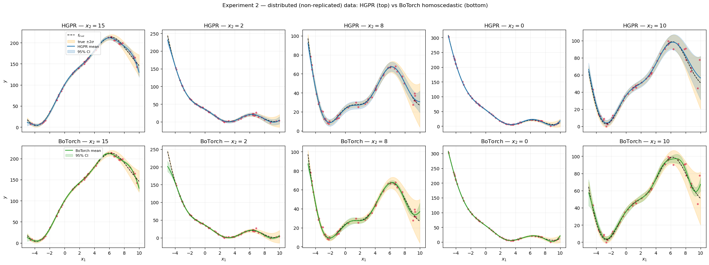
Experiment 2 — 50 distributed samples (no replicates)
Botorch is not capable of modeling the noise in this case
Notes:
The first slide should give one diagram, what is the problem
The first slide should give more context, more clear, simple, and remind her what is the problem
Always show what is the overall background
Do not show a lot of table or data on the first slide
The firs slide is important because if they are lost, they
Include the hall mobility

Slide 19
Experiment 2 — distributed samples (no replicates)
Level | Per-category GP |  |  |  | HGPR
 | MAE | RRMSE | IS | COVERAGE | MAE | RRMSE | IS | COVERAGE
15 | 2.3911 | 0.0212 | 44.945 | 0.8 | 2.318 | 0.0209 | 18.0854 | 0.95
2 | 3.3127 | 0.0398 | 66.1033 | 0.8 | 1.2823 | 0.0119 | 10.8903 | 0.95
8 | 1.4807 | 0.0369 | 16.724 | 0.9 | 0.7736 | 0.0163 | 9.7981 | 1
0 | 1.1924 | 0.0083 | 23.025 | 0.75 | 1.018 | 0.0061 | 7.239 | 0.95
10 | 2.2659 | 0.0447 | 26.9855 | 0.9 | 1.3962 | 0.0218 | 15.295 | 1
Mean | 2.1285 | 0.0302 | 35.5566 | 0.83 | 1.3576 | 0.0154 | 12.2616 | 0.97
Notes:
The first slide should give one diagram, what is the problem
The first slide should give more context, more clear, simple, and remind her what is the problem
Always show what is the overall background
Do not show a lot of table or data on the first slide
The firs slide is important because if they are lost, they
Include the hall mobility
-------------------
Some Ai agents to learn ahead of time which method to use, not just the user decide, but there is a method
Read papers about autonomos discovery to see the

