Slide 1


SAMSUNG TV
UI DESCRIPTION
Nuvio TV • Tizen 4+ • Seller Office submission draft
A big-screen media organizer for movies and series.
The user brings the sources; Nuvio organizes the experience.
PREPARED FOR CERTIFICATION
UI, navigation and test scenario
Nuvio TV • Samsung TV UI Description • 2026-08 draft
Notes:
[Sources]
Local NuvioTV-Web brand assets and product description.
Samsung Seller Office publication and packaging requirements: https://developer.samsung.com/tv-seller-office/checklists-for-distribution/launch-checklist.html

Slide 2
PRODUCT OVERVIEW
02
What the TV app does
A focused TV experience
Primary navigation
Nuvio is a modern media organizer for movies and TV shows. It helps users discover titles, build a library, save favorites, track progress and keep their watch history in sync with supported services.
Featured and popular rows with a focused hero area.
HOME
CERCA
Search titles and browse results from configured catalogs.
LIBRERIA
Saved titles, cloud libraries and progress-oriented views.
Nuvio does not host a catalog or video library. Catalogs and playable sources come from the user’s configured add-ons and supported services.
IMPOSTAZIONI
Profiles, integrations, playback, appearance and support.
Nuvio TV • Samsung TV UI Description • submission draft
Notes:
[Sources]
Nuvio Android product positioning reference: https://play.google.com/store/apps/details?id=com.nuvio.app
The public listing’s publisher/support identity is not copied here because it does not match the NuvioMedia repository identity; publisher-supplied legal and contact fields remain pending.

Slide 3
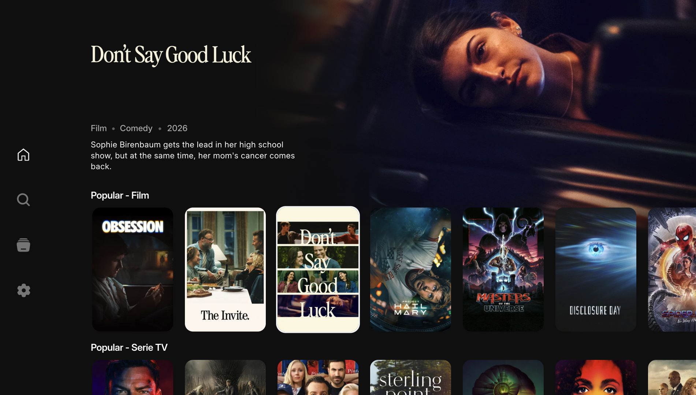
UI FLOW
03
Home: discovery at TV distance
HERO AREA
Highlights a focused title with metadata and a short synopsis.
CONTENT ROWS
Horizontal rails keep browsing predictable with remote control navigation.
FOCUS
The selected item is visually distinct and remains usable at 10-foot distance.
DATA
Home screen captured from the local TV build
Artwork and metadata are loaded from configured catalog providers.
Nuvio TV • Samsung TV UI Description • submission draft
Notes:
[Sources]
Local screenshot captured from the NuvioTV-Web build at 1920x1080.
Nuvio Android product positioning reference: https://play.google.com/store/apps/details?id=com.nuvio.app

Slide 4
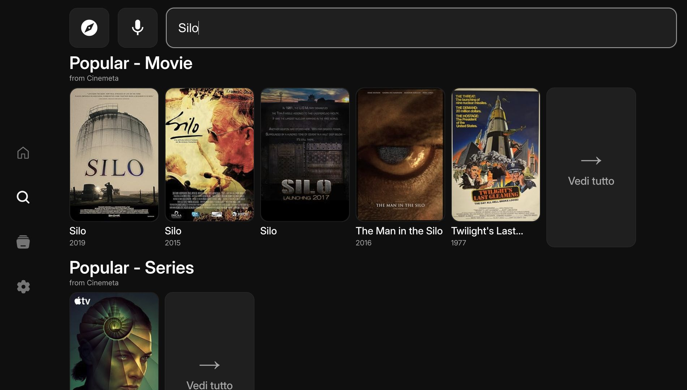
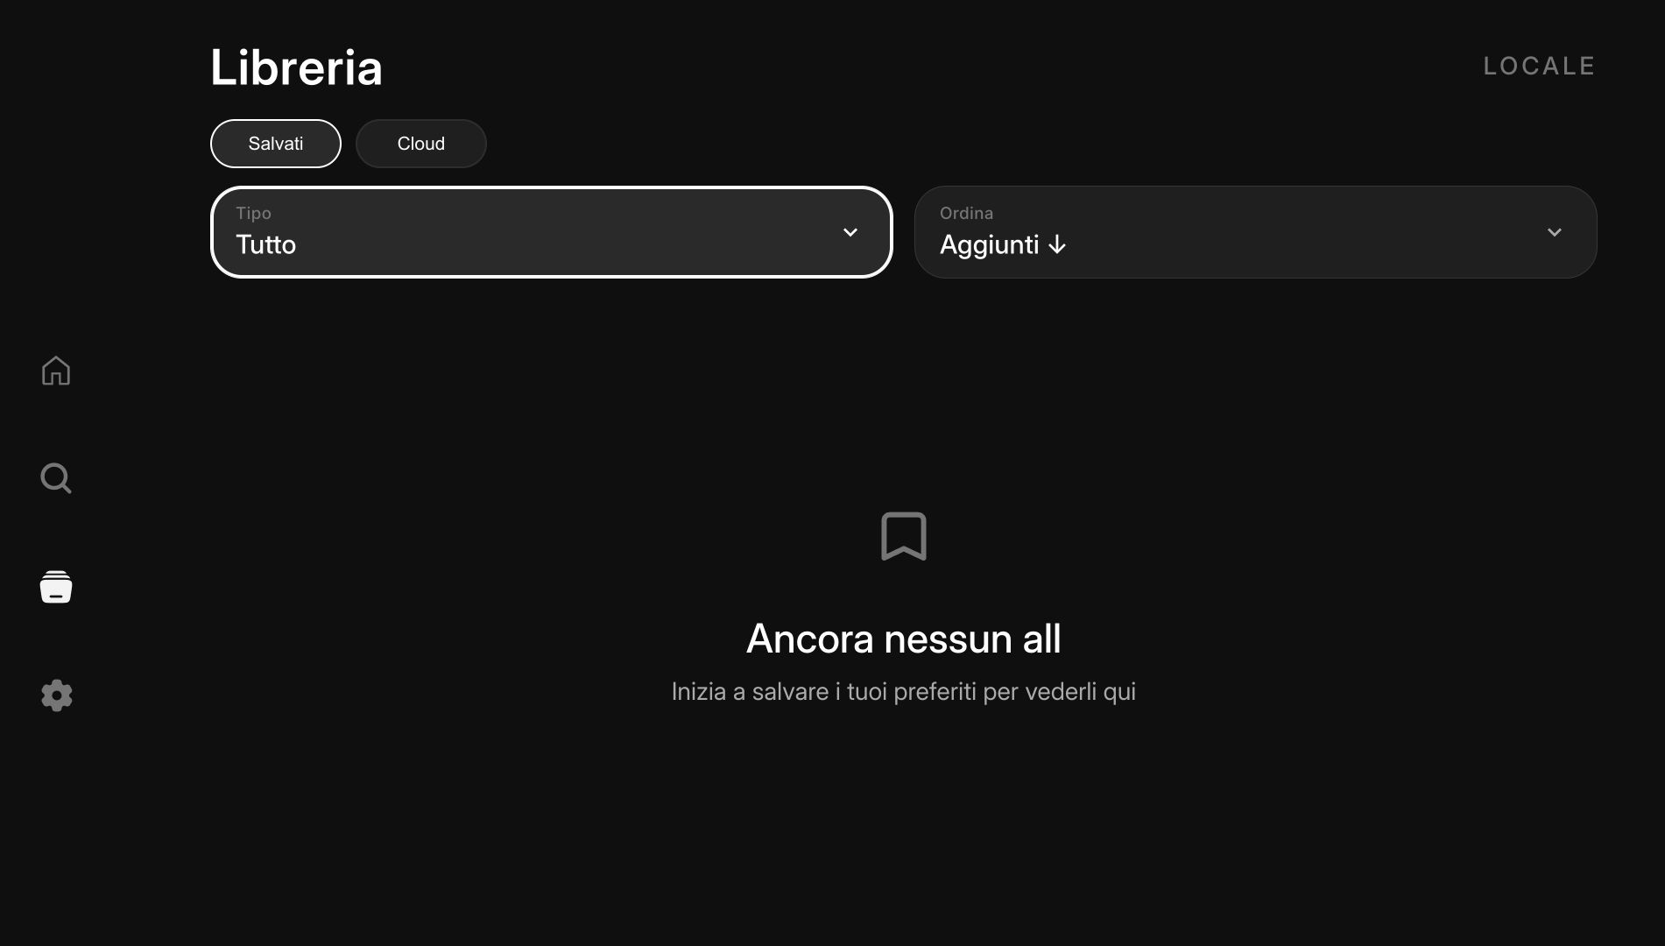
UI FLOW
04
Search and library
Search results
Library and saved titles
SEARCH
LIBRARY
Enter a title with the TV keyboard or voice search.
Switch between saved and cloud-backed views when configured.
Nuvio TV • Samsung TV UI Description • submission draft
Notes:
[Sources]
Local screenshots captured from the NuvioTV-Web build at 1920x1080.
Nuvio Android product positioning reference: https://play.google.com/store/apps/details?id=com.nuvio.app

Slide 5
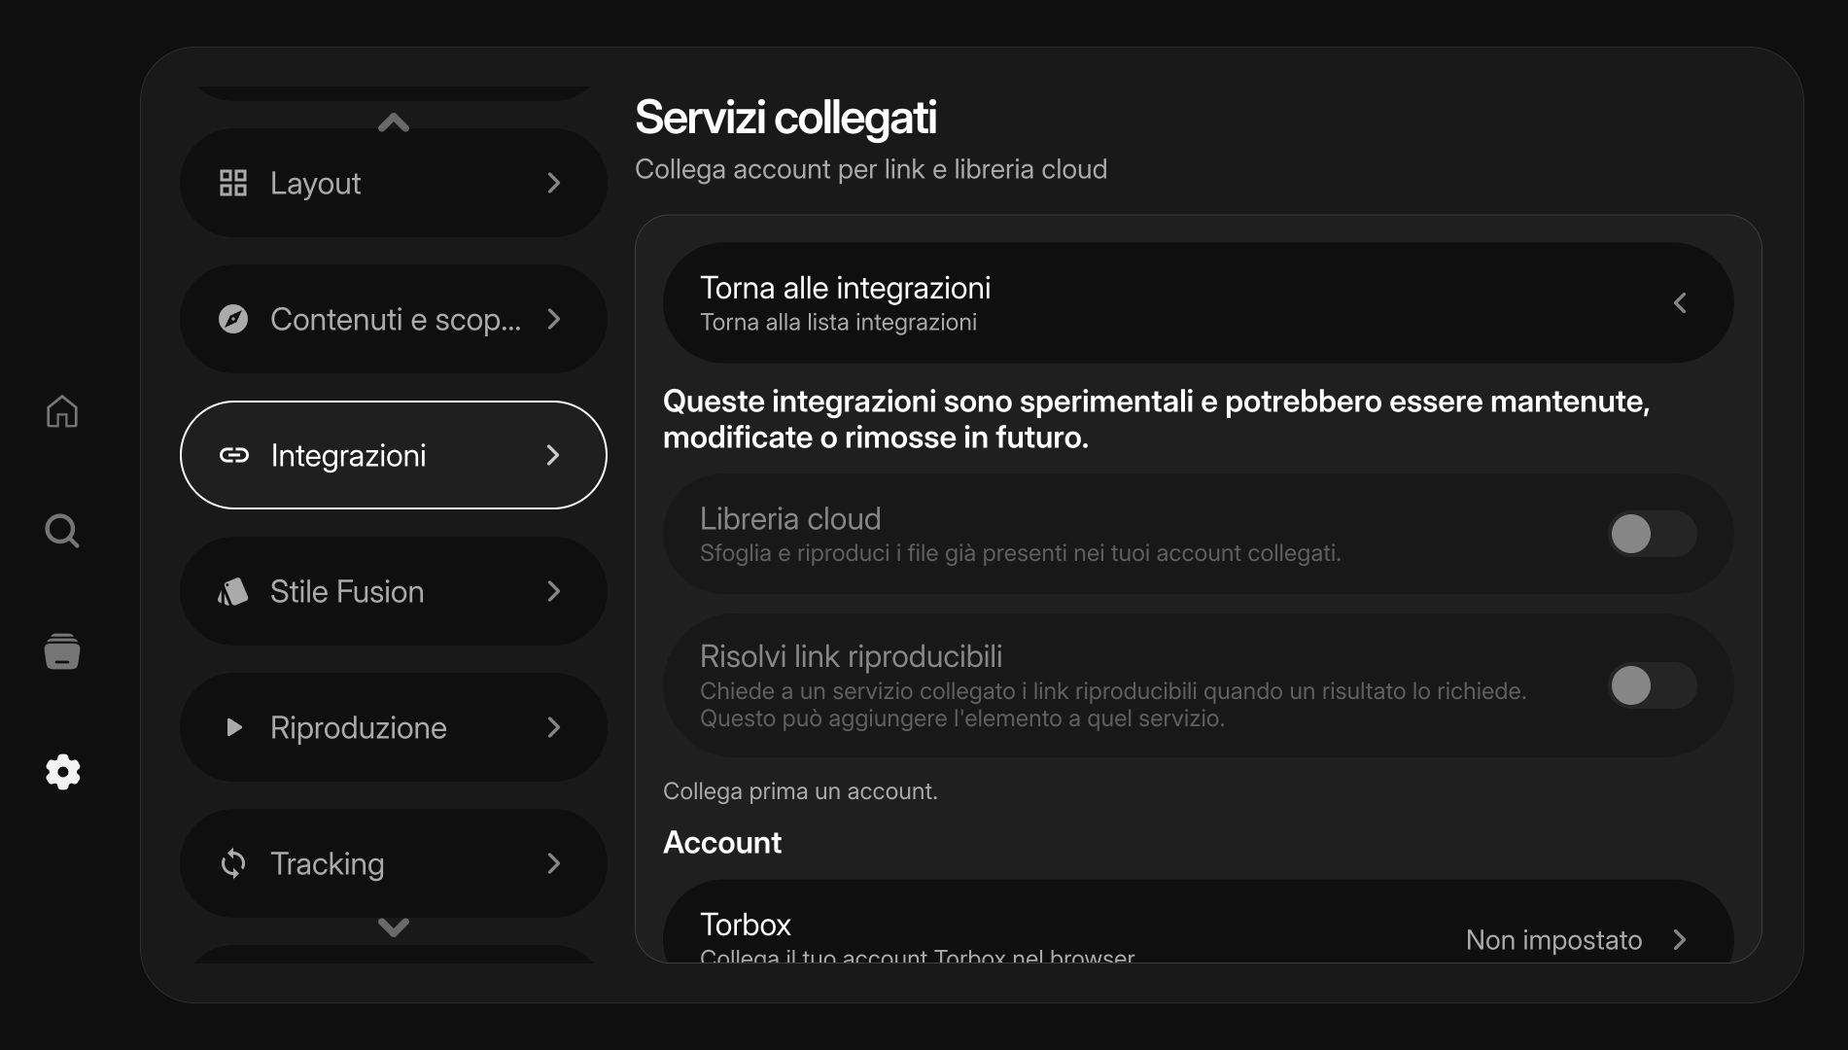
UI FLOW
05
Settings and connected services
ACCOUNT
Profile state and supported watch-history synchronization.
INTEGRATIONS
Optional services for cloud libraries and playable links.
PLAYBACK
Player, audio, subtitle and accessibility preferences.
ADVANCED
Settings screen captured from the local TV build
Capabilities are exposed according to the TV platform and package profile.
Nuvio TV • Samsung TV UI Description • submission draft
Notes:
[Sources]
Local screenshot captured from the NuvioTV-Web build at 1920x1080.
Samsung player information and service registration fields: https://developer.samsung.com/tv-seller-office/guides/applications/entering-application-information.html

Slide 6
CERTIFICATION DISCLOSURE
06
Capabilities follow the package profile
The UI remains consistent; platform capabilities are declared honestly at runtime.
TARGET
PUBLIC SELLER
PARTNER ROUTE
CURRENT RULE
Tizen 4+
TV package floor used by Nuvio.
US distribution by default; public privileges only.
Required for countries outside the US and partner-level APIs.
Torrent/P2P is enabled only when the signed package and Samsung approval authorize the service route.
Submission note
The final WGT must be signed with the publisher’s Tizen security profile and must contain exactly the privileges and metadata approved in Seller Office. This UI document does not grant partner authorization.
Nuvio TV • Samsung TV UI Description • submission draft
Notes:
[Sources]
Samsung Launch Checklist: https://developer.samsung.com/tv-seller-office/checklists-for-distribution/launch-checklist.html
Samsung Publishing an application: https://developer.samsung.com/tizen/Smart-TV/Quickstarts/Publishing-an-application.html
Samsung Becoming Partners: https://developer.samsung.com/tv-seller-office/guides/membership/becoming-partner.html
Samsung Privileges Q&A: https://developer.samsung.com/smarttv/develop/faq/privileges.html

Slide 7
CERTIFICATION TEST SCENARIO
07
Suggested verification path
01
Launch
02
Home
03
Search
Open the signed WGT and verify the initial profile screen.
Select a profile and verify hero focus, rows and remote navigation.
Search a known title and open the matching result.
04
Library
05
Playback
06
Recovery
Save a title and confirm it appears in the local library.
Play a publisher-supplied test source and check audio/subtitle controls.
Return to Home, relaunch and confirm saved state remains stable.
Pending publisher input: test account, configured provider/add-on, approved country/model groups, privacy/support contacts and final rating.
Nuvio TV • Samsung TV UI Description • submission draft
Notes:
[Sources]
Samsung Seller Office requires test information for certification and verification: https://developer.samsung.com/tv-seller-office/
Samsung player information fields: https://developer.samsung.com/tv-seller-office/guides/applications/entering-application-information.html

