Slide 1
New Year Tweets
Code: https://github.com/Chris35Wills/twitter_data_visualisation

Slide 2
Task management
Mike, Victoria and Kathryn
Map development
Implementation of rotation
Date binning
Chris, Jenny and James
Data download
Geo and time querying
Data management

Slide 3
Aim
Download twitter data using the twitter API
Display tweets selected by #2016 as they appeared across the globe
Interested in the 31/12/15 – 1/1/16 period

Slide 4
twitter_analysis.py
spin_globe.py
set_auth()
get_data()
query_data()
---------------------
Twitter_xyz.csv
create_map()
plot_data()
interaction()
Basic UML
overview
main.py
twitter_analysis()
spin_globe()
Runs code…!

Slide 5
Extracting the data
Need to set twitter authorisation:
consumer_key = ''
consumer_secret = ''
access_token = ''
access_token_secret = ''
auth = tweepy.OAuthHandler(consumer_key, consumer_secret)
auth.set_access_token(access_token, access_token_secret)

Slide 6
Querying
Using python tweepy package
tweepy.Cursor(api.search,
geocode="52,0,100mi“
q="#2016
AND
since:2015-12-31
AND
until:2016-01-01")

Slide 7
Globe interaction
Mike will now do a demonstration….

Slide 8
Problems
Running into various encoding errors that differ between platforms – try/except blocks required
This is what smileys can cause!!! ☹

Slide 9
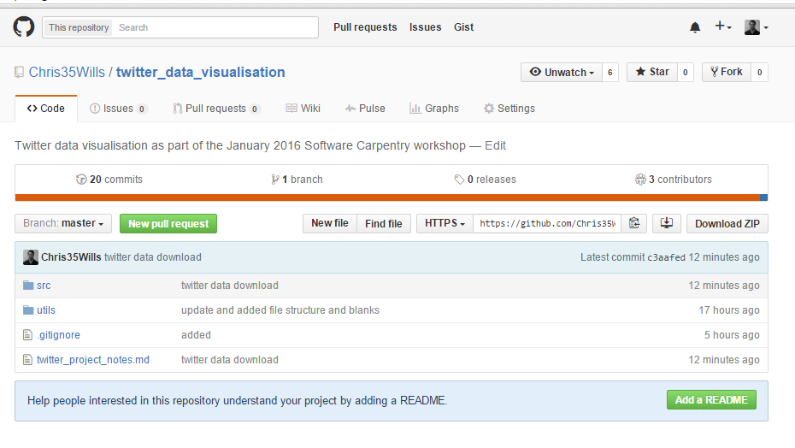
Available code

