Slide 1
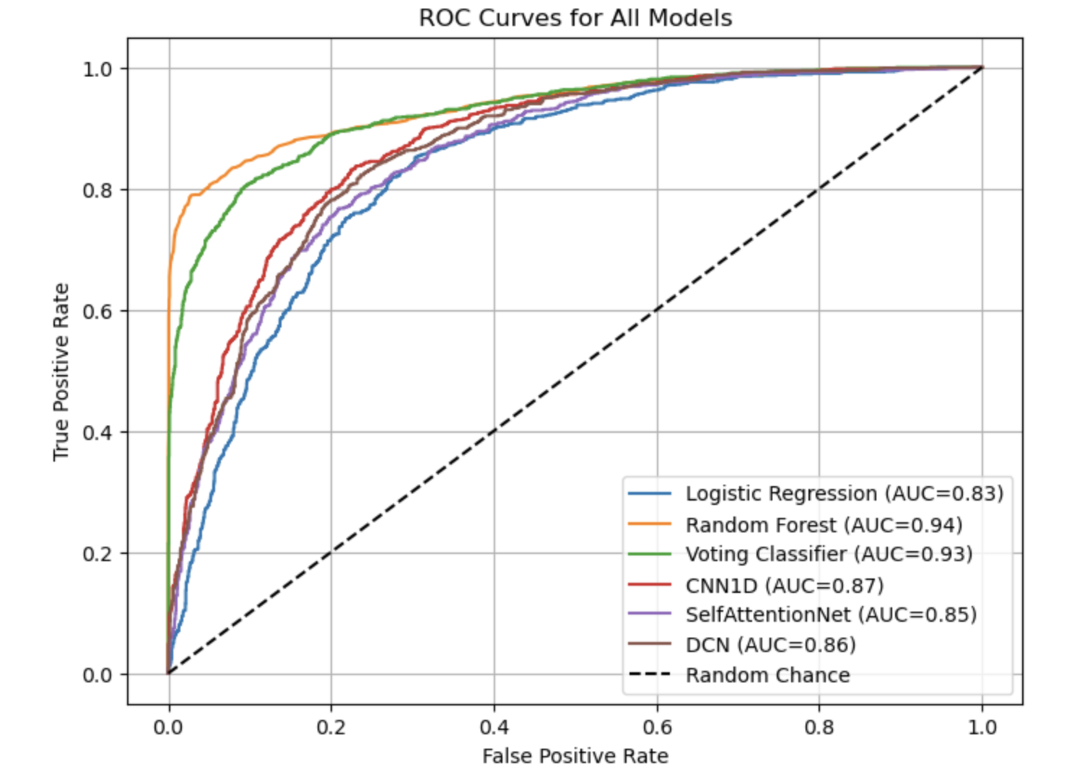
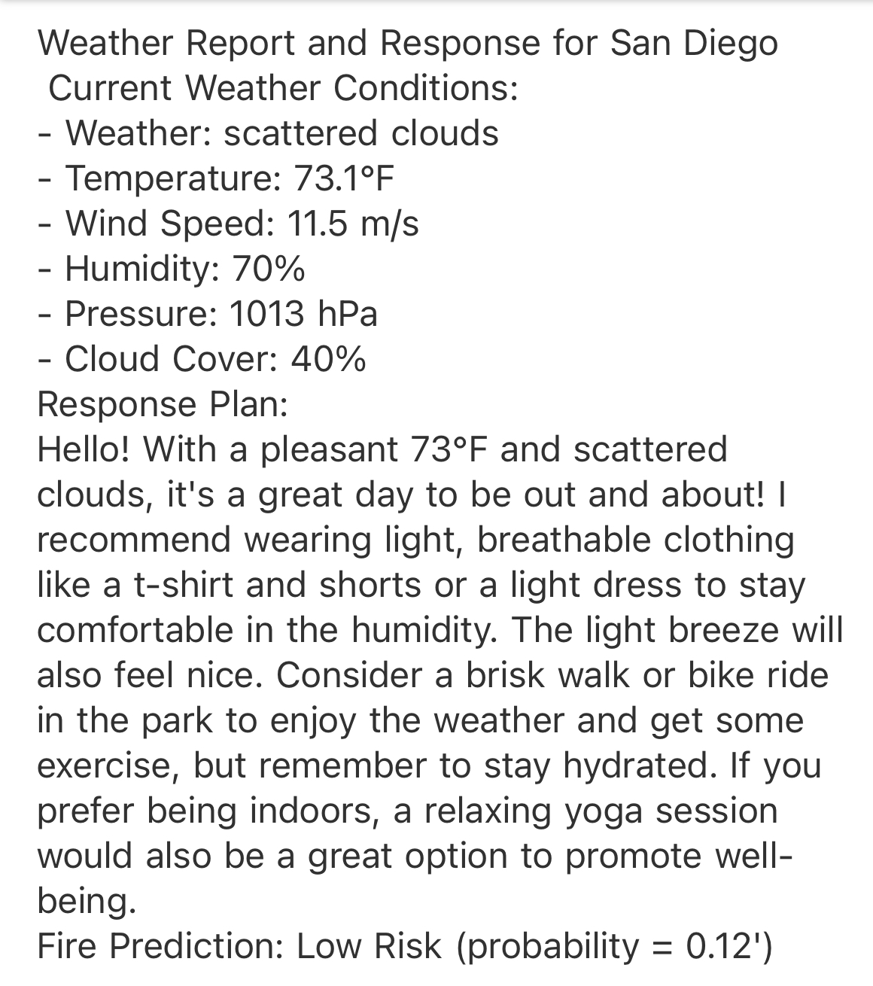
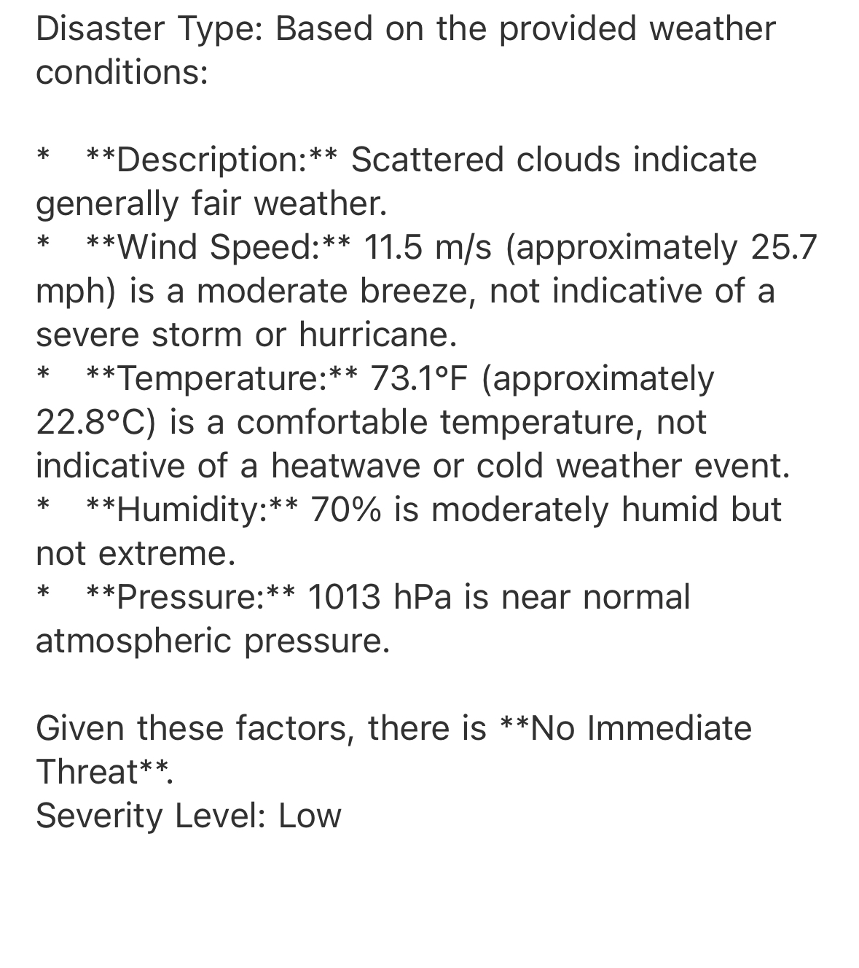
ECE 228 Project
LLM-Based Agent System for Automated Weather Disaster Management
UC San Diego | Jacobs School
Department of Electrical and Computer Engineering
Xiaoyuan Ren, Chengpeng Xing, Xiang Gao, Siqi Wang
Department of Electrical and Computer Engineering, UC San Diego
Introduction
Method
Conclusion
Objective: To build an intelligent agent system that combines machine learning and large language models (LLMs) to predict and manage weather-related disasters.
Motivation: Traditional disaster management often relies on delayed manual assessment. Automating this process enhances response speed, improves system efficiency, and reduces labor costs.
Approach: Integrate ML-based wildfire prediction with a real-time LLM agent system that assesses weather risks, determines severity, and initiates automated responses and alerts.
Wildfire Prediction: Trained and evaluated multiple machine learning models on historical climate data. Selected the best-performing model for integration into the overall system.
LLM-Based Agent System: Developed an agent system that ingests real-time weather data to assess the likelihood and severity of multiple disaster types. Based on severity and disaster types, the system triggers appropriate responses and sends email alerts.
2. LLM-Based Agent Workflow
Improvement: Integrate the ML model into our real-time LLM-based agent system that monitors multiple weather-related disasters and determines severity levels.
The system enables automated, timely, and personalized responses — including email alerts — based on current weather conditions.
Results demonstrate the effectiveness of combining ML prediction with LLM reasoning to enhance disaster preparedness and communication.
Get Weather
Weather API
Wildfire Prediction
Disaster Analysis
Flood Storm Heatwave Hurricane
No Threat
ML Model
Severity Assessment
Critical, High, Medium, or Low
By LLM
(Gemini)
1. Wildfire Prediction Framework
Average temperature
Total snowfall
Humidity
Wind speed
Precipitation
Sun hours
Year
Month
Heatwave or Hurricane
Flood or Storm
Critical or High Severity
No Threat
Future Work
Data
Civil Defense Response
Public Works Response
Emergency Response
Daily Recommendation
Wildfire dataset: combining the fire data with the California weather data following [1].
Weather API: OpenWeatherMap.
(weather description, temperature, wind speed, humidity, pressure, cloud cover, etc.)
ML Model
Prediction Results
Integrate satellite imagery or meteorological raster data (e.g., precipitation maps, vegetation indices) to enrich input features.
Develop a multi-modal framework that combines image-based and weather-based inputs for improved prediction and decision-making.
Email Alert
Audio Report
Data Logging
Experimental Results
Wildfire Prediction:
Random Forest achieved the highest performance across all metrics as further confirmed by its dominant ROC curve, making it the chosen model for wildfire risk prediction.
LLM-Based Agent System:
Example email response:
Reference
[1]https://github.com/osyounis/cali_wildfire_likelihood_predictor
[2] Wang, Lei, et al. "A survey on large language model based autonomous agents." Frontiers of Computer Science 18.6 (2024): 186345.
[3] Wang, Ruoxi, et al. "Deep & cross network for ad click predictions." Proceedings of the ADKDD'17. 2017. 1-7.
[4] Kondylatos, Spyros, et al. "Wildfire danger prediction and understanding with deep learning." Geophysical Research Letters 49.17 (2022): e2022GL099368.
Method | ACC | Recall | F1 score | AUC
Logistic Regression | 0.7668 | 0.6731 | 0.6773 | 0.8347
MLP | 0.7698 | 0.6867 | 0.6892 | 0.7528
Self-Attention Network | 0.7853 | 0.7131 | 0.7072 | 0.8546
Deep & Cross Network | 0.7968 | 0.7798 | 0.7362 | 0.8658
ConvNN-1D | 0.8032 | 0.7189 | 0.7265 | 0.8753
Voting Classifier | 0.8623 | 0.8182 | 0.8121 | 0.9274
Random Forest | 0.8905 | 0.8282 | 0.8462 | 0.9395
Notes:
Hello everyone, thank you for visiting our poster.
Our project is LLM-based agent system for automated weather disaster management.
The goal of our work is to build an intelligent agent system that combines machine learning and large language models (LLMs) to predict and manage weather-related disasters.
Our motivation is from the limitation of traditional disaster management that relies on delayed manual assessment. So, automating this process can enhance response speed, improve system efficiency, and reduce labor costs.
Our approach is Integrating ML-based wildfire prediction with a real-time LLM agent system that assesses weather risks, determines severity, and initiates automated responses and alerts.
That’s the overview of our project – it can be divided into two main components: ml-based wildfire prediction and llm-based agent system.
As for the data we used, for the first part -- the wildfire prediction – we combined the California weather data with fire data following the reference 1 and this is historical data. For the second part – the agent system, we use a weather API to get the real-time data, including weather description, temperature, wind speed, humidity, pressure, cloud cover, etc.
Then, I’ll introduce the two main components in our system (that’s the methods we used):
For the wildfire prediction, we trained and evaluated multiple machine learning models on historical climate data that just mentioned.
Here’s the framework: we used these features as the input of ml models and then we can get the prediction results. Based on the results, we selected the best-performing model to integrate into the agent system.
Then, for the llm-based agent system, we firstly get real-time weather data, and then use ML model for wildfire prediction. In parallel, use LLM (here we use the Gemini API) to analyze other types of disaster (including flood, storm, heatwave, and hurricane). [The reason why we can use LLM for disaster analysis except wildfire is that wildfire may related with many weather features (conditions) and it is not directly related to some features, but other disaster, such as heatwave, it is directly related to temperature and pressure.] So, we use LLM for other disaster analysis and then assess the severity. Based on the severity and the disaster types, we give different responses and send email alert to users. And then there’s an audio report and we log the data.
That’s the method we used.
For the results, firstly, for ML-based wildfire prediction, we find Random Forest performed best across all metrics. Here’s the metrics table for different ml models we used. Here’s the ROC curve and also label the AUC values. Then, we integrate the Random Forest model in our LLM-based agent system. Here’s the example email response that generated on last Friday for San Diego. That day is good, so it only contains the daily recommendation response instead of any emergency response.
In conclusion, we integrate the ml model into our real-time LLM-driven agent system that monitors multiple weather-related disasters and determines severity levels.
The system enables automated, timely, and personalized responses — including email alerts — based on current weather conditions.
In the future, we may integrate satellite imagery or meteorological raster data and develop a multi-modal framework that combines image-based and weather-based inputs to improve prediction and decision-making.

