Slide 1

NEEDATICKET
CONCERT TICKETS
Notes:
To change the image on this slide, select the picture and delete it. Then click the Pictures icon in the placeholder to insert your own image.

Slide 2
Arbeitsteilung
Berisa – Android App? | Java App
Blaschke – Database | Webservices
Judth – Database | Webservices
Winkler – Android App | Project Management

Slide 3
Requirements
Android App
Login
Register
Logout
Show all concerts
Show tickets to concert
Buy tickets
Show bought tickets
Show user data
Change user data
------------------------------------
Show wallet
Add/Cashout balance
Webservice connection
Java App
Login
Register
Logout
Show dashboard
Show all tickets
Create tickets
Show transactions
Show user data
Change user data
Show wallet
Add/Cashout balance
Webservice connection
Webservice
Routes as specified
Bearer authentication
Sign in / register auth.
Documentation
Database
Basic tables
Spatial-Index
Data-Warehouse

Slide 4
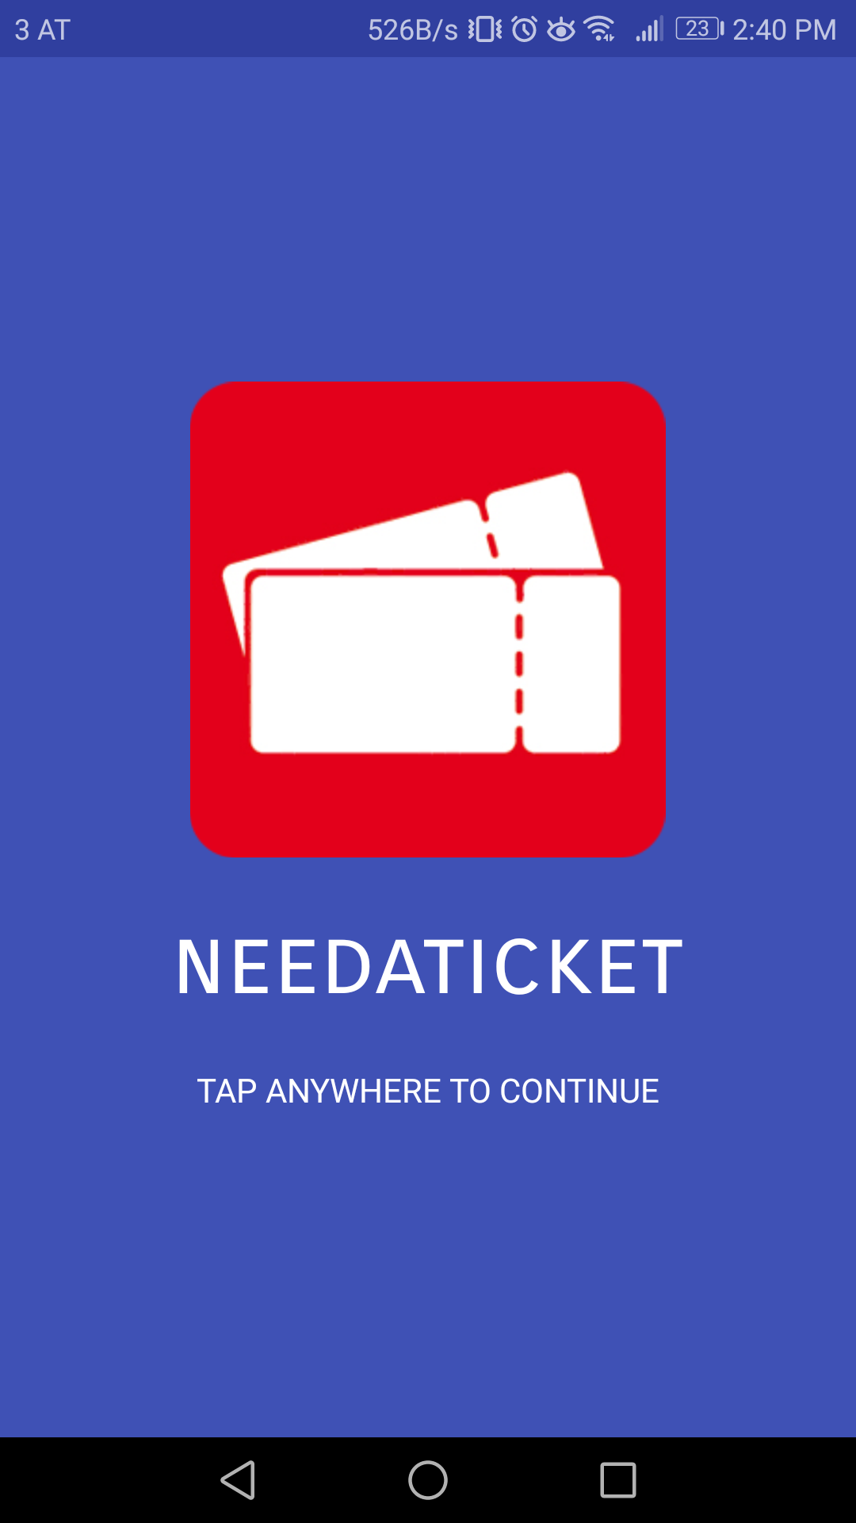
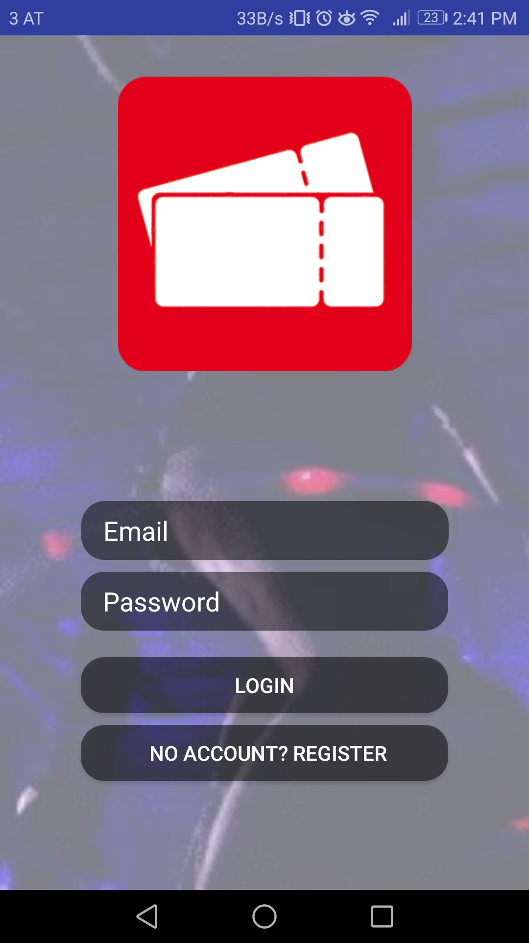
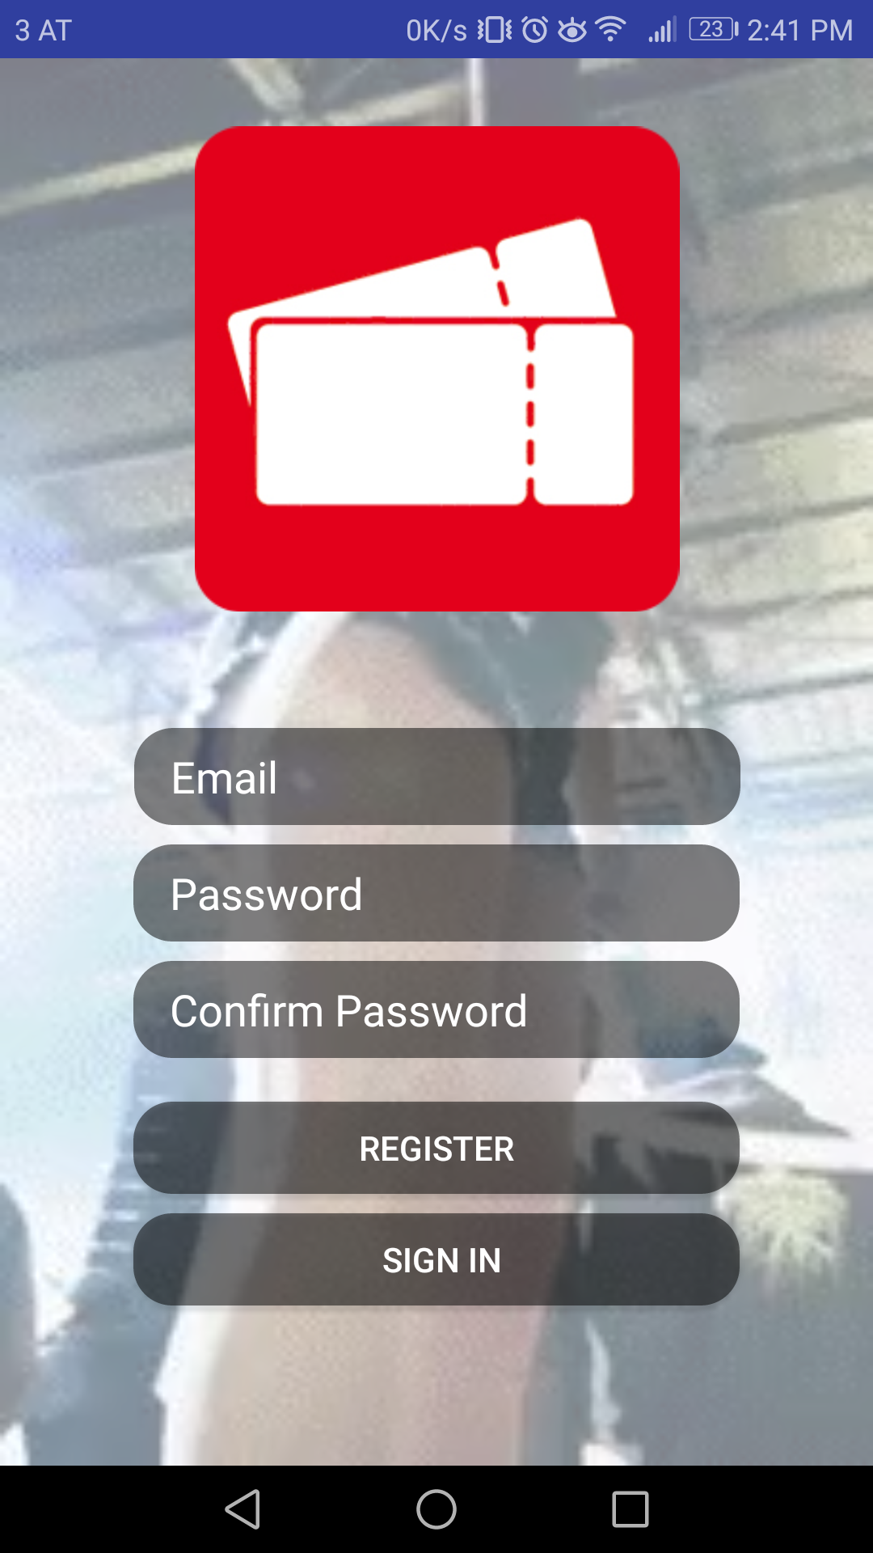
Android App
Welcome Screen
Login
Register

Slide 5
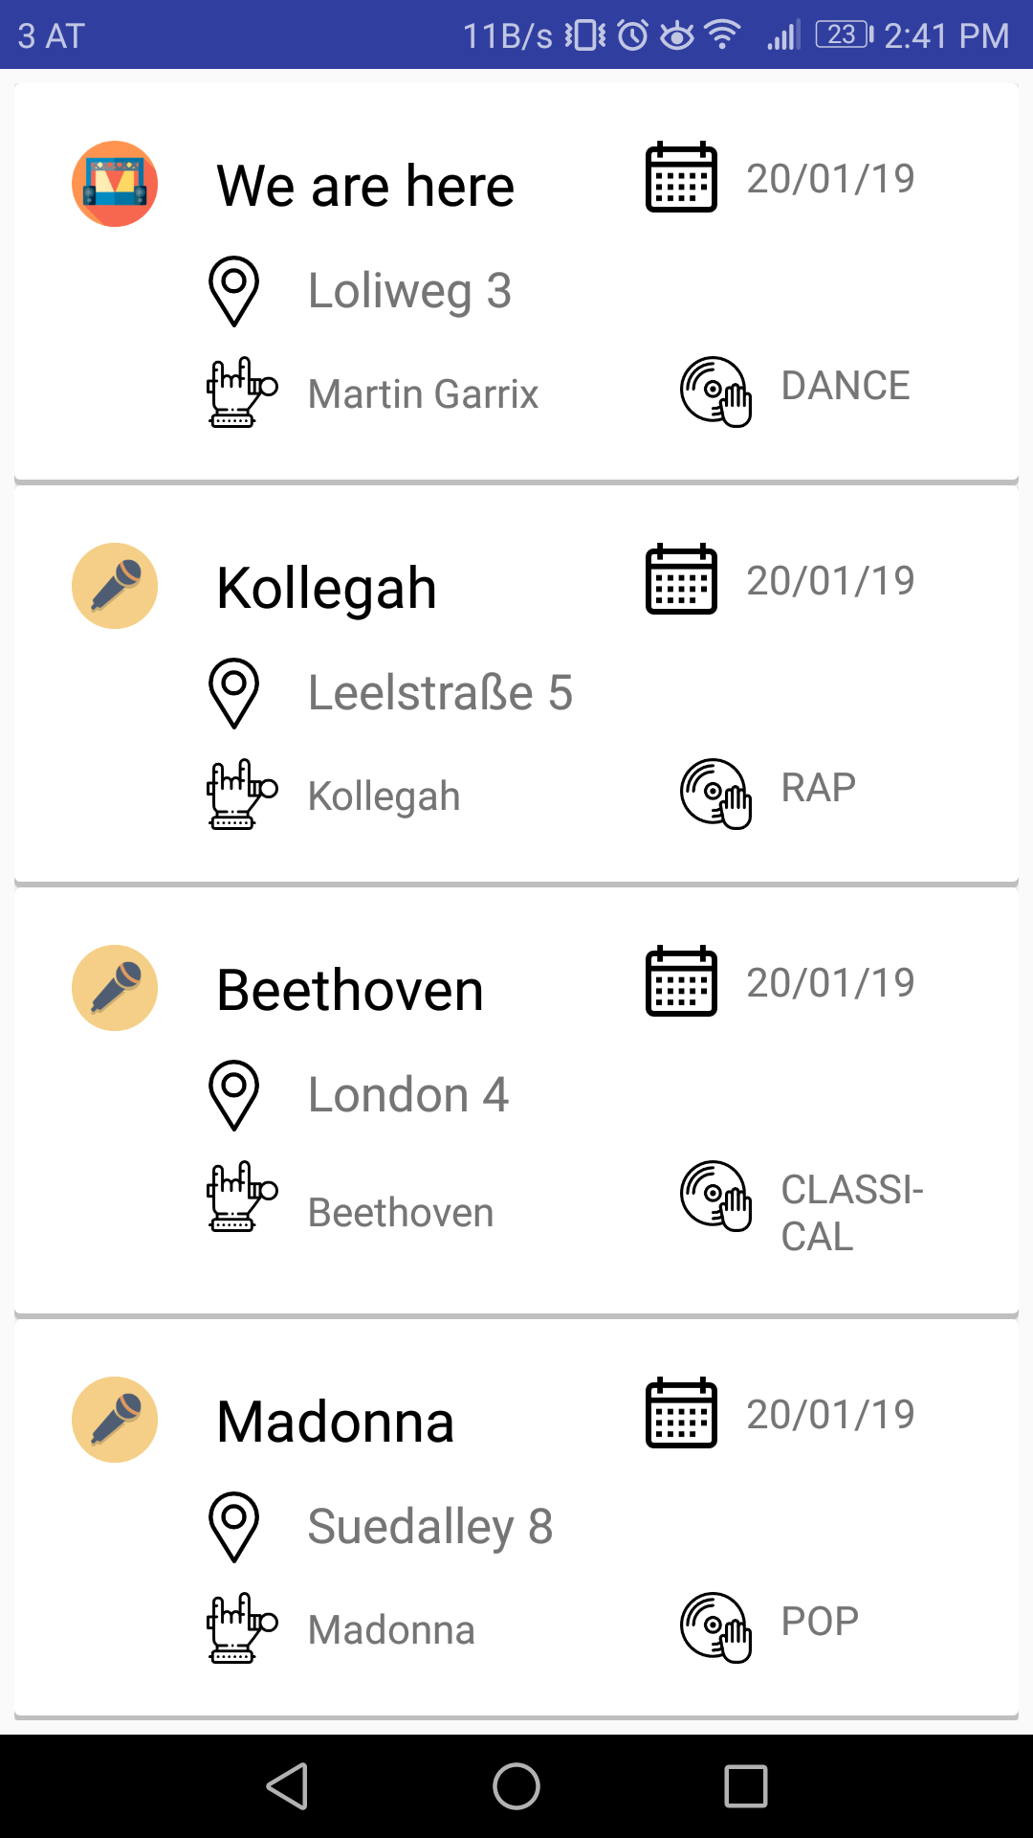
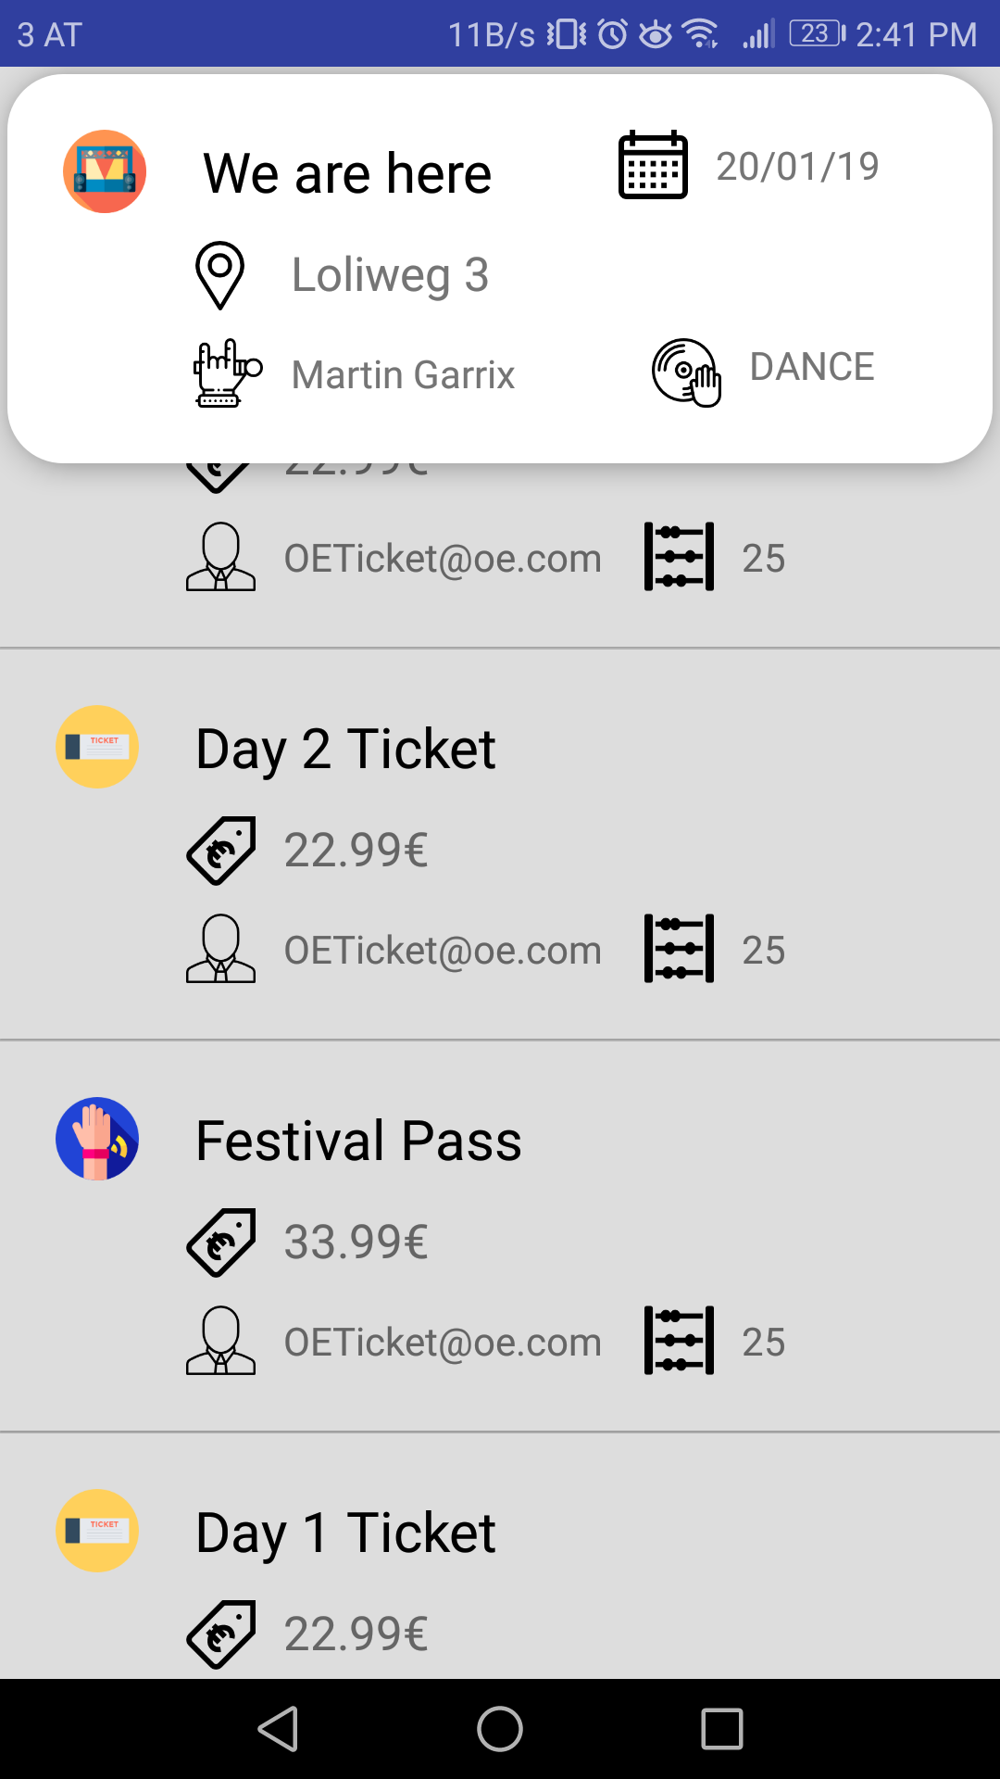
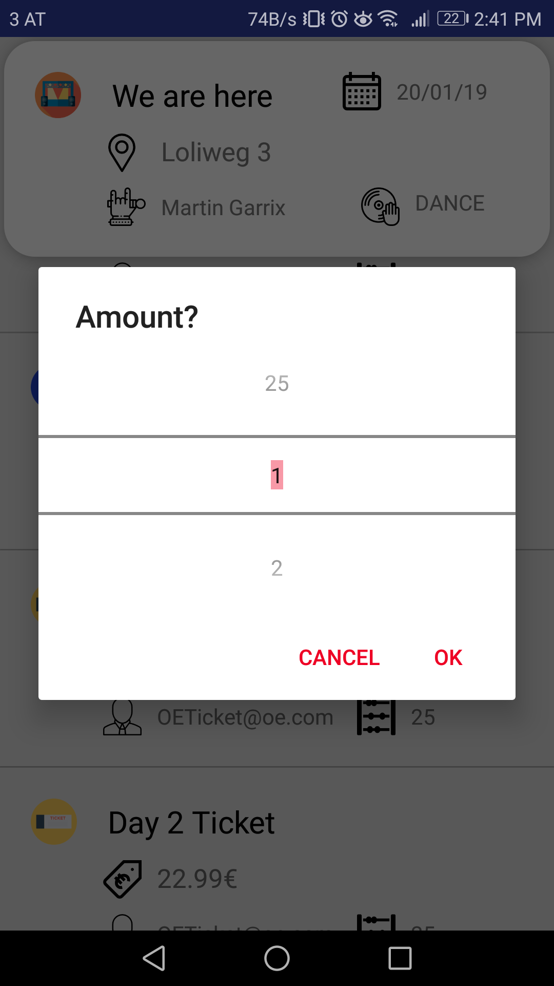
Android App
Concert list
Ticket list
Amount Picker

Slide 6
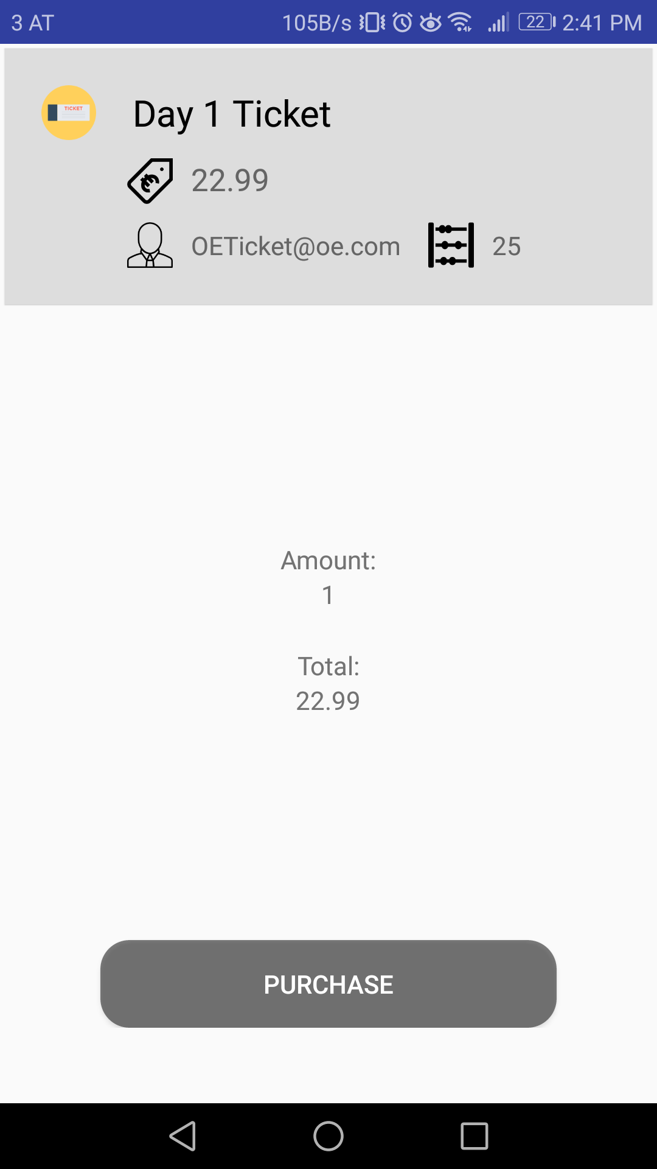
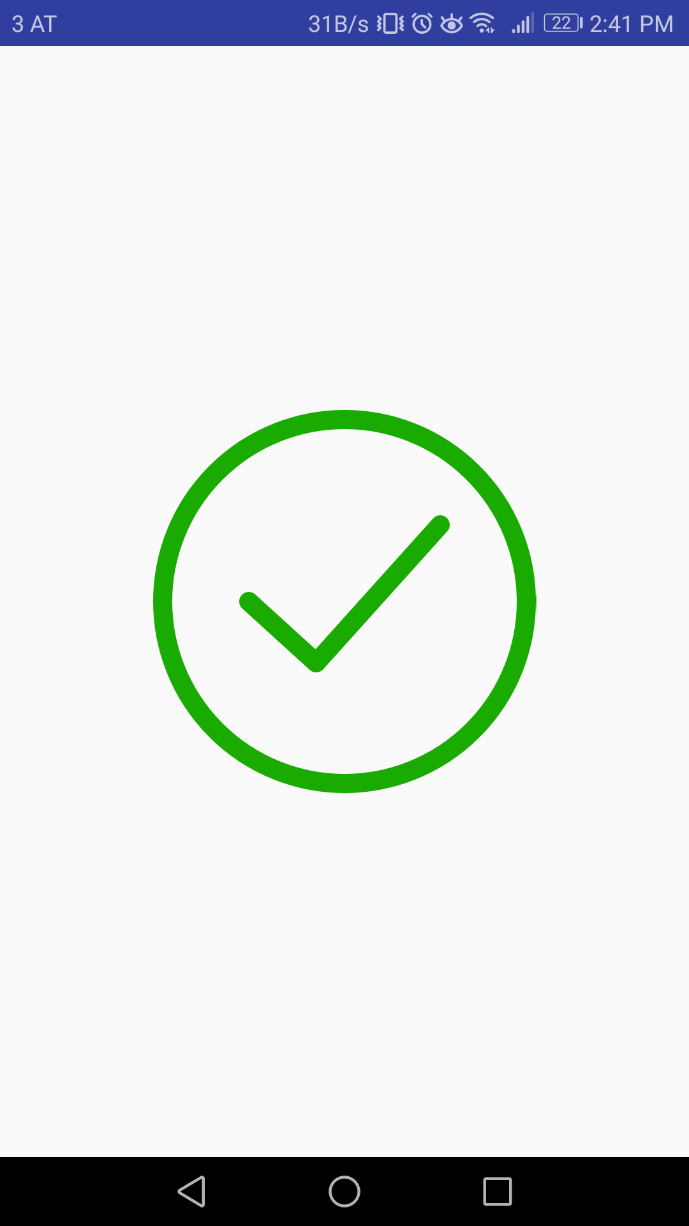
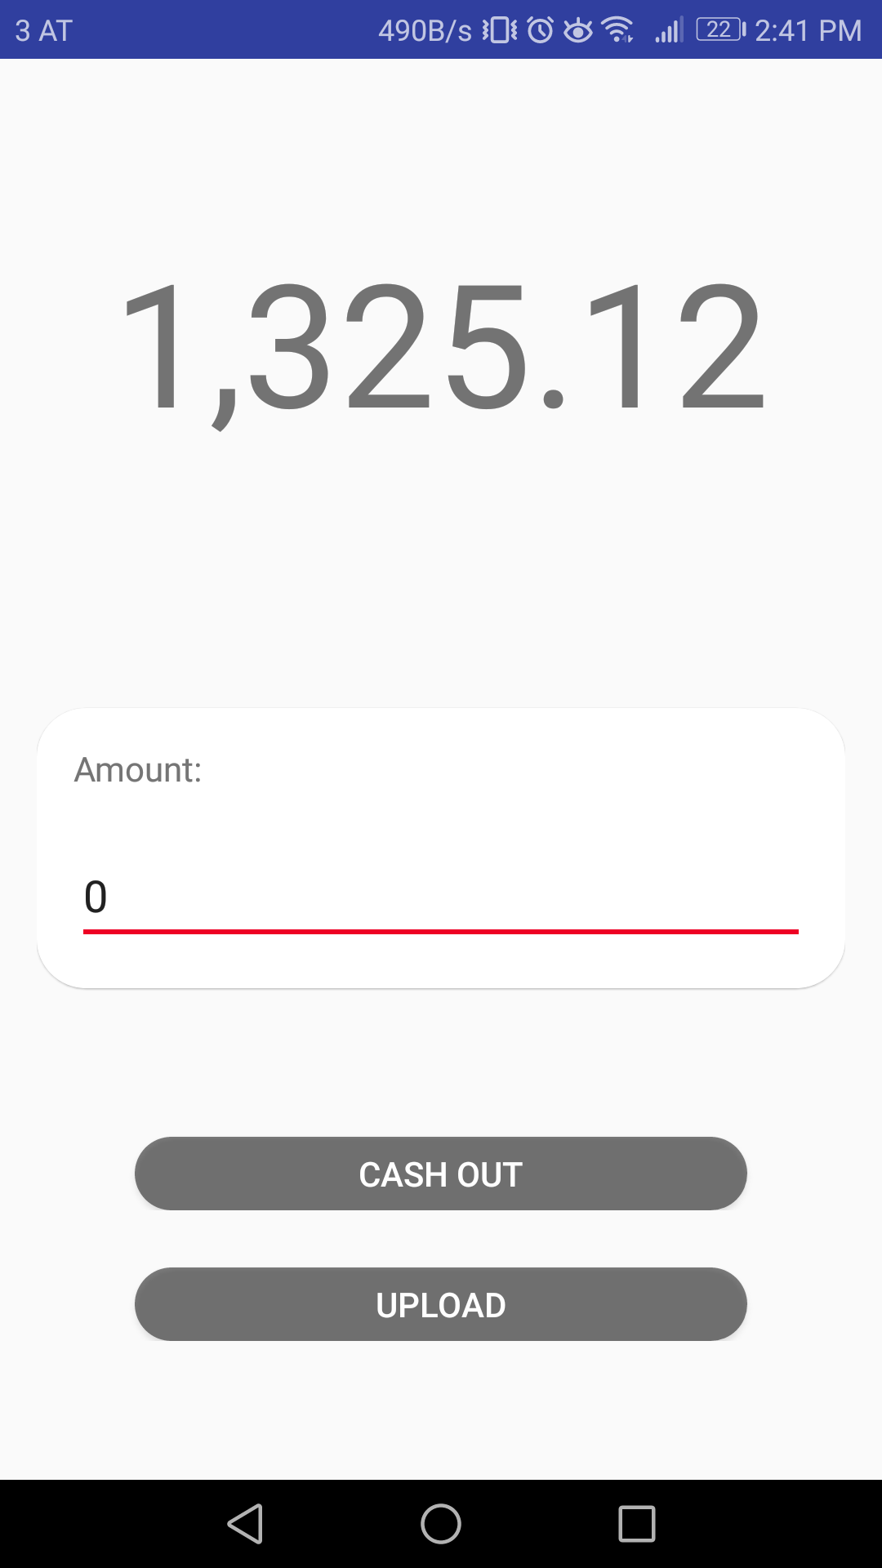
Android App
Buy ticket(s)
Checkmark (Anim)
Wallet (Anim)

Slide 7
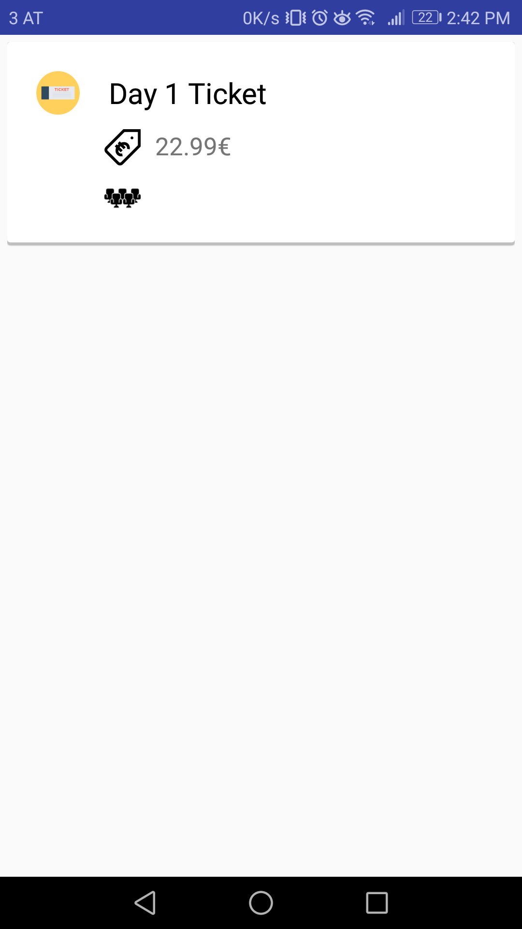
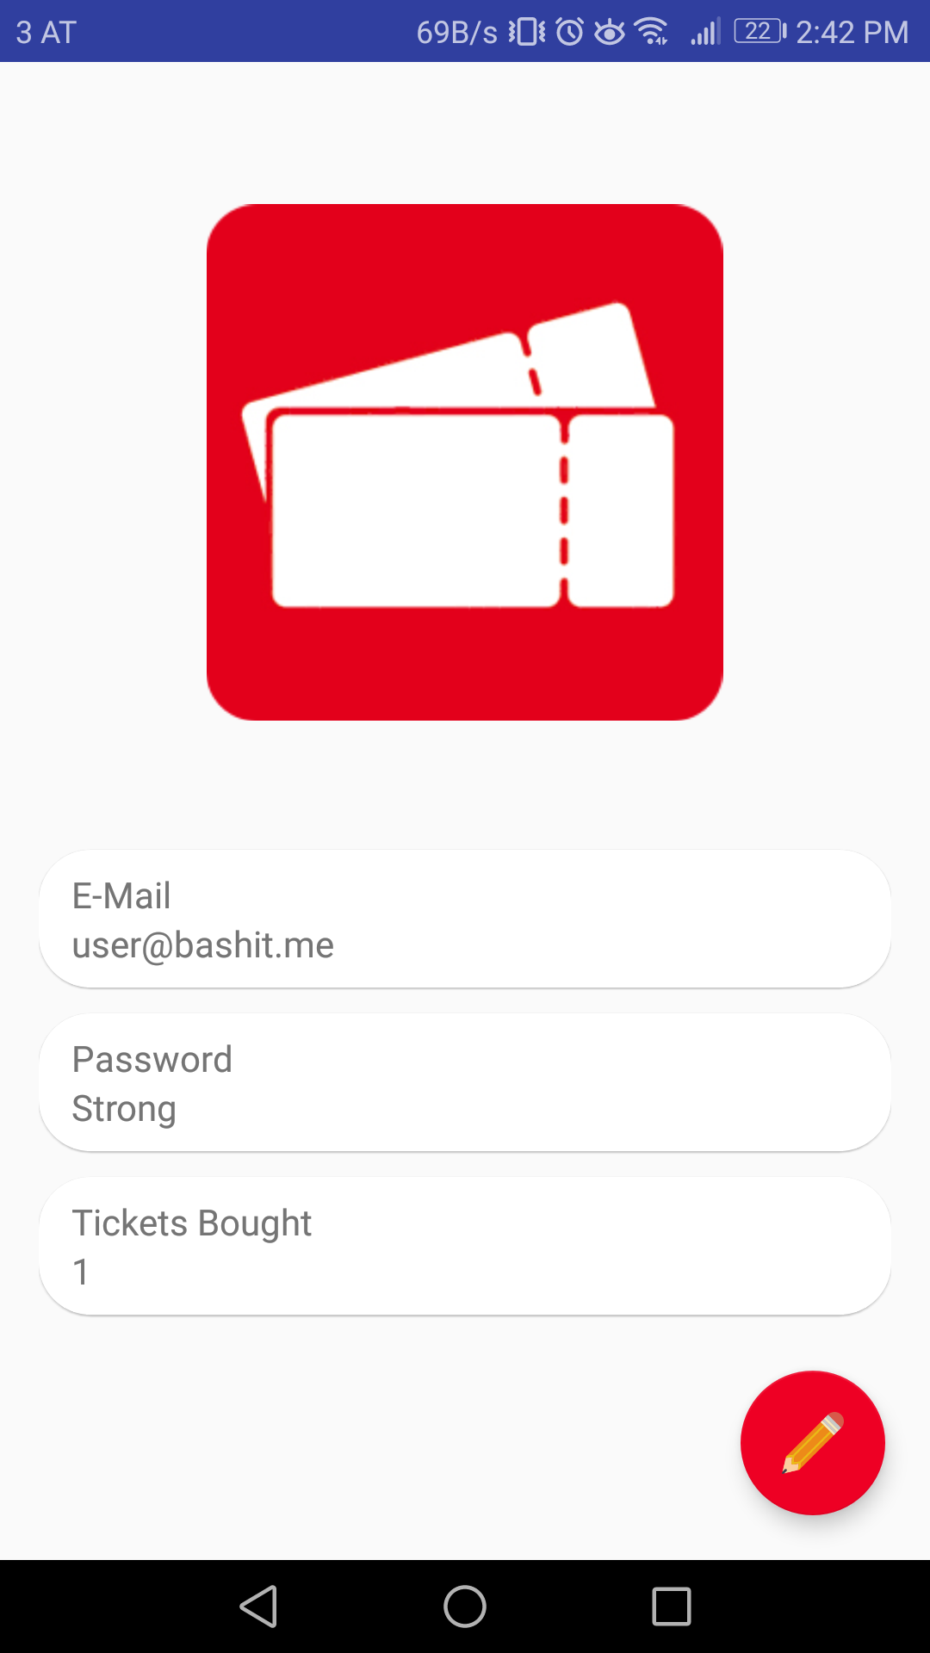
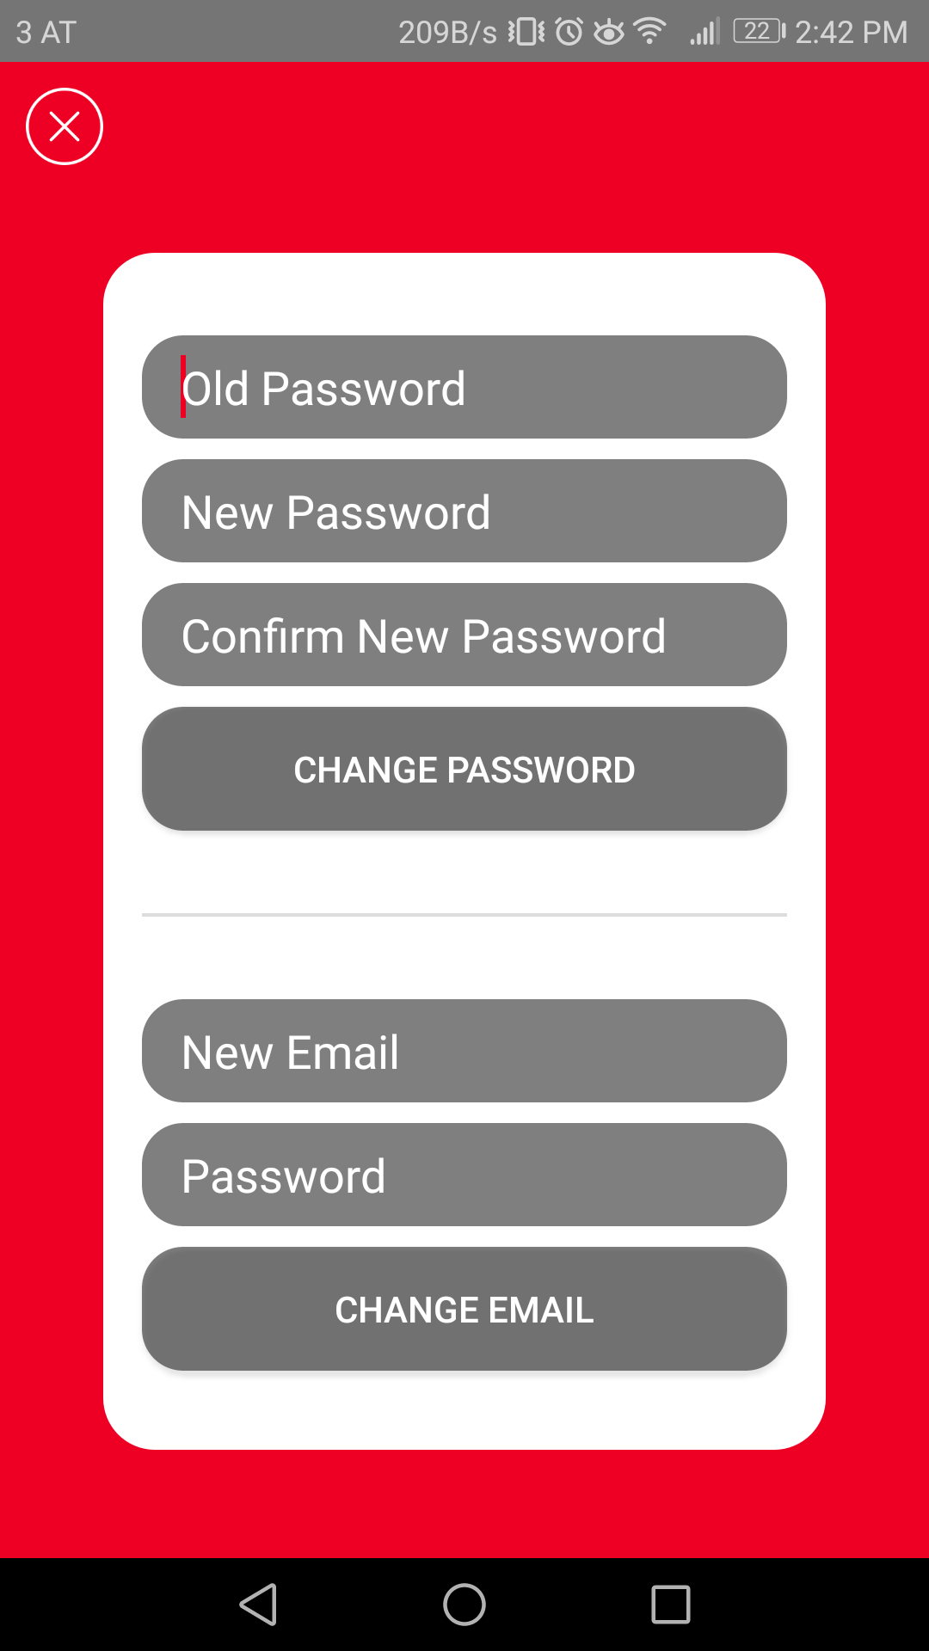
Android App
Bought tickets
User data
Change UD (Anim)

Slide 8
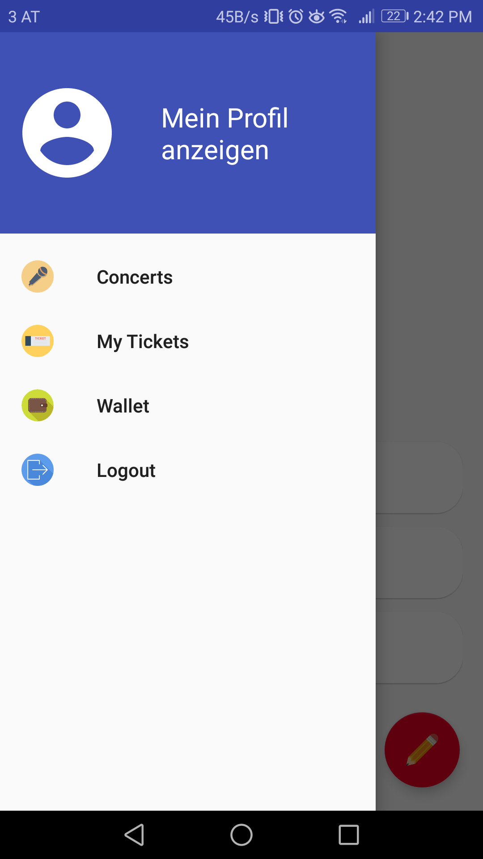
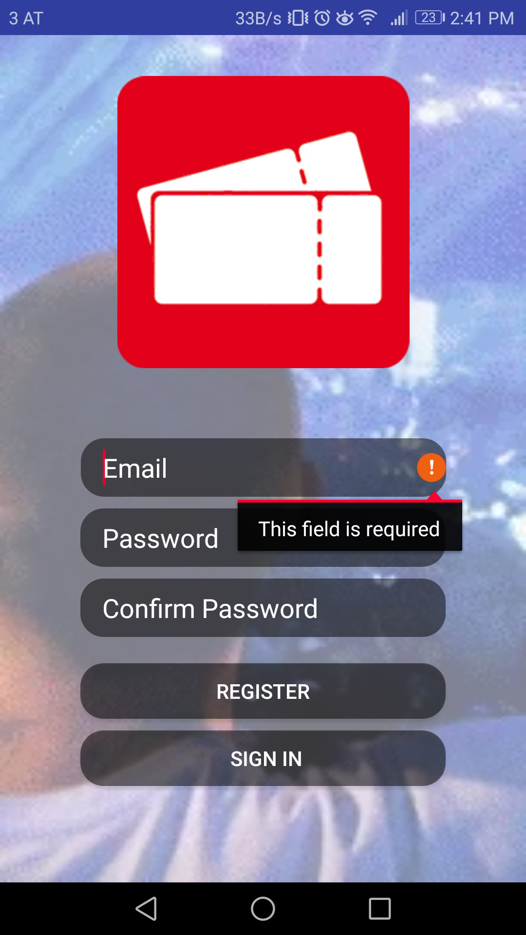
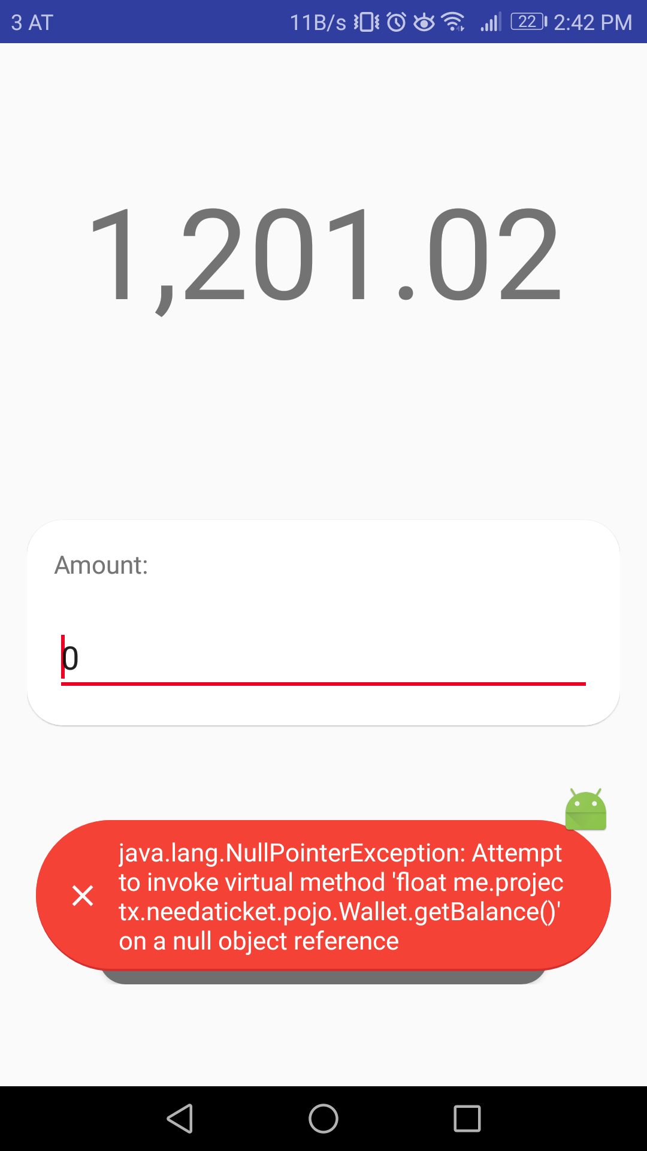
Android App
Navigation
Field Errors
Toast Errors

Slide 9

Android App
Continuous Inspection
Code Quality:
Bugs
Vulnerabilities
Technical Debt
Unclean Code
Application Security:
CWE
OWASP
SANS

Slide 10
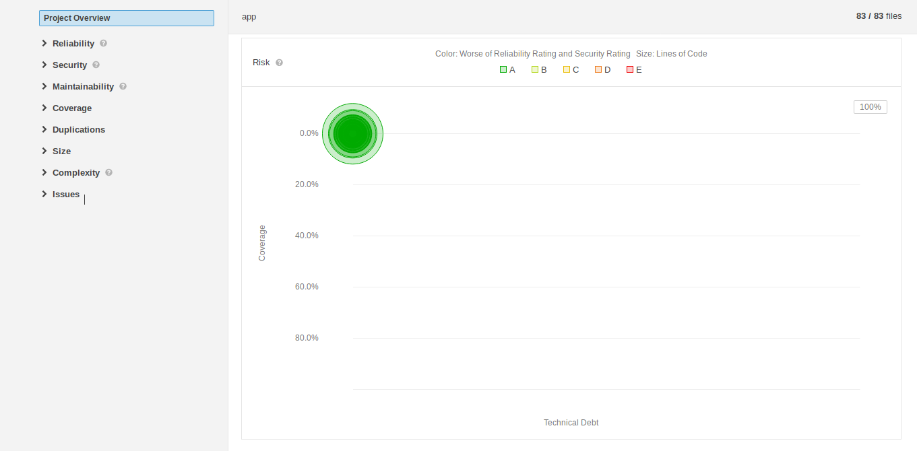
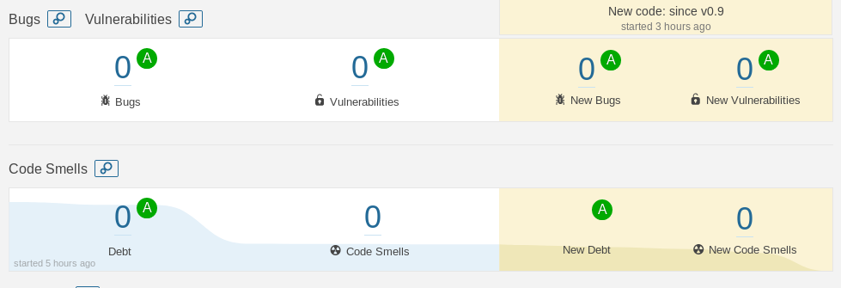
Android App
Clean Code

Slide 11
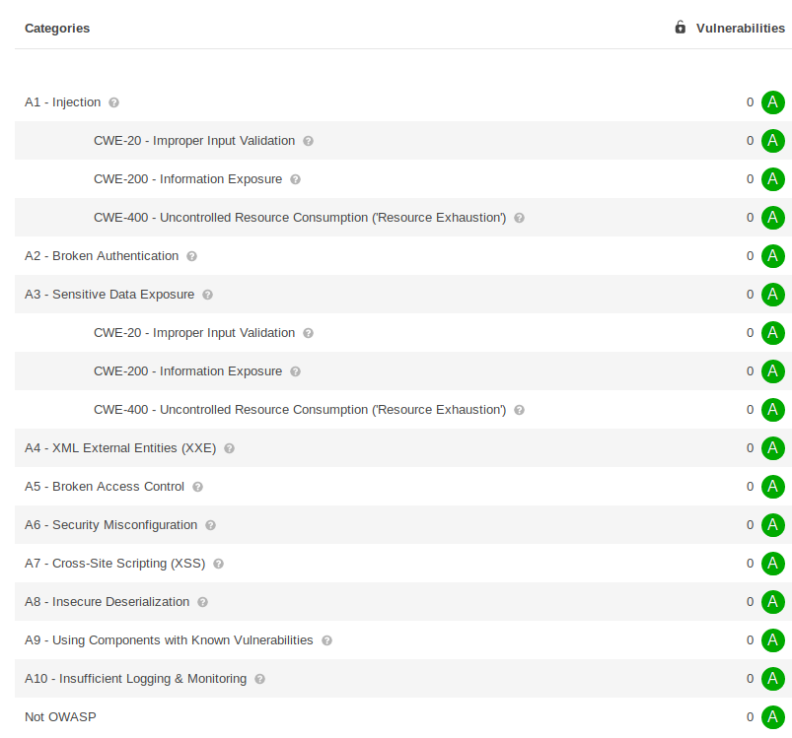
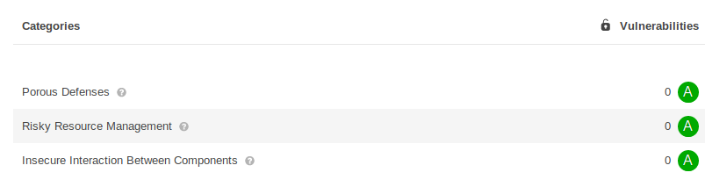
Android App
CWE (Common Weakness Enumeration)
OWASP Top 10
SANS Top 25
OWASP: Most Critical Web Application Security Risks
SANS: Most Dangerous Software Errors

Slide 12
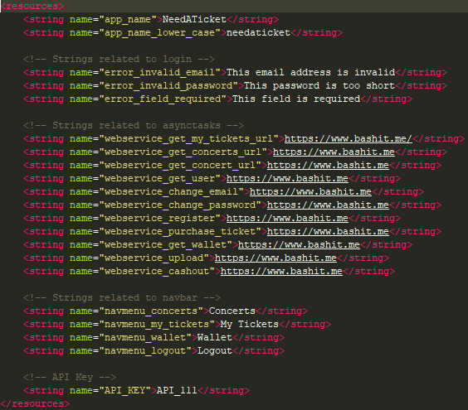
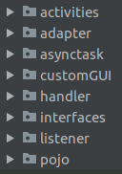
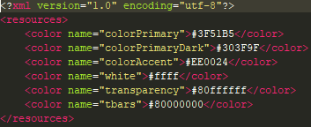
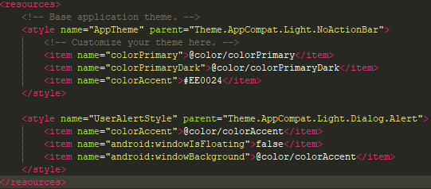
Android App
Structure

Slide 13
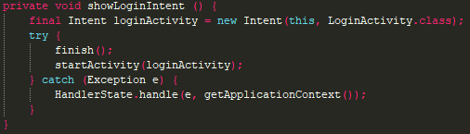
Android App
Activity Stacking

Slide 14
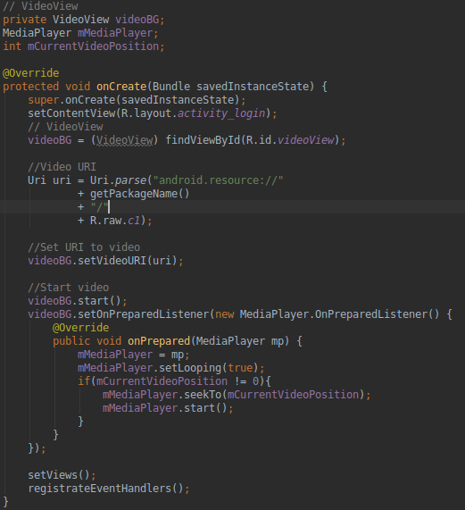
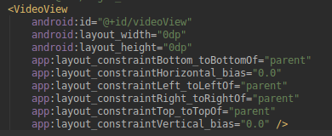
Android App
Video Background

Slide 15
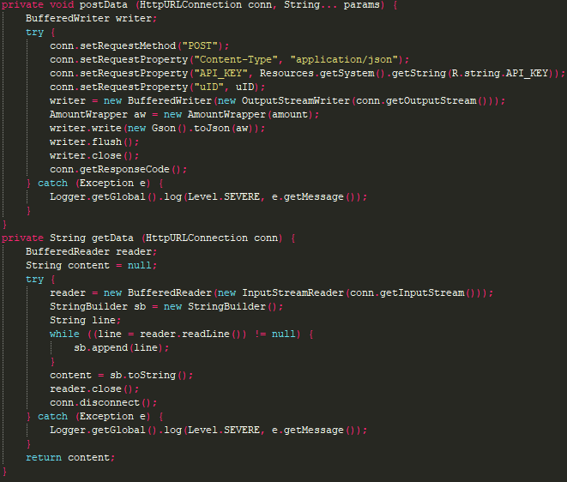
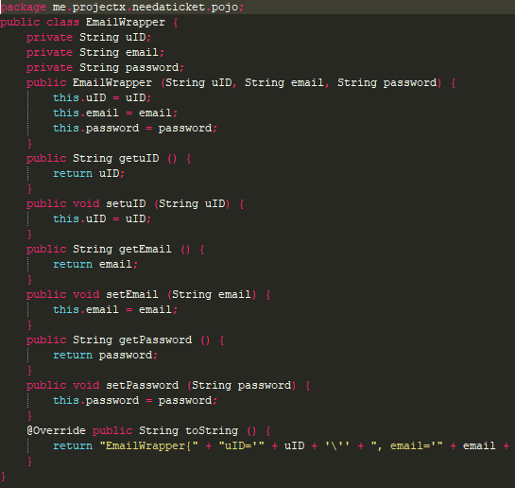
Android App
Webservice Calls

Slide 16
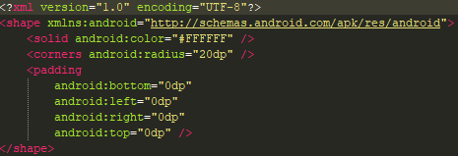
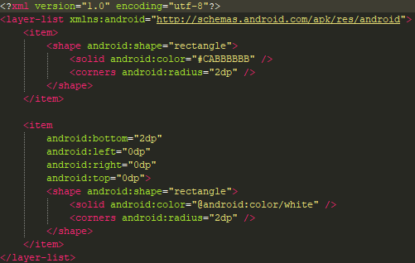
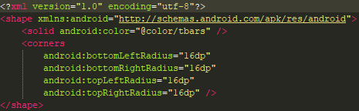
Android App
Drawables

Slide 17
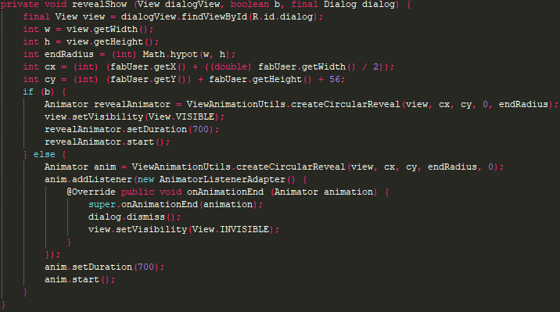
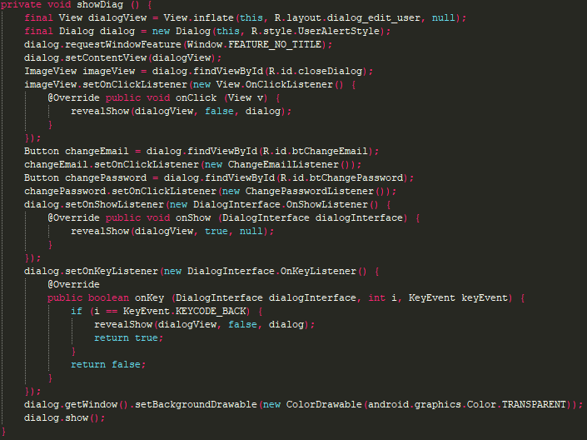
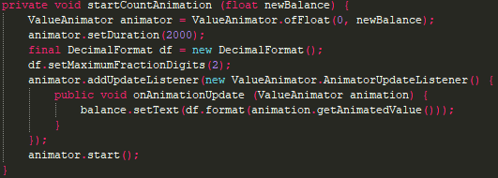
Android App
Animations

Slide 18
NEEDATICKET
CONCERT TICKETS
Vielen Dank für Ihre Aufmerksamkeit!
Notes:
To change the image on this slide, select the picture and delete it. Then click the Pictures icon in the placeholder to insert your own image.

