Slide 1

NEEDATICKET
CONCERT TICKETS
Notes:
To change the image on this slide, select the picture and delete it. Then click the Pictures icon in the placeholder to insert your own image.

Slide 2
Arbeitsteilung
Berisa – Android App? | Java App
Blaschke – Database | Webservices
Judth – Database | Webservices
Winkler – Android App | Project Management

Slide 3
Requirements
Android App
Login
Register
Logout
Show all concerts
Show tickets to concert
Buy tickets
Show bought tickets
Show user data
Change user data
------------------------------------
Show wallet
Add/Cashout balance
Webservice connection
Java App
Login
Register
Logout
Show dashboard
Show all tickets
Create tickets
Show transactions
Show user data
Change user data
Show wallet
Add/Cashout balance
Webservice connection
Webservice
Routes as specified
Bearer authentication
Sign in / register auth.
Documentation
Database
Basic tables
Spatial-Index
Data-Warehouse

Slide 4
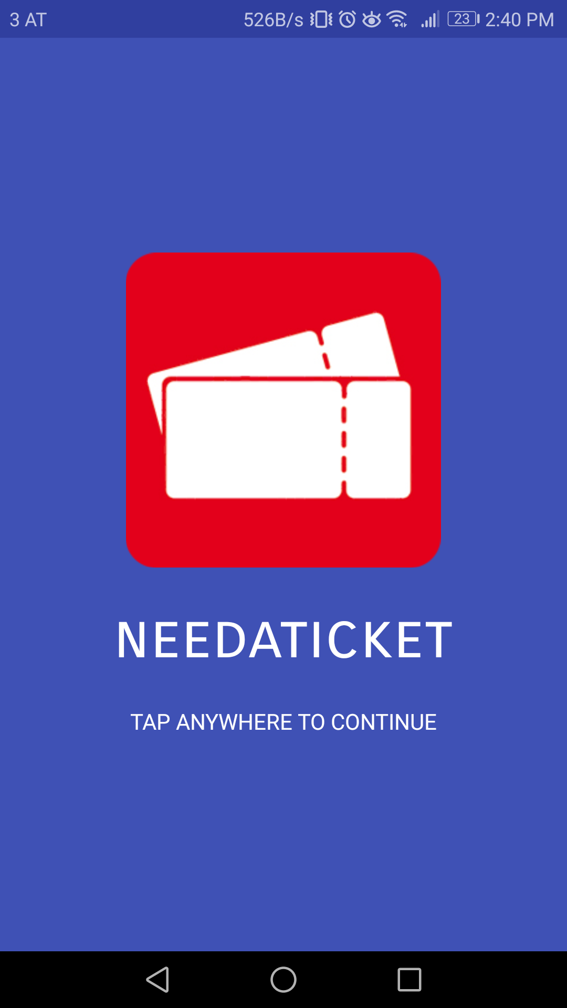
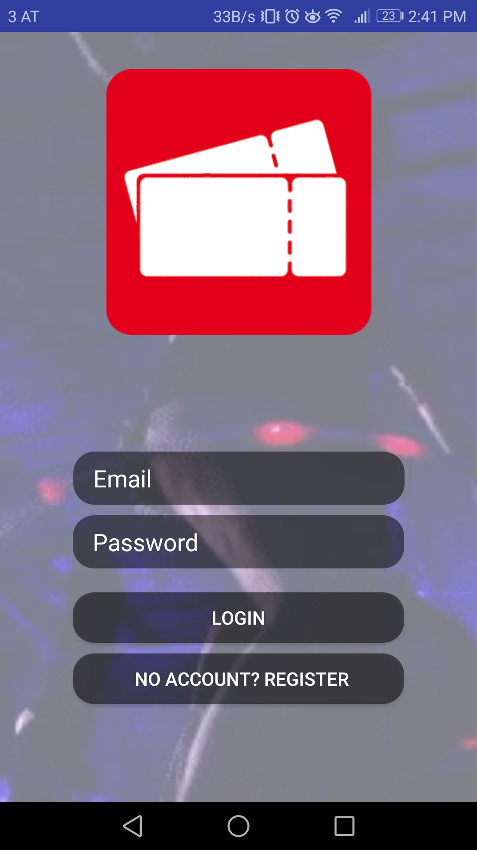
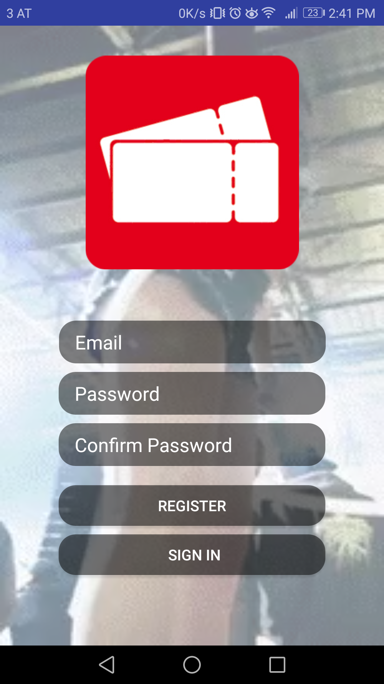
Android App
Welcome Screen
Login
Register

Slide 5
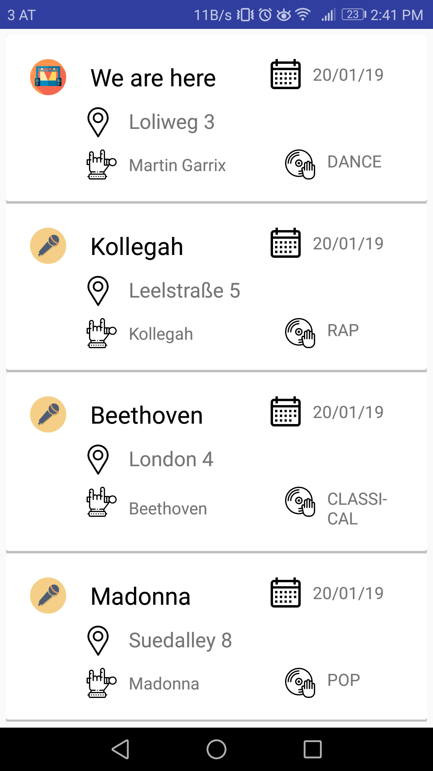
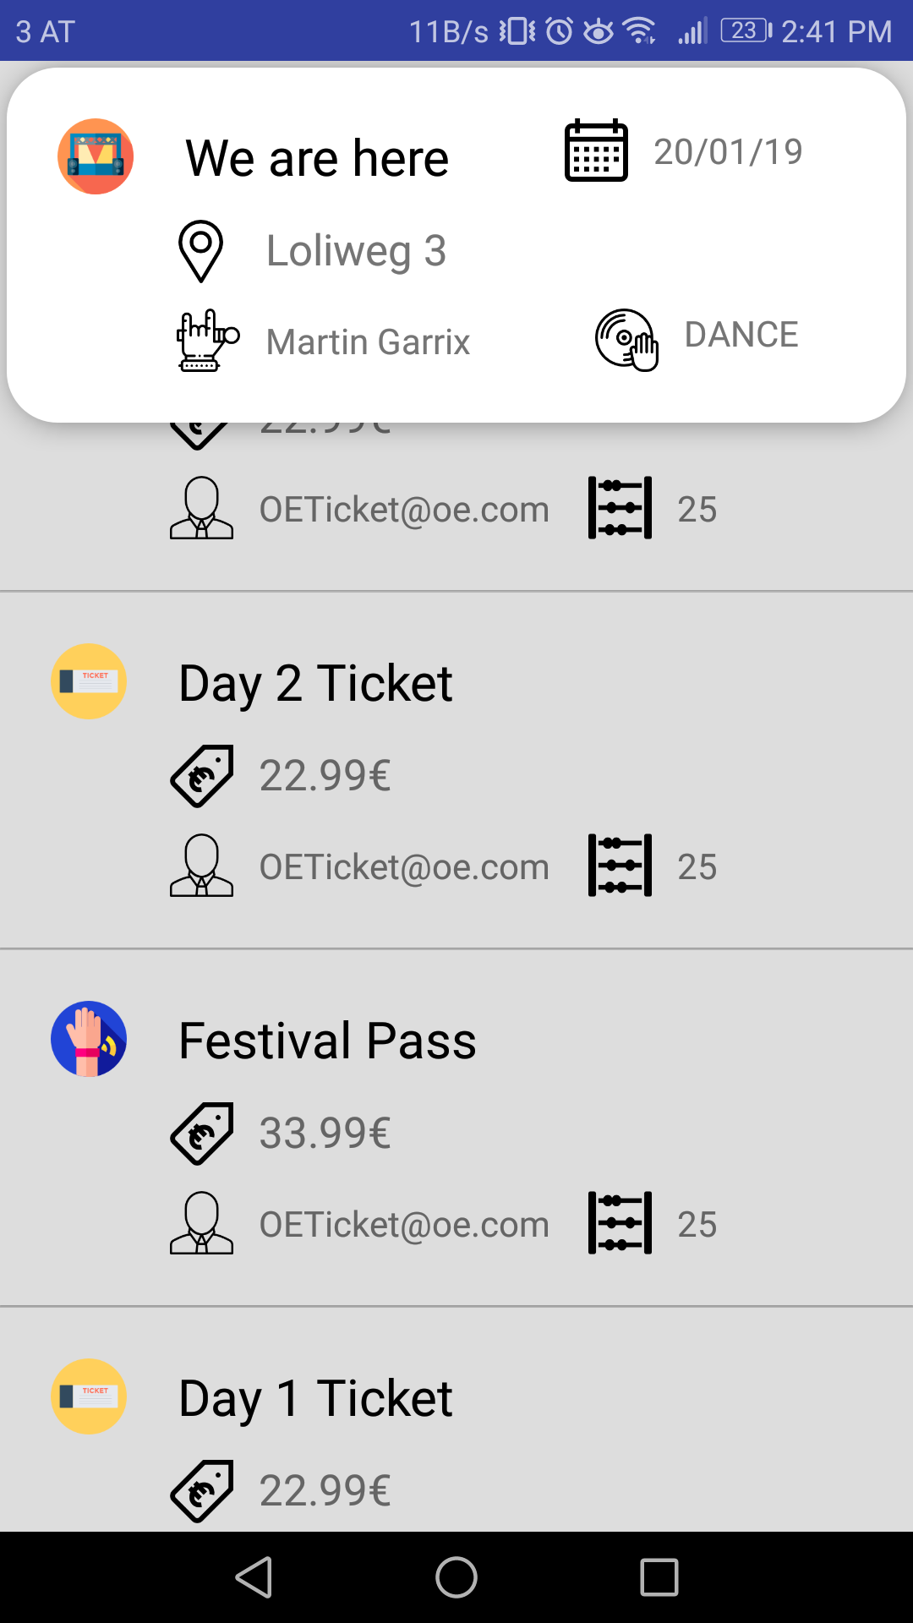
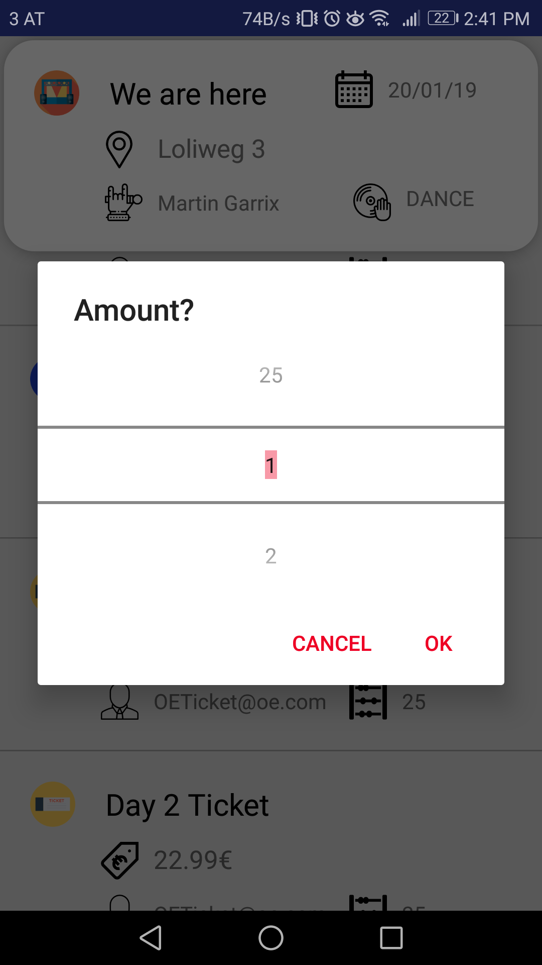
Android App
Concert list
Ticket list
Amount Picker

Slide 6
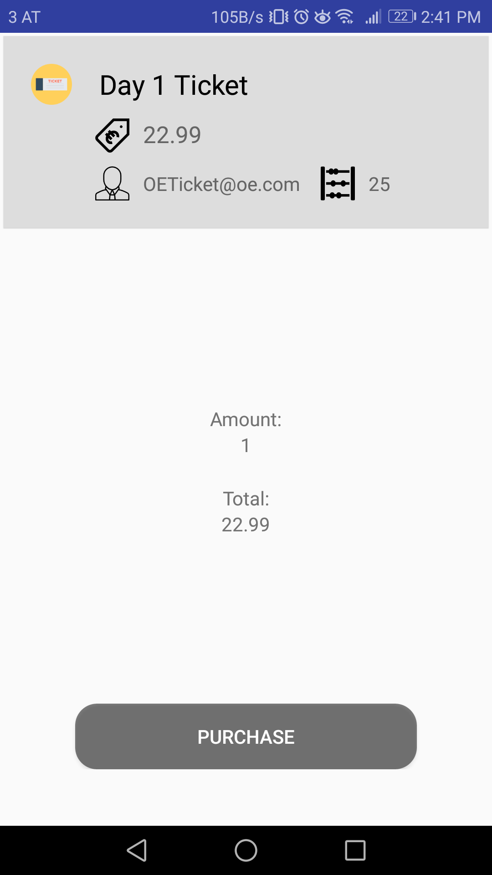
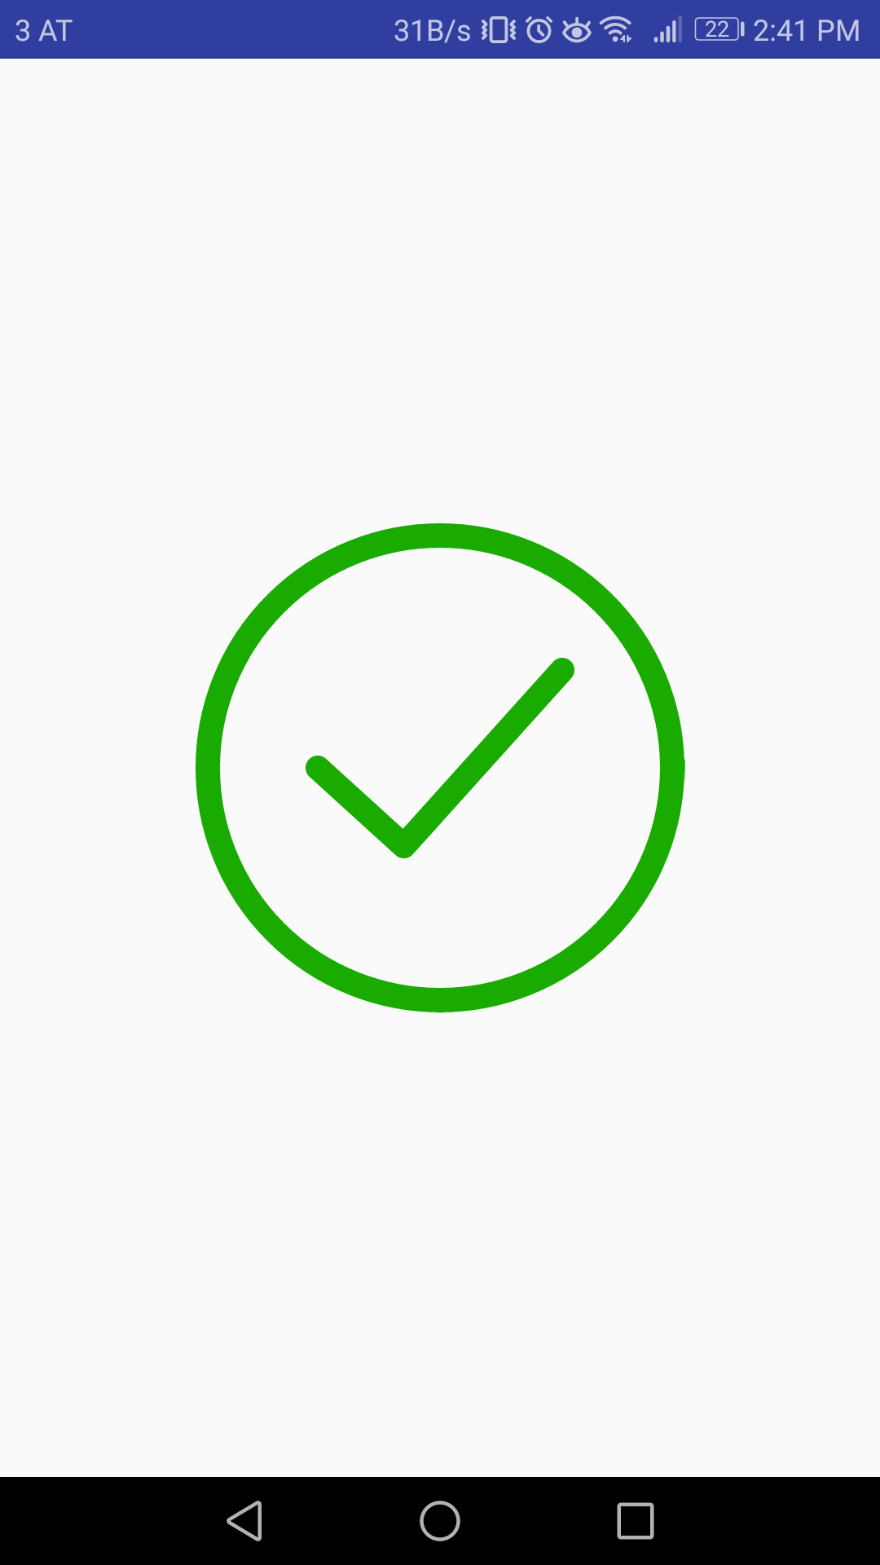
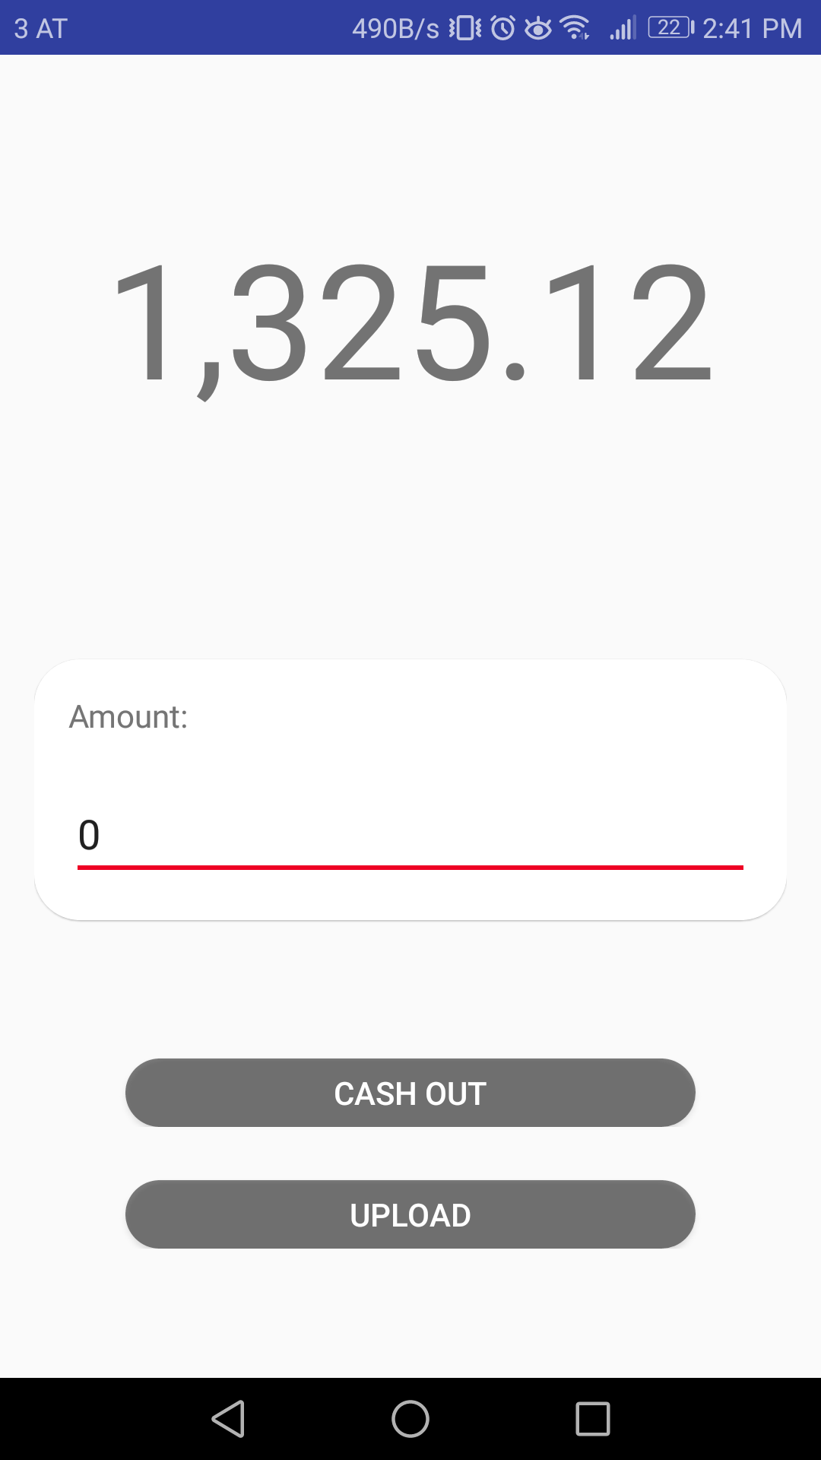
Android App
Buy ticket(s)
Checkmark (Anim)
Wallet (Anim)

Slide 7
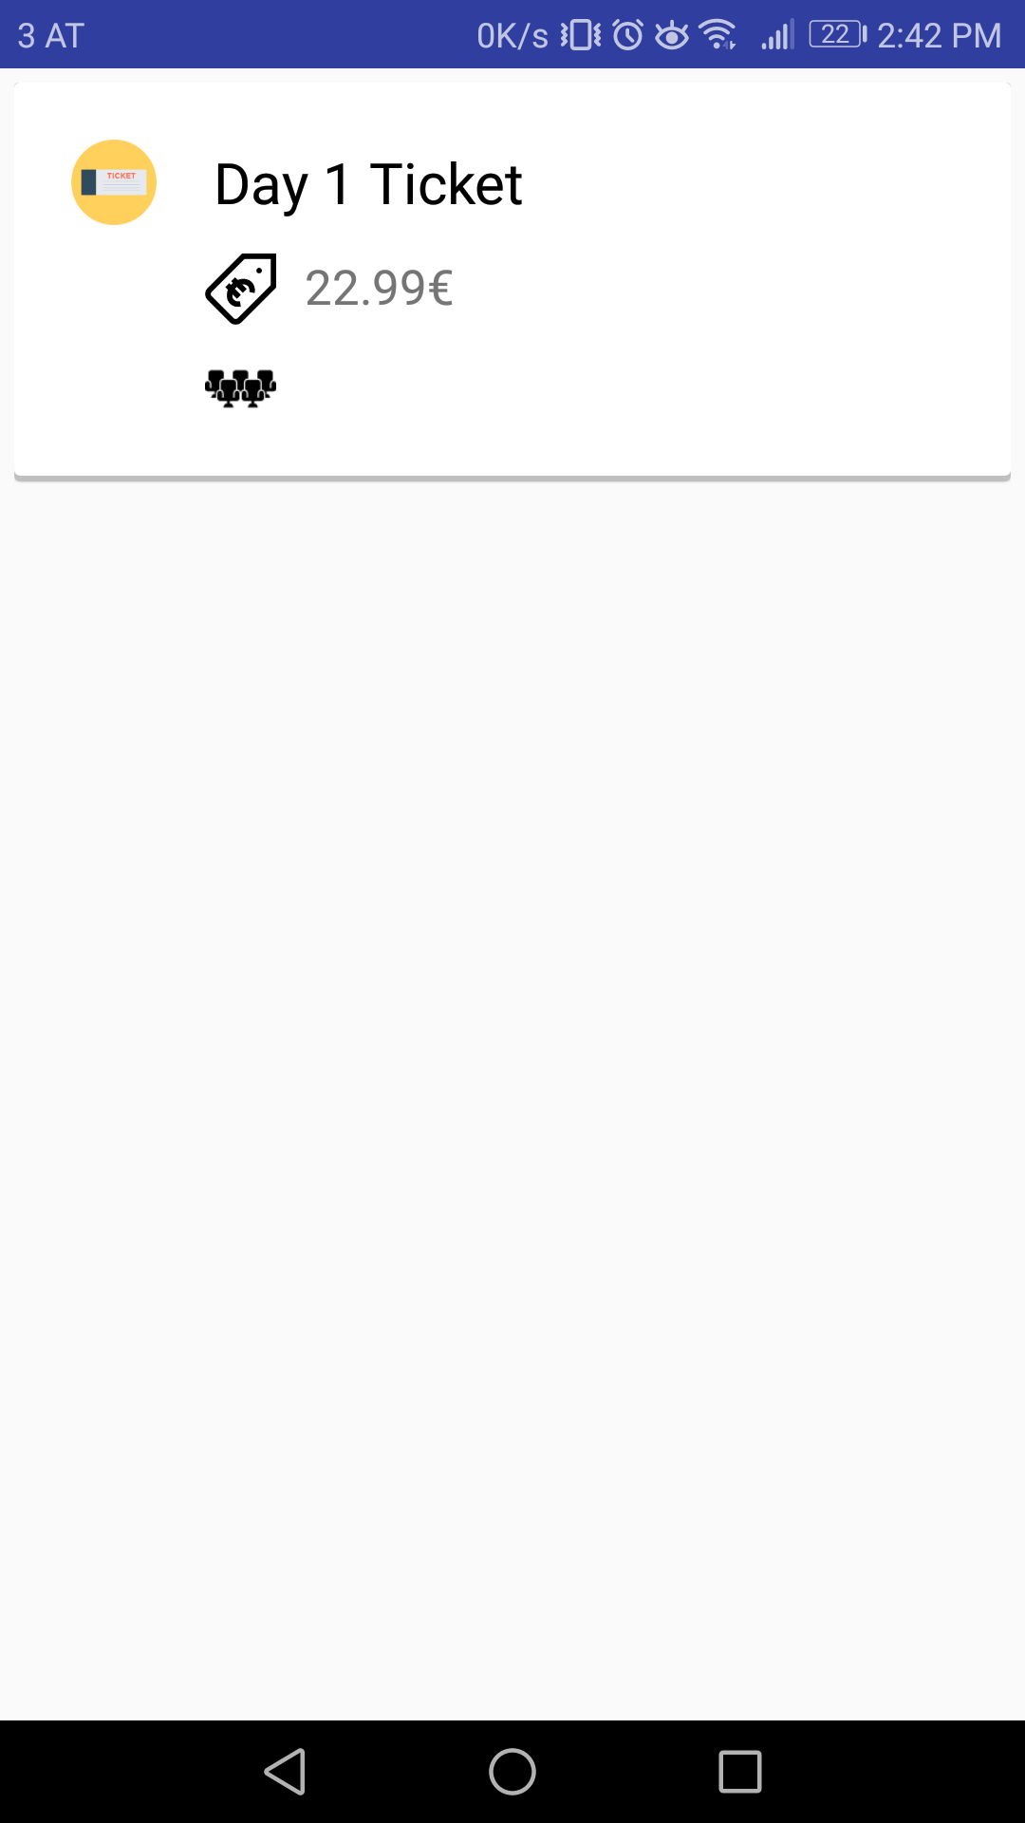
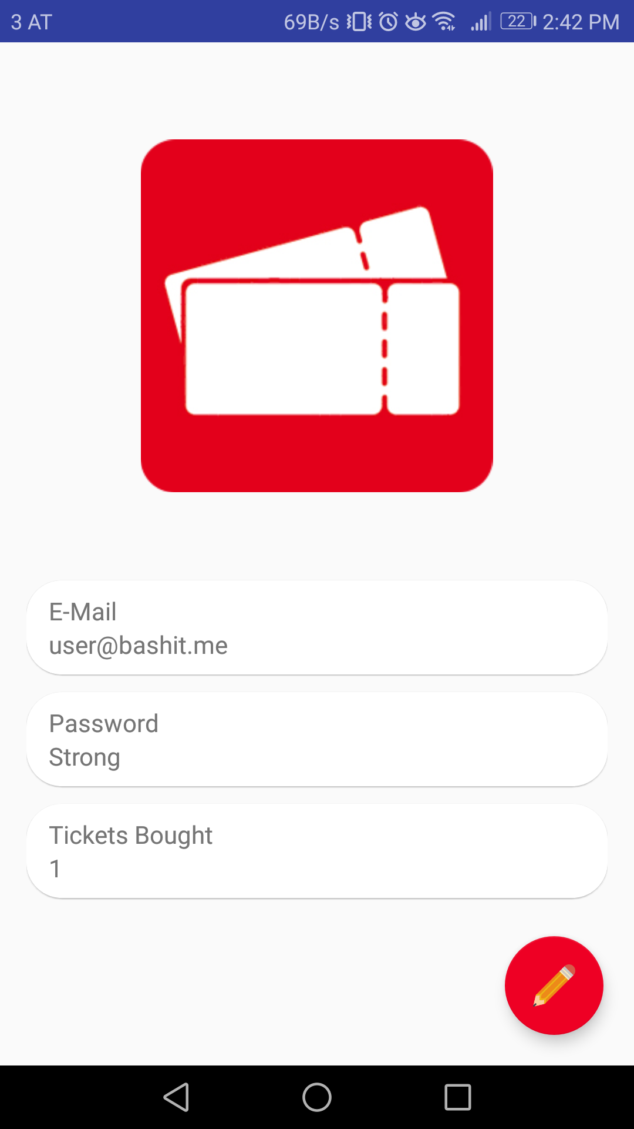
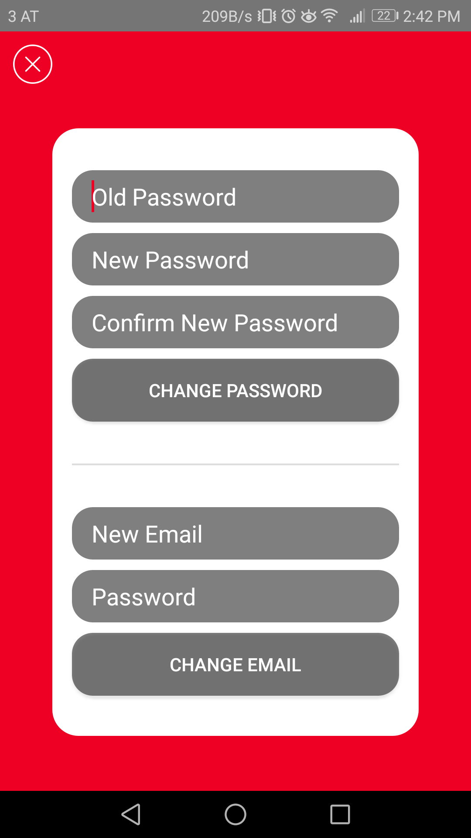
Android App
Bought tickets
User data
Change UD (Anim)

Slide 8
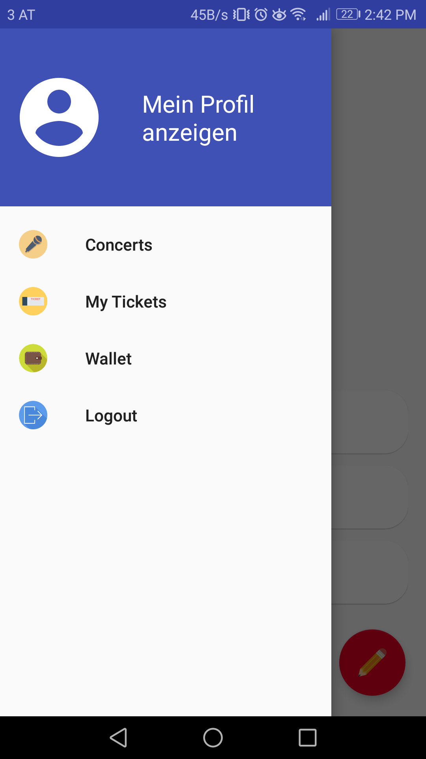
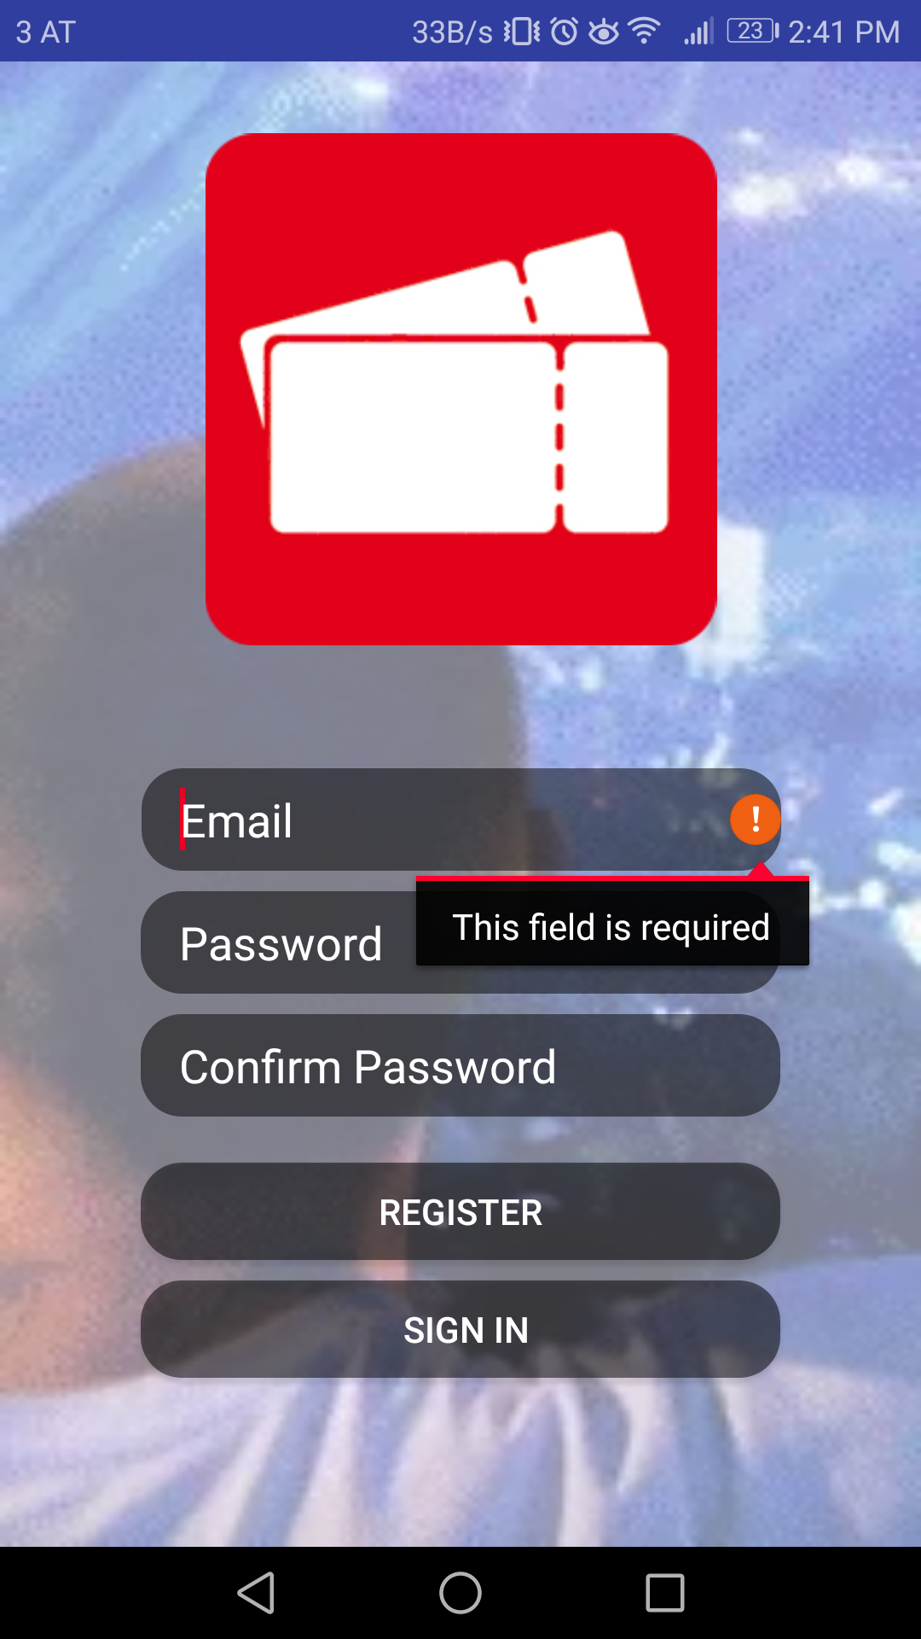
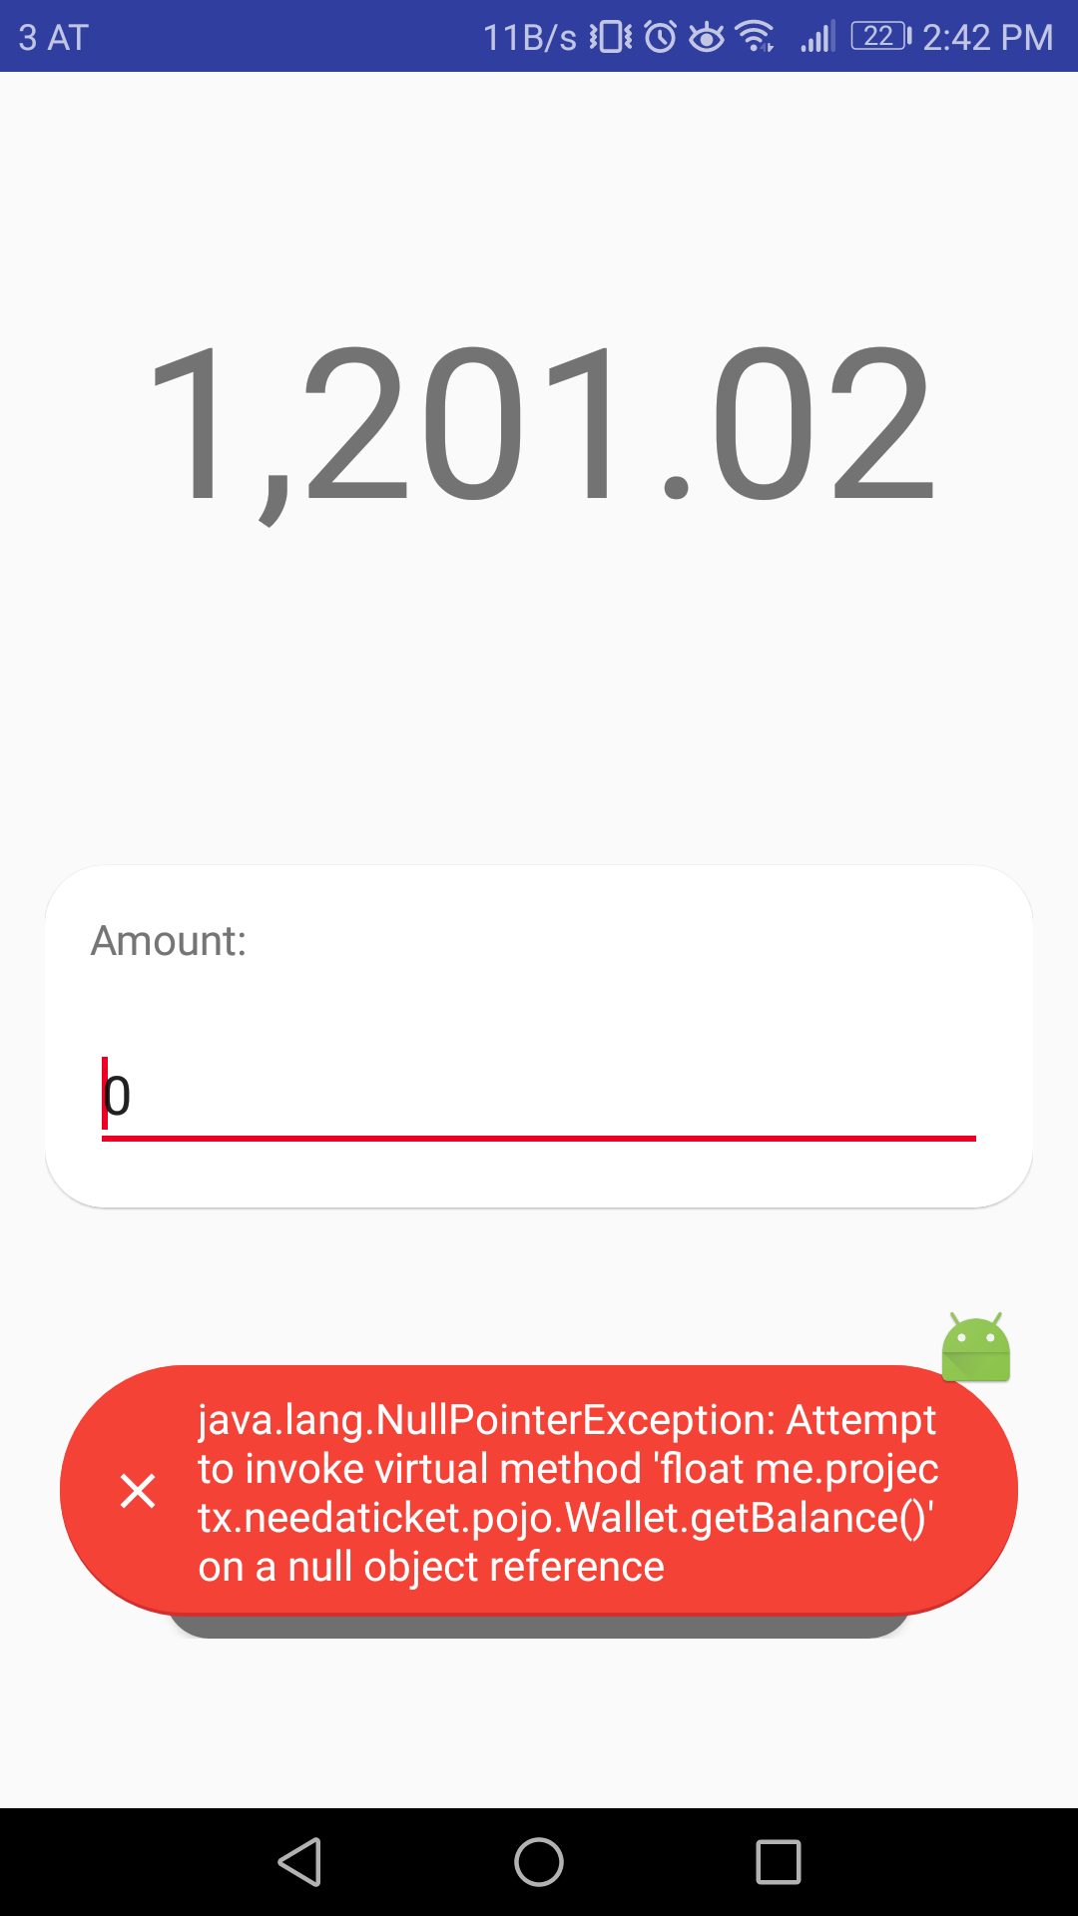
Android App
Navigation
Field Errors
Toast Errors

Slide 9
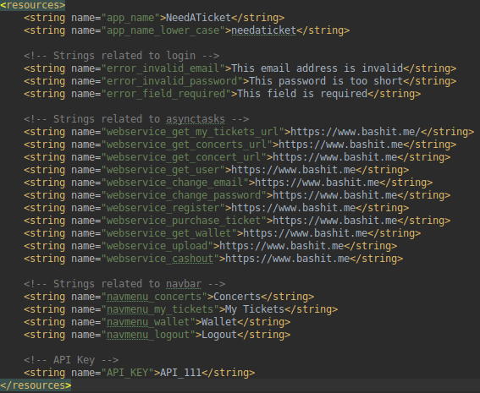
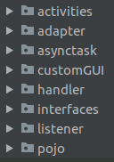
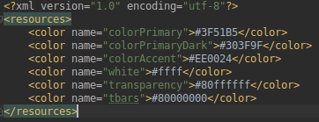
Android App
Structure

Slide 10
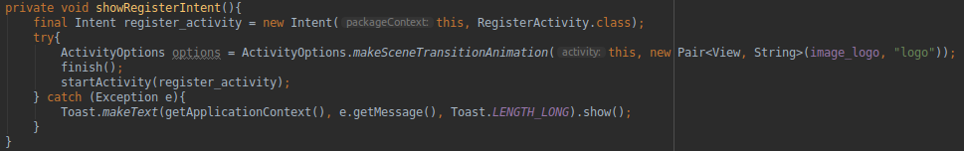
Android App
Activity Stacking

Slide 11
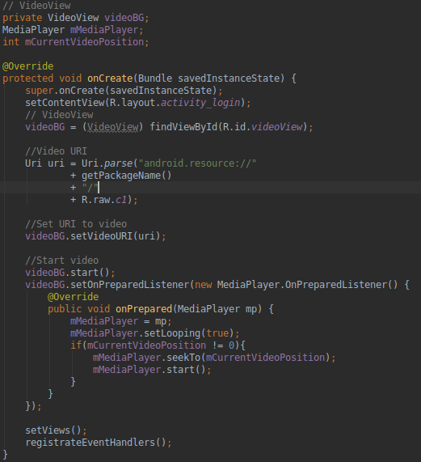
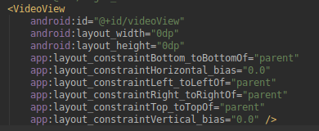
Android App
Video Background

Slide 12
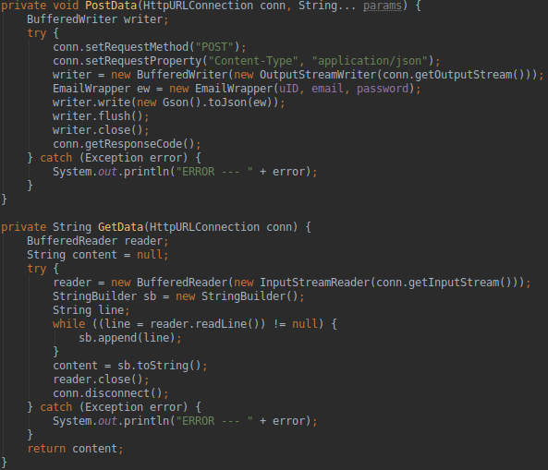
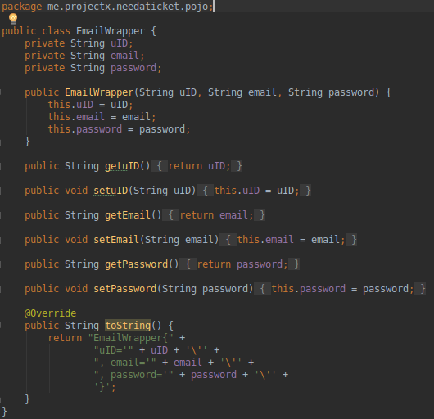
Android App
Webservice Calls

Slide 13

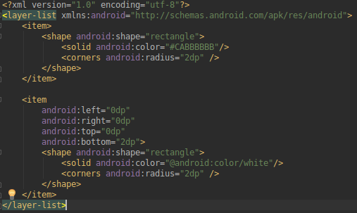
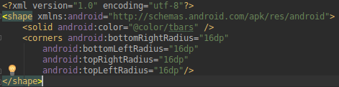
Android App
Drawables

Slide 14
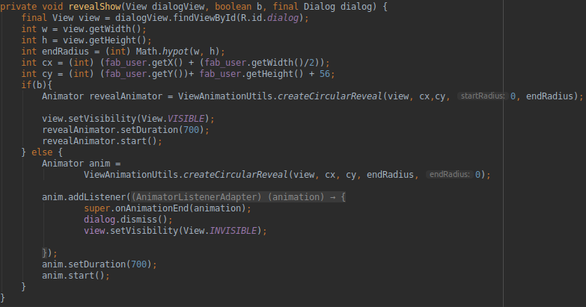
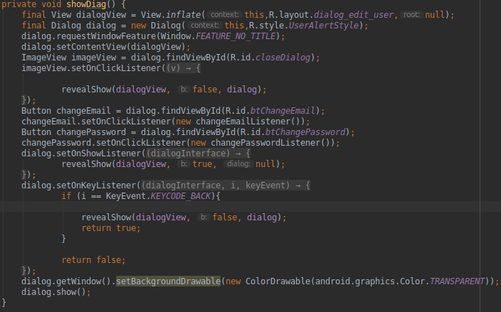
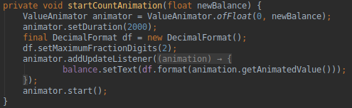
Android App
Animations

Slide 15
NEEDATICKET
CONCERT TICKETS
Vielen Dank für Ihre Aufmerksamkeit!
Notes:
To change the image on this slide, select the picture and delete it. Then click the Pictures icon in the placeholder to insert your own image.

