Slide 1
Traffic Accident Severity Classification
IBM Data Science Capstone Project
By Christopher Cammilleri

Slide 2
Problem
6 million car crashes occur annually in the United States
Results in 37,000 deaths per year, leading cause of death for healthy citizens
Costs over $200 billion each year
Over 90% due to driver carelessness

Slide 3
Introduction
Machine learning can be used to predict the severity of an accident before it occurs
Results can be used to alert drivers of dangerous situations
City officials can make decisions empowered by data to make the roads in their communities safer

Slide 4
Data Description
US Accidents (3.5 million records) by Sobhan Moosavi (Kaggle.com)
Dataset sourced from APIs which collect information from various government agencies across the countries
Over 3 million reports, and 49 features to describe each accident
Location: Street, City, County, Zipcode, State
Weather: Temperature(F), Wind_Chill(F), Humidity(%), Wind_Speed(mph), Precipitation(in)
Road Type: Crossing, Junction, No_Exit, Railway, Roundabout

Slide 5
Exploratory Data Analysis

Slide 6

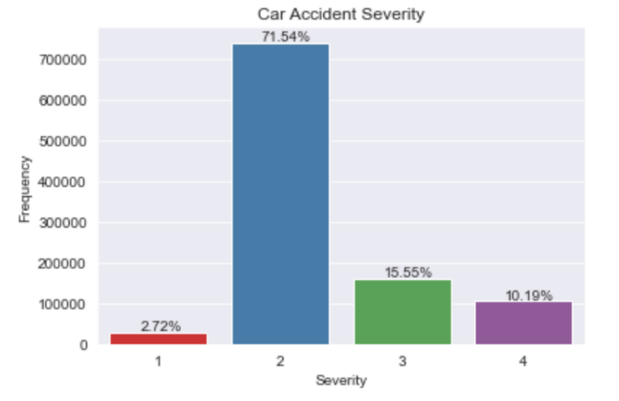
Severity
Heavily imbalanced
Vast majority fall under severity 2 category
Very few fall under severity 1

Slide 7
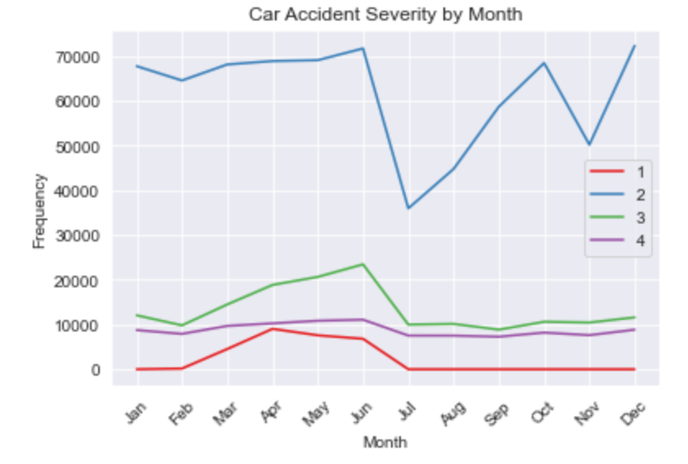
Month
Early summer seems to be safest time to drive
However, most dangerous near end of spring

Slide 8
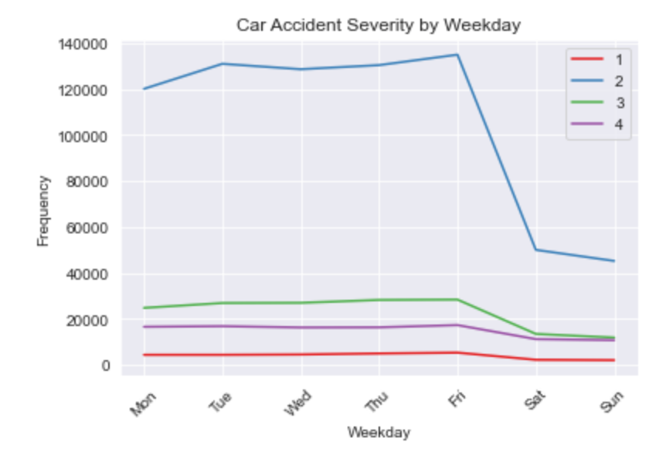
Weekday
Most accidents occurring during weekdays
Steadily increase until Friday
Massive drop off over the weekend

Slide 9
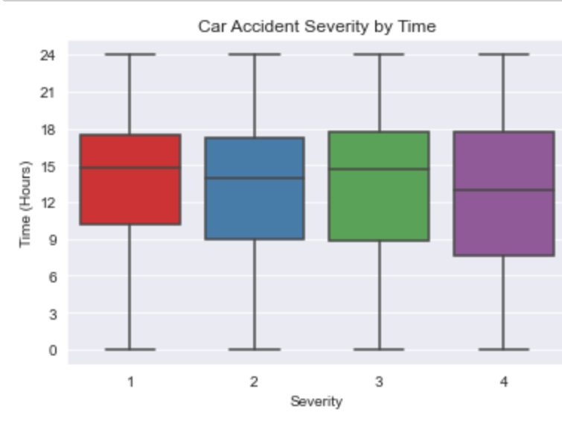
Hour of Day
Median accident occurs around 3 PM
Bulk of accidents clustered during work hours

Slide 10
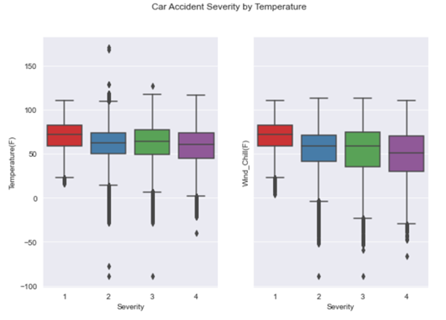
Temperature
Accident severity increases as temperature decreases

Slide 11
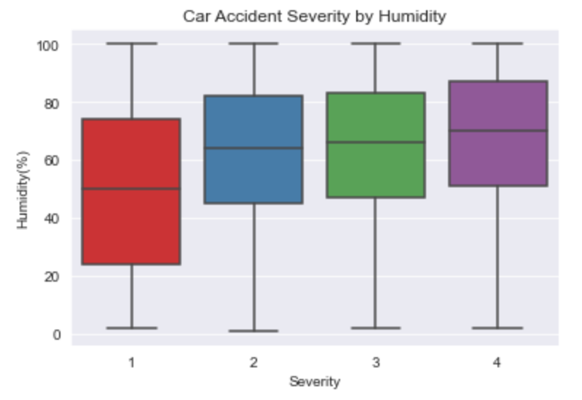
Humidity
Accident severity increases as humidity increases

Slide 12
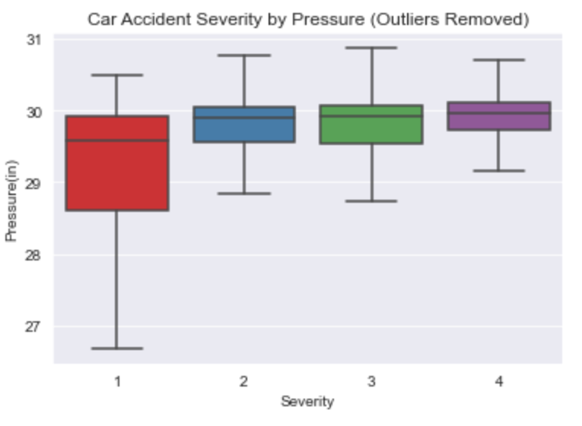
Pressure
Accident severity increases as pressure increases

Slide 13
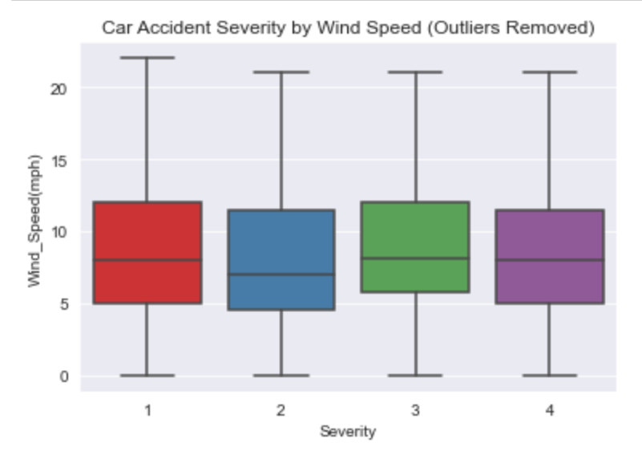
Wind Speed
No clear correlation

Slide 14
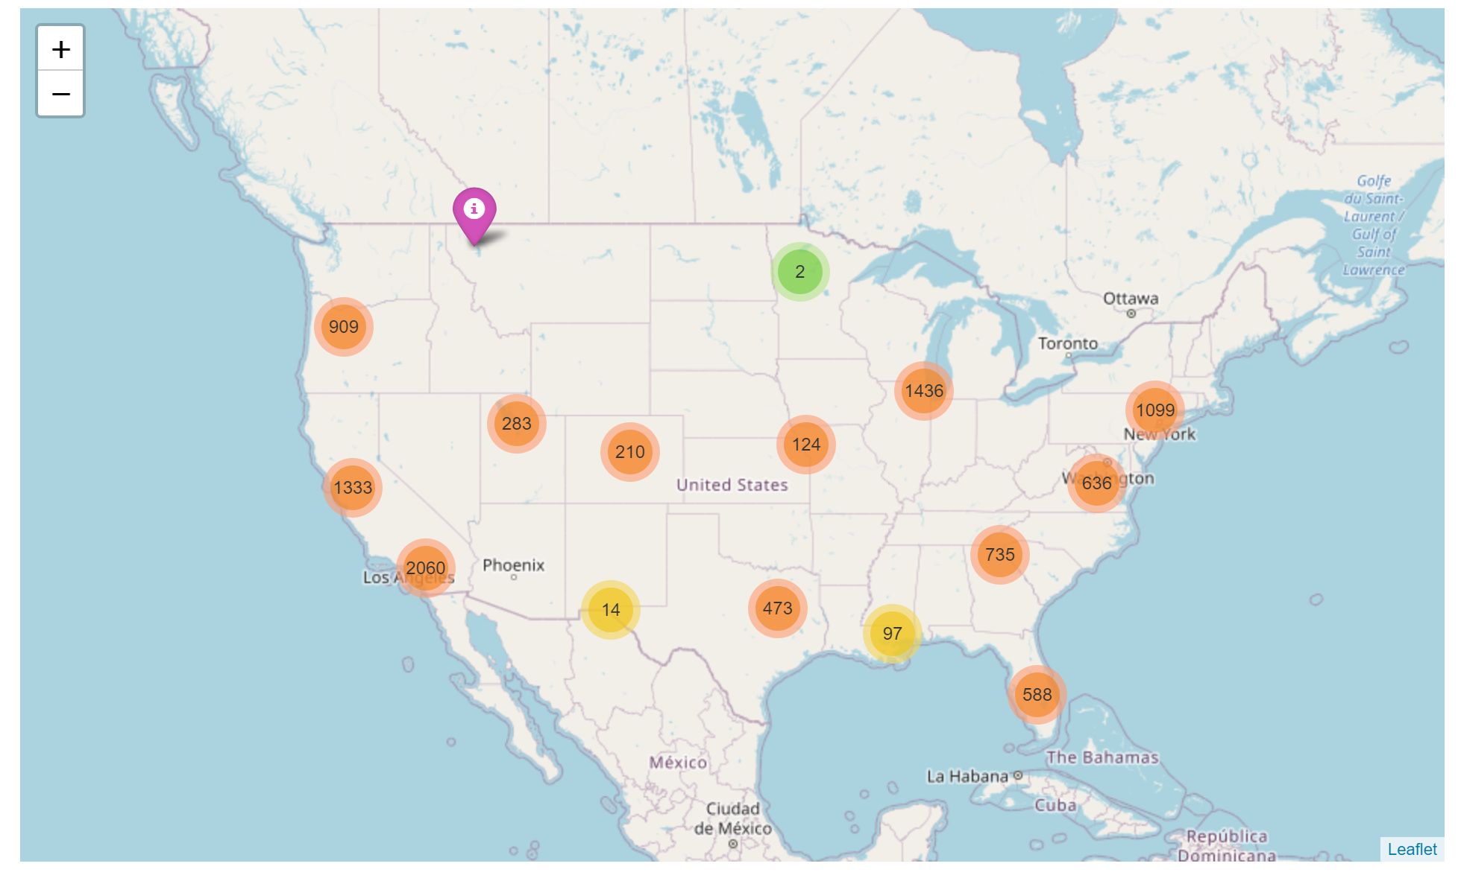
Accident Distribution
Accidents clustered towards population centers
Coasts, west coast in particular

Slide 15
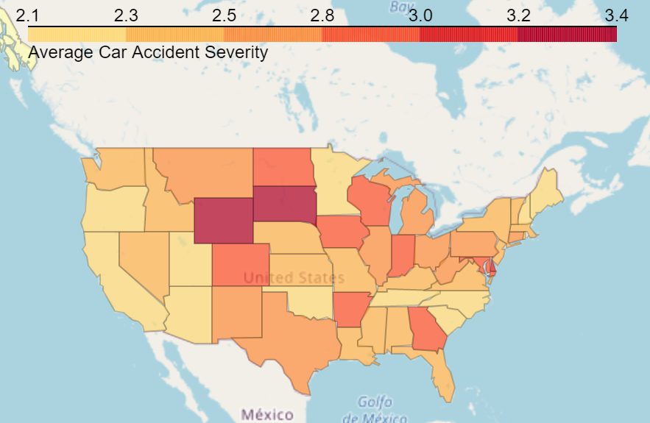
Average Severity By State
No clear geographical region with higher average severity
California has high number of accidents, but low average severity

Slide 16
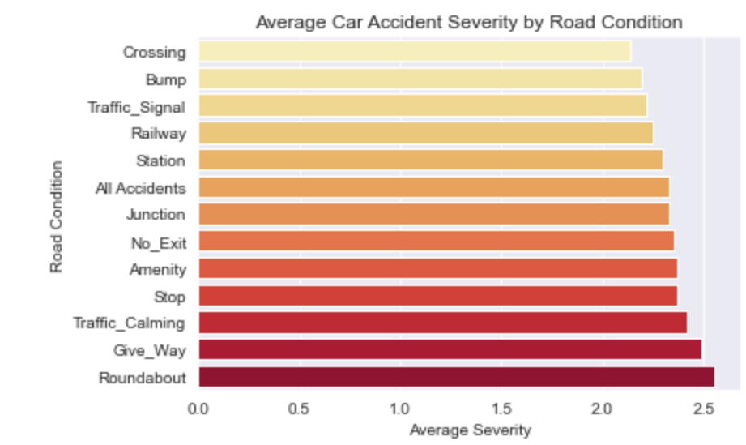
Road Condition
Roundabout and give ways have highest average severity
Crossing and bumbs have lowest average severities

Slide 17
Feature Engineering
Street Name
Highway type (US-xx = United States Highway, I-xx = Interstate Highway)
Direction (North, south, West East)
Common abbreviations (Rd, St, Dr)
Time
Time difference between beginning of accident and observance of weather condition
Accident took place on US holiday?
Wind
Headwind
Tailwind
Sidewind

Slide 18
Pre-Processing
Take only random sample of 10,000 rows for machine learning
Drop Zipcode and Street columns to reduce dimensionality
Filed in missing values
Standardize continuous columns
Dummy Categorical colums
Create a train and test set

Slide 19
Machine Learning
Logistic Regression
Accuracy: .59
Macro: .46
K-Neighbors Classifier
Accuracy: .63
Macro: .4
Decision Tree Classifier
Accuracy: .73
Macro: .31

Slide 20
Results
Logistic Regression clear winner
Tradeoff between average macro score and accuracy
Results can hopefully be used to alert drivers of dangerous situations and help local officials make informed decisions

Slide 21
acknowledgments
Moosavi, Sobhan, Mohammad Hossein Samavatian, Srinivasan Parthasarathy, and Rajiv Ramnath. “A Countrywide Traffic Accident Dataset.”, 2019.
Moosavi, Sobhan, Mohammad Hossein Samavatian, Srinivasan Parthasarathy, Radu Teodorescu, and Rajiv Ramnath. "Accident Risk Prediction based on Heterogeneous Sparse Data: New Dataset and Insights." In proceedings of the 27th ACM SIGSPATIAL International Conference on Advances in Geographic Information Systems, ACM, 2019.
https://www.kaggle.com/sobhanmoosavi/us-accidents
-https://www.thewanderingrv.com/car-accident-statistics/#:~:text=Annual%20United%20States%20Car%20Crash%20Statistics,-This%20section%20of&text=On%20average%2C%20there%20are%206,22%2C471%20caused%20only%20property%20damage.

