Slide 1

Student Attendance and performance RELATIONSHIP study
Christopher Acornley

Slide 2
STUDY AIM
Investigate if there is a relationship between student attendance to live lectures and their grade.
This study is based on the basis that recorded versions of the lectures are available for students to view.
Students can view the same material if they cannot or decide not to attend a lecture session.
Additional aim of the investigation is to determine if providing pre-recorded lectures is a suitable substitute to live lectures.
This could mean teaching staff can focus on preparing the material ahead of term, freeing up their in-term teaching to respond to student queries, host more practical sessions, or live workshops for students.

Slide 3
External Research
There are numerous studies that explore the relationship between attendance and grades / academic achievement.
A study exploring a large sample of students, found a strong correlation between attendance and performance, including a substantial correlation between peer attendance and their own. (Kassarnig, et. al., 2017)
Study used Bluetooth and location data to determine the contacts a student had, as well as their location during class time to determine their attendance and their general social contacts within the class.
Use of Spearman’s correlation coefficient, and Theil-San Regression over linear regression.
Similarly, an analysis of class attendance and class grades in college classes showed a similar strong correlation between attendance and grade score (Credé, Roch, Kieszczynka, 2010)
Study mentions that a correlation coefficient above 0.50 indicates a large effect size (Cohen, 1988)

Slide 4
External Research
This trend of attendance having a positive affect on performance is referenced in older journal articles, with similar positive correlations being identified twenty (Moore, 2003) and thirty years ago (Gunn, 1993).
In terms of including new blended learning technologies with traditional pedagogic practices, there are some sources that evaluate the introduction of these and recording technologies in teaching:
A study in Nurse Educator explored the introduction distance learning technologies to their course and their effect on grades. The consensus was the mean final grade improved over the implementation period. (Carpenter, Theeke, Smothers, 2013)
However, there are also suggestions that the use of recording systems and their availability, do not correlate with improved performance or grade. (Bacro, Gebregziabher, Fitzharris, 2010)

Slide 5
Hypothesis
Based on the existing research, it is expected there will be a close relationship between a student's attendance to class and their corresponding grade.
Due to the adoption of Blended learning approaches and the necessity of Remote teaching during lockdown, it is expected that students who chose to use the recorded materials will perform the same as the students who attended live lectures.
“Recorded Lectures provide a suitable alternative for learning should students be unable to or chose not to attend live lectures.”

Slide 6
Limitations
The study is only focusses on attendance and achievement of a single Module at Abertay University in Scotland. Methods of content delivery may not be suitable for other institutions due to technology differences, delivery method and class structure.
Module was delivered with in three classes each week. An online one-hour live lecture, then a two-hour on-campus practical session (two practical sessions were run to accommodate cohort size).
Module is focused on material that is entirely done on a computer. As such, remote teaching is potentially easier than other subjects which could limit the impact of the results.
Study is limited to two years of attendance data.

Slide 7
Data Gathering methodology
The following data was gathered as stating in the Research Proposal:
Attendance of each class Recorded on Attendance Software (JISC)
Usage of class work and Assignments on MyLearningSpace (VLE)
Grades of Students for Marked Assignment
Views of Recorded Material
Data was gathered for sessions 2020-2021, 2021-2022, and 2022-2023.
Data for 2020-2021 only contained five registers, including one for September 2021 (next academic year). As such this data was ignored.
Data for 2021-2022 ran with lectures being recorded and sessions were discussions rather than delivery of content.
Ethics approval for this project was given based on the anonymizing of student identifications. To do this, the raw data gathered was collated into a single Spreadsheet for each year, and Student ID’s were hashed during a SHA256 Hashing algorithm (Handschuh, 2005)
Converts student number into a 256-bit hexadecimal value. Hashing processes was chosen due to the high security of the process (cannot convert Hash back into original value) and very low chance of collisions.

Slide 8
Data Gathering methodology
Attendance is gathered for all students for all classes
Students split into single lecture for all, then either group A or group B for practical
Students assigned to class based on Timetable, not class list available through attendance system and MyLearningSpace
For the purposes of this study, only students who were noted as having attended were counted as attending.
There is a possibility that some students would have attended class and not registered using the MyAbertay app, as well as students who had notified reasoning for not attending. There is also a possibility that students who had a notified reason for not attending still managed to attend. To prevent speculation, only students who are recorded as attending will be used in this study.
Attendance data in the following format was considered as not attending a class:
Not Attended
Notified Absence
Not Required

Slide 9

Analysis Methodology
Comparison
Correlation & Covariance
Network Predictions

Slide 10
Comparison
Grade Changes
Attendance
Overall
Expected
Lecture
practical

Slide 11
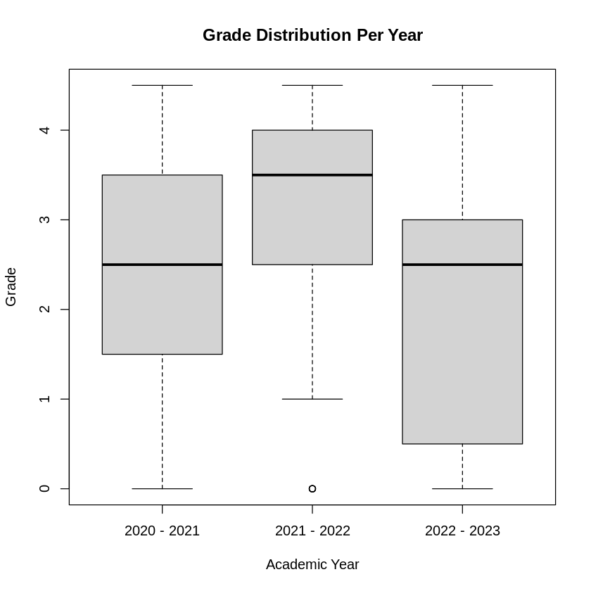
Grade Data
Grade Distribution over the three years.
Observations:
2021-2022 year, no students recorded as MF or F, only a relatively small number of NS grades
Median for 2020-2021 and 2022-2023 are the same, however general performance appears to have dropped.

Slide 12
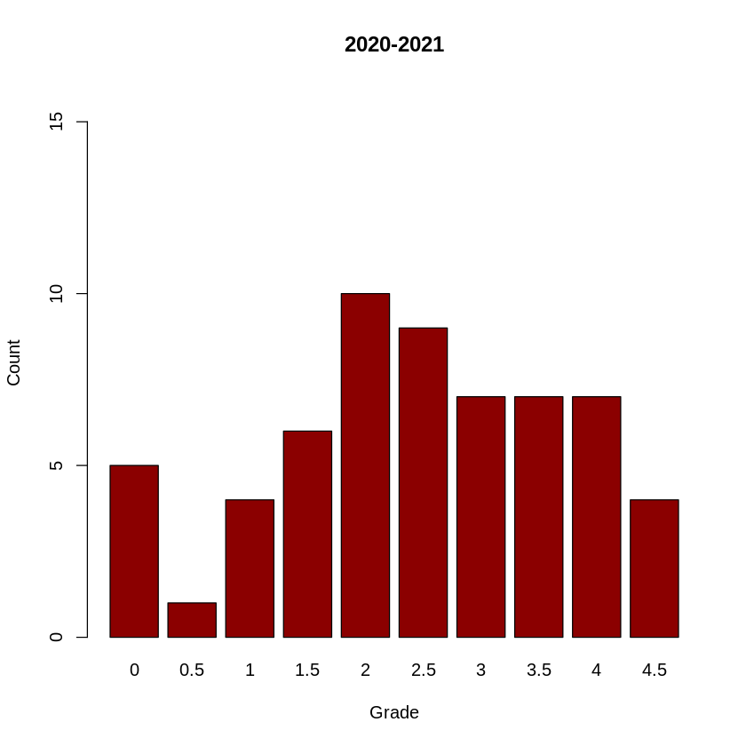
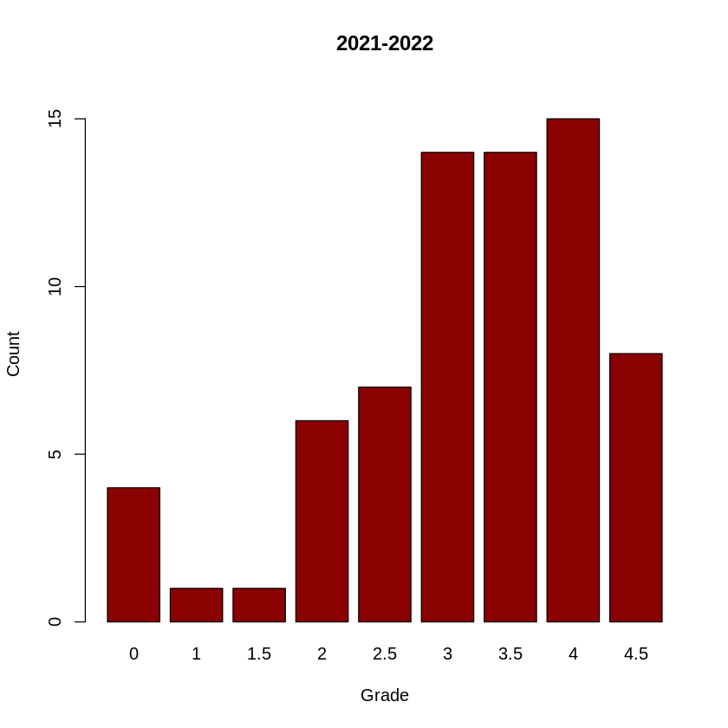
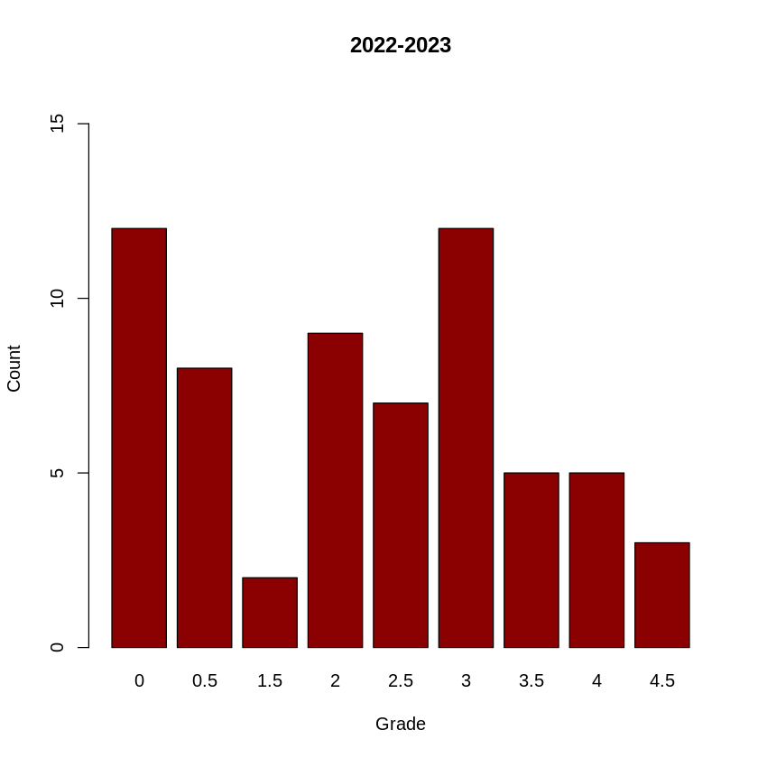
Grade Data

Slide 13
Grade Data
Relatively even distribution of grades when compared with the other years.
Mean: 2.458
Median: 2.5
Total students: 60
A+ | A | B+ | B | C+ | C | D+ | D | MF | F | NS
4 | 7 | 7 | 7 | 9 | 10 | 6 | 4 | 1 | 1 | 4

Slide 14
Grade Data
Heavy focus on upper grades.
No Marginal Fail or Fail grades, only 4 NS submissions.
Mean: 3.129
Median: 3.5
Total students: 70
A+ | A | B+ | B | C+ | C | D+ | D | MF | F | NS
8 | 15 | 14 | 14 | 7 | 6 | 1 | 1 | 0 | 0 | 4

Slide 15
Grade Data
Larger number of students did not submit (both count and percentage of cohort size).
Assignment and grading criteria are the same.
Marking Team different.
Mean: 2.056
Median: 2.5
Total students: 63
A+ | A | B+ | B | C+ | C | D+ | D | MF | F | NS
3 | 5 | 5 | 12 | 7 | 9 | 2 | 0 | 8 | 1 | 11

Slide 16
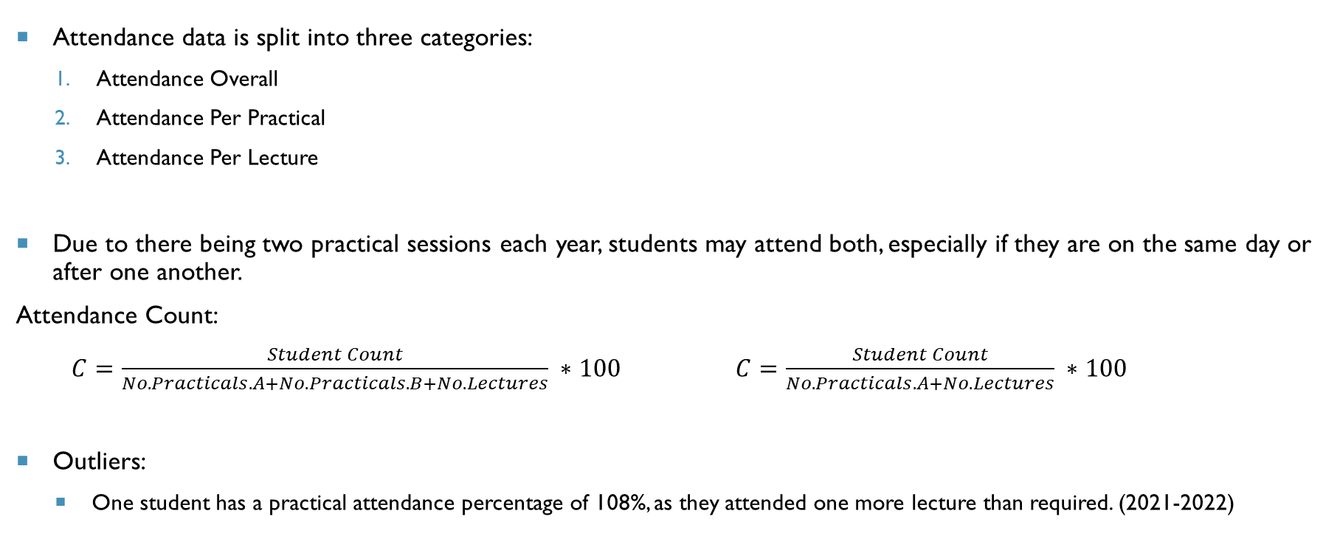
ATTENDANCE DATA
Attendance data is split into three categories:
Attendance Overall
Attendance Per Practical
Attendance Per Lecture
Due to there being two practical sessions each year, students may attend both, especially if they are on the same day or after one another.
Attendance Count:
$C=\frac{Student Count}{No. Practicals.A+No.Practicals.B+No. Lectures} ∗100$ $C=\frac{Student Count}{No. Practicals.A+No. Lectures} ∗100$
Outliers:
One student has a practical attendance percentage of 108%, as they attended one more lecture than required. (2021-2022)

Slide 17
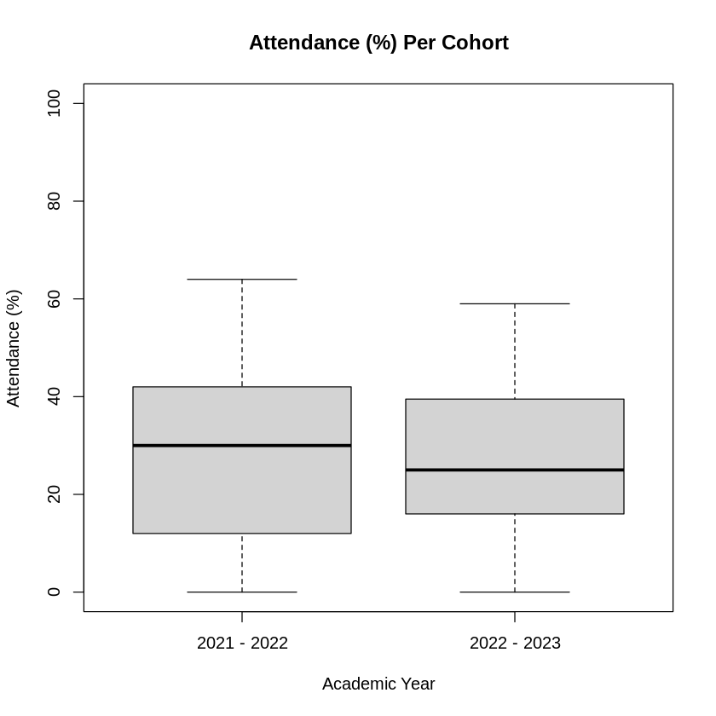
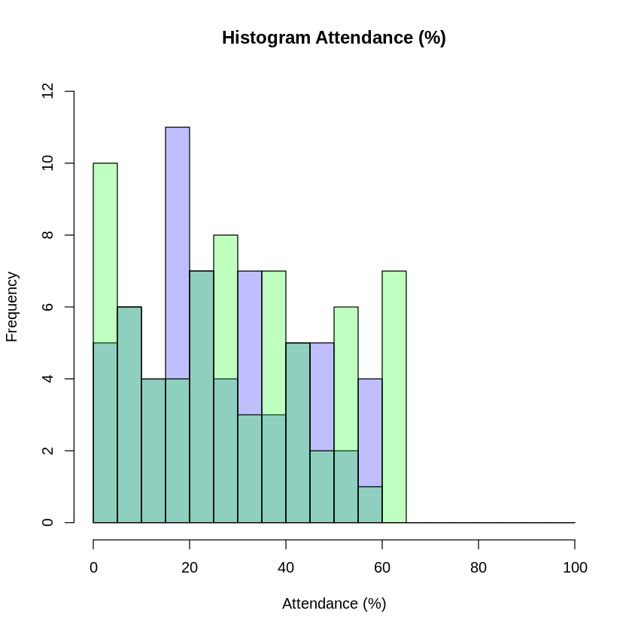
Attendance Data
Attendance Percentage for last two years.
General attendance is similar, slightly lowered
Decrease in size of interquartile range, lower median.

Slide 18
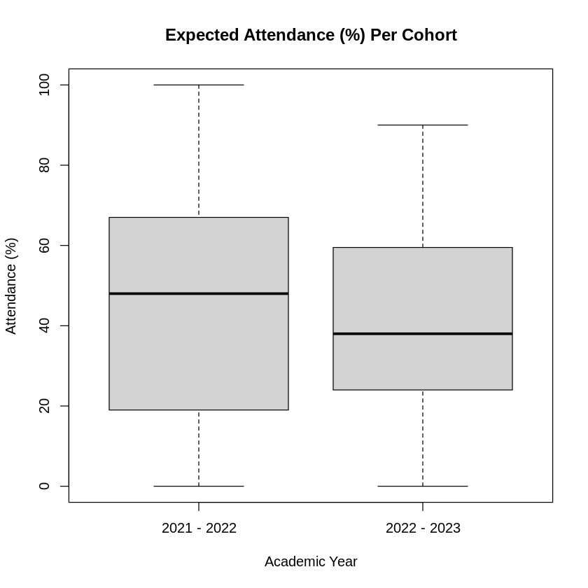
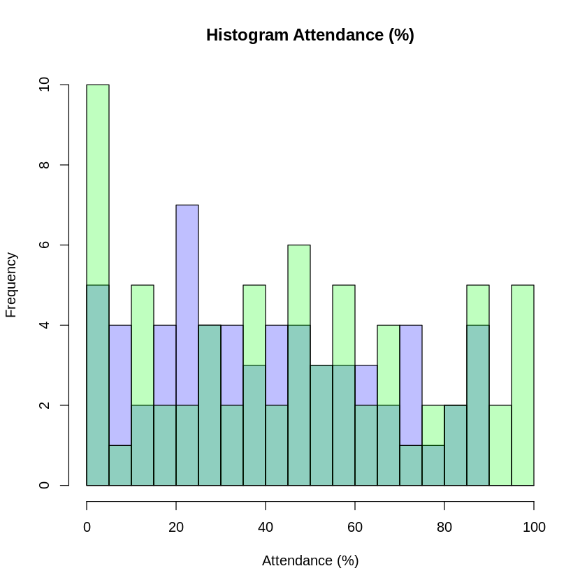
Expected Attendance Data
No student in 2022-2023 cohort managed to reach 100% attendance.
Multiple instances in 2021-2022.
Similar pattern to previous slide.

Slide 19
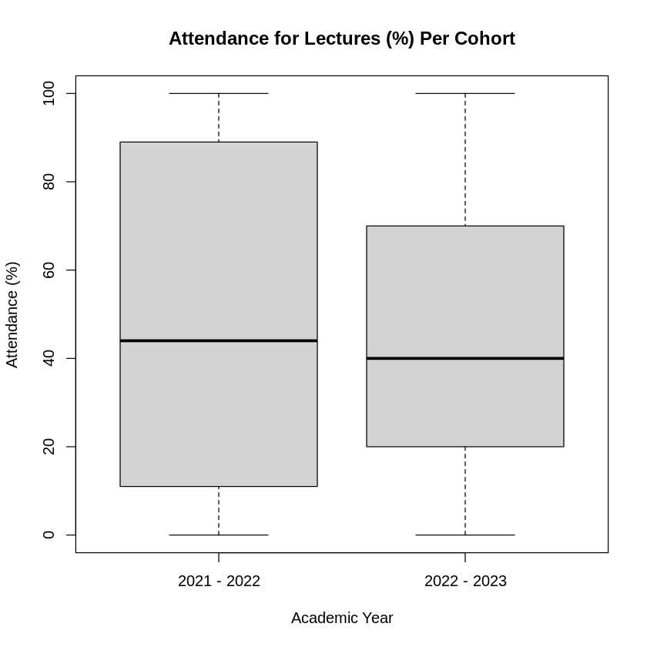
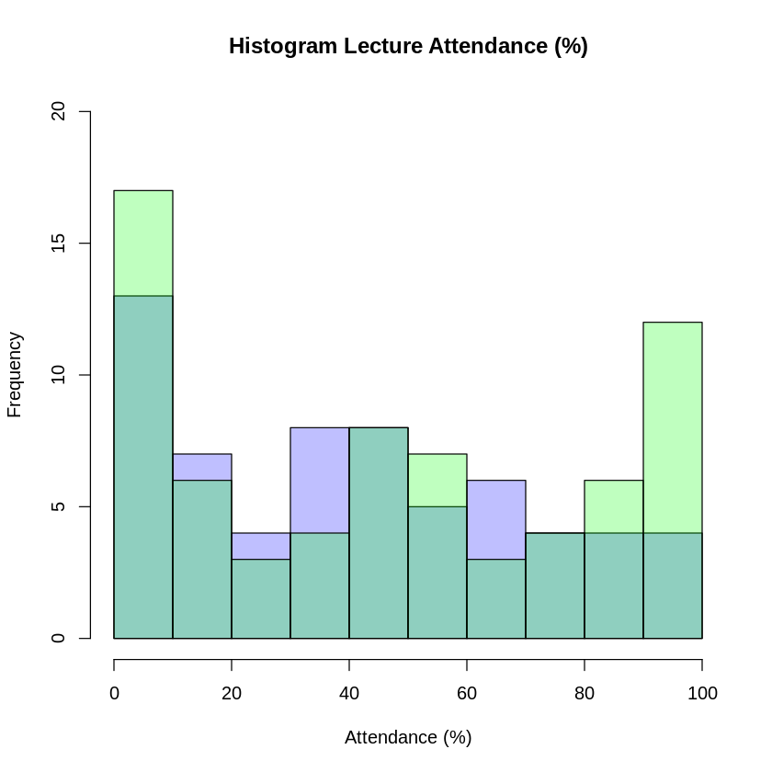
Attendance Lecture Data
Lecture attendance has similar median, interquartile range reduced more significantly.
Less students attending lectures than previous year

Slide 20
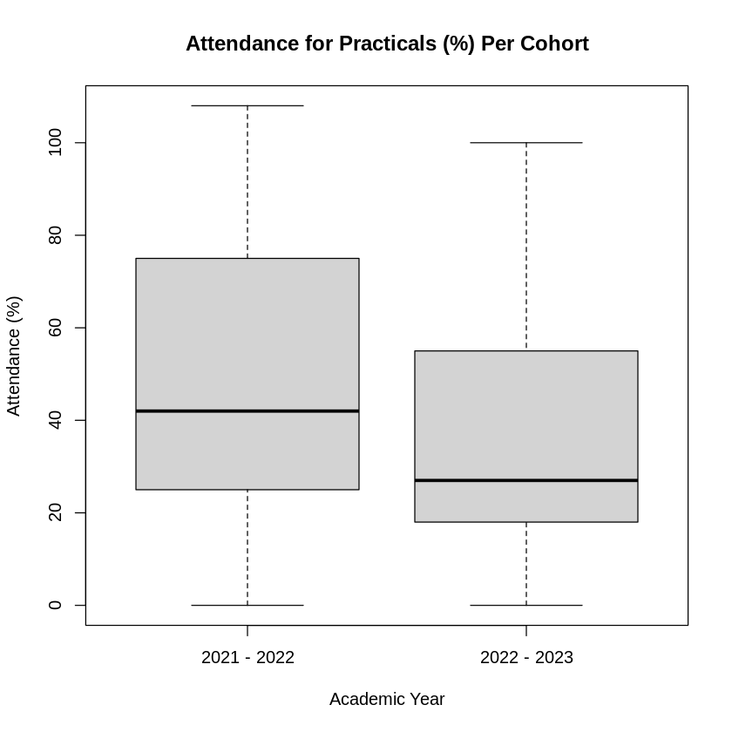
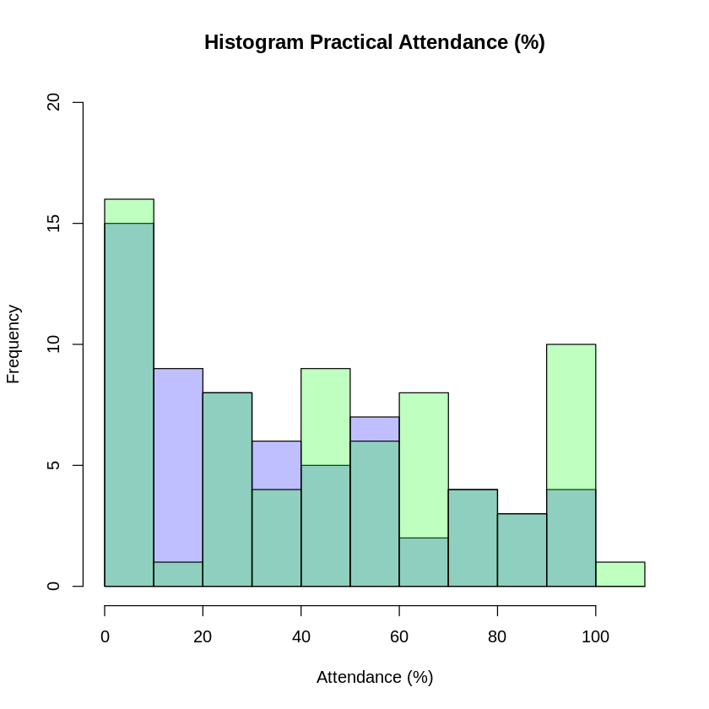
Attendance Practical Data
Clear reduction in attendance to practical sessions.
Median reduced, range reduced.
Skewed result as some students would have attended more practical session than required (one student with 108% attendance)

Slide 21
Summary
Grade average has reduced since last session.
Compared to last year, attendance has also fallen. Average and median in all categories has gone down.
Some relationship between the reduced attendance and the lowering of grade.
Year | Grade(M) | Grade (Mdn) | Attendance (M) | Attendance (Mdn) | Attendance Expected (M) | Attendance Expected (Mdn) | Attendance Lecture (M) | Attendance Lecture (Mdn) | Attendance Practical (M) | Attendance Practical (Mdn)
2020-2021 | 2.458 | 2.5 | N/A | N/A | N/A | N/A | N/A | N/A | N/A | N/A
2021-2022 | 3.129 | 3.5 | 29.69 | 30 | 46.84 | 48 | 46.5 | 44 | 47.03 | 42
2022-2023 | 2.056 | 2.5 | 26.7 | 25 | 40.63 | 38 | 44.92 | 40 | 36.6 | 27

Slide 22
Correlation & Covariance
Grade ~ Attendance
Grade ~ Expected Attendance
Grade ~ Practical Attendance
Grade ~ Lecture Attendance

Slide 23
Correlation & Covariance TABLE
Use of Pearson’s correlation calculation
Expected linear relationship
2021-2022 shows a very low correlation between attendance and grade.
Negative relationship is suggested
2022-2023 shows a stronger positive relationship
Stronger relationship between lecture attendance and grades than others.
Year | Grade ~ Attendance Correlation | Grade ~ Attendance Covariance | Grade ~ E. Attendance Correlation | Grade ~ E. Attendance Covariance | Grade ~ Lecture Attendance Correlation | Grade ~ Lecture Attendance Covariance | Grade ~ Practical Attendance Correlation | Grade ~ Practical Attendance Covariance
2021-2022 | -0.0412 | -0.9010 | -0.038 | -1.2983 | 0.0818 | 3.4275 | -0.1318 | -4.8588
2022-2023 | 0.5349 | 12.703 | 0.5356 | 19.367 | 0.5054 | 22.384 | 0.4052 | 16.692

Slide 24
Correlation & Covariance TABLE
Use of Spearman’s Correlation
Better for monotonic relationship identification
Higher correlation value suggests relationship is more linear than monotonic (2022-2023), though difference is very small, especially for lecture attendance.
2021-2022 data suggests otherwise, but difference is still very slight and correlation value is very close to zero in all four cases baring Practical attendance.
Year | Grade ~ Attendance Correlation | Grade ~ Attendance Covariance | Grade ~ E. Attendance Correlation | Grade ~ E. Attendance Covariance | Grade ~ Lecture Attendance Correlation | Grade ~ Lecture Attendance Covariance | Grade ~ Practical Attendance Correlation | Grade ~ Practical Attendance Covariance
2021-2022 | -0.057 | -23.225 | -0.057 | -23.225 | 0.0844 | 34.047 | -0.1798 | -73.04
2022-2023 | 0.5108 | 169.5 | 0.5108 | 169.5 | 0.5021 | 166.06 | 0.3713 | 122.7

Slide 25
Regression Explanation
All four metrics were run against the three following methods of regression:
Linear Regression
Straightforward method of determining a linear relationship between the two vectors of data.
Theil-Sen Regression
Quadradic Regression

Slide 26
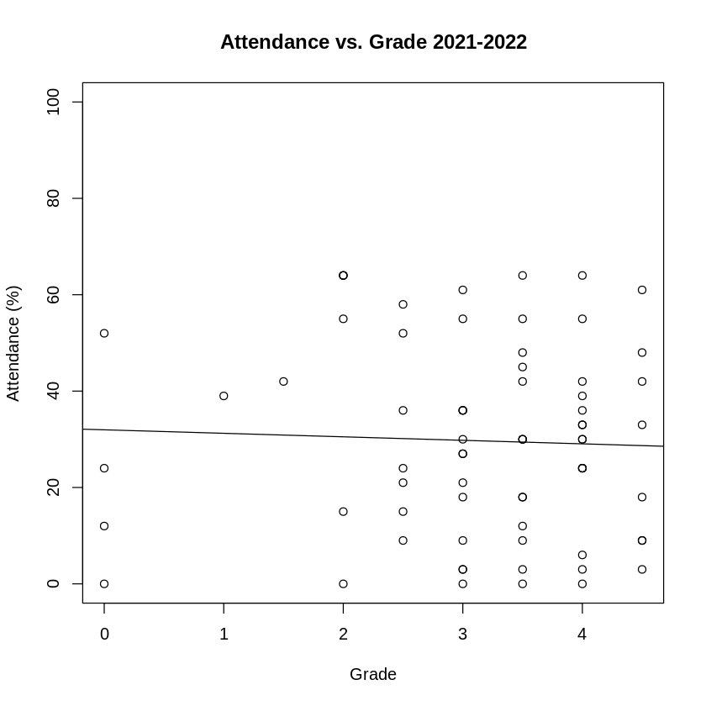
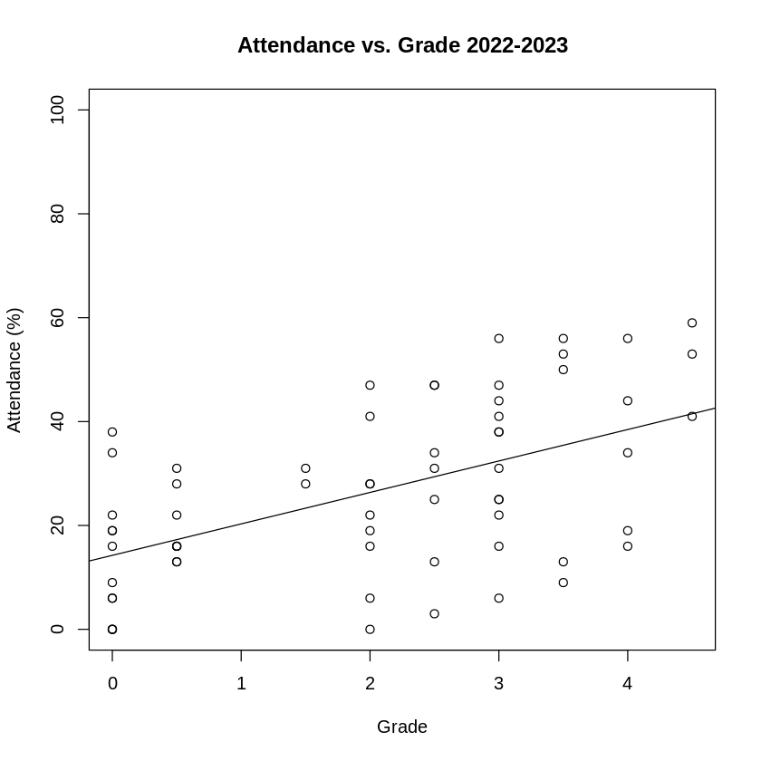
LINEAR REGRESSION MODEL - ATTENDANCE
Much stronger correlation in most recent year than previous.
Reason for the difference is likely due to cohort difference, or due to method of delivery.
Content delivered is the same.
Grades from last session had no MF or F instances, results in lack of correlation.

Slide 27
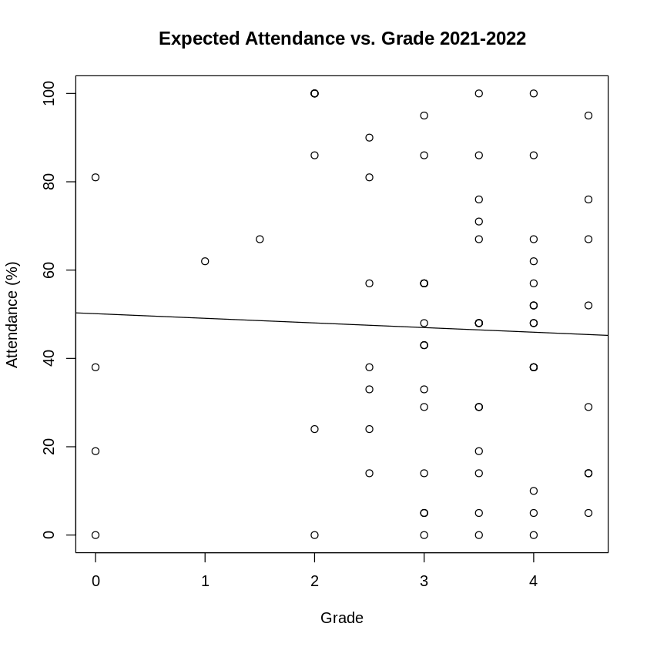
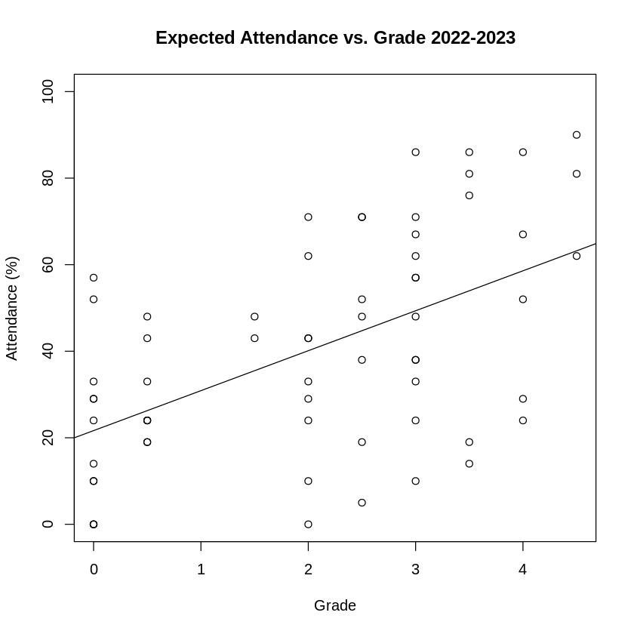
LINEAR REGRESSION MODEL – Expected ATTENDANCE
Similar to previous slides, stronger correlation noticed with current year.

Slide 28
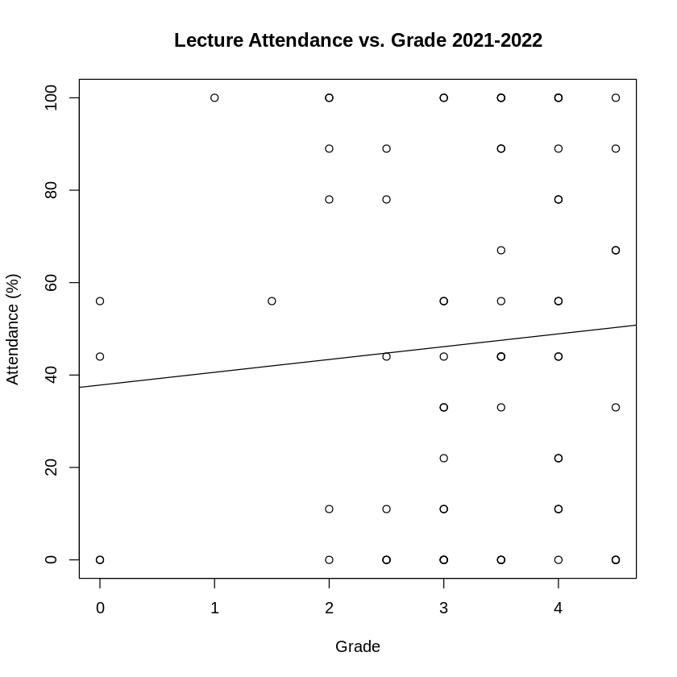
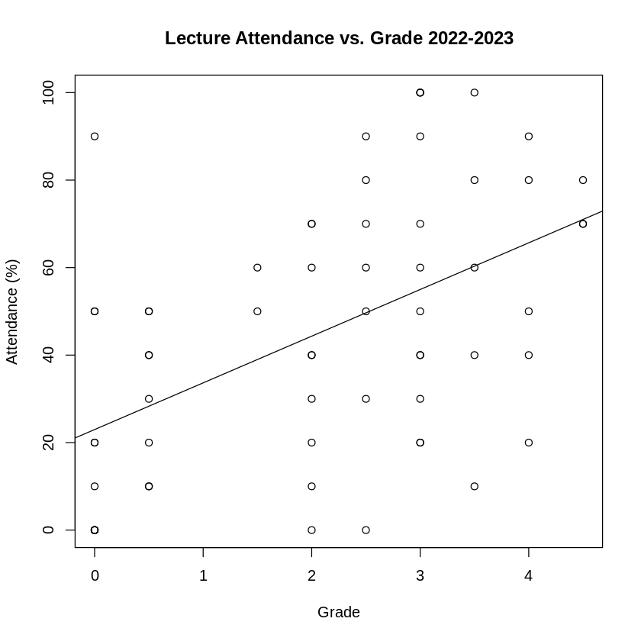
LINEAR REGRESSION MODEL – LECTURE ATTENDANCE
Slight positive correlation between lecture attendance and grade with 2021-2022 data.
Similar for lectures as with regular attendance 2022-2023.

Slide 29
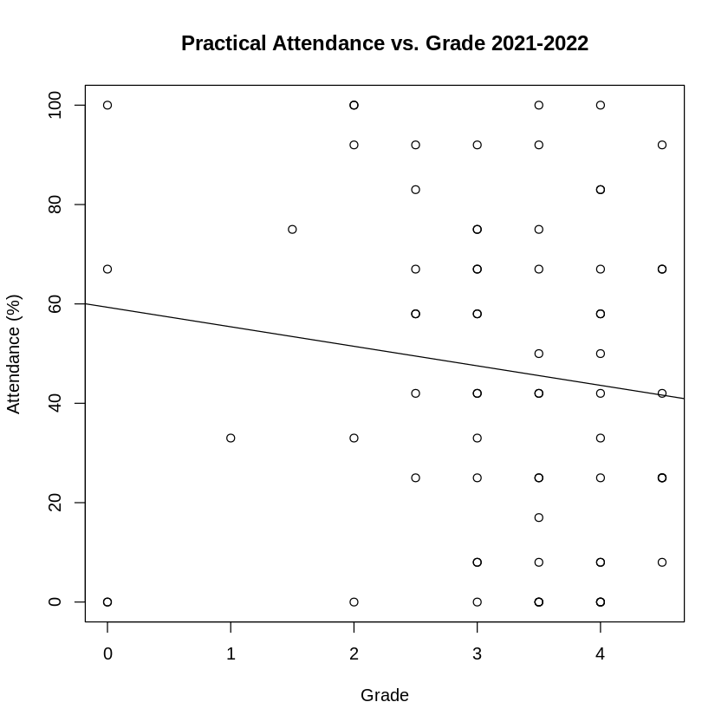
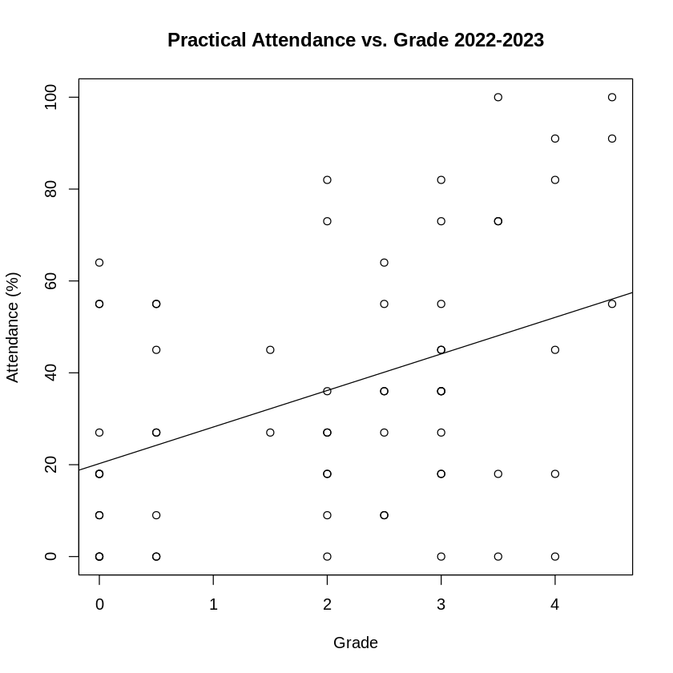
LINEAR REGRESSION MODEL – PRACTICAL ATTENDANCE
2021-2022 has strongest negative correlation score (still very low at -0.1318).
Weakest positive correlation for 2022-2023 data (0.4052)

Slide 30
PREDICTIONS
Grade ~ Attendance
Grade ~ Expected Attendance
Grade ~ Practical Attendance
Grade ~ Lecture Attendance

Slide 31
CONCLUSION
SUMMARY
HYPOTHESIS ANSWER
FURTHER DEVELOPMENT

Slide 32

Thank You
Christopher acornley
1000697@UAD.ac.uk

Slide 33
References
Bacro, T. R. H., Gebregziabher, M. and Fitzharris, T. P. (2010) ‘Evaluation of a lecture recording system in a medical curriculum’, Anatomical Sciences Education, 3(6), pp. 300–308. doi: 10.1002/ase.183.
Carpenter, R., Theeke, L. and Smothers, A. (2013) ‘Enhancing Course Grades and Evaluations Using Distance Education Technologies’, Nurse Educator, 38(3). Available at: https://journals.lww.com/nurseeducatoronline/Fulltext/2013/05000/Enhancing_Course_Grades_and_Evaluations_Using.17.aspx
Cohen, J. (1988). Statistical Power Analysis for the Behavioral Sciences (2nd ed.). Routledge. https://doi.org/10.4324/9780203771587
Credé, M., Roch, S. G. and Kieszczynka, U. M. (2010) ‘Class Attendance in College: A Meta-Analytic Review of the Relationship of Class Attendance With Grades and Student Characteristics’, Review of Educational Research, 80(2), pp. 272–295. doi: 10.3102/0034654310362998.
Gunn, K. P. (1993). A correlation between attendance and grades in a first-year psychology class. Canadian Psychology / Psychologie canadienne, 34(2), 201–202. https://doi.org/10.1037/h0078770

Slide 34
References
Handschuh, H. (2005) ‘SHA Family (Secure Hash Algorithm)’, in van Tilborg, H. C. A. (ed.) Encyclopedia of Cryptography and Security. Boston, MA: Springer US, pp. 565–567. doi: 10.1007/0-387-23483-7_388.
Kassarnig, V. et al. (2017) ‘Class attendance, peer similarity, and academic performance in a large field study’, PloS one. United States, 12(11), p. e0187078. doi: 10.1371/journal.pone.0187078.
MOORE, R., 2003. Attendance and performance. Journal of College Science Teaching, 32(6), pp. 367-371.

