Slide 1

Student Attendance and performance RELATIONSHIP study
Christopher Acornley

Slide 2
STUDY AIM
Investigate if there is a relationship between student attendance to live lectures and their grade.
This study is based on the basis that recorded versions of the lectures are available for students to view.
Students can view the same material if they cannot or decide not to attend a lecture session.
Additional aim of the investigation is to determine if providing pre-recorded lectures is a suitable substitute to live lectures.
This could mean teaching staff can focus on preparing the material ahead of term, freeing up their in-term teaching to respond to student queries, host more practical sessions, or live workshops for students.

Slide 3
External Research
Attendance vs Grades
Class Attendance in College (sagepub.com)
Credé, M., Roch, S.G. and Kieszczynka, U.M., 2010. Class attendance in college: A meta-analytic review of the relationship of class attendance with grades and student characteristics. Review of Educational Research, 80(2), pp.272-295.
A correlation between attendance and grades in a first-year psychology class. (apa.org)
Gunn, K. P. (1993). A correlation between attendance and grades in a first-year psychology class. Canadian Psychology / Psychologie canadienne, 34(2), 201–202. https://doi.org/10.1037/h0078770
Attendance and performance – ProQuest
MOORE, R., 2003. Attendance and performance. Journal of College Science Teaching, 32(6), pp. 367-371.
Pedagogic positives of recording matierall
Multiple approaches available

Slide 4
Hypothesis
Based on the existing research, it is expected there will be a close relationship between a student's attendance to class and their corresponding grade.
Due to the adoption of Blended learning approaches and the necessity of Remote teaching during lockdown, it is expected that students who chose to use the recorded materials will perform the same as the students who attended live lectures.
“Recorded Lectures provide a suitable alternative for learning should live lectures be unavailable.”

Slide 5
Limitations
The study is only focusses on attendance and achievement of a single Module at Abertay University in Scotland. Methods of content delivery may not be suitable for other institutions due to technology differences, delivery method and class structure.
Module was delivered with in three classes each week. An online one-hour live lecture, then a two-hour on-campus practical session (two practical sessions were run to accommodate cohort size).
Module is focused on material that is entirely done on a computer. As such, remote teaching is potentially easier than other subjects which could limit the impact of the results.
Study is limited to single year of attendance data.

Slide 6
Data Gathering methodology
The following data was gathered as stating in the Research Proposal:
Attendance of each class Recorded on Attendance Software (JISC)
Usage of class work and Assignments on MyLearningSpace (VLE)
Grades of Students for Marked Assignment
Views of Recorded Material
Data was gathered for sessions 2020-2021, 2021-2022, and 2022-2023.
Data for 2020-2021 only contained five registers, including one for September 2021 (next academic year). As such this data was ignored.
Data for 2021-2022 ran with lectures being recorded and sessions were discussions rather than delivery of content.
Ethics approval for this project was given based on the anonymizing of student identifications. To do this, the raw data gathered was collated into a single Spreadsheet for each year, and Student ID’s were hashed during a SHA256 Hashing algorithm (Handschuh, 2005)
Converts student number into a 256-bit hexadecimal value. Hashing processes was chosen due to the high security of the process (cannot convert Hash back into original value) and very low chance of collisions.

Slide 7
Data Gathering methodology
Attendance is gathered for all students for all classes
Students split into single lecture for all, then either group A or group B for practical
Students assigned to class based on Timetable, not class list available through attendance system and MyLearningSpace
For the purposes of this study, only students who were noted as having attended were counted as attending.
There is a possibility that some students would have attended class and not registered using the MyAbertay app, as well as students who had notified reasoning for not attending. There is also a possibility that students who had a notified reason for not attending still managed to attend. To prevent speculation, only students who are recorded as attending will be used in this study.
Attendance data in the following format was considered as not attending a class:
Not Attended
Notified Absence
Not Required

Slide 8

Analysis Methodology
Comparison
Correlation & Covariance
Network Predictions

Slide 9
Comparison
Grade Changes
Attendance
Overall
Expected
Lecture
practical

Slide 10
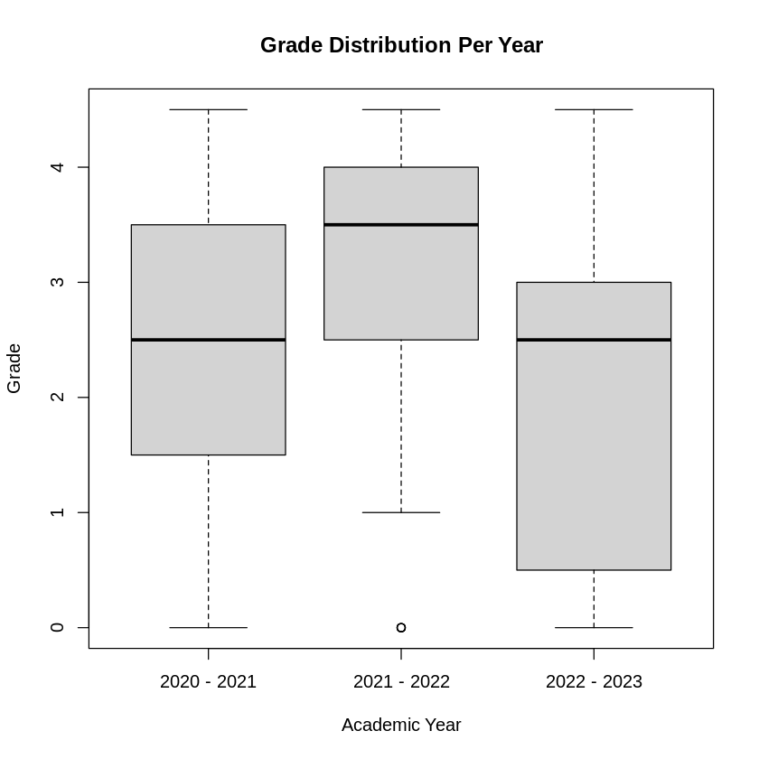
Grade Data
Grade Distribution over the three years.
Observations:
2021-2022 year, no students recorded as MF or F, only a relatively small number of NS grades
Median for 2020-2021 and 2022-2023 are the same, however general performance appears to have dropped.

Slide 11
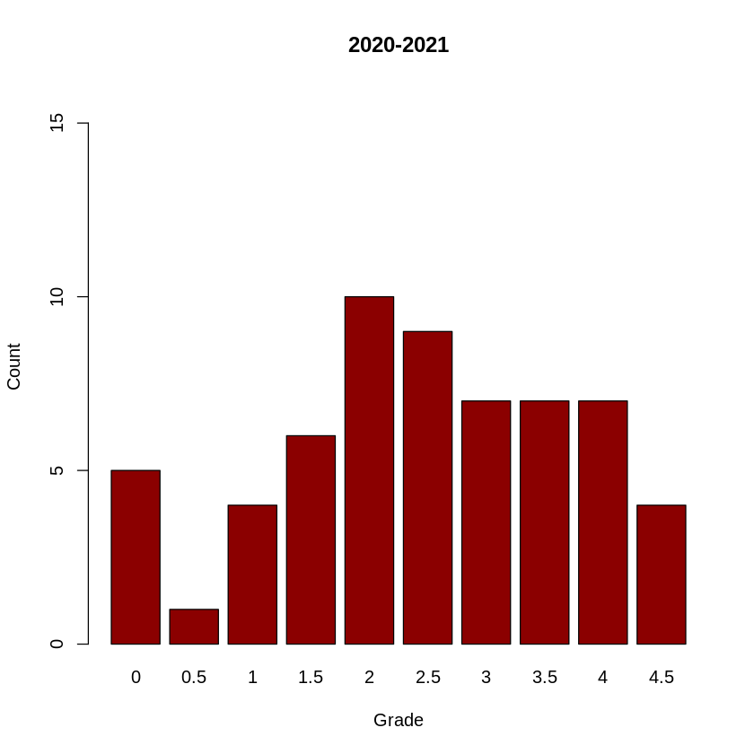
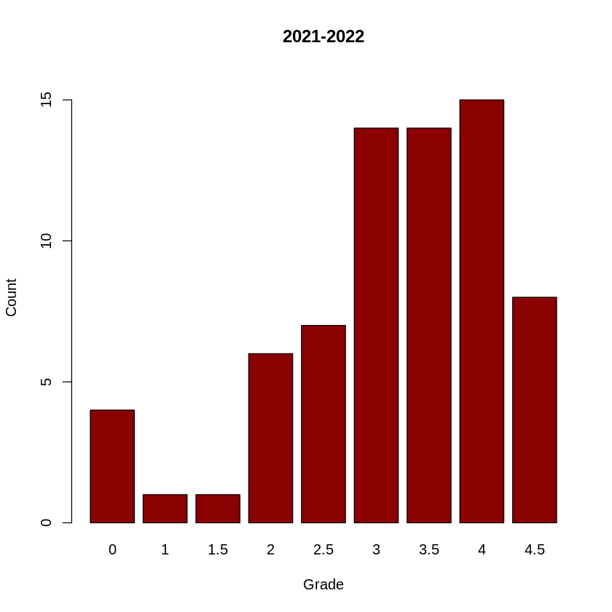
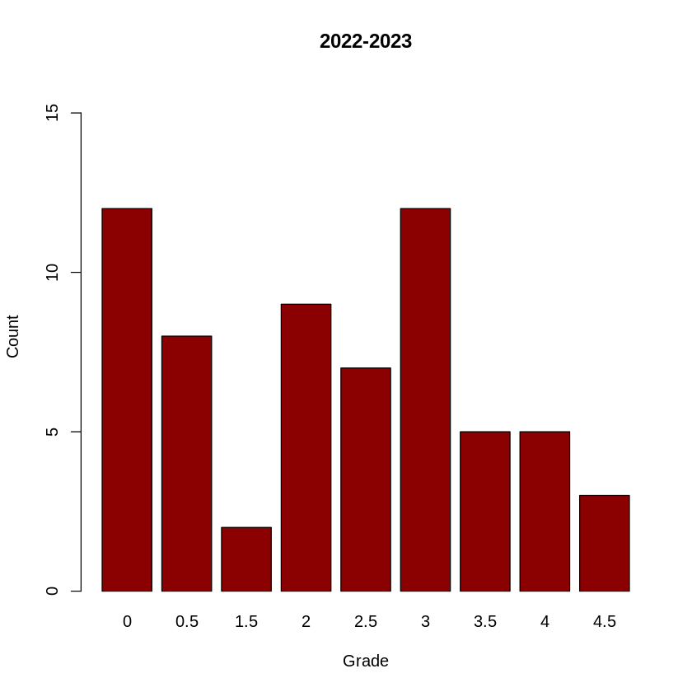
Grade Data

Slide 12
Grade Data
Relatively even distribution of grades when compared with the other years.
Mean: 2.458
Median: 2.5
Total students: 60
A+ | A | B+ | B | C+ | C | D+ | D | MF | F | NS
4 | 7 | 7 | 7 | 9 | 10 | 6 | 4 | 1 | 1 | 4

Slide 13
Grade Data
Heavy focus on upper grades.
No Marginal Fail or Fail grades, only 4 NS submissions.
Mean: 3.129
Median: 3.5
Total students: 70
A+ | A | B+ | B | C+ | C | D+ | D | MF | F | NS
8 | 15 | 14 | 14 | 7 | 6 | 1 | 1 | 0 | 0 | 4

Slide 14
Grade Data
Larger number of students did not submit (both count and percentage of cohort size).
Assignment and grading criteria are the same.
Marking Team different.
Mean: 2.056
Median: 2.5
Total students: 63
A+ | A | B+ | B | C+ | C | D+ | D | MF | F | NS
3 | 5 | 5 | 12 | 7 | 9 | 2 | 0 | 8 | 1 | 11

Slide 15
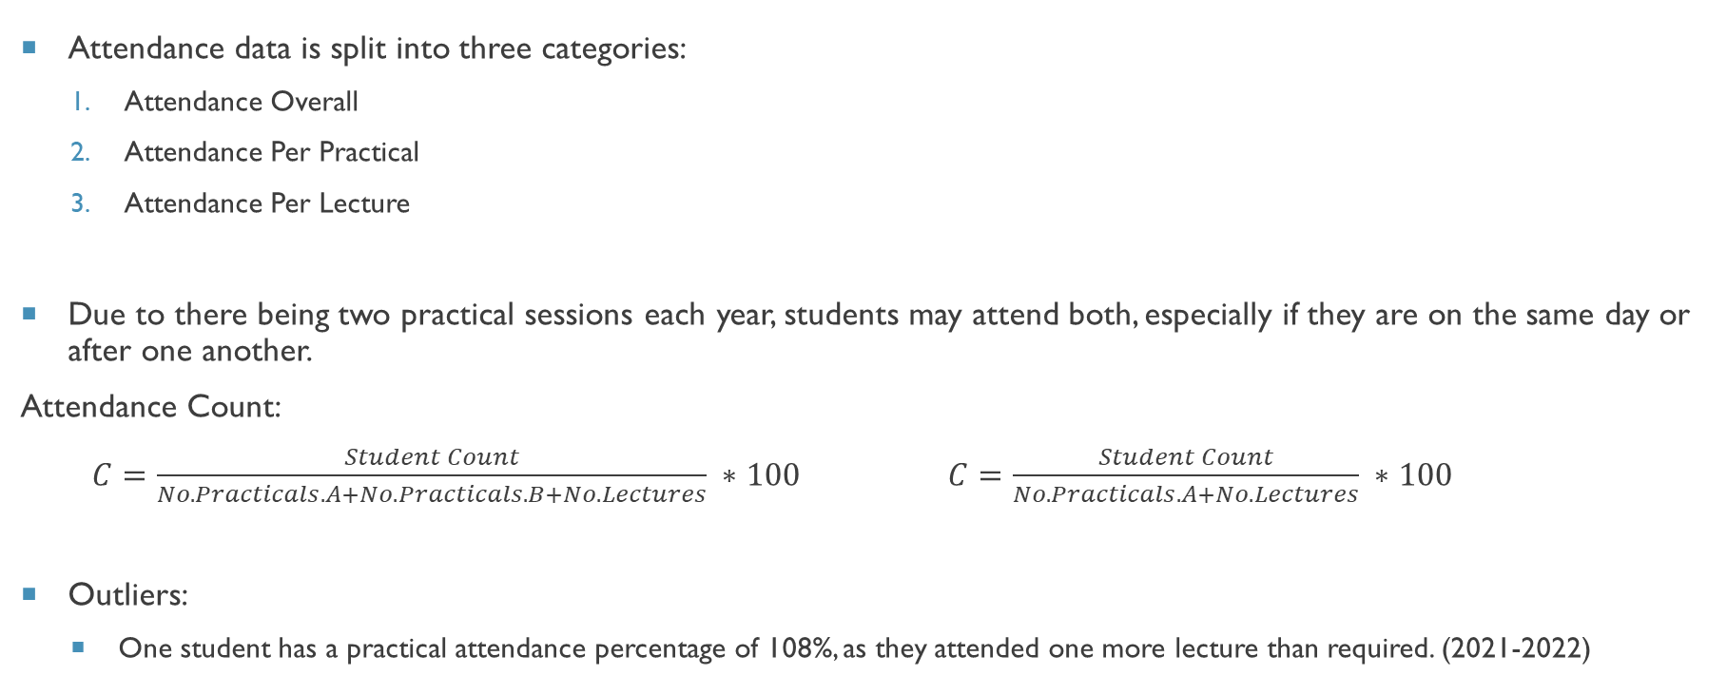
ATTENDANCE DATA
Attendance data is split into three categories:
Attendance Overall
Attendance Per Practical
Attendance Per Lecture
Due to there being two practical sessions each year, students may attend both, especially if they are on the same day or after one another.
Attendance Count:
$C=\frac{Student Count}{No. Practicals.A+No.Practicals.B+No. Lectures} ∗100$ $C=\frac{Student Count}{No. Practicals.A+No. Lectures} ∗100$
Outliers:
One student has a practical attendance percentage of 108%, as they attended one more lecture than required. (2021-2022)

Slide 16
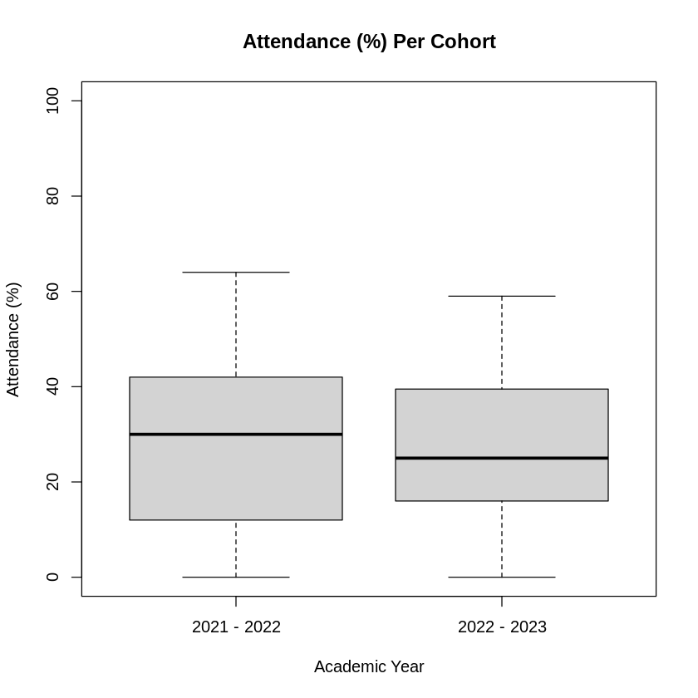
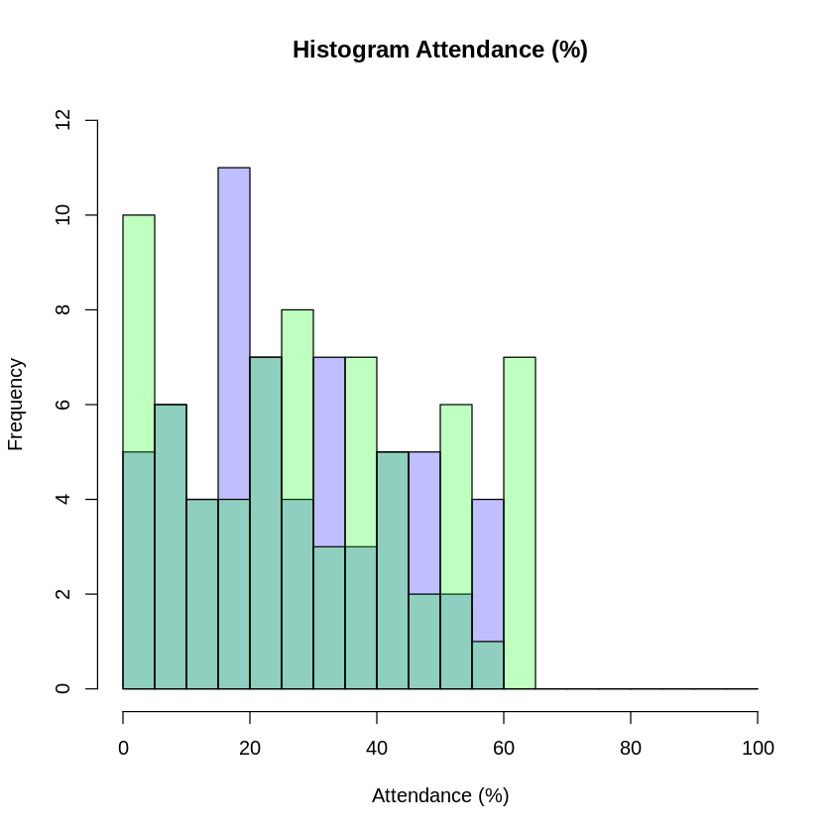
Attendance Data
Attendance Percentage for last two years.
General attendance is similar, slightly lowered
Decrease in size of interquartile range, lower median.

Slide 17
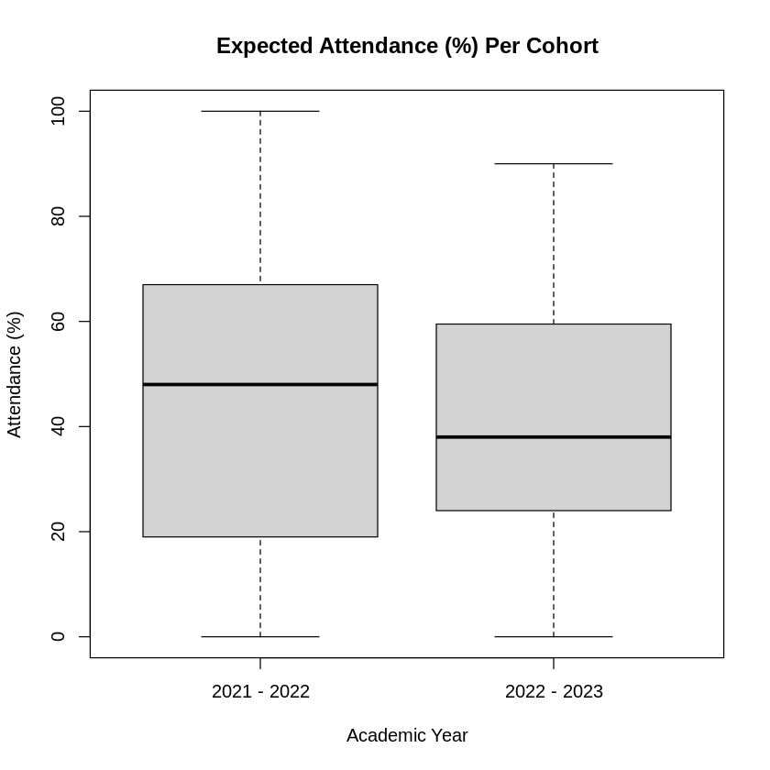
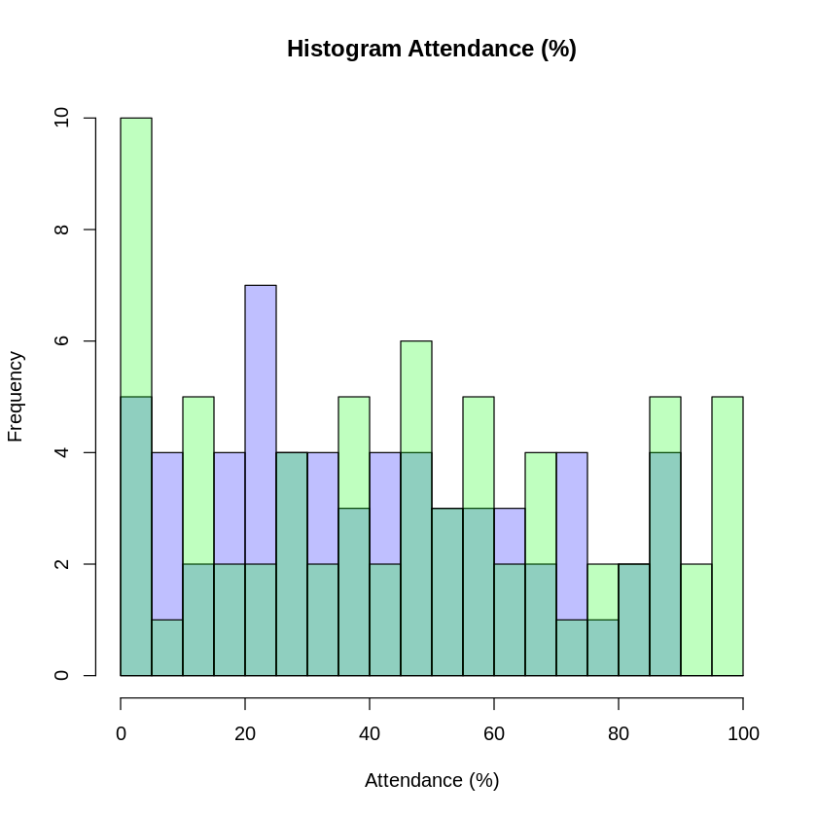
Expected Attendance Data
No student in 2022-2023 cohort managed to reach 100% attendance.
Multiple instances in 2021-2022.
Similar pattern to previous slide.

Slide 18
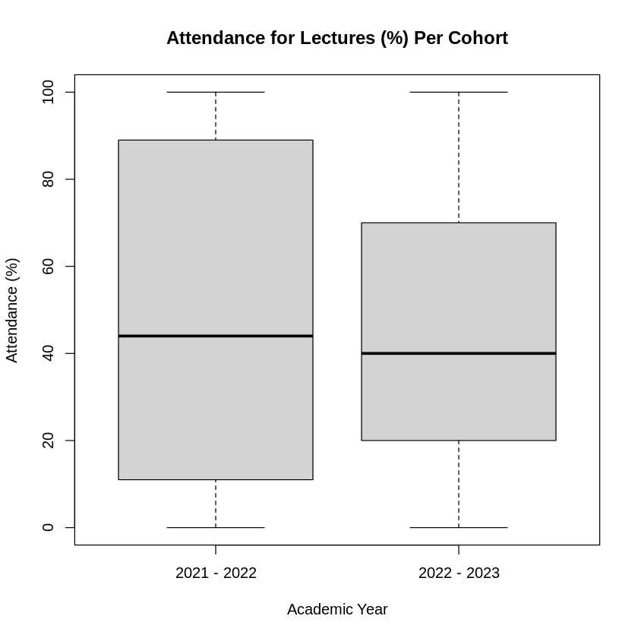
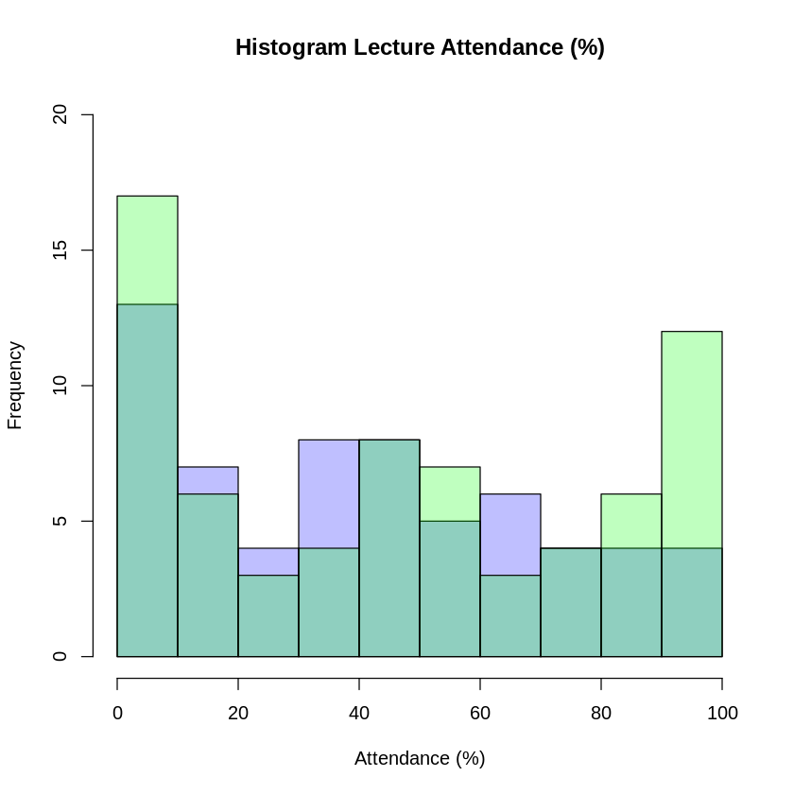
Attendance Lecture Data
Lecture attendance has similar median, interquartile range reduced more significantly.
Less students attending lectures than previous year

Slide 19
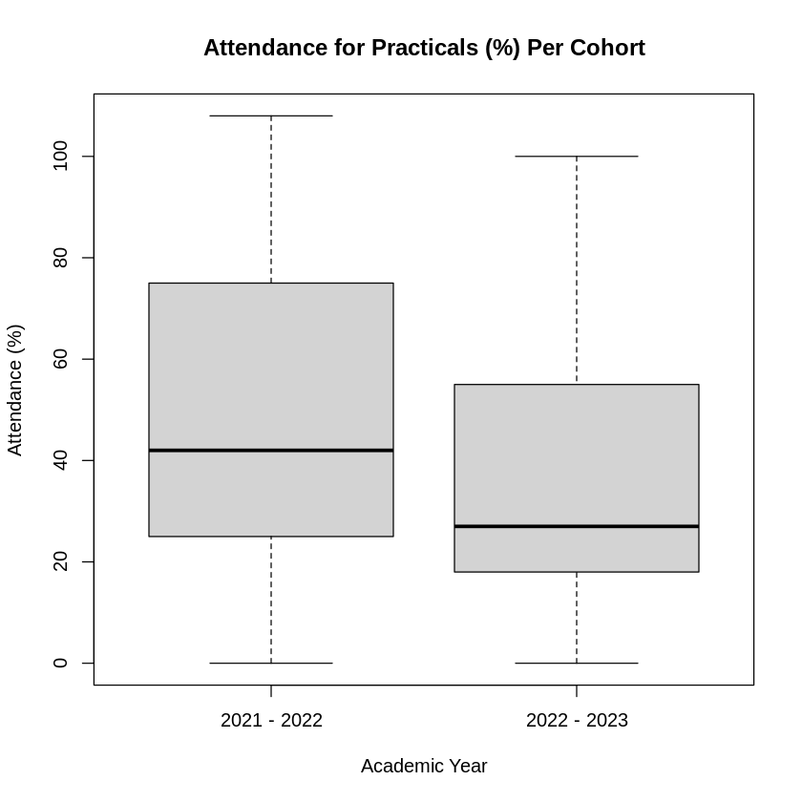
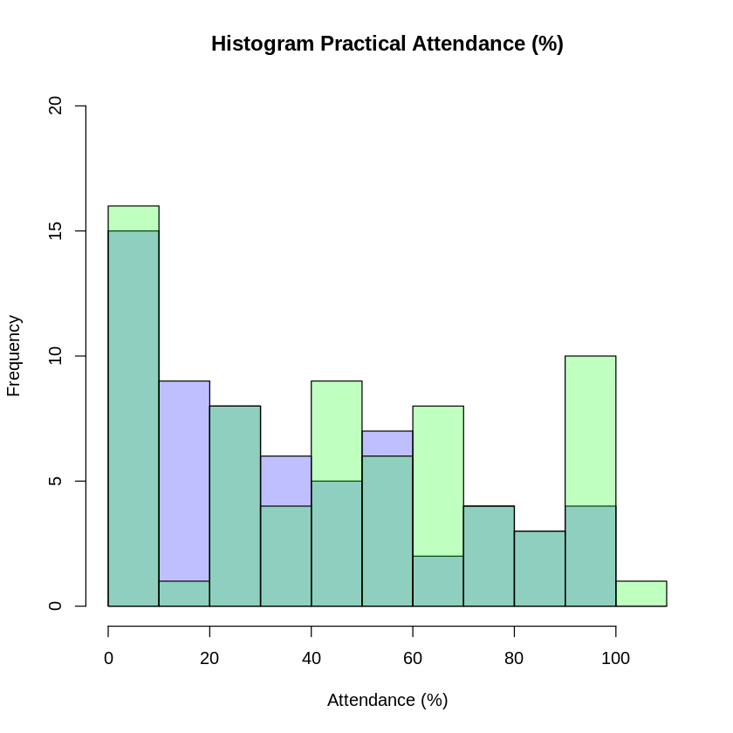
Attendance Practical Data
Clear reduction in attendance to practical sessions.
Median reduced, range reduced.
Skewed result as some students would have attended more practical session than required (one student with 108% attendance)

Slide 20
Summary
Grade average has reduced since last session.
Compared to last year, attendance has also fallen. Average and median in all categories has gone down.
Some relationship between the reduced attendance and the lowering of grade.
Year | Grade(M) | Grade (Mdn) | Attendance (M) | Attendance (Mdn) | Attendance Expected (M) | Attendance Expected (Mdn) | Attendance Lecture (M) | Attendance Lecture (Mdn) | Attendance Practical (M) | Attendance Practical (Mdn)
2020-2021 | 2.458 | 2.5 | N/A | N/A | N/A | N/A | N/A | N/A | N/A | N/A
2021-2022 | 3.129 | 3.5 | 29.69 | 30 | 46.84 | 48 | 46.5 | 44 | 47.03 | 42
2022-2023 | 2.056 | 2.5 | 26.7 | 25 | 40.63 | 38 | 44.92 | 40 | 36.6 | 27

Slide 21
Correlation & Covariance
Grade ~ Attendance
Grade ~ Expected Attendance
Grade ~ Practical Attendance
Grade ~ Lecture Attendance

Slide 22
Correlation & Covariance TABLE
Use of Pearson’s correlation calculation
Expected linear relationship
2021-2022 shows a very low correlation between attendance and grade.
Negative relationship is suggested
2022-2023 shows a stronger positive relationship
Stronger relationship between lecture attendance and grades than others.
Year | Grade ~ Attendance Correlation | Grade ~ Attendance Covariance | Grade ~ E. Attendance Correlation | Grade ~ E. Attendance Covariance | Grade ~ Lecture Attendance Correlation | Grade ~ Lecture Attendance Covariance | Grade ~ Practical Attendance Correlation | Grade ~ Practical Attendance Covariance
2021-2022 | -0.0412 | -0.9010 | -0.038 | -1.2983 | 0.0818 | 3.4275 | -0.1318 | -4.8588
2022-2023 | 0.5349 | 12.703 | 0.5356 | 19.367 | 0.5054 | 22.384 | 0.4052 | 16.692

Slide 23
Correlation & Covariance TABLE
Use of Spearman’s Correlation
Better for monotonic relationship identification
Higher correlation value suggests relationship is more linear than monotonic (2022-2023), though difference is very small, especially for lecture attendance.
2021-2022 data suggests otherwise, but difference is still very slight and correlation value is very close to zero in all four cases baring Practical attendance.
Year | Grade ~ Attendance Correlation | Grade ~ Attendance Covariance | Grade ~ E. Attendance Correlation | Grade ~ E. Attendance Covariance | Grade ~ Lecture Attendance Correlation | Grade ~ Lecture Attendance Covariance | Grade ~ Practical Attendance Correlation | Grade ~ Practical Attendance Covariance
2021-2022 | -0.057 | -23.225 | -0.057 | -23.225 | 0.0844 | 34.047 | -0.1798 | -73.04
2022-2023 | 0.5108 | 169.5 | 0.5108 | 169.5 | 0.5021 | 166.06 | 0.3713 | 122.7

Slide 24
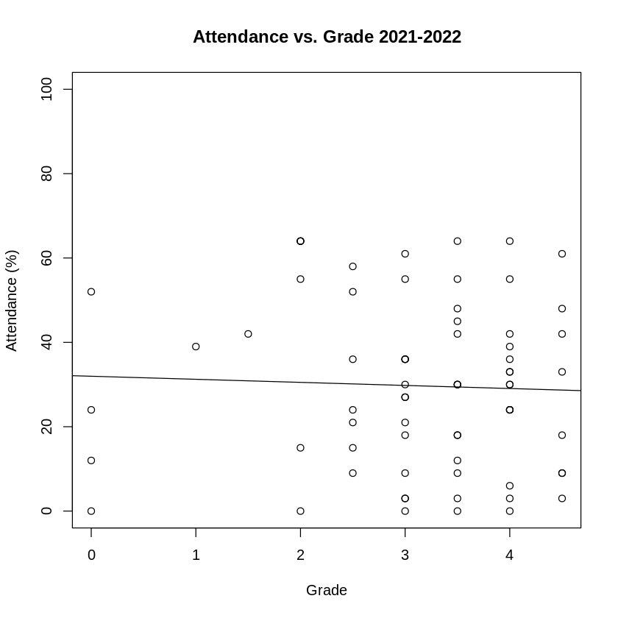
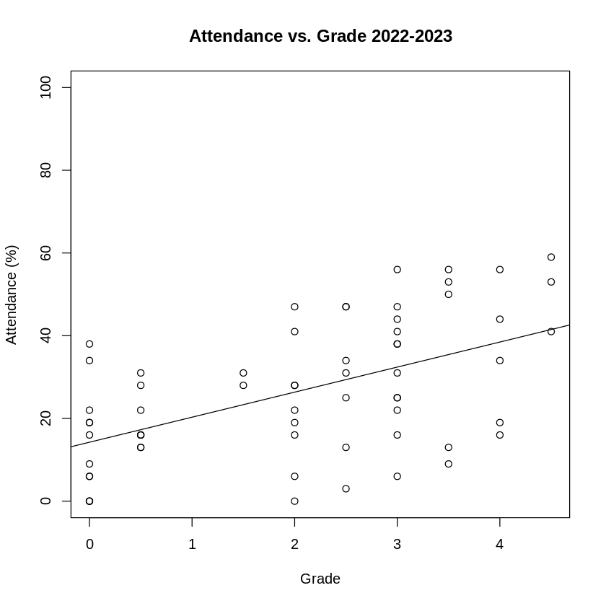
LINEAR REGRESSION MODEL - ATTENDANCE
Attendance Percentage for last two years.
General attendance is similar, slightly lowered
Decrease in size of interquartile range, lower median.

Slide 25
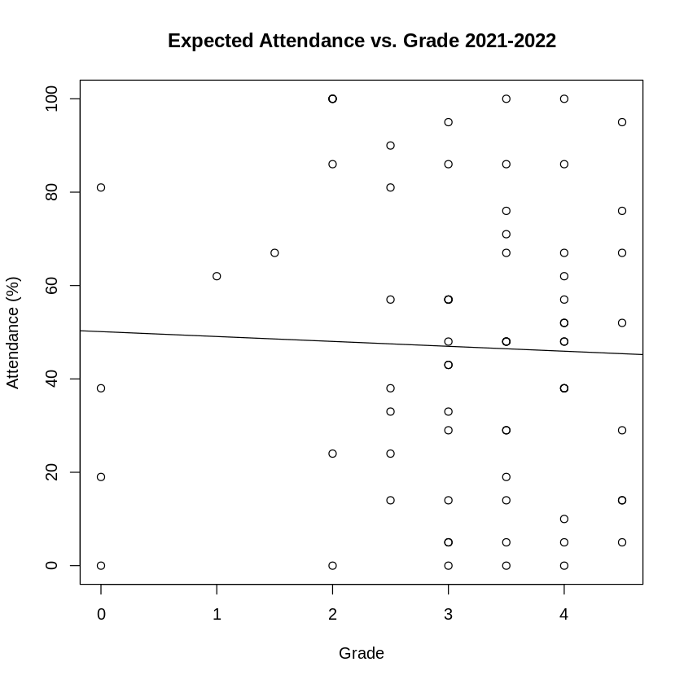
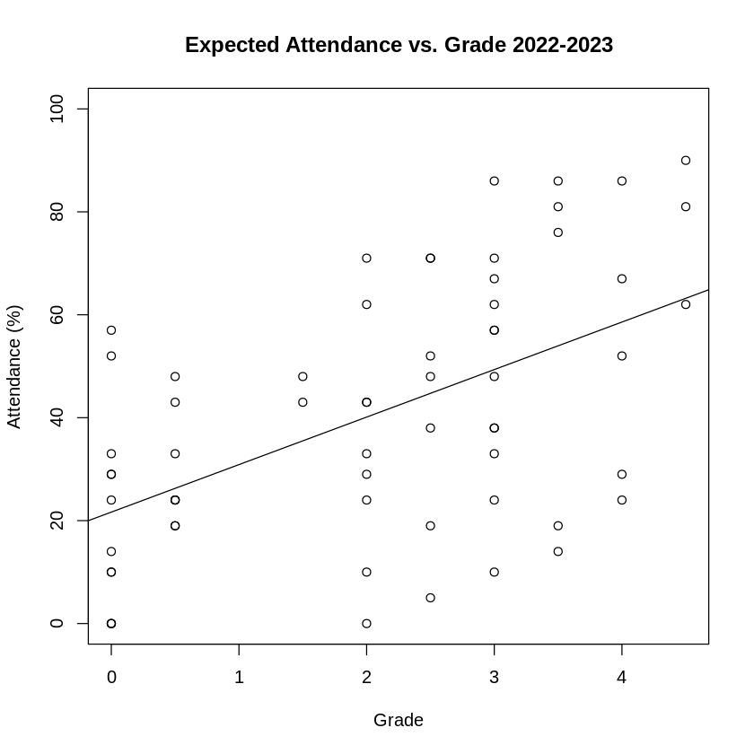
LINEAR REGRESSION MODEL – Expected ATTENDANCE
Attendance Percentage for last two years.
General attendance is similar, slightly lowered
Decrease in size of interquartile range, lower median.

Slide 26
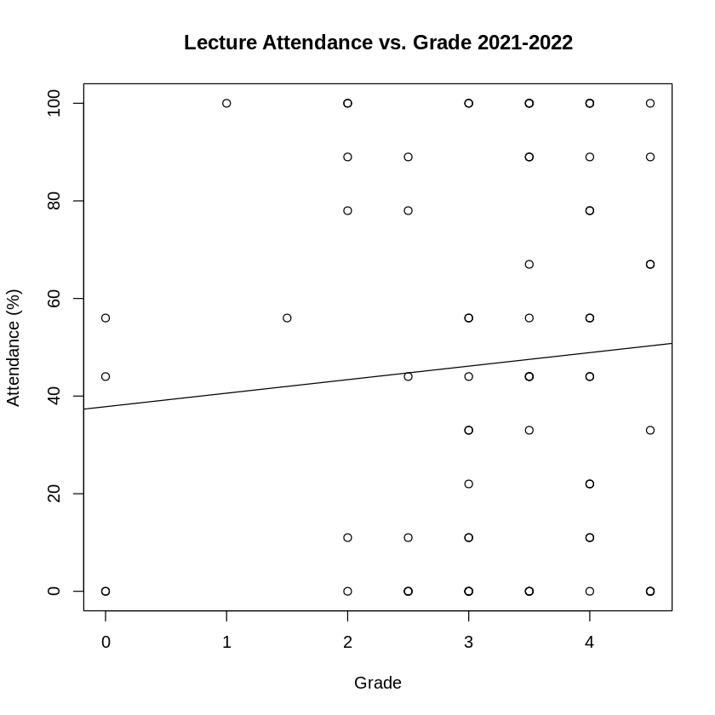
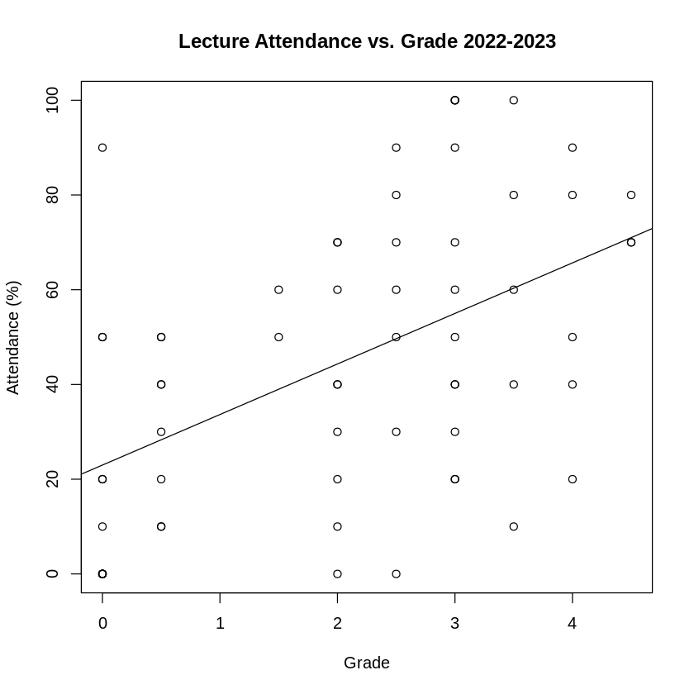
LINEAR REGRESSION MODEL – LECTURE ATTENDANCE
Attendance Percentage for last two years.
General attendance is similar, slightly lowered
Decrease in size of interquartile range, lower median.

Slide 27
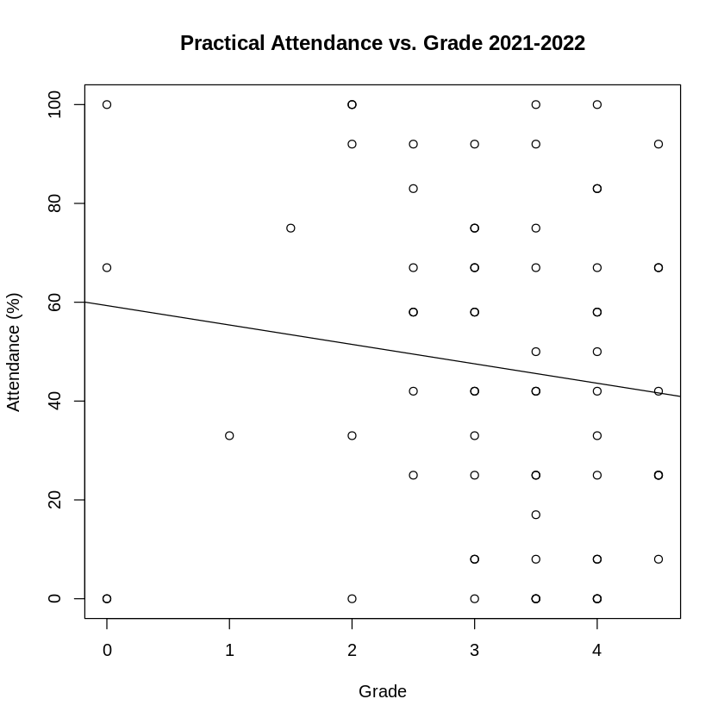
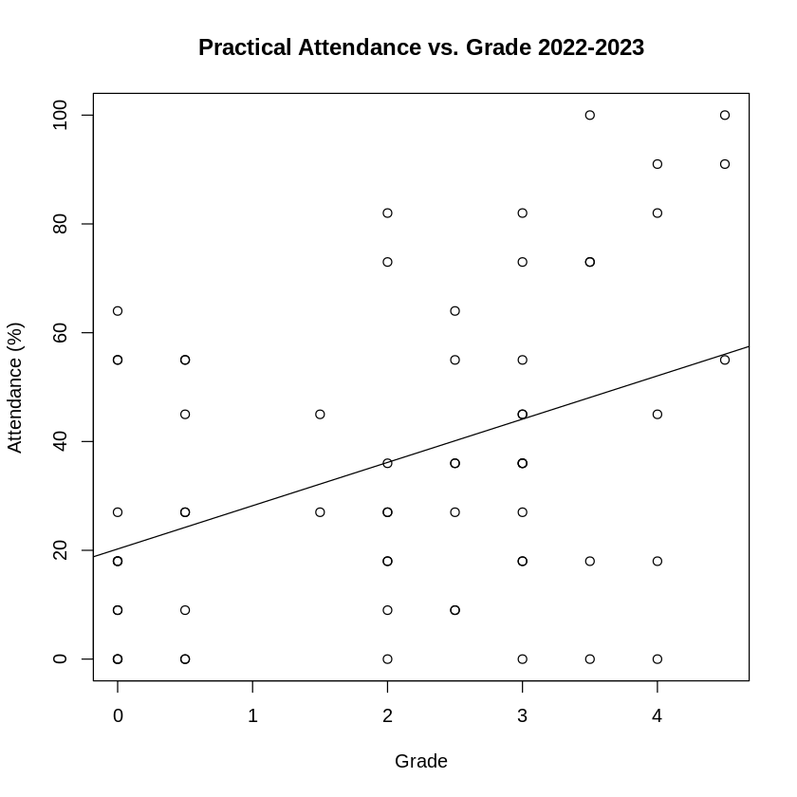
LINEAR REGRESSION MODEL – PRACTICAL ATTENDANCE
Attendance Percentage for last two years.
General attendance is similar, slightly lowered
Decrease in size of interquartile range, lower median.

Slide 28
PREDICTIONS
Grade ~ Attendance
Grade ~ Expected Attendance
Grade ~ Practical Attendance
Grade ~ Lecture Attendance

Slide 29
CONCLUSION
SUMMARY
HYPOTHESIS ANSWER
FURTHER DEVELOPMENT

Slide 30
References
Handschuh, H. (2005) ‘SHA Family (Secure Hash Algorithm)’, in van Tilborg, H. C. A. (ed.) Encyclopedia of Cryptography and Security. Boston, MA: Springer US, pp. 565–567. doi: 10.1007/0-387-23483-7_388.

Slide 31

Thank You
Christopher acornley
1000697@UAD.ac.uk

