Slide 1

Student Attendance and performance correlation study
Christopher Acornley

Slide 2
STUDY AIM

Slide 3
NOTES
Attendance is gathered for all students for all classes
Students split into single lecture for all, then either group A or group B for practical
Students assigned to class based on Timetable, not class list available through attendance system and MyLearningSpace
Not Attended, Notified Absence and Not Required all count as not attended
Anonymity of students username by using SHA256 hashing algorithm on their username
Cannot be reversed

Slide 4
Tech Requirements
Network
Satellite
Link

Slide 5

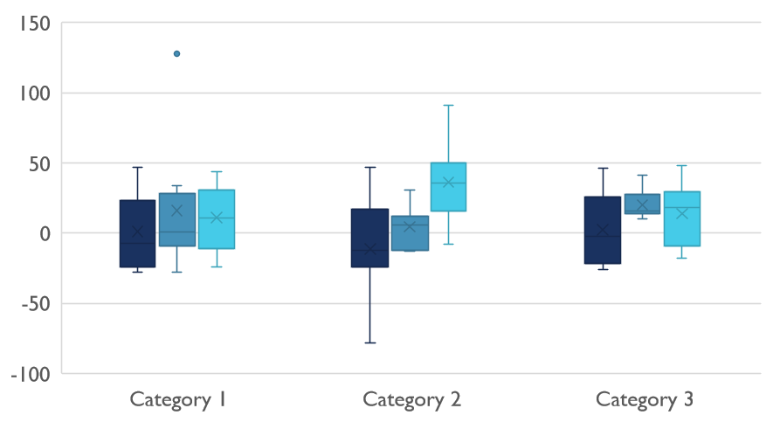
Competitive Landscape

Slide 6

Digital Communications
Cloud
Local
Hybrid

Slide 7

Thank You
someone@example.com

