Slide 1

Student Attendance and performance RELATIONSHIP study
Christopher Acornley

Slide 2
STUDY AIM
Investigate if there is a relationship between student attendance to live lectures and their grade.
This study is based on the basis that recorded versions of the lectures are available for students to view.
Students can view the same material if they cannot or decide not to attend a lecture session.
Additional aim of the investigation is to determine if providing pre-recorded lectures is a suitable substitute to live lectures.
This could mean teaching staff can focus on preparing the material ahead of term, freeing up their in-term teaching to respond to student queries, host more practical sessions, or live workshops for students.

Slide 3
External Research
Attendance vs Grades
Class Attendance in College (sagepub.com)
Credé, M., Roch, S.G. and Kieszczynka, U.M., 2010. Class attendance in college: A meta-analytic review of the relationship of class attendance with grades and student characteristics. Review of Educational Research, 80(2), pp.272-295.
A correlation between attendance and grades in a first-year psychology class. (apa.org)
Gunn, K. P. (1993). A correlation between attendance and grades in a first-year psychology class. Canadian Psychology / Psychologie canadienne, 34(2), 201–202. https://doi.org/10.1037/h0078770
Attendance and performance – ProQuest
MOORE, R., 2003. Attendance and performance. Journal of College Science Teaching, 32(6), pp. 367-371.
Pedagogic positives of recording matierall
Multiple approaches available

Slide 4
Hypothesis
Based on the existing research, it is expected there will be a close relationship between a student's attendance to class and their corresponding grade.
Due to the adoption of Blended learning approaches and the necessity of Remote teaching during lockdown, it is expected that students who chose to use the recorded materials will perform the same as the students who attended live lectures.
“Recorded Lectures provide a suitable alternative for learning should live lectures be unavailable.”

Slide 5
Limitations
The study is only focusses on attendance and achievement of a single Module at Abertay University in Scotland. Methods of content delivery may not be suitable for other institutions due to technology differences, delivery method and class structure.
Module was delivered with in three classes each week. An online one-hour live lecture, then a two-hour on-campus practical session (two practical sessions were run to accommodate cohort size).
Module is focused on material that is entirely done on a computer. As such, remote teaching is potentially easier than other subjects which could limit the impact of the results.
Study is limited to single year of attendance data.

Slide 6
Data Gathering methodology
The following data was gathered as stating in the Research Proposal:
Attendance of each class Recorded on Attendance Software (JISC)
Usage of class work and Assignments on MyLearningSpace (VLE)
Grades of Students for Marked Assignment
Views of Recorded Material
Data was gathered for sessions 2020-2021, 2021-2022, and 2022-2023.
Data for 2020-2021 only contained five registers, including one for September 2021 (next academic year). As such this data was ignored.
Data for 2021-2022 ran with lectures being recorded and sessions were discussions rather than delivery of content.
Ethics approval for this project was given based on the anonymizing of student identifications. To do this, the raw data gathered was collated into a single Spreadsheet for each year, and Student ID’s were hashed during a SHA256 Hashing algorithm (Handschuh, 2005)
Converts student number into a 256-bit hexadecimal value. Hashing processes was chosen due to the high security of the process (cannot convert Hash back into original value) and very low chance of collisions.

Slide 7
Data Gathering methodology
Attendance is gathered for all students for all classes
Students split into single lecture for all, then either group A or group B for practical
Students assigned to class based on Timetable, not class list available through attendance system and MyLearningSpace
For the purposes of this study, only students who were noted as having attended were counted as attending.
There is a possibility that some students would have attended class and not registered using the MyAbertay app, as well as students who had notified reasoning for not attending. There is also a possibility that students who had a notified reason for not attending still managed to attend. To prevent speculation, only students who are recorded as attending will be used in this study.
Attendance data in the following format was considered as not attending a class:
Not Attended
Notified Absence
Not Required

Slide 8
Analysis Methodology
Correlation
Covariance
Linear Regression

Slide 9
Analysis methodology
Overview
Correlation (Pearson, Kendall & Spearman)
Grade vs Overall Attendance (%)
Grade vs Lecture Attendance (%)
Linear Regression
Grade vs Attendance

Slide 10
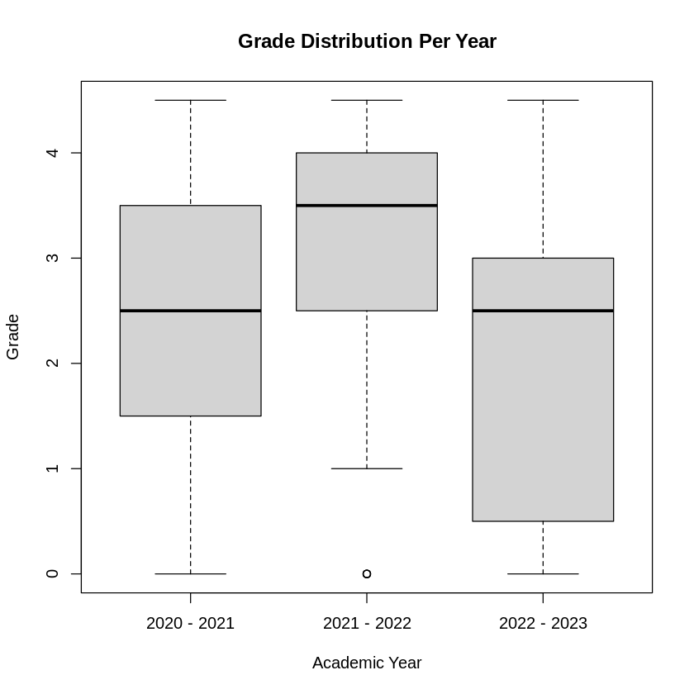
Grade Data
Grade Distribution over the three years.
Observations:
2021-2022 year, no students recorded as MF or F, only a relatively small number of NS grades
Median for 2020-2021 and 2022-2023 are the same, however general performance appears to have dropped.

Slide 11
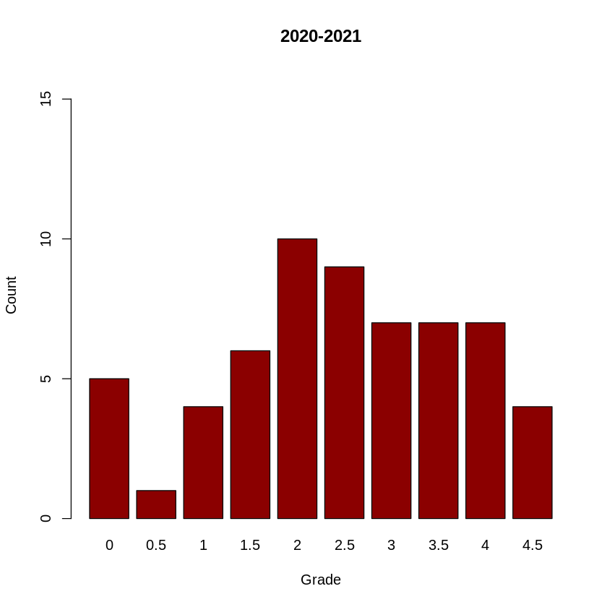
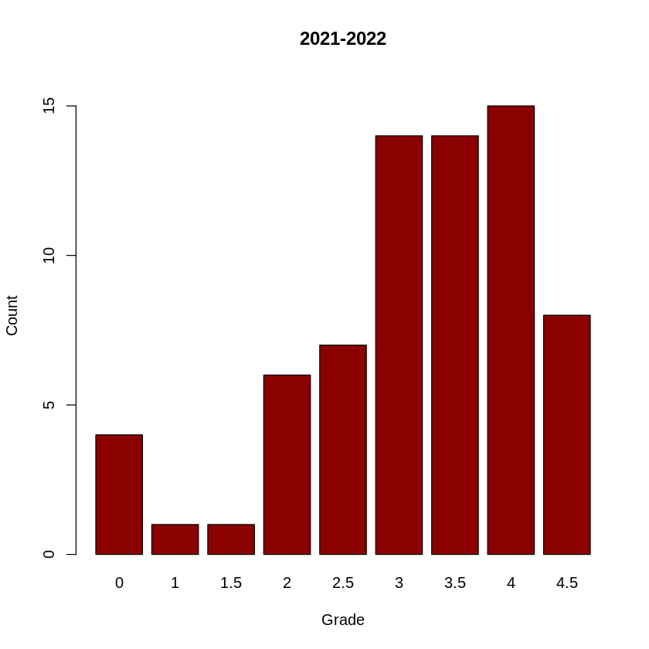
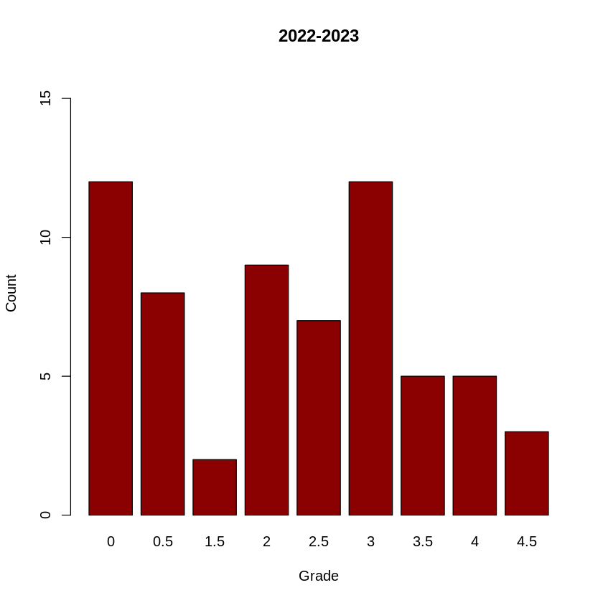
Grade Data

Slide 12
Grade Data
Heavy focus on upper grades.
No Marginal Fail or Fail grades, only 4 NS submissions.
Total students: 70
A+ | A | B+ | B | C+ | C | D+ | D | MF | F | NS
8 | 15 | 14 | 14 | 7 | 6 | 1 | 1 | 0 | 0 | 4

Slide 13
Grade Data
Larger number of students did not submit (both count and percentage of cohort size).
Assignment and grading criteria are the same.
Total students: 63
A+ | A | B+ | B | C+ | C | D+ | D | MF | F | NS
3 | 5 | 5 | 12 | 7 | 9 | 2 | 0 | 8 | 1 | 11

Slide 14
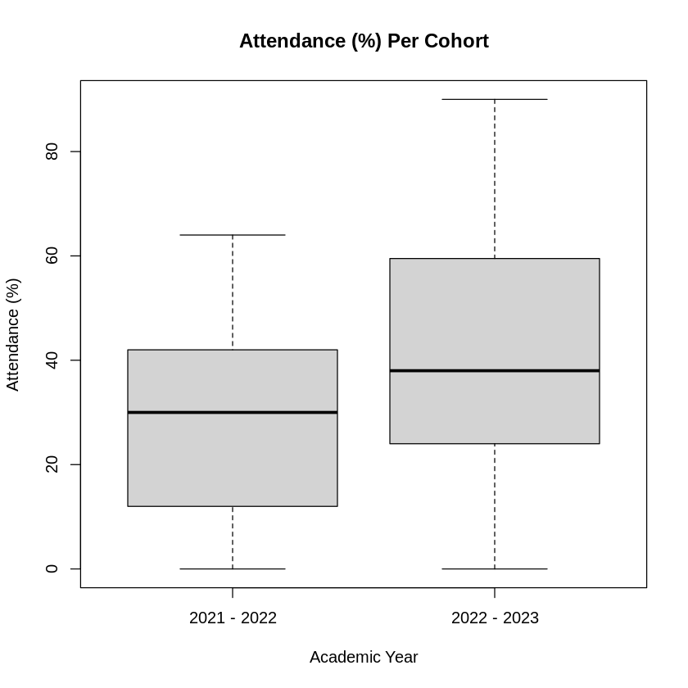
Attendance Data
Attendance Percentage for last two years.
General attendance to practical's and lectures has increased.

Slide 15
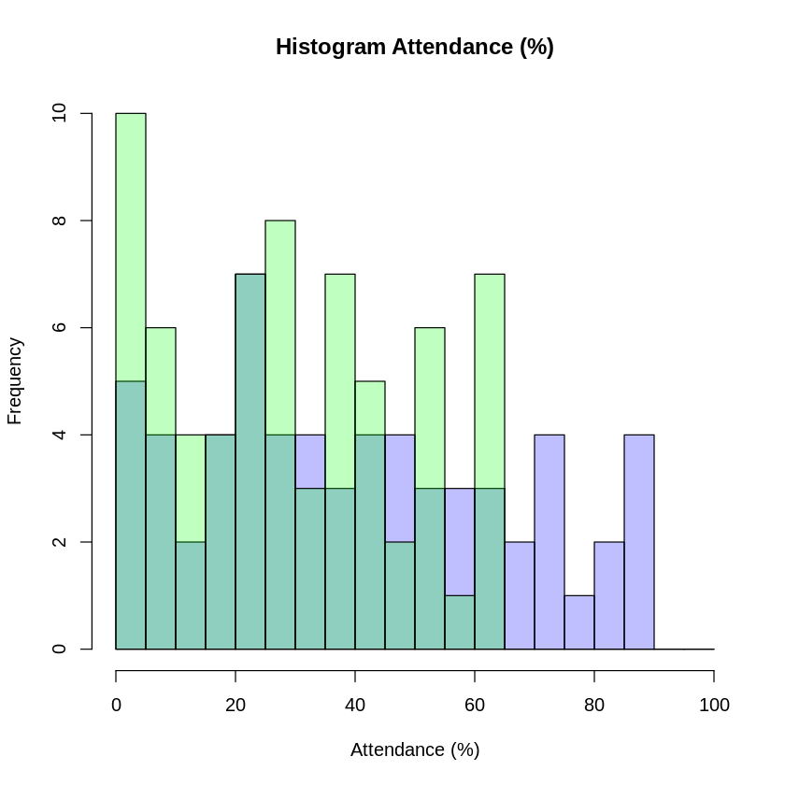
Attendance Data
Low attendance has decreased, higher rates of attendance have increased.
Comparing with grades, appears to be a decrease in grade score despite the increase in attendance in comparison to the last year.

Slide 16
Attendance Data - Lectures
Low attendance has decreased, higher rates of attendance have increased.
Comparing with grades, appears to be a decrease in grade score despite the increase in attendance in comparison to the last year.

Slide 17
Attendance Data - Practical's
Low attendance has decreased, higher rates of attendance have increased.
Comparing with grades, appears to be a decrease in grade score despite the increase in attendance in comparison to the last year.

Slide 18

Further Development
Cloud
Local
Hybrid

Slide 19
References
Handschuh, H. (2005) ‘SHA Family (Secure Hash Algorithm)’, in van Tilborg, H. C. A. (ed.) Encyclopedia of Cryptography and Security. Boston, MA: Springer US, pp. 565–567. doi: 10.1007/0-387-23483-7_388.

Slide 20

Thank You
Christopher acornley
pe02ca@uhi.ac.uk

