Slide 1

Student Attendance and performance RELATIONSHIP study
Christopher Acornley

Slide 2
STUDY AIM
Investigate if there is a relationship between student attendance (with specific focus to live lectures) and their grade.
This study is based on the basis that recorded versions of the lectures are available for students to view.
Students can view the same material if they cannot or decide not to attend a lecture session.
Additional aim of the investigation is to determine if providing pre-recorded lectures is a suitable substitute to live lectures.
This could mean teaching staff can focus on preparing the material ahead of term, freeing up their in-term teaching to respond to student queries, host more practical sessions, or live workshops for students.

Slide 3
External Research
There are numerous studies that explore the relationship between attendance and grades / academic achievement.
A study exploring a large sample of students, found a strong correlation between attendance and performance, including a substantial correlation between peer attendance and their own. (Kassarnig, et. al., 2017)
Study used Bluetooth and location data to determine the contacts a student had, as well as their location during class time to determine their attendance and their general social contacts within the class.
Use of Spearman’s correlation coefficient, and Theil-San Regression over linear regression.
Similarly, an analysis of class attendance and class grades in college classes showed a similar strong correlation between attendance and grade score (Credé, Roch, Kieszczynka, 2010)
Study mentions that a correlation coefficient above 0.50 indicates a large effect size (Cohen, 1988)

Slide 4
External Research
This trend of attendance having a positive affect on performance is referenced in older journal articles, with similar positive correlations being identified twenty (Moore, 2003) and thirty years ago (Gunn, 1993).
Karen L. St. Clair does not advise mandatory attendance in Higher Education in their article (St. Clair, 1999), referencing many articles that show a correlation between attendance and grade, but there are other factors that can influence a students grade. Included in this is:
Motivation (Van Blerkom, 1996)
Intelligence, Persistance & Personal Circumstances (Slem, 1993)
Ability at independent learning (Hyde, Flournoy, 1986)
A study focusing on student attendance and grade during the COVID-19 pandemic has also found moderate/strong correlation between attendance/online activity and grades (Finlay, Simpson, Tinnion, 2022)
Similar use of Spearman correlation was utilised.

Slide 5
External Research
In terms of including new blended learning technologies with traditional pedagogic practices, there are some sources that evaluate the introduction of these and recording technologies in teaching:
A study in Nurse Educator explored the introduction distance learning technologies to their course and their effect on grades. The consensus was the mean final grade improved over the implementation period. (Carpenter, Theeke, Smothers, 2013)
However, there are also suggestions that the use of recording systems and their availability, do not correlate with improved performance or grade. (Bacro, Gebregziabher, Fitzharris, 2010)

Slide 6
Hypothesis
Based on the existing research, it is expected there might be a close relationship between a student's attendance to class and their corresponding grade.
Due to the adoption of Blended learning approaches and the necessity of Remote teaching during lockdown, it is expected that students who are unable to or chose not to attend the live lectures will still perform well in comparison to those that do.
“Recorded Lectures provide a suitable alternative of learning to students who do not/ can not attend live lectures.”

Slide 7
Ethics Consideration
Ethics approval for this project was given based on the anonymising of student identifications. To do this, the raw data gathered was collated into a single Spreadsheet for each year, order was randomized and Student ID’s were hashed during a SHA256 Hashing algorithm (Handschuh, 2005)
Converts student number into a 256-bit hexadecimal value. Hashing processes was chosen due to the high security of the process (cannot convert Hash back into original value) and very low chance of collisions.
“The data to be evaluated contains student attendance data, student grades and their progress through the module <…>. This data needs to be anonymised and stored to prevent a GDPR breach. To accommodate this, each students identifying data (name, student number, etc.) that is included in the dataset will be removed and each student will be given an unrelated ID number. The data will be stored on a secure Abertay Research Drive and can only be accessed through the Abertay Network. See attached Data Management Plan.”

Slide 8
Data Gathering methodology
The following data was gathered as stating in the Research Proposal:
Attendance of each class Recorded on Attendance Software (JISC)
Overall use of MyLearningSpace per student (VLE)
Grades of Students for Marked Assignment
Views of Recorded Material – Unable to determine specific user (general view metric)
Data was gathered for sessions 2020-2021, 2021-2022, and 2022-2023.
Data for 2020-2021 only contained five registers, including one for September 2021 (next academic year). As such the attendance was ignored.
VLE use for 2020-2021 also reached thousands for individual users, far outpacing the use in later years.
Data for 2021-2022 ran without live lectures. Lectures were an hour for watching recorded material and another for discussion.

Slide 9
Data Gathering methodology
Attendance is gathered for all students for all classes
Students split into single lecture for all, then either group A or group B for practical
Students assigned to class based on Timetable, not class list available through attendance system and MyLearningSpace
For the purposes of this study, only students who were noted as having attended were counted as attending.
There is a possibility that some students would have attended class and not registered using the MyAbertay app, as well as students who had notified reasoning for not attending. There is also a possibility that students who had a notified reason for not attending still managed to attend. To prevent speculation, only students who are recorded as attending will be considered to have attended.
Attendance data in the following format was considered as not attending a class:
Not Attended
Notified Absence
Not Required

Slide 10

Analysis Methodology
Comparison
Correlation Statistics
Discussion

Slide 11
Comparison
Grade Changes
Attendance
Overall
Expected
Lecture
practical
VLE Use
Stream Views

Slide 12
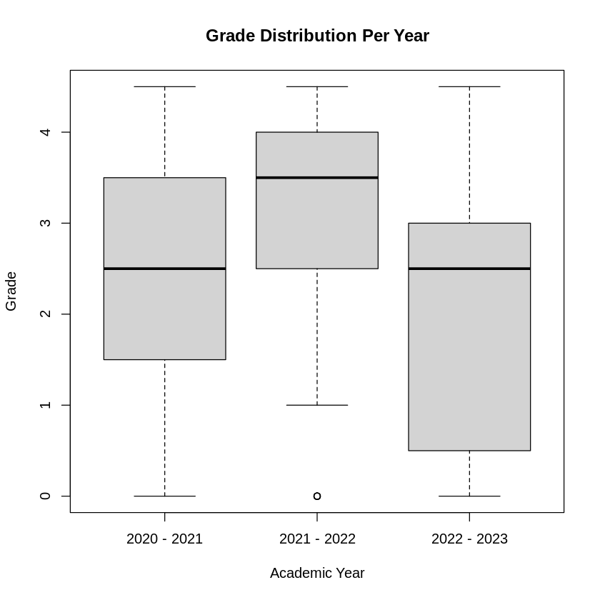
Grade Data
Grade Distribution over the three years.
Observations:
2021-2022 year, no students recorded as MF or F, only a relatively small number of NS grades
Median for 2020-2021 and 2022-2023 are the same, however general performance appears to have dropped.

Slide 13
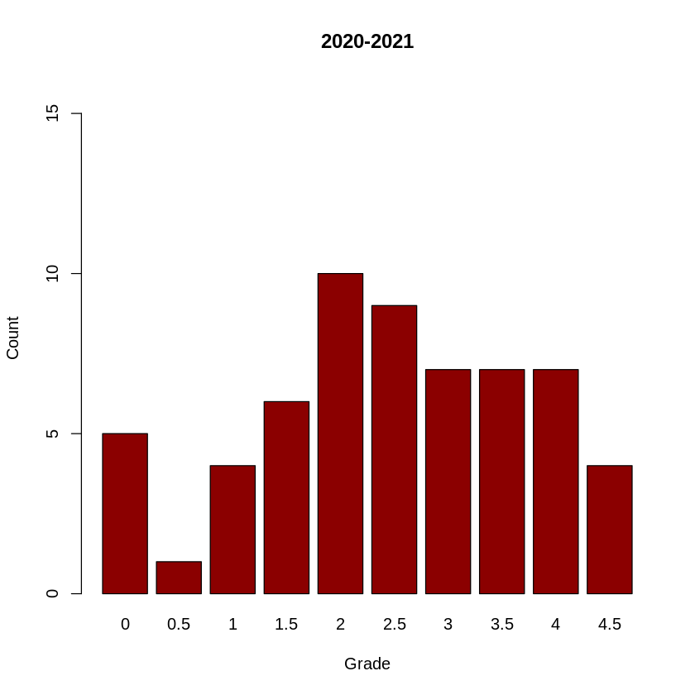
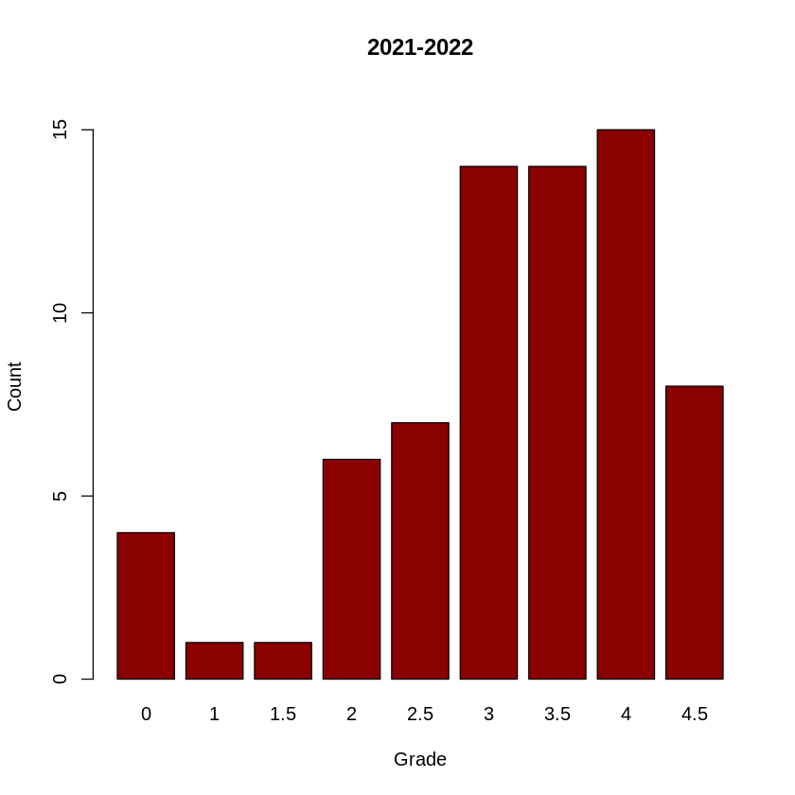
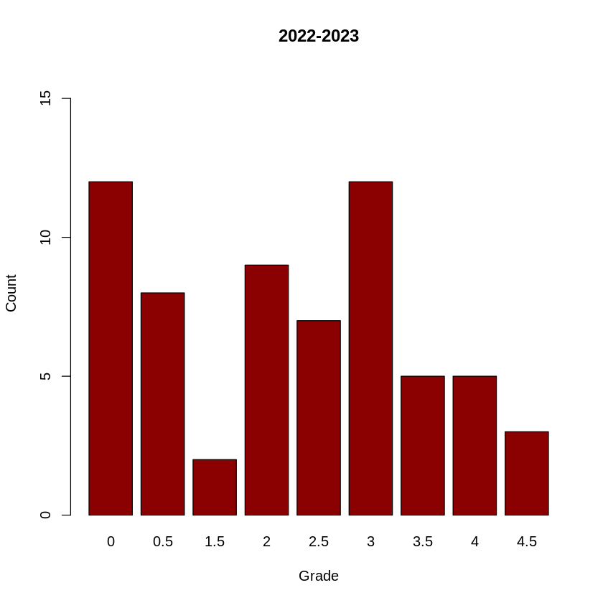
Grade Data

Slide 14
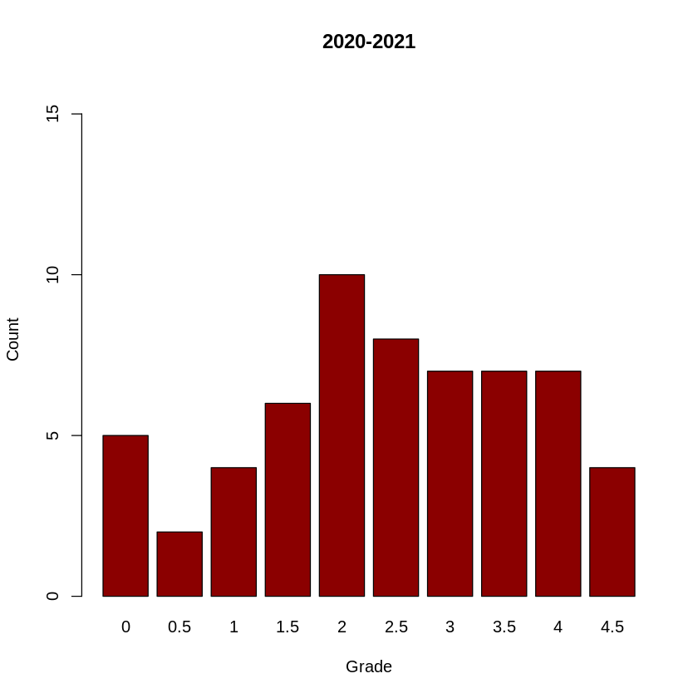
Grade Data
Relatively even distribution of grades when compared with the other years.
Mean: 2.425
Median: 2.5
Total students: 60
A+ | A | B+ | B | C+ | C | D+ | D | MF | F | NS
4 | 7 | 7 | 7 | 8 | 10 | 6 | 4 | 2 | 1 | 4

Slide 15
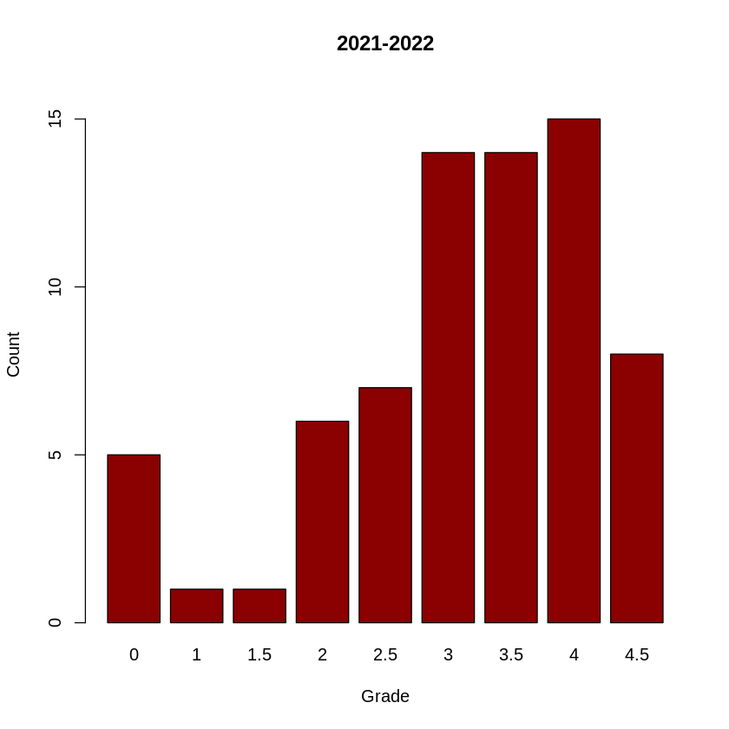
Grade Data
Heavy focus on upper grades.
No Marginal Fail or Fail grades, only 4 NS submissions.
Mean: 3.085
Median: 3.5
Total students: 71
A+ | A | B+ | B | C+ | C | D+ | D | MF | F | NS
8 | 15 | 14 | 14 | 7 | 6 | 1 | 1 | 0 | 0 | 5

Slide 16
Grade Data
Larger number of students did not submit (both count and percentage of cohort size).
Assignment and grading criteria are the same.
Marking Team different.
Mean: 2.056
Median: 2.5
Total students: 63
A+ | A | B+ | B | C+ | C | D+ | D | MF | F | NS
3 | 5 | 5 | 12 | 7 | 9 | 2 | 0 | 8 | 1 | 11

Slide 17
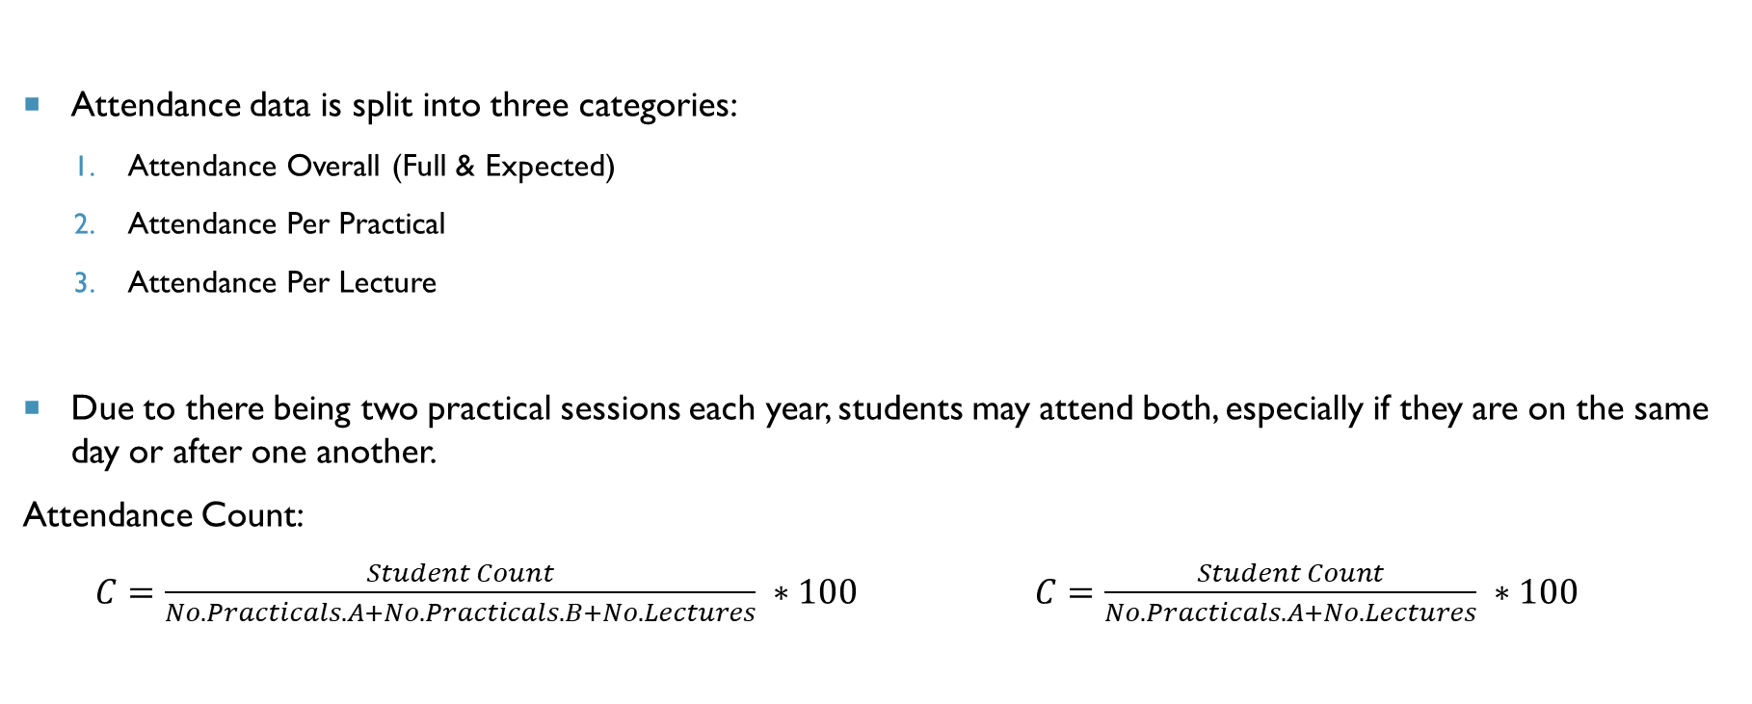
ATTENDANCE DATA
Attendance data is split into three categories:
Attendance Overall (Full & Expected)
Attendance Per Practical
Attendance Per Lecture
Due to there being two practical sessions each year, students may attend both, especially if they are on the same day or after one another.
Attendance Count:
$C=\frac{Student Count}{No. Practicals.A+No.Practicals.B+No. Lectures} ∗100$ $C=\frac{Student Count}{No. Practicals.A+No. Lectures} ∗100$

Slide 18
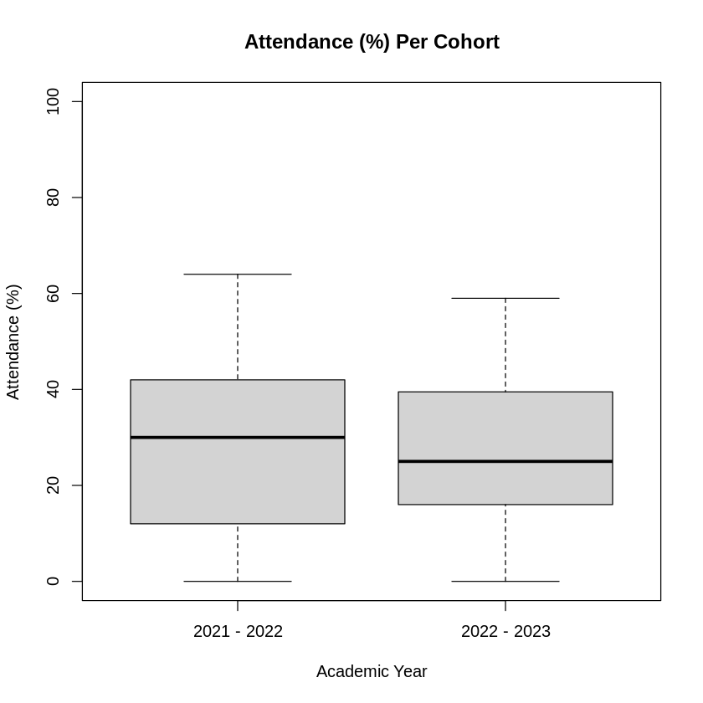
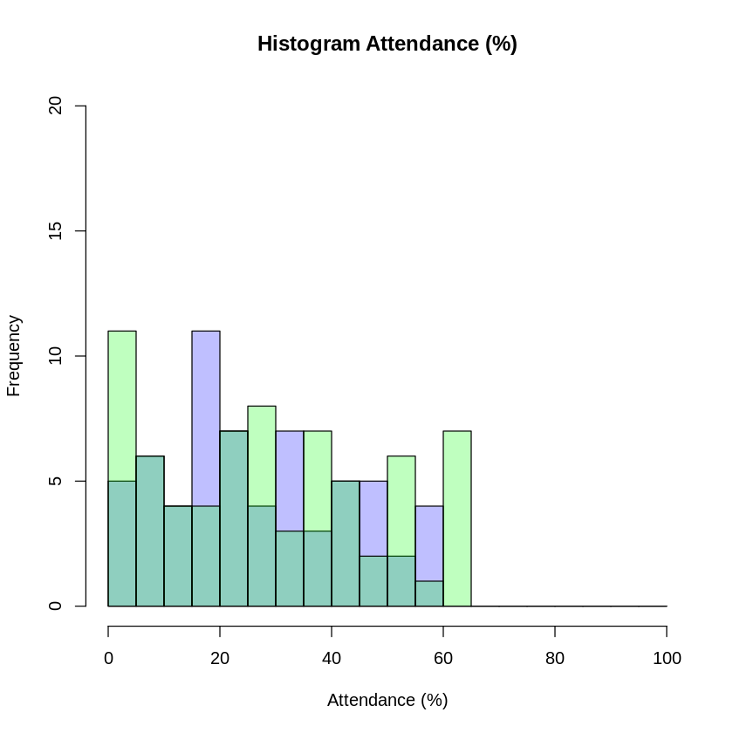
Attendance Data
Attendance Percentage for last two years.
General attendance is similar
Decrease in size of interquartile range, lower median.
2021-2022
2022-2023

Slide 19
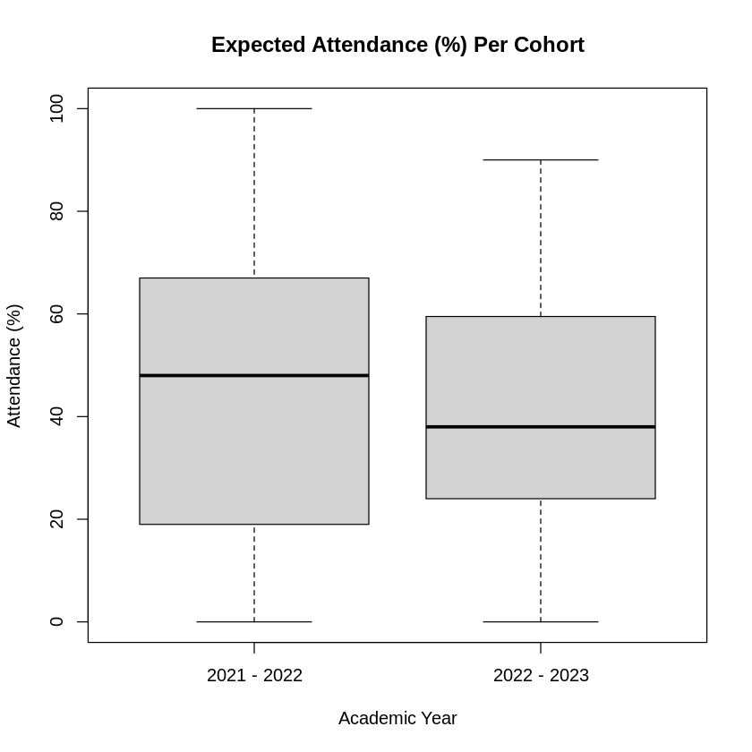
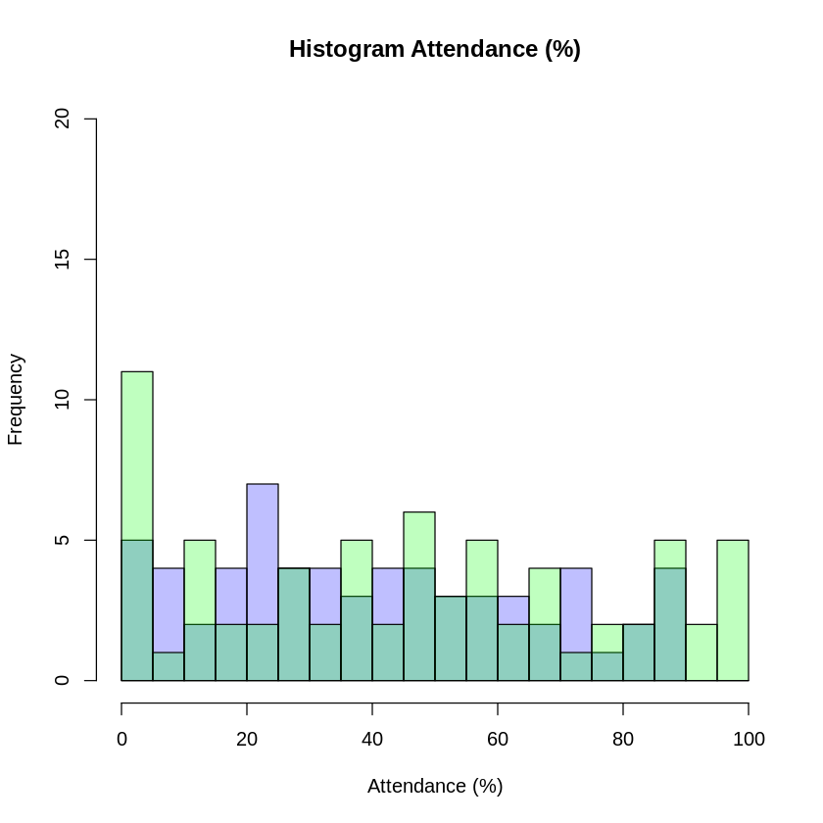
Expected Attendance Data
No student in 2022-2023 cohort managed to reach 100% attendance.
Multiple instances in 2021-2022.
Similar pattern to previous slide.
2021-2022
2022-2023

Slide 20
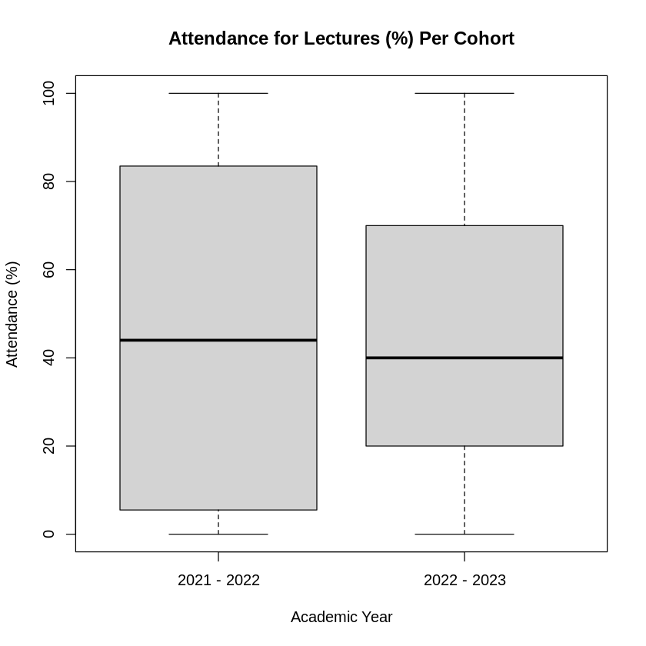
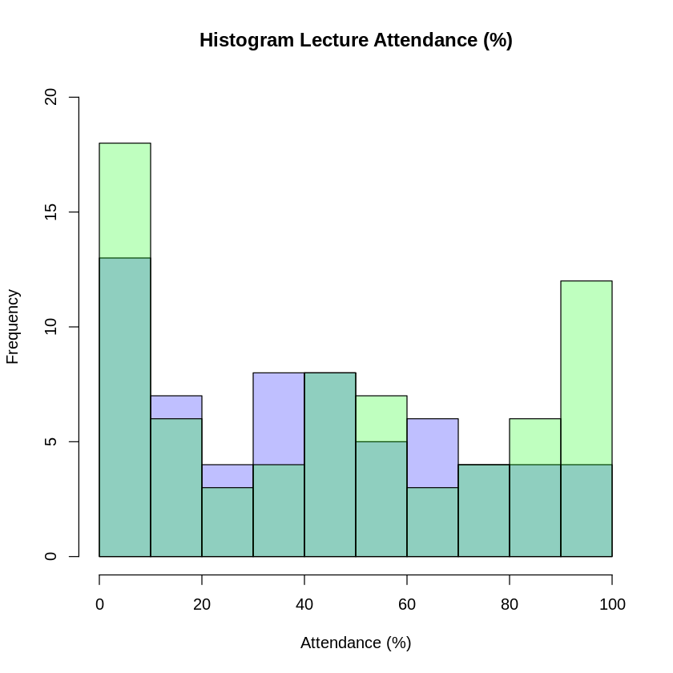
Attendance Lecture Data
Lecture attendance has similar median.
Greater spread for 2021-2022
2021-2022
2022-2023

Slide 21
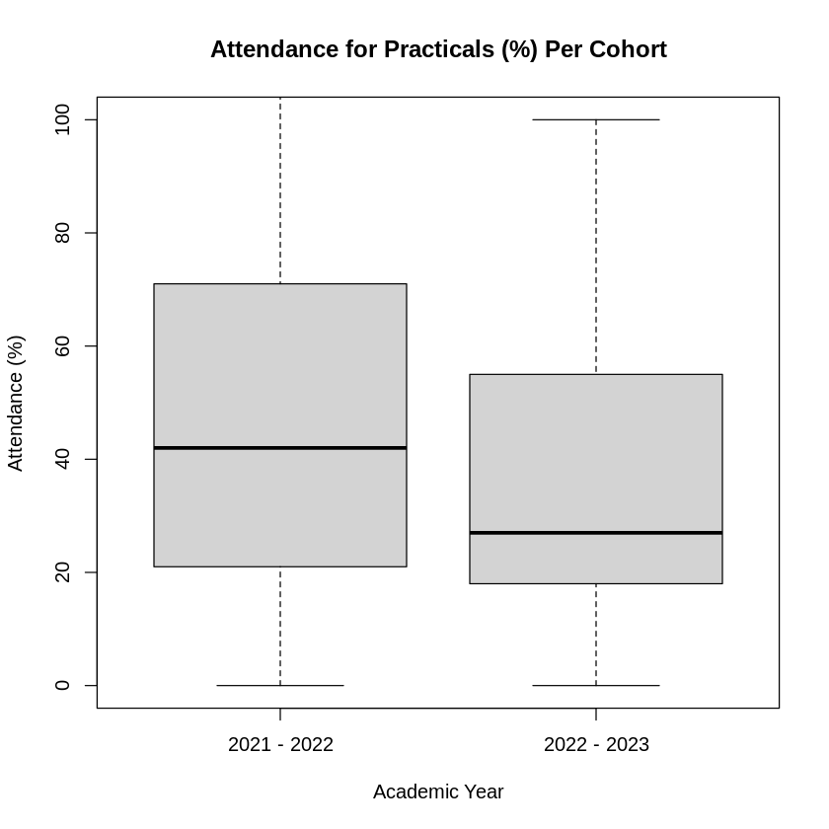
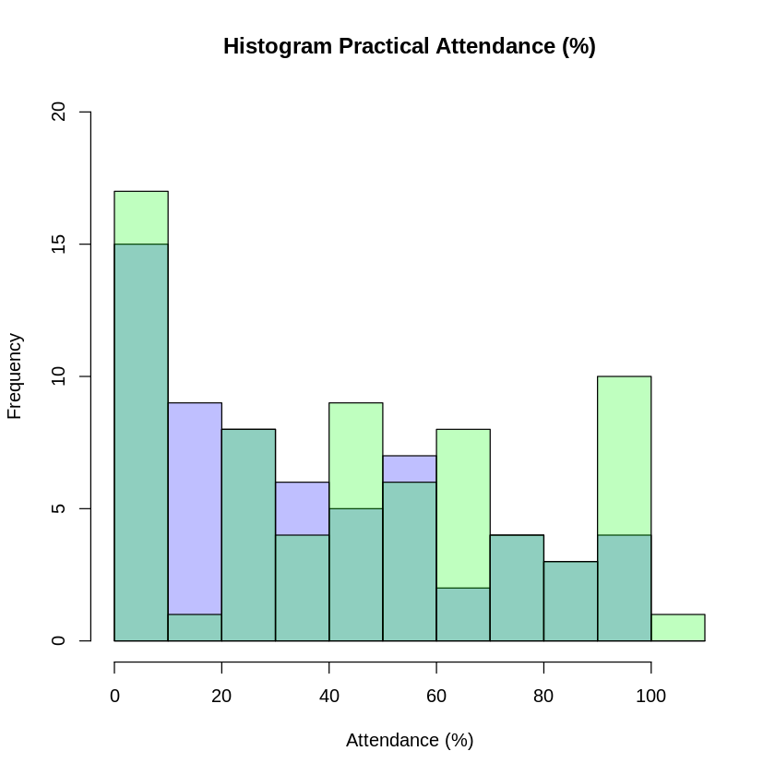
Attendance Practical Data
Clearer reduction in attendance to practical sessions.
Median reduced, range reduced.
Skewed result as some students would have attended more practical session than required (one student with 108% attendance)
2021-2022
2022-2023

Slide 22
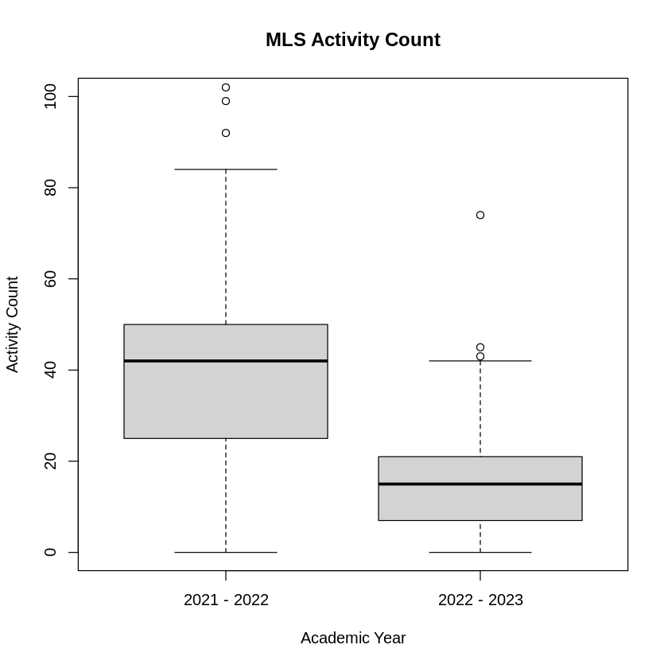
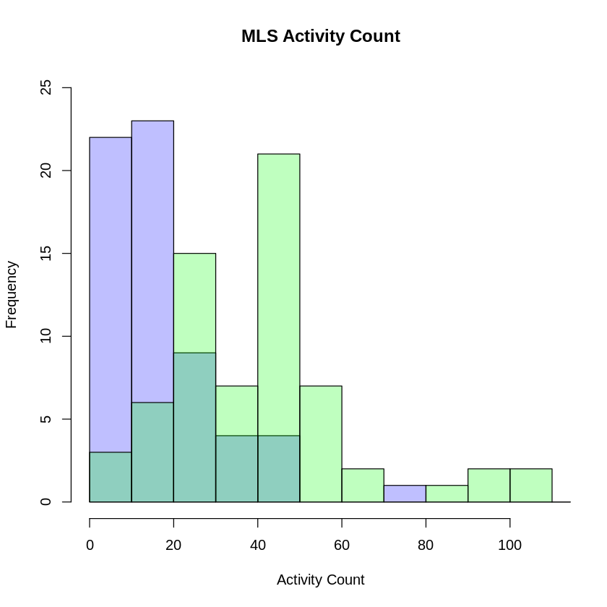
VLE Usage
MLS Count is reduced heavily from previous year.
Whilst it could be due to less student engagement, practical attendance remains similar.
Cleanup of links/topics on MLS or different style of video embedding.
Increase for 2021-2022 could also be due to students revisiting the content in later years.
2021-2022
2022-2023

Slide 23
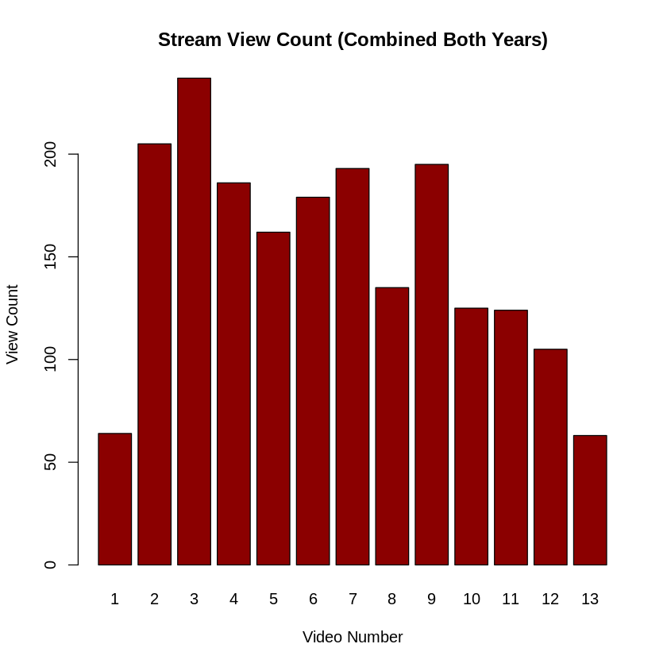
Recording Views
Recording viewings tend to decline over time.
Viewing metrics are difficult to source and how the views are counted are not known.
Videos are embedded within the VLE pages, direct links are also provided.
Views are not known to be individual users, or just each viewing.
No. | Video Name | Views
1 | CMP203 Introduction | 64
2 | Lecture CMP203 - Introduction to 3D | 205
3 | Lecture 2 CMP203 - Transforms and Hierarchical Modelling | 237
4 | Lecture 3 CMP203: Lighting Part 1 | 186
5 | Lecture 4 CMP203 Lighting Part 2 | 162
6 | CMP203 #05: Texturing | 179
7 | CMP203 Lecture - Camera | 193
8 | CMP203 #07: The Depth Buffer | 135
9 | CMP203 Lecture - Vertex Arrays | 195
10 | CMP203 #09: Model Loading | 125
11 | CMP203 Lecture - Stencil Buffer | 124
12 | CMP203 #11: Shadows | 105
13 | CMP203 - Revision and Billboarding | 63

Slide 24
Discussion
Grade average has reduced since last session, with 2021-2022 having a much higher average.
Compared to last year, attendance seems to have fallen. Average and median in all categories has gone down.
VLE usage has dropped dramatically in comparison to class attendance.
Could be seen that the lowering of attendance and VLE use is related to lowered grade.
Year | Grade(M) | Grade (Mdn) | Attendance (M) | Attendance (Mdn) | Attendance Expected (M) | Attendance Expected (Mdn) | Attendance Lecture (M) | Attendance Lecture (Mdn) | Attendance Practical (M) | Attendance Practical (Mdn) | VLE Usage Count (M) | VLE Usage Count (Mdn)
2020-2021 | 2.425 | 2.5 | N/A | N/A | N/A | N/A | N/A | N/A | N/A | N/A | NA | NA
2021-2022 | 3.085 | 3.5 | 29.27 | 30 | 46.18 | 48 | 45.85 | 44 | 46.37 | 42 | 44.29 | 42
2022-2023 | 2.056 | 2.5 | 26.63 | 25 | 40.63 | 38 | 44.92 | 40 | 36.6 | 27 | 17.11 | 15

Slide 25
Correlation – Pearson & Spearman
Grade ~ Attendance
Grade ~ Expected Attendance
Grade ~ Practical Attendance
Grade ~ Lecture Attendance
GRADE ~ VLE Use

Slide 26
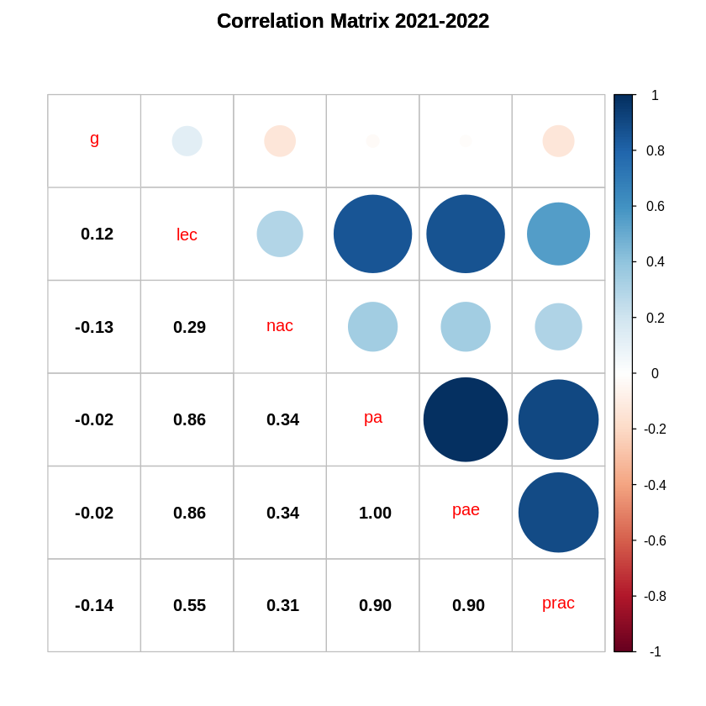
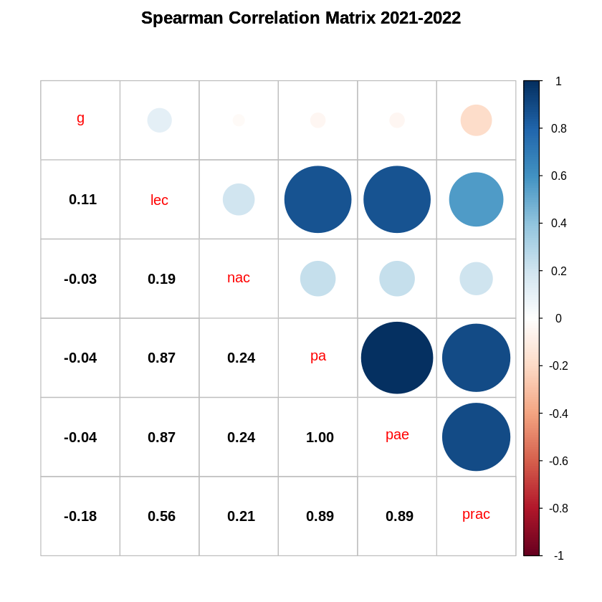
Correlation MATRIX – 2021-2022

Slide 27
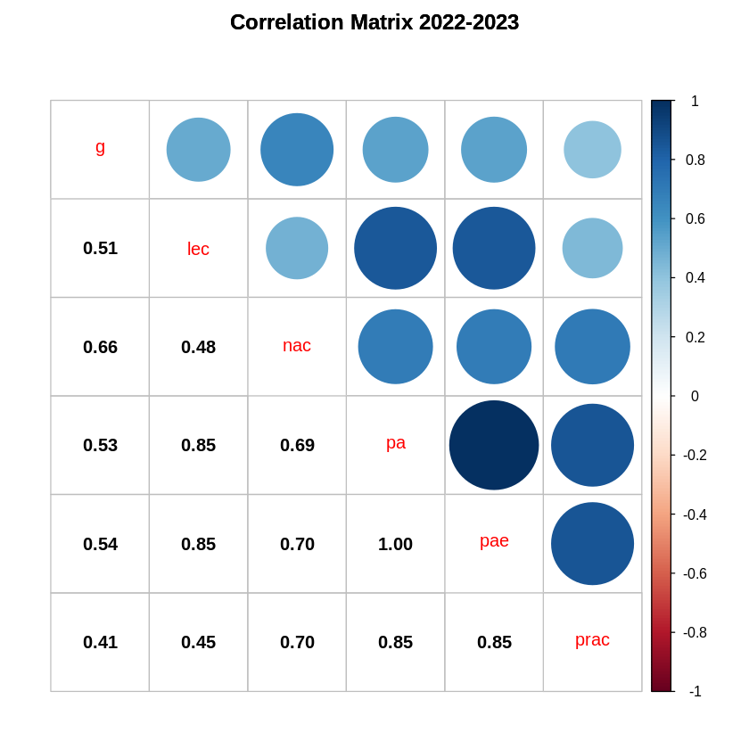
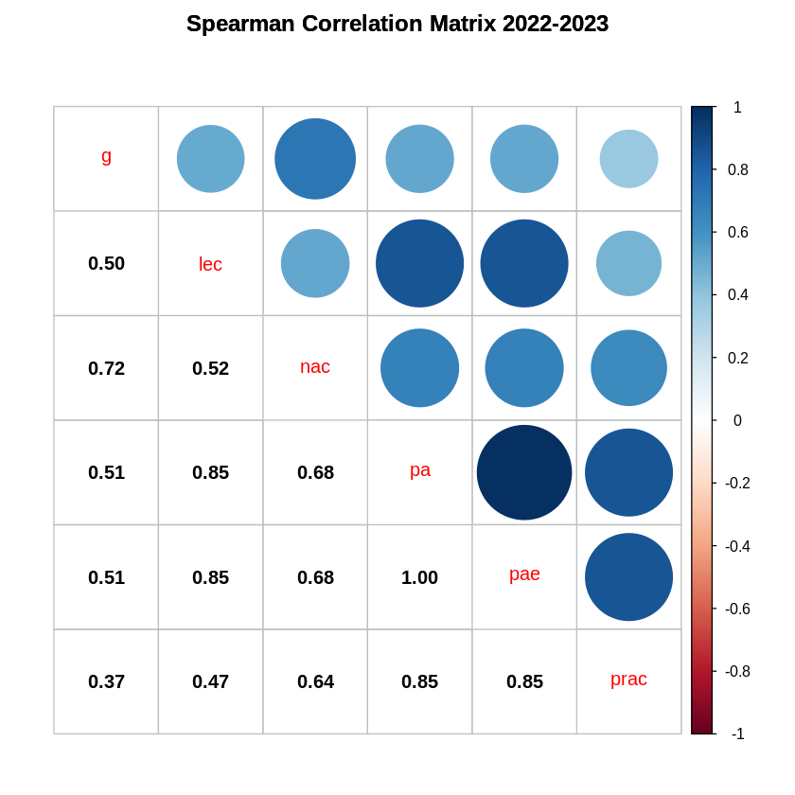
Correlation MATRIX – 2022-2023

Slide 28
Correlation MATRIX – 2022-2023
Use of Pearson’s correlation calculation
Expected linear relationship
Use of Spearman’s Correlation
Better for monotonic relationship identification
2021-2022 shows a very low correlation between attendance and grade.
Negative relationship is suggested in several cases
2022-2023 shows a stronger positive relationship
Stronger relationship between lecture attendance and grades than other attendance metrics.
Strongest overall is VLE usage

Slide 29
Regression Explanation
All five metrics were run against the three following methods of regression:
Linear Regression (RED)
Method of determining a linear relationship between the two vectors of data.
Theil-Sen Regression (BLUE)
Linear relationship regressor but less sensitive to outliers (Wilcox, 2001)
Quadradic Regression (GREEN)
Spearman correlation coefficient is similar in all cases to Pearson correlation coefficient. A quadratic regression is possible to have better accuracy.

Slide 30
P-Value for Attendance to Grade
 | 2021-2022 Attendance (%) | 2022-2023 Attendance (%) | 2021-2022 E. Attendance (%) | 2022-2023 E. Attendance (%) | 2021-2022 L. Attendance (%) | 2022-2023 L. Attendance (%) | 2021-2022 P. Attendance (%) | 2022-2023 P. Attendance (%)
Linear | 0.7351 | 0.000006301 | 0.755 | 0.000006097 | 0.5008 | 0.00002392 | 0.2767 | 0.0009853
Theil-Sen | 1 | 0.000003074 | 1 | 0.000002851 | 1 | 0.00000774 | 0.05156 | 0.0007993
Quadratic | 0.6707 | 0.00003332 | 0.6768 | 0.00003207 | 0.7849 | 0.0001263 | 0.2763 | 0.001507
P-Value helps identify if an independent variable (Attendance) is statistically significant to the dependent variable (Grade). (P-Value represents a calculated probability that the null hypothesis is true)
Significance level of 0.05 (appears to be the most common significance threshold). (Kyriacou, 2016)
Values under threshold represent a strong probability that there is a relationship between the variables.

Slide 31
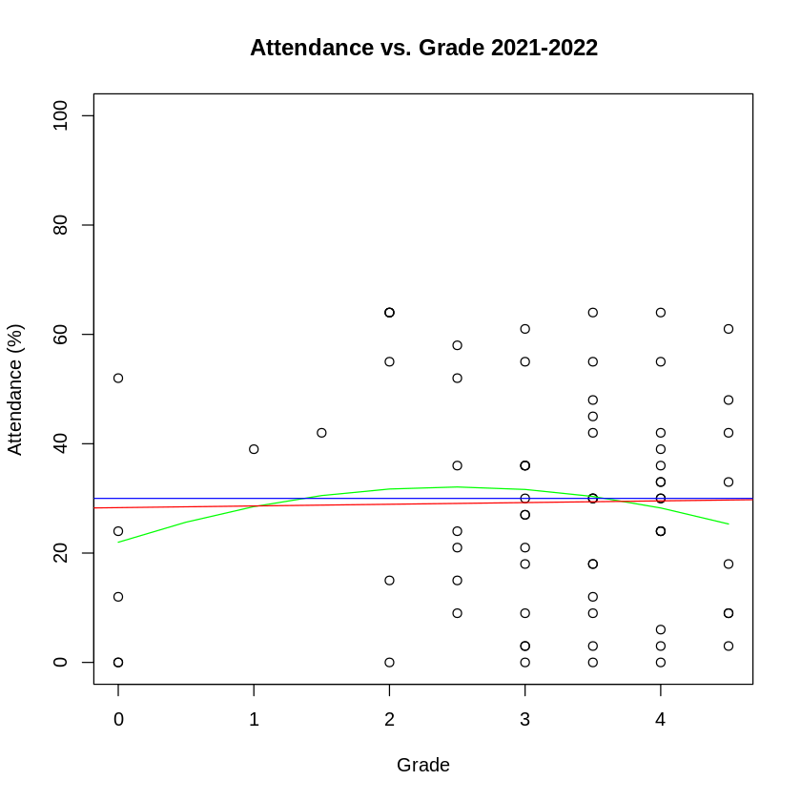
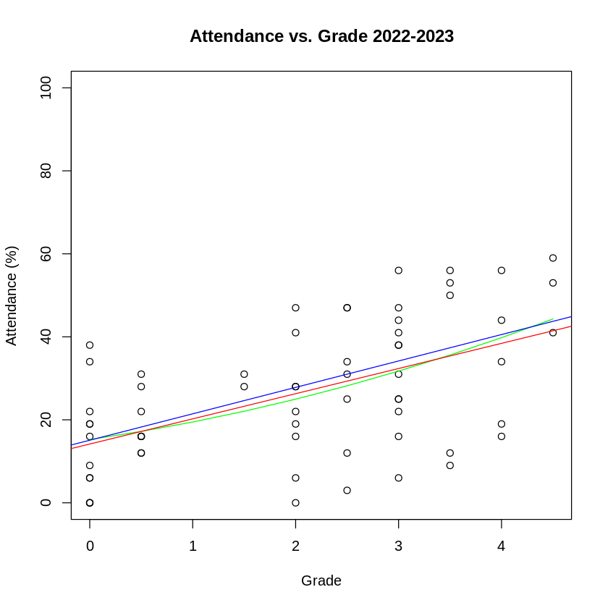
REGRESSION MODEL - ATTENDANCE
Much stronger correlation in most recent year than previous.
Reason for the difference is likely due to cohort difference, or due to method of delivery.
Content delivered is the same.
Grades from last session had no MF or F instances, results in lack of correlation.

Slide 32
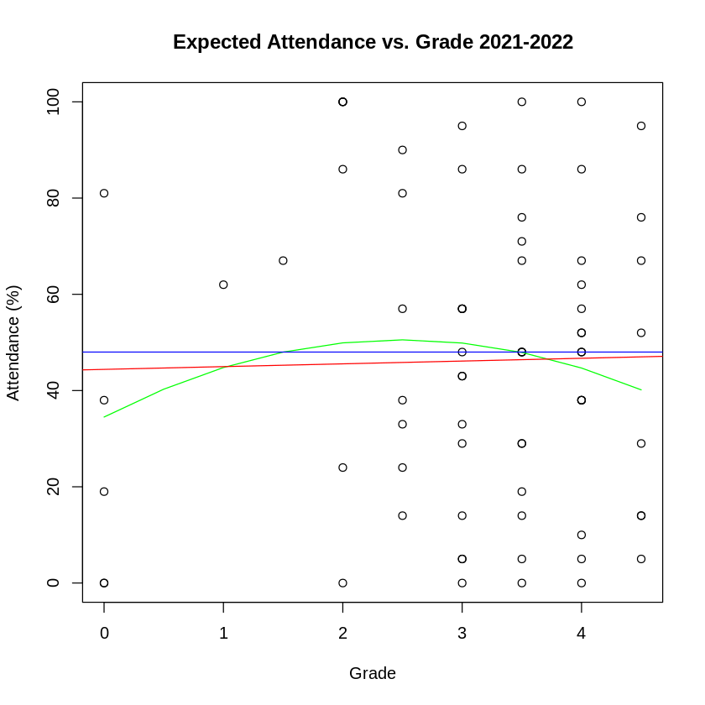
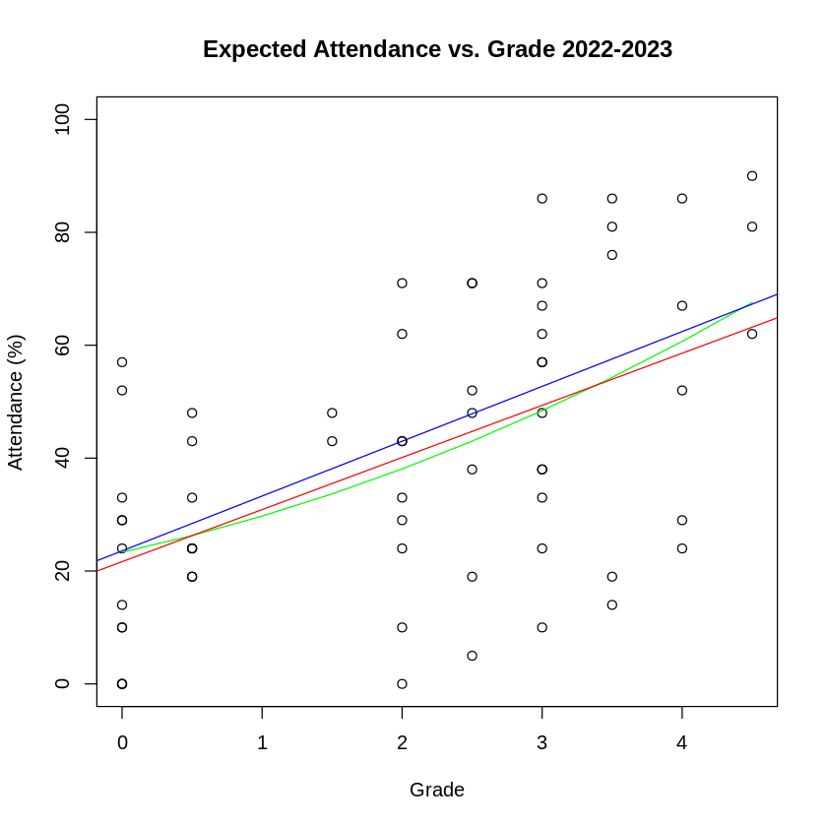
REGRESSION MODEL – Expected ATTENDANCE
Similar to previous slides, stronger correlation noticed with current year.

Slide 33
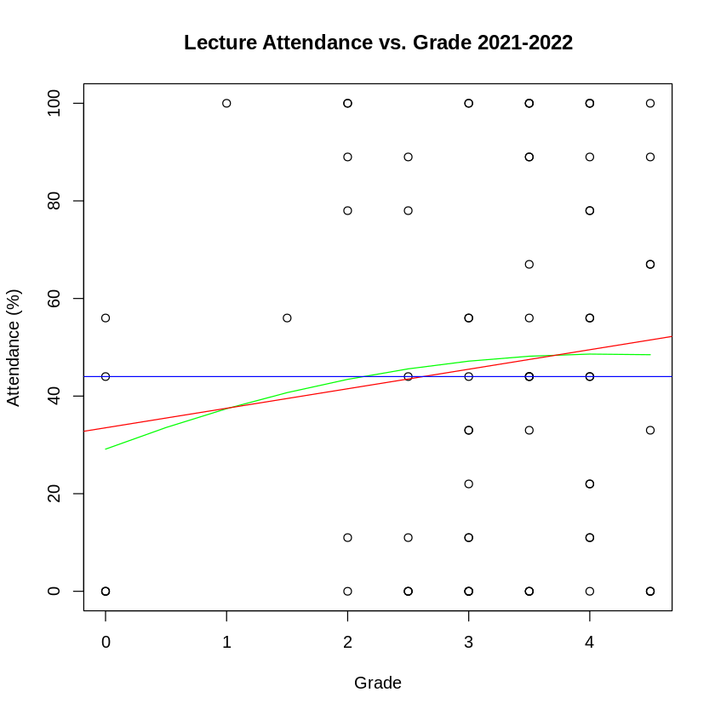
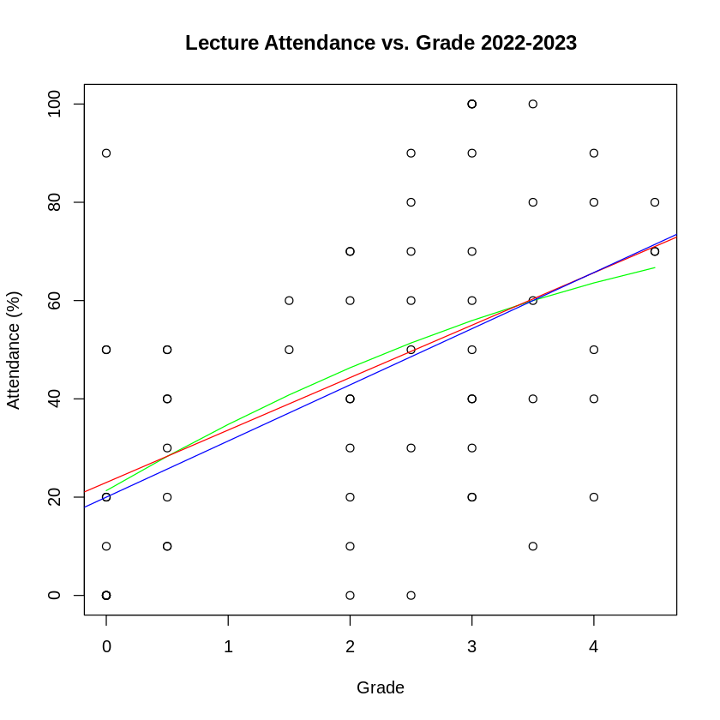
REGRESSION MODEL – LECTURE ATTENDANCE
Slight positive correlation between lecture attendance and grade with 2021-2022 data.
Similar for lectures as with regular attendance 2022-2023.

Slide 34
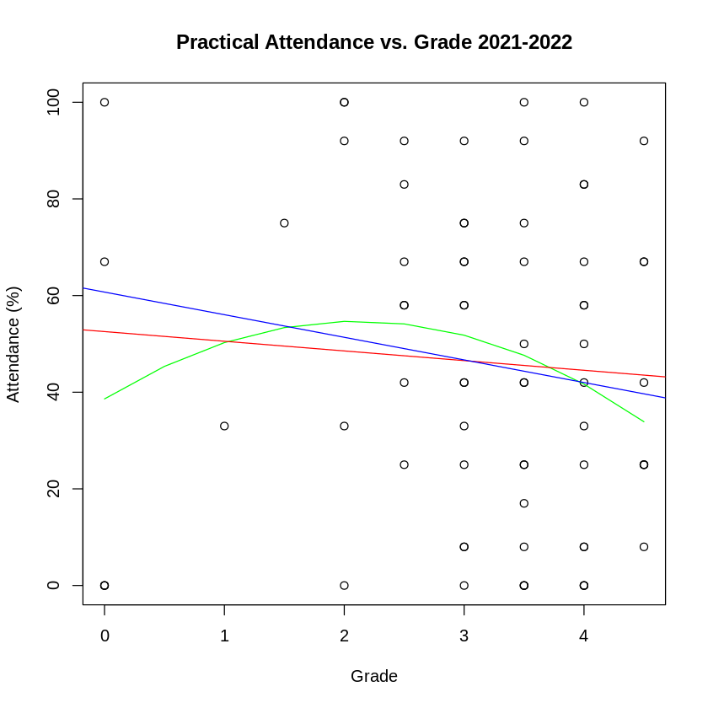
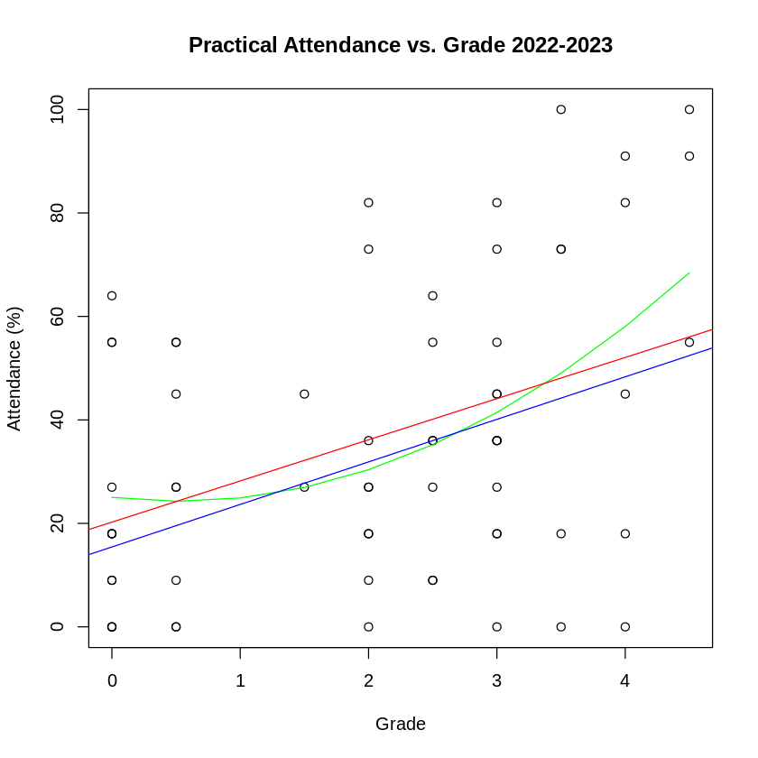
REGRESSION MODEL – PRACTICAL ATTENDANCE
2021-2022 has strongest negative correlation score (still very low at -0.1318).
Weakest positive correlation for 2022-2023 data (0.4052)

Slide 35
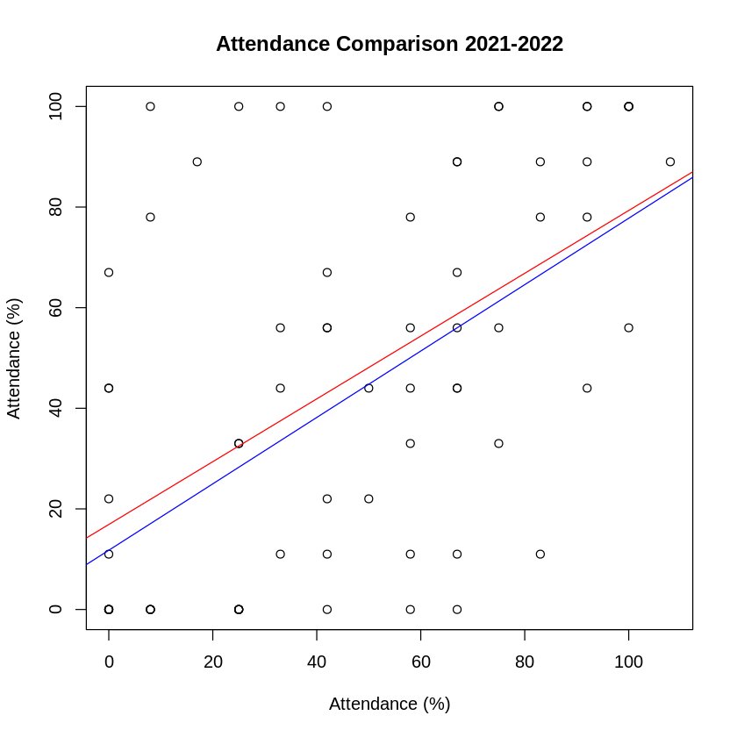
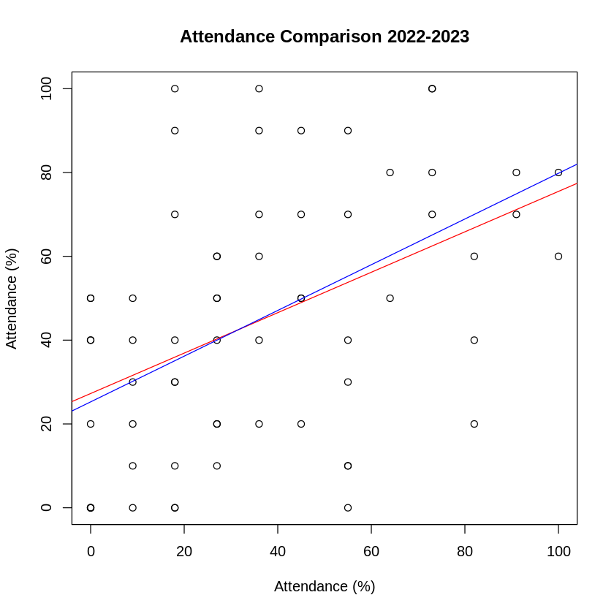
REGRESSION MODEL – PRACTICAL v. Lecture
There is a reasonable relationship between students attendance to lecture sessions and their attendance to practical sessions.
Students who have a tendency to not attend lectures have a similar tendency to their attendance to practical sessions.
0.85 – 0.87 correlation score for both years (V. Strong)
However, very wide spread of data.

Slide 36
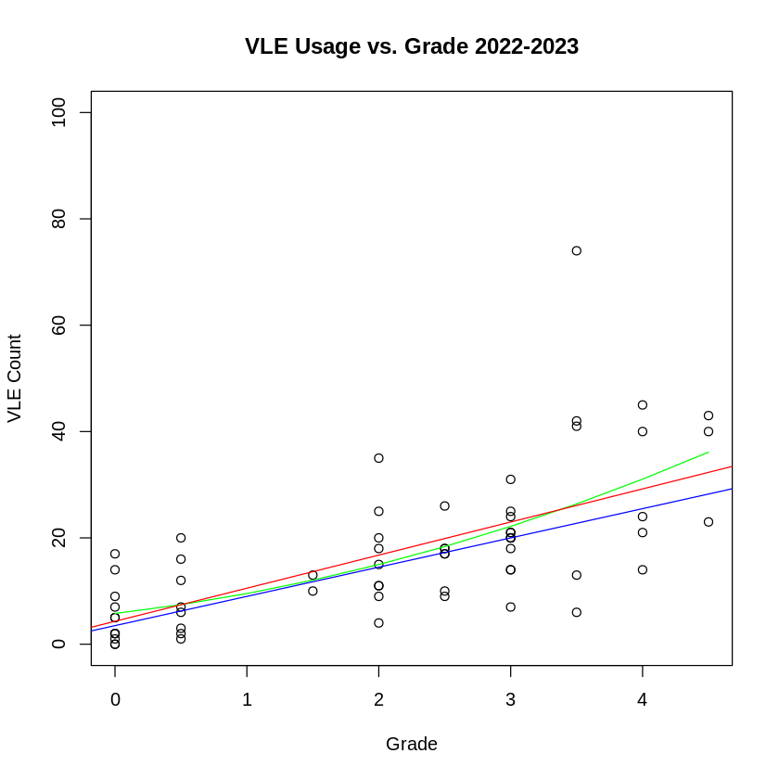
VLE Usage to Grade
 | 2021-2022 VLE Usage | 2022-2023 VLE Usage
Linear | 0.2864 | 0.000000004025
Theil-Sen | 1 | 0.0000001841
Quadratic | 0.2949 | 0.00000001816
Lowest P-Value out of any of the metrics and best correlation score.
Interaction with VLE content appears to be more important than attendance to lectures.

Slide 37
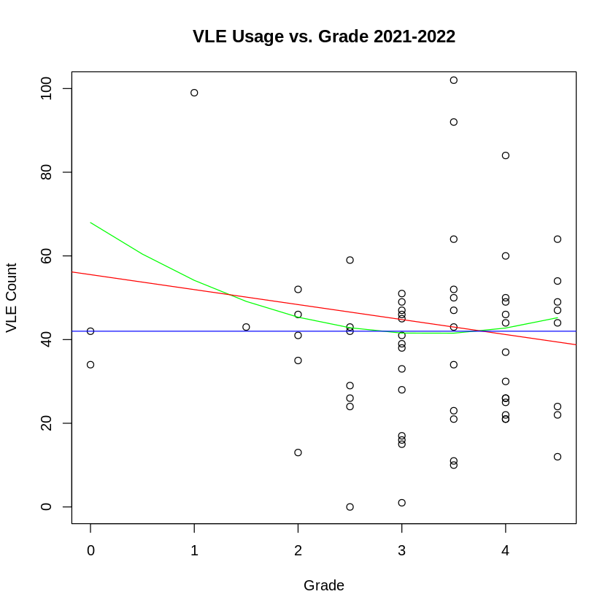
VLE Usage to Grade
 | 2021-2022 VLE Usage | 2022-2023 VLE Usage
Linear | 0.2864 | 0.000000004025
Theil-Sen | 1 | 0.0000001841
Quadratic | 0.2949 | 0.00000001816
As mentioned before, students may revisit to access material.
Correlation calculations:
Pearson: -0.13
Spearman: -0.03

Slide 38
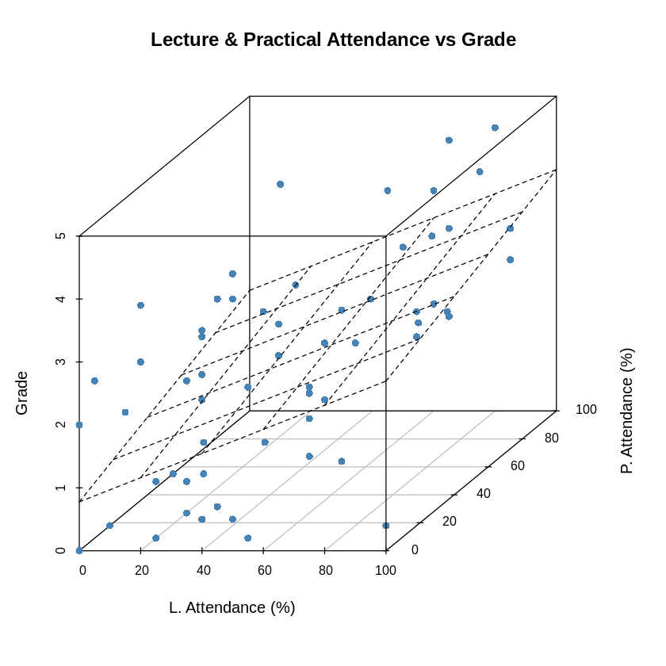
REGRESSION MODEL – Lecture & Practical - LINEAR
Further demonstrates Lecture and Practical Attendance appear to have an influence on final grade.
2022-2023
Introduced concept that lecture attendance and practical attendance have a relationship.
Students who attend lectures are more likely to attend practical sessions.
Or vice versa.

Slide 39
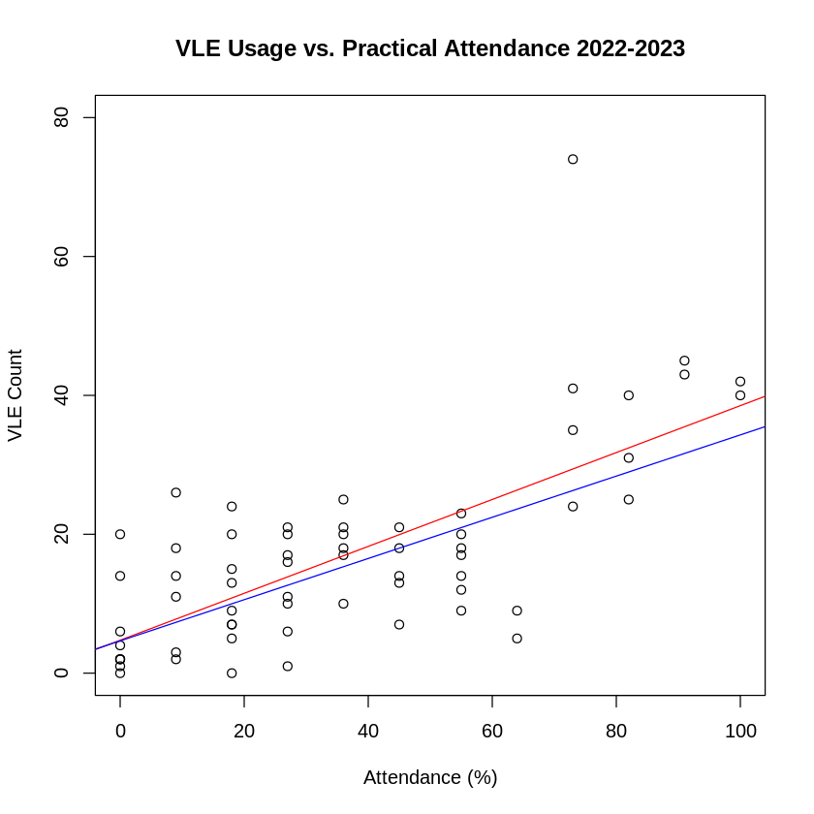
REGRESSION MODEL – Practical & VLE Use - LINEAR
Practical and VLE use share a closer correlation as students are far more likely to access VLE content during practical sessions.
Expected high correlation co-efficient.
Pearson Coefficient: 0.703
Spearman Coefficient: 0.6377
p-value Linear: 0.0000000001328
p-value Theil-Sen: 0.000000009517

Slide 40
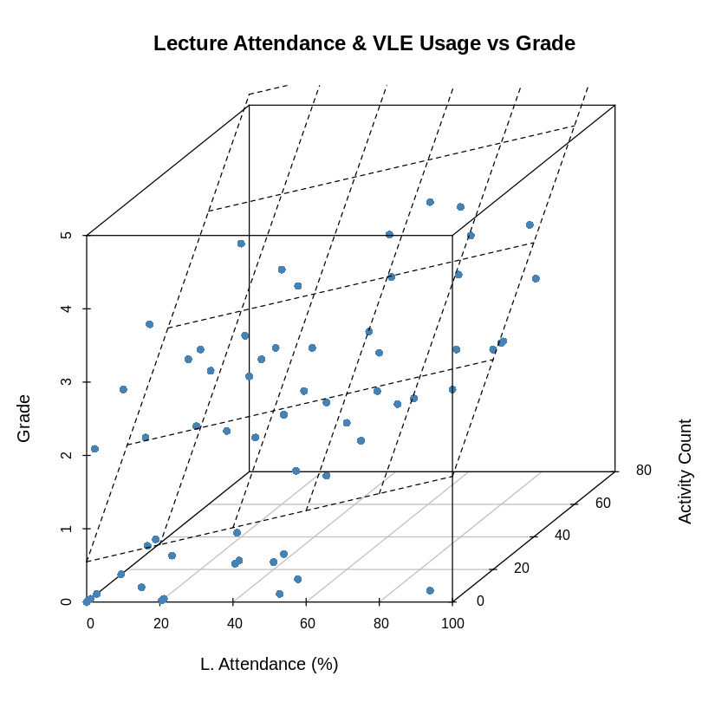
REGRESSION MODEL – Lecture & VLE Use - LINEAR
Much steeper linear plane showing a considerable influence in VLE usage in grade achievement.

Slide 41
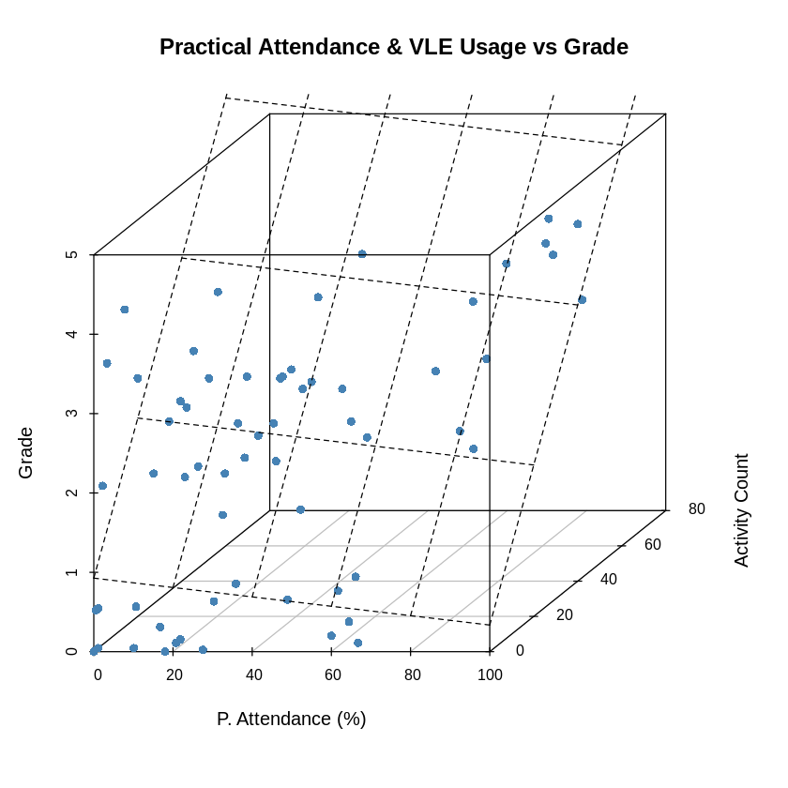
REGRESSION MODEL – Practical & VLE Use - LINEAR
Much steeper linear plane showing a considerable influence in VLE usage in grade achievement.
Note of some cases of higher practical attendance but very low VLE usage.

Slide 42
Summary
Strong correlation suggests that attendance to lecture classes has a considerable impact on achieved grade. This challenges the hypothesis, as it was expected that grade levels would remain consistent as recorded versions of them were available.
Attendance is the previous session (2021-2022) gives evidence that the method of content delivery for this year was a more suitable approach.
2021-2022: Dedicated time for watching the recorded material, time for discussion afterwards.
2022-2023: Live lecture followed by Q&A
Strongest correlation remains with VLE usage, with higher interaction with the VLE environment indicates student will achieve a higher grade.
Method of embedding videos into the VLE environment may be a contributing factors, as the VLE may not count the interaction with these elements in its statistics.
Similarly, links to external sites are not always counted by VLE analytics.

Slide 43
CONCLUSION
Discussion
HYPOTHESIS ANSWER
Limitations
FURTHER DEVELOPMENT
Impact on Teaching

Slide 44
Discussion
The best metric in the 2022-2023 cohort for grade prediction appears to be VLE use.
This seems reasonable as engagement with the content (material on VLE platform) is how students get their assignments each practical session as well as access to the lecture recordings.
For the 2022-2023 session there is a relationship between lecture attendance and achieved grade and practical attendance and achieved grade.
Whilst the spread of data is quite large, there is a calculated trend with students to have similar attendance to both classes (low attendance to one signals they will generally have low attendance for others).
In 2021-2022 session, lecture and practical attendance has almost no correlation with their achieved grade.
This suggests that the method of delivery in the most recent session not as effective as the previous session.

Slide 45
Discussion
There is also a considerable increase in the number of non-submissions, as well as submissions that are either fails, or marginal fails since the last session.
Same method of grading was used.
Not within the boundaries of this study, consideration of grades for this cohort should be explored.
General trends indicate that attendance levels overall have decreased, and grade achievement overall, has decreased as well.
Method of content delivery is more in line with approach before COVID pandemic.

Slide 46
HYPOTHESIS ANSWER
The hypothesis expected that the having recorded lectures available would mean students who did not attend the live lectures could catch up on any missed material.
As such, it was expected that attendance to lecture classes would have no relationship with achieved grades.
Explored data, on slides X and X specifically, show that student attendance (2022-2023) to lectures and practical's are linked, as well as showing each has a moderate correlation with their achieved grade.
This relationship is not present in the previous year (2021-2022) which suggests that recording lectures is useful, but not when presented as an alternative to live lecture material.
In conclusion, the hypothesis presented in this presentation is not supported by the evidence explored.

Slide 47
Limitations
The study is only focusses on attendance and achievement of a single Module at Abertay University in Scotland. Methods of content delivery may not be suitable for other institutions due to technology differences, delivery method and class structure.
Module was delivered with in three classes each week. An online one-hour live lecture, then a two-hour on-campus practical session (two practical sessions were run to accommodate cohort size).
Module is focused on material that is entirely done on a computer. As such, remote teaching is potentially easier than other subjects which could limit the impact of the results.
Study is limited to two years of attendance data.
More in-depth viewing metrics of the recordings is needed to determine if students who did not attend lectures made use of the recordings.

Slide 48
FURTHER DEVELOPMENT
Metrics for students engagement with the recorded material would help solidify the connection between VLE usage and the grade.
Implementation was links and embedded videos on VLE. Unsure how these metrics are tracked.
A wider range of years and a wider sample of classes for each year.
Comparing grade scores for classes across more than a single class and exploring similarly structured classes lecture and practical attendance could help solidify or challenge the trends found in this research.
Research methods for encouraging student engagement and attendance.
Compare these attendance results with grade achievement.

Slide 49
IMPACT on Teaching
Use of recorded material for two years has shown widely different results depending on how they are used.
Recordings being available grant students a safety net and help facilitate student learning if done correctly. (MacKay, 2019)
Even with recordings being available, there was a moderate correlation in the 2022-2023 session of attendance to lectures to achieved grade.
This is not present in the previous session (2021-2022)
If recordings are to be a main feature in class teaching, then following the practice in the 2021-2022 session.
Just having the recordings available is not enough. Perhaps manually check with students if they cannot make it to class.
More proactive in student engagement.

Slide 50
IMPACT on Teaching
Currently, simply relying on students to engage with material they have missed appears to be an impractical approach.
Recordings give students the chance to watch lecture material, their engagement is another issue.
This topic in relation to games courses requires further investigation.
Student lecture attendance vs their specific recording viewing habits.
Do students who miss lectures try to catch up?
Presently, advise teachers to record their material to enable ease of access, but suggest that there should be a system to identify students who do not attend (unless prior reason is given) and ensure they are aware of and try and encourage engagement with the recorded material.

Slide 51
IMPACT on Teaching
Availability of recordings may have an impact on student attendance. The expectation of material being available online results in students not attending their classes.
Whilst achievement of students did not fall, there was a small decrease in class attendance for classes where recorded material was available. (Leadbeater, et. al., 2013)
This study is far before the COVID pandemic. Change of expectations since the event.

Slide 52

Thank You
Christopher acornley
1000697@UAD.ac.uk

Slide 53
References
Bacro, T. R. H., Gebregziabher, M. and Fitzharris, T. P. (2010) ‘Evaluation of a lecture recording system in a medical curriculum’, Anatomical Sciences Education, 3(6), pp. 300–308. doi: 10.1002/ase.183.
Carpenter, R., Theeke, L. and Smothers, A. (2013) ‘Enhancing Course Grades and Evaluations Using Distance Education Technologies’, Nurse Educator, 38(3). Available at: https://journals.lww.com/nurseeducatoronline/Fulltext/2013/05000/Enhancing_Course_Grades_and_Evaluations_Using.17.aspx
Cohen, J. (1988). Statistical Power Analysis for the Behavioral Sciences (2nd ed.). Routledge. https://doi.org/10.4324/9780203771587
Credé, M., Roch, S. G. and Kieszczynka, U. M. (2010) ‘Class Attendance in College: A Meta-Analytic Review of the Relationship of Class Attendance With Grades and Student Characteristics’, Review of Educational Research, 80(2), pp. 272–295. doi: 10.3102/0034654310362998.
Finlay, M. J., Simpson, T. and Tinnion, D. J. (2022) ‘Association between attendance, online course activity time, and grades: Analysis of undergraduate sport science cohorts during the COVID-19 pandemic’, The journal of hospitality, leisure, sport & tourism education, 31, p. 100397.

Slide 54
References
Gunn, K. P. (1993). A correlation between attendance and grades in a first-year psychology class. Canadian Psychology / Psychologie canadienne, 34(2), 201–202. https://doi.org/10.1037/h0078770
Handschuh, H. (2005) ‘SHA Family (Secure Hash Algorithm)’, in van Tilborg, H. C. A. (ed.) Encyclopedia of Cryptography and Security. Boston, MA: Springer US, pp. 565–567. doi: 10.1007/0-387-23483-7_388.
Hyde, R. M., & Flournoy, D. J. (1986). A case against mandatory lecture attendance. Journal of Medical Education, 61(3), 175–176.
Kassarnig, V. et al. (2017) ‘Class attendance, peer similarity, and academic performance in a large field study’, PloS one. United States, 12(11), p. e0187078. doi: 10.1371/journal.pone.0187078.
Kyriacou, D. N. (2016) ‘The Enduring Evolution of the P Value’, JAMA, 315(11), pp. 1113–1115. doi: 10.1001/jama.2016.2152.
Leadbeater, W. et al. (2013) ‘Evaluating the use and impact of lecture recording in undergraduates: Evidence for distinct approaches by different groups of students’, Computers & Education, 61, pp. 185–192. doi: 10.1016/j.compedu.2012.09.011.

Slide 55
References
Slem, C. M. (1983, April). Relationship between classroom absenteeism and stress risk/buffer factors, depressogenic attributional style, depression and classroom academic performance. Paper presented at the annual meeting of the Western Psychological Association, San Francisco, CA.
MacKay, J. R. D. (2019) ‘Show and “tool”: How lecture recording transforms staff and student perspectives on lectures in higher education’, Computers & Education, 140, p. 103593. doi: 10.1016/j.compedu.2019.05.019.
MOORE, R., 2003. Attendance and performance. Journal of College Science Teaching, 32(6), pp. 367-371.
St. Clair, K. L. (1999) ‘A Case Against Compulsory Class Attendance Policies in Higher Education’, Innovative Higher Education, 23(3), pp. 171–180. doi: 10.1023/A:1022942400812.
Wilcox, R. R. (2001) Fundamentals of Modern Statistical Methods: Substantially Improving Power and Accuracy. Springer (Springer Nature Book Archives Millennium). Available at: https://books.google.co.uk/books?id=YSFb4QX2UIoC.
Van Blerkom, M. L. (1996, August). Academic perseverance, class attendance, and performance in the college classroom. Paper presented at the meeting of the American Psychological Association, Toronto, Ontario, Canada.

