Slide 1
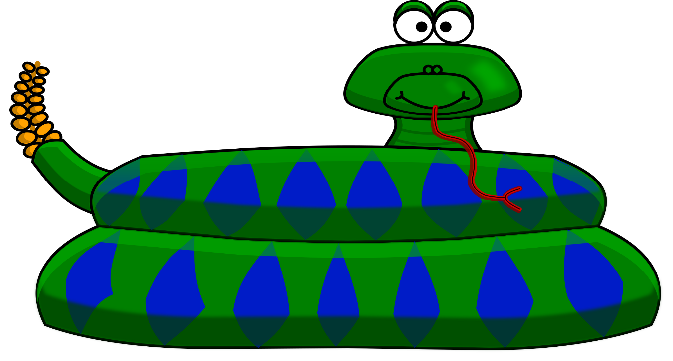
NODE TEAM
Chris, Matteo, Tamin

Slide 2

ELEVETOR PITCH
Description
Snake Express is a video game genre where the player manoeuvres a growing line that becomes a primary obstacle to itself
Gameplay:
The player controls a line that looks like a snake a on bordered plane. As it moves forward, it leaves a trail behind, resembling a moving snake.
The end of the trail is in a fixed position, so the snake continually gets longer as it moves
When the snake collides with itself, the player loses.

Slide 3

CONCEPT
User Story
As a gamer I want to surf the net and to play Snake and my scores to be saved;
SO THAT I can assess whether I am improved and compare my results to other players around the world.

Slide 4





TECNOLOGIES
❏Node JS
❏ React JS
❏ Apollo GraphQL
❏ MongoDB
❏ Heroku
❏ Express
❏ JWT Authentication

Slide 5
ROLES and CHALLENGES
Roles:
Matteo - Front End (components and interface)
Tamin – Models at early stage
Chris – Game play (from an existing one) and Back End
Challenges:
Coordinating with the team to ensure that we are on the same page with functionality and design
Technically challenging and continuously learning
Motivating each other to deliver on our goal

Slide 6
SNAKE GAME ENGINE
ENGINE
Researched and analysed 4 different game engines
Clean and easily maintainable
Easy to integrate against, extend and adapt
Simple to customise
Run stand-alone with a small number of files
Robust and function well
This project extended the existing game engine and enabled a persistent high score model for multiple players.

Slide 7
FUTURE DEVELOPMENT
Areas for development
Improve interface
Add more features
Add game level: easy, normal, hard

Slide 8
DEMO

