Slide 1

CS+Social Good

Slide 2

Mental Health Project:
Creating a Database for Personalized Resources

Slide 3
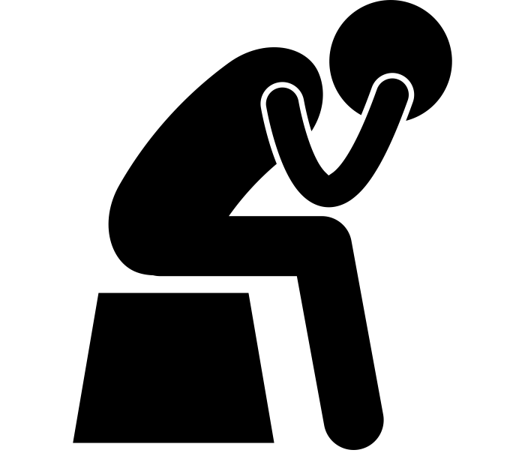

The Problem
Notes:
Made up of starting/closing tags and attributes

Slide 4
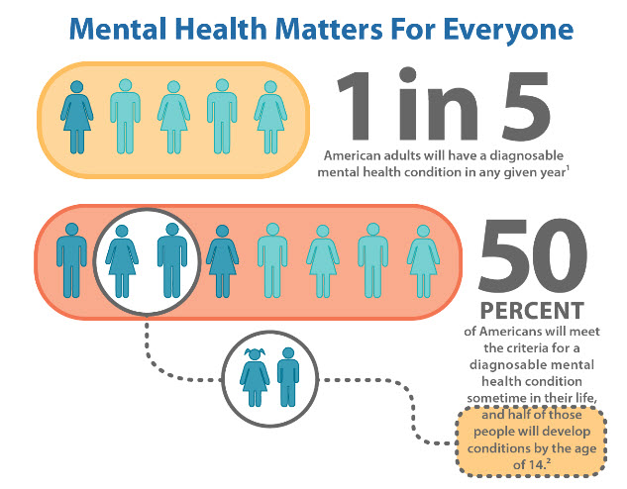
The Problem
Mental health affects millions of people every year.
Notes:
Made up of starting/closing tags and attributes

Slide 5
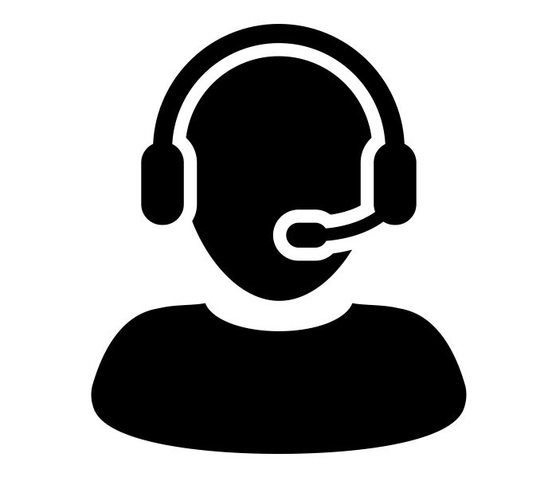
Our Task
Connect people to specific resources catered towards their specific needs.
Notes:
Made up of starting/closing tags and attributes

Slide 6
What Does CS Have to Do With This?
Use your knowledge in objects, classes, arrays, scanners, for-loops, substrings, and more to create a database to connect real people to their most specific resource.
Notes:
Made up of starting/closing tags and attributes

Slide 7
CS+Social Good

