Slide 1

The PHM ExploreR: Data tables
Andras Varady
Anna Powell
Richard Wood
@BNSSGAnalytics
Notes:
This isn’t final version
Current release scheduled for Feb
We’ll be doing a survey to see how interested in accessing

Slide 2
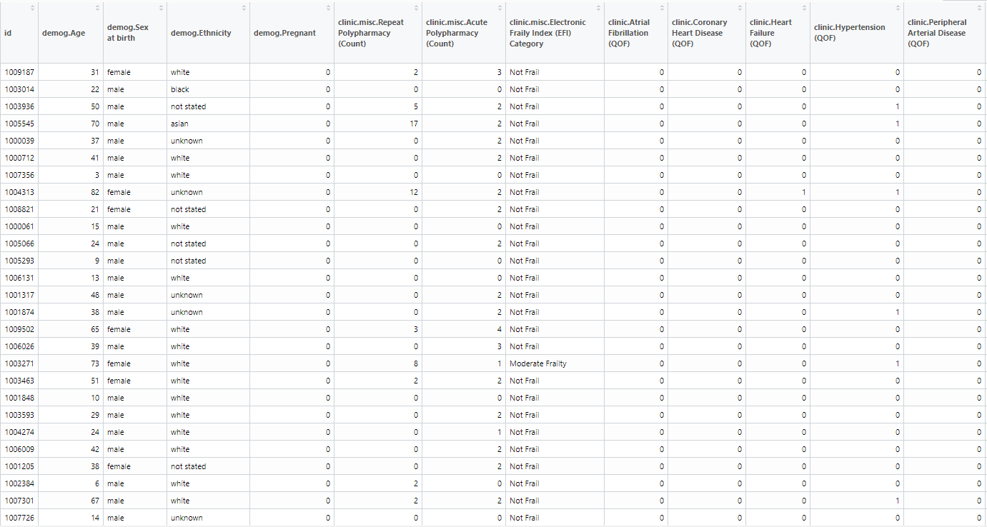
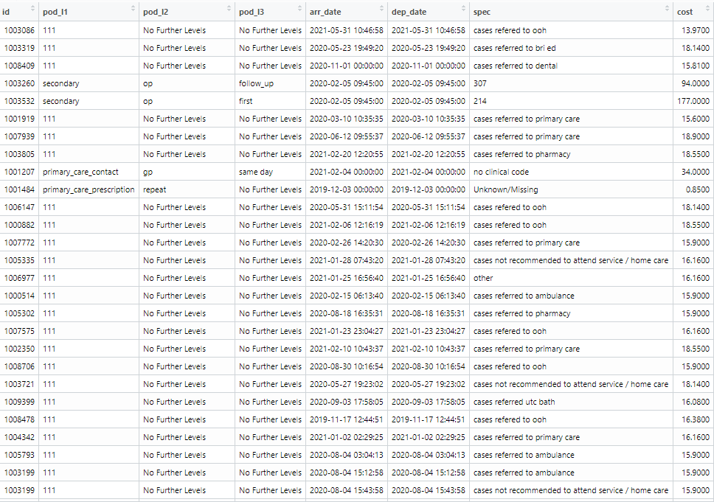
ExploreR Data Tables
Two separate data files (.csv or .rds format) linked by patient ID
Attributes
Activity

Slide 3
Attributes table
Demographic, clinical and socio-economic attributes data
Header prefixes define data type
One patient per row

Slide 4
Attributes table: minimum data requirements
Sex
Age
Ethnicity
Deprivation
At least one geographical field (e.g. locality, PCN)
At least one clinical condition

Slide 5
Activity table
Patient IDs links to attribute table
One activity event per row

Slide 6
Activity table: minimum data requirements
Point of Delivery (POD): classifies activity types (as many as convenient)
Arrival Date
Departure Date
Specialty
Cost

Slide 7
We will now start the interactive part of the workshop!

Slide 8
Any questions?
Please fill out our survey to be kept up to date with developments (link in chat) – thank you!
@BNSSGAnalytics

