Slide 1

The PHM ExploreR An open-source suite to facilitate engagement in Population Health Management
Andras Varady
Anna Powell
Richard Wood
@BNSSGAnalytics
Notes:
This isn’t final version
Current release scheduled for Feb
We’ll be doing a survey to see how interested in accessing

Slide 2
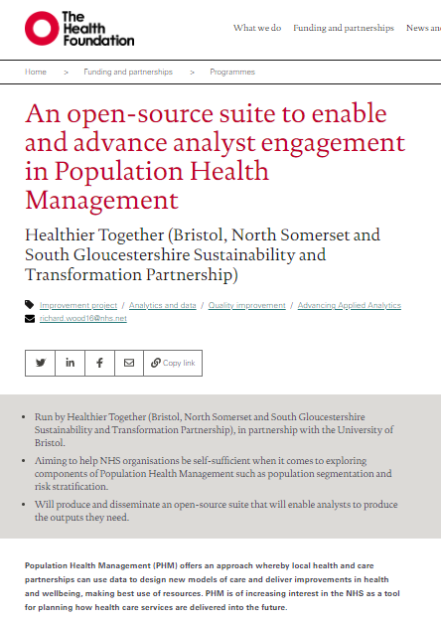
Funding and support
We gratefully acknowledge the support to this project provided by The Health Foundation.
This has been funded under Round 4 of the Advancing Applied Analytics award.
Notes:
There will be time to ask questions as we go
I’ll be watching the chat to key an eye in question

Slide 3
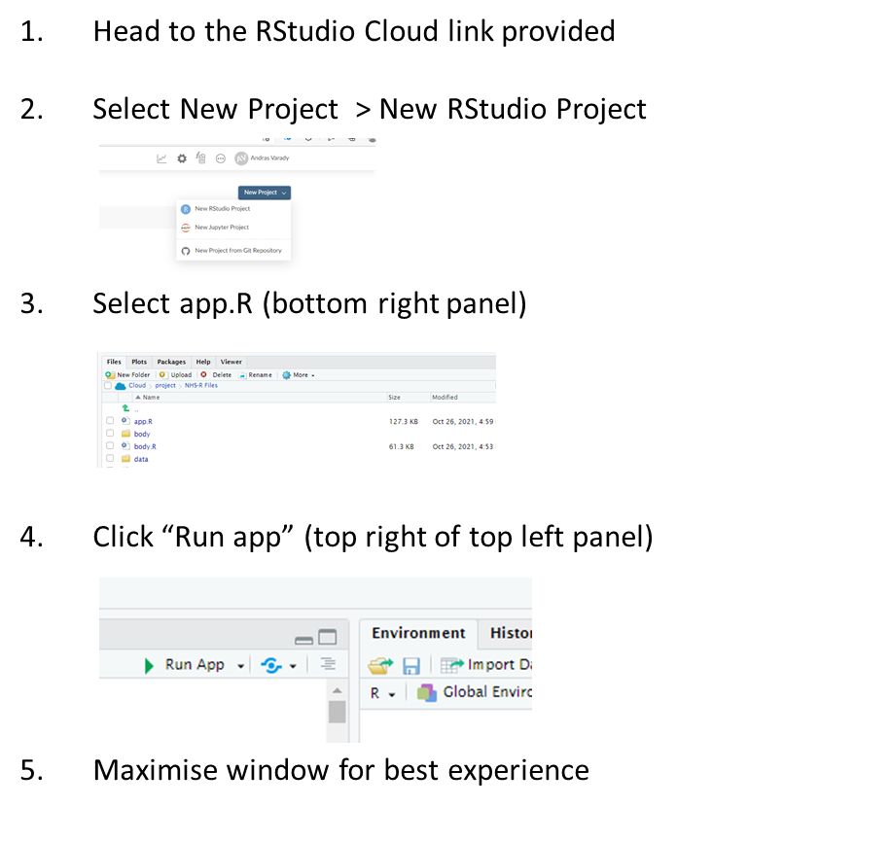
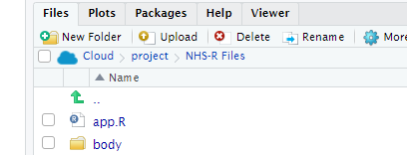
To Get Started:
Notes:
There will be time to ask questions as we go
I’ll be watching the chat

Slide 4
Workshop schedule
10:00 - 10:15 Introduction to Population Health Management & the PHM ExploreR
10:15 - 11:00 Workshop Part 1: Data format, demographics, segmentation
11:00 - 11:05 Break
11:05 - 11:45 Risk stratification, Theoplots
11:45 – 12:00 Questions and survey
Notes:
There will be time to ask questions as we go
I’ll be watching the chat to key an eye in question

Slide 5
What is Population Health Management?
“PHM focuses on key outcomes for identified groups. Often these groups share more specific common characteristics, not just a disease diagnosis”
“During 2019, we will deploy PHM solutions to support ICSs to understand the areas of greatest health need and match NHS services to meet them. Over the coming years these solutions will become increasingly sophisticated in identifying those groups of people who are at risk of adverse health outcomes”
Deloitte
“PHM is the concept of gathering data and insights about population health and wellbeing across multiple care and service settings, with a view to identifying the main health care needs of the community and adapting services accordingly”
NHS Long Term Plan
Nuffield Trust
Notes:
Astonishingly, only around 20% of a person’s health outcomes are attributable to their ability to access good quality health care. The other 80% are made up of ‘social determinants of health’. These include health related behaviours, socio-economic factors, and environmental factors, and they all play a part in the chances of someone living a long, happy and healthy life.
PHM aims to deliver the NHS Long Term Plan’s goal to move from delivering care that mainly responds when someone becomes unwell to a system of targeted early intervention and prevention

Slide 6
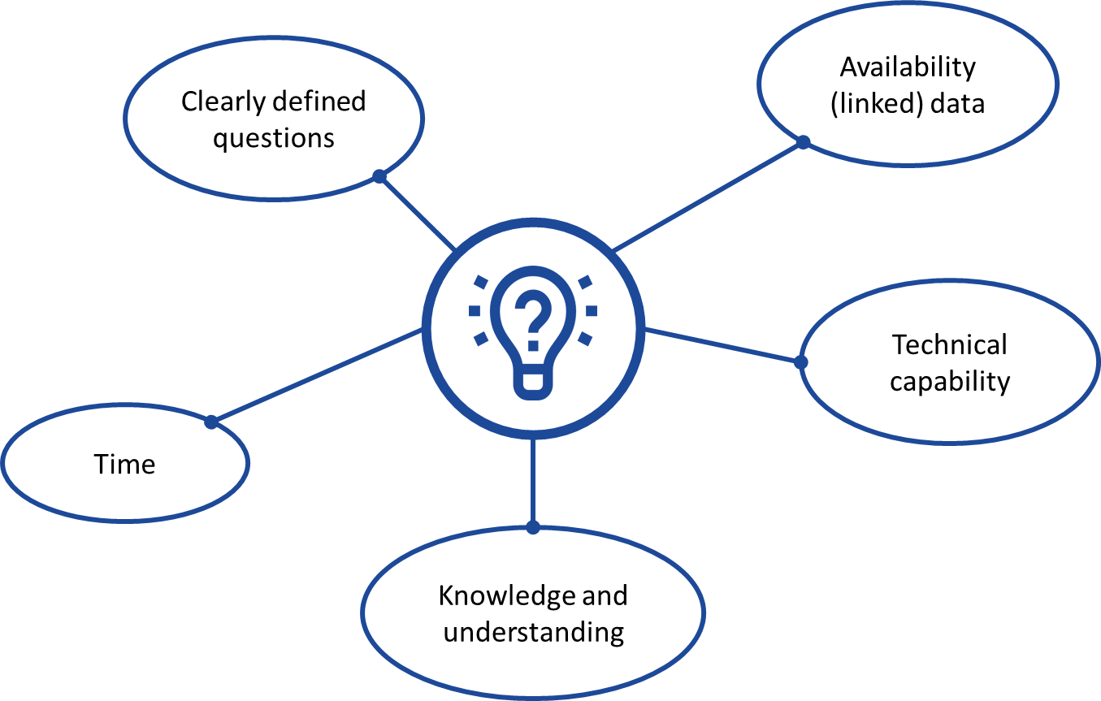
What are the challenges to embedding PHM in healthcare analytics?
Notes:
Change in approach
In our system we now have record level linked data for our entire population, including demographic information, primary and secondary care and community – and I know linked data is a high priority for many systems
Focus on tackling health inequalities and challenges presented by COVID means there is a growing awareness of the value of population level analysis.
Whilst this is a relatively new area of analysis that moves us away from routine reporting there is enthusiasm to learn new techniques and approaches to analysing population level data
One of the values of having an easy to use tool is that it can be easily interrogated to produced graphical summaries to help structure and drive discussions

Slide 7
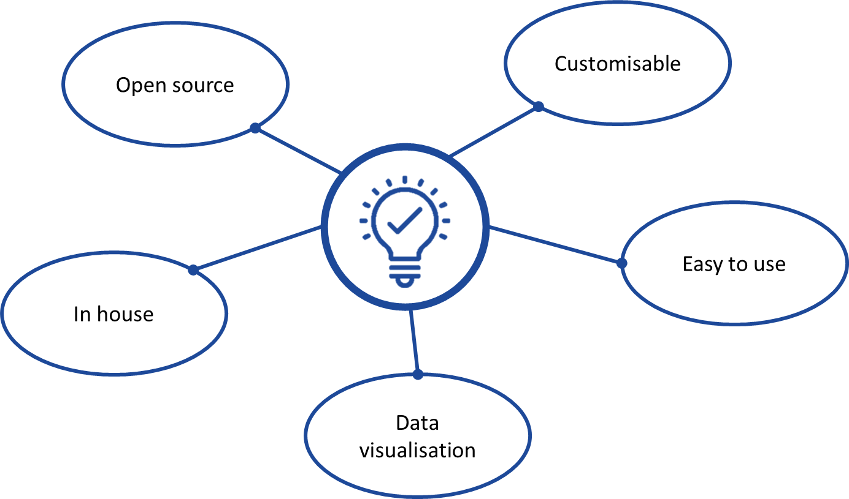
What are the benefits of using the PHM ExploreR?
Notes:
One of the values of having an easy to use tool is that it can be easily interrogated to produced graphical summaries to help structure and drive discussions
Difficulty walking the line between flexibility and user friendliness

Slide 8




PHM ExploreR functionality
Population demographics
Population segmentation
Risk stratification
Patient pathways

Slide 9
Workshop schedule
10:00 - 10:15 Introduction to Population Health Management & the PHM ExploreR
10:15 - 11:00 Workshop Part 1: Data format, demographics, segmentation
11:00 - 11:05 Break
11:05 - 11:45 Risk stratification, Theoplots
11:45 – 12:00 Questions and survey
Notes:
https://github.com/nhs-bnssg-analytics/ExploreR

