Slide 1
Priority landscapes/hubs revealed by Ian’s corridor prioritization scheme
8-28-23

Slide 2
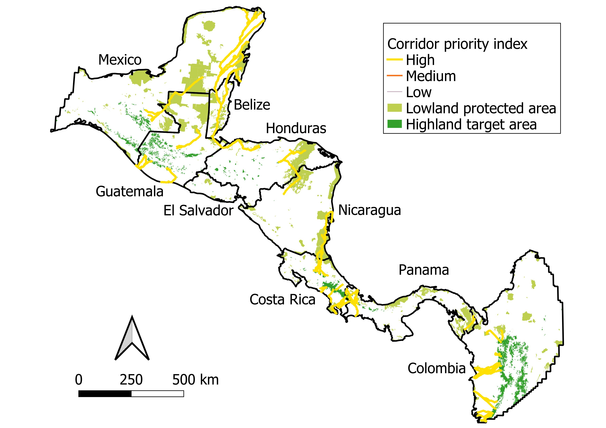
Chiquibui-Las Minas
New
SW Guatemala
Larger Chiquibui Las Minas
Out
El Salvador
Volcan-Botija (western Nicaragua)
Guanacaste-Tenorio (NW Costa Rica)
Maya-Montebello
Platano-Agalta
Indio Maiz-Braulio Carrillo
Darien
AmistOsa/
Palo Seco-Amistad

Slide 3
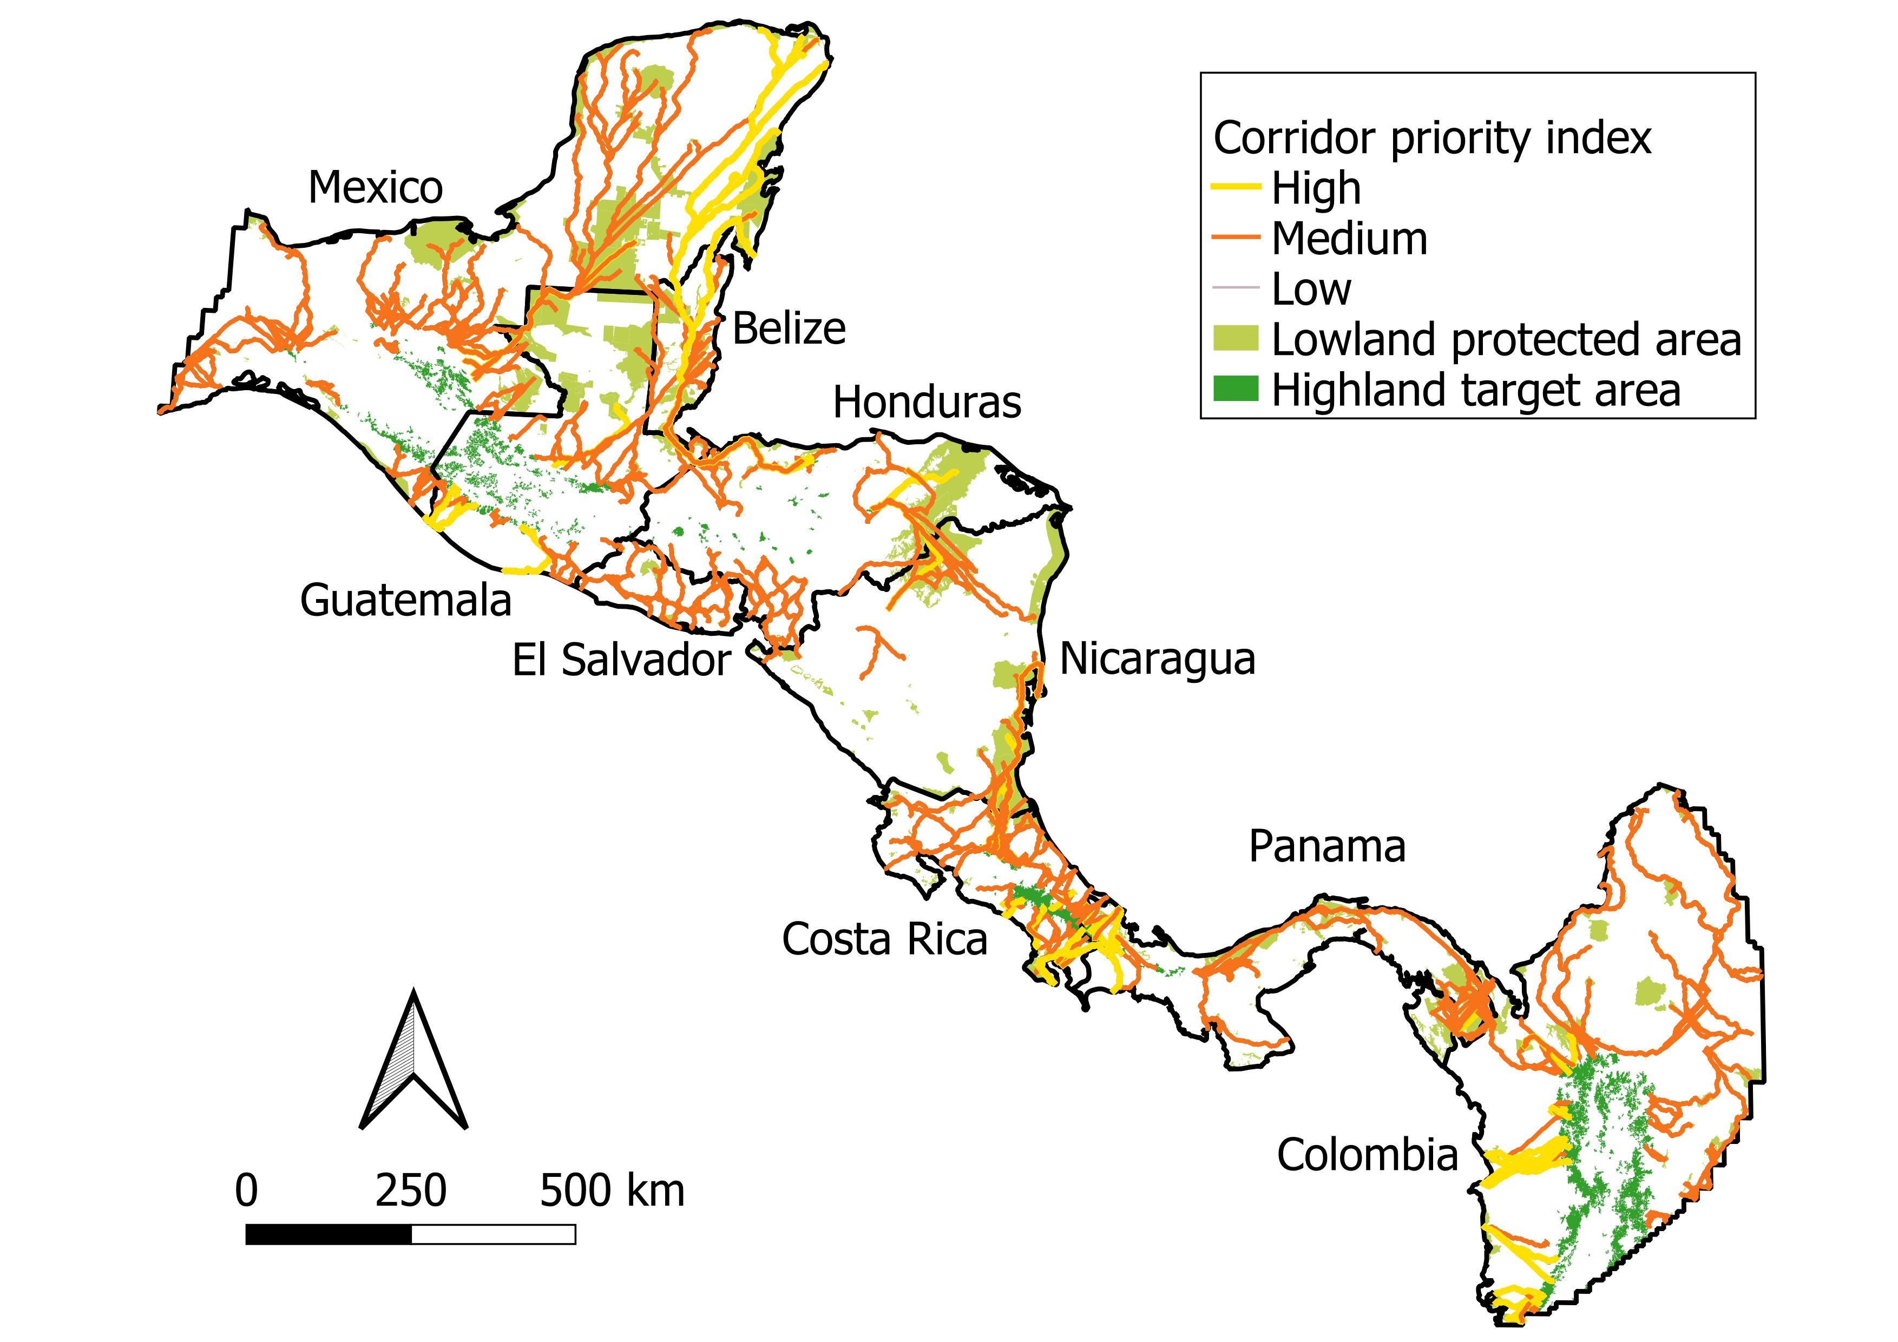
Chiquibui-Las Minas
New
SW Guatemala
Larger Chiquibui Las Minas
Out
El Salvador
Volcan-Botija (western Nicaragua)
Guanacaste-Tenorio (NW Costa Rica)
Same map, but with medium-priority corridors shown
Maya-Montebello
Platano-Agalta
Indio Maiz-Braulio Carrillo
Darien
AmistOsa/
Palo Seco-Amistad

Slide 4
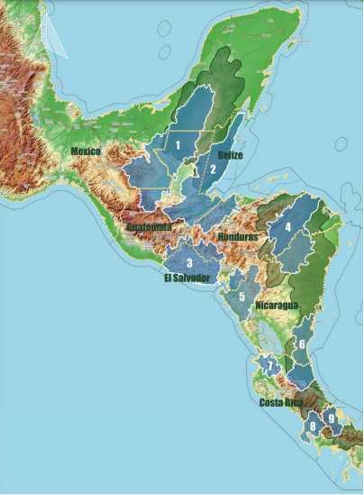
Climate lifeboats from brochure
Maya-Montebello Landscape
Chiquibui-Las Minas Landscape
Complejo-Jilguero Landscape
Platano-Agalta Landscape
Volcan-Botija Landscape
Indio Maiz-Braulio Carrillo Landscape
Guanacaste-Tenorio Landscape
AmistOsa Landscape
Palo Seco-Amistad Landscape
Darien Landscape (not shown in this map)

Slide 5
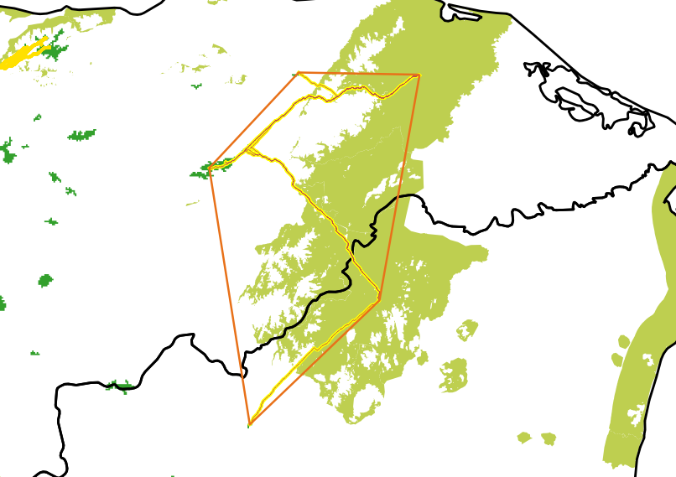
Possible approach for delineating priority landscapes: select least cost paths of interest and create a minimum convex hull around them. This could be further buffered to increase the area.
This example is based on the Platano-Agalta region in Honduras and Nicaragua.

Slide 6
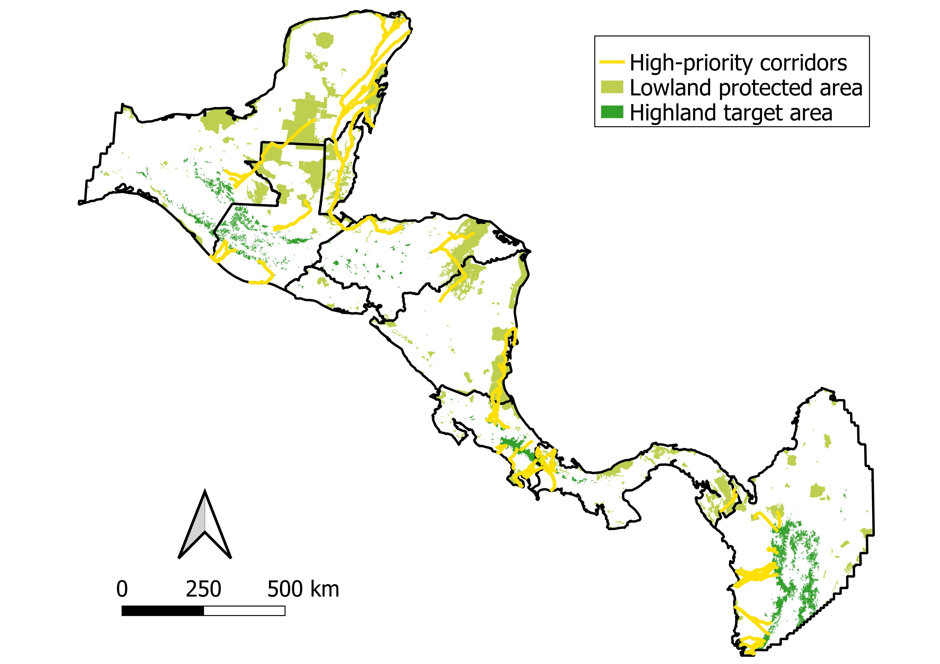

Slide 7
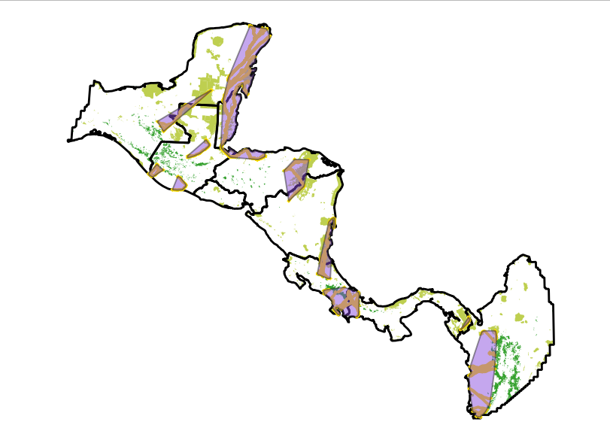
I manually aggregated high-priority corridors into “hubs” and then used minimum bounding geometry (convex hull) to create priority landscapes (which I then clipped to the country boundaries so they would not bleed into the ocean).
These could be buffered or perhaps we buffer the corridors before aggregating into hubs.
We might also consider
Naming or numbering the hubs
Dropping the one in Colombia
Breaking up or combining what I have here

Slide 9
A
Maya-Montebello
B) ?
Chiquibui-Las Minas
?
?
Platano-Agalta
Indo Maiz-Braulio Carrillo
AmistOsa/Palo-Seco Amistad
Darien
?
C
B
F
D
E
G
H
I
J

Slide 10
A
Maya-Montebello
San Román
Chiquibui-Las Minas
El Gancho Murillo/Manchón Guamuchal
Sipacate-Naranjo
Plátano-Agalta
Indio Maíz-Braulio Carrillo
AmistOsa/Palo-Seco Amistad
Darién
C
B
F
D
E
G
H
I

