Slide 1
CitiBike Trip Duration Mean Estimation
MSDS 6370 – 8/02/17
Chris Boomhower, Alex Frye

Slide 2
Agenda
Dataset Background
Outlier Removal
Task 1
SRS Prep
Proportional Allocation Design
Neyman Allocation Design
Design Effect and Post-Deff Results
Method Comparison
Task 2
5 Sampling Iterations and Confidence Interval Analysis

Slide 3

Background
CitiBike NYC dataset
10,000+ bikes and 600 stations across NYC
55 total neighborhoods
Date range = July 1st, 2013 to February 28th, 2014
Total of ~5.5 Million trip observations observed
Interested in trip durations
Population mean no problem since data shared by CitiBike
What happens when such data isn’t available?
Great test case for sampling application
(http://newyorkeronthetown.com, 2017)

Slide 4
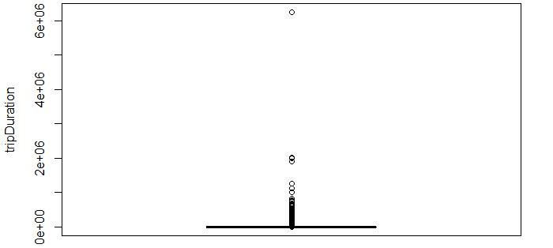
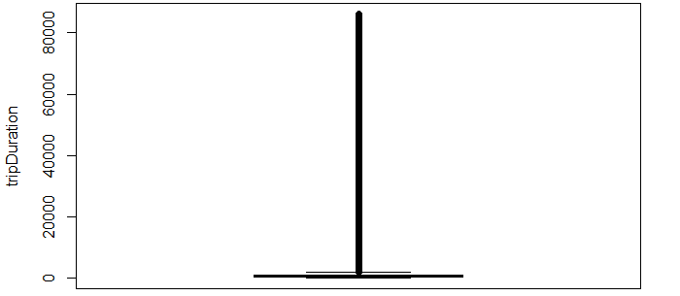
Outlier Removal
Trip durations up to 72 days
Removal of outliers > 24 hour duration
457 total removed observations
Figure 1 - Boxplot TripDuration with Outliers
Figure 2 - Boxplot TripDuration after Outlier Removal

Slide 5
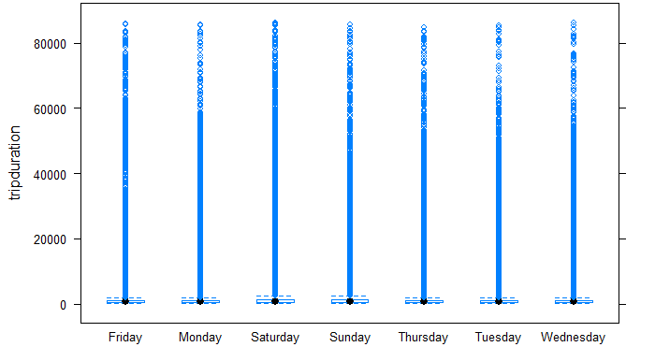
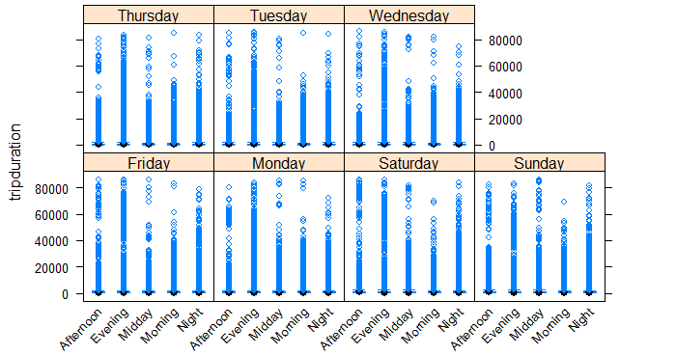
Stratification Design
First Attempt: Trip duration by Day
Expectation for variability between Weekday vs. Weekend
Consistent distribution across strata
Second Attempt: Trip duration by Day & Time of Day
Work Commute vs. Lunch commute vs. Leisure
Easily identifiable variance between time of day
Some variance between days in the same time
Figure 3 - Trip Duration by Day Boxplot
Figure 4 – Trip Duration by Day & Time of Day Boxplot

Slide 6
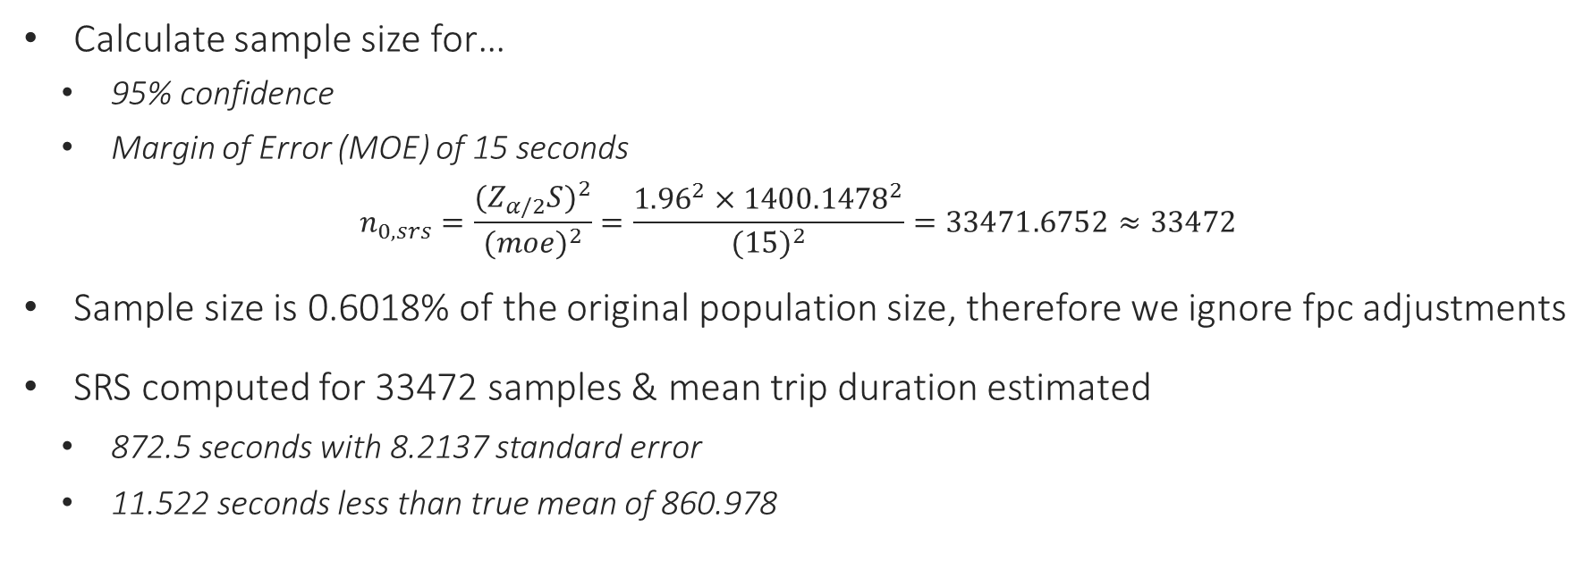
Task 1 – SRS Prep
Calculate sample size for…
95% confidence
Margin of Error (MOE) of 15 seconds
$$n_{0,srs}=\frac{(Z_{α/2}S)^{2}}{(moe)^{2}}=\frac{{1.96}^{2}×{1400.1478}^{2}}{(15)^{2}}=33471.6752≈33472$$
Sample size is 0.6018% of the original population size, therefore we ignore fpc adjustments
SRS computed for 33472 samples & mean trip duration estimated
872.5 seconds with 8.2137 standard error
11.522 seconds less than true mean of 860.978
# Create SurveyDesign mydesign <- svydesign(id = ~1, data = pop.data.SRSSampled)
srsMean <- svymean(~tripduration, design = mydesign)

Slide 7
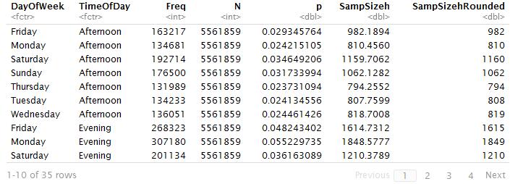
Task 1 – Proportional Allocation Design
Calculated Proportional strata sample sizes
Total sample size greater than n_{0,srs}
33474 vs. 33472  Problem for Deff
Force rounding down for two strata
SRS of calculated sizes among strata
Compute mean trip duration estimation
868.4 seconds with 8.1176 standard error
7.422 seconds less than true mean of 860.978
Table 1. Proportional Sample Count Derivations (First 10 Strata)
# Create SurveyDesign mydesign <- svydesign(id = ~1, strata = ~paste(DayOfWeek,TimeOfDay), data = pop.data.PropSampled) NeyMean <- svymean(~tripduration, design = mydesign)

Slide 8
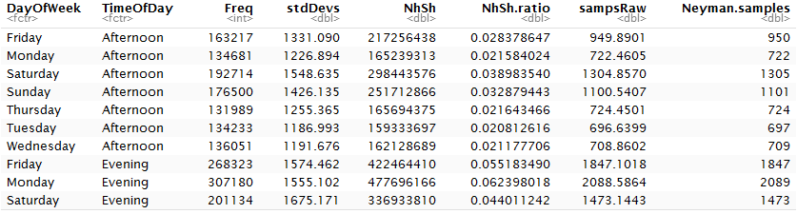
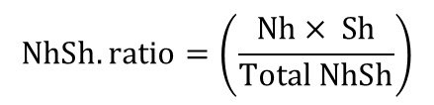
Task 1 – Neyman Allocation Design
Calculated Neyman strata sample sizes
Standard Deviation considerations
Total sample size greater than n_{0,srs}
33474 vs. 33472  Problem for Deff
Force rounding down for two strata
SRS of calculated sizes among strata
Compute mean trip duration estimation
870.75 seconds with 8.4397 standard error
9.772 seconds less than true mean of 860.978
$$NhSh.ratio=\left(\frac{Nh× Sh}{Total NhSh}\right)$$
Table 3. Neyman Sample Count Derivations (First 10 Strata)
# Create SurveyDesign mydesign <- svydesign(id = ~1, strata = ~paste(DayOfWeek,TimeOfDay), data = NeySamp) NeyMean <- svymean(~tripduration, design = mydesign)

Slide 9
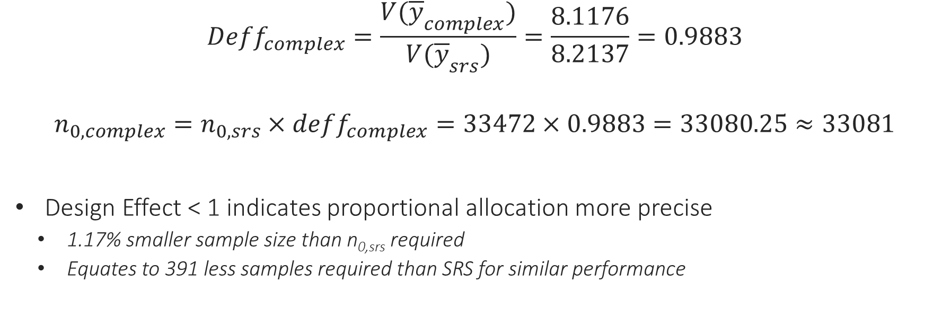
Task 1 – Design Effect: Proportional Allocation
$$Deff_{complex}=\frac{V({\overline{y}}_{complex})}{V({\overline{y}}_{srs})}=\frac{8.1176}{8.2137}=0.9883$$
$$n_{0,complex}=n_{0,srs}×deff_{complex}=33472×0.9883=33080.25≈33081$$
Design Effect < 1 indicates proportional allocation more precise
1.17% smaller sample size than n_{0,srs} required
Equates to 391 less samples required than SRS for similar performance

Slide 10
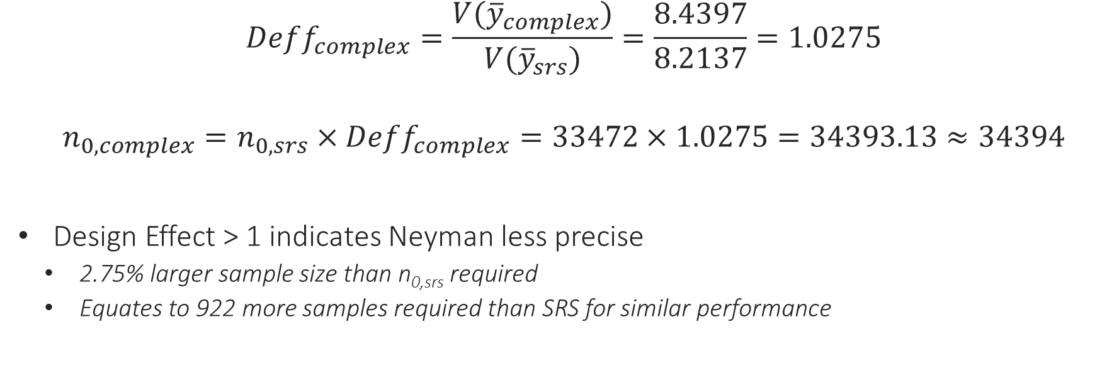
Task 1 – Design Effect: Neyman Allocation
$$Deff_{complex}=\frac{V({\overline{y}}_{complex})}{V({\overline{y}}_{srs})}=\frac{8.4397}{8.2137}=1.0275$$
$$n_{0,complex}=n_{0,srs}×Deff_{complex}=33472×1.0275=34393.13≈34394$$
Design Effect > 1 indicates Neyman less precise
2.75% larger sample size than n_{0,srs} required
Equates to 922 more samples required than SRS for similar performance

Slide 11
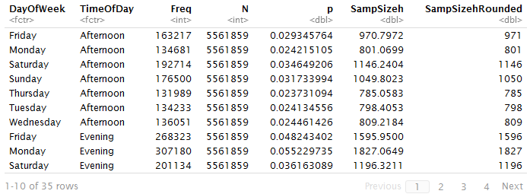
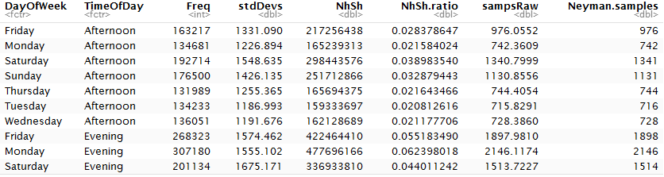
Task 1 - Post-Deff Results
Proportional allocation
Neyman allocation
Post-Deff total sample size 33081 used
Manual adjustment of single stratum size required
859.57 seconds estimate with a standard error of 7.3067
1.408 seconds less than true mean
Post-Deff total sample size 34394 used
Manual adjustment of single stratum size required
858.362 seconds estimate with a standard error of 7.193
2.62 seconds less than true mean
Table 2. Post-Deff Proportional Sample Count Derivations (First 10 Strata)
Table 4. Post-Deff Neyman Sample Count Derivations (First 10 Strata)

Slide 12
Task 1 – Comparison
Top Considerations
Interested in post-Deff sampling designs
Estimate accuracy
Standard error
Required sample size
True Population Mean = 860.978 seconds
SRS  11.5 seconds over; 8.214 SE
Proportional  1.4 seconds under; 7.307 SE
Neyman  2.6 seconds under; 7.193 SE

Slide 13
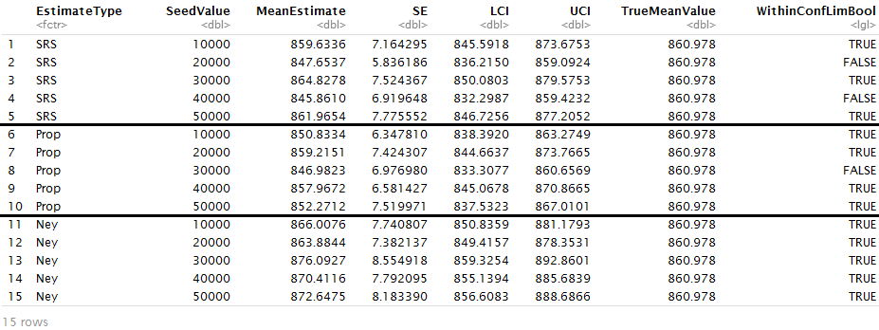
Task 2 – 5 Sampling Iterations and CI’s
Simple Random Sample:
3/5 within CI
Most variance
Proportional Allocation:
4/5 within CI
Lowest avg SE
Missed estimate still within 15 second MOE
Neyman Allocation:
5/5 within CI
Highest sample size
Table 5. Actual Mean Comparison across 5 unique random seeds

Slide 14
The Winner: Proportional Allocation!
Lowest Design Effect Calculation against SRS
Smallest Sample Size, for effective results
Lowest average SE across test iterations
1 Missed estimate still within 15 second MOE, as defined by n_{0,srs}

