Slide 1
Continuous Integration with the Open Build Service
Christian Bruckmayer
Björn Geuken

Slide 2










OBS
x86_64
openSUSE
RPM

Slide 3
Overview

Slide 4





Packaging in the wild
Just 1 build
x86_64
openSUSE
RPM

Slide 5




Packaging in the wild
A lot of builds!!
x86_64
openSUSE
RPM
x86_64
arm
s390
Debian
RedHat
Arch
Deb
PkgBuild

Slide 6

OBS to the rescue!
OBS
Done!
x86_64
openSUSE
RPM
arm
s390
Debian
RedHat
Arch
Deb
PkgBuild

Slide 7
Package building

Slide 8
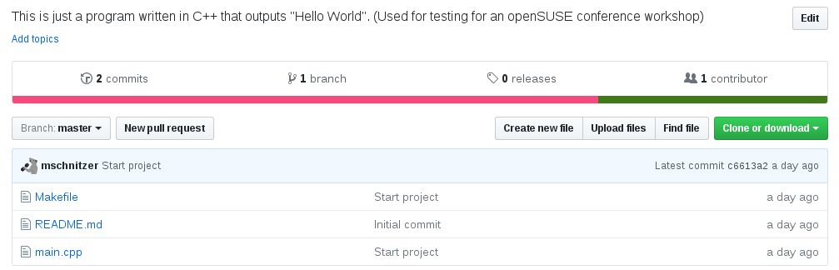

Slide 9
OBS

Slide 10


Slide 11
<services>
<service name="tar_scm">
<param name="url">
git://github.com/user/repo.git
</param>
<param name="scm">git</param>
</service>
<service name="set_version">
<param name="basename">hello-osc</param>
</service>
</services>
Notes:
tar_scm:
- versionformat
- versionprefix
- revision (branch / commit)
There are other services like:
- source service
- kiwi import service
- set version service
- recompress

Slide 12
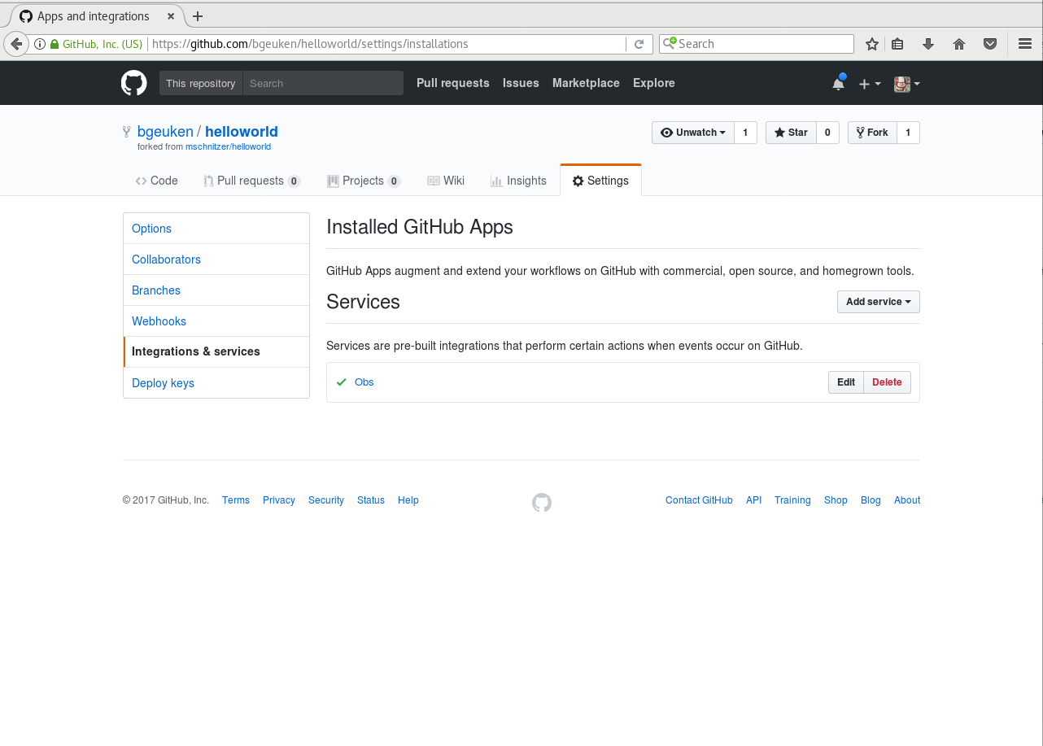

Slide 13
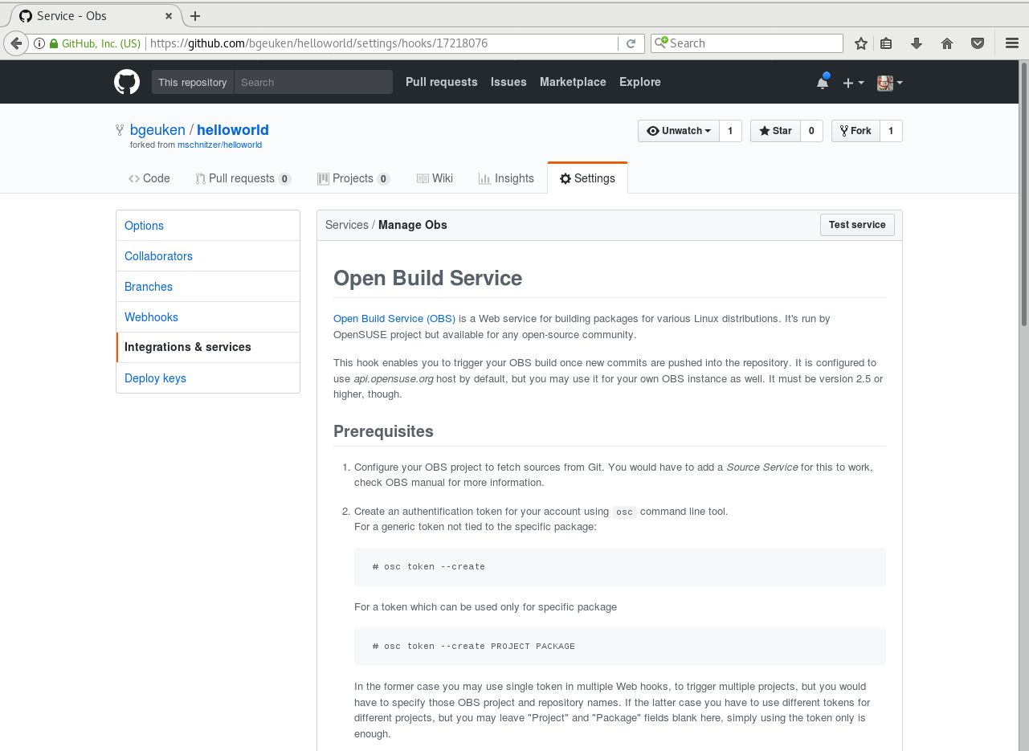

Slide 14
Appliance building

Slide 15


Slide 16
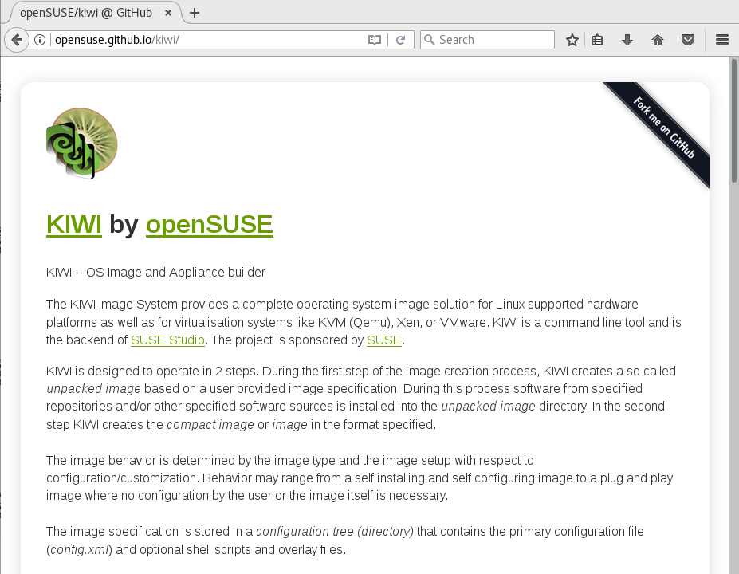

Slide 17
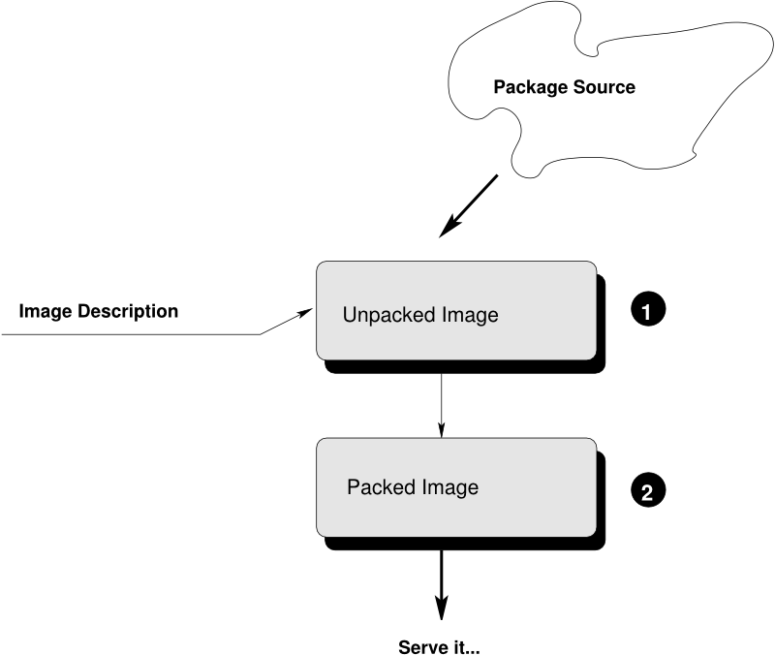

Slide 18
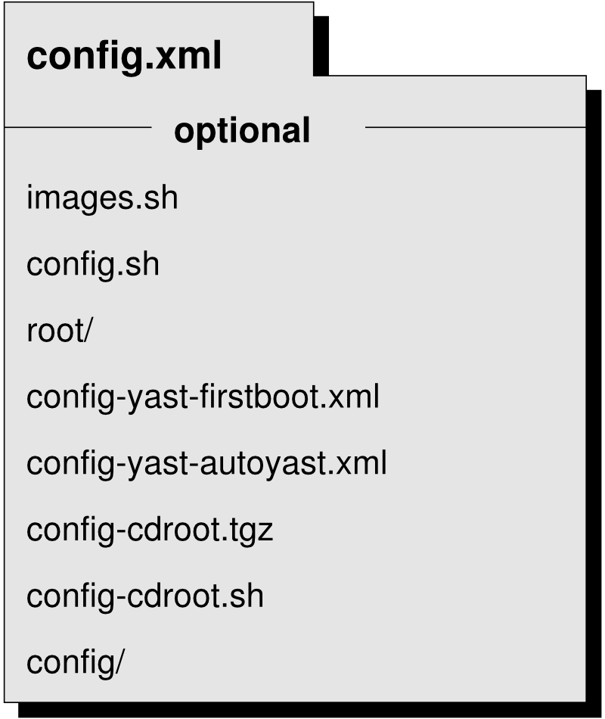

Slide 19
<image name="openSUSE_Leap_42.2">
<description type="system">
<author>Christian Bruckmayer</author>
<contact>cbruckmayer@suse.de</contact>
</description>
...
<packages type="image">
<package name="grub" />
    </packages>
    ...
Notes:
tar_scm:
- versionformat
- versionprefix
- revision (branch / commit)
There are other services like:
- source service
- kiwi import service
- set version service
- recompress

Slide 20
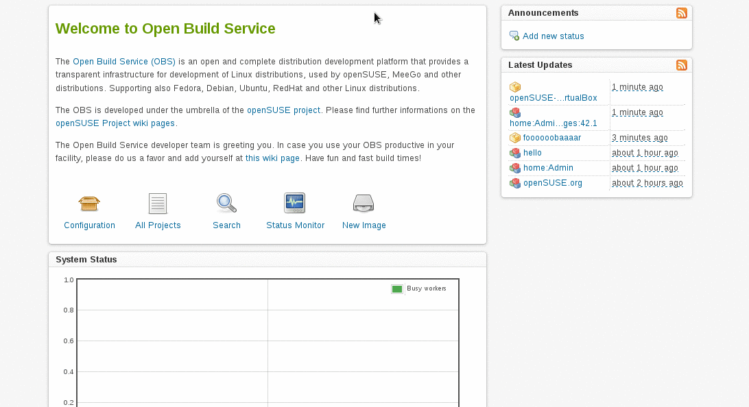

Slide 21
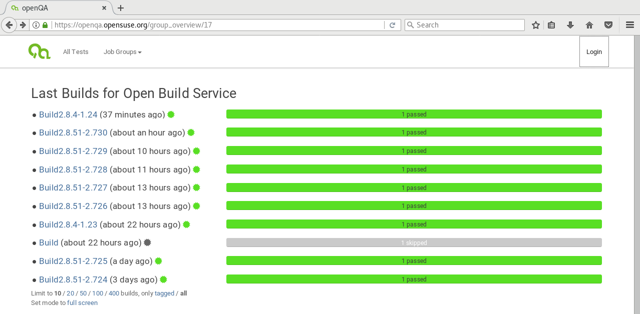

Slide 22
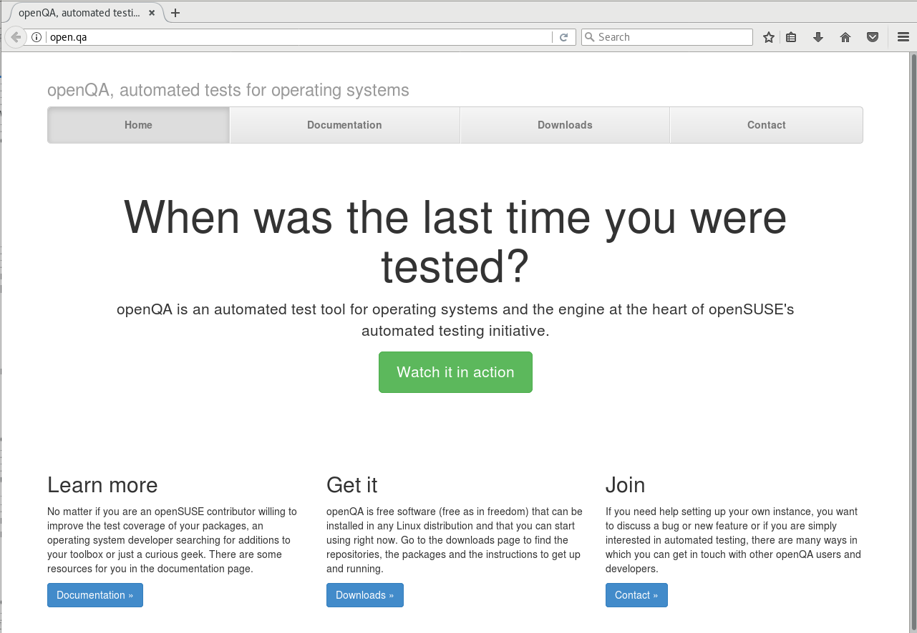

Slide 23
Hands-on

Slide 24


Slide 25
https://github.com/chrisbr/workshop-obs-ci

Slide 27
More information
https://build.opensuse.org/
http://openbuildservice.org/
https://doc.opensuse.org/projects/kiwi/doc/

Slide 28
All icons are from the Noun Project (https://thenounproject.com/):
https://thenounproject.com/iconproducer/
https://thenounproject.com/grega.cresnar/
https://thenounproject.com/antonwebium/
https://thenounproject.com/royyanwijaya/
https://thenounproject.com/mahmure.alp/
https://thenounproject.com/korawan_m/
https://thenounproject.com/unlimicon/
https://thenounproject.com/rockicon/
https://thenounproject.com/Aleksandr_Vector/
https://thenounproject.com/KimmiStudio/
https://thenounproject.com/deepz/
https://thenounproject.com/logan433/

