Slide 1

1720 – Dependency Injection
Live Backchannel: #SSWDev

Slide 2

Are you using Dependency Injection?
Tried it?
Used it in a project?
Like it?
Has it saved your bacon?
Notes:
Show of hands for each line

Slide 3


You create a genius piece of software

Slide 4


But after a while need to make a fundamental change / extension

Slide 5

The problems
Copy and paste code ?
If / Case statements for each alternative
Is this maintainable?
Is it testable?

Slide 6
How about in our Enterprise App ?
Change from: sending emails Change to: sending email, SMS or Facebook messages
Change from: Application dependent on mulpiple data sources: e.g. SQL Server, mySQL and a main frame database Change to: Application independent of data access methodology
Change from external API ‘DHL Shipping calculator’ Change to: external API ‘Fedex Shipping calculator’
Notes:
Demo: Dependency Injection Demo. Part I

Slide 7
What is the Answer ?

Slide 8
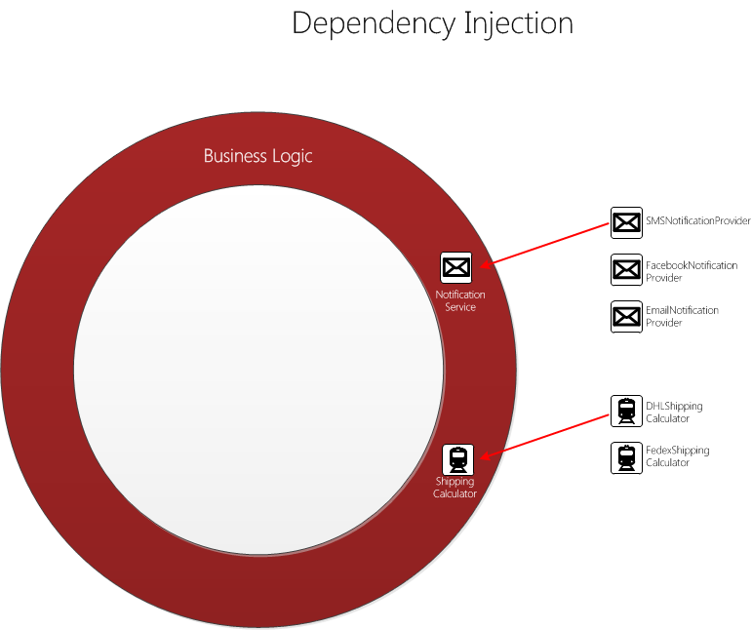
Notes:
Really clearly point out several uses of dependencies.
It gives us customizability and maintainability

Slide 9
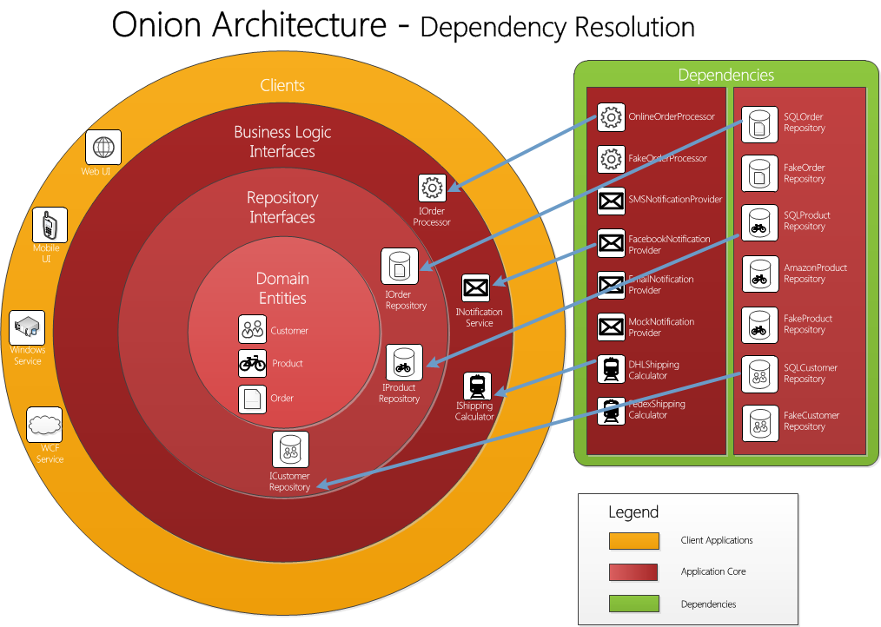
Notes:
INTRODUCE the idea of the onion architecture
We are building a pluggable architecture where we don’t lock ourselves into dependencies.
We program against interfaces or base classes and then inject our dependencies
Then introduce the idea that the outer layers can see the inner layers of the onion

Slide 10
What does this look like in code?

Slide 11

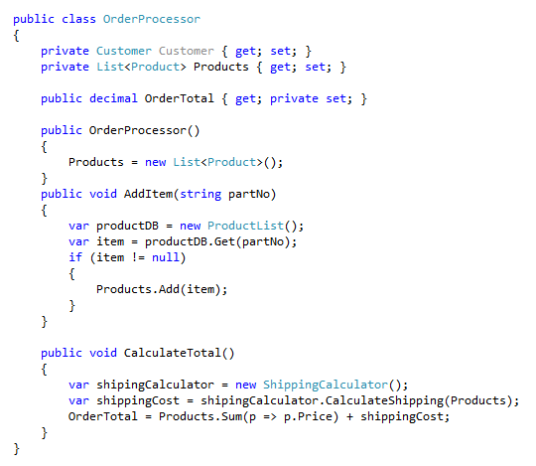
Where are the dependencies?

Slide 12
How do I fix it?

Slide 13
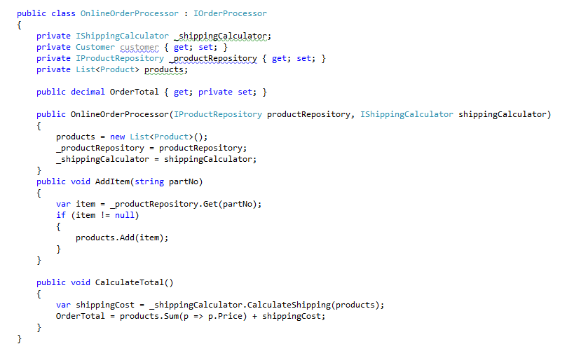


Look Mum. No Dependencies !

Slide 14

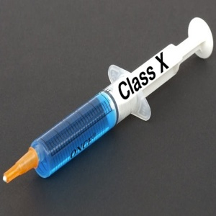

The answer: Dependency Injection
Loosely coupled classes
Increased code reuse
Maintainable code
Testable methods
All dependencies are specified in one place
Class dependencies are clearly visible in the constructor

