Slide 1
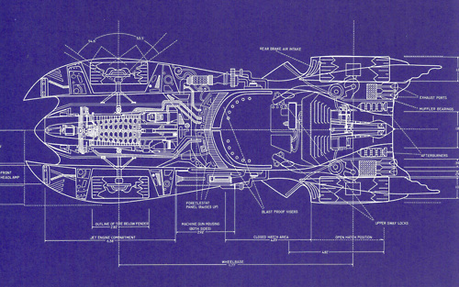
1751 - Enterprise Architecture
Designing your app the correct way
Notes:
here are some test notes.
hi.

Slide 2



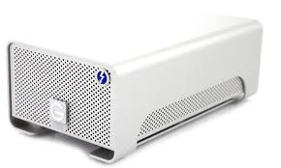
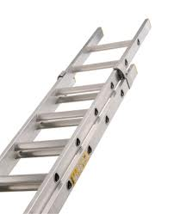


Enterprise Features
Notes:
Quiz the Audience: What are Enterprise features
There are some clues on the slides

Slide 3
What is Enterprise?
Scalable
Maintainable
Testable
Extensible
Usable
Available
Secure
http://www.robietherobot.com/buzzword.htm
Notes:
http://www.codesqueeze.com/the-7-software-ilities-you-need-to-know/
1. Usability
Software usability can be described as how effectively end users can use, learn, or control the system. Some questions to ask yourself to determine usability might be:
Is there a UI metaphor that I am using to help users adapt? (for example, the ‘desktop’ is a metaphor)
Are the most common operations streamlined to be performed quickly?
Can new users quickly adapt to the software without help? (is it intuitive?)
Do validation and error messages make sense?
2. Maintainability ( or Flexibility / Testibility)
The definition of maintainability [for me] implies how brittle the code is to change. As a result, I tie the terms flexibility and testability into the overall maintainability of a project.
Does the entire team understand the code base or does knowledge islands exist?
Is the code throughly regression tested?
Can modifications to the project be done in a timely manner?
3. Scalability
Scalability is the ability for your program to gracefully meet the demand of stress caused by increased usage. In short, ensuring your program doesn’t slow or bust when pounded by more users than you originally anticipated.
What is your current peak load that you can handle?
How many database records can create until critical operations slow down?
Is the primary scaling strategy to “scale up” or to “scale out” — that is, to upgrade the nodes in a fixed topology, or to add nodes?
4. Availability (or Reliability)
How long the system is up and running and the Mean Time Between Failure (MTBF) is known as the availability of a program.
How long does the system need to run without failure?
What is the acceptable length of time for the system to be down?
Can down times be scheduled?
5. Extensibility
Are there points in the system where changes can be made with (or without) program changes?
Can the database schema flex to accommodate change?
Does the system allow Inversion of Control (IoC)?
Can end users extend the system (scripts, user defined fields, etc)?
Can 3rd party developers leverage your system?
6. Security
I shouldn’t need to go into this one but to be thorough I like this definition of security: the measure of system’s ability to resist unauthorized attempts at usage or behavior modification, while still providing service to legitimate users.
Does the system need user or role based security?
Does code access security need to occur?
What operations need to be secured?
How will users be administered?
7. Portability
Portability is the ability for your application to run on numerous platforms. This is can include actual application hosting, viewing, or data portability.
Can the data be migrated to other systems?
For web applications, which browsers does your web app support?
Which operating systems does your program run on?

Slide 4
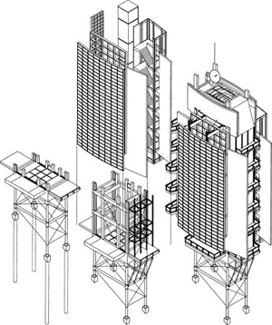
Architectural Options

Slide 5
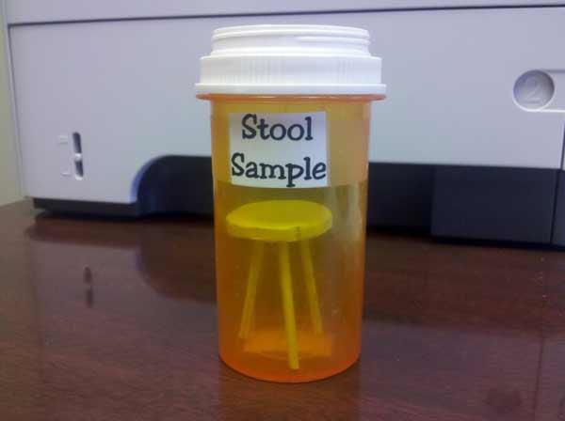
Why the Samples Aren’t Enterprise

Slide 6

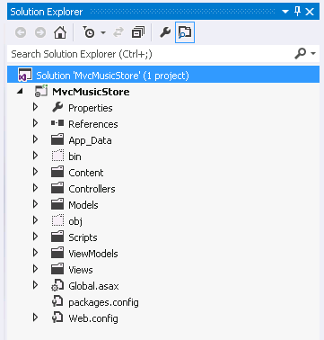
Solution Structure
Notes:
Structure is wrong
Where my interface projects and business tiers?

Slide 7
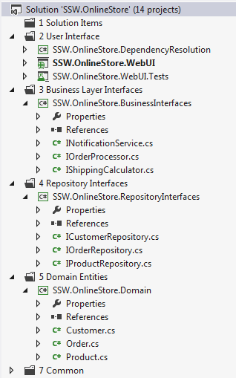
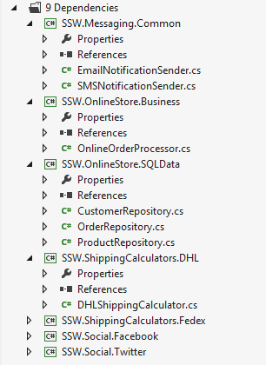
Enterprise Solution Structure
http://rules.ssw.com.au/SoftwareDevelopment/RulesToBetterDotNETProjects/Pages/SolutionStructure.aspx
Notes:
Demo: Enterprise Solution Structure

Slide 8
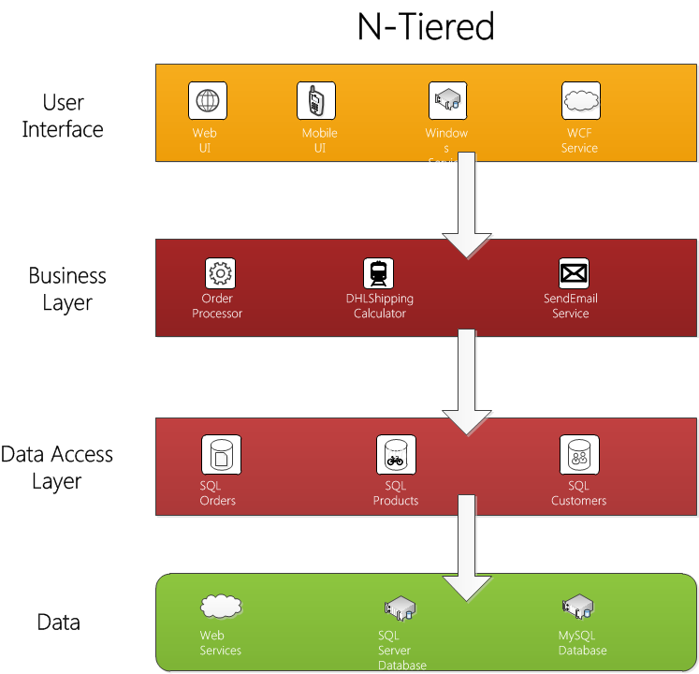
Notes:
Each layer communicates with the layer below it.
The UI talks to business logic, but it does not talk directly to data access, WCF, etc.
The layering approach calls out the need to keep certain categories of code out of the UI.
The big downfall is that business logic ends up coupled to infrastructure concerns. Data Access, I/O, and Web Services are all infrastructure.
Infrastructure is any code that is a commodity and does not give your application a competitive advantage.
This code is most likely to change frequently as the application goes through years of maintenance.
ASMX, is already deprecated in favour of WCF, which will go as well. It is foolish to tightly couple the business logic to WCF.
Data access changes every few years, so we definitely don't want to be tightly coupled to it.
For long-life, we would want our business logic to be independent of these infrastructure concerns so that as infrastructure changes, the business logic doesn't have to.

Slide 9
Why n-tier?
Separate logic and data access from presentation
Easier to maintain code
Low-coupling
Modularity/Re-use business logic
Easily add a different UI
Web UI
Smart Phone UI
Team Development

Slide 10
Data
Data Access
Business
UI
WebUI
Northwind
DAL
BL
WinUI
Common Objects
Models / Domain

Slide 11
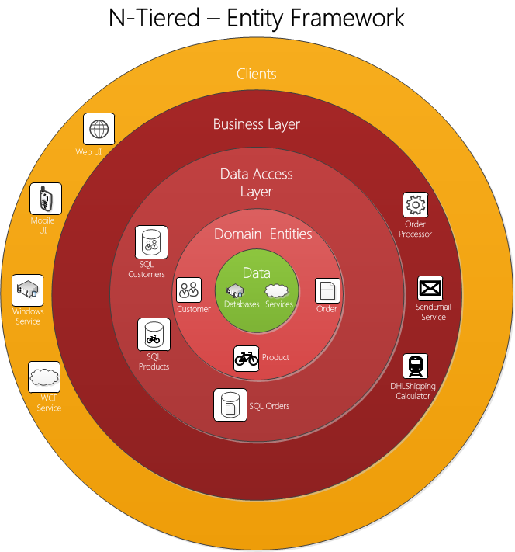
Notes:
Each subsequent layer depends on the layers beneath it, and then every layer normally will depend on some common infrastructure and utility services.
The big drawback to this top-down layered architecture is the coupling that it creates.
Each layer is coupled to the layers below it, and each layer is often coupled to various infrastructure concerns.
However, without coupling, our systems wouldn't do anything useful, but this architecture creates unnecessary coupling.
The biggest offender (and most common) is the coupling of UI and business logic to data access.
Yes, UI is coupled to data access with this approach. Transitive dependencies are still dependencies.
The UI can't function if business logic isn't there. Business logic can't function if data access isn't there.
Data access changes frequently
We can count on needing to modify data access three years from now for any healthy, long-lived systems that's mission-critical to the business.
We often don't keep systems up-to-date because it's impossible to do.
If coupling prevents easily upgrading parts of the system, then the business has no choice but to let the system fall behind into a state of disrepair. legacy systems become stale, and are rewritten.

Slide 12

Maintainability Alert
Our whole application is tightly coupled
to the database

Slide 13


You create a genius piece of software

Slide 14


But after a while need to make a fundamental change / extension
Notes:
Zombie mark2
Samari turn into ninja

Slide 15

The problems
Copy and paste code ?
If / Case statements for each alternative
Is this maintainable?
Is it testable?
Notes:
How would we do it?

Slide 16
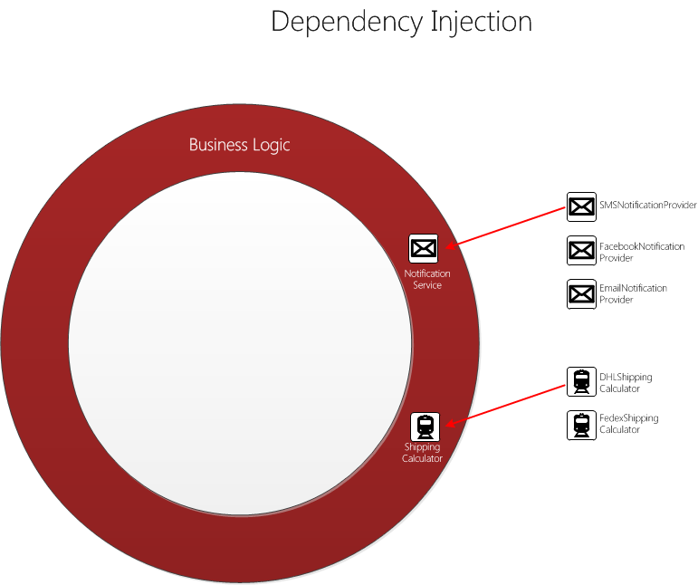
A Solution

Slide 17
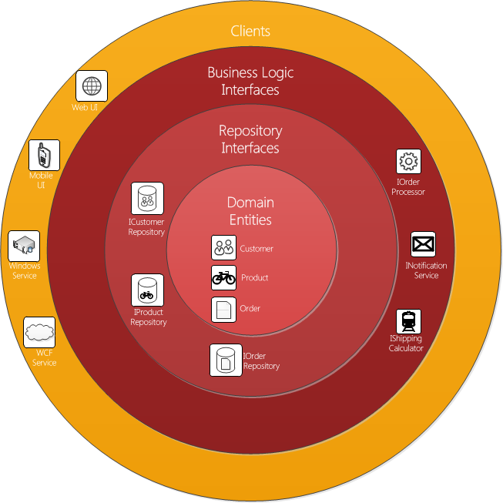
Onion Architecture
Described by Jeffrey Palermo http://jeffreypalermo.com/blog/the-onion-architecture-part-1/
The application is built around an independent object model.
Direction of coupling is toward the centre.
Inner layers define interfaces; outer layers implement interfaces.
Notes:
All application core code can be compiled and run separate from infrastructure.

Slide 18
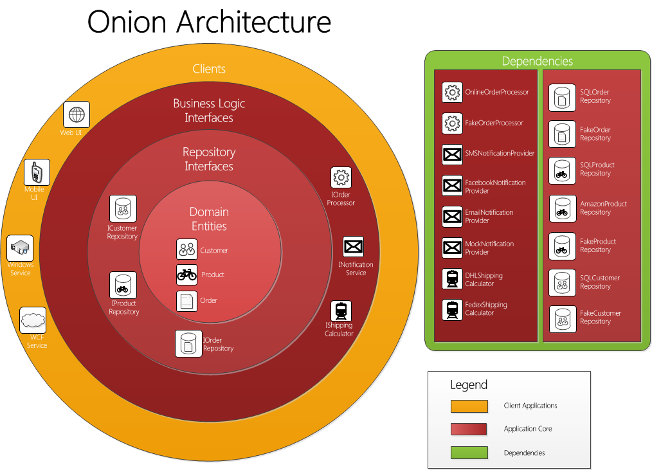
Notes:
It leads to more maintainable applications since it emphasizes separation of concerns throughout the system.
It emphasizes the use of interfaces for behaviour contracts, and it forces the externalization of infrastructure.
The main premise is that it controls coupling.
The fundamental rule is that all code can depend on layers more central, but code cannot depend on layers further out from the core.
In other words, all coupling is toward the centre.
Application Core (includes domain model, repo interfaces and BL interfaces)
This should be the big meaty part where the domain logic resides
It could have its own internal layering. Eg. Services may depend on Factories, which depend on Repositories, which depend on Entities.
All entities and business logic.
Depends on API only.
Uses DDD patterns like factory, service, specification, repository, etc.
Also contains more domain-specific interfaces which are not defined in the API.
Domain Model
In the very centre we see the Domain Model, which represents the state and behaviour combination that models truth for the organization. (and is only coupled to itself)
Repository Interfaces
The first layer around the Domain Model is typically where we would find interfaces that provide object saving and retrieving behavior, called repository interfaces.
The object saving behaviour is not in the application core, however, because it typically involves a database. Only the interface is in the application core.
Business Logic Interfaces
Business logic is also exposed via interfaces to provide decoupling of business logic. Examples of where this is useful include substituting a FacebookMessageService for an EmailMessageService or a FedexShippingCalculator for a DhlShippingCalculator
Clients
The outer layer is reserved for things that change often. E.g. UI and the other applications that consume the Application Core.
This includes the MVC project. Controllers consume the domain surface directly, and do not go through an application or service layer.
Any interface dependencies in factories, services, repositories, etc, are injected into the domain by the controller using MVC IoC (constructor injection).
Anything that requires domain-specific knowledge is delegated out to the domain, and domain classes are constructor injected into the controller.
This means any constructor-injected interfaces in domain classes are resolved automatically by the IoC container.
Dependencies
Implementations of interfaces defined in Repository and Business Logic Interfaces and Domain.
These classes are specific implementations and can be coupled to a particular method of data access, or specific service technology.
e.g. this is where the EF DbContext is implemented, as well as things like logging, email sending, etc.
These dependencies are injected into the application core.
Because the Application core only relies on abstractions of the dependencies, it is easy to update them.
The Onion Architecture relies heavily on the Dependency Inversion principle.
The application core needs implementation of core interfaces, and if those implementing classes reside at the edges of the application, we need some mechanism for injecting that code at runtime so the application can do something useful.
The database is not the center. It is external.
With Onion Architecture, there are no database applications.
There are applications that might use a database as a storage service but only though some external infrastructure code that implements an interface which makes sense to the application core.
Decoupling the application from the database, file system, etc, lowers the cost of maintenance for the life of the application.
References:
http://blog.tonysneed.com/2011/10/08/peeling-back-the-onion-architecture/
http://stackoverflow.com/questions/9732747/what-type-of-architecture-is-this-called/9933371#9933371

Slide 19
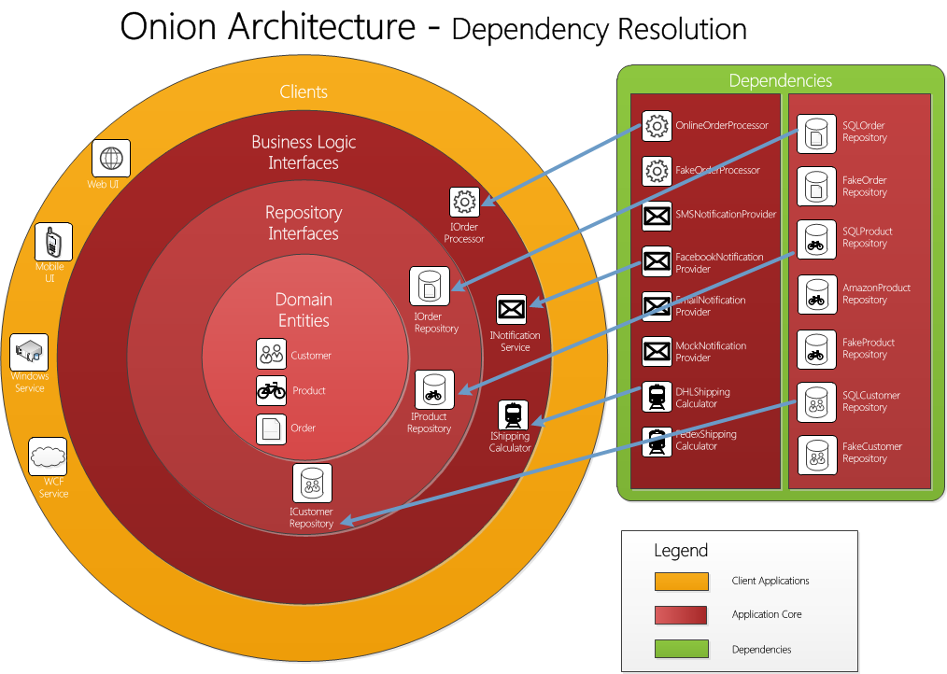

Slide 20
Enterprise Project Structure

Slide 21

Enterprise Solution Structure
http://rules.ssw.com.au/SoftwareDevelopment/RulesToBetterDotNETProjects/Pages/SolutionStructure.aspx
Notes:
Demo: Enterprise Solution Structure

Slide 22
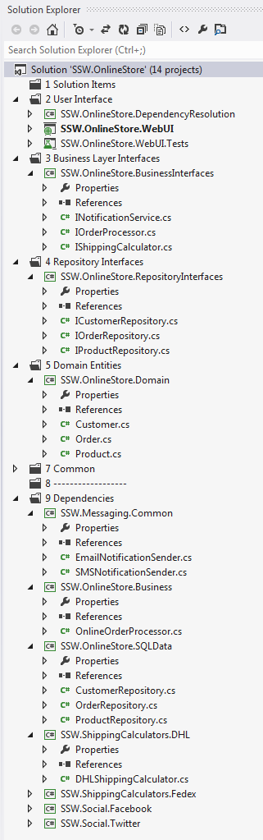
Project / Onion Mapping

Slide 23
Notes:
Last

Slide 24
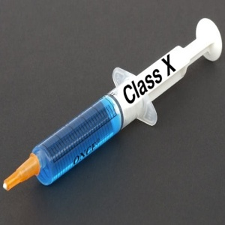

The answer: Dependency Injection
Loosely coupled classes
Increased code reusing
Maintainable code
Testable methods
All dependencies are specified in one place
Class dependencies are clearly visible in the constructor

Slide 25
References
Bob martin on architecture
http://www.confreaks.com/videos/759-rubymidwest2011-keynote-architecture-the-lost-years

