Slide 1
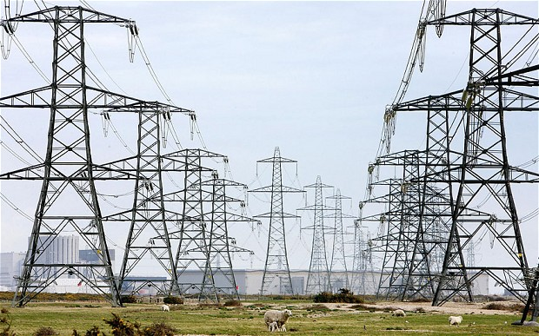



The Energetic Mathematician
Chris Budd

Slide 2

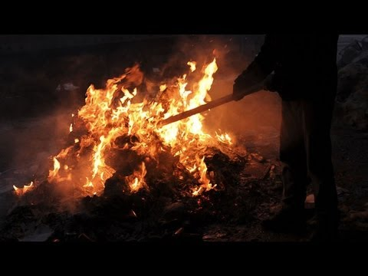
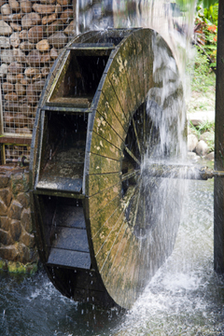
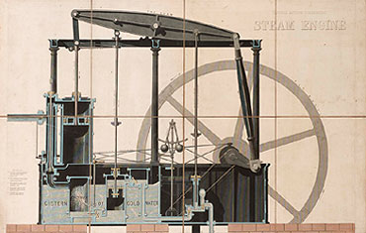
We all require energy to live
Sun
Fire
Water
Steam

Slide 3
Majority of the world’s energy is now supplied
by high voltage electricity

Slide 4
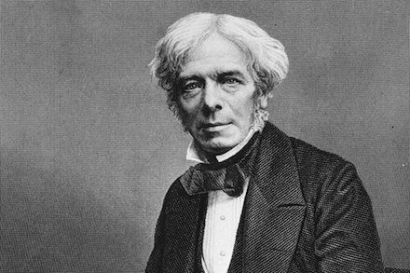
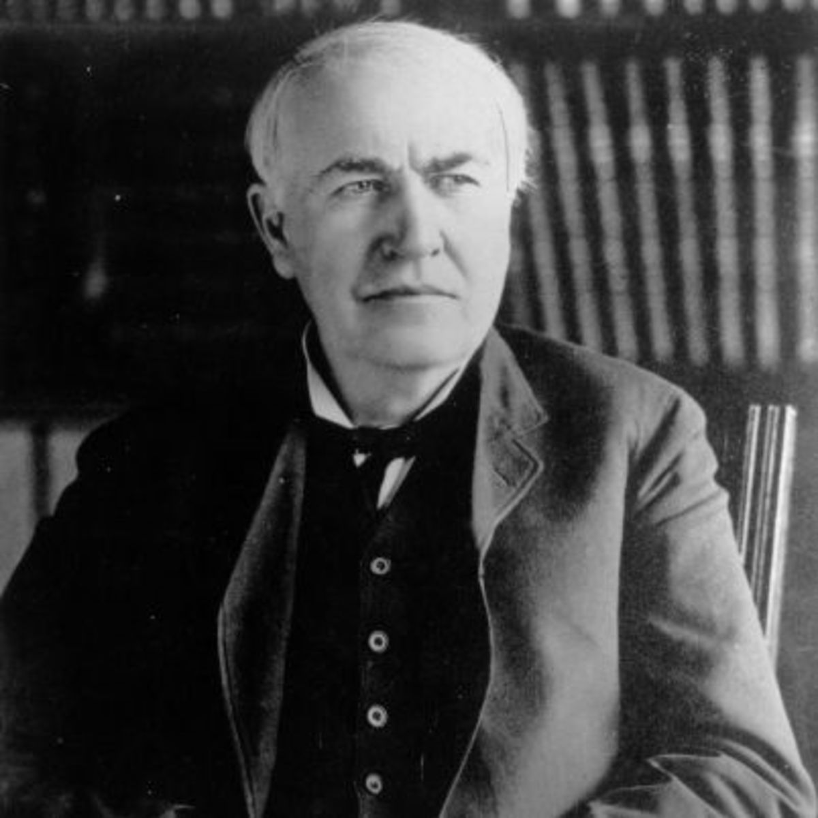
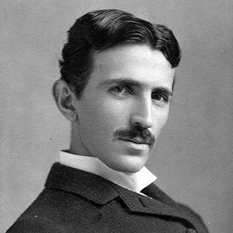
Faraday
Edison
Tesla

Slide 5

Projected huge increase in the demand for electricity in the UK
Currently around 80GW

Slide 6
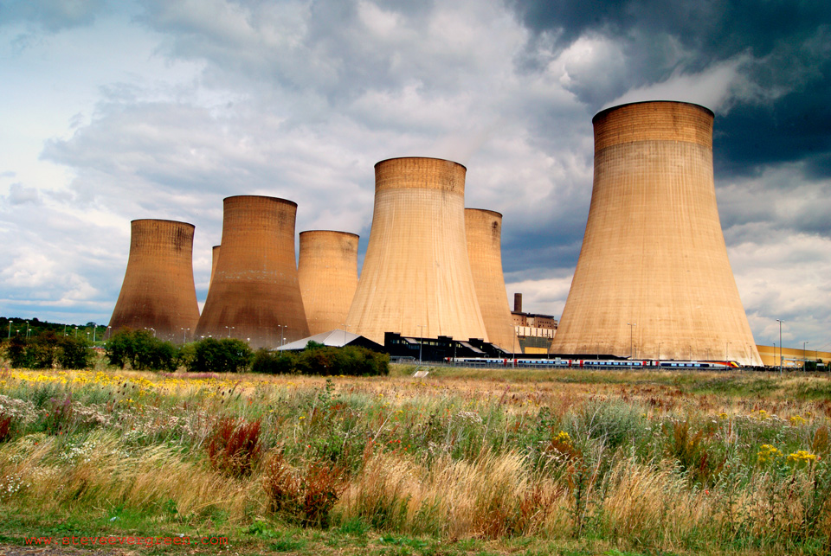


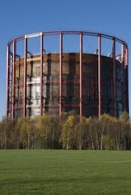
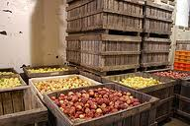

But keeping the system in balance is difficult
Electrical Energy
Low tolerance to
interruption
Must be consumed
as soon as purchased
Cannot be stored
in large quantity

Slide 7

Aims to provide reliable AC electrical power from suppliers to consumers
Needs to ensure the AC power
Has near constant voltage
Has near constant frequency
Regardless of the power demanded from it

Slide 8

Problem
Too much demand and insufficient supply can result in a power cut
World Cup 1990: Near Miss!
At the end of the match, power surged by 2.8 GW
11% of total capacity or 1 million Kettles

Slide 9
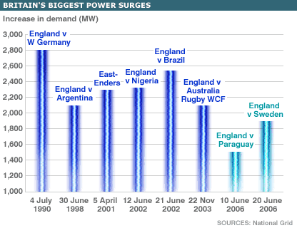

Slide 10
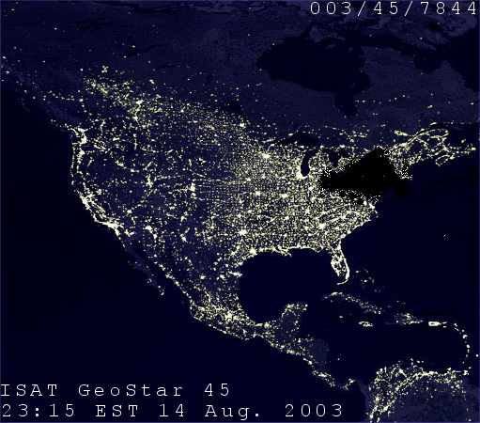
What can go wrong: US NE Coast Blackout 2003

Slide 11
Cost of 2003 US Blackout estimated at
$5 Billion!
Keeping the lights on is a huge issue of concern to both the general public and to politicians
Security of supply is paramount
Mathematics offers real insights into this.

Slide 12
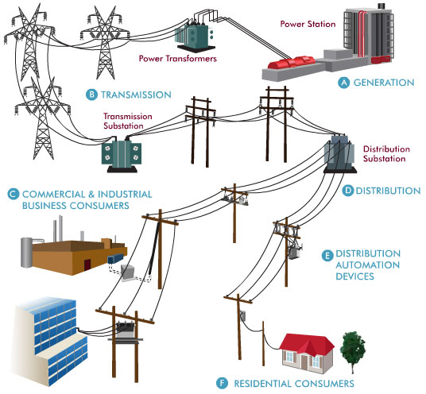
Electricity is supplied over a complex network
EHV 400kV
HV 11kV
LV
400V

Slide 13
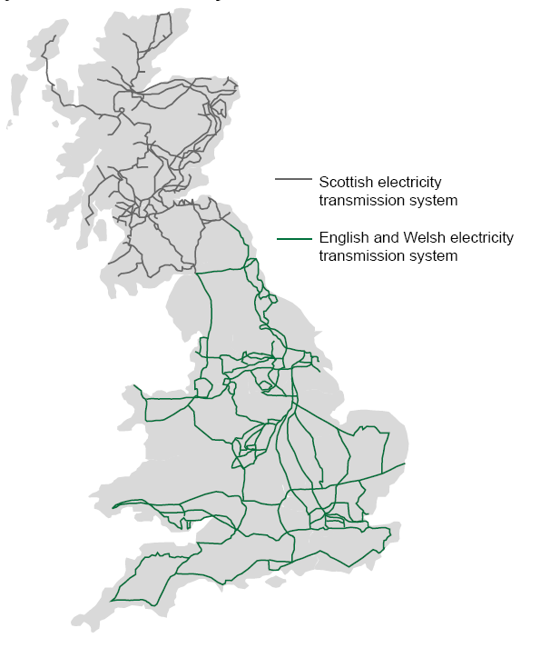
UK National EHV Grid

Slide 14
Eg. Eindhoven sub-network
10kVA, cosø=1.0
DB-2
5 houses
3 houses
Each house demands 3500kWh / year
60m
50m
80m
4 houses
120m
80 kVA, cosø=1.0
50m
100m
TR-1
5 houses
V1
2 houses
90kVA, cosø=1.0
100m
5 houses
150m
10kV net
2 houses
Station-2
Station-1
135m
40m
60m
TR-2
Nomenclature
3 houses
30m
250m
50m
20m
GPLK 4*50 Cu (paper insulated cable)
10kV net
VVMvKsas 4*95 Al (PVC insulated cable)
DB-1
V2
TR – 10,25kV/400V, 400kVA transformer
2 houses
Node point
25kVA, cosø=1.0

Slide 15
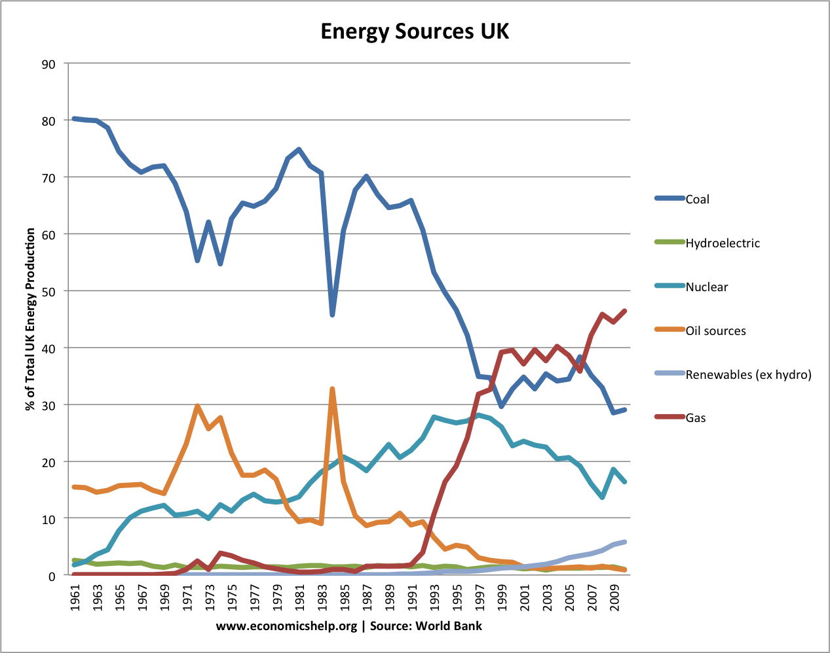
Suppliers
The nature of energy supply is changing rapidly

Slide 16
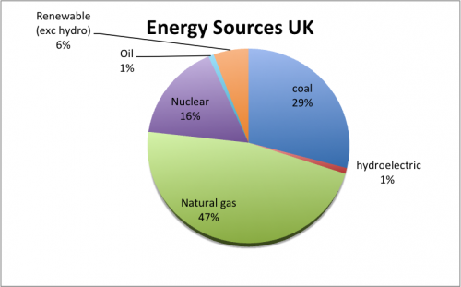
Situation in 2010

Slide 17
Situation on 21st April 2017

Slide 18
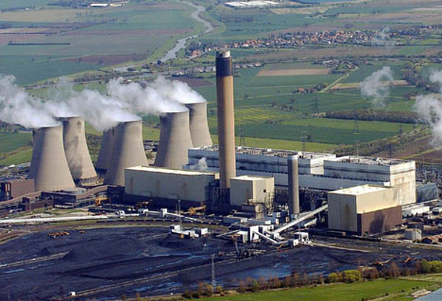
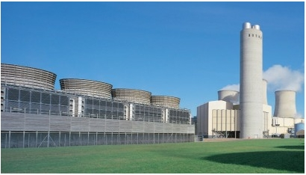
Fossil Fuels : 160 large power plants
Coal Oil Gas Peat
1-2 GW

Slide 19
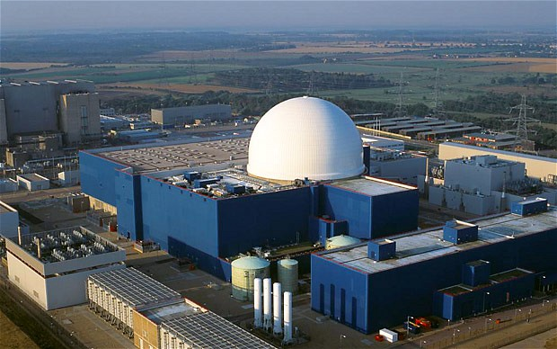
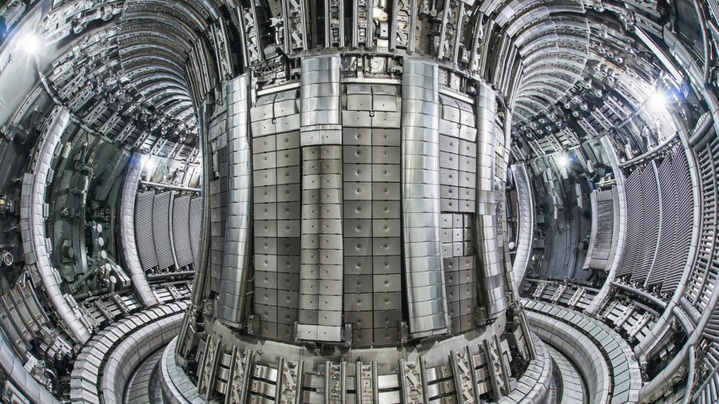
Nuclear 16% of total, 15 reactors
Fission 1-2 GW
Fusion ?????

Slide 20
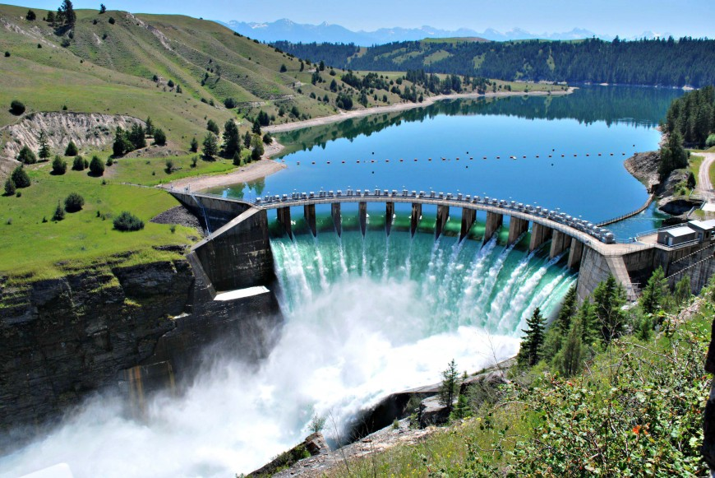
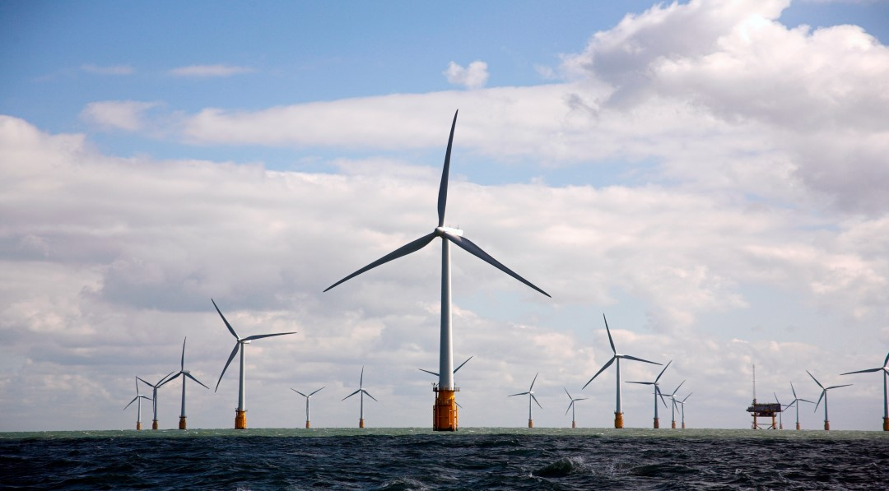
Renewables: 25% in 2017
Hydro Electric 100MW- 20 GW
Wind 500 MW
2016: UK generated more electricity from wind power than from coal

Slide 21
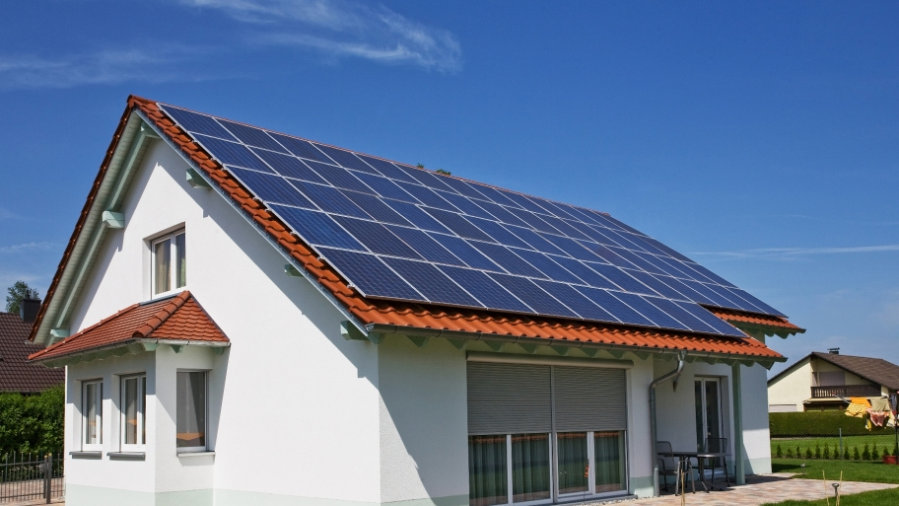
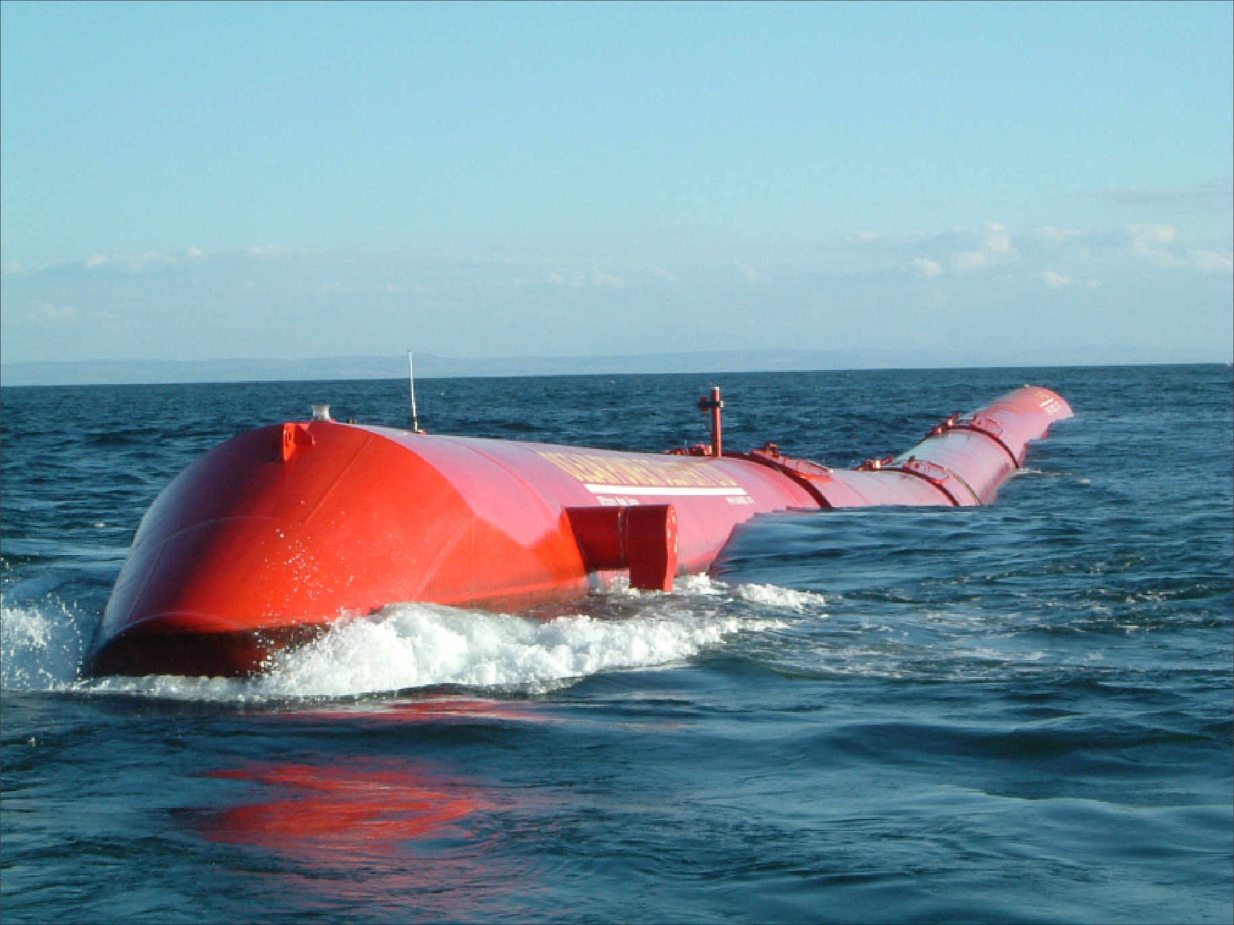
Solar 10 kW
Wave 20 MW
Tidal: Sihwa (Korea) 200 MW

Slide 22
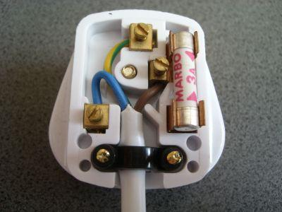
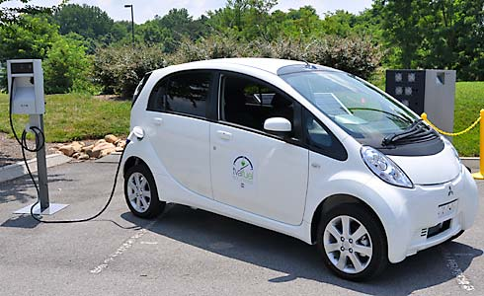
Consumers
Factory
Household 500W
Smart users
Electrical vehicles 1-2 kW!!

Slide 23
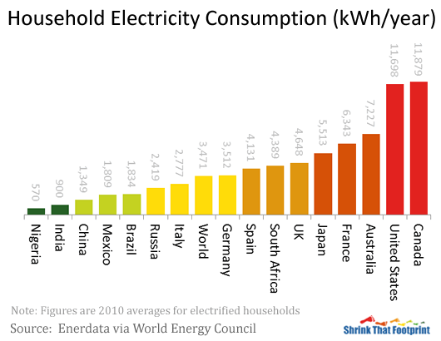
UK: 4600 kWHours = 500W on average

Slide 24
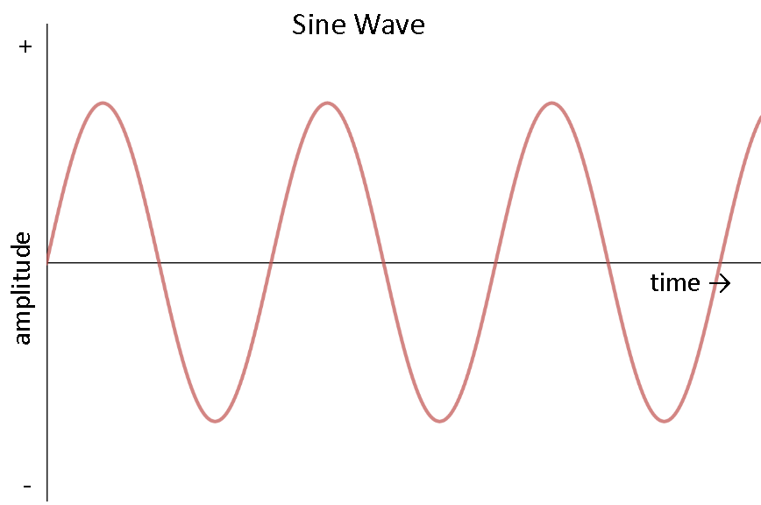
Power is supplied as three phase Alternating Current

Slide 25

Anatomy of a power network
Represent AC voltage by a complex voltage V and a and associated complex current I
AC Power
P: Real Power
Q: Reactive Power
In a typical network P and Q are given functions

Slide 26
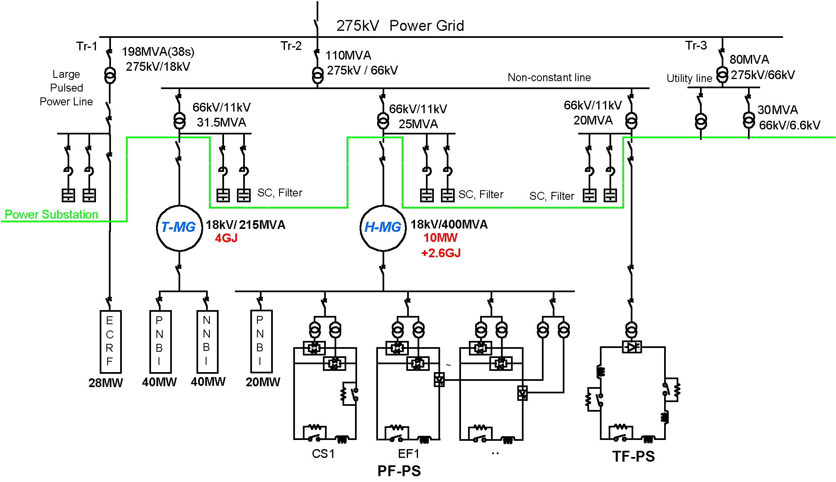
Typical network: many nodes and bus connections

Slide 27
Grid represented by a set of N nodes with bus connections
Complex Voltage at each connection is
Complex Current through the connection
Connections have complex admittance
Power drain/supply at each node

Slide 28
Ohm’s law
Power at each node

Slide 29
Combined system of equations
N: number of nodes
S: complex nodal demand vector (Nx1)
V: complex nodal voltage vector (Nx1)
: complex nodal admittance matrix (NxN)
Then we solve the following quadratic equation system to find V

Slide 30

Electricity supply is all about solving networks of coupled quadratic equations!

Slide 31
Simplest quadratic equation
Solutions

Slide 32
Particular example
Solutions
No solution if

Slide 33
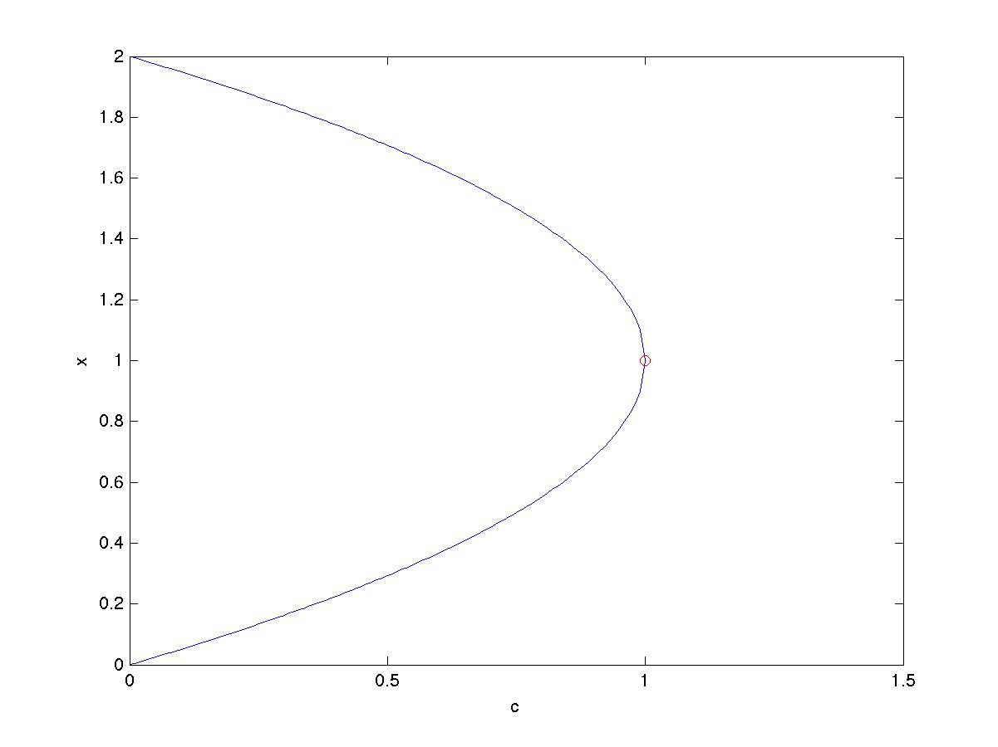
Plot of the solutions
x
Tipping point
c

Slide 34
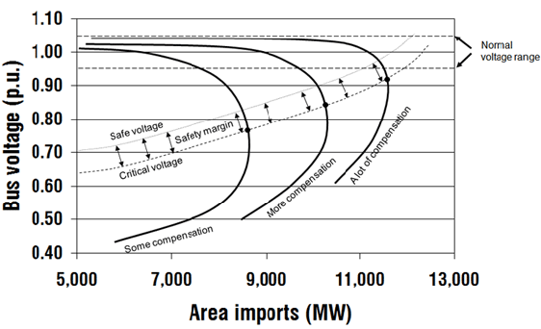
Voltage vs. demand often represented by a ‘nose curve’
Very similar to the solution of the quadratic
Tipping point occurs when the demand gets too high and the ‘voltage collapses’ to zero

Slide 35
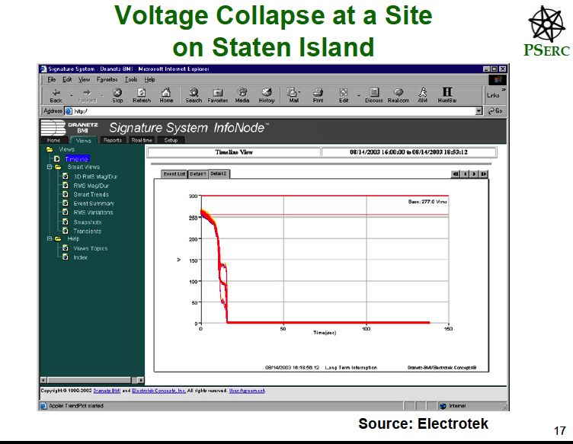

Slide 36
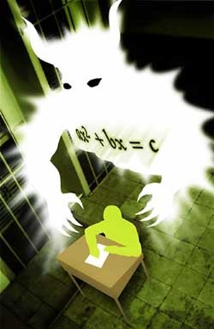
We design, monitor, simulate and control the power network to avoid a voltage collapse
Involves solving large numbers of quadratic equations very quickly to react to changes in supply and demand

Slide 37
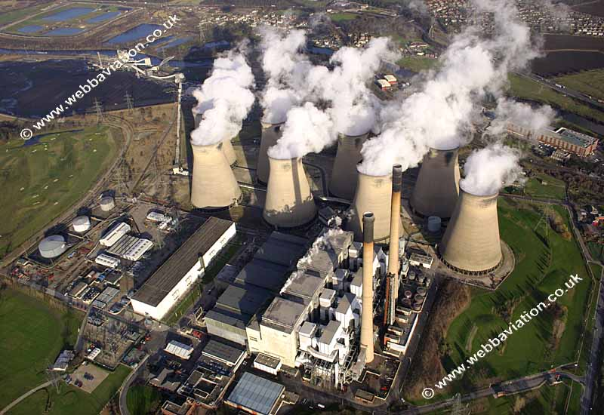
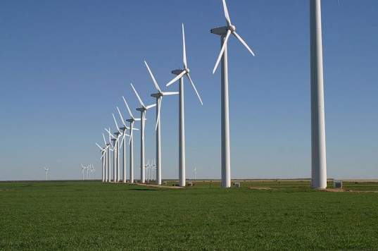
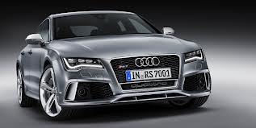
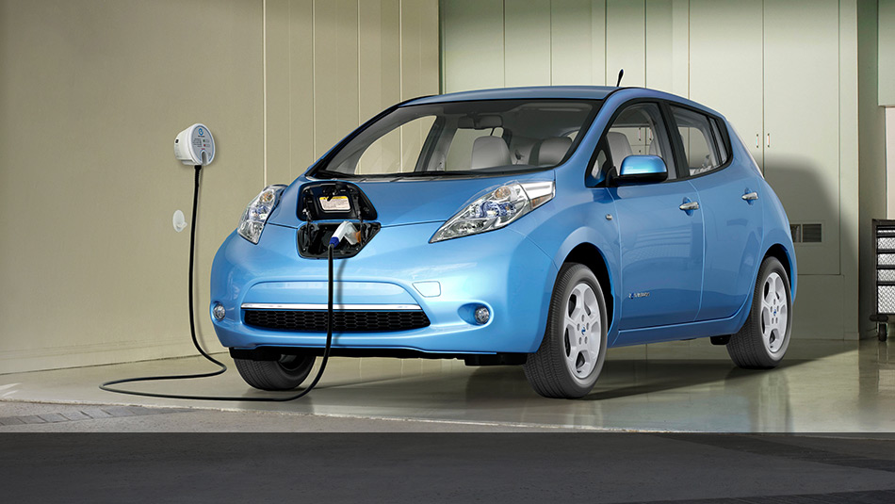
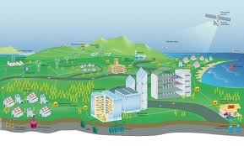
Future Challenges
Low carbon generation
Low carbon consumption
And storage
Modernising the legacy infrastructure
Notes:
This requires fundamental changes to the way we generate, deliver and consume enegy
Our eneryg landscape is going to change dramatically in the coming decades, responsing to the government’s 2050 carbon target. The change will expect to happen in three key areas
Low carbon generation, low carbon consumption, accommodating the new energy landscope, fit for the
Modernising the legacy infrastructure to provide greater information, communication and control to substantially improve the supply efficiency
Require fundamentally change the way we generate, deliver and consume electricity

Slide 38
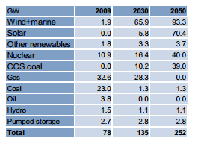
Projected changes in electricity supply
Notes:
In 2010, Decc published 7 pathways to achieve the 80% carbon reduction, Poyry and bath were the first to examine the impications to the electrical supply system and quantify its cost. We picked alpha pathways, because it has the most ambitious plans for renewable expansion and high level of heat and transport demand
For demand, electrification will push up the demand from the current 300TWh to 505 in 2030 and more than double by 2050.
On the generation side, we need to substantially increase our renewables generation. For example,
The traditional coal and gas willl almost dispear completely. Coal generation with carbon capture and storage will develop to 40GW
If we carry on to operate and plan the low carbon system with the current high carbon technologies, the cost will be in the order of £158billions
Low carbon technologies, such as wind and nuclear, can help to reduce our carbon emissions. However,
integrating high levels of these technologies with the present `predict and provide' electricity supply paradigm could lead to
system solutions that are either very expensive or potentially not resilient and secure.
Low carbon generation, low carbon consumption, accommodating the new energy landscope,
Require fundamentally change the way we generate, deliver and consume electricity

Slide 39
The answer is blowing in the wind???
Largest realistic source of renewable energy is off-shore and on-shore wind power: UK leads the world 14.6 GW 20% of total

Slide 40
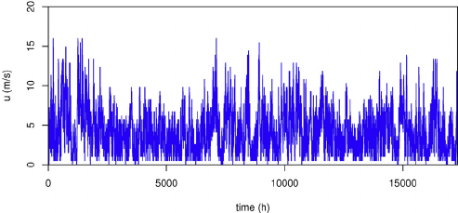
Problem: wind speeds vary a lot with time
How can we ensure a predictable supply of power?

Slide 41
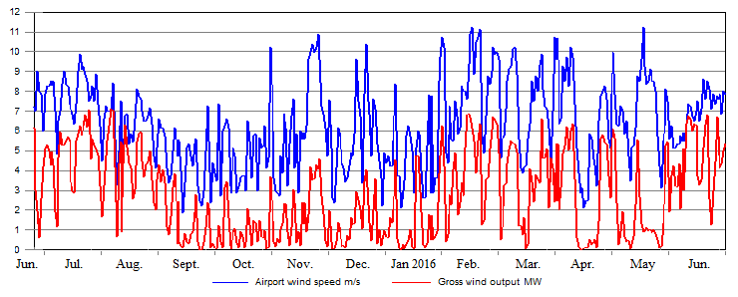
Partial solution:
Predict up 4 hours ahead using machine learning algorithms (see Big Data Talk)
More complete solution:
Need to understand the effects of climate change .. See future lectures.

Slide 42
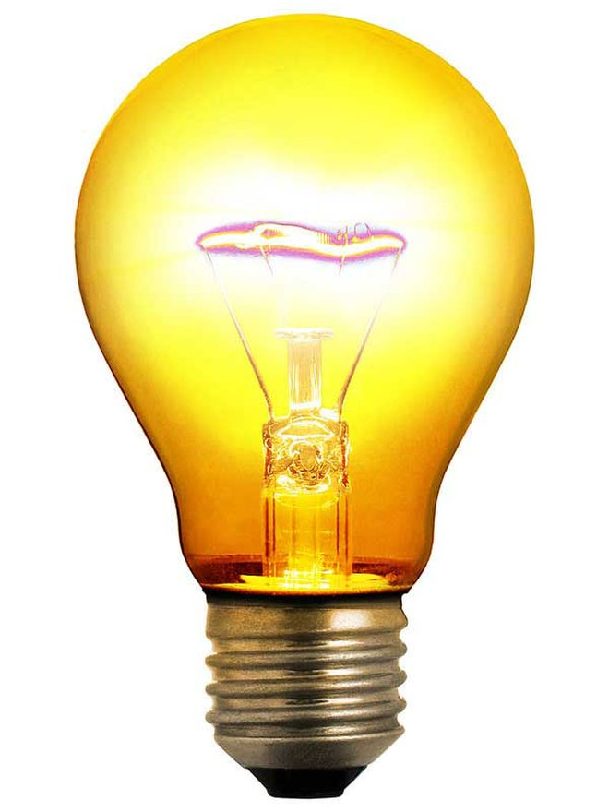
Conclusions
Energy matters to all of us
The challenge of supplying enough energy in a clean and safe way, is one of the greatest faced by humanity
Energy supply networks are already highly sophisticated, and will get more so as the way we use and supply electricity changes
To deliver a secure supply well into the future will require equally sophisticated mathematics.
However, to keep the lights on we all need to be able to solve lots of quadratic equations

