Slide 1
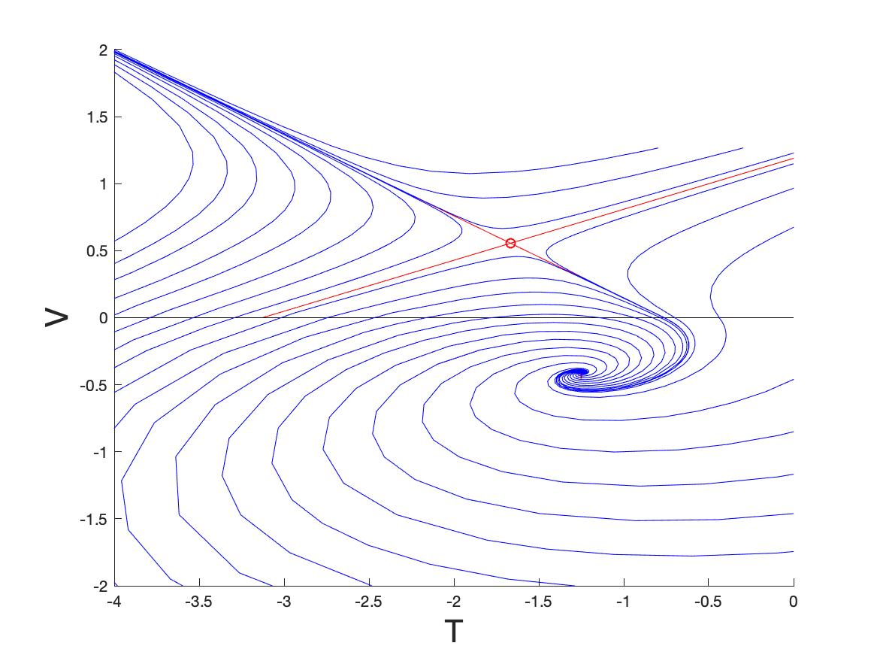

Resonant Dynamic B-Tipping Close to a
Non-Smooth Saddle-Focus Bifurcation
Chris Budd OBE, Bath & Rachel Kuske, Georgia Tech
SIAM Dynamical Systems 2025

Slide 2
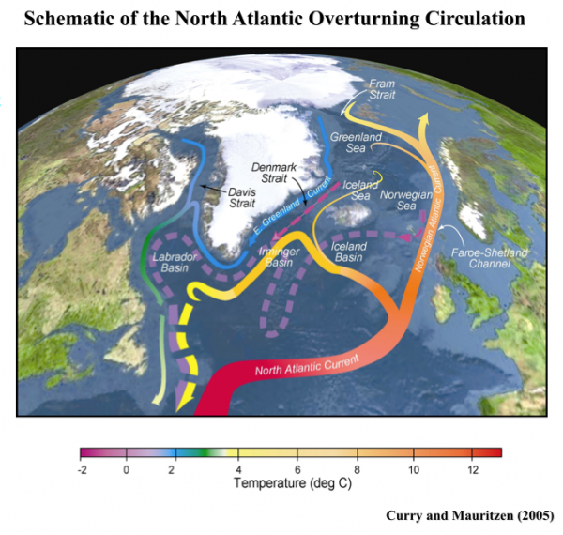
Study tipping in this system

Slide 3
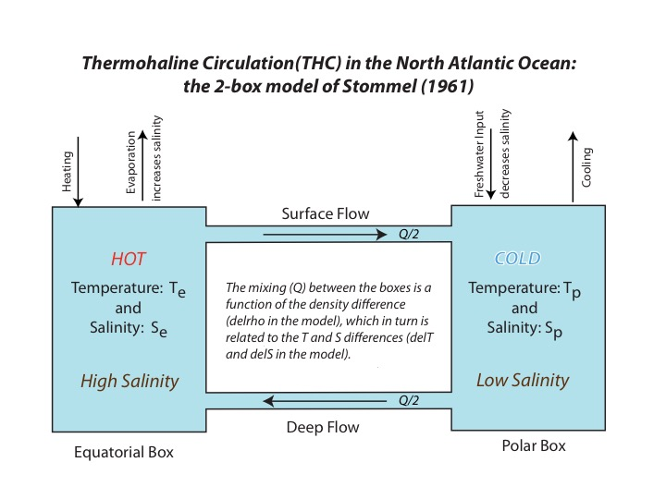
Non-Smooth Stommel 2-Box Model of Thermohaline circulation
[Stommel 61, Dijkstra 2014, Kuske + B 2021,24,25]
T = T_{e} – T_{p} S = S_{e} - S_{p}

Slide 4
Model as a non-smooth system
Freshwater forcing
Second derivative jump on manifold:

Slide 5
Basic dynamics close to non-smooth fold for slowly varying
Temperature dominated
Node
NSB-Tipping
V = T - S
Saddle-Node
Non-smooth fold
Saddle
Focus
Salinity dominated

Slide 6
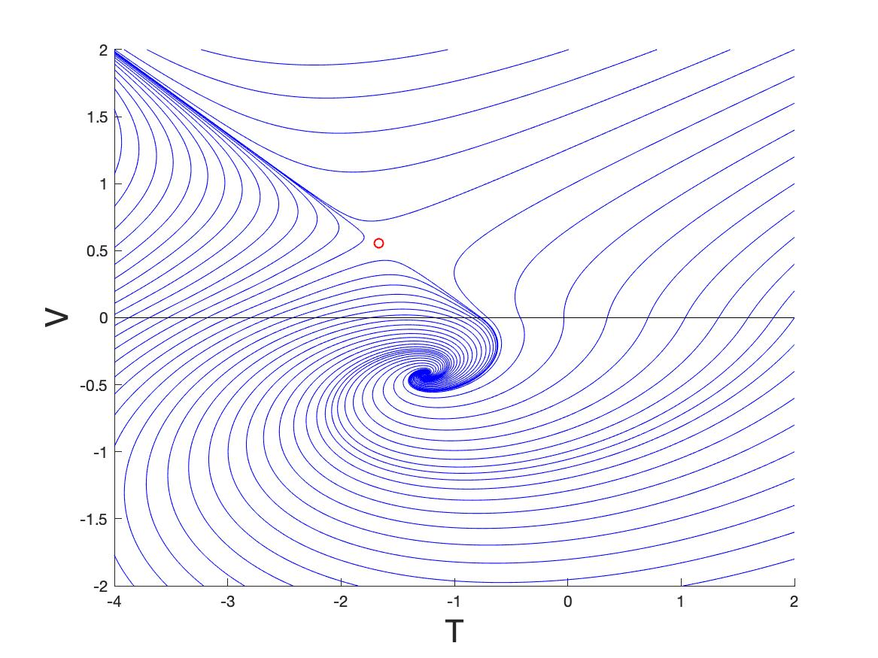
Perturbation (T,V) phase plane close to non-smooth fold
Saddle-Focus
Stable node
saddle
focus

Slide 7
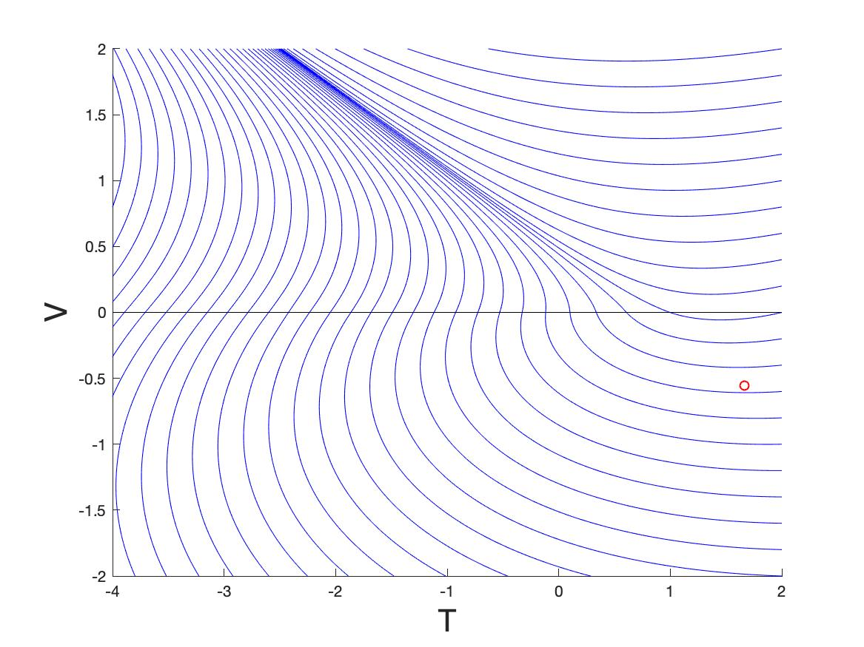
Stable node
Only node is stable

Slide 8

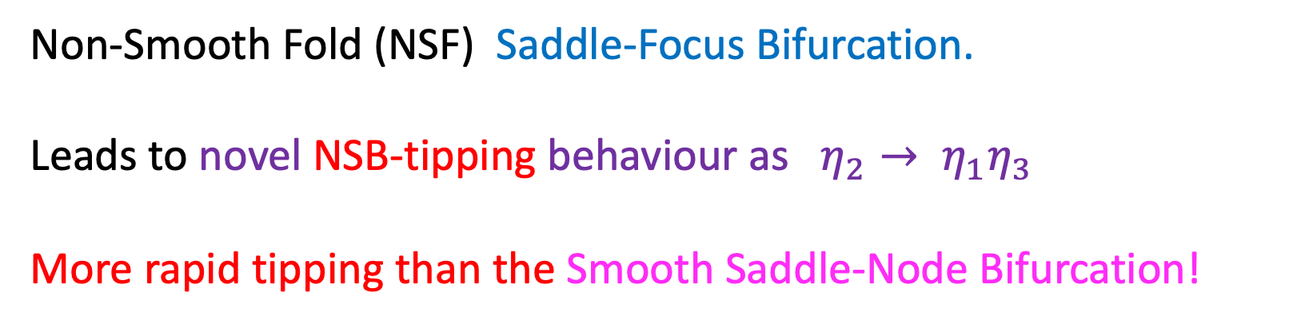
We see tipping between states as parameters such as $η_{2}$ vary.
Saddle and Focus coalesce when
Non-Smooth Fold (NSF) Saddle-Focus Bifurcation.
Leads to novel NSB-tipping behaviour as $η_{2}→ η_{1}η_{3}$
More rapid tipping than the Smooth Saddle-Node Bifurcation!

Slide 9
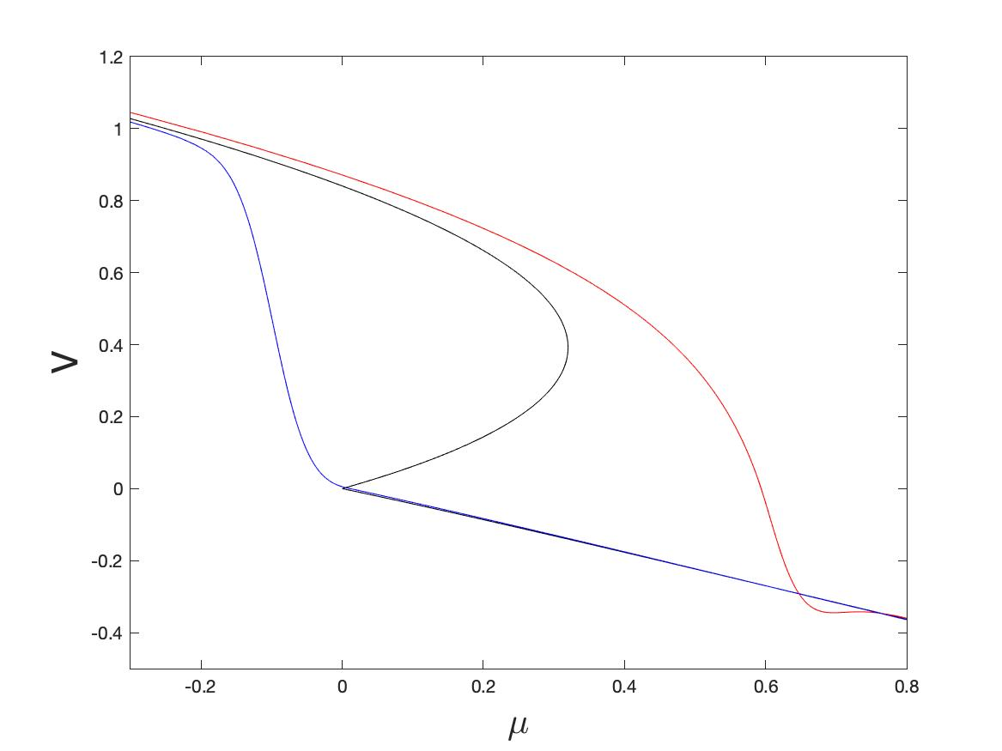
Non-smoothness leads to more rapid tipping

Slide 10

0
$$μ$$
0.5
Seasonal variation advances tipping

Slide 11
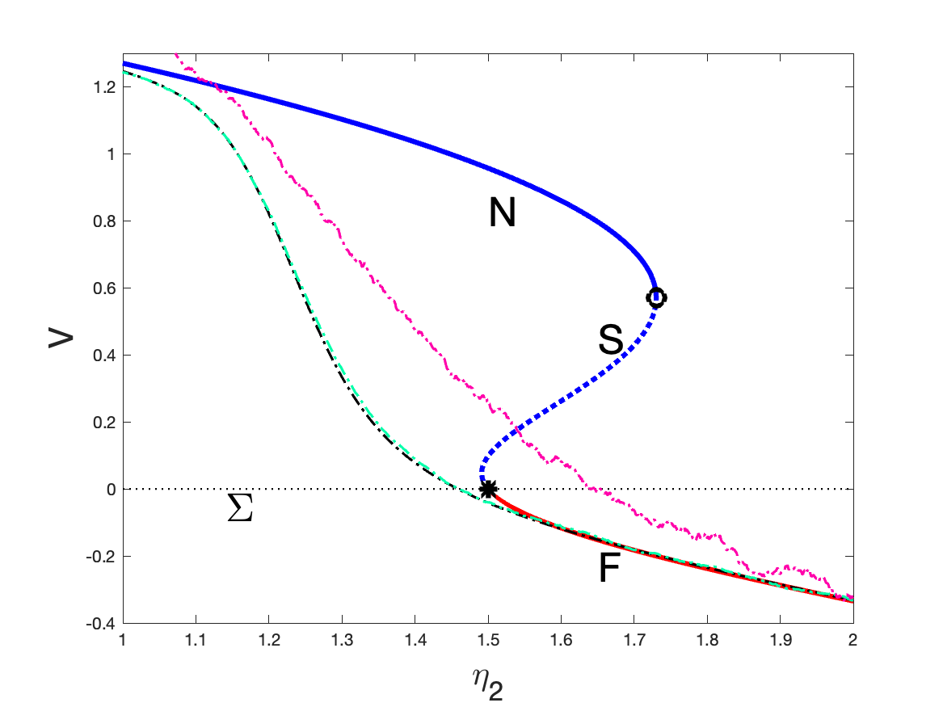
0
$$μ$$
0.5
Noise advances tipping

Slide 12
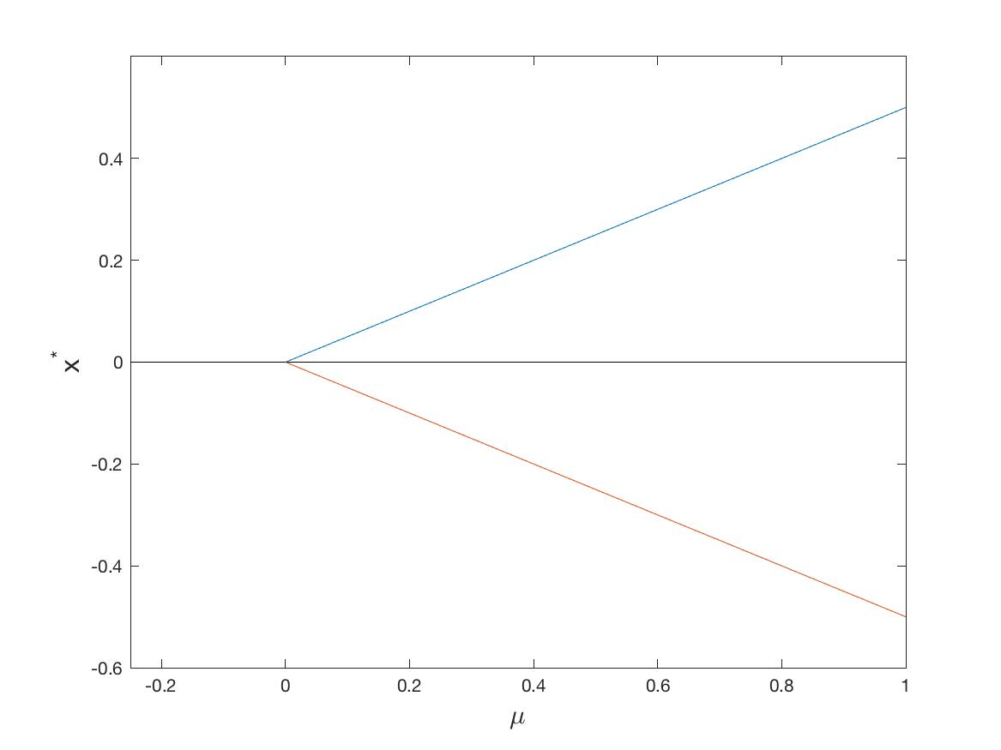

Simplified one-dimensional non-smooth system
Non-smooth fold
Unstable
Fixed points:
$$μ=0$$
Stable

Slide 13
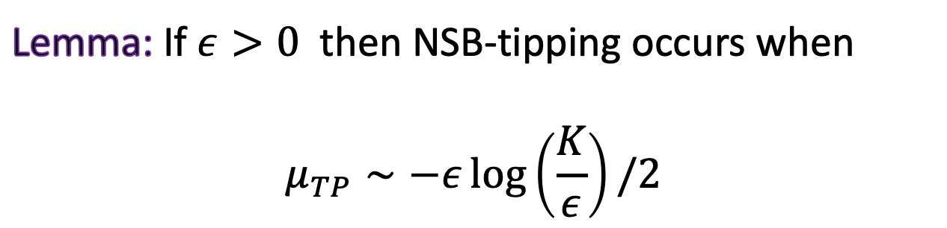
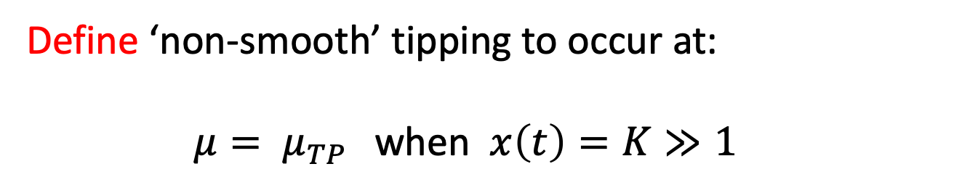
Case 1: Slow parameter drift
Define ‘non-smooth’ tipping to occur at:
$μ= μ_{TP }$ when $x\left(t\right)=K≫1$
Lemma: If $ε>0$ then NSB-tipping occurs when
$$μ_{TP}∼−ε\log\left(\frac{K}{ε}\right)/2$$

Slide 14
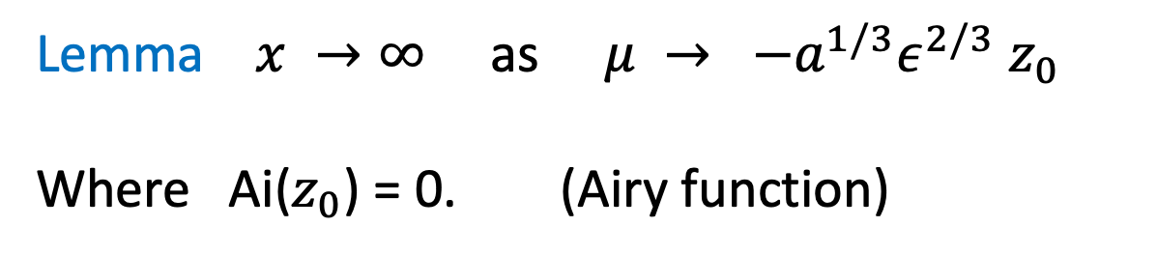
Comparison with a SNB
Lemma $x →∞$ as $μ → {−a^{1/3}ε}^{2/3}$ $z_{0}$
Where Ai($z_{0}$) = 0. (Airy function)

Slide 15
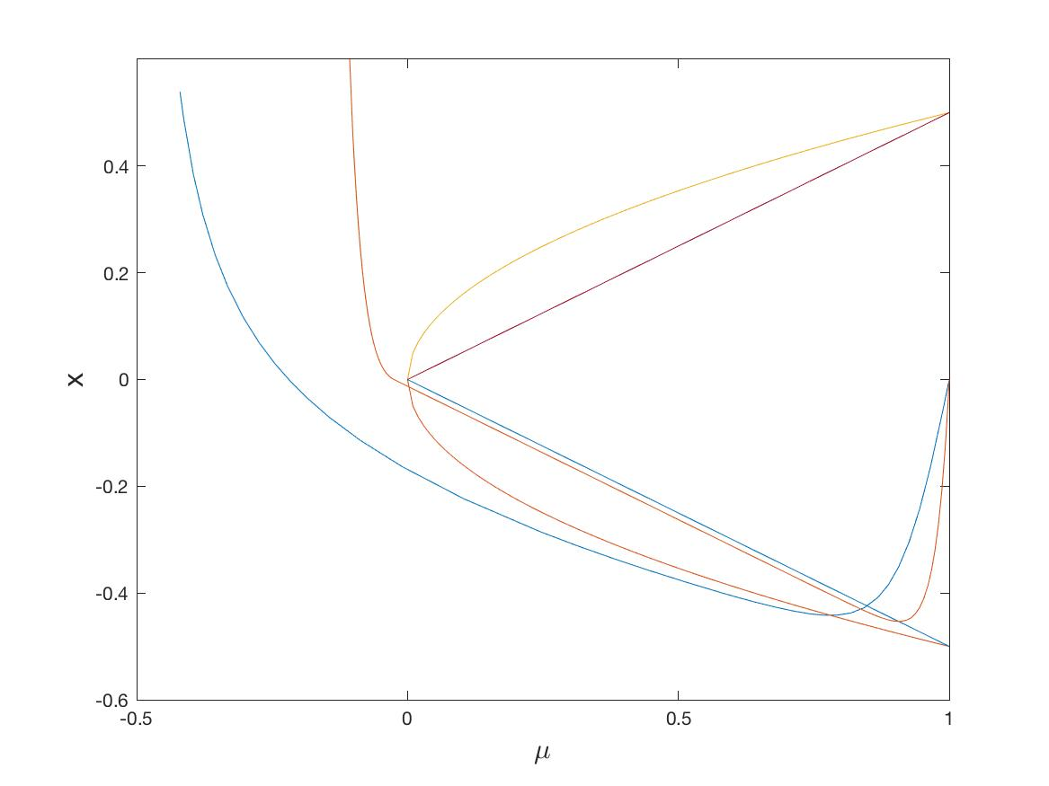
Comparison between smooth and non-smooth tipping
Smooth systems tip later than non smooth ones!

Slide 16
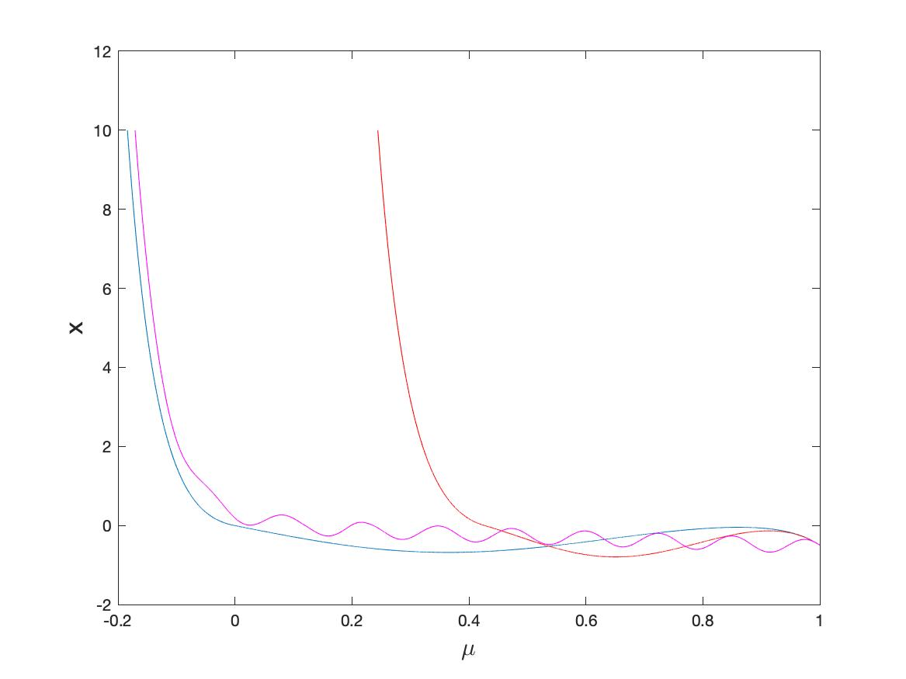
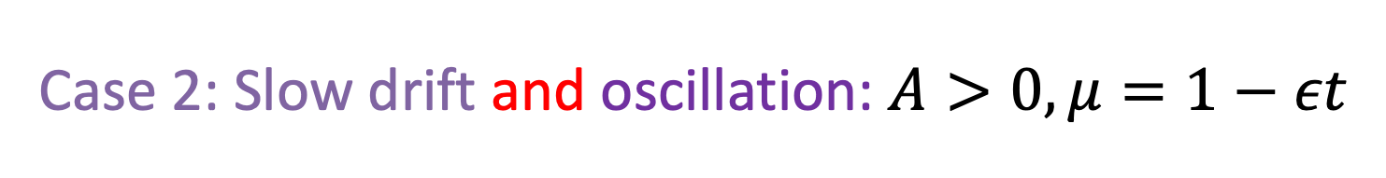
Case 2: Slow drift and oscillation: $A>0, μ=1−εt$
High $ω$
Medium $ω$
Low $ω$

Slide 17
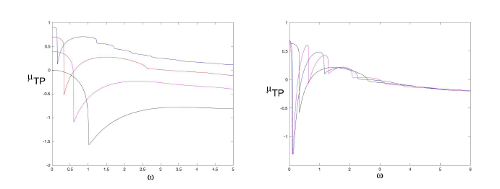
A cos($ωt)$forcing, $μ=m−εt, ε=0.025, 0.1, 0.25, 0.5, A=1$
See similar variations close to a SNB [RK]

Slide 18
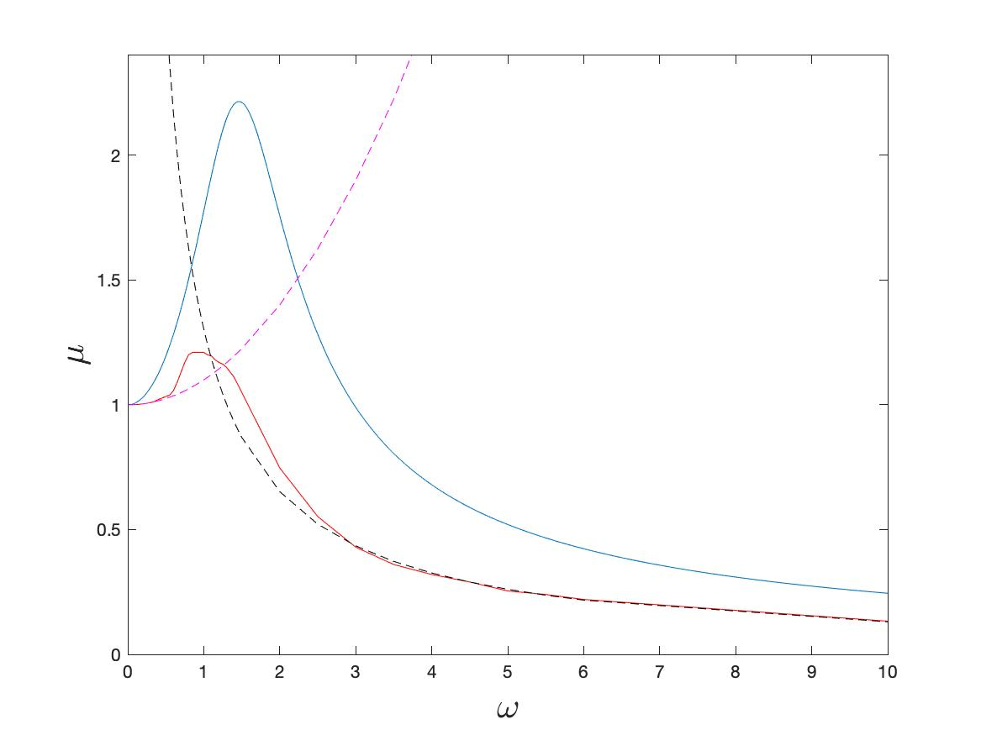
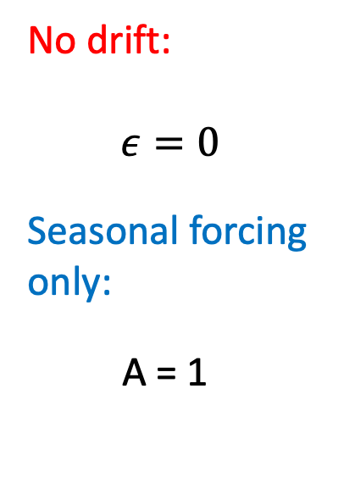
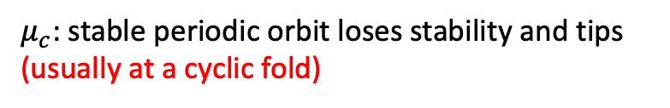
Case 3: Full two-dimensional model
See significant impact of resonance between the forcing frequency and the frequency of the focus and much more complex orbits
No drift:
$$ε=0$$
Seasonal forcing only:
A = 1
No tipping
$μ_{G}$ : stable periodic orbit grazes the discontinuity set
$μ_{c}$: stable periodic orbit loses stability and tips (usually at a cyclic fold)
Tipping

Slide 19
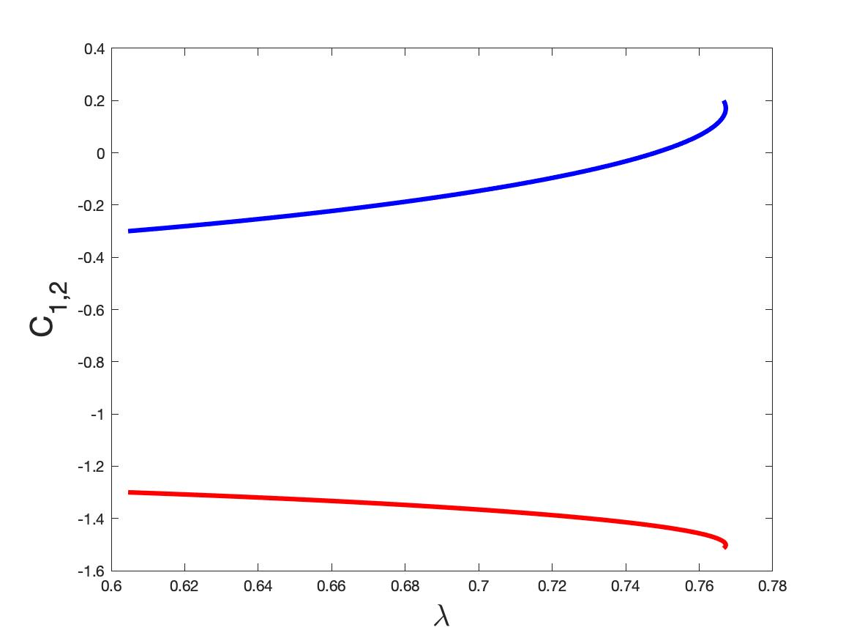
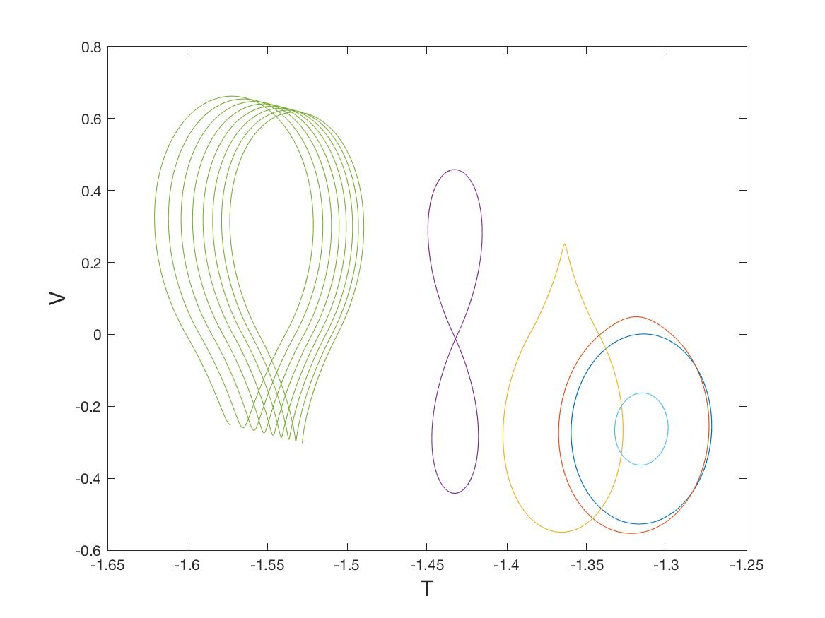
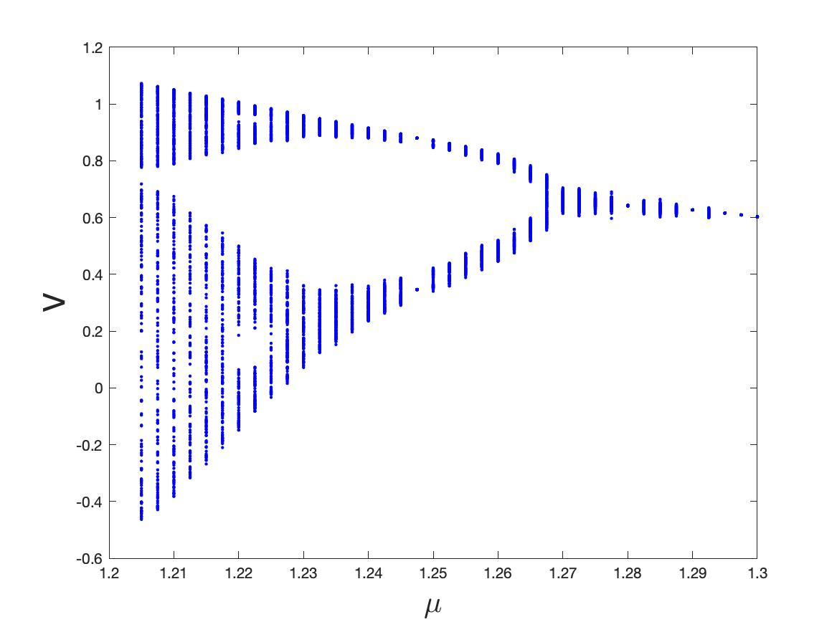
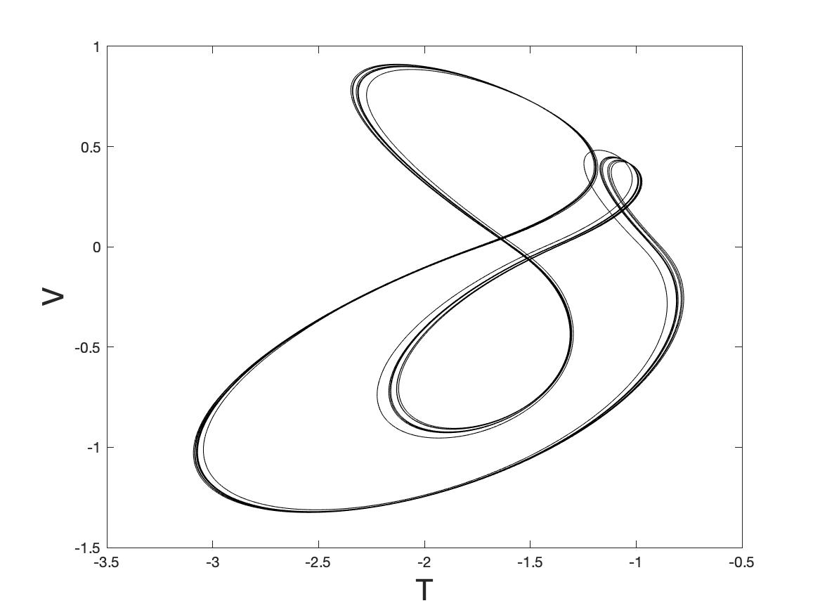
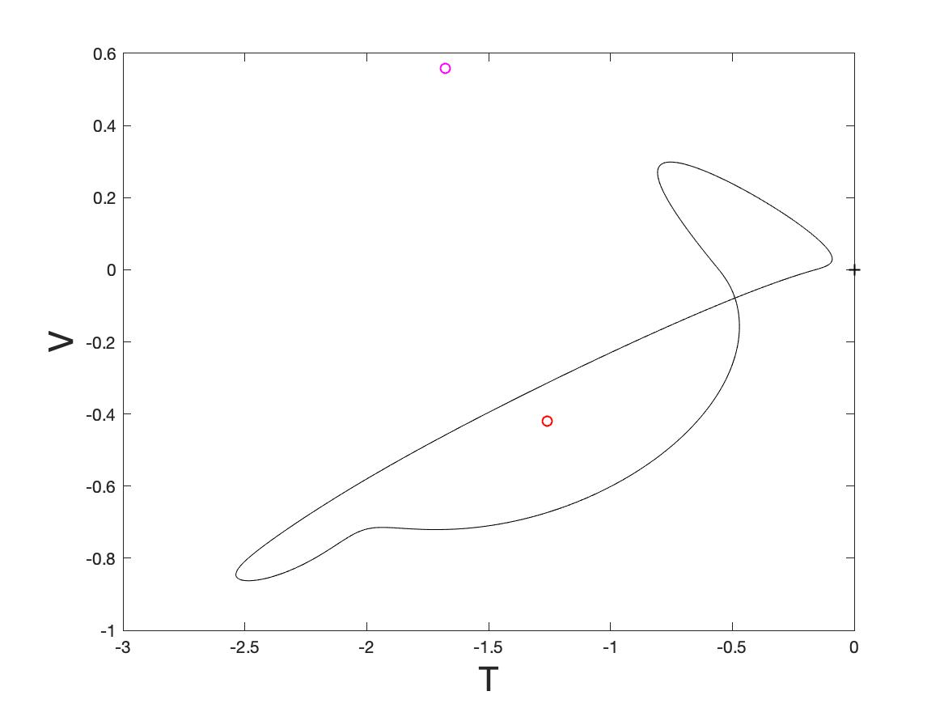
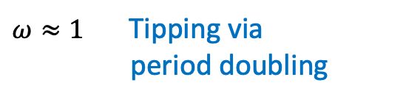
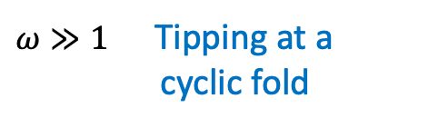
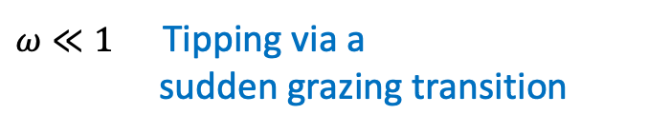
$ω≫1$Tipping at a
cyclic fold
$ω≈1$ Tipping via
period doubling
$ω≪1$ Tipping via a
sudden grazing transition

Slide 20
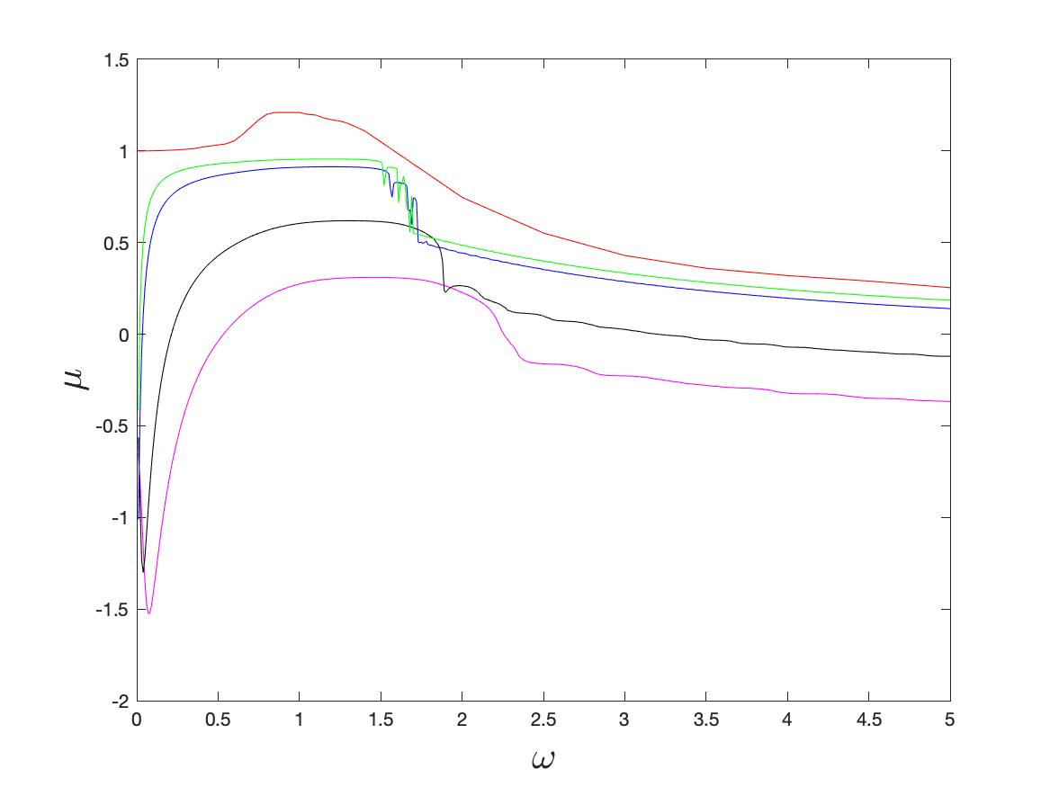
Slow drift: Resonance advances tipping

Slide 21
Conclusions
Stommel 2-box model has very rich
dynamics, lots still to do
This includes tipping at a non-smooth fold (NSF)
Non-smooth tipping occurs earlier than ‘smooth tipping’ and is sensitive to resonance effects, which advance it significantly
It is also harder to detect as there is no slowing down
This could have profound implications in modelling!

