Slide 1
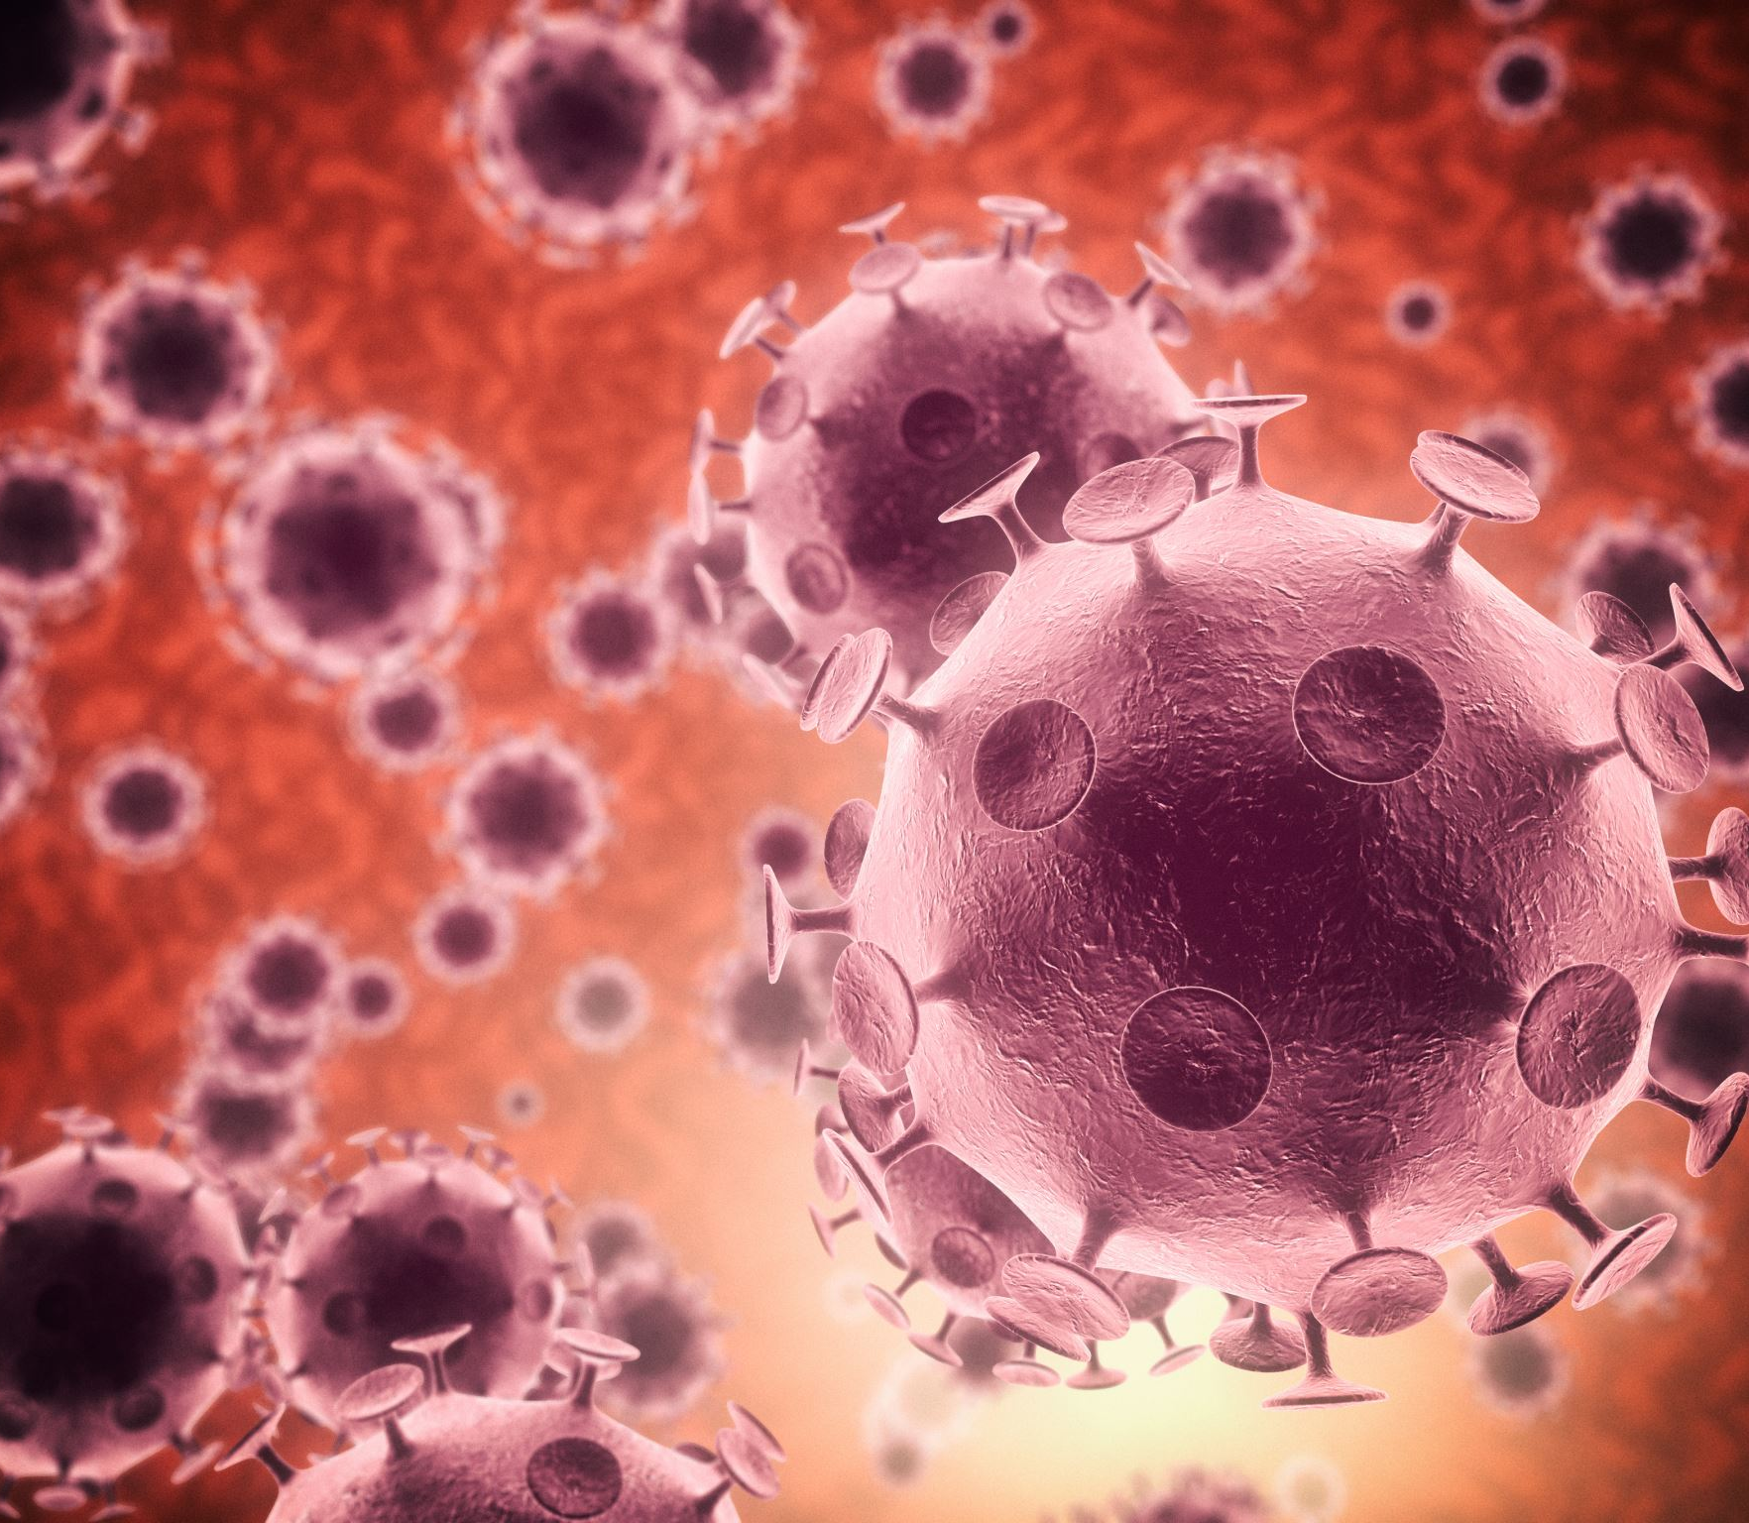
From germs… to people
How we can use statistics to help us detecting a disease

Slide 2
What do we know so far
We know how germs spread inside the body and how fast they spread between hosts / people.
However, do we check if everyone in the population has a disease?
We are able to count the number of colds in a school, or city.
But how to count colds over all UK?
And which schools or city should we “use” to count the colds?
What if the number of colds changes by school or city: then what is the correct answer?

Slide 3






Population versus sample
A population is the entire group that we want to draw conclusions about.
Size of the population: $N$
A (random) sample is the specific group that you will collect data from.
Size of the sample: $n < N$

Slide 4
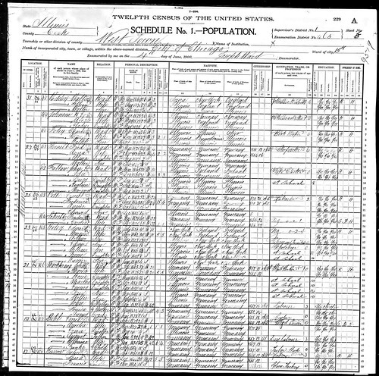

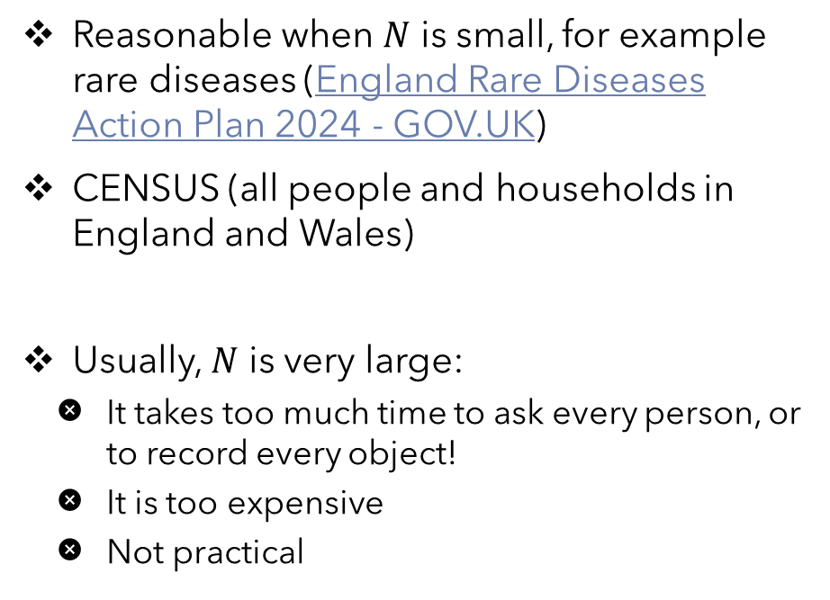
Collecting data from a population
Reasonable when $N$ is small, for example rare diseases (England Rare Diseases Action Plan 2024 - GOV.UK)
CENSUS (all people and households in England and Wales)
Usually, $N$ is very large:
  It takes too much time to ask every person, or to record every object!
  It is too expensive
  Not practical
This Photo by Unknown Author is licensed under CC BY

Slide 5
Collecting data from a sample
More efficient
(storing and running statistical analyses on smaller datasets is easier and reliable)
More cost-effective
(fewer participant, laboratory, equipment, and researcher costs)
Ideally, a sample should be randomly selected and representative of the population
Each member of the population has an exactly equal chance of being selected
The members in the sample reflect the properties of an entire population

Slide 6
Is the sample randomly selected?
Is it representative?
Population
Sample

Slide 7
Is the sample randomly selected?
Is it representative?
Population
Sample

Slide 8
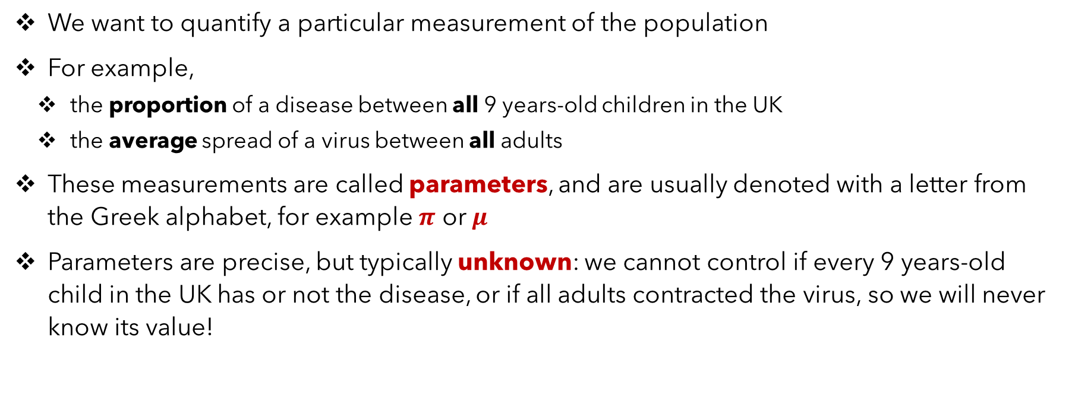
Why we need data?
We want to quantify a particular measurement of the population
For example,
  the proportion of a disease between all 9 years-old children in the UK
  the average spread of a virus between all adults
These measurements are called parameters, and are usually denoted with a letter from the Greek alphabet, for example $π$ or $μ$
Parameters are precise, but typically unknown: we cannot control if every 9 years-old child in the UK has or not the disease, or if all adults contracted the virus, so we will never know its value!

Slide 9
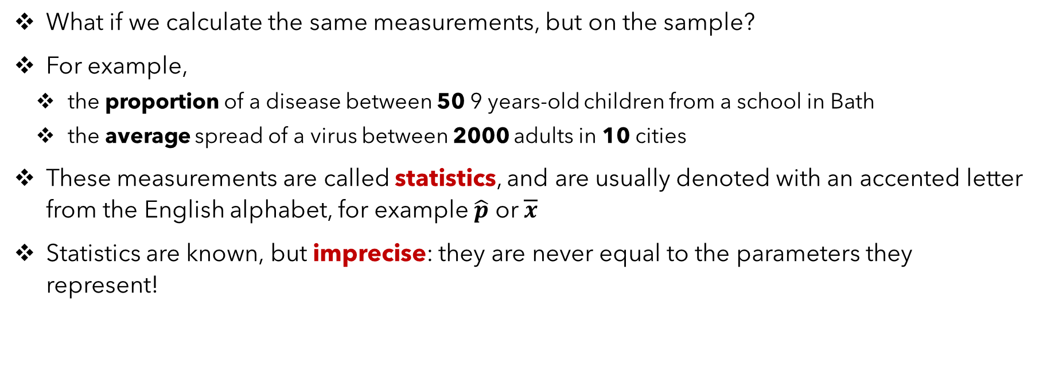
The sample to the rescue!
What if we calculate the same measurements, but on the sample?
For example,
  the proportion of a disease between 50 9 years-old children from a school in Bath
  the average spread of a virus between 2000 adults in 10 cities
These measurements are called statistics, and are usually denoted with an accented letter from the English alphabet, for example $\hat{p}$ or $\overline{x}$
Statistics are known, but imprecise: they are never equal to the parameters they represent!

Slide 10
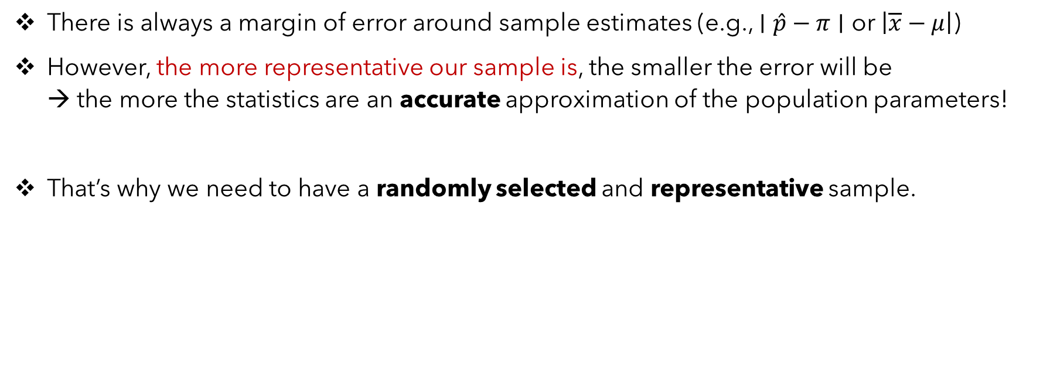
The important value of being a good sample
There is always a margin of error around sample estimates (e.g., $∣\hat{p}−π∣$ or $\left|\overline{x}−μ\right|$)
However, the more representative our sample is, the smaller the error will be
→ the more the statistics are an accurate approximation of the population parameters!
That’s why we need to have a randomly selected and representative sample.

Slide 11
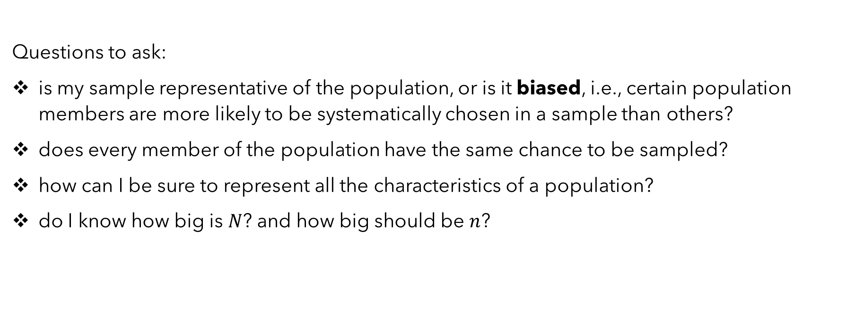
Workshop interval
Questions to ask:
is my sample representative of the population, or is it biased, i.e., certain population members are more likely to be systematically chosen in a sample than others?
does every member of the population have the same chance to be sampled?
how can I be sure to represent all the characteristics of a population?
do I know how big is $N$? and how big should be $n$?

Slide 12
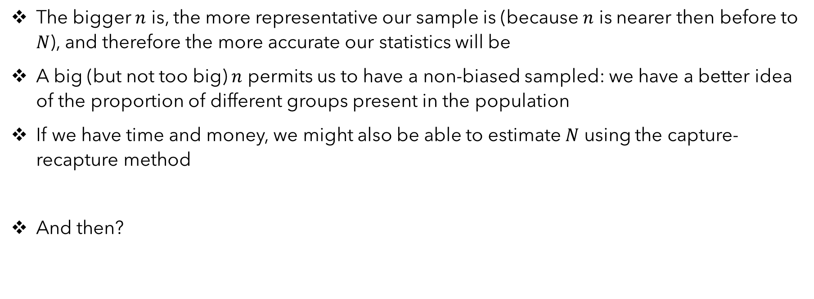
Recap from the workshop
The bigger $n$ is, the more representative our sample is (because $n$ is nearer then before to $N$), and therefore the more accurate our statistics will be
A big (but not too big) $n$ permits us to have a non-biased sampled: we have a better idea of the proportion of different groups present in the population
If we have time and money, we might also be able to estimate $N$ using the capture-recapture method
And then?

Slide 13
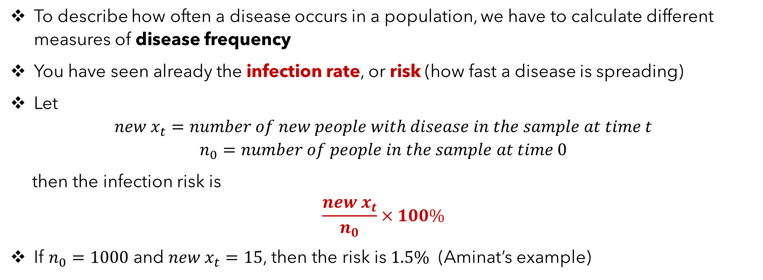
Incidence vs prevalence of a disease
To describe how often a disease occurs in a population, we have to calculate different measures of disease frequency
You have seen already the infection rate, or risk (how fast a disease is spreading)
Let
$${new x}_{t}=number of new people with disease in the sample at time t$$
$$n_{0}=number of people in the sample at time 0$$
then the infection risk is
$$\frac{new x_{t}}{n_{0}}×100\%$$
If $n_{0}=1000$ and ${new x}_{t}=15$, then the risk is $1.5\%$ (Aminat’s example)

Slide 14
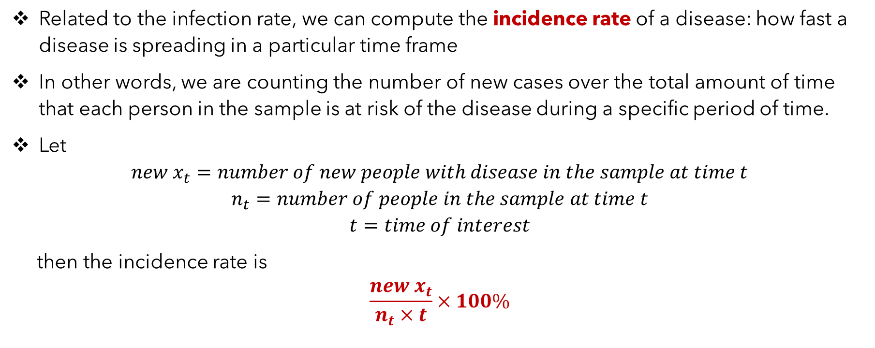
Incidence vs prevalence of a disease
Related to the infection rate, we can compute the incidence rate of a disease: how fast a disease is spreading in a particular time frame
In other words, we are counting the number of new cases over the total amount of time that each person in the sample is at risk of the disease during a specific period of time.
Let
$${new x}_{t}=number of new people with disease in the sample at time t$$
$$n_{t}=number of people in the sample at time t$$
$$t=time of interest$$
then the incidence rate is
$$\frac{new x_{t}}{n_{t}×t}×100\%$$

Slide 15
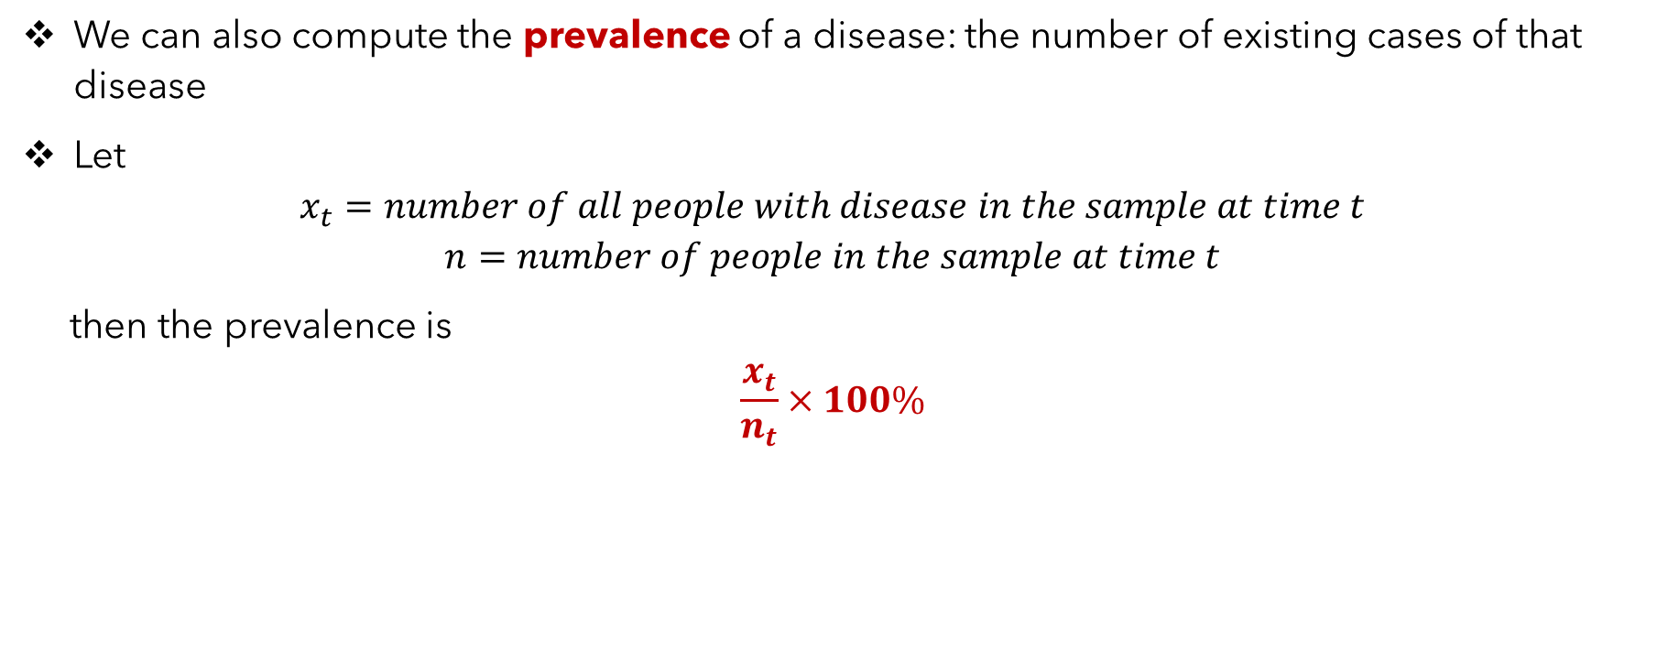
Incidence vs prevalence of a disease
We can also compute the prevalence of a disease: the number of existing cases of that disease
Let
$$x_{t}=number of all people with disease in the sample at time t$$
$$n=number of people in the sample at time t$$
then the prevalence is
$$\frac{x_{t}}{n_{t}}×100\%$$

Slide 16
Incidence vs prevalence: example
Year | Number of children with a cold | Total number of children in the sample
2021 | 54 | 500
2022 | 84 | 500
2023 | 65 | 500
Prevalence in 2021?
Risk of cold between 2021 and 2022?
Incidence between 2021 and 2022?
Incidence between 2021 and 2023?

Slide 17
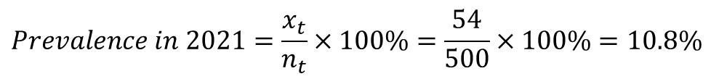
Incidence vs prevalence: example
Year | Number of children with a cold | Total number of children in the sample
2021 | 54 | 500
2022 | 84 | 500
2023 | 65 | 500
$$Prevalence in 2021=\frac{x_{t}}{n_{t}}×100\%=\frac{54}{500}×100\%=10.8\%$$
$$Infection risk in 2021/2022=\frac{{new x}_{t}}{n_{0}}×100\%=\frac{84−54}{500}×100\%=6\%$$
$$Incidence rate in 2021/2022=\frac{{new x}_{t}}{n_{t}×t}=\frac{84−54}{500×1}×100\%=6\%$$
$$Incidence rate in 2021/2023=\frac{{new x}_{t}}{n_{t}×t}=\frac{65−54}{500×2}×100\%=1.1\%$$

