Slide 1
Breaking the web (Before your users do)
Automated browser testing with Python & Splinter

Slide 2
Why write browser tests?
Verify user workflows work as expected
Catch UI bugs
Ensure your application handles errors and edge-cases gracefully
Faster, easier, and more reliable than manual testing alone

Slide 3
What is splinter?
Splinter is a Python package that gives programmers a Pythonic wrapper for the Selenium browser automation toolkit. The package provides helper functionality for interacting with, and verifying the contents of, web pages.

Slide 4
Requirements FOR TESTING with splinter
Python 3.8+
WebDriver application for your browser
Splinter and Selenium Python packages
Basic knowledge of HTML/CSS
Understanding of automated testing

Slide 5
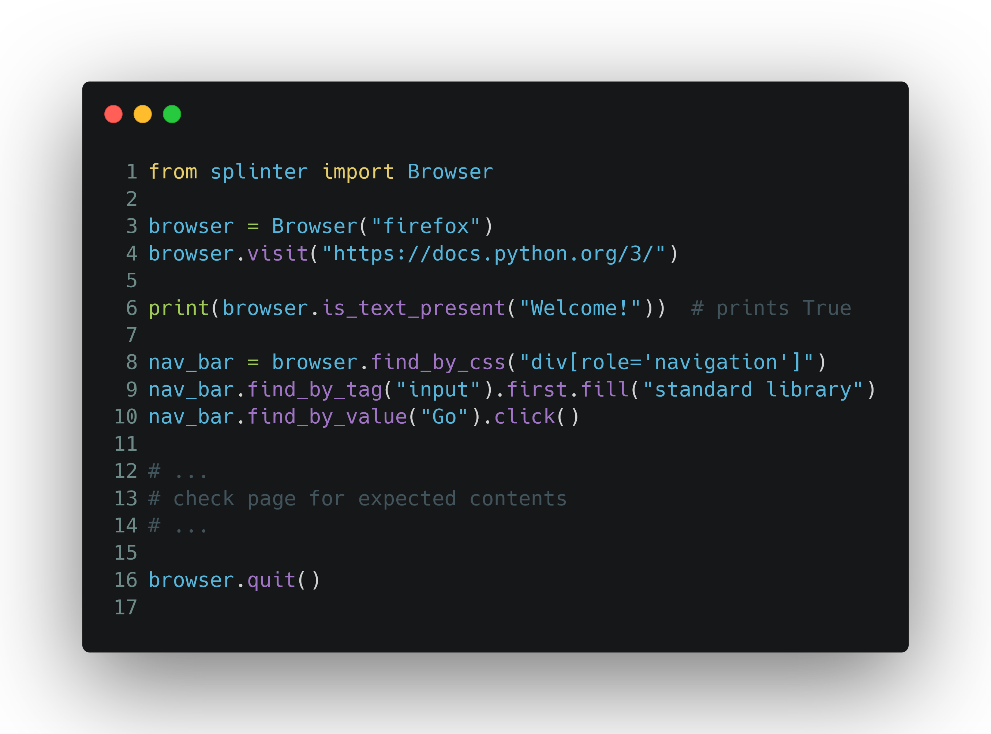
How it works

Slide 6
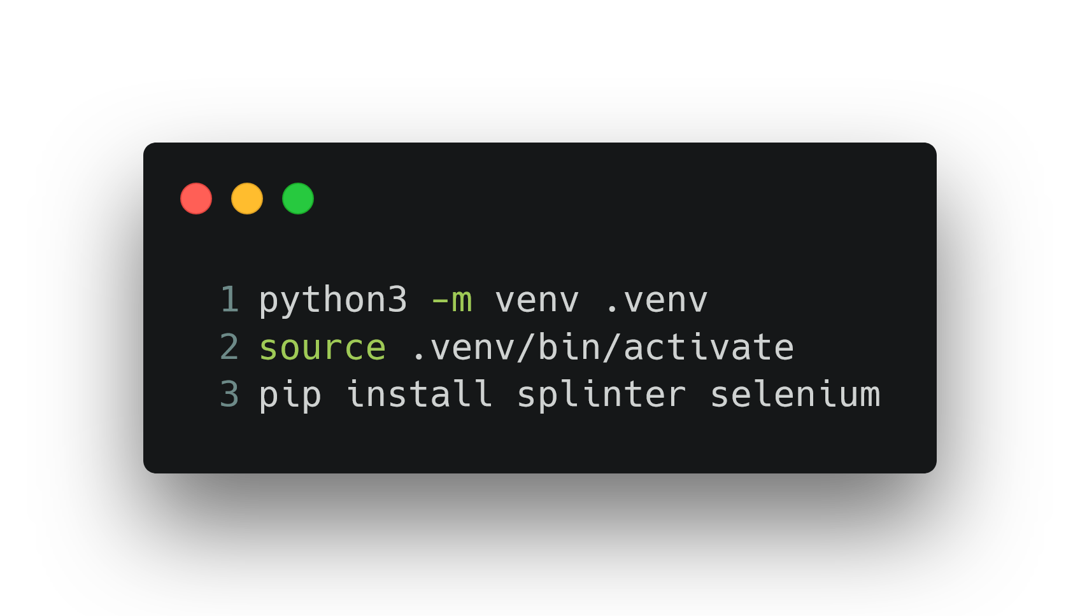
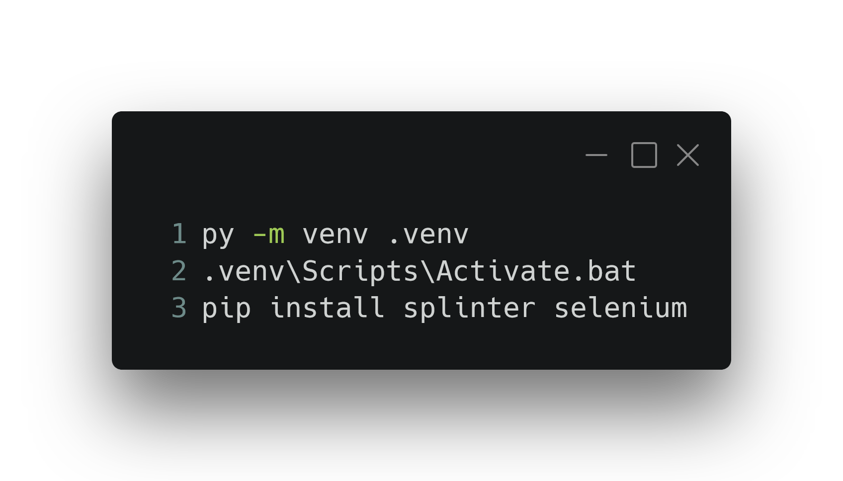
Installation and Setup
Create Python virtual environment
Enter the virtual environment
Install dependencies
Linux & macOS
Windows

Slide 7
SPLINTER’S APIs

Slide 8
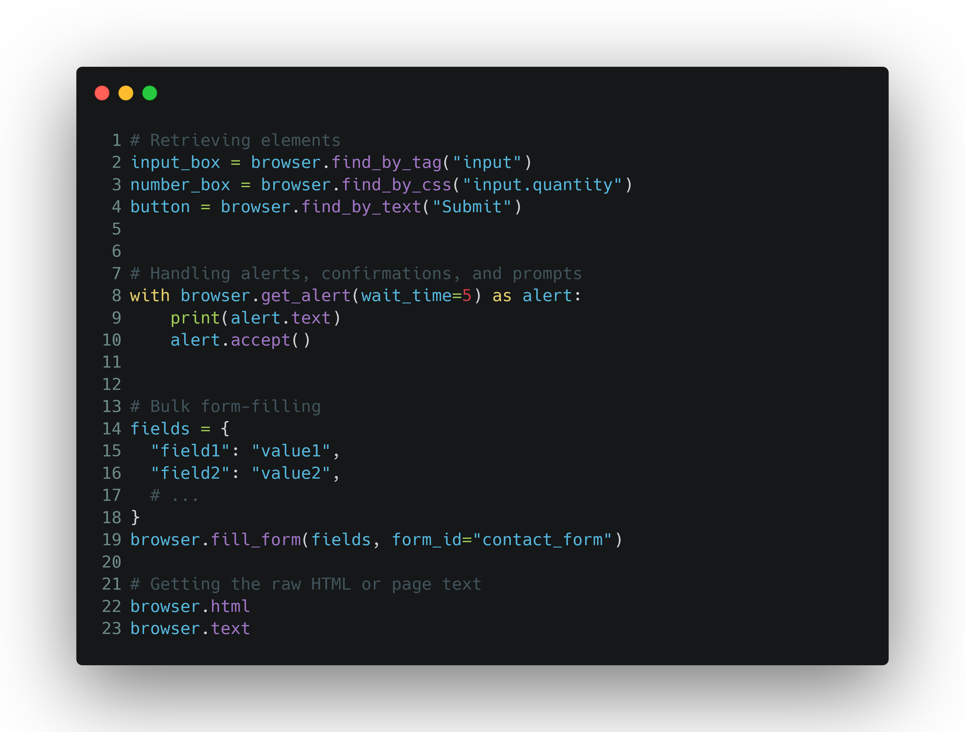
The Browser API
A small collection of the Browser object’s functionality

Slide 9
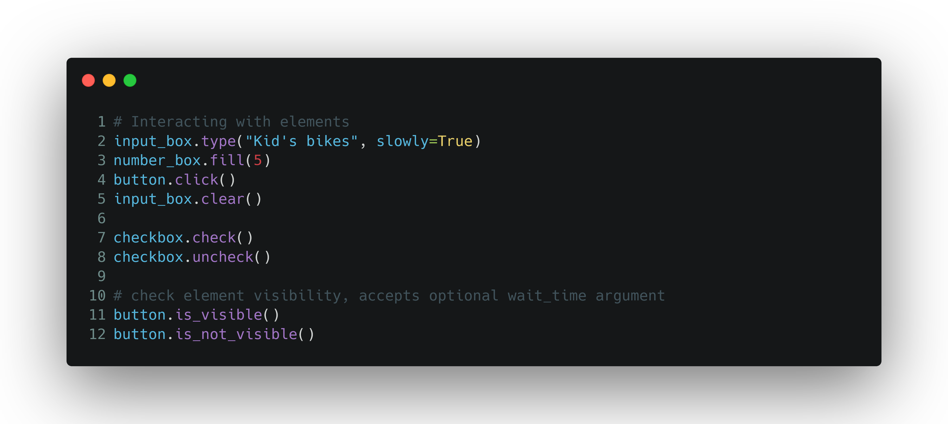
The Element API
Some functionality for interacting with elements on the page

Slide 10

Time for the Live Demo
Demo Source Code can be found here:

