Slide 1
Measuring distance between datapoints
OLA 2
Christoffer Drejer Mikkelsen

Slide 2

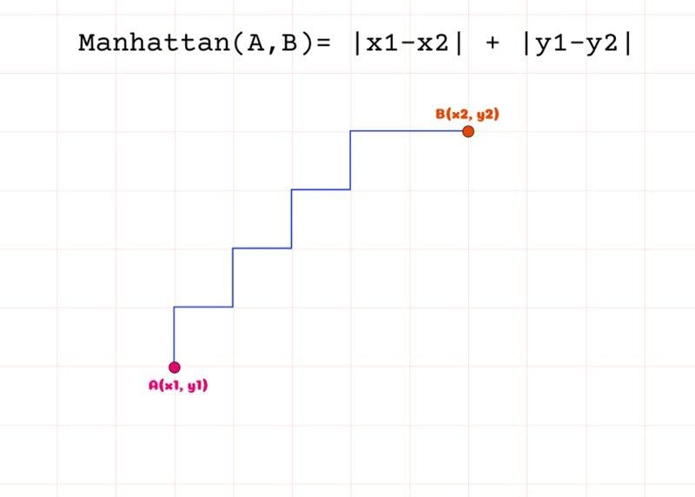
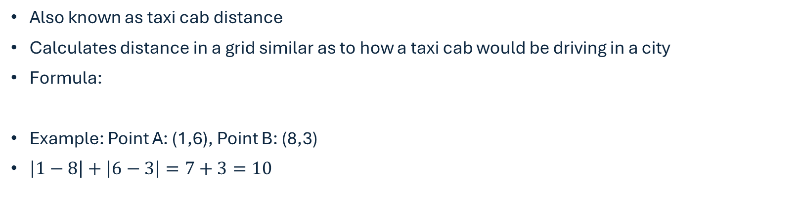
Manhattan Plot
Also known as taxi cab distance
Calculates distance in a grid similar as to how a taxi cab would be driving in a city
Formula:
Example: Point A: (1,6), Point B: (8,3)
$\left|1−8\right|+\left|6−3\right|=7+3=10$

Slide 3
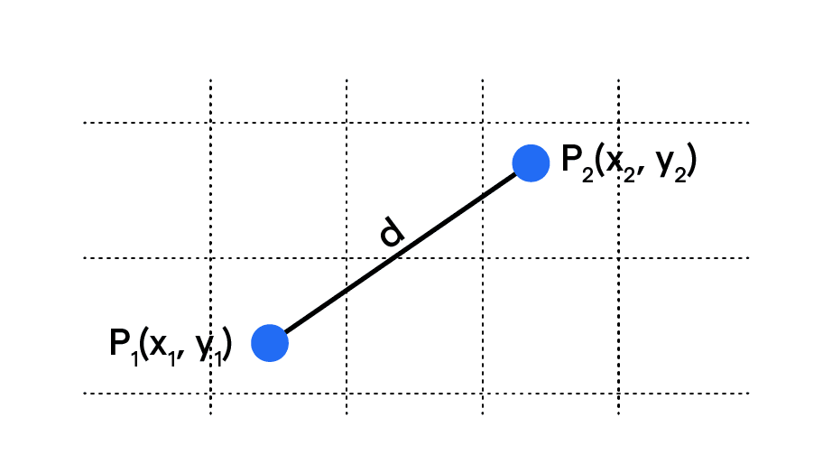

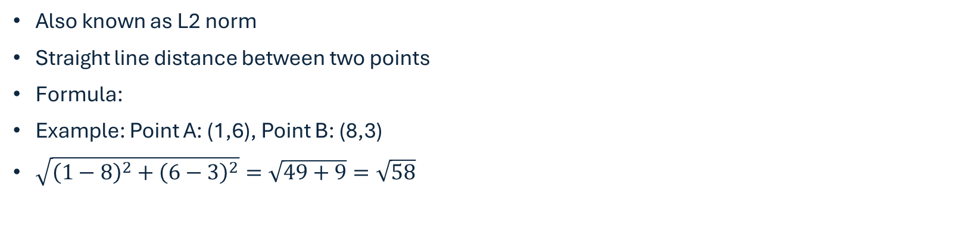
Euclidean Distance
Also known as L2 norm
Straight line distance between two points
Formula:
Example: Point A: (1,6), Point B: (8,3)
$\sqrt{{\left(1−8\right)}^{2}+{\left(6−3\right)}^{2}}=\sqrt{49+9}=\sqrt{58}$

Slide 4
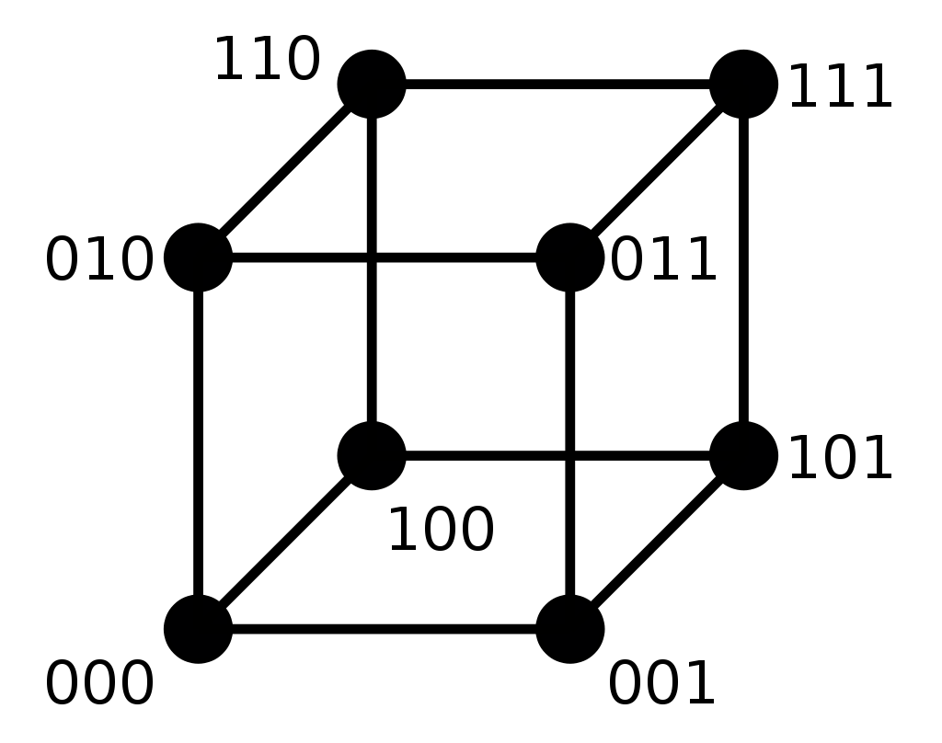
Hamming distance
Calculates the minimum number of substitutions required to change one string into another of equal length
Example: Consider two binary strings: "1101" and "1010“
Hamming Distance = Number of positions with different symbols = 2 (the 2nd and 3rd positions)

Slide 5
Why are there different measures?
Manhattan Distance is often used in circuit design, image processing, and robot navigation, where movements are restricted to certain directions or paths.
Euclidean Distance is widely used in various fields such as machine learning (e.g., clustering algorithms like K-means), computer vision, and statistics.
Hamming Distance is crucial in error detection and correction codes, DNA sequence analysis, and cryptography, where it helps measure the similarity or difference between two binary strings.

