Slide 1

CMPSC431W Project Reflection
Songqi Chen

Slide 2
Difficulties During the Project

Slide 3
The Backend & Frontend
Have no experience in developing backend system and frontend HTML.
Have no experience in combining the whole website with the Database.

Slide 4
The Django SQL Commend
Django use it own SQL API. It is not even close to the SQL query language.
The join and the Database schema should all be modified because of the Django SQL language.

Slide 5
New Functions

Slide 6
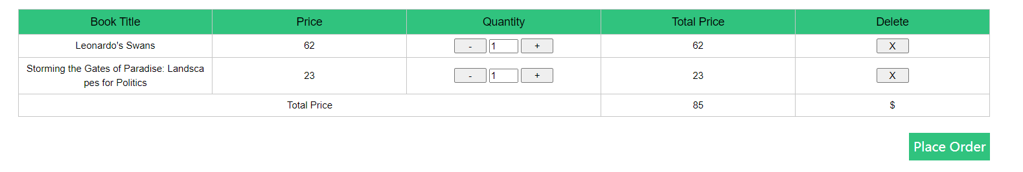
Shopping Cart
By adding unique Shopping CartID to each user.
Store the shopping Cart information in a separate table.
User is able to add Quantity and Delete from the Shopping Cart.
User can directly place all the item in the Shopping Cart with one click.

Slide 7
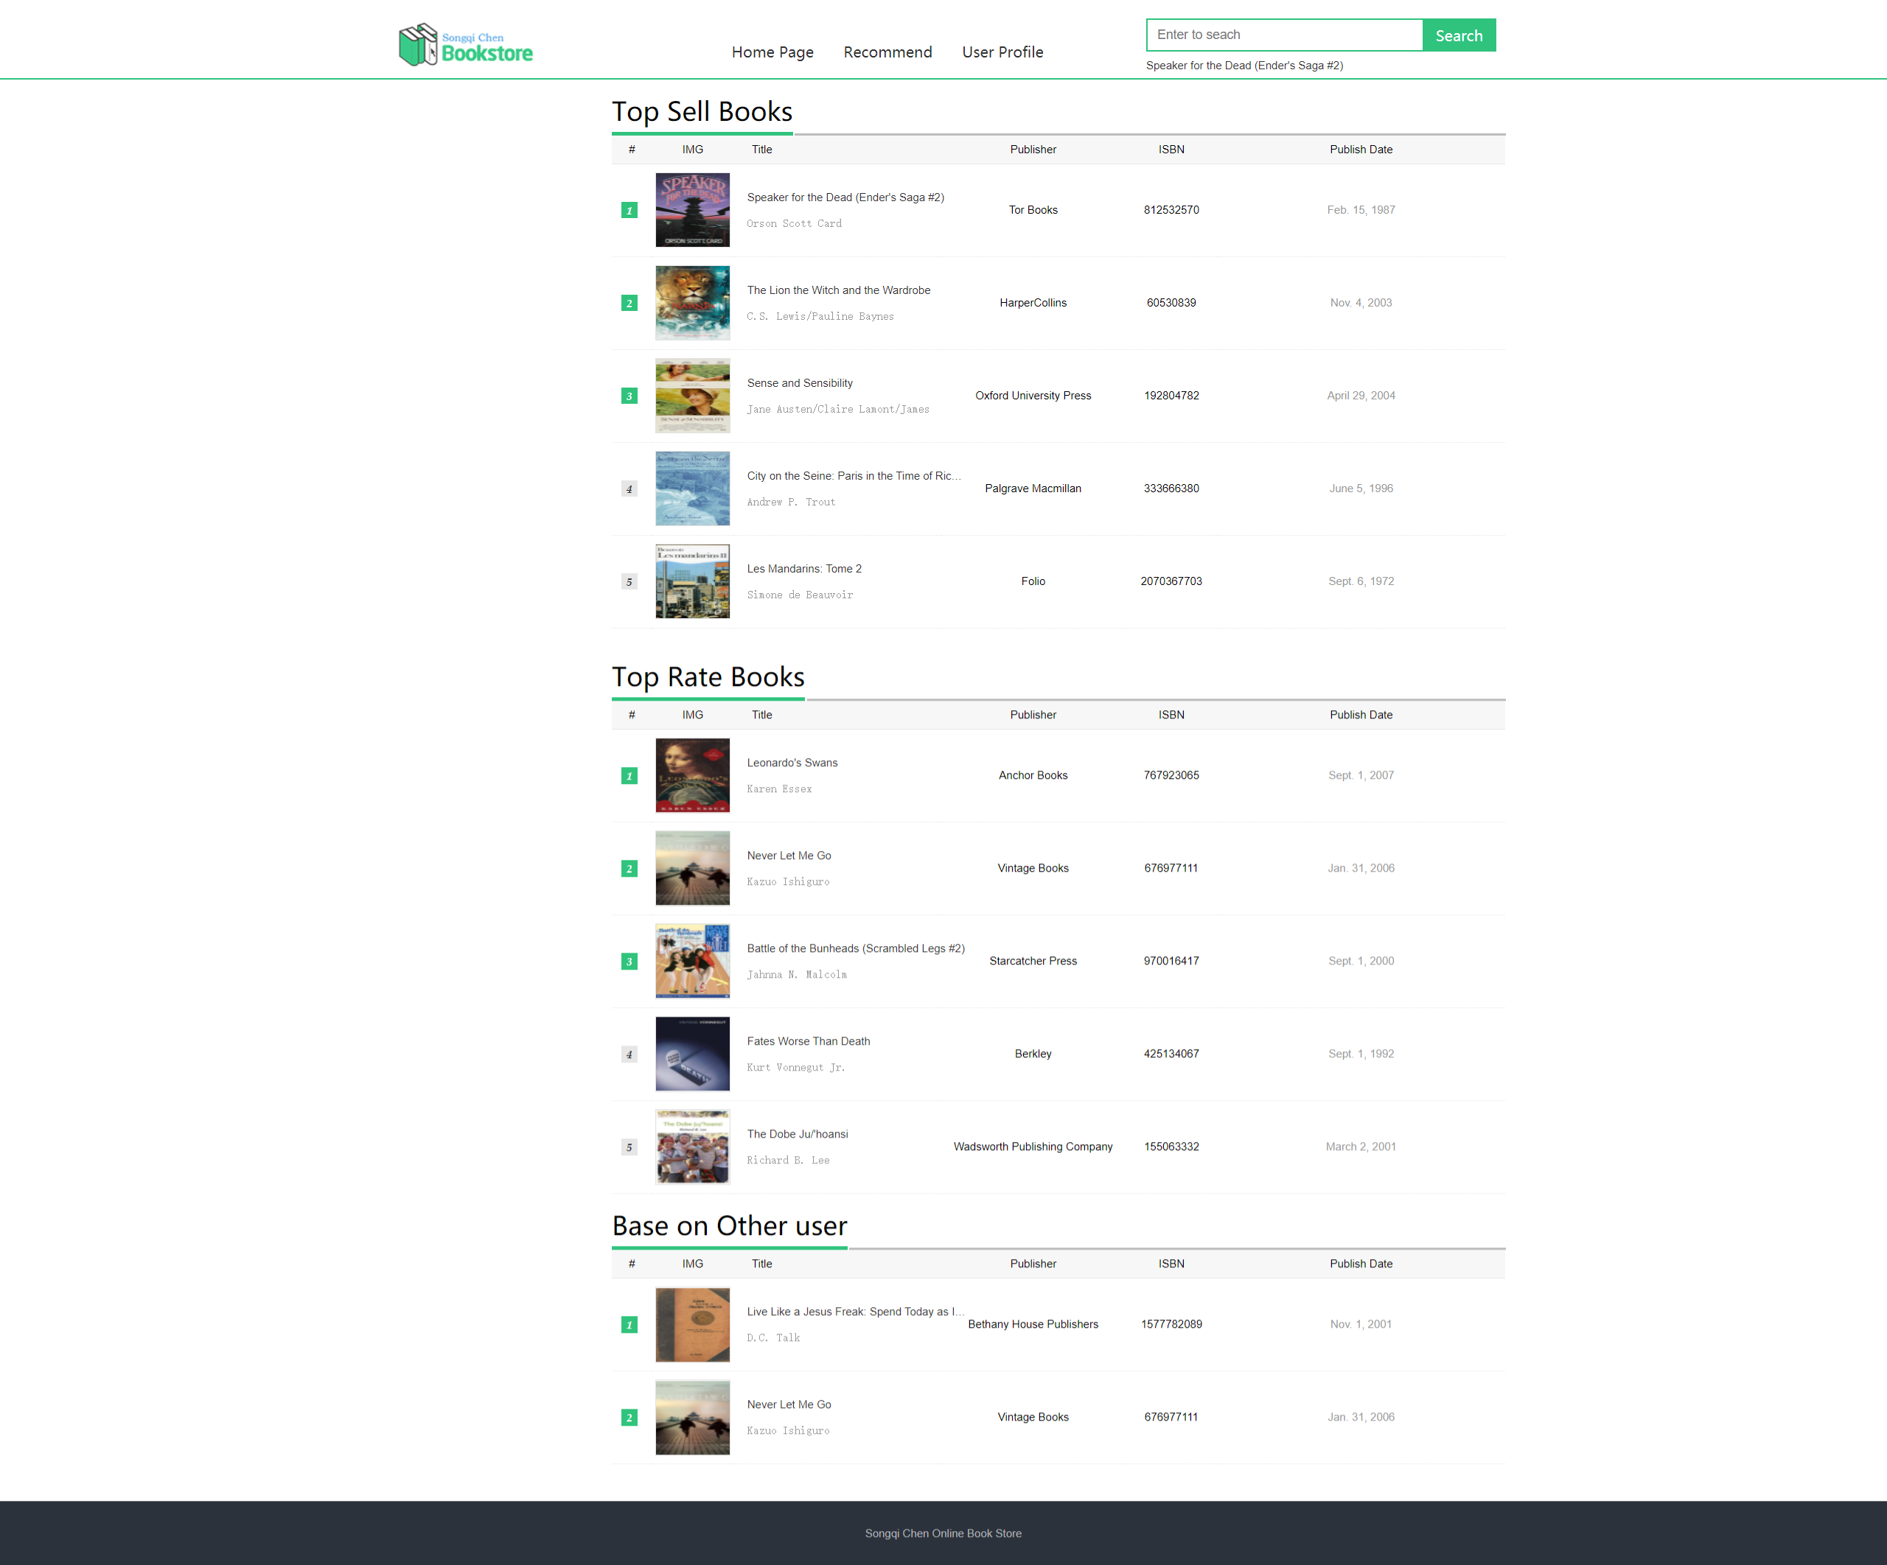
Recommend
There will be top sell books section
There will be Top rate books section
There will be recommend based on the books that other user buy.

Slide 8
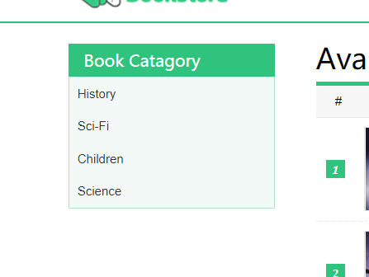
View the Book Based on Different Book Catagory
Add label to each book about their category.
User can click on the category then the book in the category will show

Slide 9
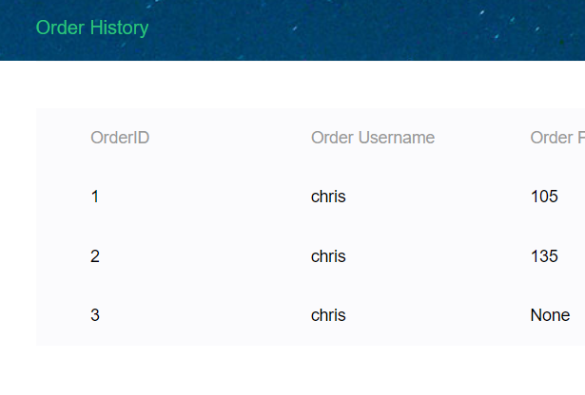
Order History
User is able to view all the order that they placed.

