Slide 1
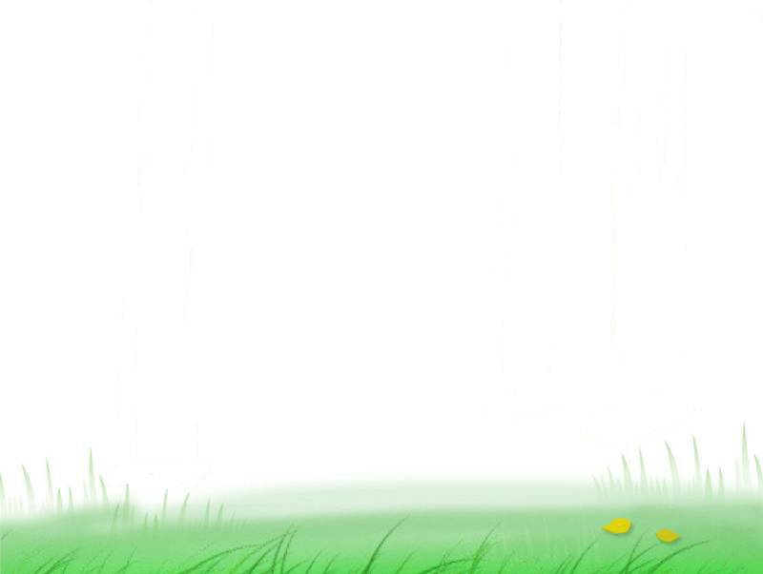
English Basic Tenses
(时态)

Slide 2

他每天都来。
他昨天来了.
他已经来了.
他明天来.
汉语借助词汇手段而非词的形态变化来表示动作的发生,而英语主要通过谓语动词时态变化来表现.任何句子都要先注意时态.
He comes every day.
He came yesterday.
He has come.
He will come tomorrow.

Slide 3
语态 时态 | 主动
一般现在时
一般过去时
一般将来时 | .
过去将来时
现在完成时
过去完成时
现在进行时
过去进行时
现在完成进行时
v. / v-s/es
V-ed
will + v
would + v.
have / has + done
had + done
am /is / are + V-ing
was / were + V-ing
have/has been+ V-ing

Slide 4
语态 时态 | 主动
将来进行时 | will be doing
将来完成时 | will have done

Slide 5
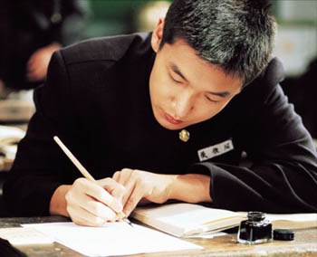
How is your daily life as a student?
( using 3 sentences or more,使用实意动词
和系动词, 注意动词形式变化)

Slide 6
一、 一般现在时 (The Simple Present tense )
1. 结构: do/does
2. 用法: 1) 经常性或习惯性的动作，常与表示频率的时间状语连用，如often, usually, always, every day/year, sometimes, on Sunday等。
I study hard every day and I get along well with my classmates, but sometimes I miss my families.
2)表示不受时间限制的科学事实或客观真理。
The earth moves around the sun.

Slide 7
3）汽车、飞机、会议等按时刻表将要发生的事。 The train leaves at three this afternoon.
The meeting starts at 2:00 p.m.
4）在时间、条件、方式、让步状语从句中，用一般现在时代替一般将来时,即主将从现。
If it ___ (be) fine tomorrow ,we _______ (go) to the countryside.
If he ______ (come) this afternoon，we__________ (have) a meeting.
is
will go
comes
will have

Slide 8
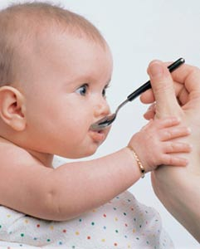
How did you spend your childhood?
Example:
I _______ (spend) my childhood happily with my old friends. We always ________(play) football and basketball together and we _______ (not) have so much homework to do as now. We _______ (be) happy at that time.
spent
played
didn’t
were

Slide 9
二、一般过去时 ( The Simple Past Tense )
1. 结构: 谓动用动词过去式 (V-ed)
2. 用法: 在过去时间里所发生的动作或存在的状态。常与表示过去时间的时间状语连用。如 yesterday, last week, an hour ago, in 1982等。

Slide 10
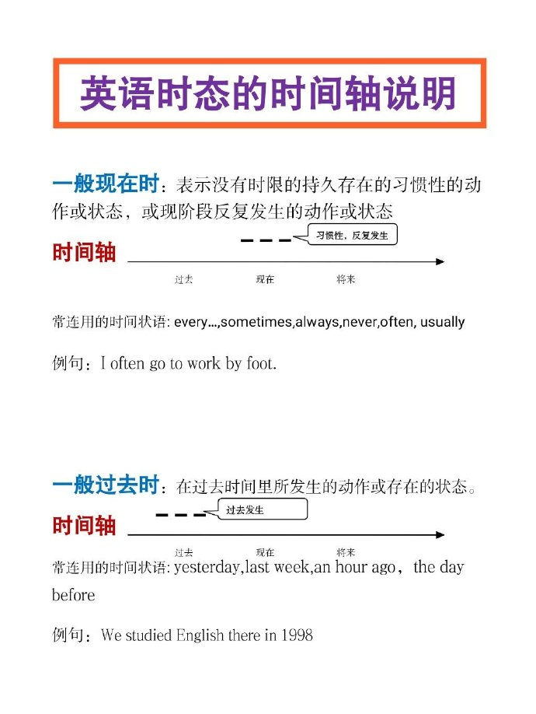

Slide 11
examples:
He was in Beijing some years ago.
She traveled in Europe last year.
When I was at collage, I wrote home once a week.
He went to town ,bought some books and visited his daughter last Sunday.
He said he would go for a holiday when he finished his work.

Slide 12
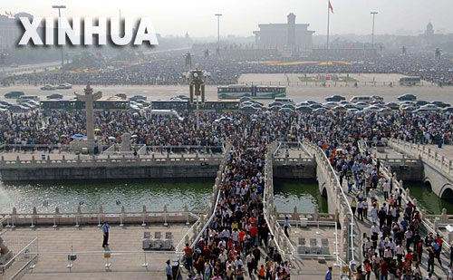
犹如
picture
How will you spend your winter holiday?
I will…
I’m going to…

Slide 13
三. 一般将来时
.表示将来时的四种形式
① will / shall + 动词原形
② be going to do
③ be about to do...when
④ be to do

Slide 14
be going to 有很强的计划性，打算干什么，而will表示谈话时临时决定的意图，具有临时性和偶然性。
① ----The telephone is ringing.
----I _____ answer it.
will B. am going to C. am to D. am about to
② ---Alice, why didn’t you come yesterday?
---I _____, but I had an unexpected visitor.
A. had B. would C. was going to D. did
be going to 可用来表达某种迹象要发生的事。 而will 不能表示
Look at the clouds! It __________ rain.
√
√
is going to

Slide 15
3. be to 表示因约定、计划，职责、义务要求即将发生的动作, 或客观安排或受人指示而做某事。
be going to 表示主观的打算或计划。
I am to play football tomorrow afternoon.
I'm going to play football tomorrow afternoon.

Slide 16
4．be about to do 表示“正要干什么…”，
1)表示即将发生的动作，不与表示将来的时间状语连用。
2)常与when 连用，when 意思是“此时”： “就在这时”，是并列连词. 构成句型： … be about to do …when….
Eg: I was about to leave when it rained.

Slide 17

四.过去将来时(The past future simple Tense)
1. 用法: 过去将来时表示立足于过去某一时间看将要发生的动作或存在的状态, 常用于宾语从句中.
2. 结构:
should / would + 动词原形
The boy promised he would work hard.
I told my parents I should return early.

Slide 18
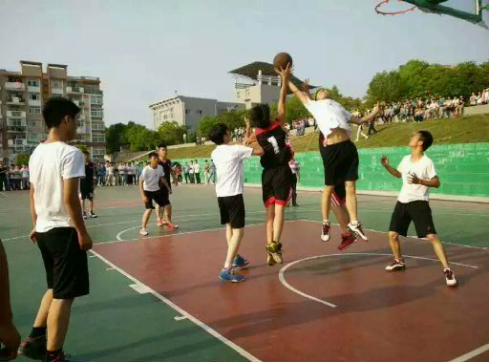
What are they doing now?
They are playing basketball.

Slide 19
五. 现在进行时
be (am, are, is)+ doing
1．表示说话时正在进行而尚未完成的动作或状态
① I don’t really work here. I’m helping until the new secretary comes.
② Selecting a mobile phone for personal use is no easy task because technology___ so rapidly.
A. will have changed B. has changed
C. is changing D. will change
√

Slide 20
2.与always，constantly(不断地；时常地)等连用，表示赞成或厌恶的感情色彩。如：
他总是帮助别人。
He is always helping others.

Slide 21
六. 过去进行时(The Past Continuous Tense)
1. 结构：was/ were + doing
2. 用法:表示过去某时或某段时间正在进行的动作或状态。常用的时间状语
at ten yesterday, from nine to ten last evening, when…, while…, at that time…
I first met Lisa three years ago . She ____ at a radio shop at the time.
has worked B. was working
C. had been working D. had worked
√

Slide 22
3. 与always，forever，constantly连用，表示赞成或厌恶的感情色彩。如：
他总是考虑别人，从未考虑自己。
He was always thinking of others，never
thinking of himself.
My brother was always losing his key.

Slide 23
七. 现在完成时(The present Perfect Tense)
1. 结构: have (has) + done
2.用法:
1). 现在完成时表示过去某一时间开始，一直延
续到现在的动作或状态, 通常用于延续性动词. 常与表示延续性的时间状语连用, 如: so far, up to now, recently, since, for , over time等．
I have lived in Zhuhai for 3 years.

Slide 24
He has lived here since last summer.
过去
现在
时间线
lived
延续到现在:has lived
last summer
since…

Slide 25
1.----When did he go to America?
---Oh, he ______ there since half a year ago.
A. went B. has been C. has gone D. was
2.Shelly _____ California for Texas and ____ there ever since. You can go and pay her a visit on your way to Mexico.
A. left, worked B. has left, had worked
C. left, has worked D. has left , worked
√
√

Slide 26
比较一般过去时与现在完成时
1). 一般过去时只表示发生在过去的动作或存在的状态, 不涉及对现在的影响；现在完成时表示发生在过去的动作或状态一直延续到现在, 或强调过去的事情对现在造成的影响。
They have worked together for ten years
(可能仍在合作，也可能刚刚结束合作）
They worked together for ten years.
(过去曾一起合作，但现在已不在一起工作）
I saw this film yesterday.
（强调看的动作发生过了。）
I have seen this film.
（强调对现在的影响，电影的内容已经知道了。）

Slide 27
2). 过去时常与具体的表示过去的时间状语连用，而现在完成时通常与不确定的或包括现在在内的时间状语连用，或无时间状语.
I ______ (study) in Sun Yat-sen university in 2000.
I ___________ (teach) in Sun Yat-sen university since 2000.
I _____ just _______ (buy) an apartment. (just表示不确定的时间状语）
studied
have taught
have
bought

Slide 28
八.过去完成时 (The past perfect Tense)
You graduated (毕业) from Junior Middle School in July 2013. You had stayed there for 3 years when you graduated.
结构: had + done
概念：表示过去的过去
----|--------------|---------|---->
过去的过去 过去 现在 将来

Slide 29
用法
(1) 表示过去某一时刻或某一动作之前完成的动作或状态。句中常用by，before，until，when等词引导的时间状语。如：
By the end of last term we had learnt 20 units.
过去的过去
过去
现在
时间线
had learnt
the end of
last term

Slide 30
2.表示过去未曾实现的愿望或打算(“本想”; “本来打算”)。
I had hoped to see more of ShangHai.
I had meant to help you, but I was too busy at the moment.
I had thought you would come tomorrow.

Slide 31
1).When the police arrived, the thieves _________________(run away).
2).When I came into the classroom, my dear students ______________ (begin) reading.
He walked in as if he __________ (buy) the school .
had run away
had run away
had run away
had begun
had bought

Slide 32
c
3. I _____ to take a good holiday this year, but I wasn’t able to get away.
A. hope B. have hoped
C. had hoped D. hoped
4. Helen _____ her key in the office so she had to wait until her husband _____ home.
A. has left; comes B. left; had come
C. had left; came D. had left; would come
c

Slide 33
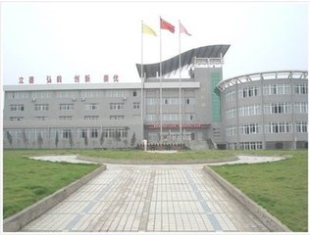
---How long have you been studying in this school?
---Almost three months.

Slide 34
九、现在完成进行时
主语 + has / have + been +doing….
表示过去某一时间发生一直持续到现在还会继续下去的动作（动作未完成），动词必须用延续性动词。
He has been working here for three years.
The number of foreign students attending Chinese universities has been rising steadily since 1990.

Slide 35
--- Isn’t it hard to drive downtown to work?
--- Yes, that’ why I ____to work by train.
A. have been going B. have gone
C. was going D. will have gone
√

Slide 36
现在完成时与现在完成进行时的区别
现在完成时:表到现在为止已经完成，或过去发生的动作对现在的影响或产生的结果，也可表示延续性；
现在完成进行时: 往往强调仍将继续下去的动作。
I have written a letter. （已完成）
I have been writing a letter.（未完成）
过去
现在
时间线
have written
have been writing

Slide 37
10 将来进行时（will be doing）
表将来某一时刻，某一段时间正在进行的动作。
I will be sleeping at this time tomorrow.

Slide 38
11．将来完成时（will have done）
表将来某一时间已经做完某事
We will have learnt 1000 words by the end of this term.

Slide 39
最常用的几种时态与时间状语的搭配
一般现在时
现在进行时
现在完成时
现在完成进行时
often, always, usually, sometimes, on Sunday, every …, at weekends, once in a while, three times a day…
(right) now, at this moment, at present, for the time being, this year, always, …
for, since, so far, in/over/during the past/ last few years, lately, recently, just, up to now, up till now, already, yet, ever, never, twice, three times, before, …
all the time, all this morning, for, since, in the past few years, …

Slide 40
最常用的几种时态与时间状语的搭配
一般过去时
过去进行时
过去完成时
过去将来时
yesterday, last…, the day before yesterday, …ago, in 2000, in the past, the other day, just now, once upon a time,…
at 10 last night, then, this morning, at that time/ moment, this time yesterday, last year, always, …
by+过去时间，by then, by the end of + 过去时间，by the time you did sth,…..

Slide 41
最常用的几种时态与时间状语的搭配
一般将来时
将来进行时
将来完成时
tomorrow, the day after tomorrow, in 2020, in a few years, in future, in the future, soon, next…, another day, …
at 10 tomorrow, then, this time tomorrow, next year, …
by +将来时间, by then, by the end of + 将来时间, by the time you do sth, …

Slide 42
group competition
Exercises
I usually ____ up at 6:00, but yesterday I ______ up at 7:00 and tomorrow I _________ up at 6:30. (get)
Listen! Someone ____________ (knock) at the door.
I ___________ (be) in Beijing for two years.
How often _____ Andy _______ (surf) the internet?
He fell asleep while he ___________ (read) a book.
get
got
will get
is knocking
have been
does
surf
was reading

Slide 43
have
6. I ________ never _______ (hear) of that man before.
7. My brother often _________ (go) for walks last summer.
8. Lily said she _______ (put) on the new dress the next day.
9. ______ the story ________ (happen) in London in 1949?
10. What ______ his mother ______ (do) when he opened the door?
heard
went
would put
Did
happen
was
doing

Slide 44
doesn’t rain
11. If it ______________ (not rain) tomorrow, they ___________ (go) fishing.
12. ______ your mother ________ the piano every Sunday?
13. They _______ (not) call you the day after tomorrow.
14. Tom _____________ (work) there since two years ago.
15. By the time I _________ (walk) into the classroom, the teacher ___________ (start) teaching.
will go
Does
play
won’t
has worked
walked
had started

Slide 45
Jenny
Jenny _____ (be) a foreign girl. She _______ (come) from the United States. Look, she _____________ (draw) pictures in the living room.
Two years ago, her parents _________ (move) to China. Jenny ____________ (not have) any friends, so she _______ (feel) lonely. But now, she _______ (have) many Chinese friends and _______ (study) with them everyday. Jenny ___________ (visit) her grandparents in the United States next month.
is
comes
is drawing
moved
didn’t have
felt
has
studies
will visit

Slide 46

One good turn deserves another
I _____________ (have) dinner at a restaurant when Tony Steele came in. Tony _______ (work) in a lawyer's office years ago, but he ____________ (work) at a bank now. He ______ (get) a good salary, but he always _______ (borrow) money from his friends and never ______ (pay) it back. Tony _____ (see) me and _____ (come) and ____ (sit) at the same table. He ___ never ____________ (borrow) money from me. While he ______________ (eat), I _____ (ask) him to lend me twenty pounds. To my surprise, he _____ (give) me the money immediately. 'I have never borrowed any money from you,' Tony said, 'so now you can pay for my dinner!'
was having
worked
is working
gets
borrows
pays
saw
came
sat
has
borrowed
was eating
asked
gave

Slide 47
动词的语态 (voices)
动词语态有两种：主动语态和被动语态。
主语是动作的发出者为主动语态；
主语是动作的接受者为被动语态。
动词谓语部分结构：be + v.pp

Slide 48
动词时态语态一览表(以do为例）
时态 | 主动 | 被动
一般现在时 | do/does
现在进行时 | am/is/are doing
现在完成时 | have/has done
一般过去时 | did
过去进行时 | was/were doing
过去完成时 | had done
一般将来时 | will do
将来完成时 | will have done
am/is/are done
am/is/are being done
have/has been done
was/were done
was/were being done
had been done
will be done
will have been done

Slide 49
类别 |  | 构成形式 | 例句
时 态 | 一般现在时 | am/is/are+done | English is widely used in the world.
 | 一般过去时 | was/were+done | We were asked to help them.
 | 一般将来时 | will/shall+be done | A class meeting will be held next Monday.
 | 过去将来时 | should/would+be done | She said those flowers should be watered.
 | 现在进行时 | is/am/are+being done | The blackboard is being painted now.
 | 过去进行时 | was/were+being done | Those flowers were being watered when I left.
 | 现在完成时 | have/has+been done | All these flowers have been watered.
 | 过去完成时 | had+been done | The building had been completed before I arrived.

Slide 50
主动形式表被动意义
The steel feels cold.
His plan proved (to be) practical.
The yogurt in the fridge ______________
(已经变质）.
1. 连系动词look, sound, feel, smell, taste, appear, seem, go, prove, turn, stay, become, fall, get, grow, keep + adj. 构成系表结构,主动表被动。
has gone bad

Slide 51
2. 表示开始、结束、运动的动词。如:begin, finish, start, open, close, stop, end, shut, run, move 等主动表被动。
Work began at 7 o’clock this morning.
The shop closes at 6 p.m. every day.
3. need / want / require doing, be worth doing, be to blame主动表被动。
The equipment in the corner ________________
(需要修理).
requires repairing

Slide 52
C
Who do you think ____ for the failure of their marriage?
A. to blame B. to be blame
C. is to blame D. is to be blamed
I feel it is your husband who ______ for the spoiled child.
A. is to blame B. is going to blame
C. is to be blamed D. should blame
A

Slide 53
Nylon cleans easily. This material has worn thin.
Your pen writes smoothly. The recorder won’t play.
(这种布耐洗。)
(他的书没有销路。)
★4. 表示主语的某种属性特征的动词。
如read, write, act, iron, cut, draw, drive, sell,
wash, clean, wear, open, cook, lock, shut, dry,
eat, drink.这类动词一般不单独使用，常有一个修饰语。
The cloth washes well.
His book does not sell.

Slide 54
Murtiple choice
A
1. This coastal area ______ a national wildlife reserve last year.
A. was named B. named C. is named D. names
D
2. I need one more stamp before my collection ____.
A. has completed B. completes
C. has been completed D. is completed

Slide 55
3. The new suspension bridge _____ by the end of last month.
A. has been designed B. had been designed
C. was designed D. would be designed
B
说明：by the end of 短语一般都与完成时连用。
4. Rainforests _____ and burned at such a speed that they will disappear from the earth in the near future.
cut B. are cut
C. are being cut D. had been cut
C

Slide 56
1、对於这个问题，关注很少。
Little attention was paid to this problem.
2、课堂上应该鼓励小组讨论。
Group discussion should be encouraged in class.
3、据报导，这里将修建一条新的马路。
It is reported that a new road will be built here.
4、必须采取措施来防止河流受到污染。
Measures should be taken to stop the river from being polluted.

