Slide 1
Named-entity recognition
人工智慧於醫療應用與服務
Ying-Jia Lin
2022/12/06

Slide 2
What is Named-entity recognition?
Named-entity recognition (NER)
B-LOC
O
B-LOC
O
B-ORG
I-ORG
Model
Japan
beat
Spain
at
World
Cup

Slide 3
Sequence-tagging (labeling) problems
Part-of-speech tagging
NOUN
VERB
NOUN
PREP
NOUN
NOUN
Model
Japan
beat
Spain
at
World
Cup

Slide 4
Sequence-tagging (labeling) problems
Word segmentation
B
B
B
B
B
I
Model
Japan
beat
Spain
at
World
Cup

Slide 5
A sequential problem
B-LOC
O
B-LOC
O
B-ORG
I-ORG
Japan
beat
Spain
at
World
Cup
t=1
t=2
t=3
t=4
t=5
t=6

Slide 6
Markov Property
Definition:
The probability of the next state only depends on the current state.
P(future | present, previous) = P(future | present, previous)
Markov property

Slide 7
Markov Chain
States
B-LOC
O
B-LOC
O
B-ORG
I-ORG
Observations
Japan
beat
Spain
at
World
Cup
t=1
t=2
t=3
t=4
t=5
t=6

Slide 8
Hidden Markov Model (HMM)
Probabilities
0.9
0.87
0.89
0.56
0.49
0.35
States
B-LOC
O
B-LOC
O
B-ORG
I-ORG
Observations
Japan
beat
Spain
at
World
Cup
t=1
t=2
t=3
t=4
t=5
t=6

Slide 9
Hidden Markov Model (HMM)
Probabilities
0.9
0.87
0.89
0.56
0.49
0.35
States
B-LOC
O
B-LOC
O
B-ORG
I-ORG
Observations
Japan
beat
Spain
at
World
Cup
t=1
t=2
t=3
t=4
t=5
t=6

Slide 10
Computation issue of Markov models
N candidates:
LOC
ORG
TIME
PERSON
OTHER
MISC
…
If there are T steps (sequence length):
Complexity = O(N^T)
Solutions:
Viterbi algorithm (O(N^2*T))

Slide 11
Drawback of HMM: Markov Property
Probabilities
0.9
0.87
0.89
0.56
0.49
0.35
States
B-LOC
O
B-LOC
O
B-ORG
I-ORG
Observations
Japan
beat
Spain
at
World
Cup
t=1
t=2
t=3
t=4
t=5
t=6

Slide 12
A generalized HMM:
Conditional Random Fields (CRF)
Lafferty, John, Andrew McCallum, and Fernando CN Pereira. "Conditional random fields: Probabilistic models for segmenting and labeling sequence data." (ICML 2001).
Probabilities
0.9
0.87
0.89
0.56
0.49
0.35
States
B-LOC
O
B-LOC
O
B-ORG
I-ORG
Observations
Japan
beat
Spain
at
World
Cup
t=1
t=2
t=3
t=4
t=5
t=6

Slide 13
BiLSTM
B-LOC
O
B-LOC
O
B-ORG
I-ORG
forward
backward
Japan
beat
Spain
at
World
Cup
t=1
t=2
t=3
t=4
t=5
t=6

Slide 14
BiLSTM + CRF
Huang, Zhiheng, Wei Xu, and Kai Yu. "Bidirectional LSTM-CRF models for sequence tagging."
arXiv preprint arXiv:1508.01991(2015).
B-LOC
O
B-LOC
O
B-ORG
I-ORG
forward
backward
Japan
beat
Spain
at
World
Cup
t=1
t=2
t=3
t=4
t=5
t=6

Slide 15
Training with BiLSTM + CRF
Huang, Zhiheng, Wei Xu, and Kai Yu. "Bidirectional LSTM-CRF models for sequence tagging."
arXiv preprint arXiv:1508.01991(2015).
B-LOC
O
Transition matrix
forward
backward
Gradient desent with back-propagation
Japan
beat
t=1
t=2

Slide 16
Inference with BiLSTM + CRF
Huang, Zhiheng, Wei Xu, and Kai Yu. "Bidirectional LSTM-CRF models for sequence tagging."
arXiv preprint arXiv:1508.01991(2015).
B-LOC
O
Transition matrix
forward
backward
Using Viterbi algorithm (dynamic programming) to perform decoding
Japan
beat
t=1
t=2

Slide 17
Implementation

Slide 18
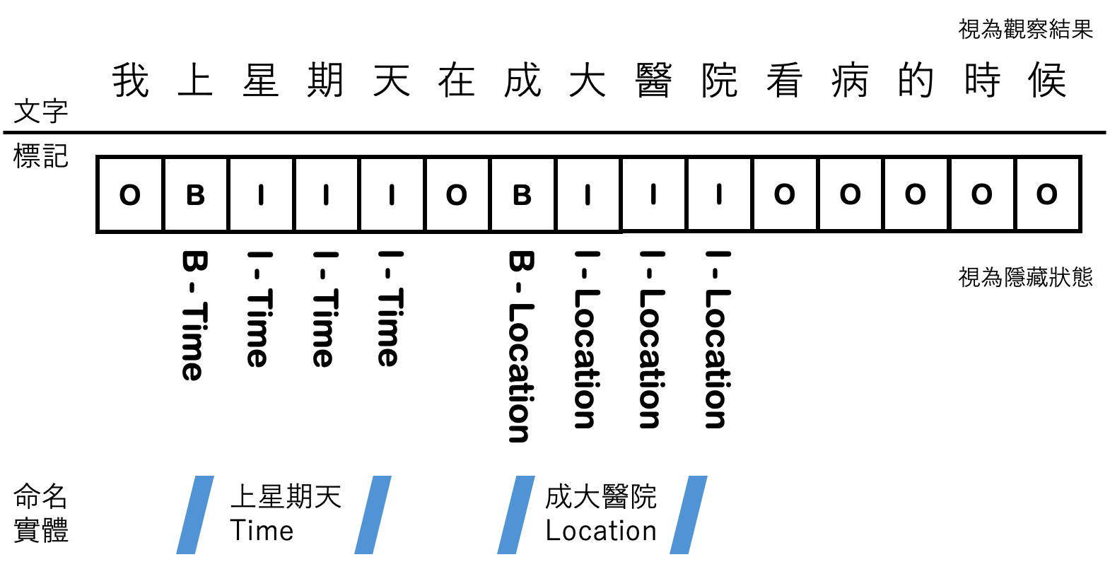
Homework: Introduction

Slide 19
Homework: Requirements
Your score should be higher than the baseline score in the sample code.
Compress your code with report (.docx, .pdf) into the .zip file before upload to Moodle.

Slide 20
Other materials
Viterbi algorithm
https://towardsdatascience.com/named-entity-recognition-with-nltk-and-spacy-8c4a7d88e7da
https://www.kaggle.com/code/bavalpreet26/ner-using-crf

