Slide 1
ExoPAG SAG13: Exoplanet Occurrence Rates and Distributions
Ruslan Belikov
on behalf of SAG13
Disclaimer: some results in this presentation are still preliminary
ExoPAG 15, Grapevine, TX, 1/2/2017

Slide 2
SAG13 members
Belikov, Ruslan (Chair, rulsan.belikov@nasa.gov)
Stark, Christopher (Co-chair)
Batalha, Natalie (Steering Committee)
Burke, Chris (Steering Committee)
Angerhausen, Daniel | Gaudi, Scott | Savransky, Dmitry
Apai, Daniel | Ge, Jian | Serabyn, Gene
Bendek, Eduardo | Gould, Andy | Shabram, Megan
Bennett, David | Hogg, David W | Shao, Mike
Blackwood, Gary | Howard, Andrew | Solmaz, Arif
Boss, Alan | Kane, Stephen | Sparks, William
Brown, Robert | Kasting, Jim | Stahl, Philip
Bryden, Geoff | Kopparapu, Ravi | Stapelfeldt, Karl
Cahoy, Kerri | Macintosh, Bruce | Stark, Christopher
Catanzarite, Joe | Mandell, Avi | Still, Martin
Ciardi, David | Mendez, Abel | Suzuki, Daisuke
Clanton, Christian | Meyer, Michael | Swain, Mark
Cowan, Nick | Morgan, Rhonda | Traub, Wes
Danchi, William | Mulders, Gijs | Turnbull, Margaret
Domagal-Goldman, Shawn | Nielsen, Eric | Unwin, Stephen
Dressing, Courtney | Petigura, Erik | Vanderbei, Bob
Farr, Will | Ragozzine, Darin | Walkowicz, Luzianne
Foreman-Mackey, Daniel | Roberge, Aki | Weiss, Lauren M.
Fressin, Francois | Rogers, Leslie | Wolfgang, Angie
 |  | Youdin, Andrew

Slide 3
Charter
Over 5000 exoplanets and exoplanet candidates have been discovered to date. Many studies have been published and are on-going to determine exoplanet occurrence rates and distributions, particularly for potentially habitable worlds. These studies employ different statistical and debiasing methods, different definitions of terms such as eta_Earth and habitable zone, different degrees of extrapolation, and present distributions in different units from each other. The primary goal of this SAG is to evaluate what we currently know about planet occurrence rates, and especially eta_Earth, by consolidating, comparing, and reconciling discrepancies between different studies. A secondary goal is to establish a standard set of occurrence rates accepted by as much of our community as possible to be used for mission yield estimates for missions to be considered by the decadal survey.
Key objectives and questions:
Propose standard nominal conventions, definitions, and units for occurrence rates/distributions to facilitate comparisons between different studies.
Do occurrence estimates from different teams/methods agree with each other to within statistical uncertainty? If not, why?
For occurrence rates where extrapolation is still necessary, what values should the community adopt as standard conventions for mission yield estimates?
Completed
Current
activity
Current
activity

Slide 4
SAG13 role
Exoplanet
Community
Planet occurrence rates from individual teams
Consensus on conventions / definitions
Conversions between parameters (e.g. mass and radius)
General feedback and endorsement of SAG13 products
LUVOIR
STDT
SAG13
NASA ExEP Standards Committee
Survey and analysis of occurrence rates
Parametrized distributions for mission yield calculations
mission yield code w/ standardized assumptions
Mission yields
HabEx
STDT
Any other mission / concept

Slide 5
Outline
Survey of occurrence rates from community-sourced and published submissions, integrated across a standard grid of bins
Analysis of variances between submissions and possible reasons for these variances
Analysis of which parts of exoplanet parameters pace still requires extrapolation, particularly in the potentially habitable planet range
Parametrized distributions that can be used as inputs to EXOSIMS and other mission yield codes
Notes:
Scott Gaudi: “All of this looks useful, and exactly what we are looking for”

Slide 6
Outline
Survey of occurrence rates from community-sourced and published submissions, integrated across a standard grid of bins
Analysis of variances between submissions and possible reasons for these variances
Analysis of which parts of exoplanet parameters pace still requires extrapolation, particularly in the potentially habitable planet range
Parametrized distributions that can be used as inputs to EXOSIMS and other mission yield codes
Notes:
Scott Gaudi: “All of this looks useful, and exactly what we are looking for”

Slide 7
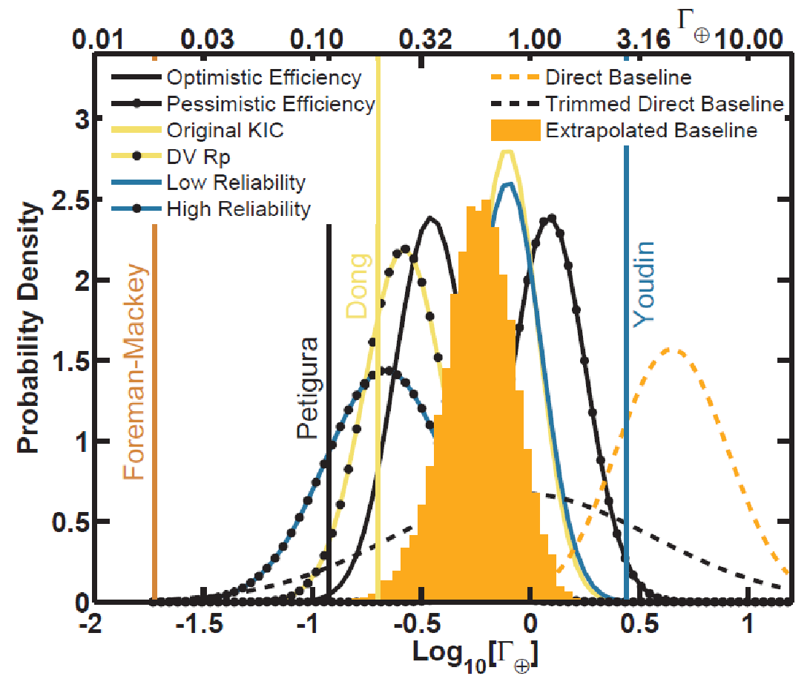

From Burke et al. 2015
“We generally find higher planet occurrence rates and a steeper increase in planet occurrence rates towards small planets than previous studies of the Kepler GK dwarf sample”

Slide 8
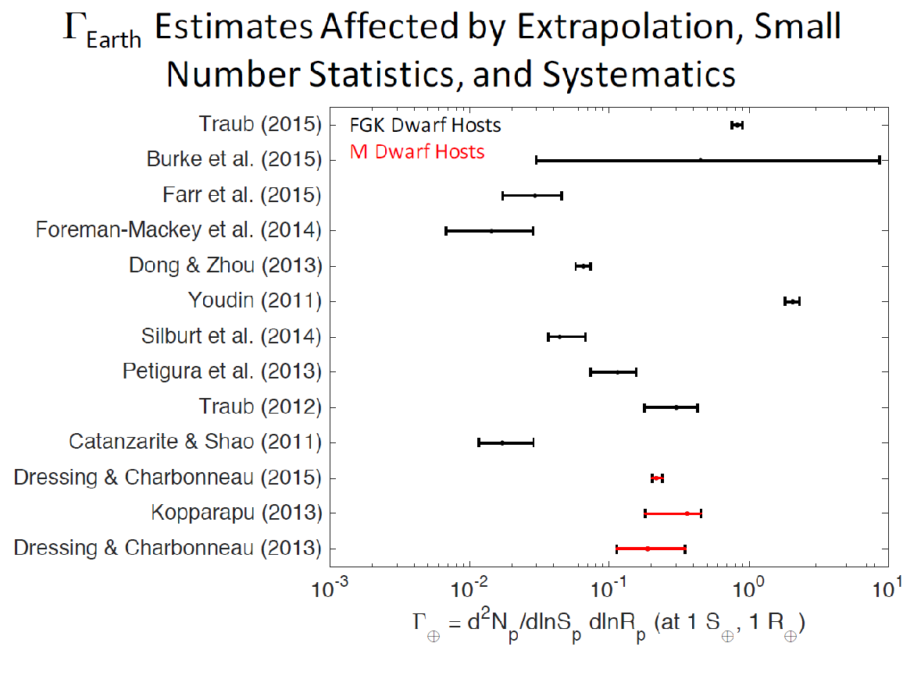
Comparison of Γ_{earth} from different publications
Courtesy of Leslie Rogers
Initially, it appears that the possible range of Γ_{earth} spans 2-3 orders of magnitude
This is true, but extremely conservative: only the middle ~couple of octaves are “likely”

Slide 9
Comparison of Γ_{earth} from different publications
Trend:
Newer results are
systematically
higher
D. F-M: “should use
Burke 2015”
Initially, it appears that the possible range of Γ_{earth} spans 2-3 orders of magnitude
This is true, but extremely conservative: only the middle ~couple of octaves are “likely”

Slide 10
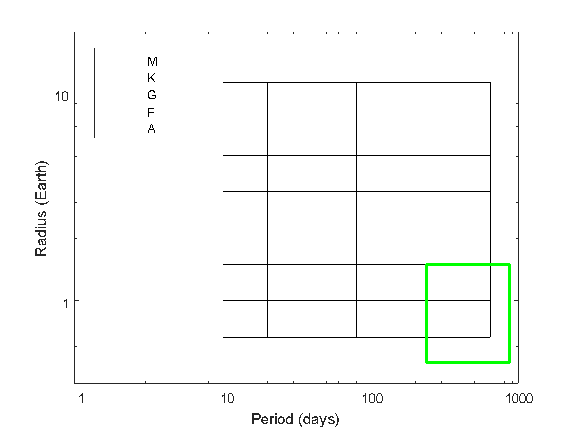
Standardized eta grid
Kepler candidates from Q1-Q17, dr24
12 community sourced
occurrence tables
SAG13 η grid
Batalha, Natalie (2)
Belikov, Rus
Burke, Chris
Catanzarite, Joe
Dressing, Courtney*
Farr, Will
Foreman-Mackey, Daniel*
Kopparapu, Ravi
Mulders, Gijs
Petigura, Erik*
Traub, Wes*
1.5
η_{habSol,SAG13}
0.5
237
860
*dataset was based on prior publications and
re-integrated across SAG13 bins by Burke
All datasets and documents can be found on SAG13 repository: https://drive.google.com/drive/folders/0B520NCfkP4aOQUJYdmUzQTJkdkE
η_{habSol,SAG13}
R = [0.5 – 1.5], P = [237 860] (Kopparapu optimistic HZ for Sol twin)
This is not exactly η_{Earth} , just a tentative rough representation of a potentially habitable region

Slide 11
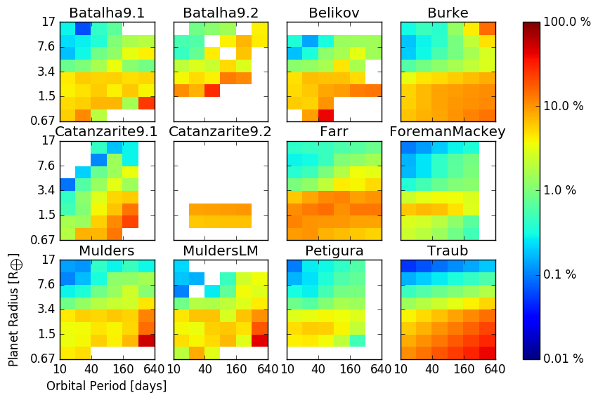
Example: submitted occurrence rates for G-dwarfs
Plots and analysis are generated with the make_plots.py script
in the SAG13 Google drive, code by Gijs Mulders.
Plot by Gijs Mulders

Slide 12
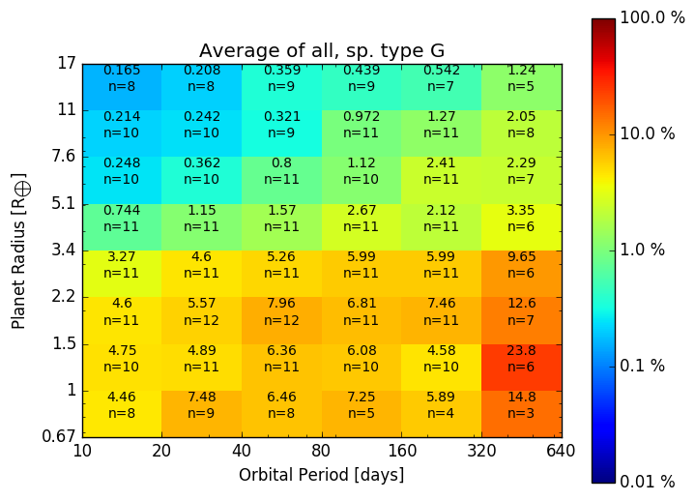
Closer look at G-dwarf average
legend
% occurrence
# of submissions
Note: this is a simple average across submissions
More sophisticated combination methods are being explored, such as weighting by quoted uncertainties and/or accounting for dependencies
η_{habSol,SAG13} ~ 0.58
(based on best power law fit)
Plots and analysis are generated with the make_plots.py script
in the SAG13 Google drive, code by Gijs Mulders.
Notes:
Maybe define Gamma_earth
And the green rectangle
Chris: a parameter like Gamma as a normalization at a point, and then a local power law
Eta_R[0.5-1.5]_P[237-860]

Slide 13
Outline
Survey of occurrence rates from community-sourced and published submissions, integrated across a standard grid of bins
Analysis of variances between submissions and possible reasons for these variances
Analysis of which parts of exoplanet parameters pace still requires extrapolation, particularly in the potentially habitable planet range
Parametrized distributions that can be used as inputs to EXOSIMS and other mission yield codes
Notes:
Scott Gaudi: “All of this looks useful, and exactly what we are looking for”

Slide 14
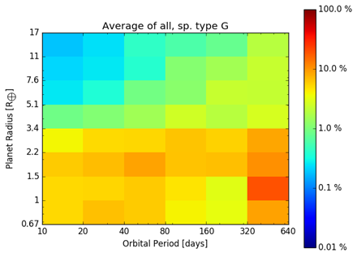
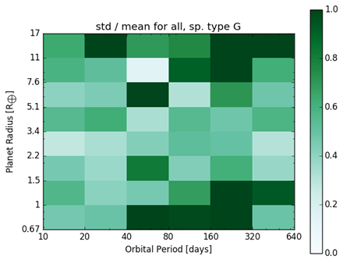
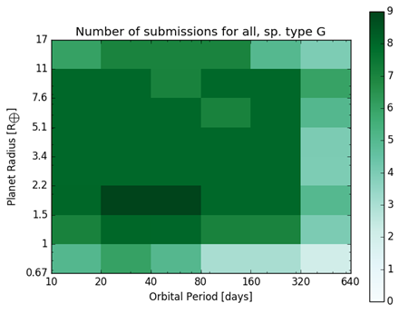
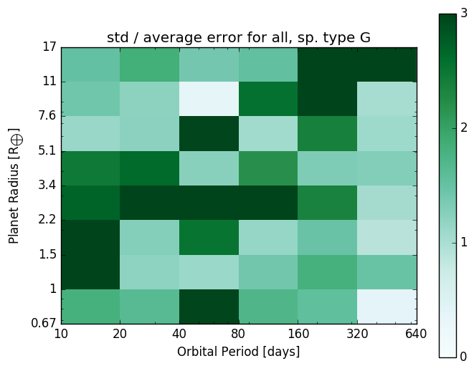
Analysis of variations in submissions (for G-dwarfs)
Low # of
crowdsourced
submissions
for hab planets
by Gijs Mulders

Slide 15
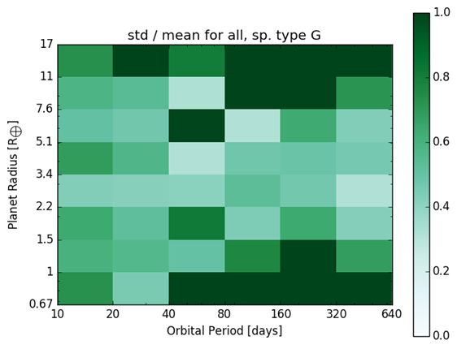
Coefficient of Variation (aka relative standard deviation = std / mean)
Poor CoV
Low # of detections => high statistical uncertainty
Good CoV
High # of detection => low statistical uncertainty
Agreement not within statistical uncertainty
Poor CoV
Low # of detections => high statistical uncertainty
Good statistical agreement

Slide 16
Sensitivity of occurrence rates to methodologies and assumptions
Completeness curves and catalog seem to make the largest systematic differences
More recent completeness curves and catalogs seem to lead to systematically higher numbers
Other things (estimation method, details of the code, extrapolation) usually result in occurrence rates that are consistent to better than a factor of 2, usually much better

Slide 17
Outline
Survey of occurrence rates from community-sourced and published submissions, integrated across a standard grid of bins
Analysis of variances between submissions and possible reasons for these variances
Analysis of which parts of exoplanet parameters pace still requires extrapolation, particularly in the potentially habitable planet range
Parametrized distributions that can be used as inputs to EXOSIMS and other mission yield codes
Notes:
Scott Gaudi: “All of this looks useful, and exactly what we are looking for”

Slide 18
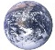
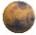
Kepler candidates from Q1-Q17, dr24
SAG13 η grid
mid-K
η_{habSol,SAG13}
1.5
Extrapolation region
0.5
237
860

Slide 19
Importance of 0.5-1.0 Earth size bin
dN / dln(R)
(marginalized across
237-860d periods)
“Optimistic”
η_{habSol,SAG13} ~ 2
Unknown extrapolation for G-dwarfs
(better constrained for M-dwarfs)
“Straight”
η_{habSol,SAG13} ~ 1)
Peer-reviewed power law fit
coefficients ~ 0.5-1.0
“flat”
η_{habSol,SAG13} ~ 0.8
“rollover”
η_{habSol,SAG13} ~ 0.5
“Cut-off”
η_{habSol,SAG13} ~ 0.25
Current average
from SAG13
submissions: 0.2
(1-sigma dev: ~2x)
R (log scale)
0.5
0.67
1
1.5
2
Any estimate of eta_Earth should always very clearly specify:
Whether 0.5-1.0 bin is included or not
What extrapolation assumption was made
Many discrepancies in eta_Earth estimates can be traced to inclusion or exclusion of 0.5-1.0 bin
Mission study teams may want to consider the possibility of a large number of potentially habitable planets in the 0.5-1.0 bin
Notes:
The numbers are not final. Less text, use larger numbers.

Slide 20
Outline
Survey of occurrence rates from community-sourced and published submissions, integrated across a standard grid of bins
Analysis of variances between submissions and possible reasons for these variances
Analysis of which parts of exoplanet parameters pace still requires extrapolation, particularly in the potentially habitable planet range
Parametrized distributions that can be used as inputs to EXOSIMS and other mission yield codes
Notes:
Scott Gaudi: “All of this looks useful, and exactly what we are looking for”

Slide 21
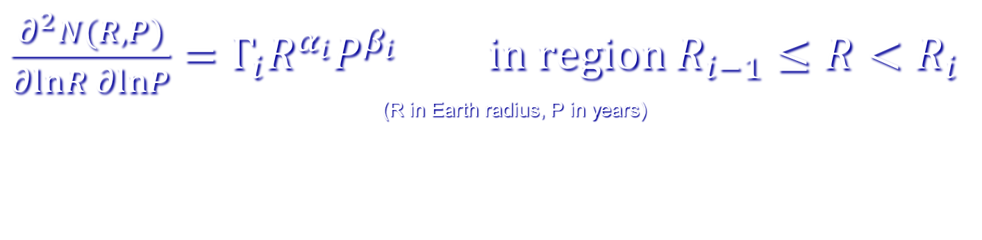
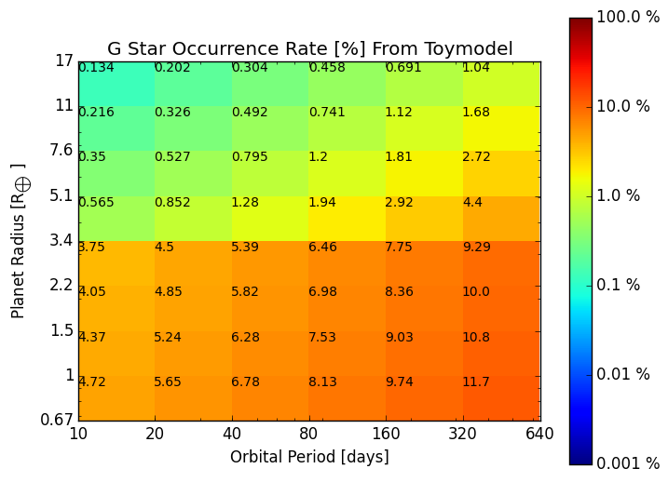
Parametric fit (for G-dwarfs)
0.38 | -0.19 | 0.26 | 3.4
0.73 | -1.18 | 0.59 | Inf
Submission average
Parameteric fit (integrated across bins)

Slide 22
Calculations of habitable occurrence rates
Integrating SAG13 parametric fit
 |  | HZ (from Kopparapu 2013)
 |  | Conservative | Optimistic
Planet radius range | 1.0-1.5 | 0.14 | 0.20
 | 0.5-1.5 | 0.40 | 0.58
η_{habSol,SAG13}
Using Burke et al. 2015 posterior tool
https://github.com/christopherburke/KeplerPORTs
 |  | HZ (from Kopparapu 2013)
 |  | Conservative | Optimistic
Planet radius range | 1.0-1.5
 | 0.5-1.5

Slide 23
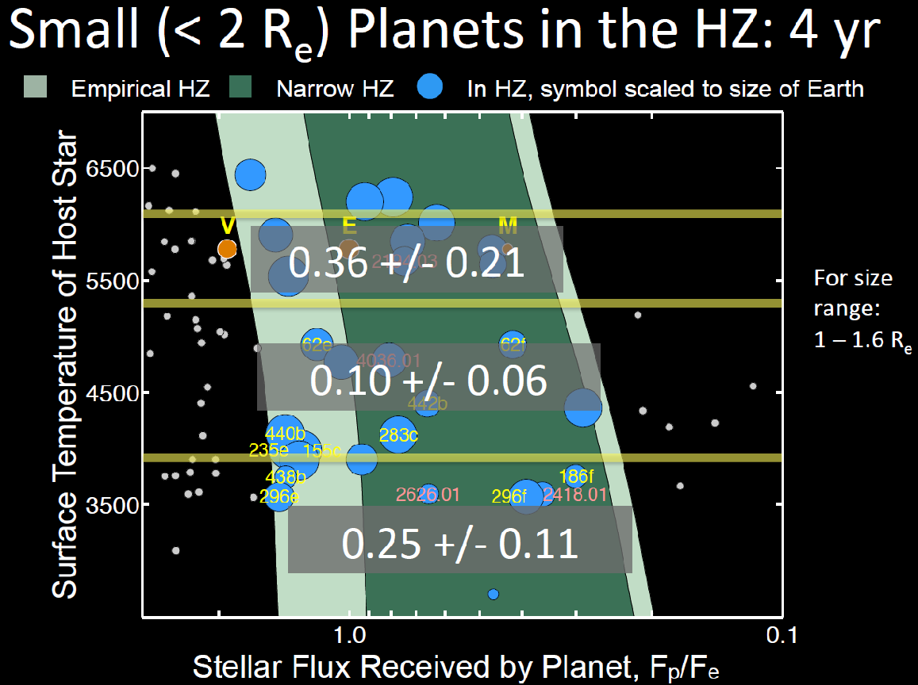
Courtesy of Natalie Batalha
G
K
M
Note: for planet size range of 0.5 – 1.6 R_{e} , expected # of planets may be a factor of ~2-3 higher
(based on extrapolation)

Slide 24
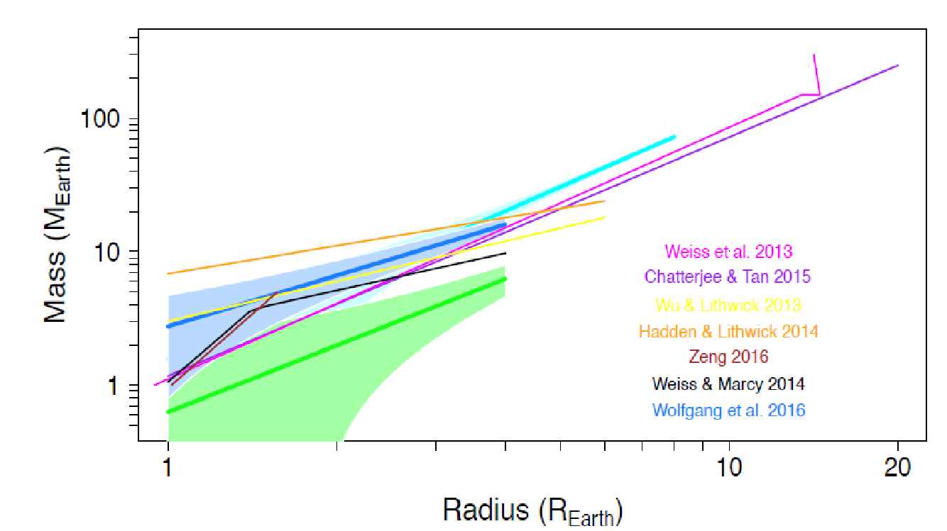
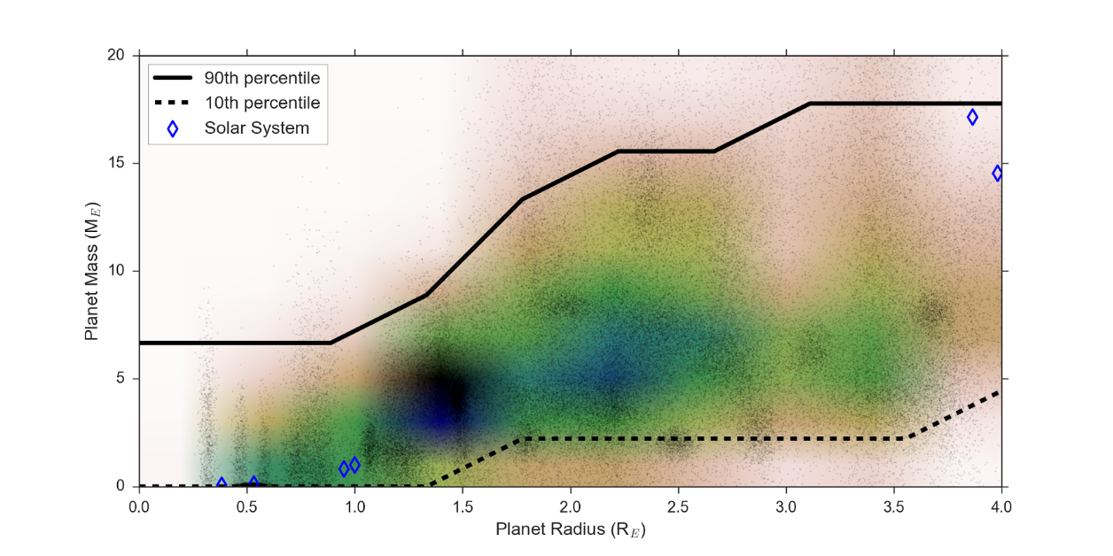
Converting between Mass and Radius (focus group led by Angie Wolfgang and Lauren Weiss)
'Previous M-R relations in the literature:
wide variety of radius, mass ranges and datasets used
Purpose: enable SAG13 occurrence rate submissions based on RV planets
M-R relationship is fundamentally not a 1-1 map (e.g. M = f(R) ), but a correlation (e.g. density function C(M,R) )
M-R focus group deliverables
an estimate of this correlation based on open community input
analysis of uncertainties and dependency on period and other parameters
Notes about plots / methods
TTV data is included
Black dots: MC posterior simulation accounting for uncertainties on currently known M-R planets
Color map: estimate of the 2D correlation density function (using Gaussian kernel density estimator)
Plot by Angie Wolfgang
Preliminary estimate of M-R correlation
Plot by Lauren Weiss
Notes:
Lauren: includes TTVs

Slide 25
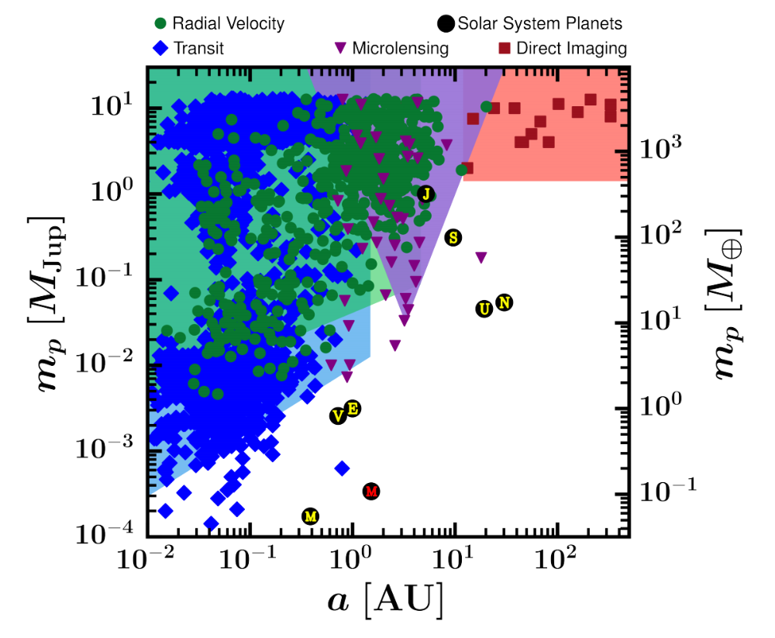
Linking to results from non-Transit techniques (Christian Clanton)

Slide 26
Conclusions
Mean SAG13 occurrence rate implies eta_Earth is significantly higher (~0.6) than many previous estimates, especially if going down to 0.5 Earth size.
Values >1 appear to be more likely than < 0.3
Caveat: SAG13 products are not formal scientific results, but rather represent a meta-analysis to achieve consensus on “most likely” assumptions for mission studies. The upcoming Kepler closeout will yield a formal scientific result.
Although many orders of magnitude of Gamma_Earth (or eta_Earth) are possible, only a small range (~ few octaves) within that is “likely”
Tentative parametrized distributions are available to use with mission yield calculation codes (or any other purpose)
Based on input from the entire exoplanet community
Notes:
Alan:
eta_Earth_SAG13
An assumption for mission planning cannot just be a single number.

Slide 27
Backup slides

Slide 28
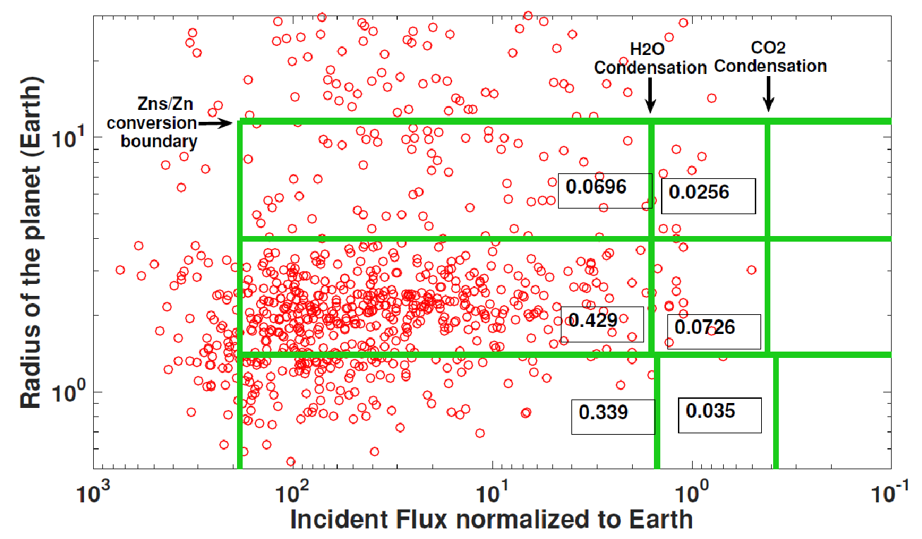
Occurrence rates for new proposed planet classification (from Kopparapu, Domagal-Goldman, et al., in prep) Numbers based on integrating SAG13 parametric fit
0.09
0.09
0.69
0.35
0.82
0.41

Slide 29
Variances between individual parameterized distributions
dN/dlog(SMA)
dN/dlog(R)
Log sma
Log R

Slide 30
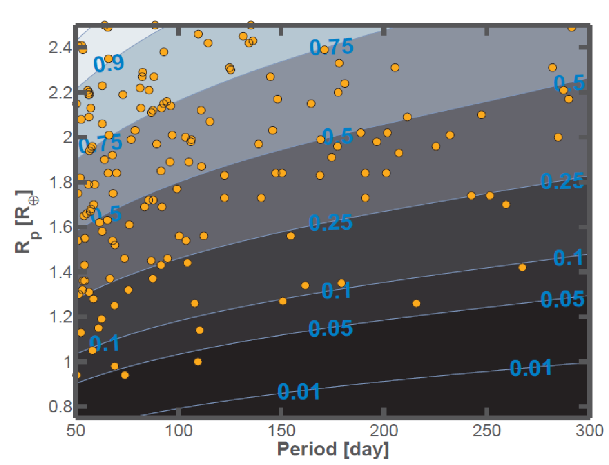
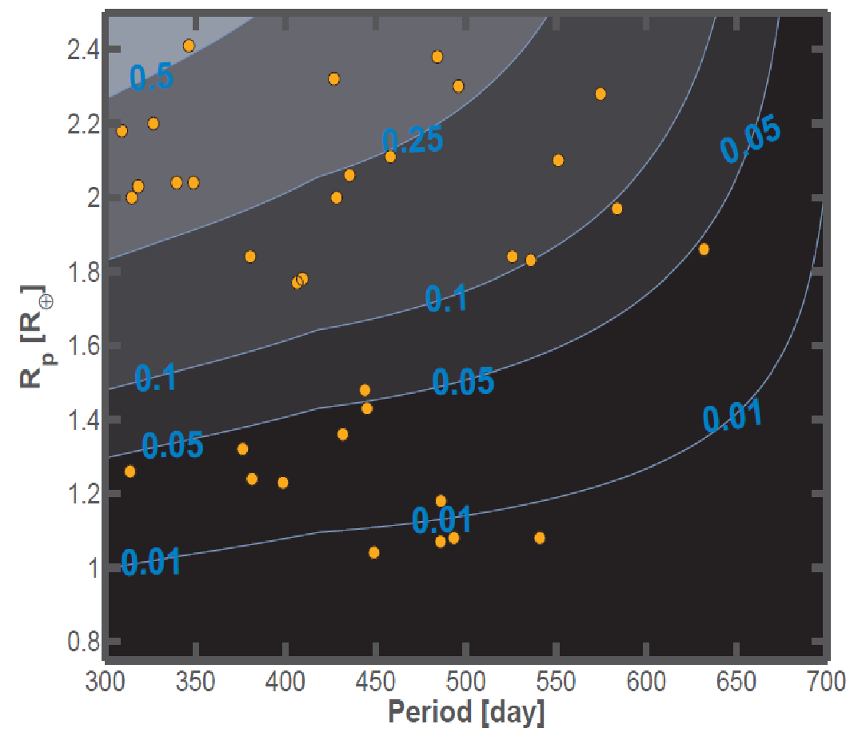
Current edge of planet candidates
[potential slide, meant to show actual planets and thus better visualize Poisson uncertainty]
Shorter periods, more reliable
Longer periods, less reliable
Contours and blue numbers represent completeness
Suspected
False positives
(excluded from
SAG13 analyses)
Burke et al. 2015
0.5-1.5 Earth size
237-860 days (Kopparapu extended HZ for Sun)

Slide 31
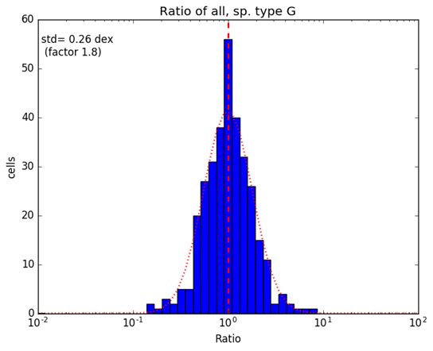
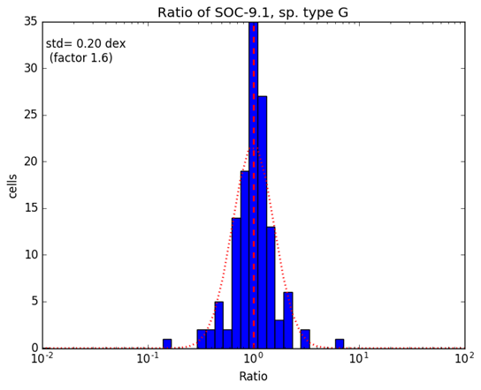
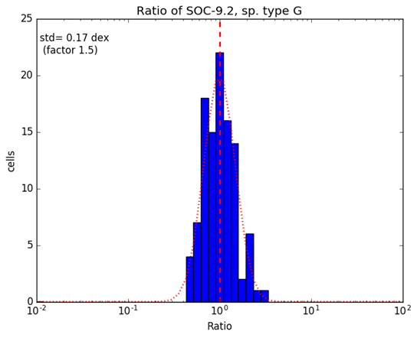
Variance in submissions
Courtesy of Gijs Mulders
Notes:
Chris: remove slide, because it is redundant?

Slide 32
Slide which shows any key correlations we found between variances / outliers and submission parameters (catalog, method, etc.) [Goal is to show status and any key preliminary patterns we found in the most clear and concise way but emphasize that this is still a work in progress]
Rough idea for visualization:
Log(R)
Value of Γ_{earth} | catalog | Completeness ? | Methodology?
Lowest value | Early catalog ?
Highest value | More recent catalog ?
Low variance region
High variance region
Log(P)
ROUGH DRAFT
[Note – for now, table entries are purely illustrative, not necessarily ones that we will have in the final slide]

Slide 33
Details of submitted rates
 | Catalog | Filters | Completeness model | Vetting efficiency | Reliability | Methodology | Value of Γ_{earth}
Batalha, Natalie (2)
Belikov, Rus
Burke, Chris
Catanzarite, Joe
Dressing, Courtney*
Farr, Will
Foreman-Mackey, Daniel*
Kopparapu, Ravi
Mulders, Gijs
Petigura, Erik*
Traub, Wes**
ROUGH DRAFT / SLIDE IDEA

Slide 34

Closer look at G-dwarf average
legend
% occurrence
# of submissions
by Gijs Mulders
Notes:
Maybe define Gamma_earth
And the green rectangle
Chris: a parameter like Gamma as a normalization at a point, and then a local power law
Eta_R[0.5-1.5]_P[237-860]

Slide 35
How do we combine different submissions into one occurrence table?
Full accounting:
Only “independent” submissions are averaged
Accounting for “dependency”
between submissions
No accounting:
Simply average all submissions
Best for producing an actual scientific measurement
Measuring “dependency” is not trivial (and may be impossible in principle)
Consensus on method can be challenging
Psychological biases are challenging to identify and control
Will not generate a scientific measurement, but possibly best for predictions?
Simple method
Easier consensus: all submissions are automatically fairly represented
Crowdsourcing / Prediction market philosophy: psychological biases are in theory averaged out
The question of which method is “correct” is possibly philosophical
Will probably do both, explicitly describe the process, and leave interpretation to the reader
Feedback on our strategy is welcome and encouraged
Notes:
Sparks: simple average may be better because we get an empirical uncertainty
Chris: there aren’t really any independent submissions; we should be able to fairly easy to identify which are dependent, which are independent;
Natalie: these are not independent calculations
It is more meaningful to go through and see why we agree and disagree.
Chris: If we approach this thinking that we have to pick an extrapolation for comparison, in the end it can be used to justify something that’s wrong
It is not our job to tell STDTs what to do. Provide occurrence estimates with the uncertainties involved
Rhonda: the job of the standards team is to do an apples-to-apples comparison between mission studies
Maggie: HabEx discussed this at length, plan is to explore a range of parameters. Need to be aware of the uncertainties.
Chris: SAG13 role – reporting a reasonable range; a pessimistic, default, and optimistics one.
Rhonda – report uncertainties and where the extrapolation begins

