Slide 1

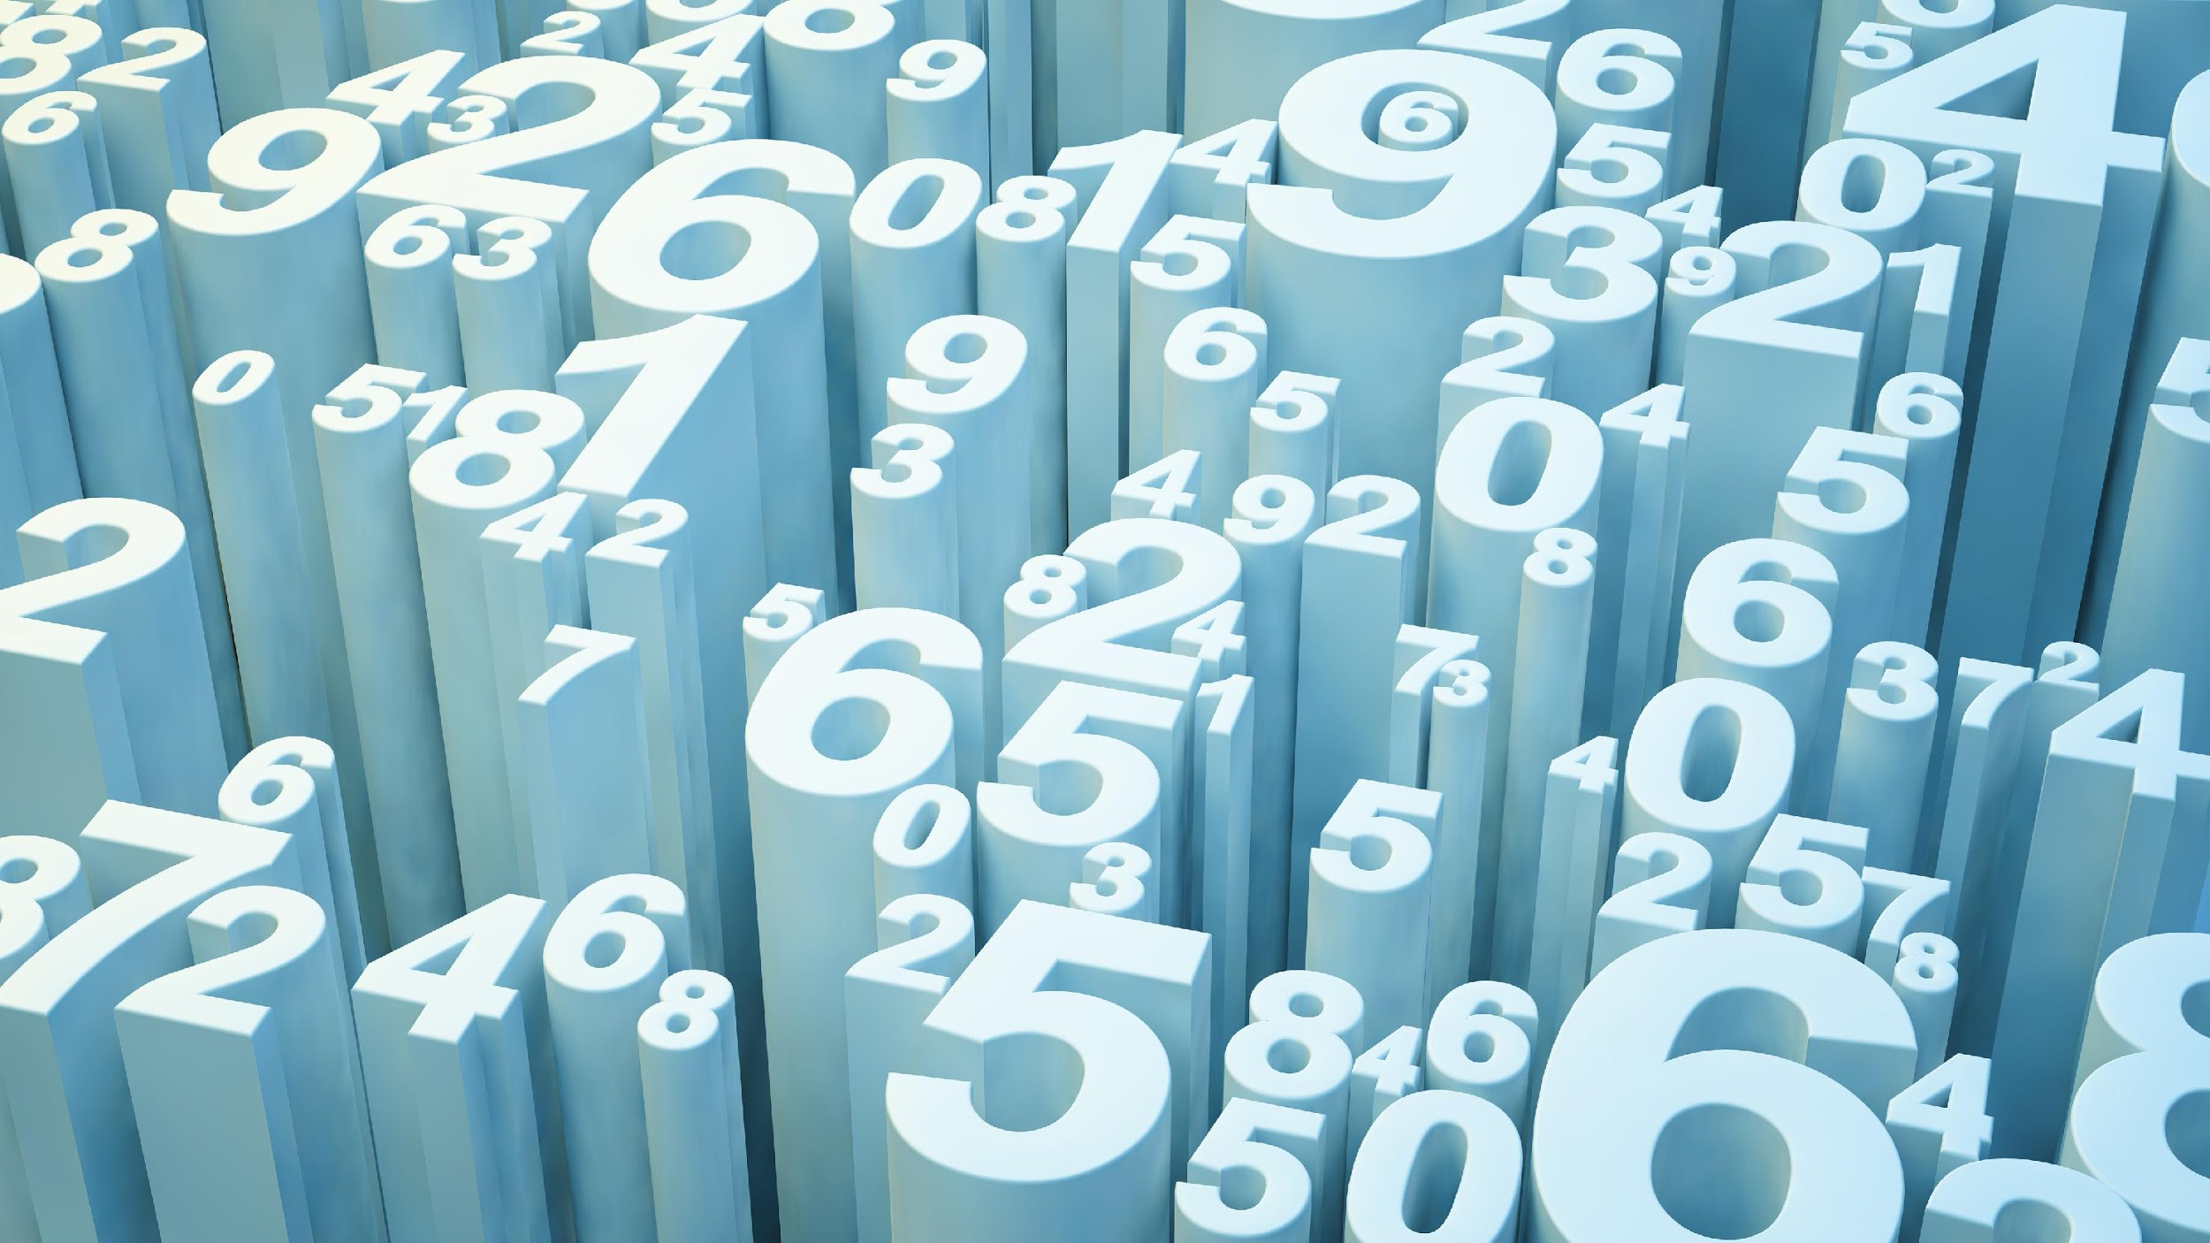
Essential Goods Locator
Chris Ducharme, Kevin Cox, Chad Worthan

Slide 2
Essential Goods Locator
Elevator Pitch: Our app was developed to help people find essential goods during the current pandemic. Users are able to create an account using their email and setting up a password. Once logged into the app the user is presented with a list of essential goods. When the user clicks on an essential goods “see product info” button they are directed to a page that displays all stores that have the selected product, how many are on hand at given store, along with the price and serving size. The user can then click on save product and our app will save the selected product to the Users own saved products page.

Slide 3
Essential Goods Locator
User Story: As a citizen in need of essential goods, I want an application that will allow me to search local stores for essential goods. I want to be able to see current inventory, price and location of stores that have the essential goods in stock.
Motivation: As we are all going to unprecedented times, we undoubtedly have gone to a store looking for a certain item only to find the shelves bare and item nowhere to be found. Our app would take the guesswork out of the store scavenger hunt.

Slide 4
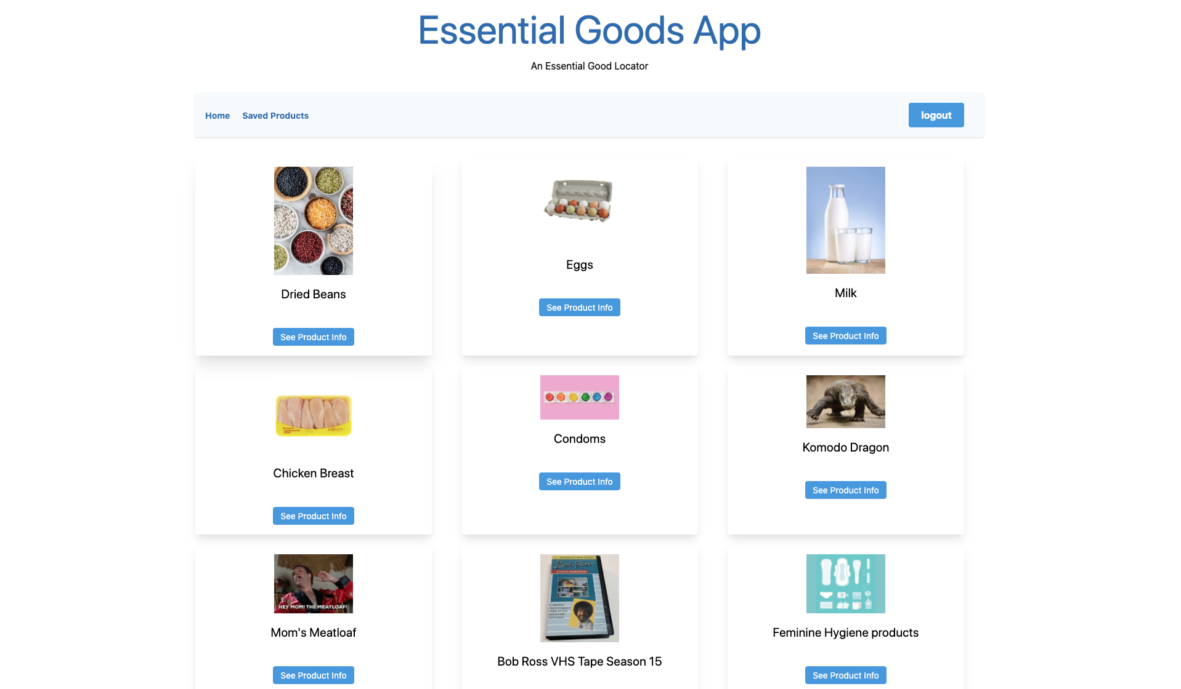
App

Slide 5
Essential Goods Locator
GitHub Repository: https://github.com/ChrisDucharme1793/project_02.git
Heroku: https://essential-goods-locator.herokuapp.com/

Slide 6
Essential Goods Locator
Technologies Used: Node.js, Express, Express-handlebars, Mysql, EsLint, Travis CI, Bootstrap, Normalize CSS frameworks.
Task & Roles: Combo
Challenges: Getting the saved items to create and render to their own page
Successes: Didn’t break my computer...yet

Slide 7
Essential Goods Locator
Directions for Future Development: Have the app create a route with directions to multiple stores using an API call and the data supplied from the Users saved product page.
Get the app to pull real time data of inventory levels of essential goods

