Slide 1
tRiLLbEaTz TBASS - Drum Synthesizer/Sequencer
Alfred Young
Anthony Assi
Chris Egan
Giselle Gutierrez
Gabe de la Mora

Slide 2
Introduction
Simple interface to make drum loops using samples and synthesizer tones
Application Domain
Musicians
Producers
Untrained Musicians
Sound Designers

Slide 3
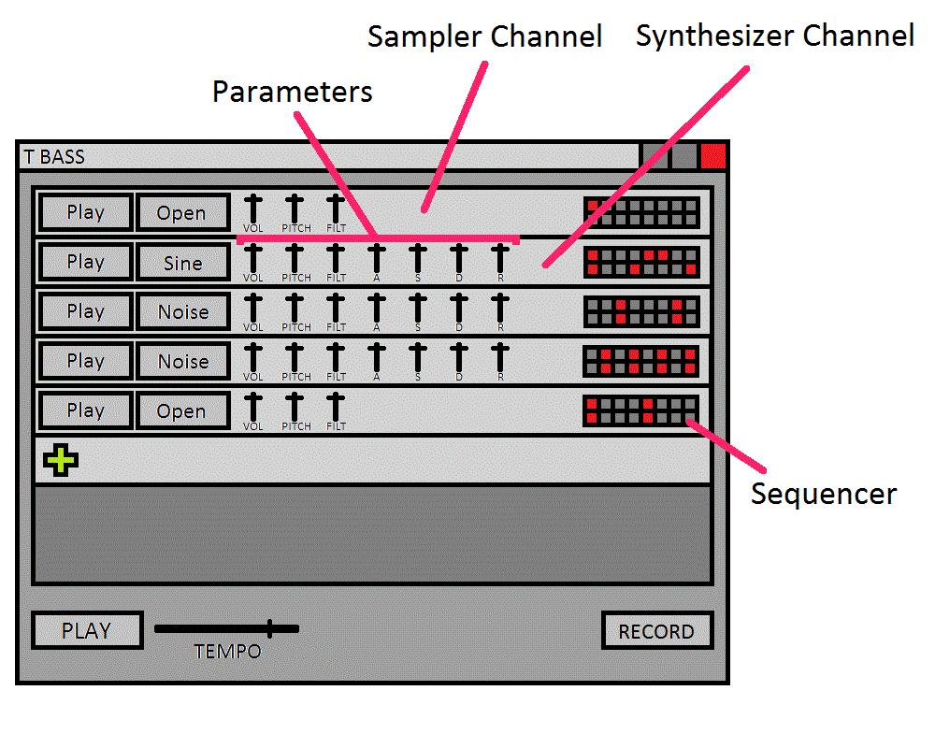
Planned Product

Slide 4
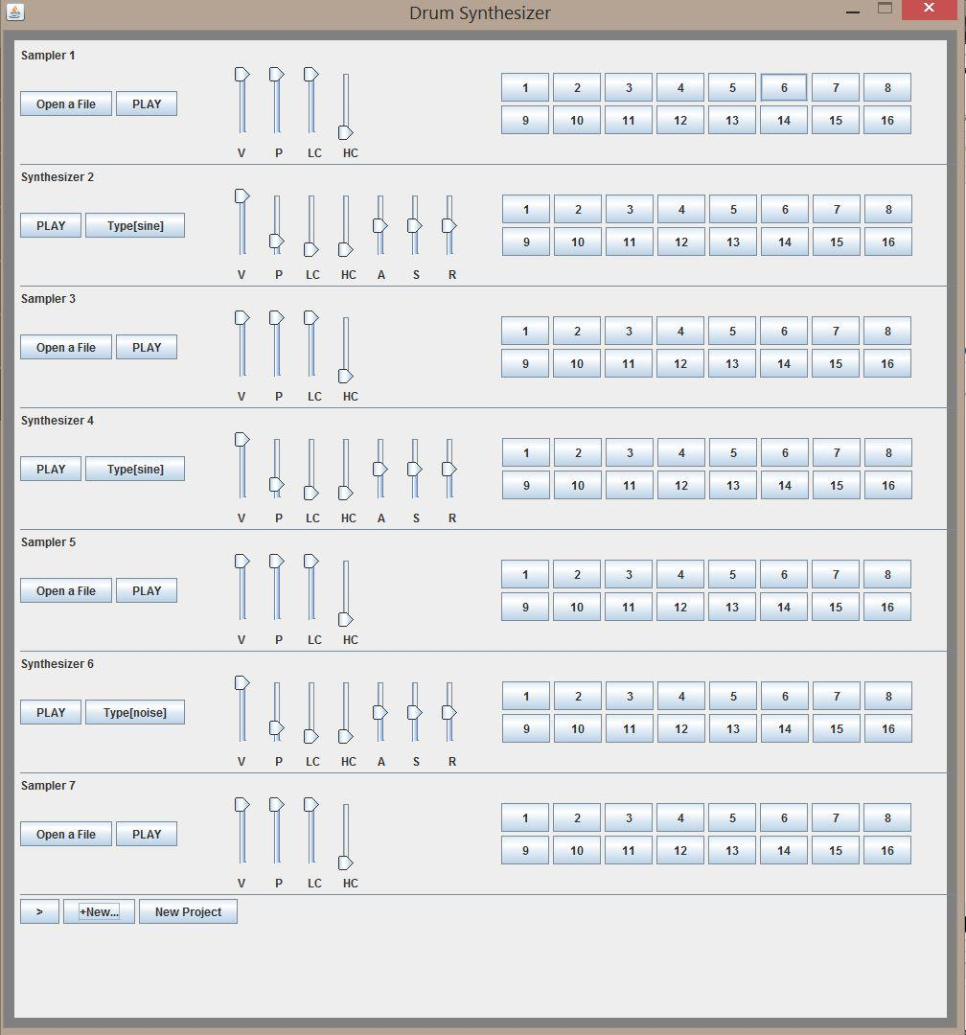
Actual Product

Slide 5
Goals
Code efficient enough for audio processing
minimal latency
effective multi-threading

Slide 6
Goals
Accessible to anyone
intuitive interface for beginners
streamlined for ease of use

Slide 7
Goals
Allow for creativity
enough parameters to create a variety of sounds
simple effects
tempo and swing control
users can add their own external audio files for editing as well as export their newly edited sounds

Slide 8
Challenges and Accomplishments
Basic Sound Synthesis
create synthetic tones
use volume envelope to shape waveform
allow user the ability to effectively use these tools

Slide 9
Challenges and Accomplishments
Sequence samples and tones
play sound from multiple sources at once using threads
keep playback on beat, despite latency

Slide 10
Challenges and Accomplishments
GUI Layout
challenging to correctly format the layout

Slide 11
Technologies
Libraries
JSYN - audio processing library
Java Swing - graphical user interface library

Slide 12
Management Techniques
Agile Development
Individuals and Interactions over Processes and Tools
Responding to change over Following a plan
SCRUM

Slide 13
Lessons Learned
SCRUM values
Small tasks to tackle big problems
Responding to unexpected events during development
Keep it Simple and Stupid

Slide 14
Personal Reflections
Teamwork and friendship
Made great software and great friends
It was great working on a large scale project

