Slide 1
Many conversations · one topic
Meaning Across Representations
Semantic modelling for boundary-crossing and AI-native operations
How multiple discussions and problem contexts point at the same need: a semantic model for network information — meaning made explicit and independent of form, supporting bridging of model and system boundaries and consumption by machines.
THE SYNOPSIS
THE THEORY
RESEARCH TOPIC
many takes, one requirement
form · meaning · use
ad hoc semantic models

Slide 2
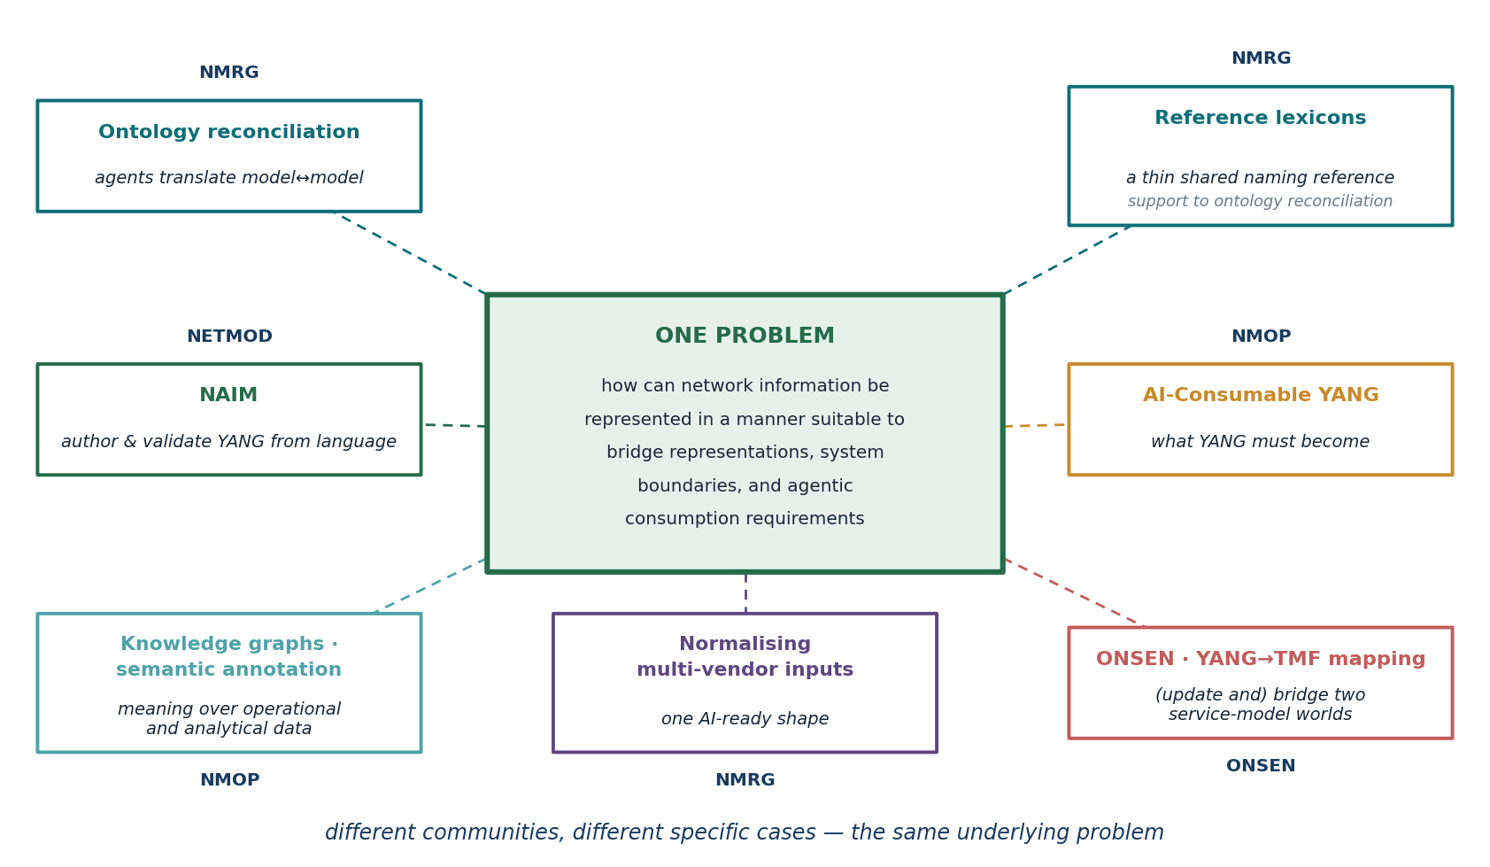
Many conversations: do they point at a common problem?
Ontology reconciliation, reference lexicons, NAIM, AI-consumable YANG, knowledge graphs and annotation, multi-vendor normalisation, the ONSEN YANG↔TMF bridge — separate threads, separate communities. Analysed separately, a common problem emerges.
2

Slide 3
Why now?
First — operations are moving to machine-driven automation, and machines need meaning and context around data for reliable comprehension.
Second — that automation is targeted across multiple network and other technology domains and across consumer–provider boundaries, crossing ontological spaces, while leveraging focused abstraction (intent).
Machines now consume meaning, not just form
Autonomy spans spheres — different ontologies, not just grammars
Cognitive agents can automate the bridging itself
YANG has always been consumed as a grammar — validate, encode, transport. Agents are now asked to reason over what it means, the layer models carry least.
A full operations stack bridges models of different provenance and spheres — often different ontologies, not just grammars — so bridging is reconciliation at the semantic level.
Systems that converse and reason can perform that semantic reconciliation at runtime, with the right information support — not a model agreed and frozen in advance.
Meeting these drivers turns on one thing in common: a sufficient semantic model — shared meaning, with provenance — so agent actions are trusted, repeatable, and traceable.
3

Slide 4
A shared workflow, a common requirement
A common workflow
A common requirement
The different cases point at a common workflow: make models' meanings explicit — create their semantic representations — bridge semantic gaps, and create new representations as needed. The cases make greater or lesser use of machine cognition and communication to automate the workflow.
The common requirement: a complete (sufficient) semantic representation or model.
The next few slides set up the theory behind that common requirement — what a model's meaning is, where it leaks, and why each case is a take on the same problem.
4

Slide 5
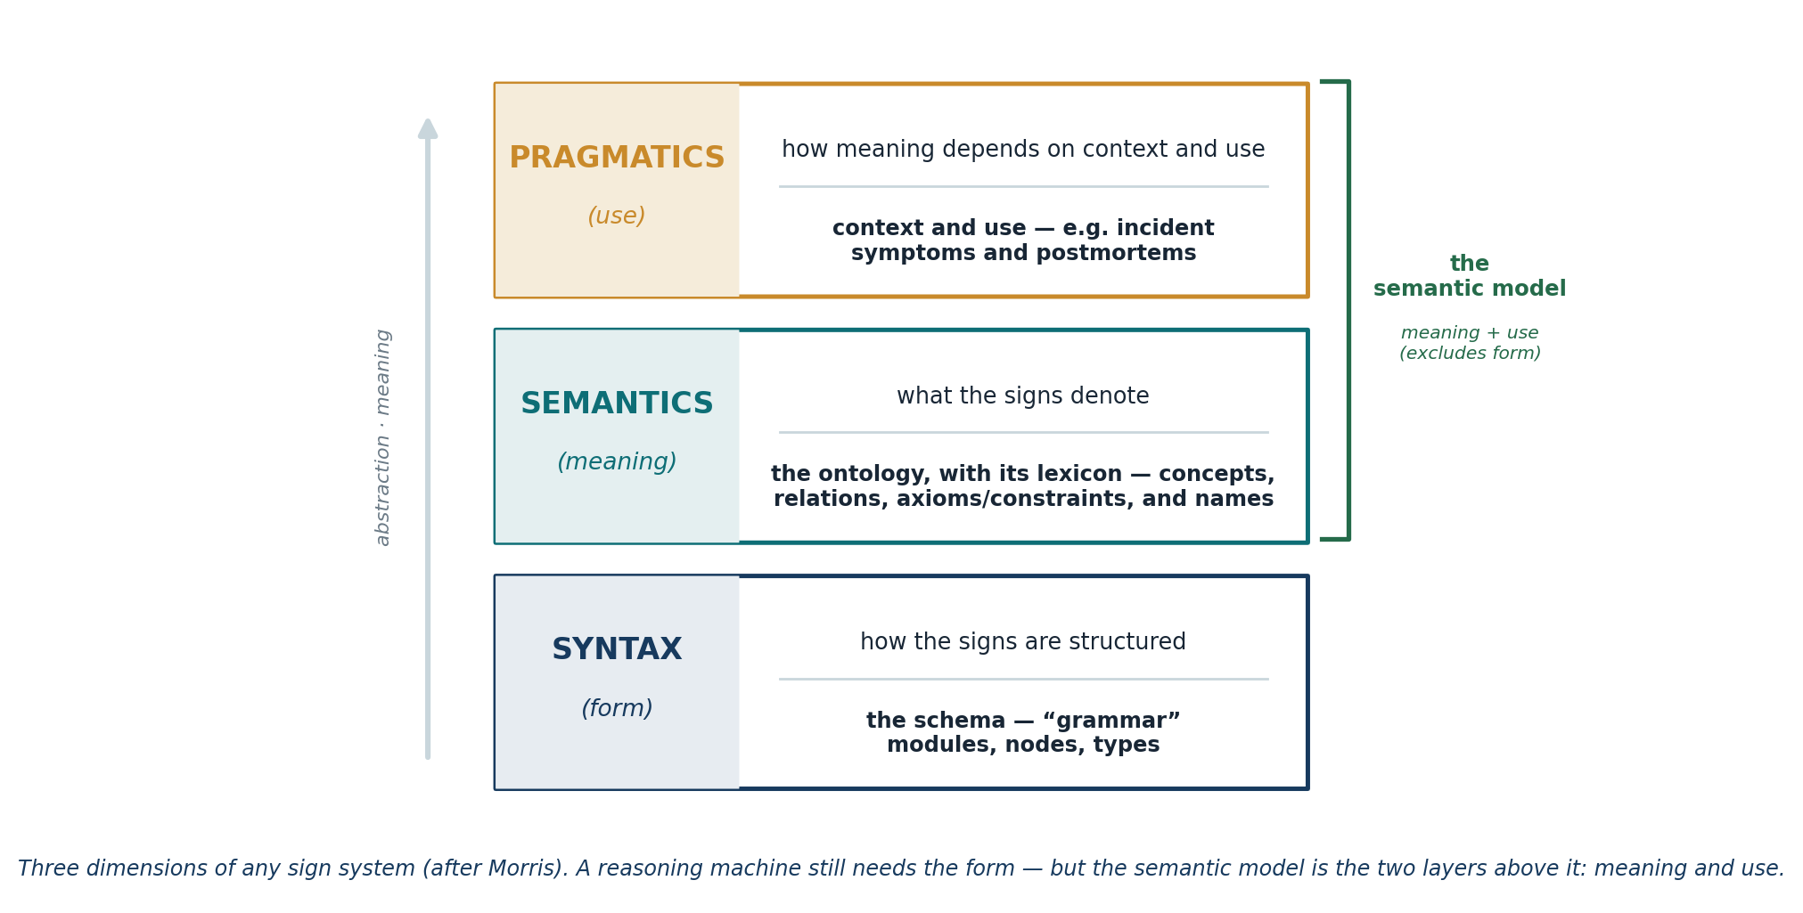
Form, meaning, use
Machines have long consumed the form; the new demand is the two layers above it — semantics and pragmatics. In referring to a semantic model, we use “semantic” in a broad sense — as on the semantic web: meaning and use together; everything above the form.
Reference: C. W. Morris, Foundations of the Theory of Signs (1938), International Encyclopedia of Unified Science, Univ. of Chicago Press.
5

Slide 6
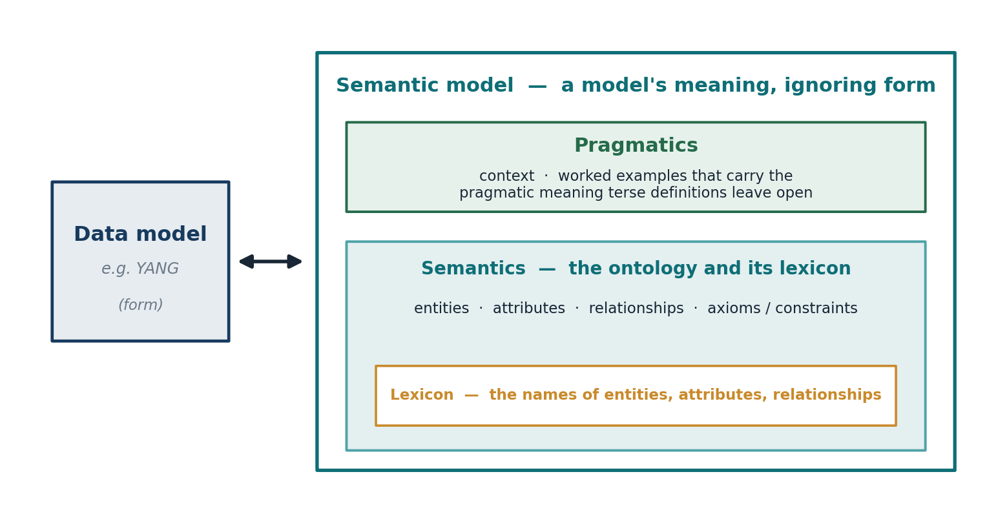
A semantic model: meaning made form-independent
A semantic model captures meaning in the broad sense — its semantics and its pragmatics both (the ontology and its lexicon, and use), and not its form. Because it is form-independent, it can support bridging between forms, can support semantic evolution, and is needed to support machine reasoning.
6

Slide 7
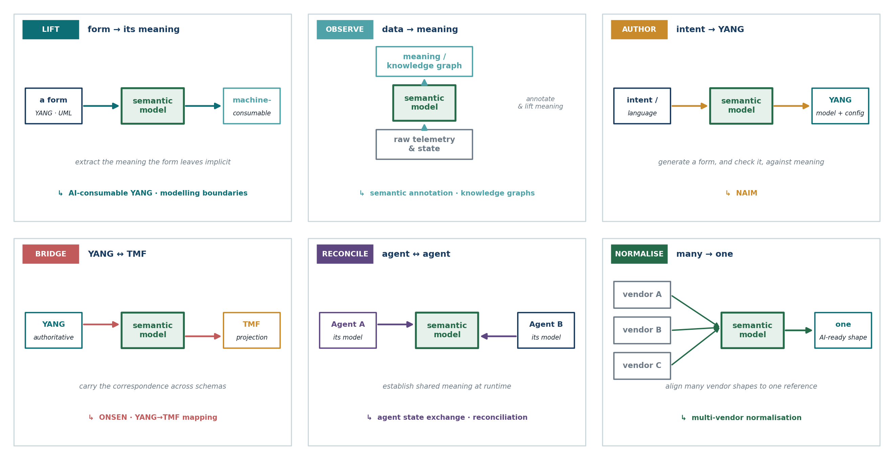
In every case, a semantic model is the bridge
The permutations are the cases under discussion across IETF and IRTF. In each, a converged or bridged semantic model is the necessary bridge between representations — or what a reasoning agent consumes directly.
7

Slide 8
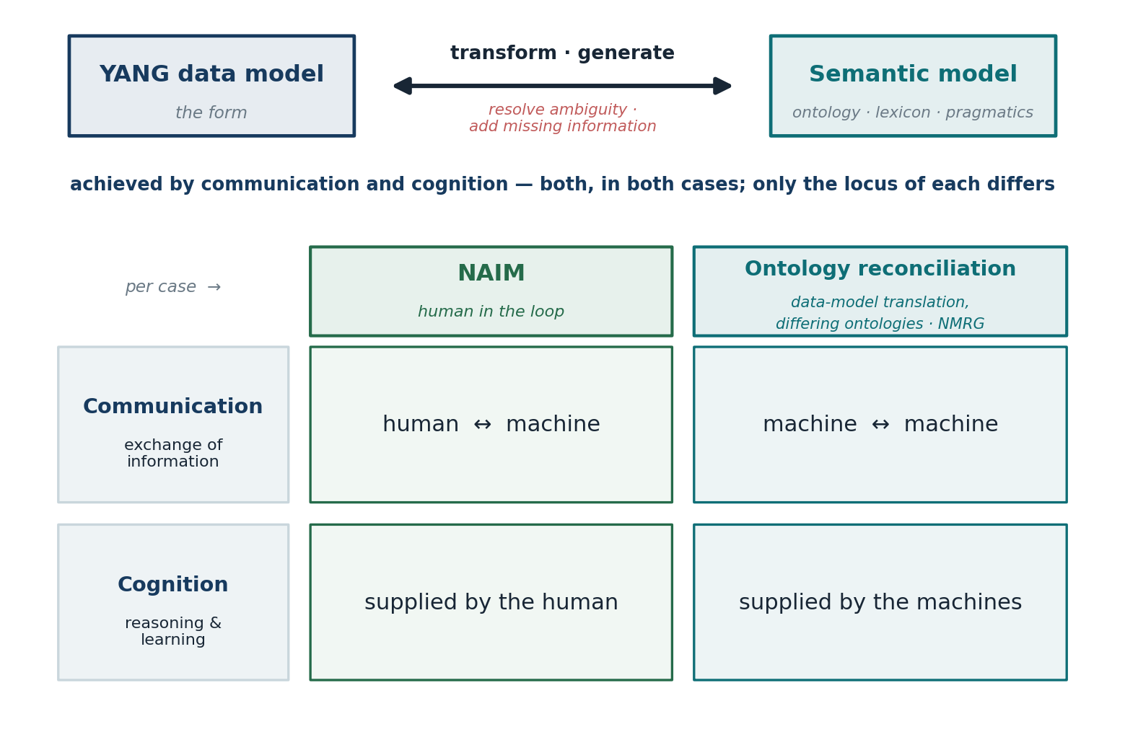
The common workflow up close: authoring vs. reconciliation
Two of the cases from the previous slide, in depth. NAIM (YANG model generation) vs. the NMRG ontology-reconciliation draft (data-model translation on similar-but-not-identical ontologies). Similar workflows: what differs is how much machine communication and cognition automate.
Similar workflows, same role of semantic model — what differs is where communication and cognition sit.
A further human-or-machine example: the NMOP network-anomaly lifecycle and semantics drafts — annotators human or algorithmic, validated in the loop.
8

Slide 9
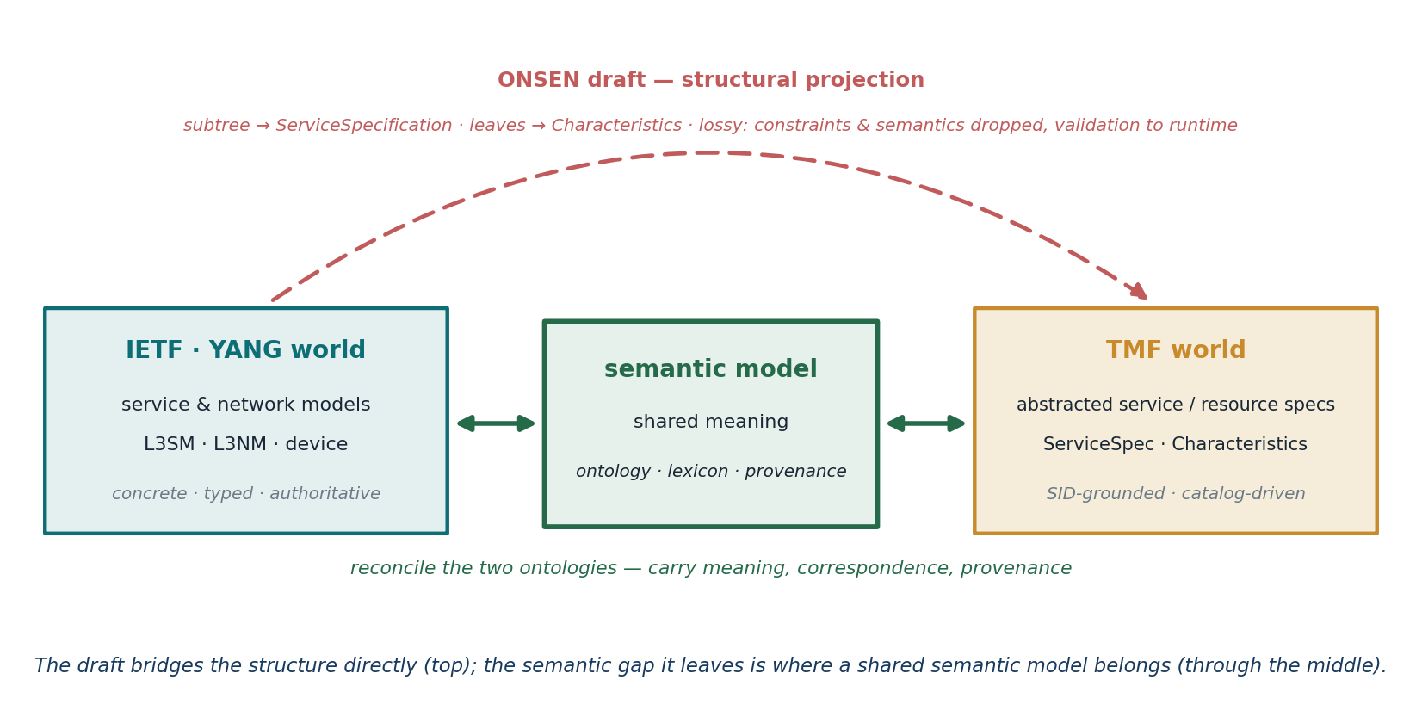
The common workflow up close: the TMF↔YANG bridge
Another of the cases, in more detail. TMF and the IETF model “a service” in two differently-abstracted ontologies — so a faithful bridge needs a semantic model between them, not a projection that distorts or drops what one side has and the other lacks.
As in the previous case, automation varies: the draft's projection is deterministic; the semantic reconciliation it defers is where cognition would do more.
9

Slide 10
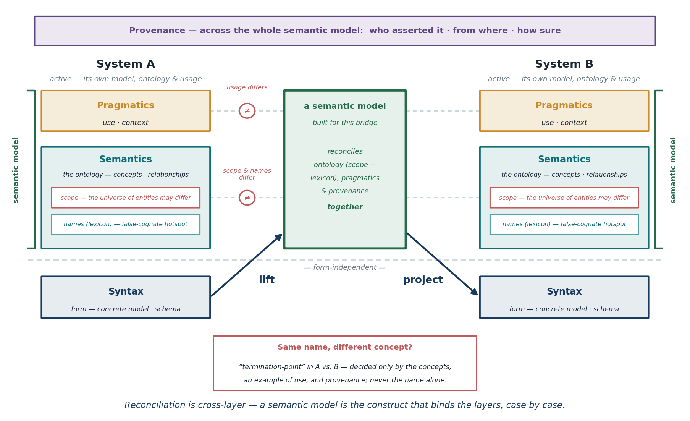
Why it takes a semantic model: reconciliation is cross-layer
Two systems' representations can differ at every layer, and no layer reconciles alone — which is exactly why the bridging construct must be a semantic model, built case by case.
10

Slide 11
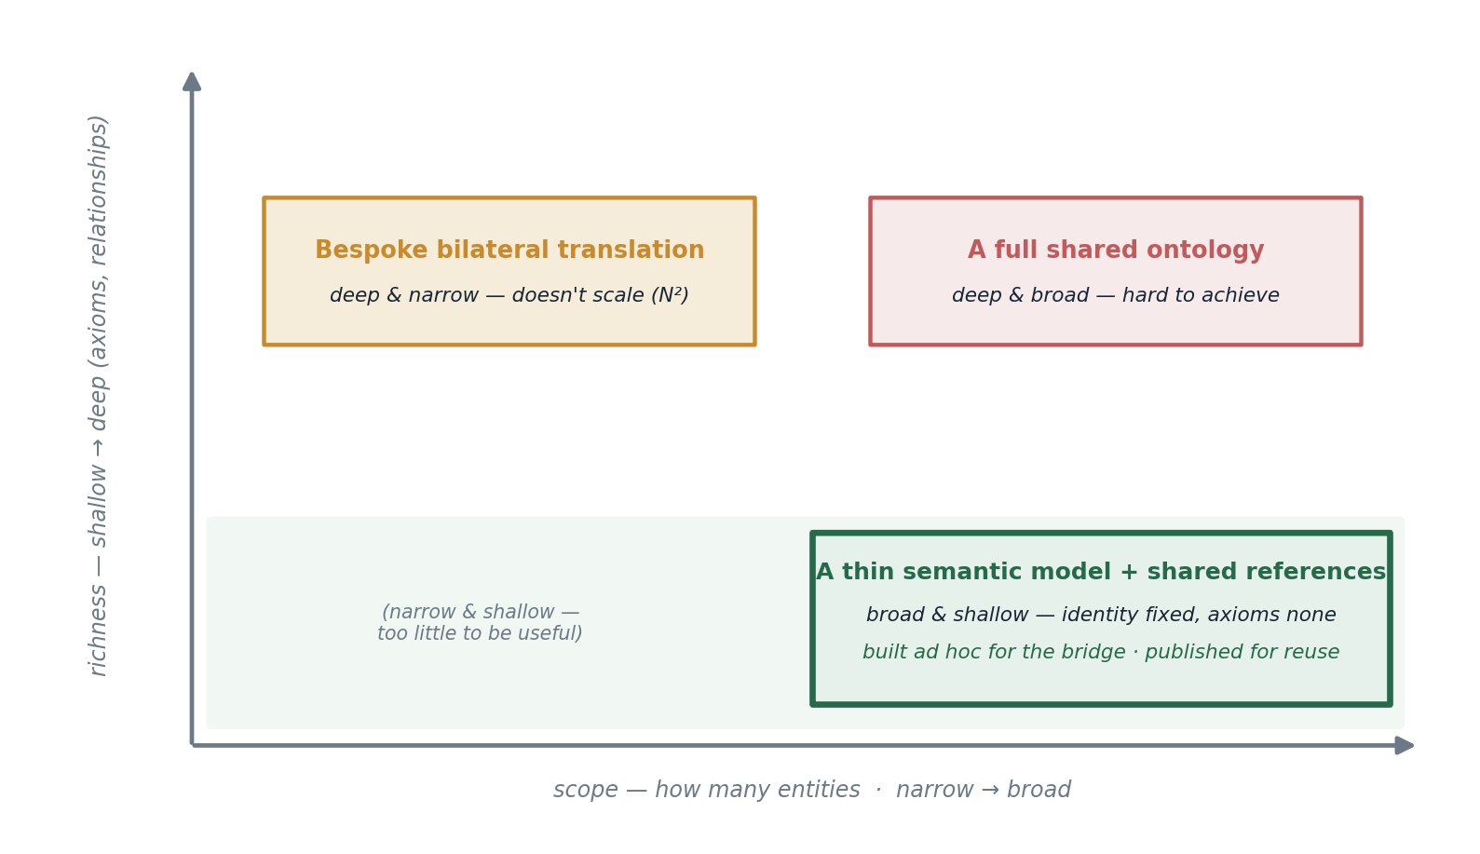
Practical semantic models are ad hoc, not universal
We are not proposing — and could not pre-agree — a universal semantic model: independently-built, evolving systems differ in scope and ontology, so meaning can't be settled in full in advance.
So a semantic model is built for the bridge at hand; only thin supports are standardized, and useful pieces are published for reuse.
Framing after draft-janz-nmrg-reference-lexicons.
11

Slide 12
For research: a process, its supports, its reuse
Because the practical, useful semantic models are ad hoc artefacts, the work is not to define a semantic model but to work out how to support maximally automated ad hoc semantic-model creation, reconciliation across systems, and use. Three aspects — and two recent NMRG drafts together point to all three.
AUTOMATE THE PROCESS
STANDARDIZE THIN SUPPORTS
PUBLISH & REUSE
generate & reconcile, per case
supports, not machine-consumed models
a commons, bottom-up
Agents make each ontology explicit, converse to resolve their differences, and generate a translator for ordinary operation — cognition spent once, at negotiation.
A thin reference lexicon — identifiers, names, definitions, examples; identity fixed, axioms none — with provenance conventions. Broad but shallow, easily extended.
Correspondences settled per case, contributed back rather than kept private, become standing infrastructure — the next similar pair reuses a settled correspondence.
draft-janz-nmrg-ontology-reconciliation
draft-janz-nmrg-reference-lexicons
draft-janz-nmrg-reference-lexicons
Scaling has two levers: thin shared references — bind N to a reference, not N² pairwise bridges — and a growing commons of published correspondences, where each settled ad hoc case spares the next.
12

Slide 13
The landscape: the field is already working these — 1 of 2
THE CONVERSATION / TAKE | WHAT IT IS | ELEMENT OF THE COMMON TOPIC — AND HOW IT LINKS | DRAFTS & STANDARDS
AI-consumable YANG ↳ bridging: LIFT | Models must present their meaning, not just their form, for agents to reason over them. | The object itself — the semantic model everything else transforms. It sets the whole problem. | draft-mw-nmop-yang-ai-challenges draft-ietf-netmod-yang2
NAIM — canonical AI format ↳ bridging: AUTHOR | Author and validate YANG from language, through a canonical intermediate form. | The form↔meaning lift, at the human↔machine locus of the one workflow. | draft-feng-netmod-naim draft-feng-netconf-naim-op
Ontology reconciliation ↳ bridging: RECONCILE | Agents make each ontology explicit, converse to resolve differences, and generate a translator. | The same workflow at the machine↔machine locus — differing ontologies reconciled at runtime. | draft-janz-nmrg-ontology-reconciliation draft-cui-nmop-agent-sketch-com
Normalising multi-vendor inputs ↳ bridging: NORMALISE | Many vendor shapes lifted into one AI-ready shape for LLM-assisted operation. | Alignment to a shared reference — the lexicon seam that makes matching a lookup. | draft-prabhu-nmrg-prompt-schema-llm
… continues →
13

Slide 14
The landscape: the field is already working these — 2 of 2
THE CONVERSATION / TAKE | WHAT IT IS | ELEMENT OF THE COMMON TOPIC — AND HOW IT LINKS | DRAFTS & STANDARDS
Semantic annotation · knowledge graphs ↳ bridging: OBSERVE | Meaning laid over raw operational state and telemetry, as graphs and annotations. | Lifting form to ontology + lexicon — the “observe” bridging of the model. | draft-ietf-nmop-network-anomaly-semantics draft-mackey-nmop-for-netops
ONSEN — YANG→TMF bridge ↳ bridging: BRIDGE | Project an authoritative YANG subtree into a TMF ServiceSpecification and back. | The cross-system transform; correspondence and provenance across two schema worlds. | draft-lambrechts-onsen-yang-tmf-mapping TMF633 / 634 / 641
Modelling boundaries · UML→YANG ↳ bridging: LIFT | Where one model's meaning stops, and disciplined translation to another begins. | The joints between representations — lifting and boundary-crossing, made explicit. | draft-davis-netmod-modelling-boundaries draft-mansfield-netmod-uml-to-yang
Reference lexicons ↳ role: thin support | A thin shared naming reference — stable identifiers, definitions, examples; axioms none. | The standardizable support reconciliation consults — broad but shallow, published for reuse. | draft-janz-nmrg-reference-lexicons
The shared element: every row works the same object — a semantic model. Our reconciliation + reference-lexicon pair points to the whole shape: the process, the thin support, and the published reuse.
14

Slide 15
A research activity — an NMRG × NMOP collaboration
The activity — automate, with cognitive machines, the per-case making and reconciling of semantic models: the process, the thin supports worth standardizing, and the reusable pieces worth publishing. Automating through cognitive machines is the natural focus — though the supports it needs serve other purposes too. Not a universal model.
What the activity takes on
Anticipated outcomes
Automating — with cognitive machines — the per-case generation & reconciliation of semantic models
Which minimal supports (reference lexicon, provenance) are worth standardizing — thin, easily evolved
How reusable correspondences get published and reused — an accumulating commons
How a human-in-the-loop workflow validates the automation and feeds it back
A framework & vocabulary for the cognitively-automated generation / reconciliation process
A small set of thin standardizable supports — reference lexicon, bindings, provenance conventions
A publish-and-reuse pattern for an accumulating commons of correspondences
A running, human-in-the-loop experiment across cases — NAIM, ONSEN, reconciliation, anomaly semantics
An NMRG × NMOP collaboration: research proposes the ontology, lexicon and the automation; operators contribute the pragmatics — incident symptoms and postmortems — and human-in-the-loop validation.
15

