Slide 1

Walmart
Capstone Project
Author: Christopher Freyre

Slide 2
Contents
Business Problem
Data understanding
Data cleaning
Model and Validation

Slide 3



Business Problem
Walmart has been running out of stock during busy periods recently and are looking for a way to predict future sales In order to maintain appropriate levels of stock.

Slide 4
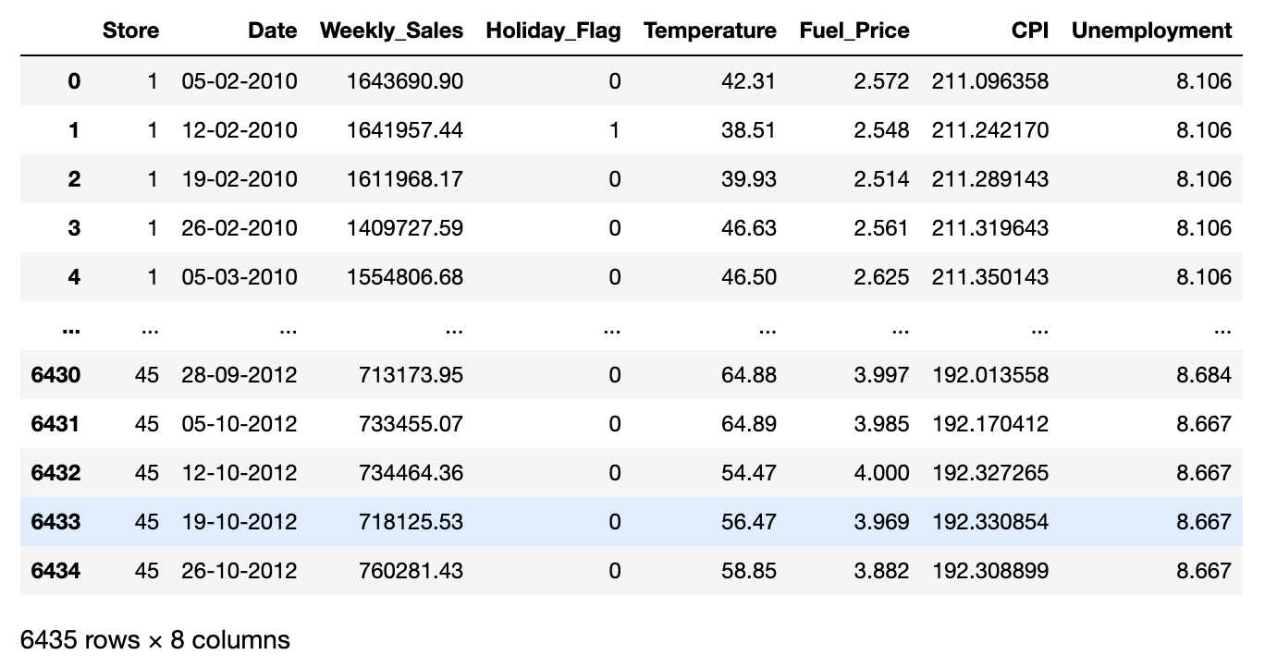
Data Understanding
Stores - 45
Date (2010-2013)
Weekly Sales
Holiday Sales
Temperature -℉
Fuel Price
CPI – Prevailing consumer price index
Unemployment

Slide 5

Data Cleaning Process
Missing values
Unique values
Transformation Datetime
Checking and removing Outliers
IQR Trimming and Capping Method
Log Transformation
Scaling
Modeling
Validation

Slide 6
Model and Validation
Improvement of models
Performing creating of dummies variables for categorical values
Performing Logarithmic transformation
Scaling Data values
Validation T-test
Cross validation method

Slide 7
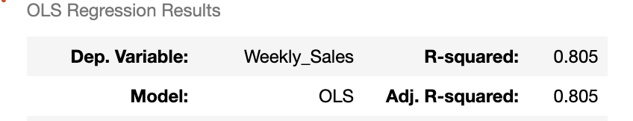
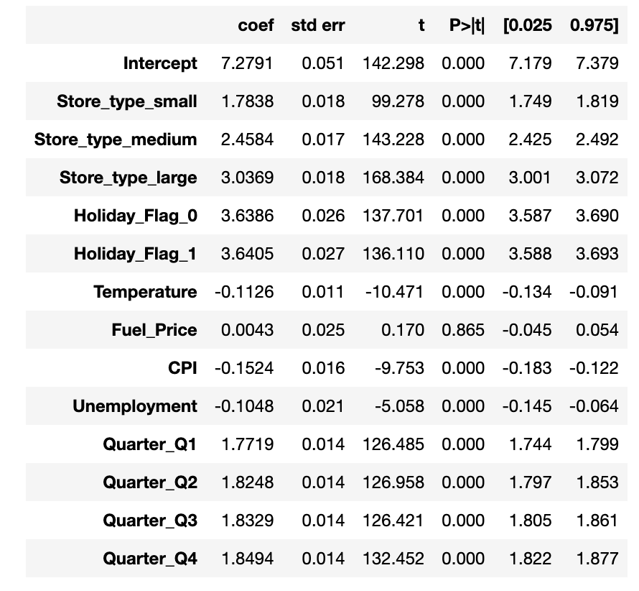
Validation
R-square value:
0.805
Coeff values:
Q1<Q2<Q3<Q4
Small<Medium<Large
Days<Holiday Days
T-test scores:
Train MSE = 0.0377
Test MSE = 0.0387
Cross Validation:
MSE = 0.0874

Slide 8
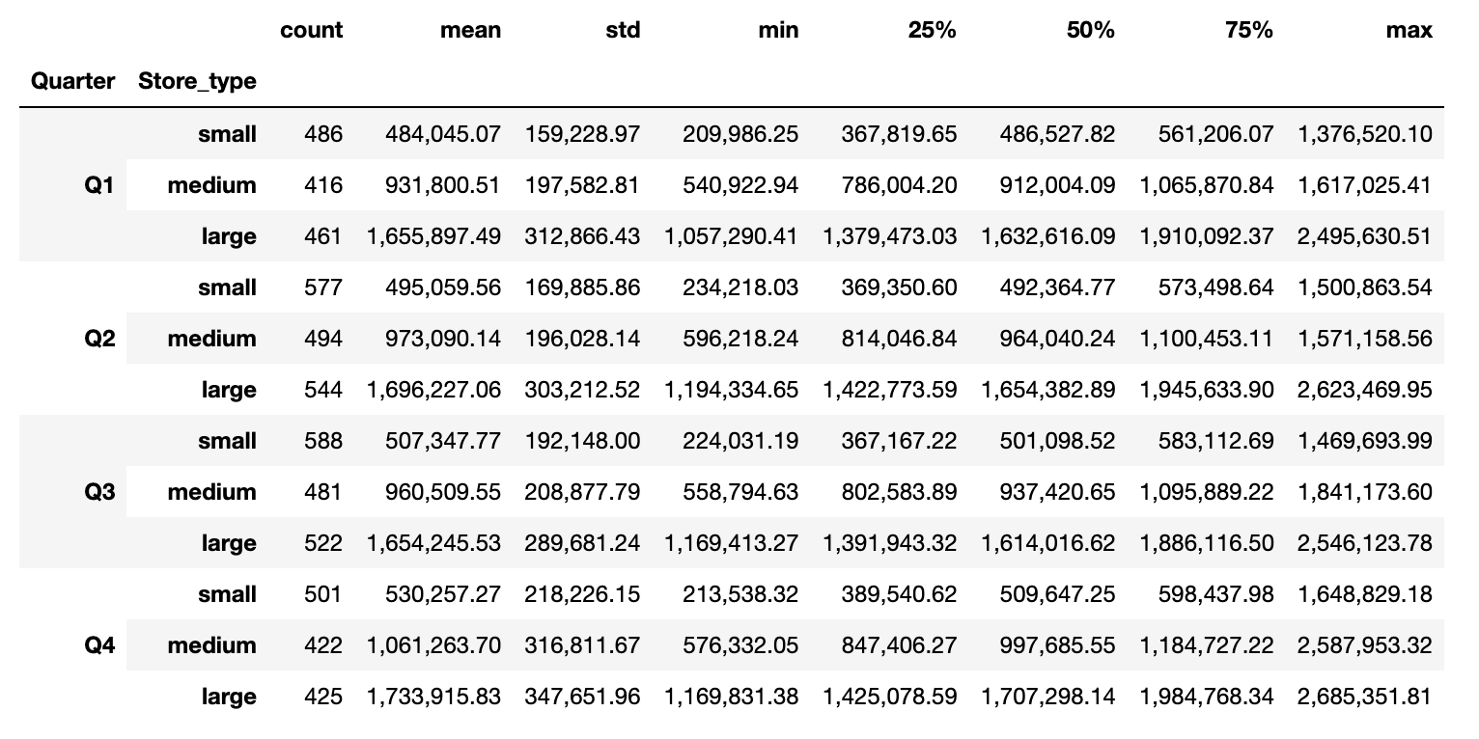
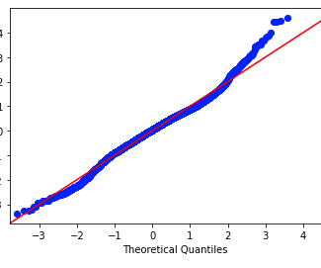
Conclusion
Model_q3 provided the best fit for linear regression with an R-squared value of 0.805. Meaning that it represents 80.5% of the data.
Validating it with T-test, provided a Mean Squared Error value: 0.0377.
Cross Validation result: 0.087
Important Coeff:
Quarters
Store Types
Holiday Flag

Slide 9

Recommendations
Using my final model, I advise Walmart Stores:
Demand will increase quarterly and will be significantly higher during the last quarter of the year.
Store type format for small, medium and large stores will prepared them for future demand and stock supply.
Demand amount will depend on the store size, the model tell us that lager store the higher the demand.
Be prepared for holiday days as they are a factor that will increase demand.

