Slide 1

King County Housing
Analysis by Christopher Freyre

Slide 2
Contents
Business Problem
Data Understanding
Data Cleaning
Model and Validation

Slide 3


Business Problem
Real-State agencies are looking to advise home owners on how performing a renovation might increase price of home sales and if so, what factors are relevant to this renovation.

Slide 4
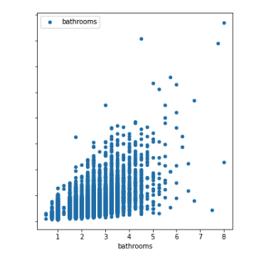
Data understanding
House sales data in King County in 2014-2015
Price
Id & date
Bedrooms, Bathrooms & Floors
Square foot: Living, Lot, Above, Basement, 15
Grade & Condition
Area: Zip code, Lat & Long
Year: built & renovated
Waterfront
Views
Notes:
Price as dependent variable
Bedrooms, bathrooms
Sqft living and lot
Grade & condition

Slide 5
Data cleaning process
Missing values.
Data type conversions.
Checking for and removing multicollinearity.
Normalizing our numeric data.
Converting categorical data to numeric.
Dropping Columns not relevant.
Checking for outliers. (z-score)

Slide 6
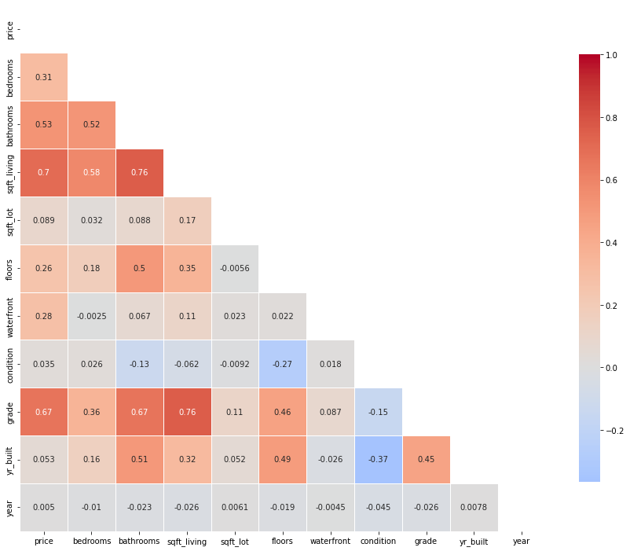

Model and Validation
Correlations
Dependent and independent variables
Dummy variables
Log Transformation

Slide 7
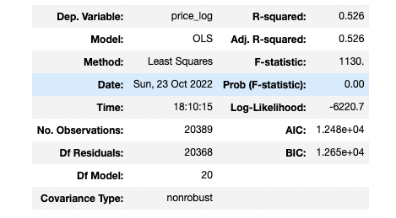
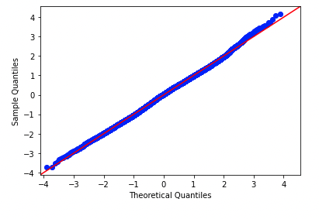
Validation
Checking R-squared value
Coeff values
T-Test / Mean square error
Cross validation

Slide 8
Conclusion
Model 3 provided the best fit for linear regression with an R- Squared value of 0.526. Meaning that it represents 52.6% of the data.
Validating it with T-test, provided a Mean Squared Error value: 0.10 (MSE)
Cross validation resulted in 0.10
Highest Coeff contributing to a high price by high condition and grade, implying a quality renovation is key to sell at a higher price :
Condition 5 = 1.5164 Coeff
Grade 11 = 1.2728 Coeff

Slide 9

Recommendation
I would recommend Real Estate agencies advise their clients that:
Price of properties increase by square foot living, bedrooms and bathrooms.
Renovations that provide a high condition rate of 5, or at least in a range 2 to 5.
Renovations that provide a high grade rate of 11, or at least in a range 5 to 11.

Slide 10

thank you
Email: Christopher.Freyre@gmail.com
Github: @Chrisfreyre
Linkedin: https://www.linkedin.com/in/christopher-freyre-56760b136

