Slide 1
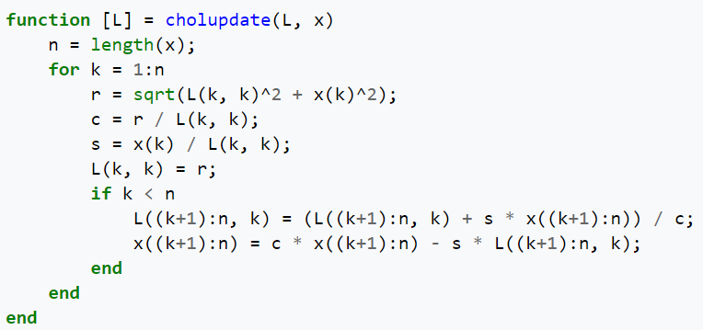


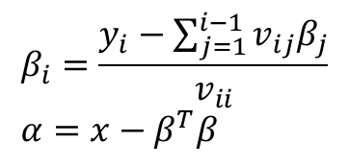

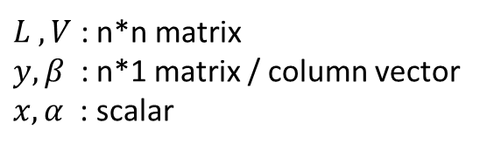

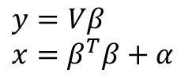


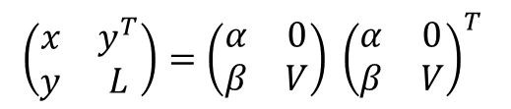
$$L=VV^{T}$$
$$\left(\begin{matrix}x & y^{T} \\ y & L\end{matrix}\right)=\left(\begin{matrix}α & 0 \\ β & V\end{matrix}\right) {\left(\begin{matrix}α & 0 \\ β & V\end{matrix}\right)}^{T}$$
$$\left(\begin{matrix}L & y \\ y^{T} & x\end{matrix}\right)=\left(\begin{matrix}V & 0 \\ β^{T} & α\end{matrix}\right){\left(\begin{matrix}V & β^{T} \\ 0 & α\end{matrix}\right)}^{T}$$
$$L=ββ^{T}+VV^{T}$$
$L ,V$ : n*n matrix
$y, β$ : n*1 matrix / column vector
$x, α$ : scalar
$$V_{1}=choupdate(V, β)$$
Rank-one update
$$L=V_{1}V_{1}^{T}$$
$$y=Vβ \\ x=β^{T}β+α$$
$$β_{i}=\frac{y_{i}−\sum_{j=1}^{i−1}{v_{ij}β_{j}}}{v_{ii}} \\ α=x−β^{T}β$$
$$\det{{(L}_{n+1})}=\det{{(L}_{n})} α^{2}$$
https://en.wikipedia.org/wiki/Cholesky_decomposition#Rank-one_update
https://www.mathworks.com/help/matlab/ref/cholupdate.html
Notes:
https://www.mathworks.com/help/matlab/ref/cholupdate.html

