Slide 1

ELT Pipeline
Coded Using Python & SQL on a MySQL Database
Connie Sau Chow, John Chen, Chris Garcia

Slide 2
Overview
High Level Overview
Application and Database Architecture
Limitations & Scalability

Slide 3
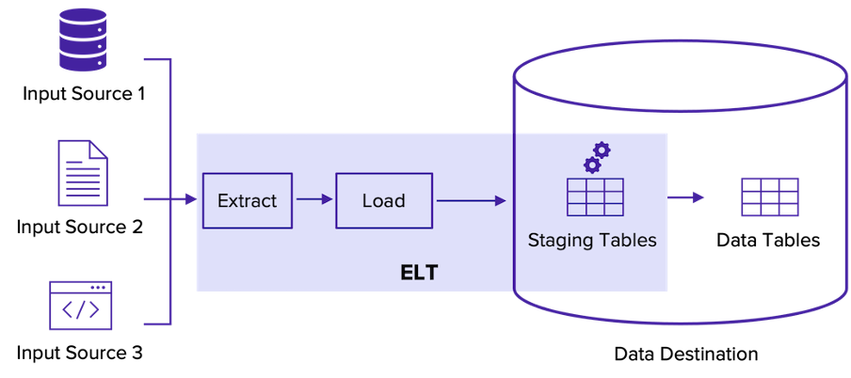
High Level Design & Architecture

Slide 4
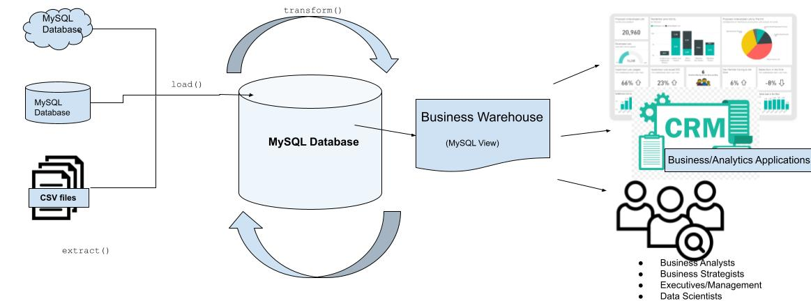
Application Design & Architecture

Slide 5
Data Sources
 | Size | Row Count | Number of Columns
Consumer Expenditures | 337.6 MB | 2,047,961 | 10
Household Members |  | 137,355 | 6
Households |  | 56,812 | 11
GDP | 5.2 KB | 304 | 2
CPI | 22.7 KB | 1,303 | 2

Slide 6
Limitations
Dynamic Extraction of Tables
Hardcoded Table Names and Column Types

Slide 7
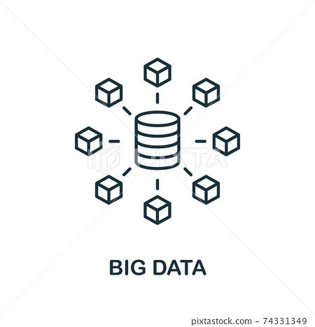

Limitations
Lacks Scalability For Larger Datasets and Data Processing Capacity
Uses Local MySQL Database
Uses SQLAlchemy libraries which may not be most efficient

Slide 8


Limitations
Maintainability of Code
Needs centralized configuration file
Needs centralized logging options for different users

Slide 9
Future Implementation Items
More robust ELT pipeline that can scale & integrate
Automatic scheduled pulls configurable per data source
Dynamic extraction of external data sources
New Pipeline Segment to batch extract and combine data sources before writing to database (Data Lake/Staging Area)
Configurable Log Files Based on User Requirements
Centralized Configuration File for Storing file locations, etc.

