Slide 1
Keep Critical
The impact of coding on
the testing mind-set
Robert Herbst

Slide 2


Slide 3
a tale
filled with good intentions

Slide 4
monolith.co.za
prod

Slide 5
layered.co
domain
data
prod

Slide 6
web-scale.io
micro
service
love
mssql
oracle
obscure

Slide 7
where
did it break?

Slide 8
end to end

Slide 9
component

Slide 10
integration

Slide 11
unit

Slide 12
tests
multiply like rabbits

Slide 13
back end

Slide 14
front end

Slide 15
full stack

Slide 16
is the
system
working?

Slide 17
the system
qa

Slide 18
the system
end to end

Slide 19
qa
lets ask
end
to
end
to write
tests!

Slide 20
selenium

Slide 21

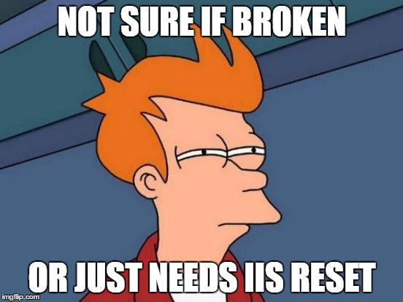
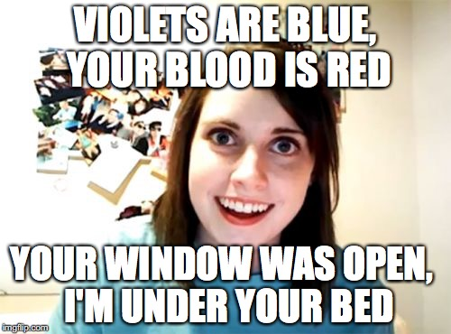


Slide 22




Slide 23

javascript!

Slide 24
who fulfils a
testing
role?

Slide 25
who writes
code
to automate tests?

Slide 26
stop!
I’m not saying…

Slide 27
we can only keep
four
things in
working memory

Slide 28
build
it
test
it

Slide 29
make
it
break
it

Slide 30
separation
duties
of

Slide 31
we are
attached
to what we
create

Slide 32
edge cases
are a
specialization

Slide 33
?
so what now

Slide 34
qa
is still a
thing

Slide 35
coding
is also a
thing

Slide 36
be
aware
of the costs

Slide 37
separation
duties
of
create test cases first

Slide 38
separation
duties
of
don‘t test
your own code

Slide 39
Keep Critical

