Slide 1
Electroless Deposition Revisited E. J. O’Sullivan, C. Camagong, J.J. Nowak, M. Hopstaken, P.L. Trouilloud, E.A. Galligan, C. Kothandaraman, Y. Luo, and M. Krishnan IBM Research Division, T.J. Watson Research Center, P.O. Box 218, Yorktown Hts., New York 10598, USA,

Slide 2
Outline
Why electroless deposition?
Evaluation of electroless Ni(P) cap layer for final Cu interconnect level in MRAM test vehicles
Test results
Wrap-up

Slide 3
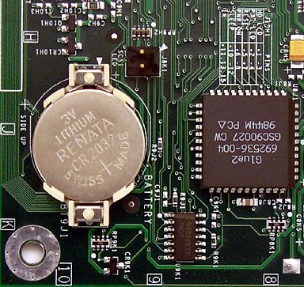
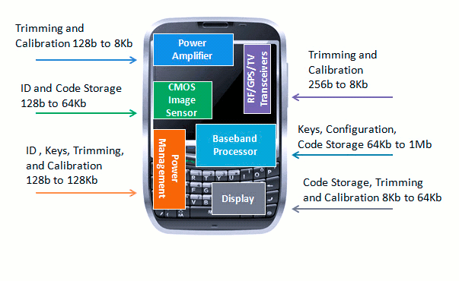
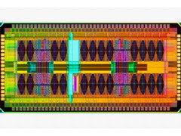
Why MRAM?
Standalone
Low end embedded
High end embedded
Replace battery-backed SRAM
Buffer for hard disk drive
Microcontroller program code
Encryption key storage
Trimming and calibration
Replace eFuse
Fast dense memory for L3 cache
Alternative to eDRAM
Key requirements Application examples
DRAM replacement
Lower temp process is OK
1 - 64 Mb/1Gb and up
30 ns/10ns read/write
Unlimited endurance (10¹⁷)
Lower temp process is OK
1 - 64 Mb/1Gb and up
30 ns/10ns read/write
Unlimited endurance (10¹⁷)
400⁰C process required
1 k – 1 Mb
No performance requirement
Endurance: 10⁶ writes/bit
400⁰C process required
~ 256 Mb
1 - 2 ns read/write
Unlimited endurance (10¹⁹)

Slide 4
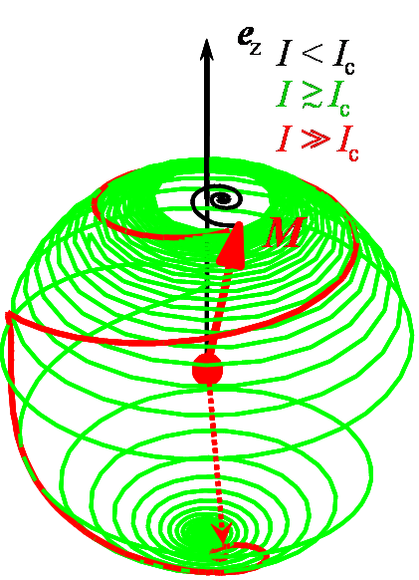
Spin Torque MRAM overview
Switch “free layer” by passing current through magnetic tunnel junction (MTJ).
Angular momentum of spin-polarized current is transferred to free layer.
Sufficient current switches the free layer moment (precession and reversal).
Read and write using the same transistor, at low and high voltage.
-250
H (Oe)
-100
7
R (kΩ)
Ni(P) cap layer on bitline Cu
3
-0.2 0 0.2
I (mA)
Bit Line
Word Line
Bit Line Complement
J.C. Slonczewski, J. Magn. Magn. Mater. 159, L1-L7 (1996).
J. A. Katine et al., Phys. Rev. Lett. 84, 3149 (2000).
J. Z. Sun, IBM J. Res. Dev. 50, 81 (2006).

Slide 5
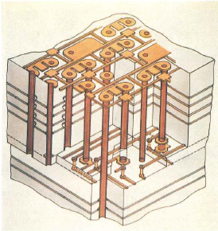
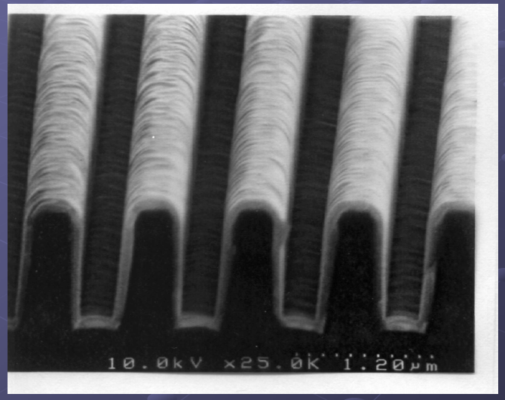
Why Electroless Deposition?
Long history of use
Selective, conformal deposition
Electroless Cu for printed circuit board wiring (thru-holes)
Electroless Co magnetic films
On nonmagnetic, electroless Ni(P) films on Al disks
Electroless Co(W)(P)
Originally a strong candidate to replace PVD Ta-based liners for CMOS BEOL builds
Despite meeting selectivity, diffusion barrier and reliability requirements, it was shelved, in part for cost reasons
Isometric view of a printed-circuit board cross section
D. Seraphim, IBM J. Res. Develop. 26(1), 37, 1982
Y. Shacham –Diamand, www.ec.appchem.waseda.ac.jp/series_lectures/pdf/A1_2.pdf
E. Liniger, et al., Microelectron. Eng., 70, 406 (2003).

Slide 6
Electroless Ni(P) as Cu Cap Layer
Selective deposition
Self-aligned capping layer
Amorphous Ni(P) is nonmagnetic
Ni(P) resistivity
Typically 80 – 100 μΩ for 10 – 12 wt% P content films
Ni(P) thin films can protect Cu from oxidation
No grain boundaries in amorphous Ni(P) layer
Minimal surface oxidation in air in range 100 – 200 ⁰C
Thus, we have investigated Ni(P) as a Cu capping layer to evaluate data-retention in our MRAM hardware in this temperature range

Slide 7
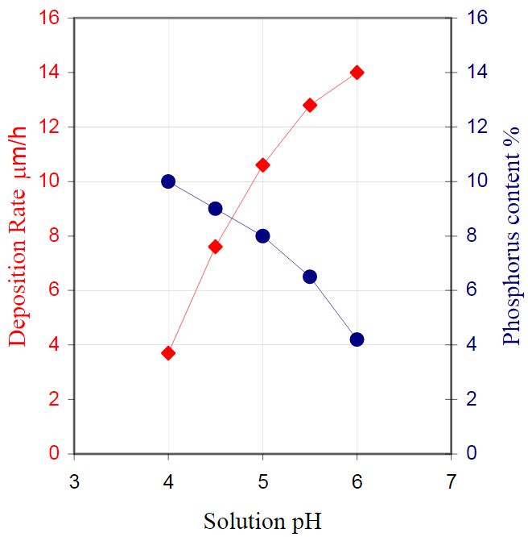
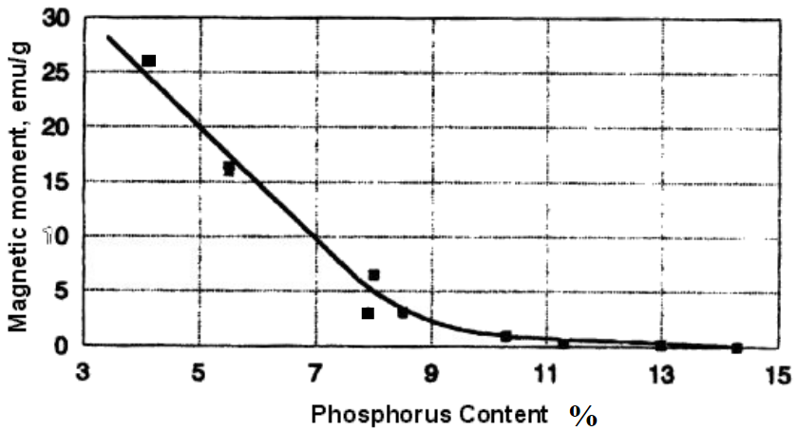
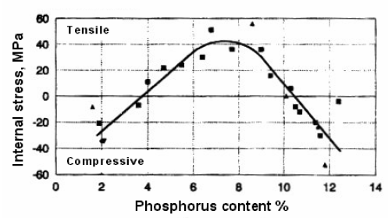
Electroless Ni(P) Properties
Magnetism and Stress
Solution pH
See, e.g., R. Taheri, “Evaluation of Electroless Nickel-Phosphorus (EN) Coatings”, Ph.D thesis, 2003, and refs therein.
E.g., R. N. Duncan, Plat. Surf Finish., Nov. (1996), p. 65

Slide 8
Outline
Why electroless deposition?
Evaluation of electroless Ni(P) cap layer for final Cu interconnect level in MRAM test vehicles
Test results
Wrap-up

Slide 9
Experimental
Electroless Ni(P) solution used
Commercial: from Uyemura
→ 10 – 12 wt% P, i.e., ca. 20 – 23 at% P, in Ni(P) films
Commercial solutions evolution
Additives evolution: more environmental-friendly components and additives have been adopted by industry

Slide 10
Ni(P) Solution Operating Conditions
Solution pH: 4
Relatively low dep rate (thin film)
Ensures high P content (12+ wt %)
Amorphous film, better protection
Lower pH ensures less active bath, decreased tendency for nodule formation, fewer particles
Deposition temperature: 85 ⁰C
All solutions were filtered
0.1 - 0.2 μm pore size used

Slide 11
Copper Surface Preparation: Cleaning
Oxide removal
Various oxides may exist on the Cu surface, e.g., CuO, Cu₂O, CuOH and Cu(OH)₂ (best removed in acidic solution):
CuO + 2H₃O⁺ → Cu⁺² + 3H₂O
CMP-related layers
Film-forming/passivation layers are usually used in Cu/liner CMP, e.g., Cu(I)-BTA
Similar removal reactions can be written for these layers

Slide 12
Copper Surface Preparation: Activation
A catalyst is needed
Cu⁰ → Cu⁺² + 2e⁻
Pd⁺² + 2e⁻ → Pd⁰
------------------------
Cu⁰ + Pd⁺² = Cu⁺² + Pd⁰ … Overall reaction
Both of the above “half” reactions may occur on nanoscopically-different/separated regions of the Cu surface.

Slide 13
Deposition Selectivity
A concern with electroless deposition
Pd⁺² ions may chemisorb on dielectric surface, and become reduced to form catalytically active sites
TEOS dielectric used
Surface condition likely to be different to bulk material due to CMP slurry solution reactions
TEOS pH-of-zero-charge likely to be in range 2 – 4
H₂SO₄/PdSO₄ catalyzation solution used
TEOS surface likely in a neutral/protonated state
Apparently negligible Pd⁺² ion adsorption on TEOS

Slide 14
Ni(P) Solution Operation: pH = 4, 85⁰C
Activation energy of 17.3 kcal/mol is in line with lit values
No dummy plating “loading factor”
Reduces solution components depletion
Removal of dissolved O₂ not required

Slide 15
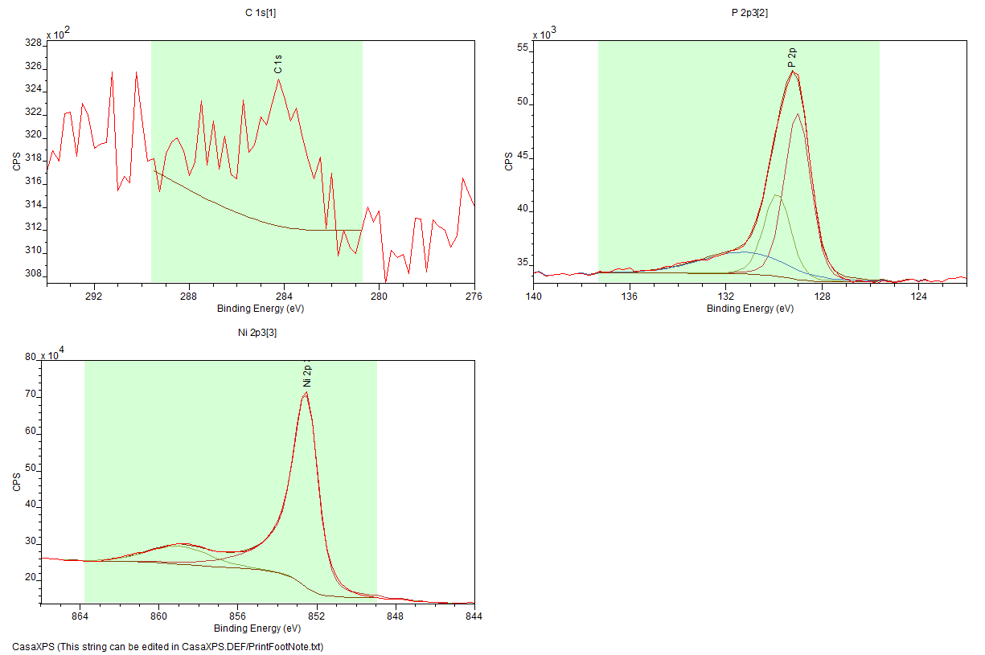
Ni(P) XPS Film Composition
Name | Position | FWHM | R.S.F. | Area | % Conc.
C 1s | 284.25 | 2.22 | 1 | 4191.25 | 3.15
P 2p | 129.25 | 1.85 | 1.25 | 43614.36 | 26.26
Ni 2p 3/2 | 852.5 | 1.55 | 13.92 | 1305765 | 70.59
[Ni] / [P] atomic ratio ~ 2.7
- pH = 4.0, temp = 85⁰C

Slide 16
Ni(P) Film SIMS (Cs M⁺) Depth Profile
1,430 nm Ni(P)
Sharp Pd feature at Cu-interface
Constant Ni-P composition

Slide 17
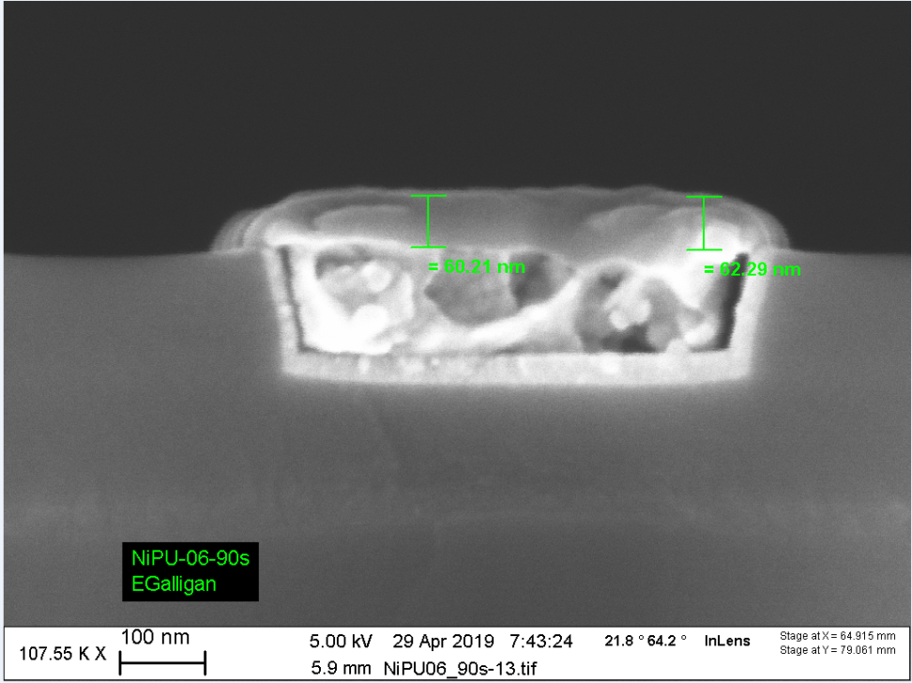
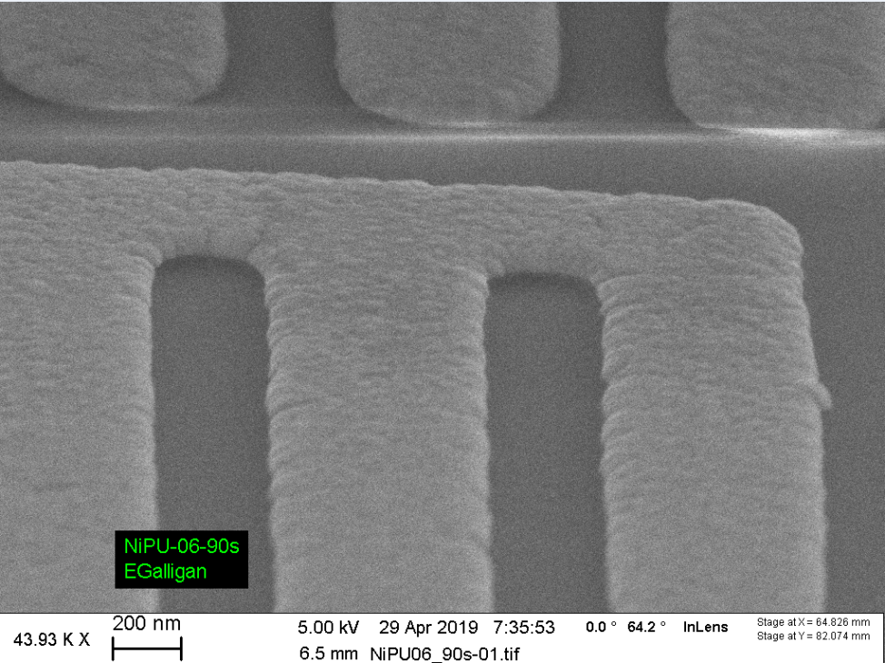
Ni(P) Coverage
Ni(P) thickness: ca. 60 nm
Coverage: Excellent
Ni(P)
Ni(P)
Cu

Slide 18
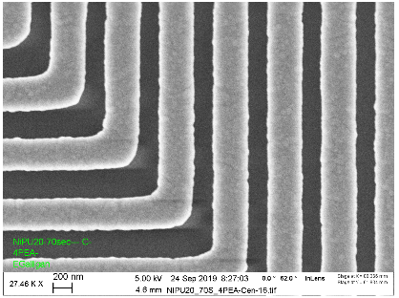
Excellent Selectivity
65 – 70 nm Ni(P) thickness
Cu

Slide 19
Ni(P) Corrosion Properties
Test: Immersion in 70% HNO3 at room temp
Roughly 20 - 30 nm/s Cu etch rate
Can be used as a simple porosity test of Ni(P) on Cu
Blanket Ni(P)/Cu test results were “excellent”
Ni(P) film thickness was in range 40 – 60 nm
Ni(P) films were relatively intact up to 13 min, in this test

Slide 20
Outline
Why electroless deposition?
Evaluation of electroless Ni(P) cap layer for final Cu interconnect level in MRAM test vehicles
Test results
Deposition mechanism review
Wrap-up

Slide 21
MRAM R & MR
Freelayer and pinned layer moments pointing in the same direction:
This is the low-resistance path for the current (Rmin)
If the moments are pointing in the opposite direction:
This is the high-resistance path for the current (Rmax)
Thus, in case of spintorque MRAM, tunneling magnetoresistance (TMR) is defined as:
TMR = (Rmax – Rmin)/Rmin
Ni(P) capping of the final Cu level is to enable rapid, high-temperature, data-retention testing
Bit Line

Slide 22
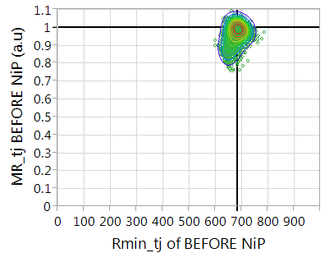
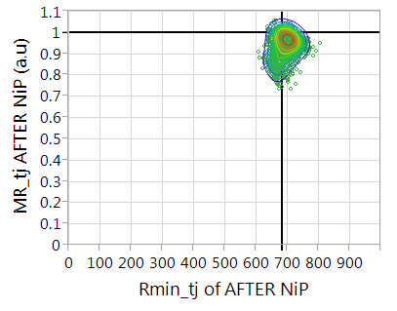
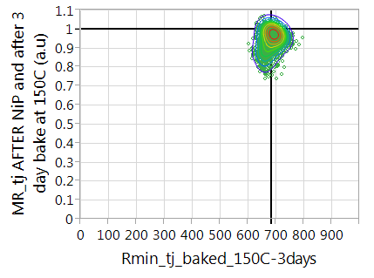
Effect of Ni(P) and Baking on R & MR
4K MRAM arrays
Initial
After Ni(P) dep
After 150 ⁰C / 3 days bake (air)

Slide 23
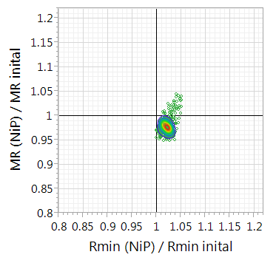
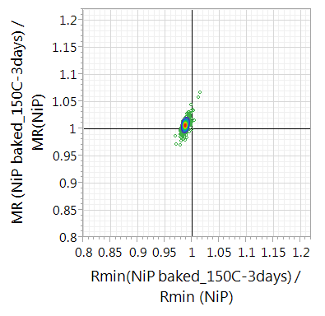
R & MR Ratios: Deeper Look at Data
R & MR ratios allow one to see changes in R & MR
Slightly worse contact after Ni(P) dep.
Improved contact after 150 ⁰C bake
After 150⁰C / 3 days baking (air), we see R & MR recovery – about +1 % in MR, and +1% in wafer contact

Slide 24
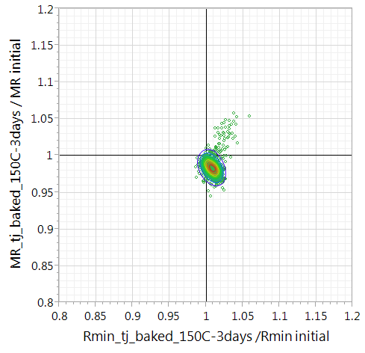
Net Change After Ni(P) + 3-day Bake at 150⁰C
MR lower by less then 2%
Rmin larger by less than 1%
Process tweaks may decrease these values

Slide 25
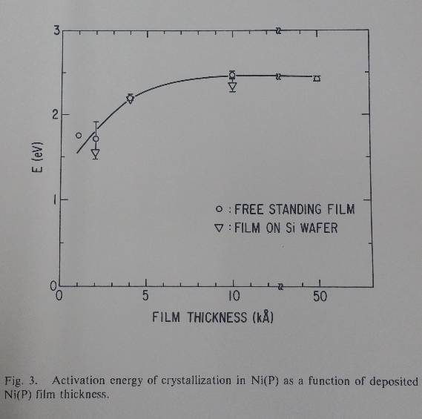
Crystallization Kinetics Of Ni(P) Thin Films
Max value of activation energy of 2.4 eV for thick films (300 – 375 ⁰C)
Close to bulk value of 2.3 – 2.35
Thinnest films (100 - 200 nm) had values of ca. 1.7 eV
Could not measure films < 100 nm
(no DSC peaks)
Lowering of crystallization temp:
Residual stress from substrate
Change in mechanism:
Growth mechanism of the new crystallized phase may change to be two dimensional
Shi, L.T., & O'Sullivan, E.J. (1993). “Thickness Effect On The Crystallization Kinetics Of Electrolessly-Deposited Ni(P) Thin Films.” MRS Proceedings, 321, 319. doi:10.1557/PROC-321-319

Slide 26
Outline
Why Electroless Deposition?
Selectivity Challenges
Electroless Ni(P) Cap Layer for Cu Interconnects
Mechanism Discussion
Wrap-up

Slide 27
Electroless Deposition: Future Prospets
Niche applications in existing technologies
Take advantage of selective and conformal deposition
Selectivity → fast turnaround time
Enabling technology for new devices
For example, nanobiosenors
Development of thin films with novel compositions and properties

Slide 28
Acknowledgements
The authors gratefully acknowledge the efforts of the management and staff of the Microelectronics Research Laboratory (MRL) at the IBM T. J. Watson Research Center, where the “back-end-of-line” fabrication was carried out.

